Slide 1





2020 Model Release 4.2.3
Updates to BMP TRAINS 2020
Virtual Workshop for Professionals
By: Marty Wanielista December 1, 2020

Slide 2
Guidance for this workshop is based primarily on Input from the professionals enrolled in the workshop
What is BMP Trains?
How is residence time related to permanent pool?
How to analyze BMPs in series?
DCIA, why not just average CNs, “wet-areas and DCIA?
Examples of how to improve overall removal when wet detention does not work?
What kind of media are used in biofiltration? Service life?
How do we get an average EMC when there are multiple land uses or user inputs?
Side bank downflow filters vs up-flow filters?
How to get very high removals for net improvement?
Do examples of harvesting with and without wet detention.
Show a pre-treatment BMP used before retention. Also two user defined BMPs .
How do we incorporate net improvement when the pre-condition has a BMP?
How do we get nutrient reduction to groundwater feeding estuaries and springs?
Examples of Swales, Harvesting, and Vegetated Filter Strips (VFS).

Slide 3
Guidance for information needs best answered by the Review Agencies (ie. WMD, DEP) and from my experience
Design parameters that are different than currently approved (ex. Swale SHWT elevations, harvesting rates > 4 inches per week). Usually do long term (20 year) simulations and one-year monitoring.
BMPs without field data on removal (ex. filtration media not currently approved, magnetic separation, inlet screening, ultrasonics, micro-organisms). One year of data collection from the field application.
There is no EMC available? Check all available sources
for EMC data and for input from the review agencies.
Dry Detention:
  examples were completed using SWFWMD and SFWMD data and the results of sampling done by ERD for SF ponds. The results indicated that retention was needed and usually the retention volume was very small unless intentionally designed. Design guidance from the WMDs. YES, BMP Trains has been used!

Slide 4

What is BMP Trains 2020?
BMP Trains 2020: a C++ and VB based model for estimating annual removal effectiveness.
The acronym is derived for the analysis of stormwater BMPs in series
The model is used to evaluate Best Management Practice Treatment options based on Removal using Annual loadings by those Interested in Nutrients in Stormwater.
Mailing list for updates: https://stars.library.ucf.edu/bmptrains/announcements.html
2 Locations for the manual and the program:
http://www.stormwater.ucf.edu
https://stars.library.ucf.edu/bmptrains/
Credit and thanks for the programming and technical skills of: Dr. Ron Eaglin, Dr. Mike Hardin, Dr. Harvey Harper, Dr. Ikiensinma Gogo-Abite, Eric Livingston, Rich Magee and Chris Kuzlo

Slide 5
Some considerations in the choice of a model to evaluate BMP systems
Uses Florida Rainfall.
Uses Florida soils and physical land use conditions.
Uses event mean concentration data from Florida based studies.
Incorporates removal effectiveness for many structural BMPs and LIDs.
Evaluates the effectiveness of BMPs in series and parallel.
Peer reviewed by professionals and “passed” administrative hearings.
Be available in the open literature (no cost to purchase).
Acceptable to many practicing professionals.
Acceptable and updated by local, regional (WMD), Department of Transportation (FDOT), and FDEP regulatory and review professionals.
BMP Trains provides all of the above.

Slide 6
What is the compatibility with other modeling software?
BMP Trains provides an estimated for annual removal of nutrients. Not event based.
It is for assessment. Not a design model. Design is complicated by many site factors.
However, as an example, I have seen wet detention pond sizing done with a routing model based upon the average annual residence time (example 31 days) from BMP Trains, the permanent pool is determined from (PP=Res Time x conv / Annual Runoff).
I have also seen larger flood control models (all proprietary ) use the output from BMP Trains to determine flood control design details.
For BAM, like B&G, State of SC has accepted their use (IDEAL model).
BMP Trains is based on the Harper Method. Thus any spreadsheet using the Harper Method should produce similar results provided there is only stand alone BMPs. One reason why BMP Trains was developed and an example of using published tables is:

Slide 7
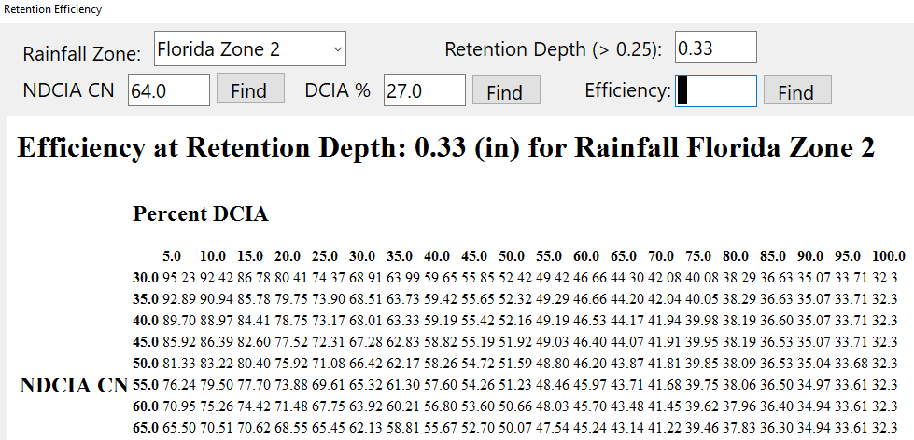

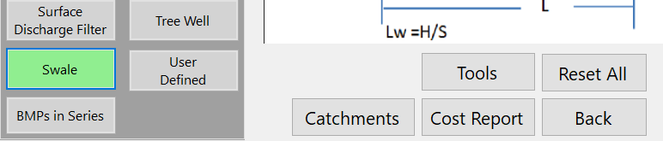
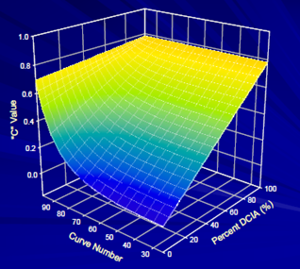
Retention Tables, set for 0.25, 0.50, 0.75, etc
The EXCEL version is not recommended because of added design and review features as well as instabilities in spreadsheets for large # of catchments.

Slide 8
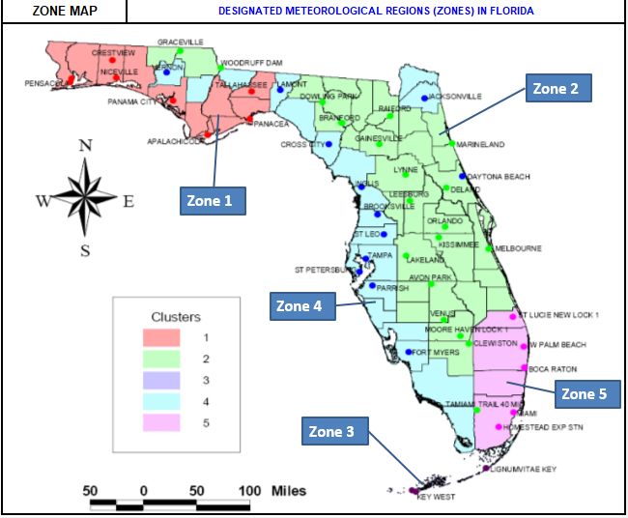
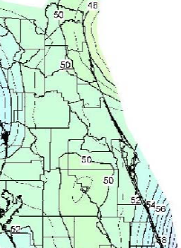
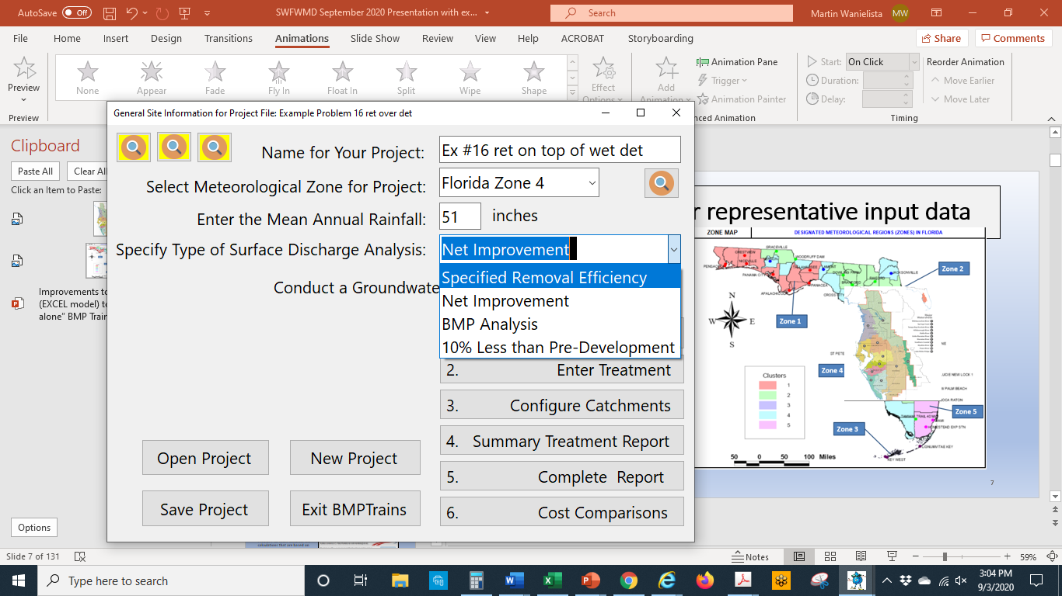
Rainfall and Analysis Types
Basic Understanding and Background
Decisions made on annual mass loadings: annual mass = annual flow x average concentration
Where are we?
  What meteorological zone?
How much annual rainfall?
  Use of local rainfall? 20 years
What kind of analysis?
  Net improvement
  Other?

Slide 9
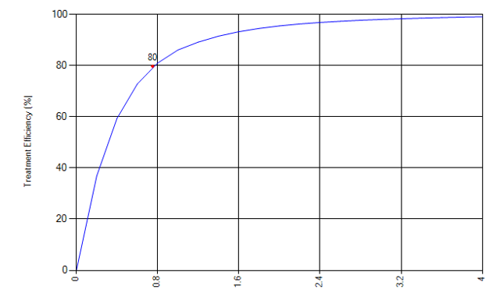
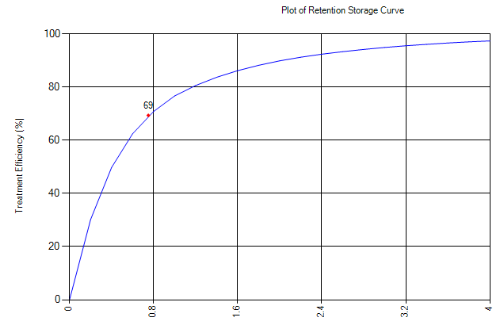
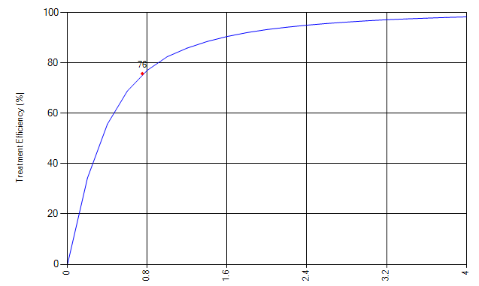
Variability of rain capture with rain depth and by zone
Capture the cumulative volume of rain from every rain event up to a design depth
Zone 2 80%
Example rain depth = 0.75 inches
Zone 1 69%
Zone 4 76%
NOTE: For design depths above 4-inches, there is marginal capture with increasing size. Thus, can disconnect areas with retention of 4 inches or more.
Rain depth (inches)
Rain depth (inches)
Rain depth (inches)
NOTE: For retention, annual capture = annual treatment efficiency (y axis data)

Slide 10
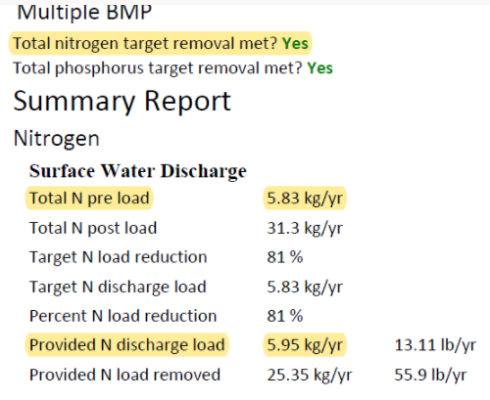
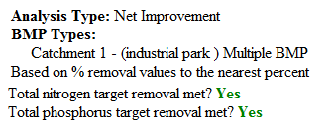
Reporting and Significant Digits
Historically: Standards were set to 2 place accuracy: example 80% removal
In Practice: sometimes would like the option of using post = pre many place accuracy
Older version
Newest version
81.37%
New State Stormwater Rule may specify place accuracy for impaired water (net improvement)
80.99%

Slide 11
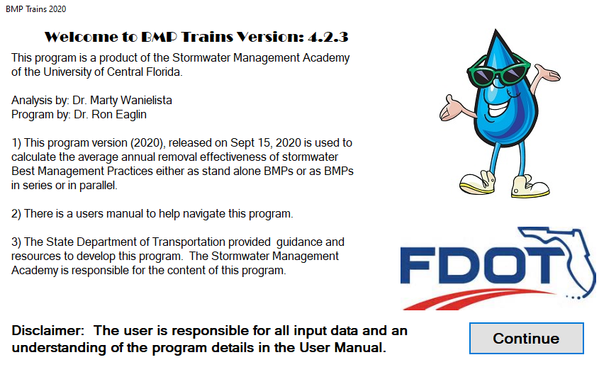
Initial “splash” screen for the BMP Trains 2020 model
No Charge for the program
https://stars.library.ucf.edu/bmptrains/

Slide 12
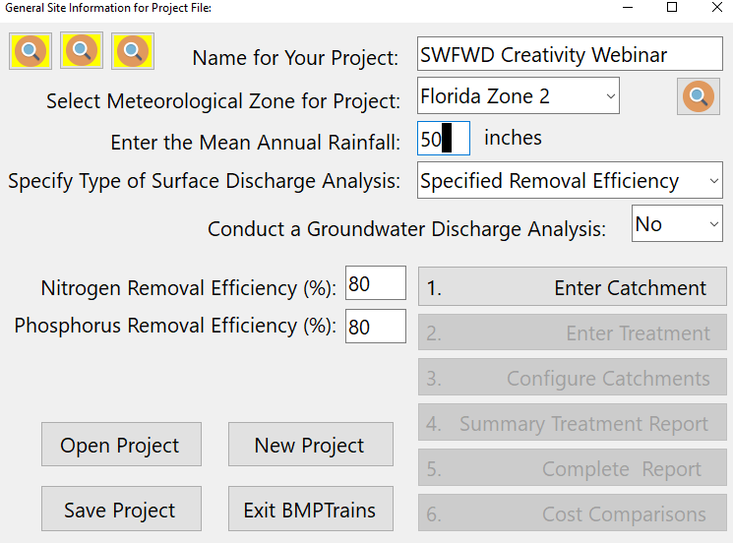


Navigation, Site Specific Data & Supporting Information
Contextual Information Pages
Worksheets to understand methods, enter data, and retrieve results
Rainfall
Data
Drop Down Menu
Choices
limited
Harper 2007
Draft 2010 Rule
User Manual
Navigation Buttons
Data Cells
Unlimited
Entries

Slide 13
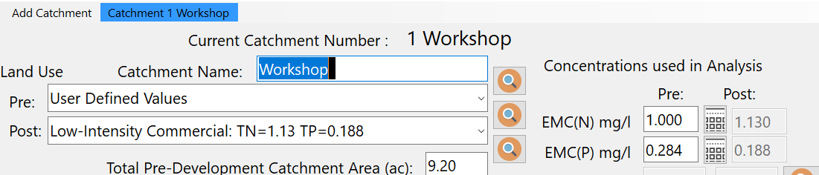
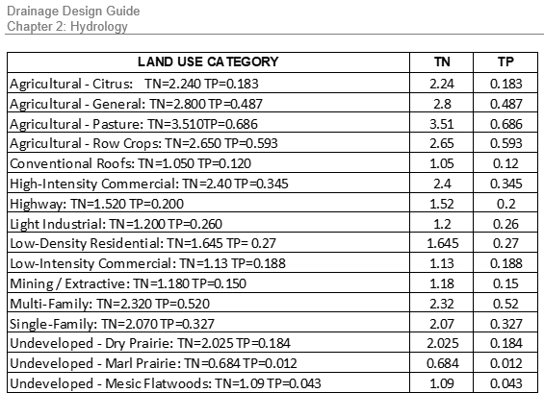
Catchment Data: Land Use and EMCs
Note: Option to add site specific data or “average” values

Slide 14
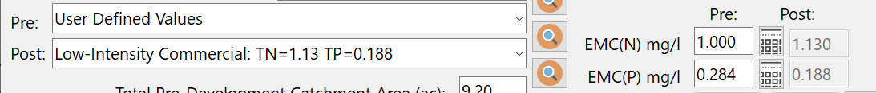
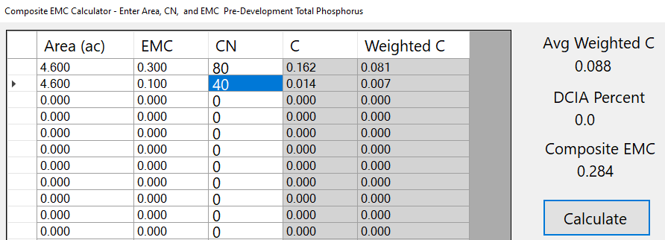
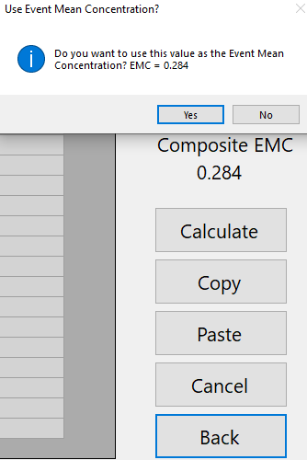
EMCs based on multiple land use
Simple Average = 0.2

Slide 15
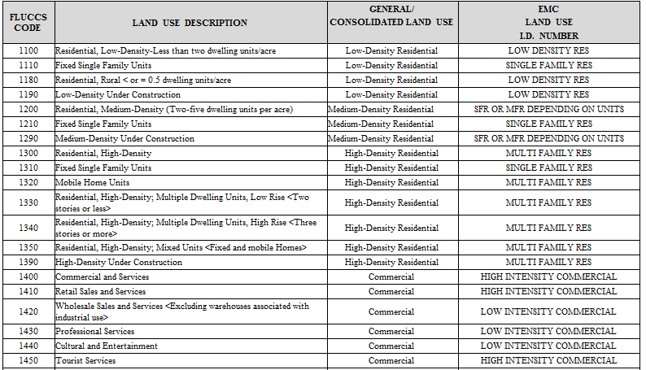
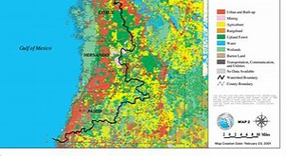
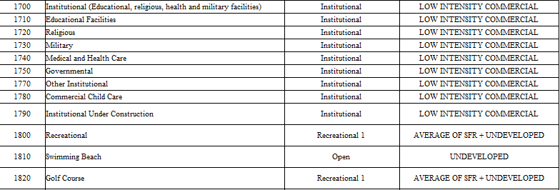
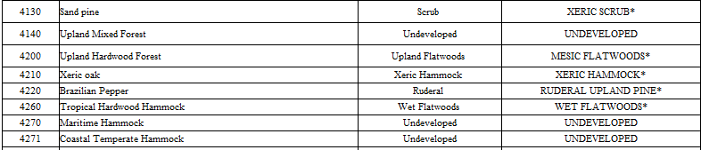
Land Use EMCs (FLUCCS)
Associated BMPTRAINS name

Slide 16

Question: Why use the DCIA for runoff volume?
As opposed to using a composite curve number (CCN)
CCN from a weighted area under-estimates the volume of runoff for low rain events
Note: about 90% of events are less than 1 inch

Slide 17
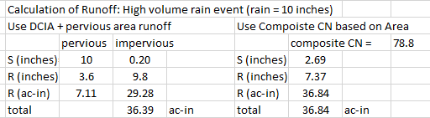
What about flood events and the DCIA?
For flood storm events (example using 10 inches) use either
High volume rain event (in) 10
Can use CCN or DCIA + pervious for flood control rain events

Slide 18
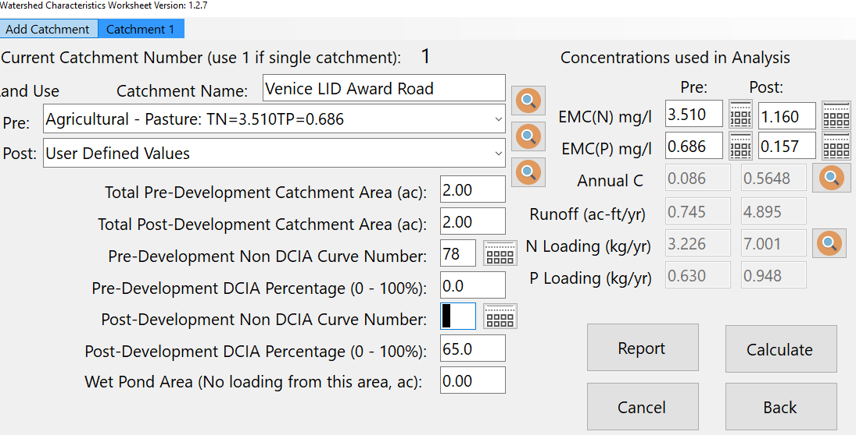

CN for multiple land uses
Calculate the CN based on the annual runoff from each land use

Slide 19
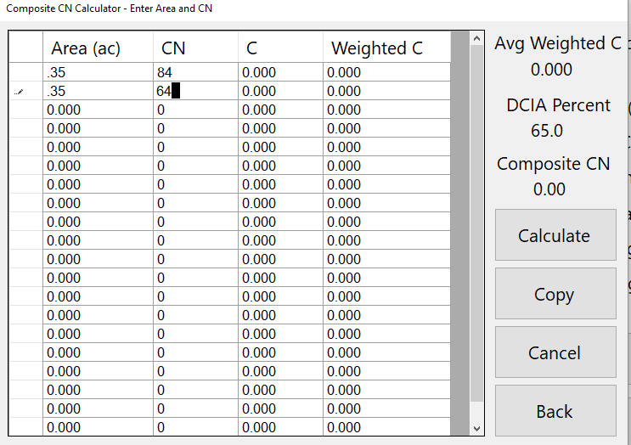

CN Based on area
weighting would be 74

Slide 20
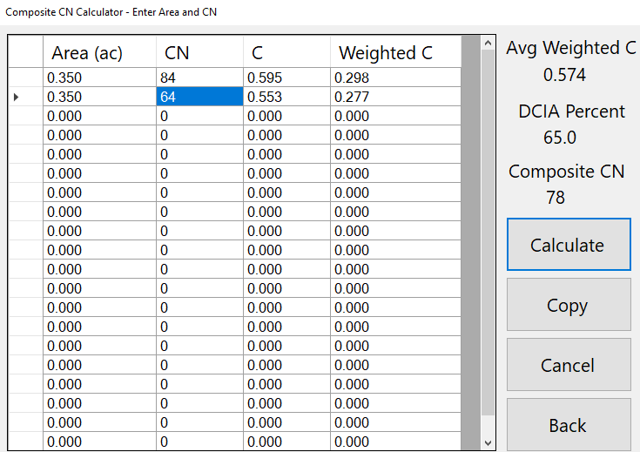
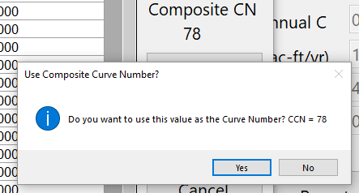

Slide 21
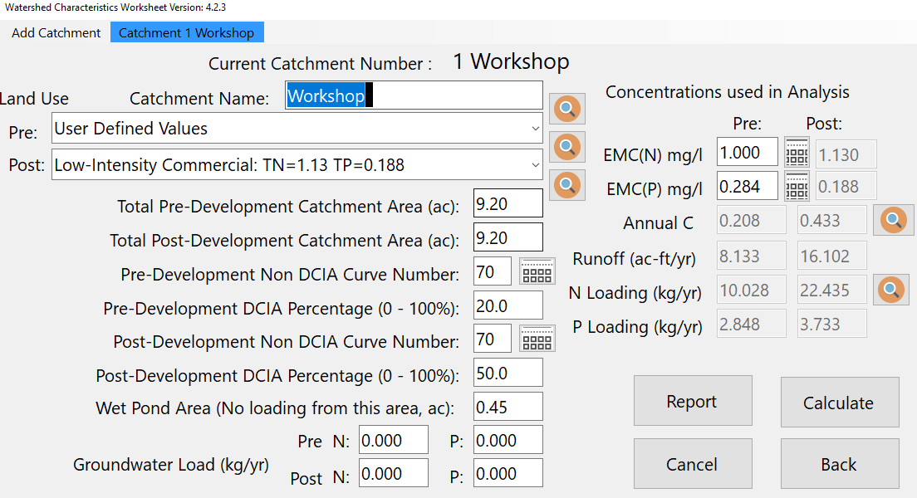
Loading = EMC x Annual Runoff Volume note wet ponds are considered to have no annual runoff
(including harvesting operations)
For wet pond areas, their areas can be removed here or in the pre- or post-catchment data inputs, not both places.

Slide 22
“Wet-Areas”
How are they defined for Runoff Estimation?
Do not flow for rainfall less than about 4 inches.
Resources:
1. Wet land delineation experts. High water marks, vegetation
2. USGS gaging stations for streamflow to get runoff (take out base flow)
(less than ~0.1 CFS/SQ MI: ~1.4”/yr (~2-3% of annual rainfall))
Ground observations:
Some flow most of the time with or without Groundwater so when it rains, there is runoff or DCIA includes wet areas.
Others do not flow or contain runoff for up to 4 inches., do not include wet-areas in DCIA.

Slide 23
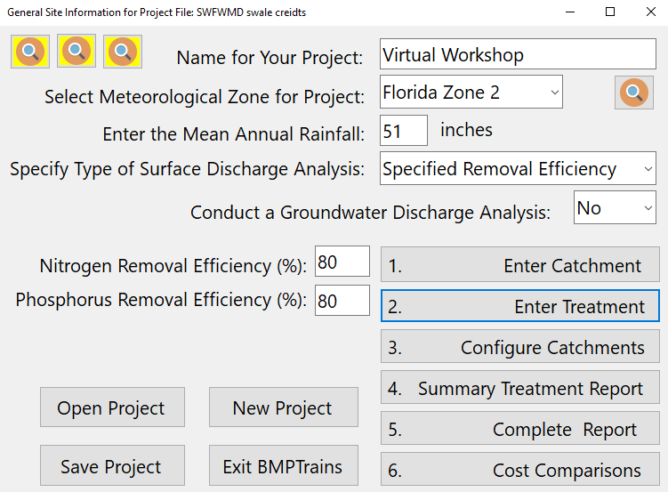
Questions related to BMP Treatment Effectiveness

Slide 24
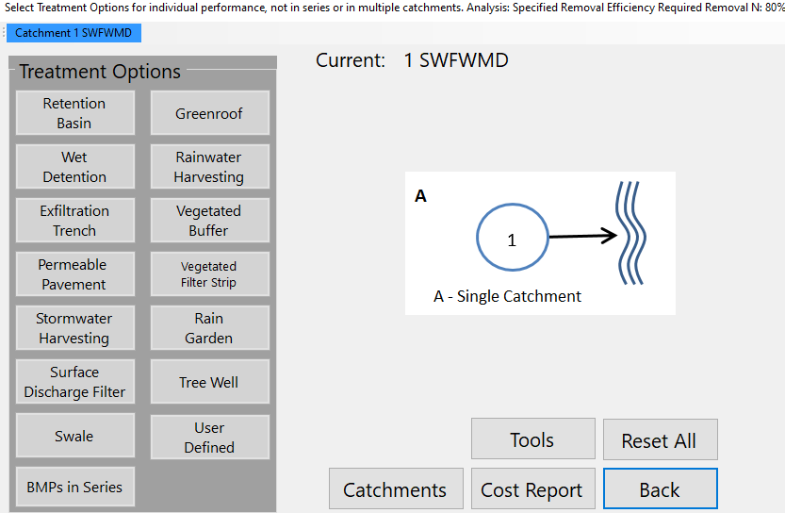
14 Treatment BMP Options
For 13 BMPs: Design Information Found in User Manual
For a design other than the 13 listed,
enter as User Defined
For two or more different BMPs in the same catchment
Calculating tools helpful for design

Slide 25
a. Retention BMPs Treating Runoff from the Same Catchment Area
References: Harper, 2007, pages 208-209 User Manual
BMP Efficiency Determination
BMP Trains gives you this efficiency curve
Retention Efficiency Plot
For a treatment rate of 1 inch per hour (low rate because of non-homogeneous soil types).
For multiple retention BMPs used within a single catchment the overall efficiency is determined by adding up the total volume retained to obtain the associated treatment efficiency
Treatment rate can be increased using a certified mix examples in Marion County and NW Fl Karst Regions
Varies with land use and meteorological zone and treatment depth = ret vol/catchment area x conv factor

Slide 26
Example for Two Retention BMPs in Series
Q: I double the retention but not get double the removal?
References: pages 209-210 User Manual
BMP Efficiency Determination
Retention Efficiency Plot
Assume two retention BMPs in series – first captures 0.5 in and the second captures 0.5 in
50% + 50% = 100% X
Add the volume retained
0.5in + 0.5in = 1in
  70%
The avg annual cumulative rainfall for a given retention depth or rainfall volume.

Slide 27
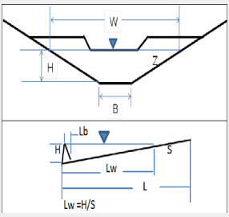
Example Retention: Swales
References: Chapter 403.803(14), Florida Statutes; Page 193, User Manual
Conditions for retention credit
Infiltration rates < or = to 5 in/hr
Side slopes of 3H:1V or greater
Triangular or trapezoidal section
Vegetation to reduce scour (Manning’s coefficient)
SHWT (> or = to 2) feet below bottom
Flow line swale slope < 5 %
Concentration reduction when swale slope < or = 1%
Swale Blocks allowed (drive-ways, constructed)

Slide 28
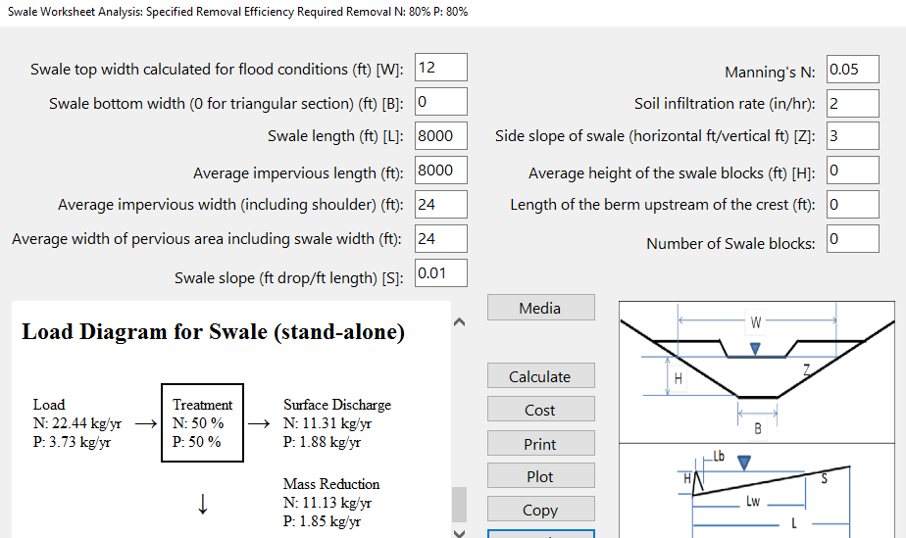
Example Swale Input and Effectiveness
Maybe sufficient retention credit before wet detention ?
When retention (swale) is before detention, the annual runoff to detention is decreased, thus for the same permanent pool the residence time is increased. RT= PP/(Runoff volume/time)

Slide 29
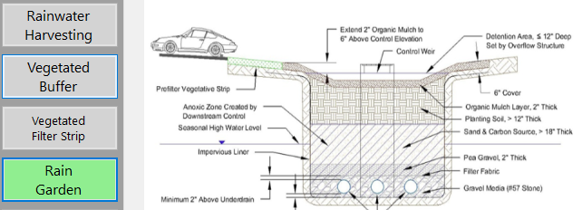
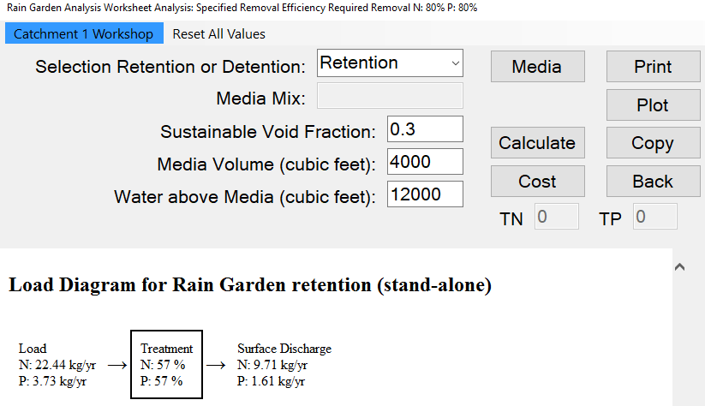

Example Retention: Rain Garden (hold no transport)
2 feet
Reference: Manual, pages 90, 192, 204, 213, 214 and others

Slide 30
groundwater: Capture and Effectiveness with retention and a reactive media
Surface Capture
P Removal before GW discharge
N Removal before GW discharge

Slide 31
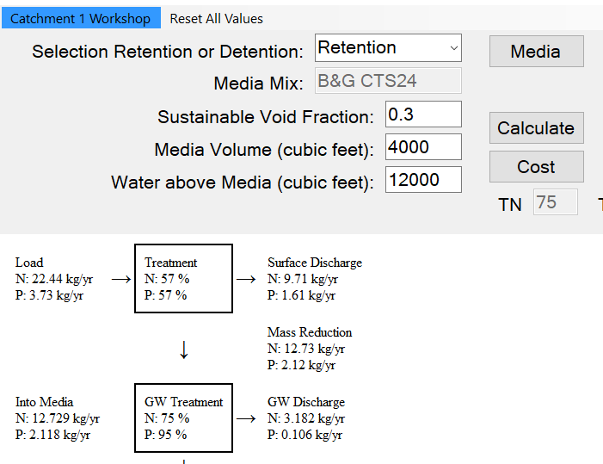
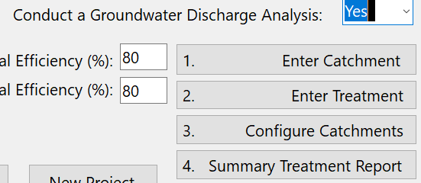
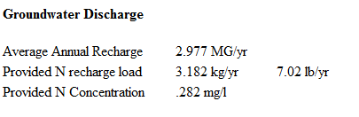
Rain garden with media for groundwater protection

Slide 32
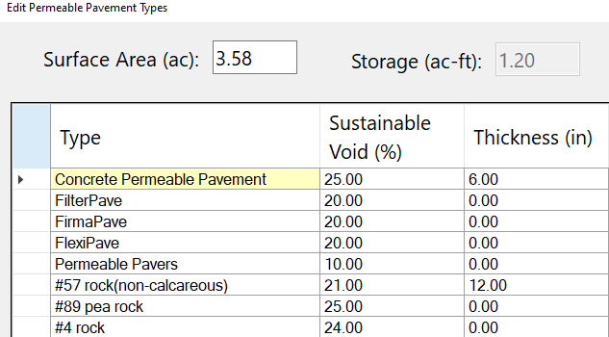
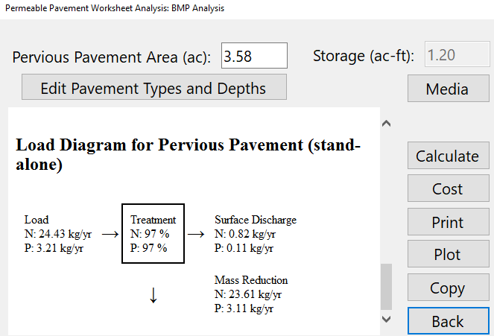

Pervious Pavements as Retention
(used to meet net improvement or “advanced treatment”)
First retention: then for rainfall after retention volume, rainfall goes to runoff.
Only 3% annual runoff

Slide 33
b. Detention BMPs Treating Runoff from the Same Catchment Area
References: Harper, 2007, pages 208-209 User Manual
BMP Efficiency Determination
Detention Efficiency Plot
Based on the residence time a treatment efficiency can be determined and note different removals for N & P
At 50 days average annual residence time, N removal is 40%, P removal is 70%.
BMP Trains gives you this efficiency curve

Slide 34
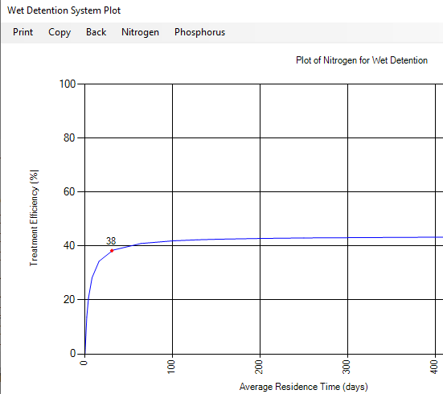
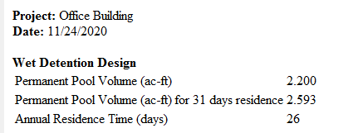
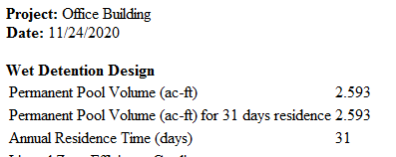
Credit for Removal based on annual residence time (RT)
RT=PP/Annual flow
Where: PP = perm pool volume
Example units:
Days = Ac-ft x 365 d/yr/(Ac-ft/yr)
Ex Plot for 31 days RT
Program allows for RT > 31 days
Some review agencies limit the choice to 31 days.

Slide 35
Example for Detention BMPs in Series
Double the PP does not double the removal
References: pages 209-210 User Manual
BMP Efficiency Determination
Detention Efficiency Plot
Assume two detention BMPs in series – each have a 50-day residence time N=40%; P=70%
  N – 40% + 40% = 80% X
  P – 70% + 70% = 140% X
  N – 50d + 50d = 100d ~ 43%
  P – 50d + 50d = 100d ~ 74%
Note: A general principle, cannot remove the same pollutants more than one time

Slide 36
c. BMPs not Related
Example: Nitrogen removal with wet detention followed by filtration
for the example: 80.2% (38+42.2)removal, not 106% (38+68).
Overall % Removal =100-100*(1-BMP1/100)*(1-BMP2/100) BMPi=%removal
or Remaining Fraction = (1-.38)x(1-.68)=0.198
Equation also used with new BMPs under review (user input). Once approved added to BMP Trains.
BMP 1
BMP 2
100 mg
38%
62 mg
68%
19.8 mg
38 mg
42.2 mg
Note: cannot remove the same pollutants twice

Slide 37

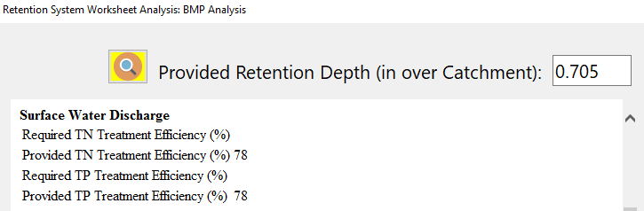

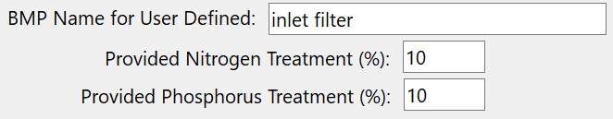
Pre-treatment (ex inlet basket) before retention volume of retention= 25,592 CF or 0.5875 Ac-Ft
Treatment (in) = Retention Volume/Catchment Area
= 0.5875 ac-ft x 12 in/ft / 10 acre = 0.705 in
From BMP Trains Annual removal = 78%
BMP 1
BMP 2
100 mg
10%
90 mg
78%
19.8 mg
10 mg
70.2 mg
Overall = 10+70.2 = 80.2% note not 10+78 = 88%

Slide 38
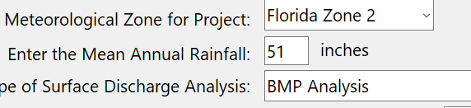
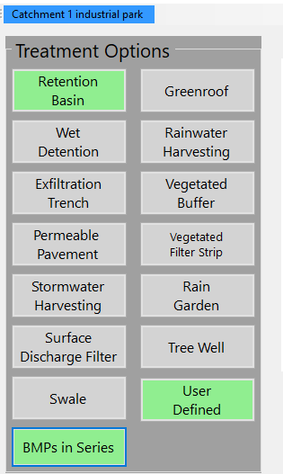
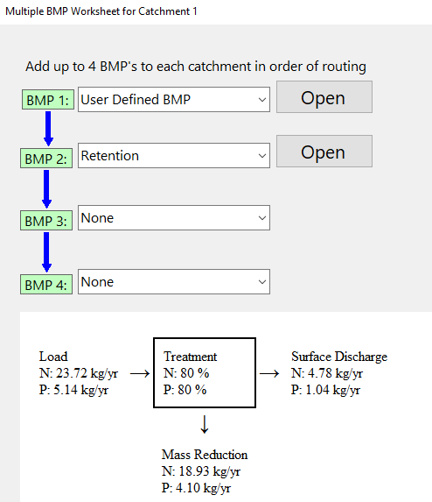
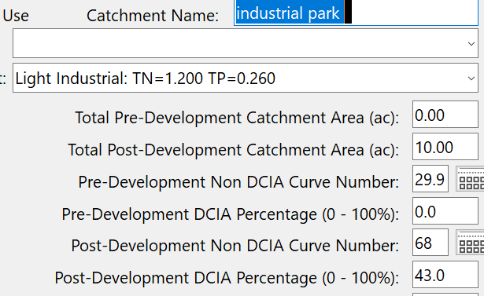
BMP Trains Series Option
Example: Inlet + Retention
For two or more different BMPs in the same catchment

Slide 39
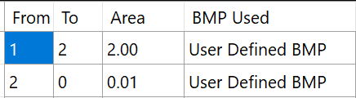
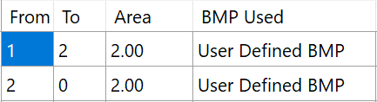
Example of same type BMPs in series
(example: both user defined)
Can not use series analysis in one catchment: NOTE For two or more different BMPs in the same catchment
BMP 1
BMP 2
No additional input between BMPs Overall = (20+16)/100 = .36 (36%)
note not: 20+20 = 40%
For 2nd BMP, use a 2nd catchment with minor input , example is 0.01-acre area or minor EMCs.
100 mg
20%
80 mg
20%
64mg
20 mg
16 mg
BMP 1
100 mg
BMP 2
Additional input between BMPs Overall = (20+36)/200 = .28 (28%)
note again not: 20+20 = 40%
For 2nd BMP, define site conditions.
100 mg
20%
80 mg
20%
144 mg
20 mg
36 mg

Slide 40


Analyze a net improvement with a BMP in pre-condition
Detailed example provided in example problem 15, BMP Trains User Manual
Target: Post discharge annual mass equals or is lower than pre discharge annual mass including the mass removed with the existing BMP.
The analysis is performed by running the model in the pre-condition with BMP and then to reduce transfer errors, the input and output for the pre-condition with BMP is transferred digitally to the new post condition BMP Trains 2020 run.
Save the project file, in this case the name of the .bmpt file is:

Slide 41



Analyze a net improvement with a BMP in pre-condition
PRE /BMP

Slide 42



Filters after a wet pond
(Typical design examples: up-flow and side bank)

Slide 43

Filter data
References: Pages 203-204,207-208, User Manual
W/Safety factor
Seek authenticity certificate
Seek performance data
Over 200 stormwater BMPs using B&G media
Largest is ~ 3 acres in Marion County
45/25 as stand alone/after wet detention and SAT effectiveness only as a stand-alone
Notes:
The DDG will also now includes informative tables such as this one. These are options within BMP Trains and are discussed both within the DDG and the BMP Trains Users Manual.
Looking at the table…
Sustainable Void % = long term void ratio accounting for operational siltation
Description of Mixes
B&G ECT3: Expanded Clay, Tire Chips – Up-flow Filters. 45/25: stand-alone BMP (captures particulates) / downstream of another BMP efficiencies (removal drops). Does not support a traffic load.
B&G CTS12: Clay, Tire Crumb, Sand, 12” thick – Underlayers, VFS
B&G CTS24: Clay, Tire Crumb, Sand, 24” thick – Underlayers, VFS. Not proportional increase in removal from extra depth but delivers longer service life for TP removal.
IFGEM: Iron filings, clay, tire crumb, and sand - thickest, best TN and TP removal, but more expensive. Much longer life expectancy for TP removal.
Per Pave: Limited to the bottom of a minimum 12 inch deep pervious pavement reservoir.
SAT: Special grade of sand (Texas Sand) designed to increase flow (nothing passing 200 sieve, no organics) - Limited to a stand-alone BMP or the first in a series of BMPs, reflecting particulate removal. Good bearing capacity, but costs about 3 times more than concrete sand.

Slide 44



Validation Testing State Road 26
SRWMD, AECOM, DOT project
Field Removal Monitoring (mainly to evaluate influent and design conditions)
Dual use Swales
Comparative Nitrogen and Pesticide Removal with Sorption Media in Linear Ditch for Groundwater and Stormwater Treatment
FDOT/SRWMD
Final Report
September 2018
SWALE
Sometimes called a linear ditch
Very sandy native soils, no NOx removal expected, Max nitrate in Groundwater is about 7.5 mg/L, Fanning springs on Suwannee River
Low water table (greater than 20 feet). Agricultural Area

Slide 45

Two Types of Media
B&G Clay/Tire/Sand (CTS) and Woodchips (WC)
Bold & Gold from ECS
Suwannee Lumber Woodchips
Traffic Bearing
50/50 blend of
2 different sizes
to get more density

Slide 46
Field Data Media Comparison by
Depth and Nitrogen Species
Unsaturated Media
Downflow infiltration
Average values
Woodchips
Groundwater
concentration
Creates ammonia (un intended)
Groundwater
concentration
CTS

Slide 47

Validation Field Site Testing (Different sampling dates)
B&G CTS Effectiveness by TN and NOx
Note: CTS Media always moist at 2’ during site visits.
Note: B&G CTS treatment rate => 0.10 gpm/SF (10 inches/hour), but safety factor used

Slide 48

Does Filter Media have to be saturated to remove pollutants via denitrification (NOx)
Need to have a residual moisture content. Usually standard is 21 days to retain more than 20% moisture.
Clay and other sorbents (organics & high surface area solids) help in moisture retention.
B&G (CTS) is a homogeneous mix that is shown to retain water.
Does not have to be saturated but must retain water for microbial activity.
CTS 24 inch
21 dry days
Due Diligence: Use of the specified media. Show certificate of authenticity (right media right place).

Slide 49


Wet Detention plus Effluent Filtration

Slide 50


Series Configuration for Wet Detention + Filter

Slide 51
Calculations: Removal for Wet Pond with Filter
Pond
Filter
Nitrogen
100 mg
38%
62 mg
68%
19.8 mg
Overall TN = 80.2
38 mg
42.2 mg
Pond
Filter
Phosphorus
100 mg
64%
36 mg
86%
5 mg
Overall TP = 95
64 mg
31 mg

Slide 52

How much filter area & What is the service life?

Slide 53


Surface Area (side bank filter)
Note: must check to see if drawdown
Time can be achieved

Slide 54


Service Life (side bank filter)
Need 1293 SF of filter,
Have space for 2000 SF
Minimum depth = 2 feet
Volume of media = 4000 CF

Slide 55


Efficiency (up-flow filter used after wet detention)

Slide 56


Surface Area and Service Life (up-flow filter)
Commercially
Available size
Is 132.5 SF
For a 30-year service life, need 6 filters. Note the area is 6 times greater than the minimum.
Advantage: takes less space, but removal is less

Slide 57


Harvesting
(ref: SJRWMD Manual of Practice and User Manual and Draft ERP Rule (2010))
SJRWMD First to codify and give credit for harvesting (early 1990’s) based on the REV
R - Harvest Volume (in/ day) x EIA
= f( rate per day & area)
E - Average Annual capture for reuse %
V – Runoff volume (in x EIA) / 12 in/ft
= pond volume for reuse (ac-ft)
R
E
IN BMP Trains….
V

Slide 58


Harvesting using underground storage
Used a 175,000-gallon (0.55 ac-ft) underground Pipe-R system

Slide 59


Harvesting with Wet Detention Pond
Compared to TN removal with MAP = 44%

Slide 60


Reduce runoff volume for harvesting due to retention before the pond
Before Retention
After 50% reduction in Retention
Load Reduction remained
the same at 40% (on the flat part of REV curve).
NOTE: You must enter the harvest volume used after retention.

Slide 61

Diagrams for Removal Calculations
Retention
Pond
Harvest
100 mg
50%
50 mg
38%
31 mg
37%
50 mg
19 mg
11 mg
80 mg
IN BMP Trains….

Slide 62



Vegetated Filter Strips (also 1st was SJRWMD)
(ref: pg. 100-103, 184; User Manual)

Slide 63


VFS Input Data and Annual Removal
Required is 39% and 12%
Reference “Hydraulic and nutrient removal performance of vegetated filter strips with engineered media for treatment of roadway runoff”, by Mohammad Shokri, et.al., Science of the Total Environment Submitted for publication, November 2020.
Obtained is 39%
and 58%
YES, no other water quality treatment needed

Slide 64
Updates to BMP TRAINS 2020
Discussion and Comments
Marty Wanielista,
Professor Emeritus, UCF
Martin.Wanielista@ucf.edu
Thank You
December 1 2020

