Slide 1
STARS and
SelectedWorks

Slide 3
In this session…
Overview of STARS
Overview of SelectedWorks
Discussion Time
Activity Time!

Slide 4
STARS stars.library.ucf.edu
UCF's Showcase of Text, Archives, Research & Scholarship
Focus is on the institution
UCF branded Digital Commons platform
Content created by, for, at, and about UCF

Slide 5
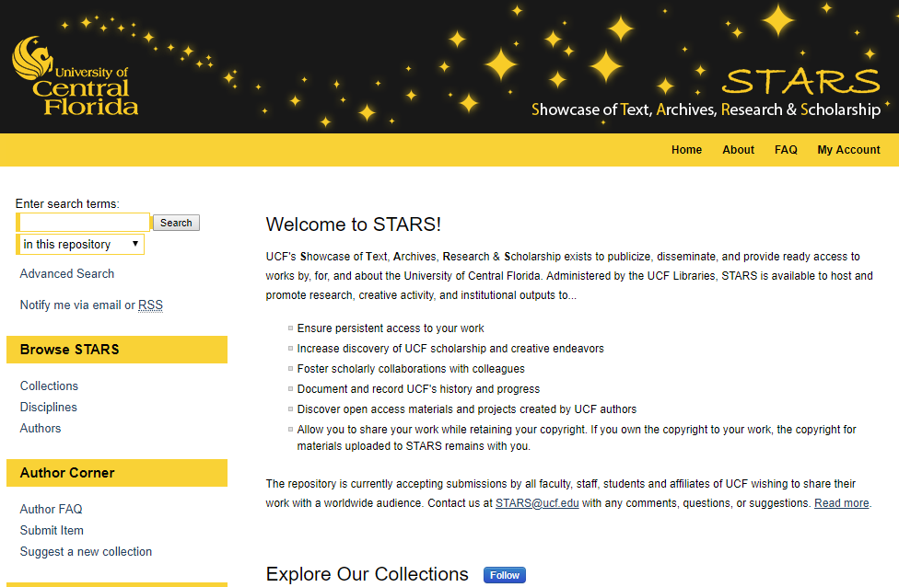
Why use STARS?
Provide persistent, UCF branded access to works
Increase discovery of UCF scholarship and creative endeavors
Share open access materials and projects
Document and record UCF's history and progress

Slide 6
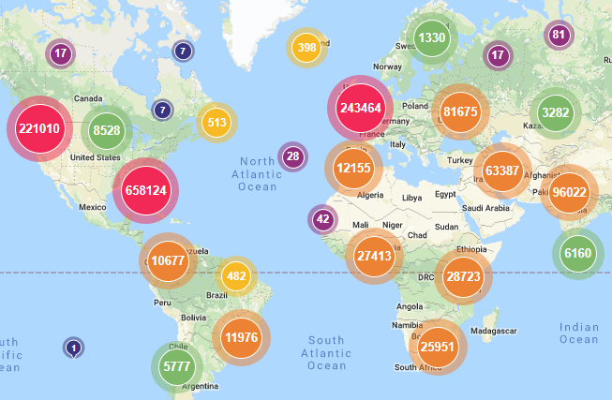
What’s Included?
Ability to organize & share the full spectrum of works
Indexing in Google and Google Scholar
Training - in person or online
Usage metrics in real-time, on demand, or monthly
Unlimited storage

Slide 7
Top 10 Benefits
of STARS

Slide 8
Top 10 Benefits of Using STARS
Highlight scholarship Launch journals Host events Share digital projects Utilize features - peer review features, access control, streaming media, communication, embedly | Manage grant outputs Empower students Showcase research Measure readership & impact Integrate with website - direct links, RSS feeds, search boxes, download maps

Slide 9
SelectedWorks works.bepress.com
Online Profile Pages
UCF branding
Hosted by bepress
Focus is on YOU
Content created by you for anything, any time, anywhere
Import your content from Digital Commons repositories

Slide 10
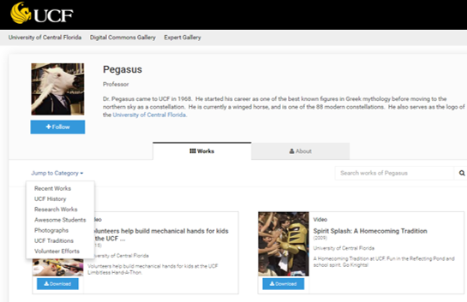
Why use SelectedWorks?
Focus is on YOU
You control your profile
You customize your profile
You choose to share existing works in STARS/Digital Commons with your profile
You may add non-UCF materials
You can take it with you

Slide 11
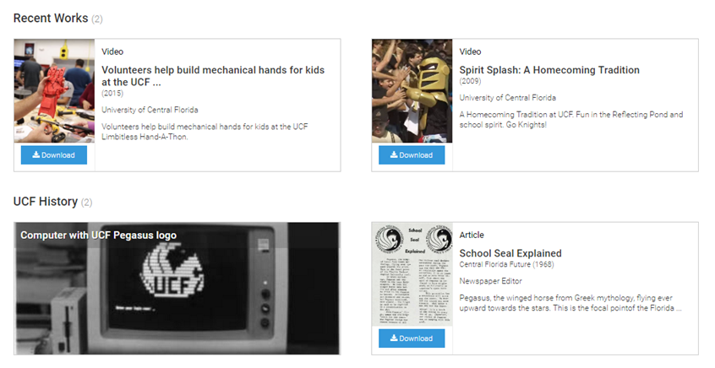
What’s Included?
Tools to create and edit customizable, UCF branded profiles
Support for a variety of file formats
Indexing in Google & Google Scholar
Readership & usage metrics

Slide 12
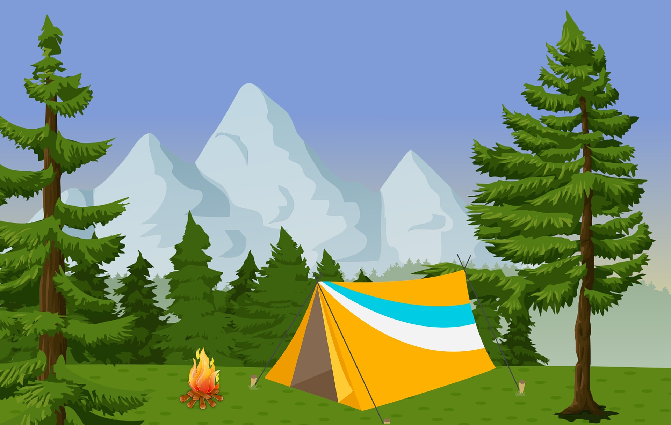
Top 10 Benefits
of SelectedWorks

Slide 13
Top 10 Benefits of Using SelectedWorks
You manage your profile and content Import existing works from STARS / Digital Commons Customize categories Choose view - Card or List Assign delegates | Personal SelectedWorks drive Highlight expertise - Expert Gallery and badges Embeddable profile galleries Comprehensive Author Dashboard We are here to help!

Slide 14
 | STARS | SelectedWorks
Institution focused | ✔
Individual focused |  | ✔
Mediated | ✔
Delete/replace files | maybe* | ✔
Google/Google Scholar | ✔ | ✔-ish
Supports export or harvesting | ✔
Access restriction/embargo | ✔
Statistics/Author Dashboard | ✔ | ✔
*At discretion of and with assistance from the STARS administrator

Slide 15
Dashboards
One case where
“you snooze, you lose” does NOT apply

Slide 16
Dashboards
Impact Dashboard
Institution focused - STARS
Available at all levels - entire repository, community, collection, works
Author Dashboard
Individual focused - YOU
One dashboard for ALL of your works in Digital Commons repositories (including STARS) and your SelectedWorks profile

Slide 17
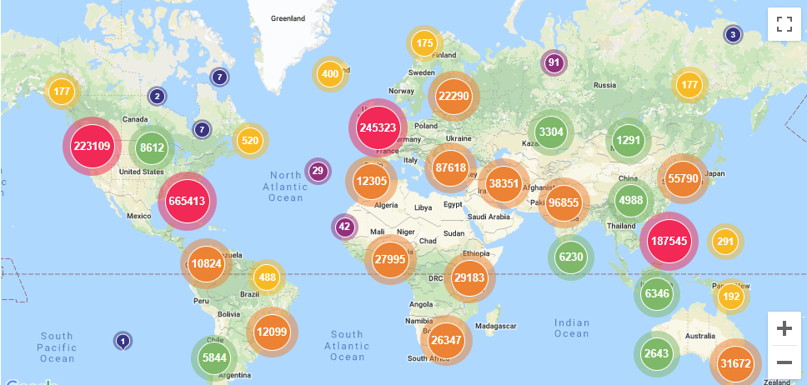

Slide 18
STARS - Impact Dashboard
Readership Map
Institutions
Countries
Referrers
Downloads
Streams
Metadata Page Hits
Works Posted
Works Downloaded
Custom Views
Saved Dashboards
Share Link (no login)
Schedule email share

Slide 19
YOU - Author Dashboard
Readership Map
Institutions
Countries
Referrers
Downloads
Metadata Page Hits
Works Downloaded
Custom Views
Saved Dashboards
Share Link (no login)

Slide 20
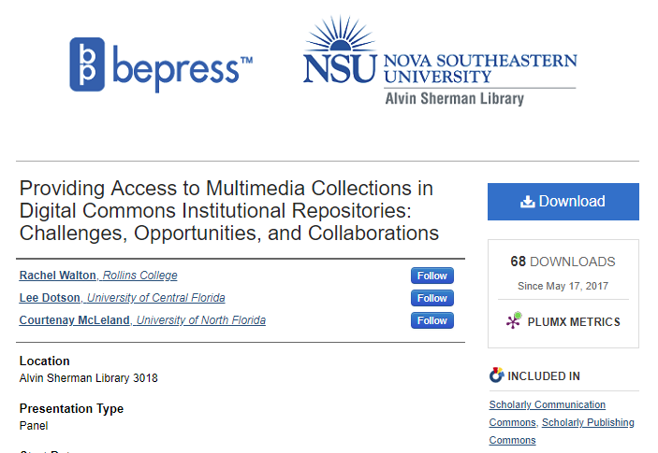
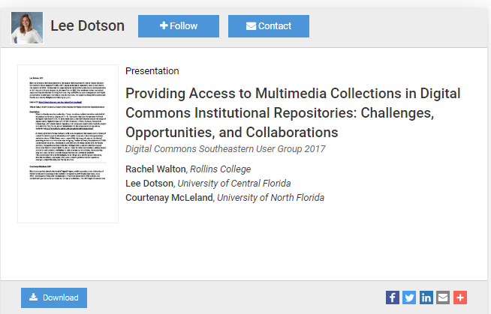

Slide 21
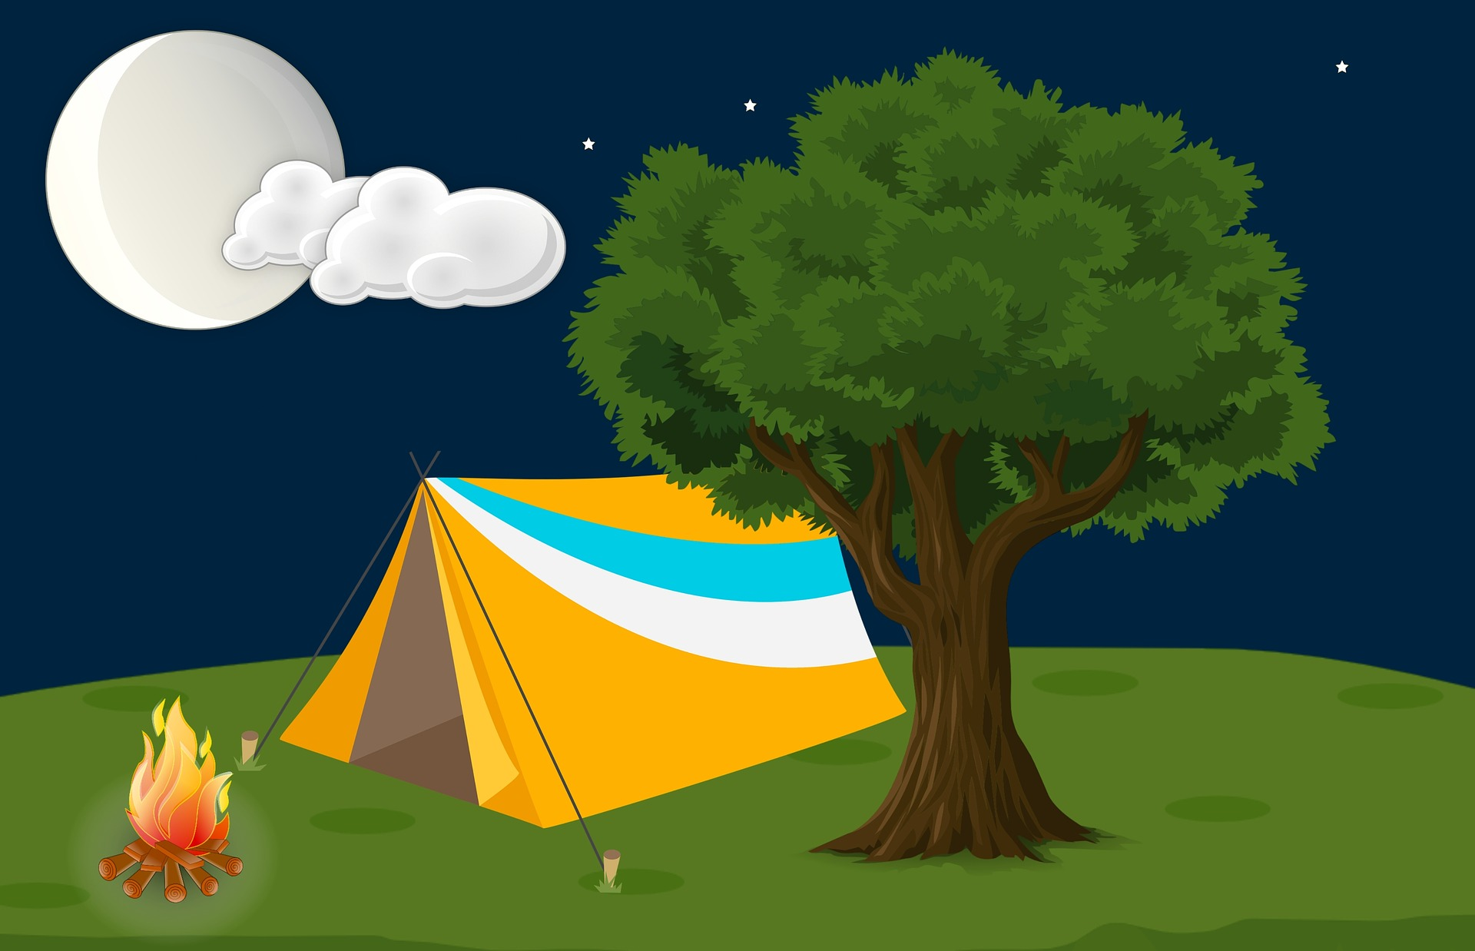
Tips and Tricks to Shine like a Star

Slide 22
Tips for Using STARS/SelectedWorks
Email address is important!
Create a STARS account at https://stars.library.ucf.edu/cgi/useradd.cgi
Start your SelectedWorks profile at https://works.bepress.com/account/register/
Submissions to STARS are collection specific
Items can be virtually shared between collections
Need a new collection in STARS? Suggest one here
Questions? Check out the STARS FAQ
More questions? Ask us! STARS@ucf.edu

Slide 23
Discussion Time!

Slide 24
Activity Time!

