Slide 1
General copyright
Lily Flick, Sarah Norris

Slide 2
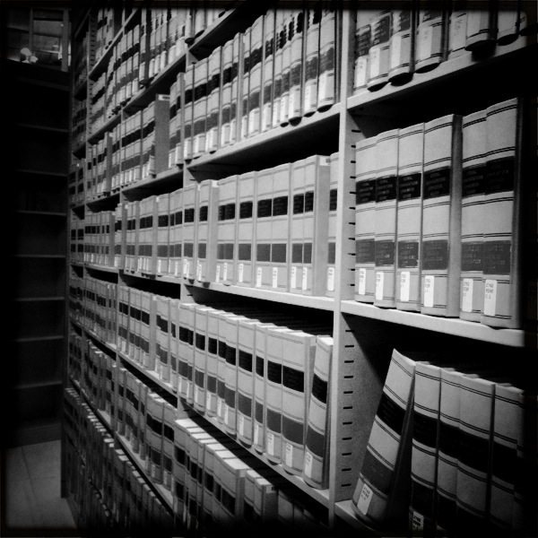
*Disclaimer
UCF Libraries does not give legal advice, and any information in this presentation is for informational purposes only.
Image retrieved from: https://flic.kr/p/9H8SCn
© Mr.TinDC

Slide 3
What is Copyright?
“Copyright is a form of protection provided by the laws of the United States (title 17, U.S. Code) to the authors of ‘original works of authorship,’ including literary, dramatic, musical, artistic, and certain other intellectual works. This protection is available to both published and unpublished works.”
http://www.copyright.gov/circs/circ01.pdf

Slide 4
What Rights are Covered by Copyright?
Generally, the following are exclusive rights given to a copyright holder:
reproduce your work
distribute your work
prepare derivative works
publicly display or perform your work
authorize others to do any of the above
*The above does not necessarily apply if the creator/author has given away rights to a publisher and/or other individual or entity

Slide 5
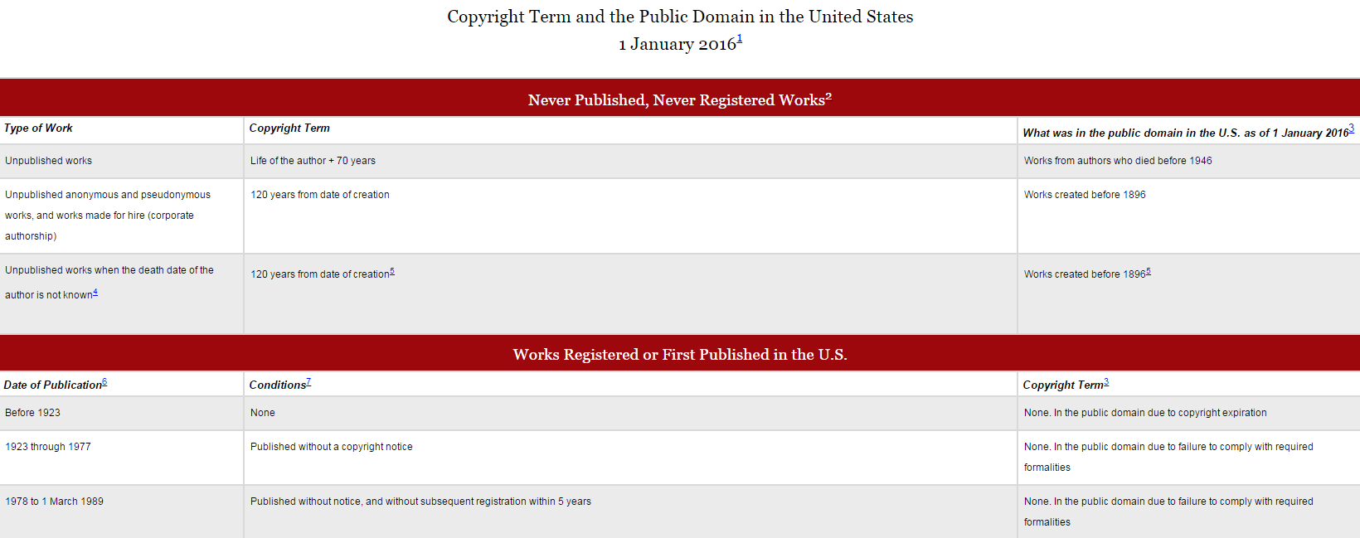
How Long Does Copyright Last?
© 2004-2016 Peter B. Hirtle. Last updated 3 January, 2016, Retrieved from: http://copyright.cornell.edu/resources/publicdomain.cfm

Slide 6
Key Contemporary Copyright Law
1998: Sonny Bono Copyright Term Extension Act (also called Sono Bono Act or the Mickey Mouse Protection Act)
1998: Digital Millenium Copyright Act (DMCA)

Slide 7
Copyright Term Extension Act
Extended terms to life of the author plus 70 years and for works of corporate authorship to 120 years after creation or 95 years after publication, whichever endpoint is earlier
Works made in 1923 or afterwards that were still protected by copyright in 1998 will not enter the public domain until 2019 or afterward (depending on the date of the product) unless the owner of the copyright releases them into the public domain prior to tha
http://www.copyright.gov/legislation/s505.pdf

Slide 8
Mickey Mouse & Copyright
Oswald the Rabbit
Created by Walt Disney Company while under contract with Universal Studios
Copyright retained by Universal Studios
Copyright transferred (called rights reversion) back to Disney in 2006
Public Domain
Used many public domain works (Snow White, Pinocchio, Little Mermaid) to create new coyrighted works
Disney sued Academy of Motion Picture Arts and Sciences in 1989, charging copyright infringement of its Snow White character and unfair competition
Disney sued publishing company that claimed ownership of Bambi, claiming Disney owned the copyright
Future? Public Domain for Mickey Mouse? Trademark Exception?

Slide 9
Image retrieved from:
https://web.law.duke.edu/cspd/publicdomainday/2016/pre-1976
© Center for the Study of Public Domain

Slide 10
Public Domain
Public domain refers to materials “whose exclusive intellectual property rights have expired, have been forfeited, or are inapplicable.”
Items can be used freely
Materials in the public domain include:
Works with expired copyright (generally, this means items published before 1923)
Works that are not copyrightable or protected by copyright
Works produced by the federal government and/or federal government employee as a part of their job
Works donated to the public domain

Slide 11
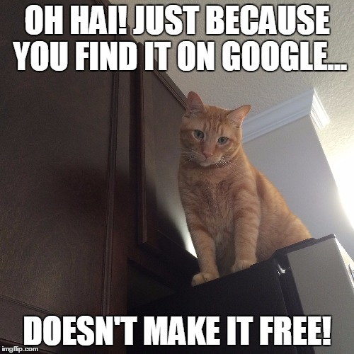
Public Domain and Internet
Not everything online is in the public domain!
In general, consider any information you find on the Internet as protected by copyright, unless specifically noted, and treat it as such. Being publicly accessible is not the same as being in the public domain.
Meme created by Sarah Norris on: https://imgflip.com/memegenerator

Slide 12
Digital Archives Examples That Use Public Domain

Slide 13
http://brockdenbrown.cah.ucf.edu/

Slide 14
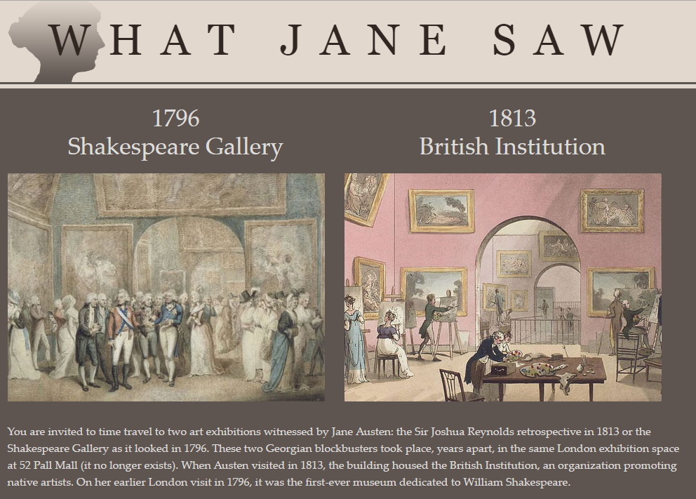
http://www.whatjanesaw.org/index.php

Slide 15
Fair Use
“Fair use is a legal doctrine that promotes freedom of expression by permitting the unlicensed use of copyright-protected works in certain circumstances. Section 107 of the Copyright Act provides the statutory framework for determining whether something is a fair use and identifies certain types of uses—such as criticism, comment, news reporting, teaching, scholarship, and research—as examples of activities that may qualify as fair use.”
http://copyright.gov/fair-use/more-info.html

Slide 16
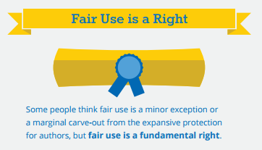
Fair Use is a Right…
http://fairuseweek.org/wp-content/uploads/2016/02/ARL-FUW-Infographic-r5.pdf

Slide 17
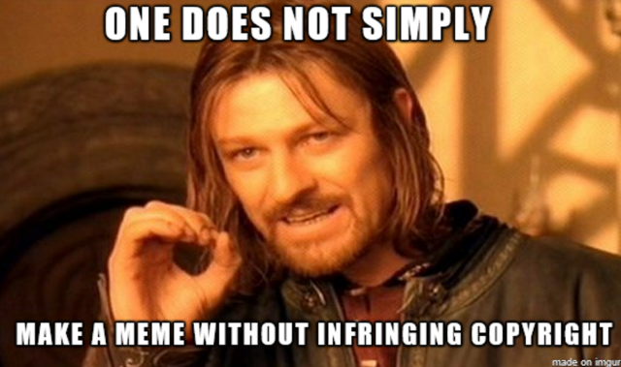
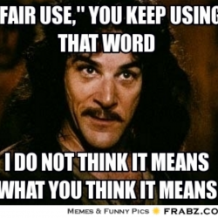
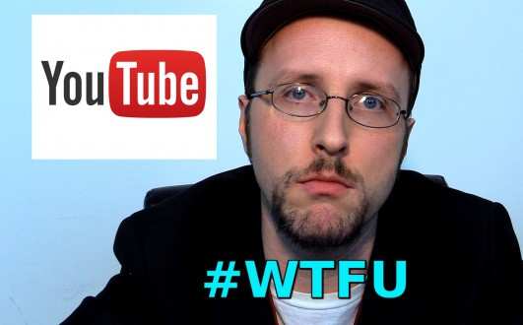

Slide 18
Four Fair Use Factors
“The four factors judges consider are:
the purpose and character of your use.
the nature of the copyrighted work.
the amount and substantiality of the portion taken, and.
the effect of the use upon the potential market.”
http://fairuse.stanford.edu/overview/fair-use/four-factors/

Slide 19
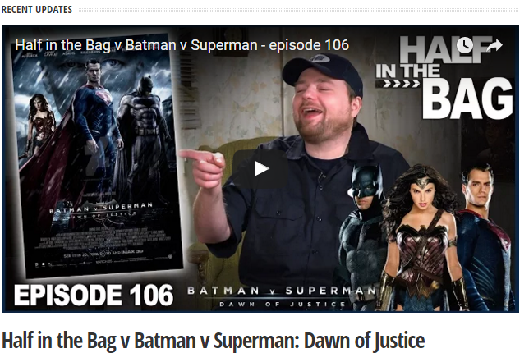
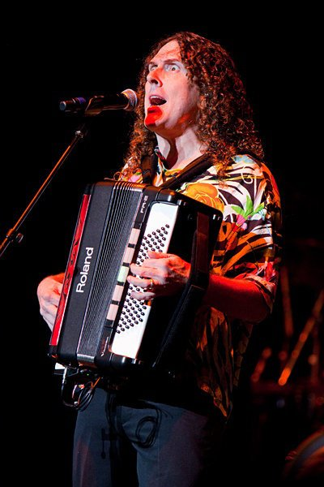
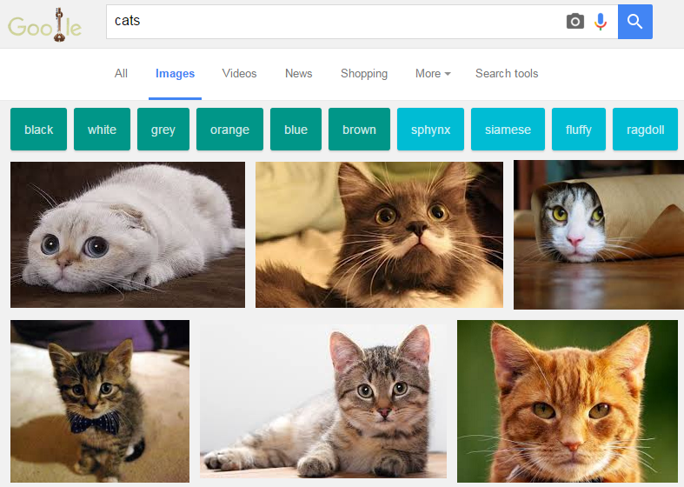
By Kristine Slipson - Own work, CC BY 3.0, https://commons.wikimedia.org/w/index.php?curid=14710006

Slide 20
Fair Use is NOT a License to Steal
When considering use of copyrighted work(s), use the Four Factors as a benchmark for whether fair use is appropriate or not
Consult faculty, librarians, or others with expertise
Look for copyrighted materials that have Creative Commons Licenses

Slide 21
Image retrieved from:
https://flic.kr/p/a8Tsiz
© Kristina Alexanderson

Slide 22
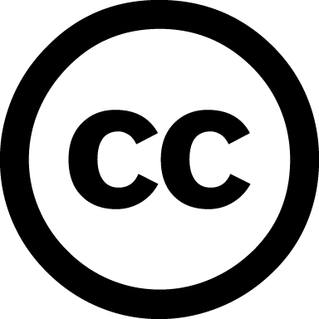
Creative Commons License
“A Creative Commons (CC) license is one of several public copyright licenses that enable the free distribution of an otherwise copyrighted work. A CC license is used when an author wants to give people the right to share, use, and build upon a work that they have created.”
https://creativecommons.org/licenses/

Slide 23
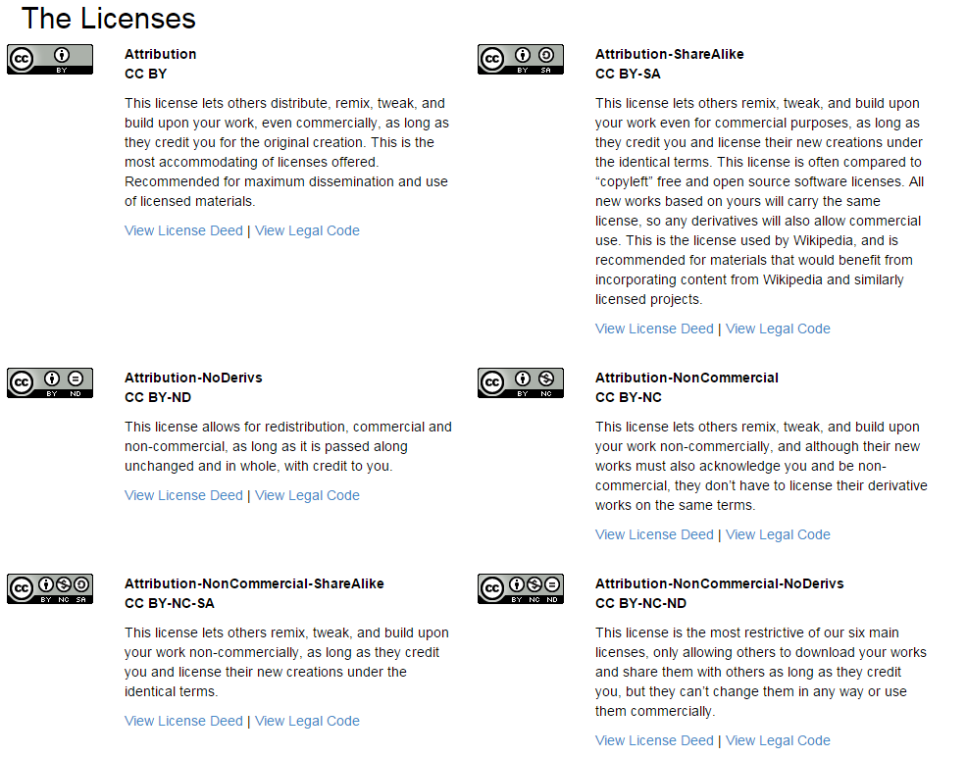
https://creativecommons.org/licenses/

Slide 24
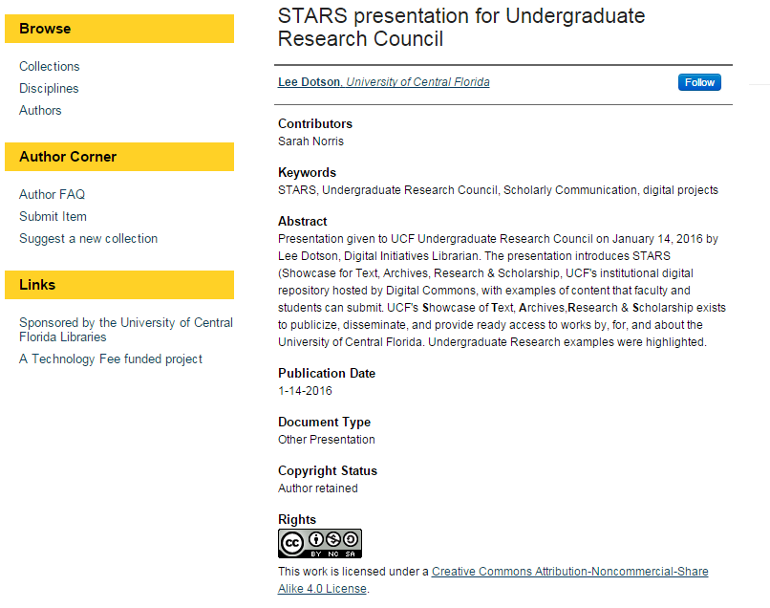
Where do you see creative commons licenses?

Slide 25
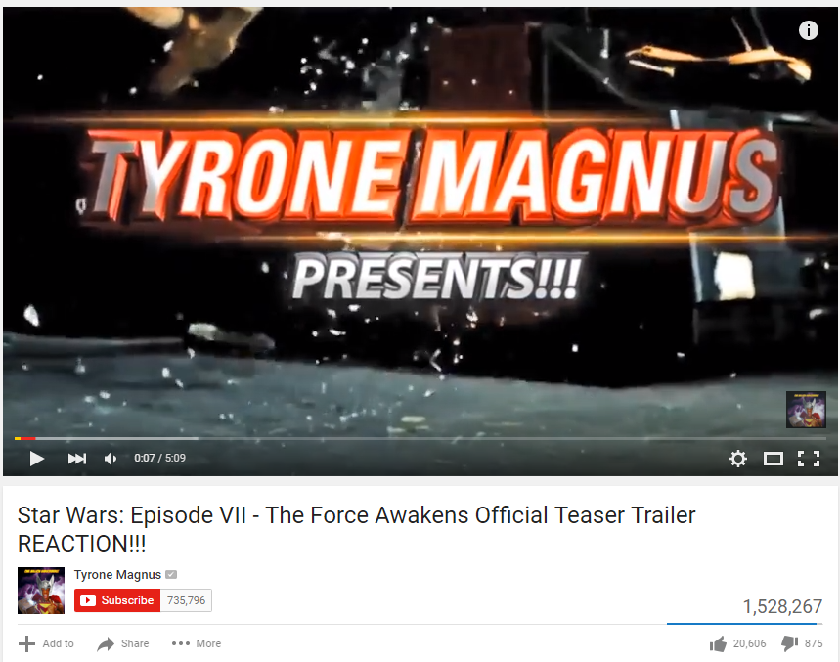

Slide 26
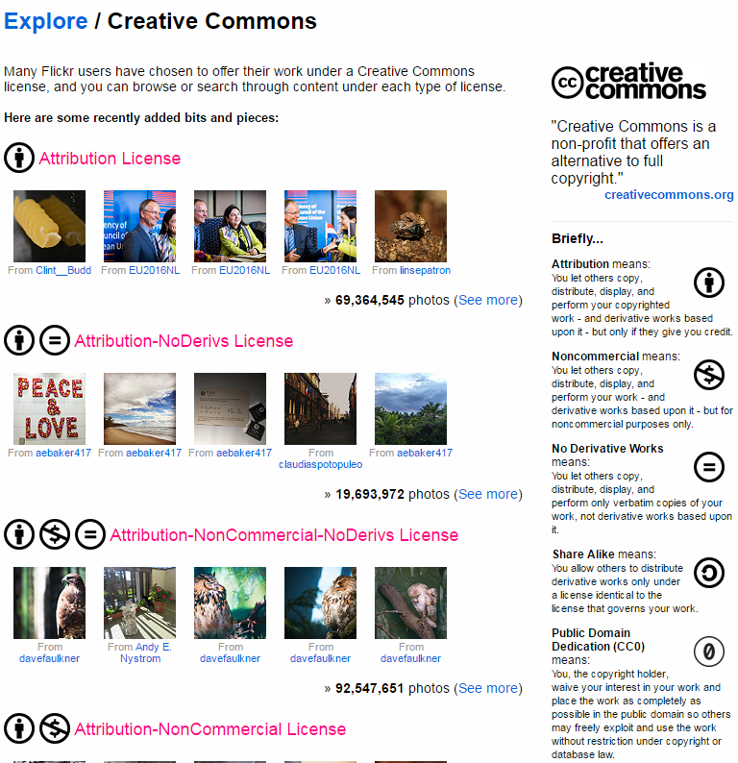

Slide 27
Using Images Online
Google Images is NOT a source
Photos with no copyright or source is NOT necessarily public domain
Look for free public domain images, stock photos, or images with Creative Commons Licenses
You may be able to use copyrighted images in some instances under Fair Use (see Four Factors)

Slide 28
Where to find images
Creative Commons Search – Search many sites at once (including Flickr Creative Commons)
Flickr Creative Commons – Search images that have various CC licenses attached to them
StockVault.net – Free images from photographers around the world
Open Clipart Library – Public domain clipart
UCF Libraries Images & Sounds Guide – Compiled list from UCF Libraries

Slide 29
YouTube & Video Considerations
Link to videos instead of embedding
Look for items in the public domain or that have creative commons licenses attached to them (YouTube advanced search)
Avoid videos on YouTube and other sites that are clear violations of copyright (i.e. video itself is infringing on copyright)

Slide 30
Citing Images & Copyrighted Resources
Cite as you normally would for specific mediums
Always cite as a matter of ethical academic practice
Use citation style(s) for your discipline
If something is in the public domain, you do not need to cite it
If you use an item with a creative commons license, cite according to the license terms (i.e. attribution, public domain, etc.)

Slide 31
When in doubt, ask!
Image retrieved from: https://flic.kr/p/hoMcw
© Marcus Ramberg

Slide 32
Resources
UCF Office of General Counsel – Legal Issues Page
https://generalcounsel.ucf.edu/legal-issues/
UCF Libraries Copyright
General: https://library.ucf.edu/about/departments/scholarly-communication/copyright/
Policies: http://library.ucf.edu/about/policies/copyright/
Copyright Office
http://www.copyright.gov/

