Slide 1
STARS
Faculty Senate
Lee Dotson Sarah Norris
Digital Initiatives Librarian Scholarly Communication Librarian
September 24, 2015

Slide 2
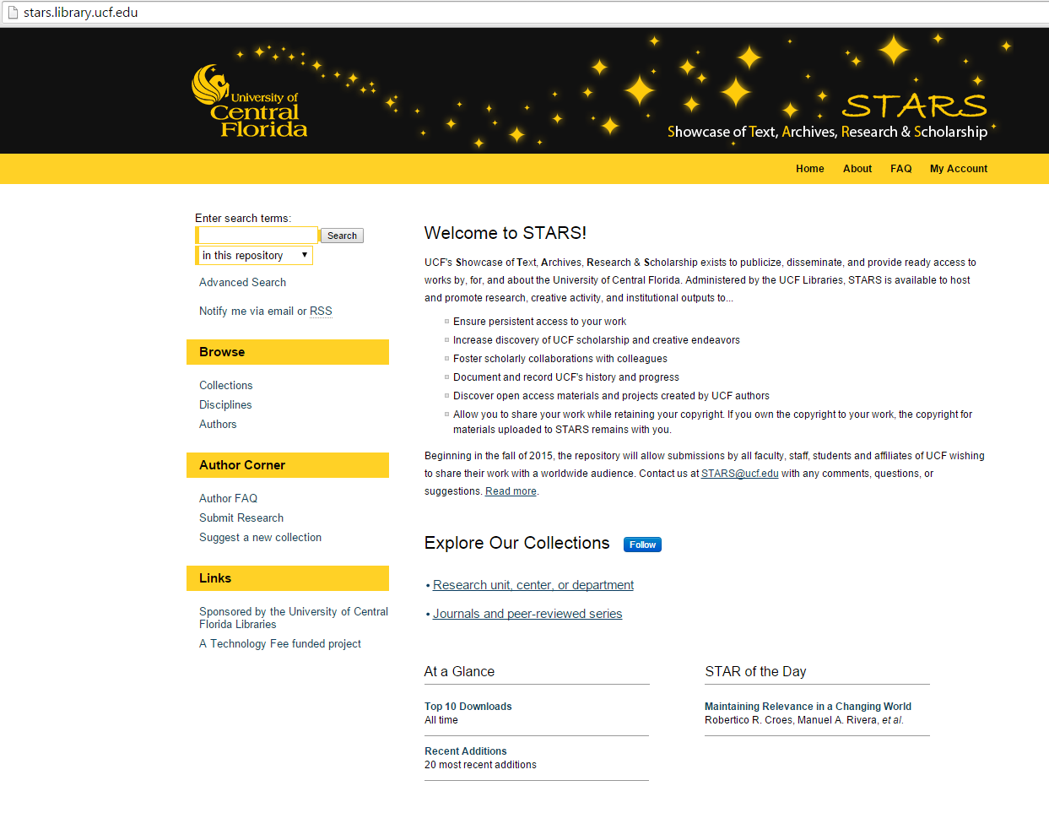
http://stars.library.ucf.edu/

Slide 3
About STARS
UCF's Showcase of Text, Archives, Research & Scholarship
The purpose of STARS is to disseminate, publicize, and share works by, for, and about UCF. The intention is to provide access to this work as broadly as possible, and for as long as possible.

Slide 4
Why STARS?
  Ensure persistent access to your work
  Increase discovery of UCF scholarship and creative endeavors
  Foster scholarly collaborations with colleagues
  Document and record UCF's history and progress
  Discover open access materials and projects created by UCF authors
  Allow you to share your work while retaining your copyright. If you own the copyright to your work, the copyright for materials uploaded to STARS remains with you.

Slide 5
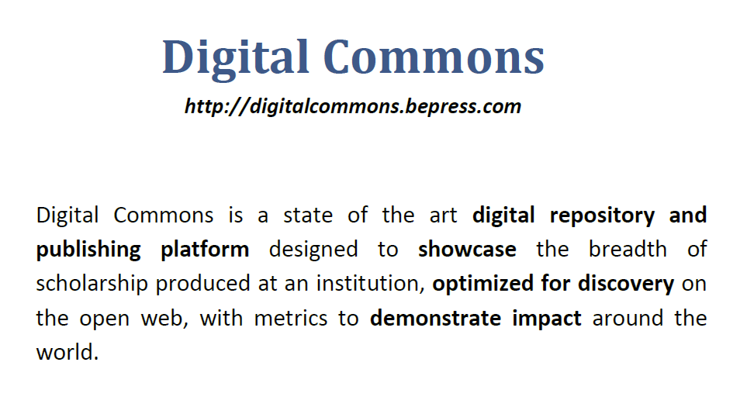

Slide 6
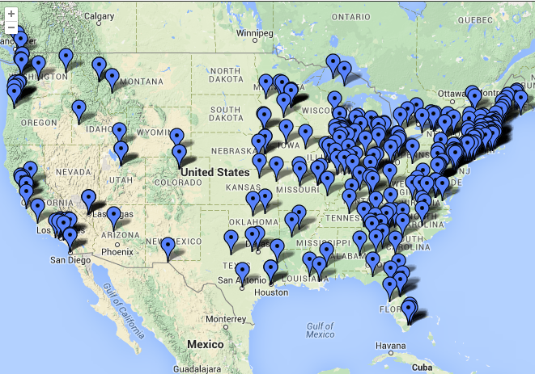

Slide 7
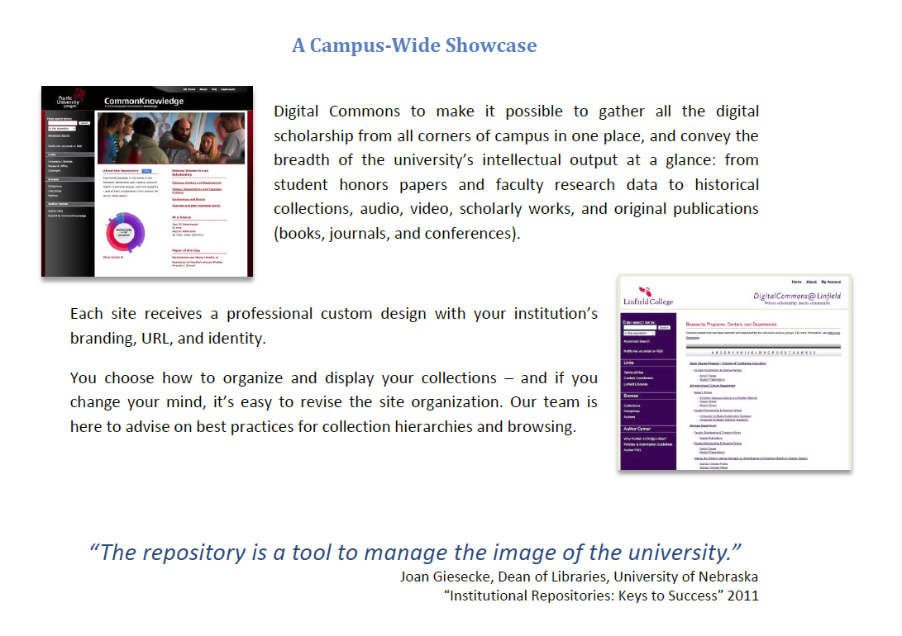

Slide 8
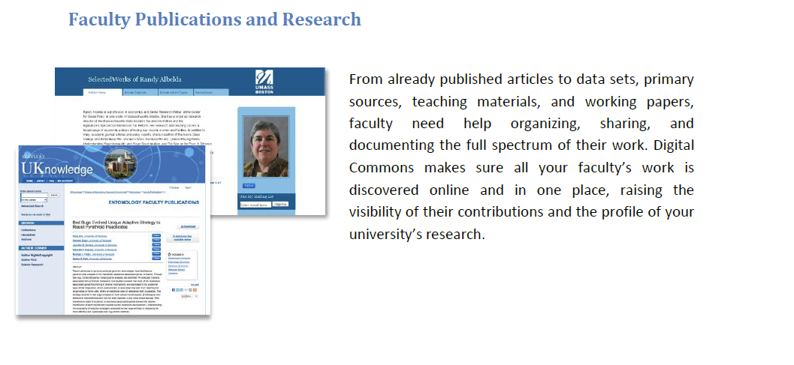

Slide 9
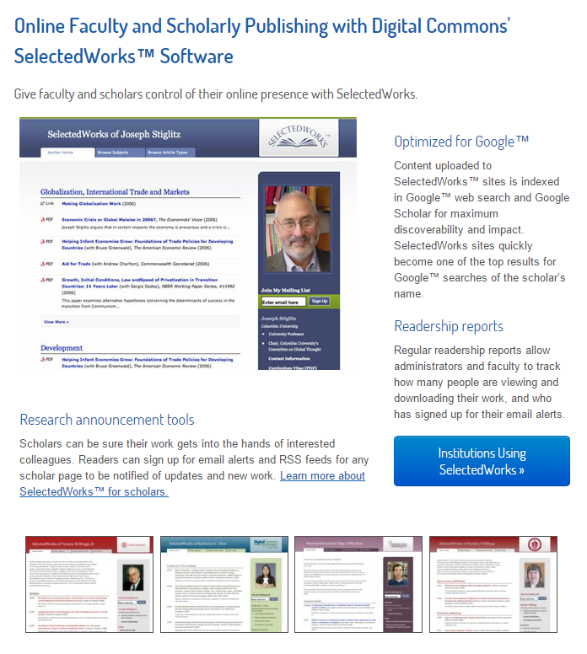

Slide 10
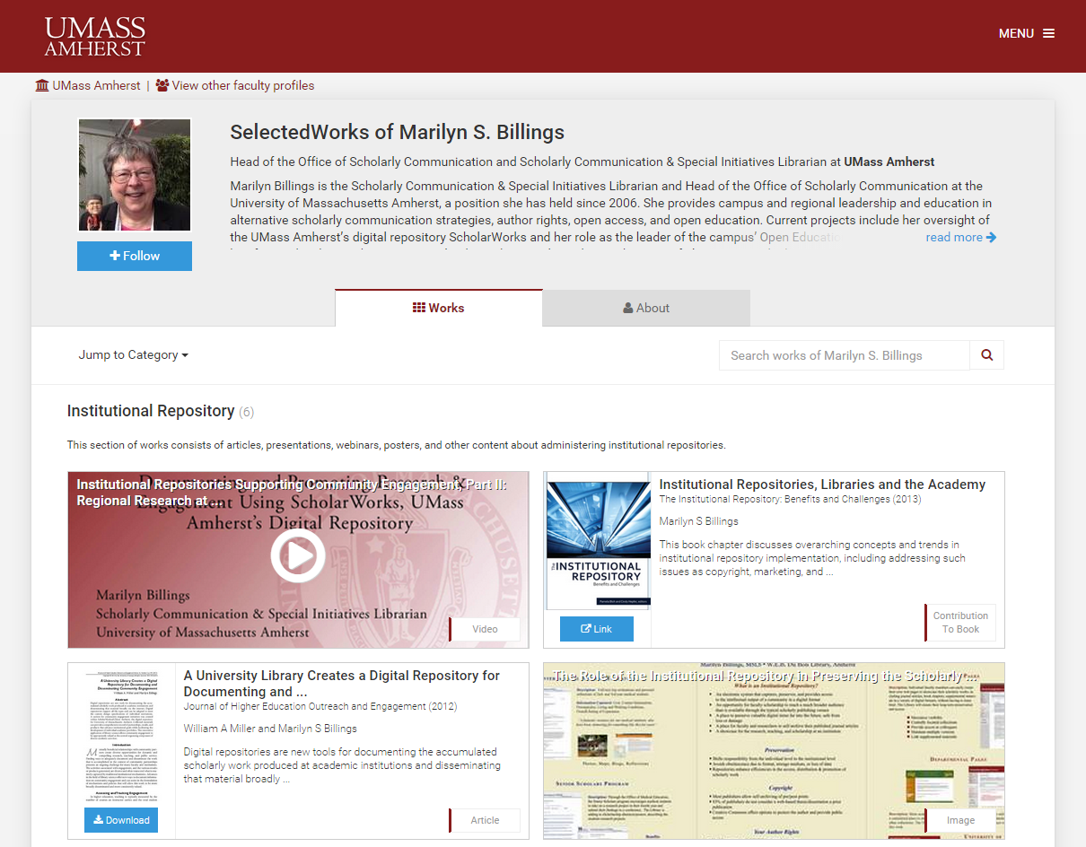

Slide 11
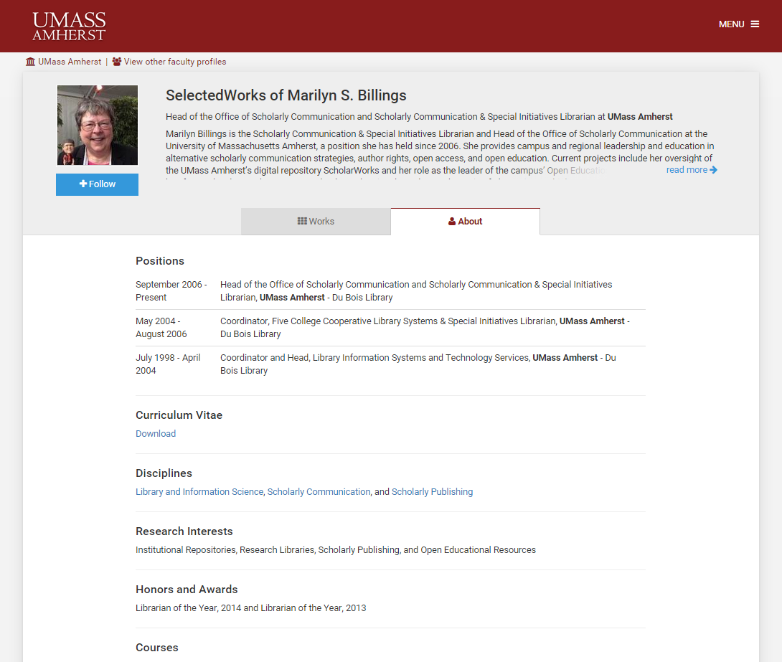

Slide 12
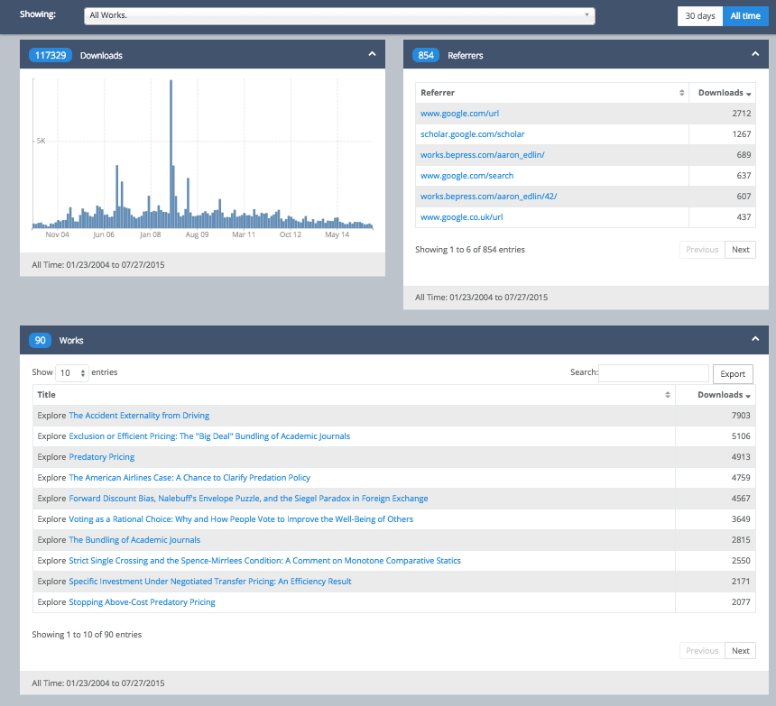

Slide 13
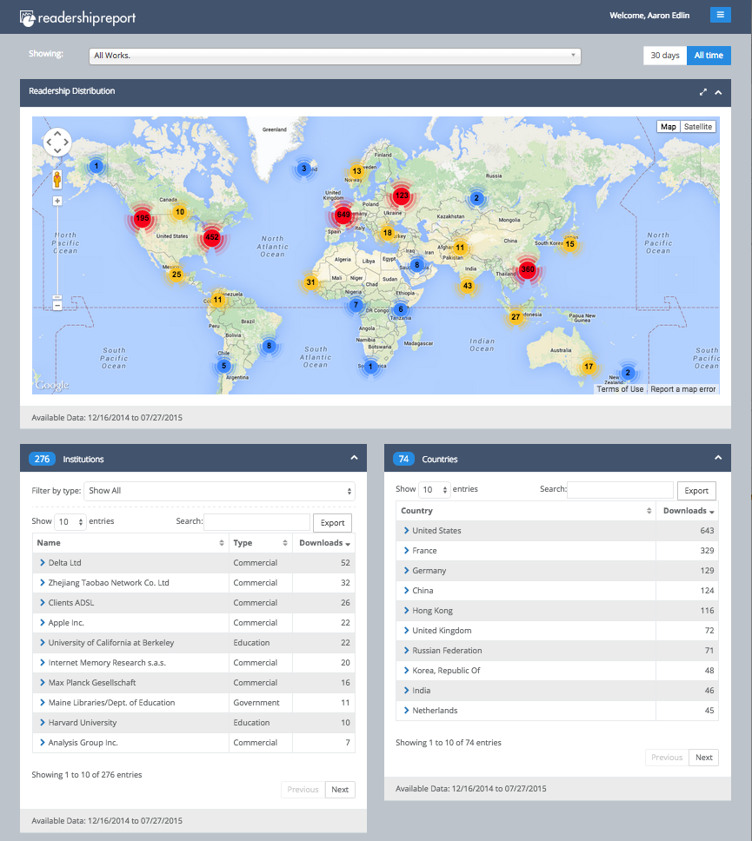

Slide 14
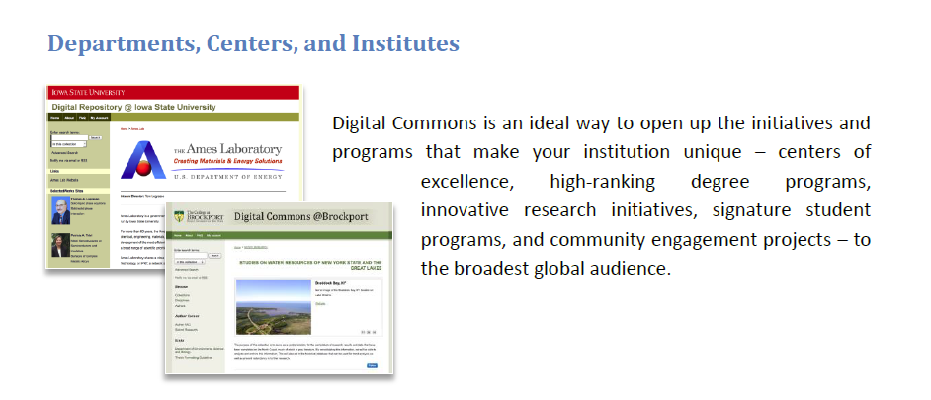

Slide 15
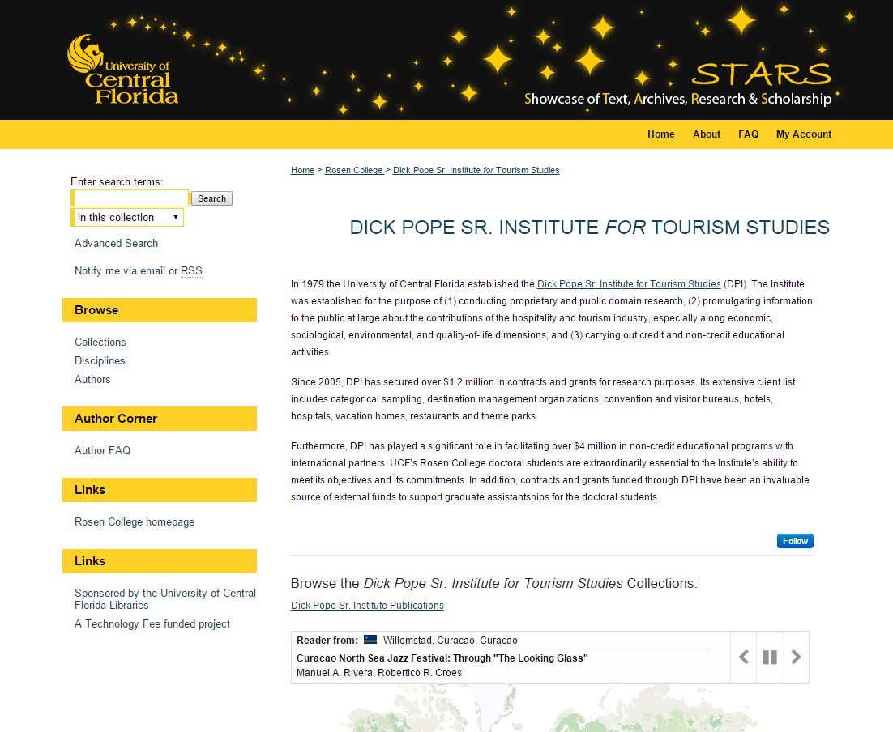
http://stars.library.ucf.edu/dickpopeinstitute/

Slide 16
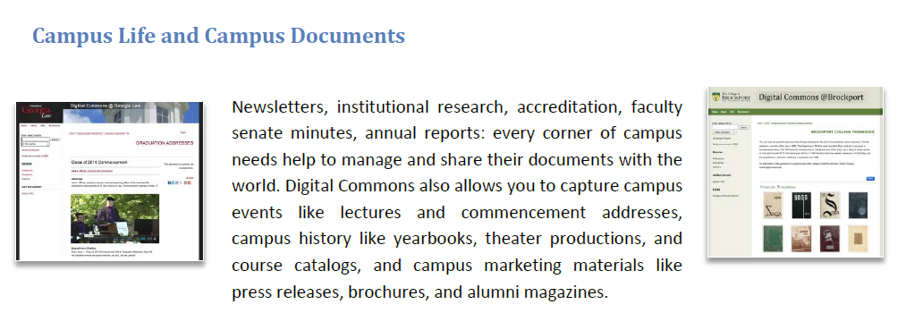

Slide 17
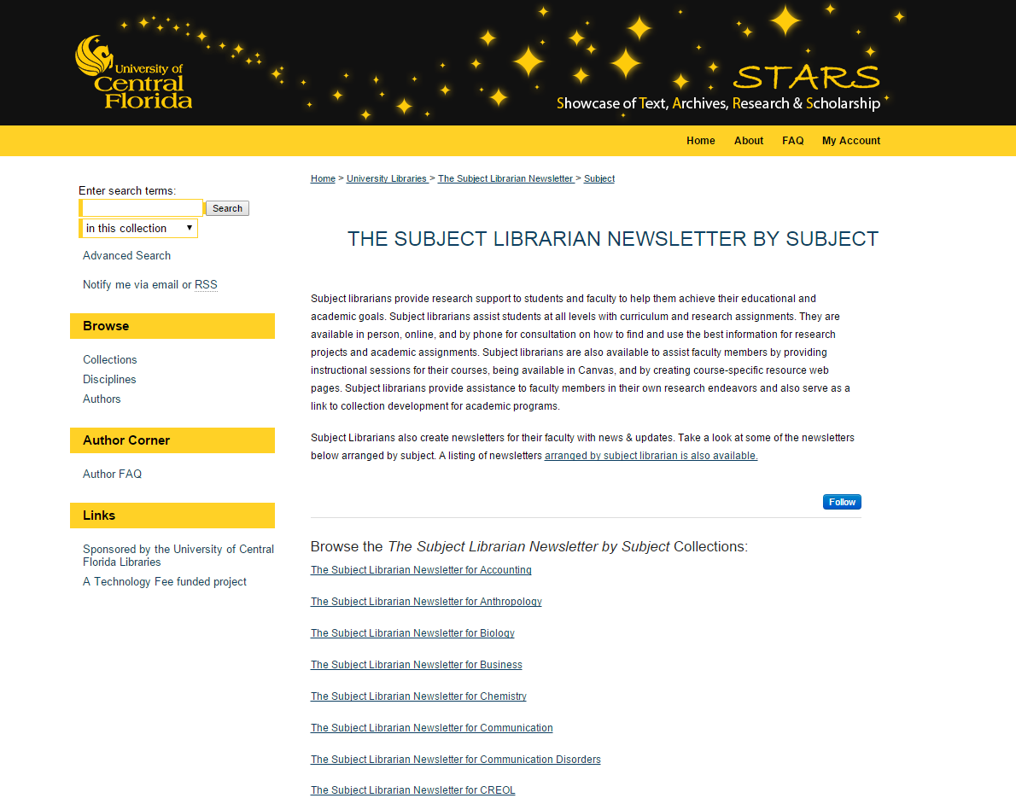
http://stars.library.ucf.edu/subjectlibnews-subject/

Slide 18
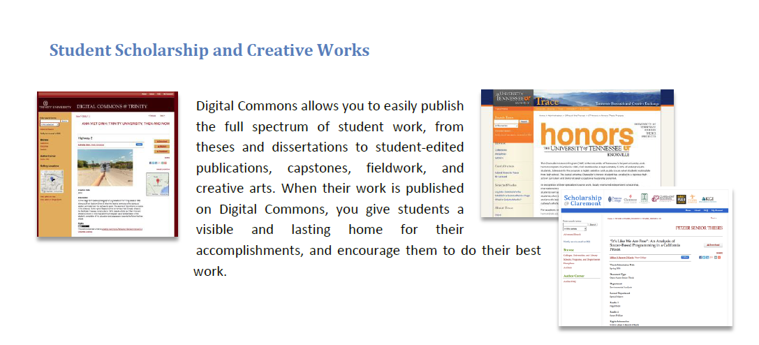

Slide 19
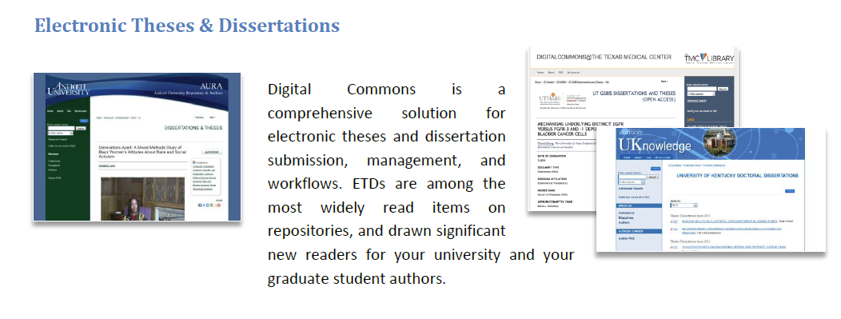

Slide 20
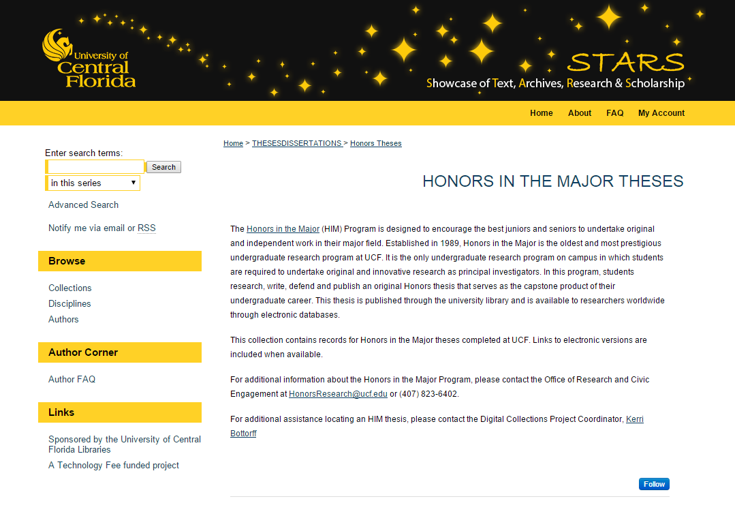
http://stars.library.ucf.edu/honorstheses/

Slide 21
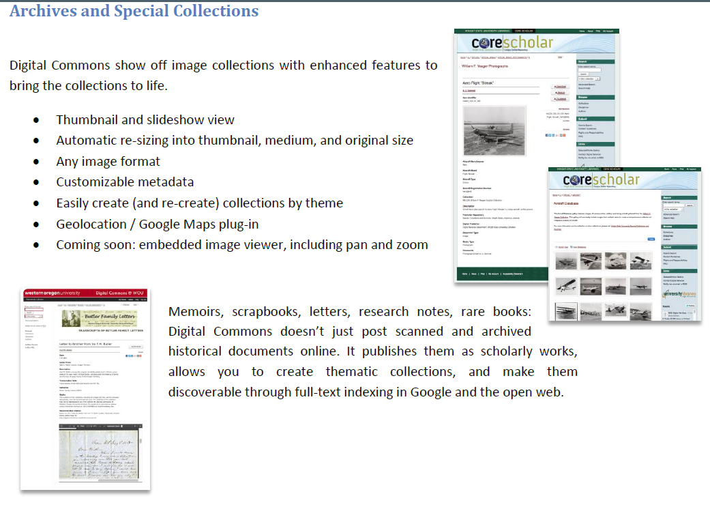

Slide 22
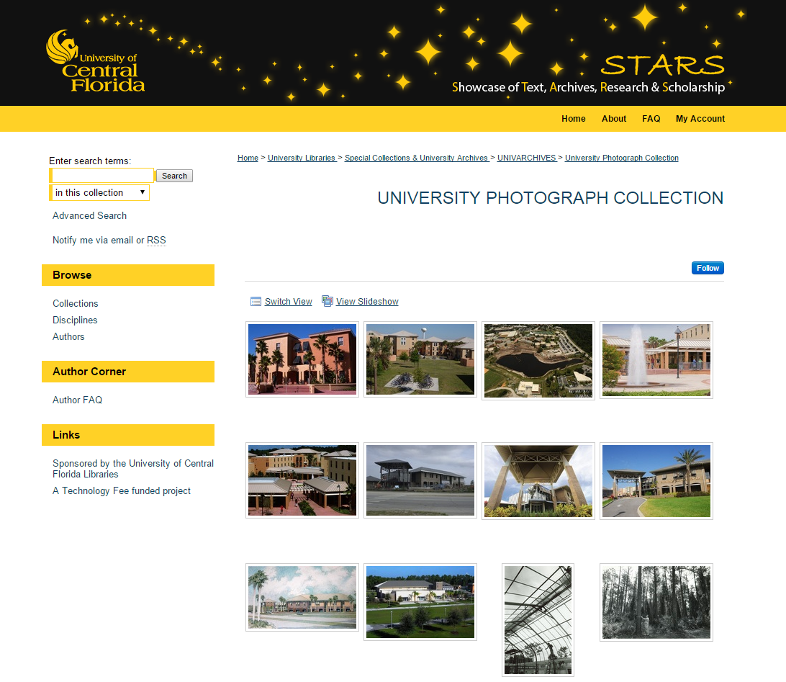
http://stars.library.ucf.edu/univphotocollection/

Slide 23
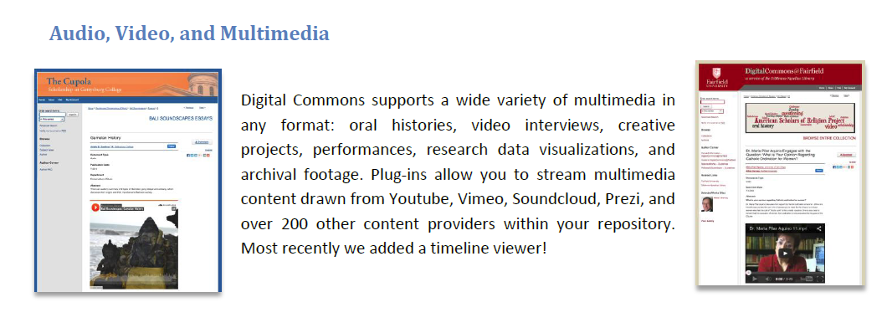

Slide 24
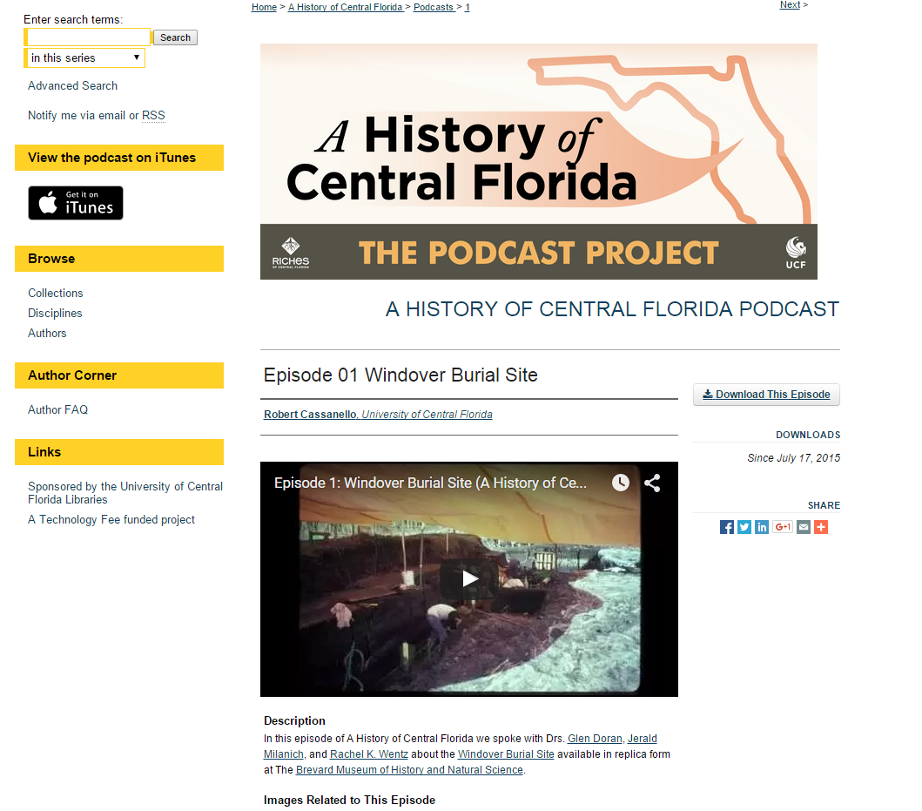
http://stars.library.ucf.edu/ahistoryofcentralfloridapodcast/1/

Slide 25
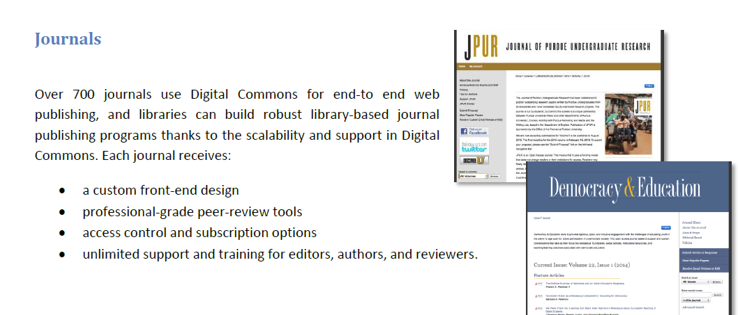

Slide 26
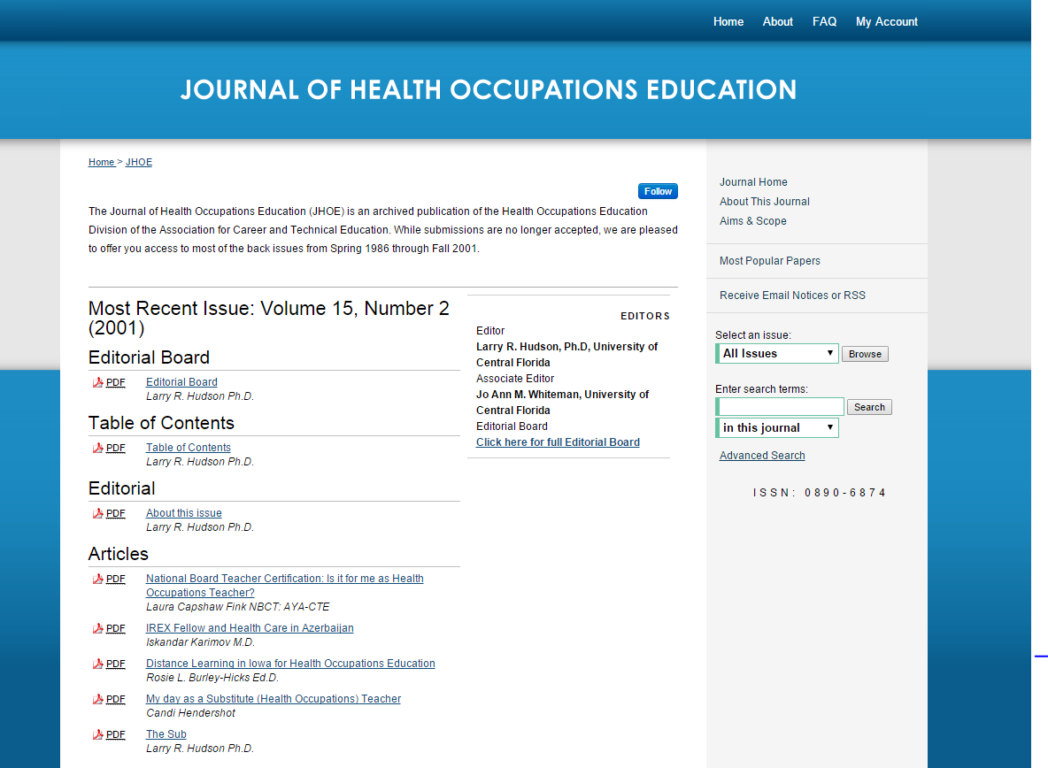
http://stars.library.ucf.edu/jhoe/

Slide 27
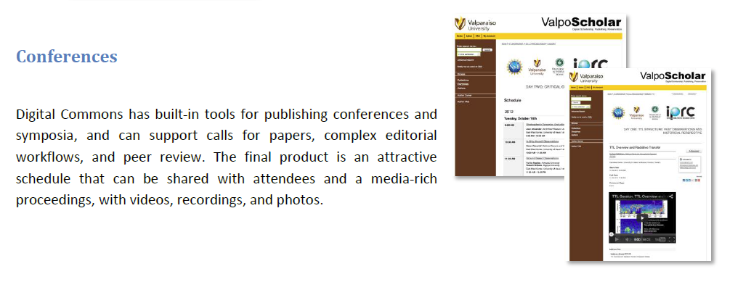

Slide 28
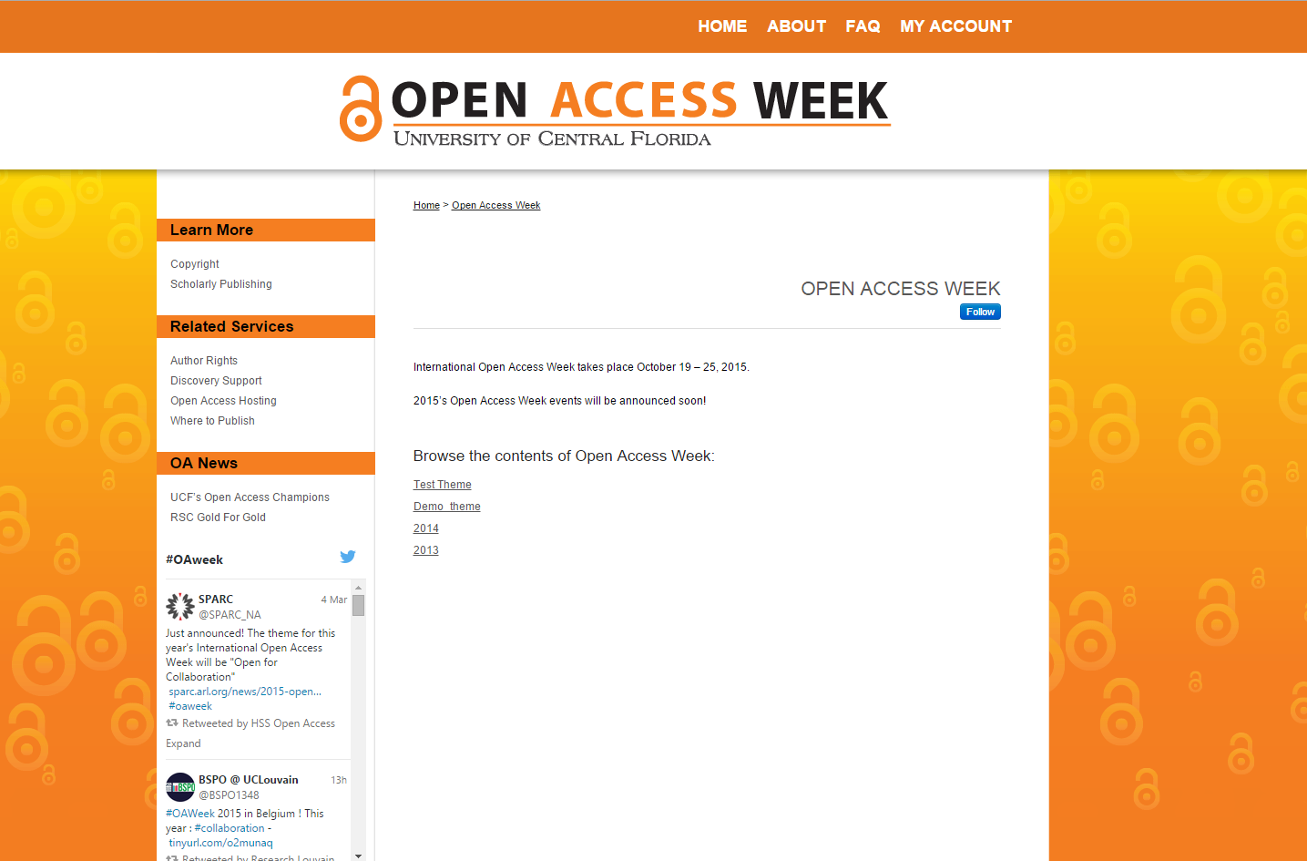

Slide 29
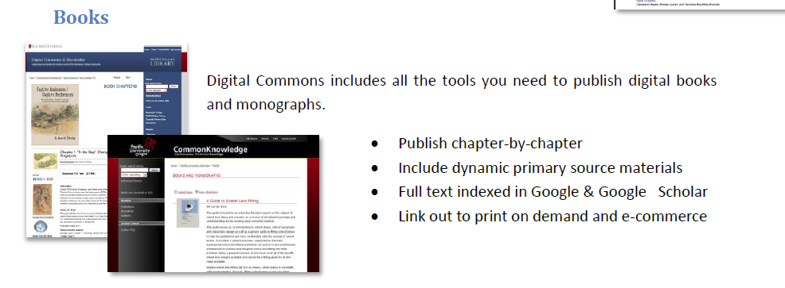

Slide 30
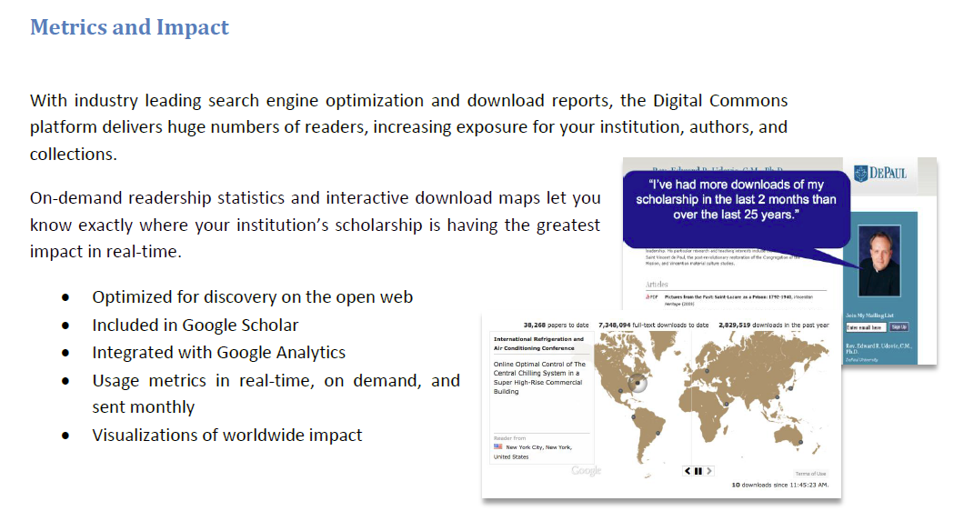

Slide 31
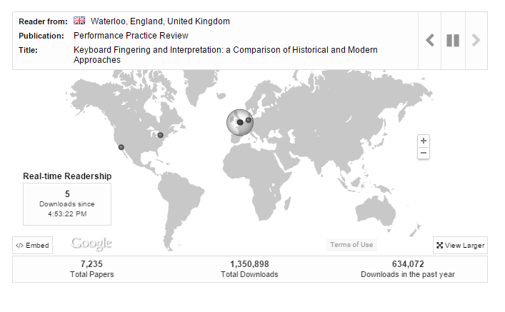

Slide 32
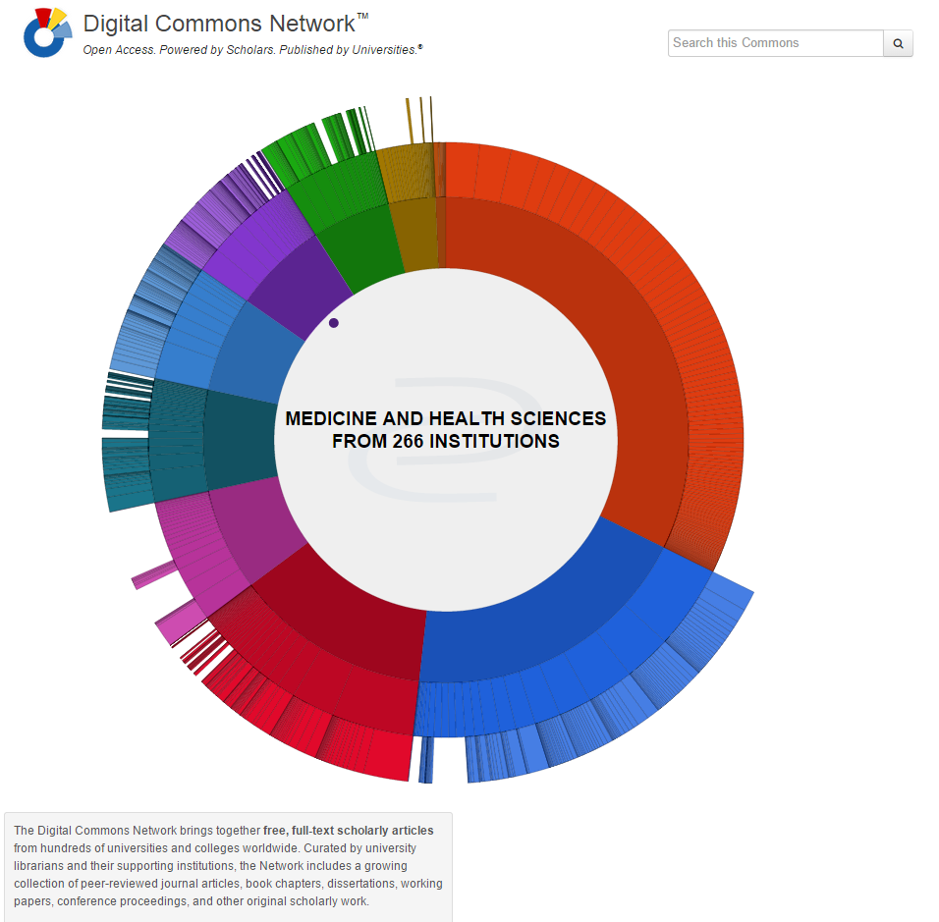

Slide 33
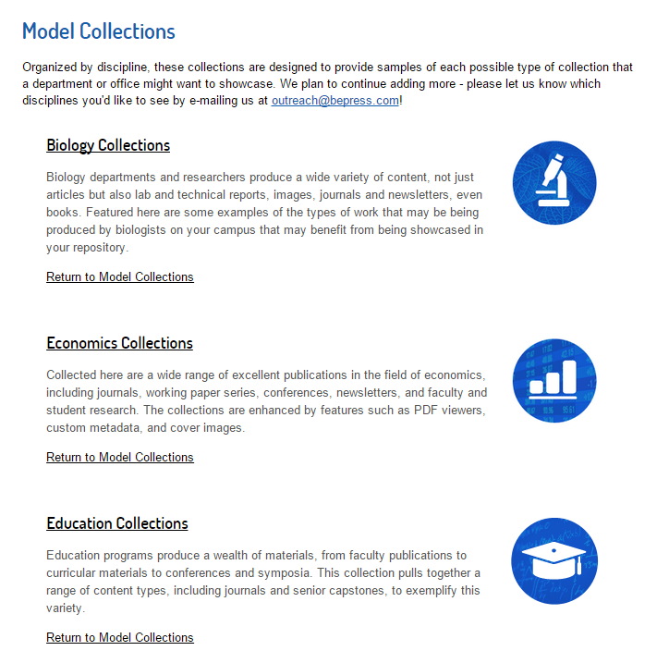
Plus…
  Engineering
  History
  Mathematics
  Medicine and Health Sciences
  Music
  Office of Research
  Political Science

Slide 34
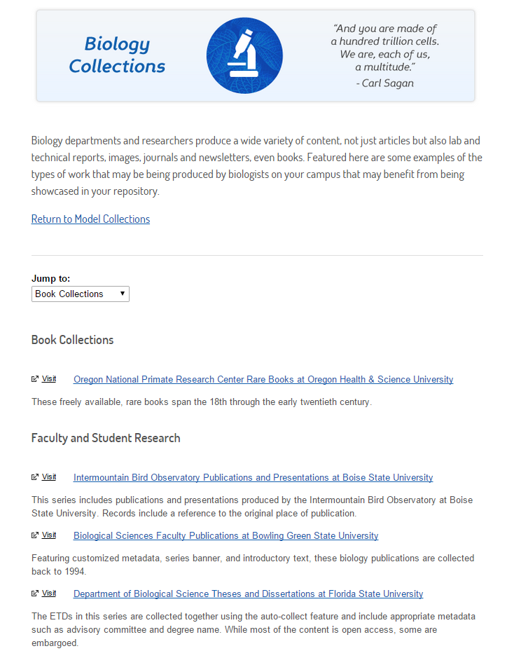

Slide 35
Beyond STARS
Scholarly Communication Services

Slide 36
What is Scholarly Communication?
“the process of academics, scholars and researchers sharing and publishing their research findings so that they are available to the wider academic community (such as university academics) and beyond.”

Slide 37
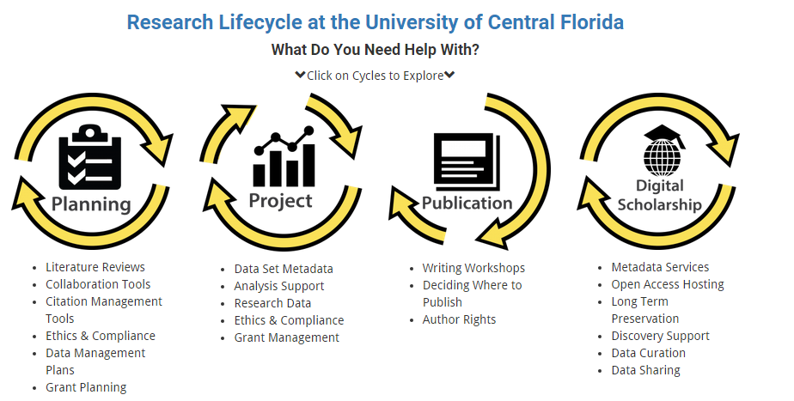
Scholarly Communication Services
http://library.ucf.edu/about/departments/scholarly-communication/

Slide 38
Contact Info
Lee Dotson Digital Initiatives Librarian
Lee.Dotson@ucf.edu
(407) 823-1236
Sarah Norris
Scholarly Communication Librarian
sarah.norris@ucf.edu
(407) 823-2402

