Slide 1
STARS UCF Undergraduate Research Council Lee Dotson Digital Initiatives Librarian January 14, 2016

Slide 2
http://stars.library.ucf.edu/

Slide 3
About STARS UCF's Showcase of Text, Archives, Research & Scholarship
The purpose of STARS is to disseminate, publicize, and share works by, for, and about UCF. The intention is to provide access to this work as broadly as possible, and for as long as possible.

Slide 4
Why STARS?
Ensure persistent access to your work
Increase discovery of UCF scholarship and creative endeavors
Foster scholarly collaborations with colleagues
Document and record UCF's history and progress
Discover open access materials and projects created by UCF authors
Allow you to share your work while retaining your copyright. If you own the copyright to your work, the copyright for materials uploaded to STARS remains with you.

Slide 6
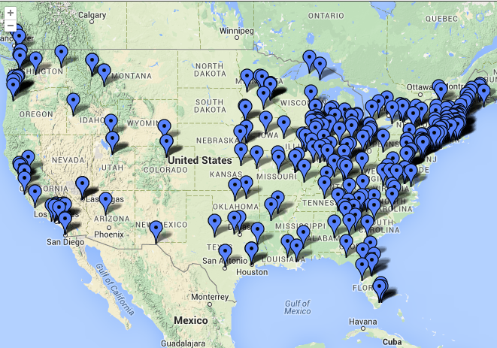

Slide 9
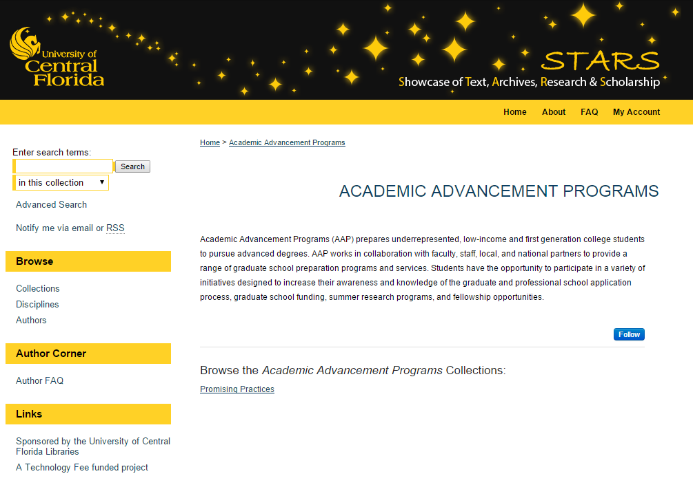
http://stars.library.ucf.edu/aap

Slide 10
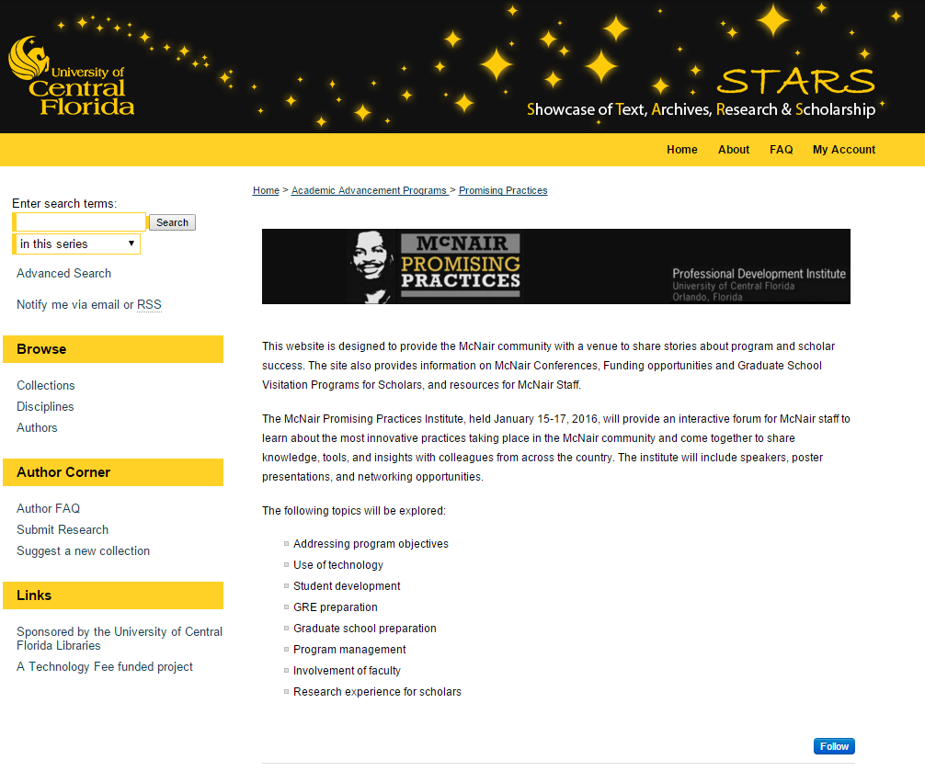
http://stars.library.ucf.edu/promisingpractices/

Slide 11
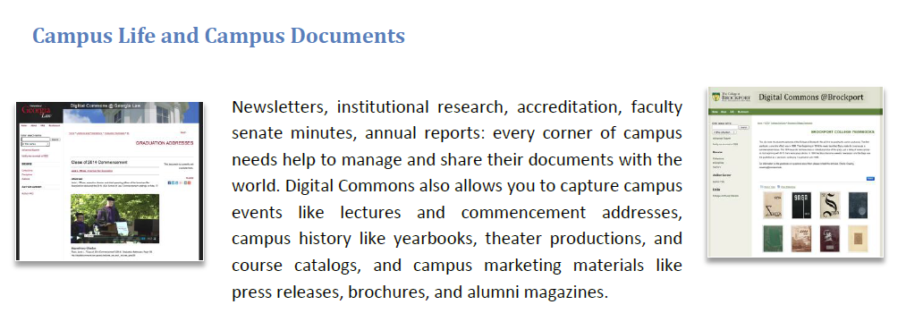

Slide 12
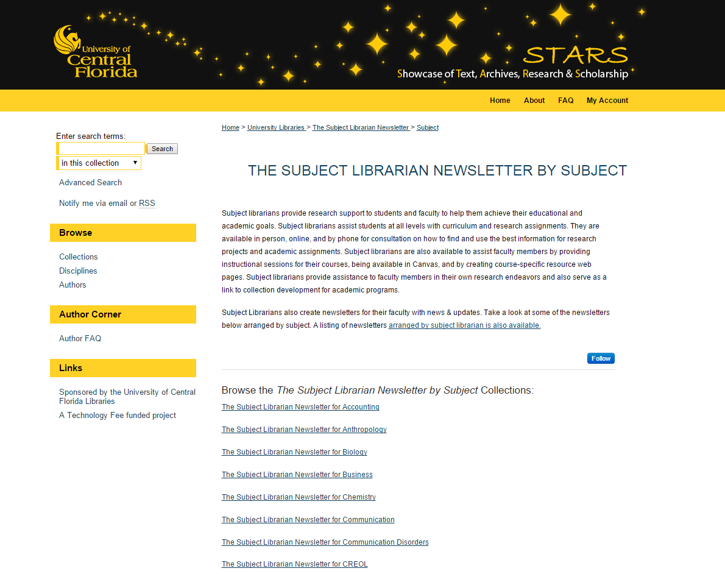
http://stars.library.ucf.edu/subjectlibnews-subject/

Slide 15
http://stars.library.ucf.edu/honorstheses/

Slide 17
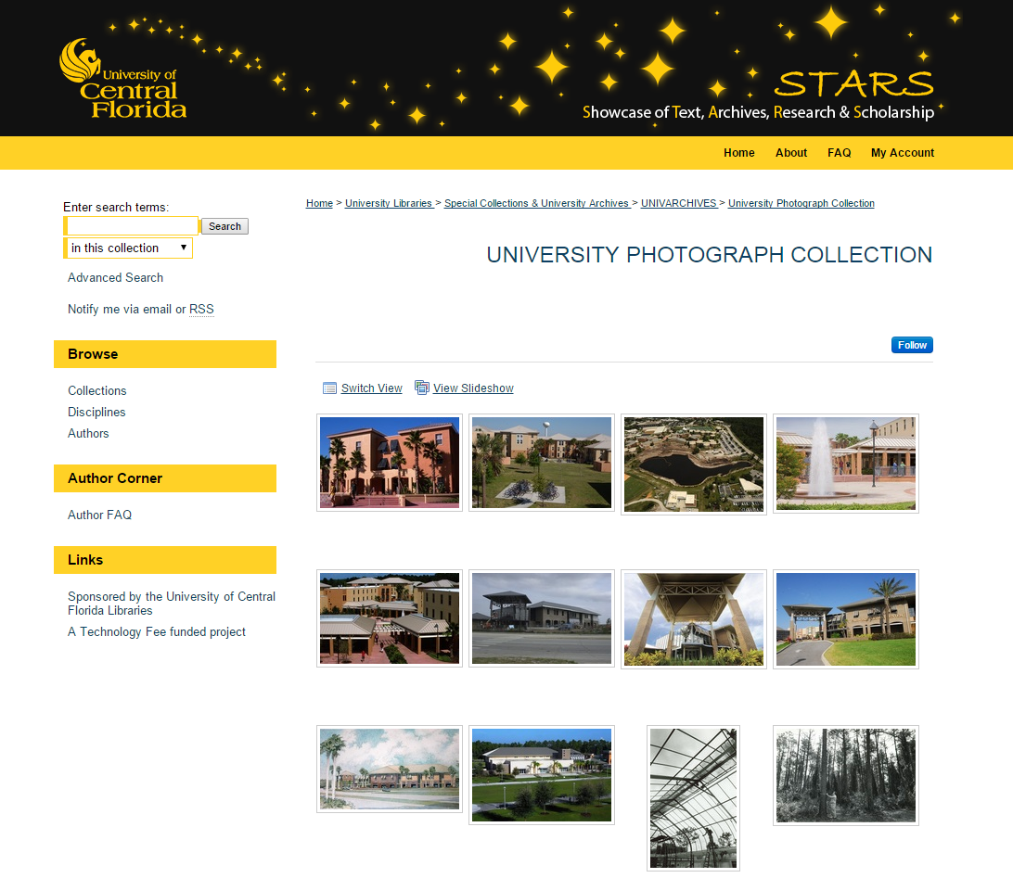
http://stars.library.ucf.edu/univphotocollection/

Slide 19
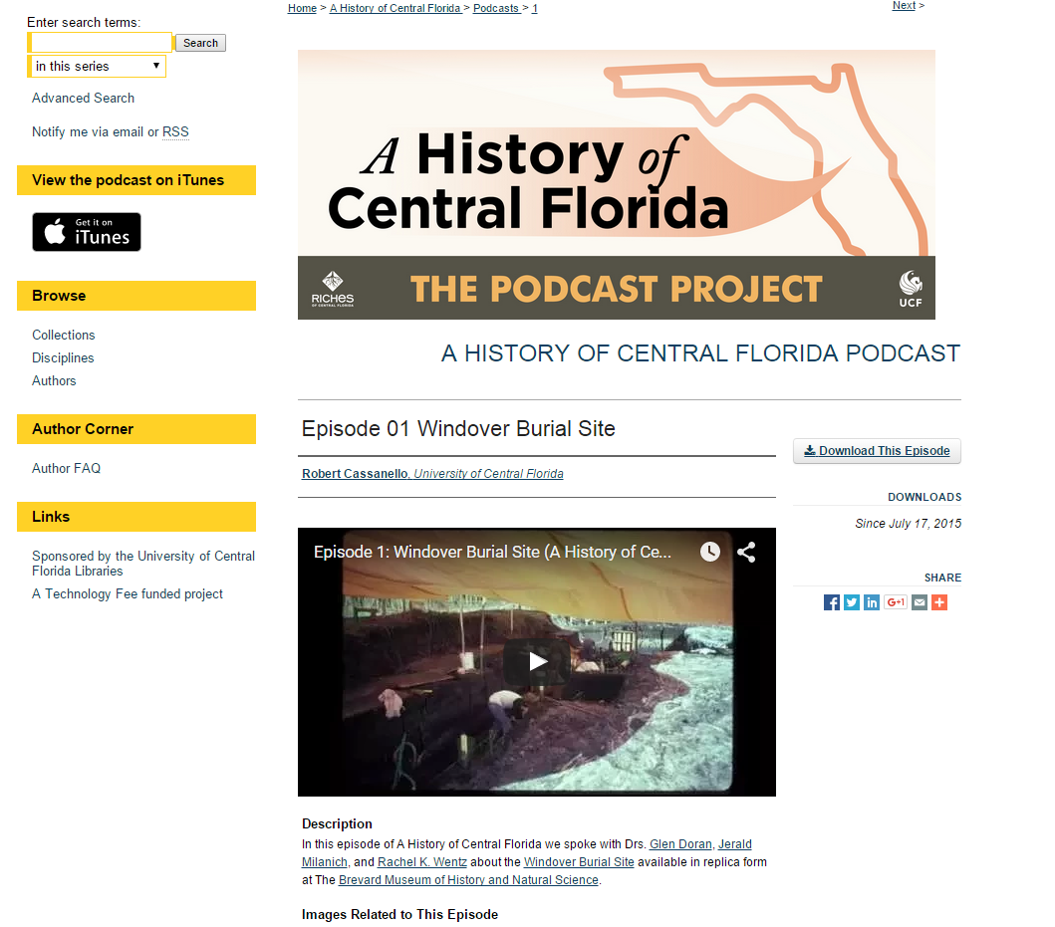
http://stars.library.ucf.edu/ahistoryofcentralfloridapodcast/1/

Slide 21
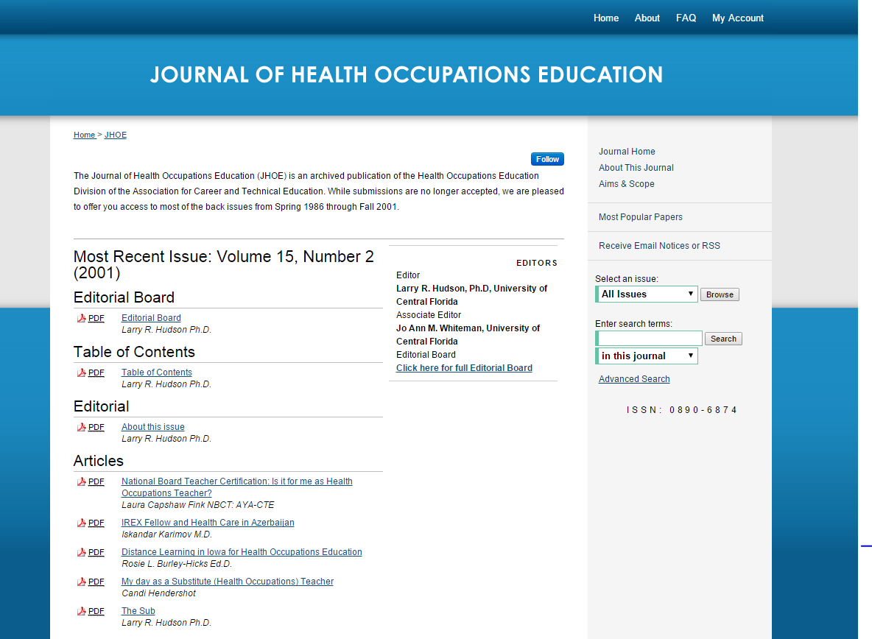
http://stars.library.ucf.edu/jhoe/

Slide 22
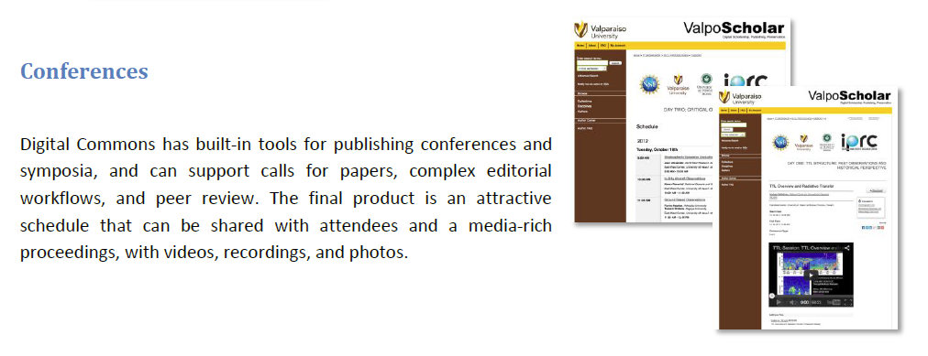

Slide 23
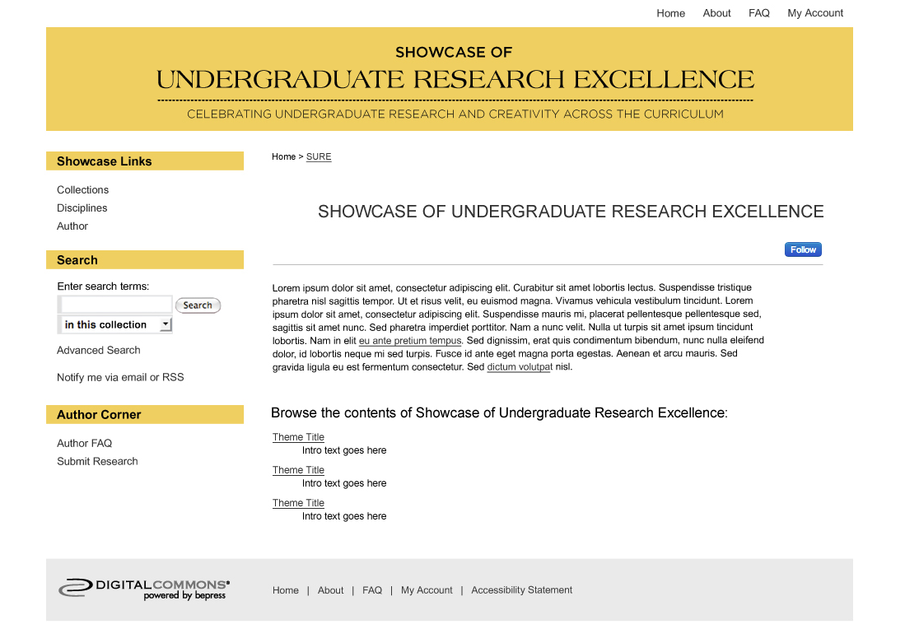

Slide 24
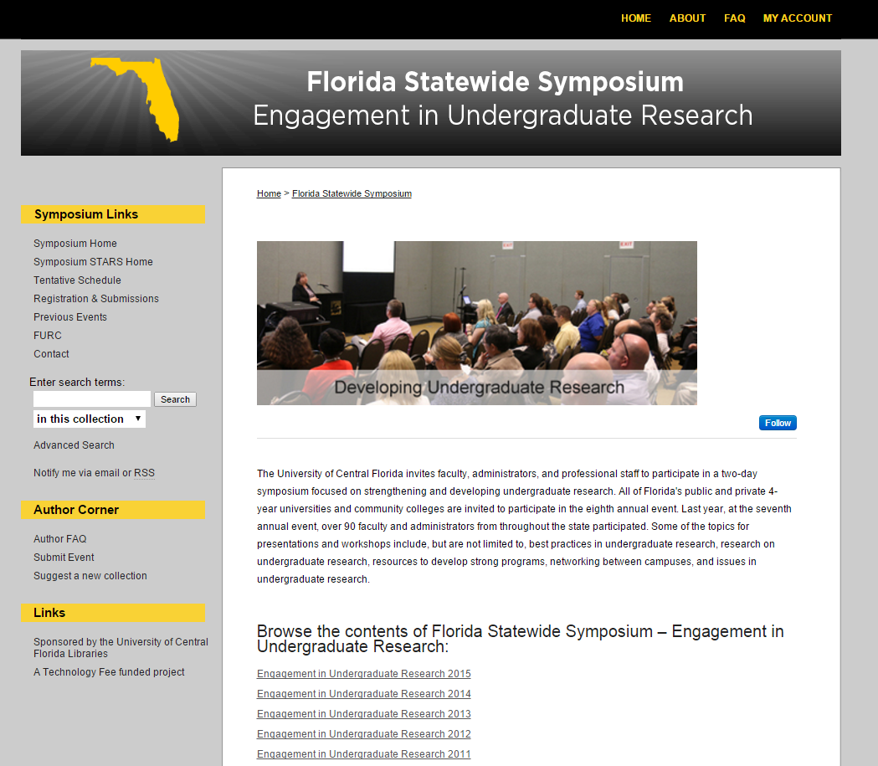
http://stars.library.ucf.edu/researchsymposium/

Slide 25
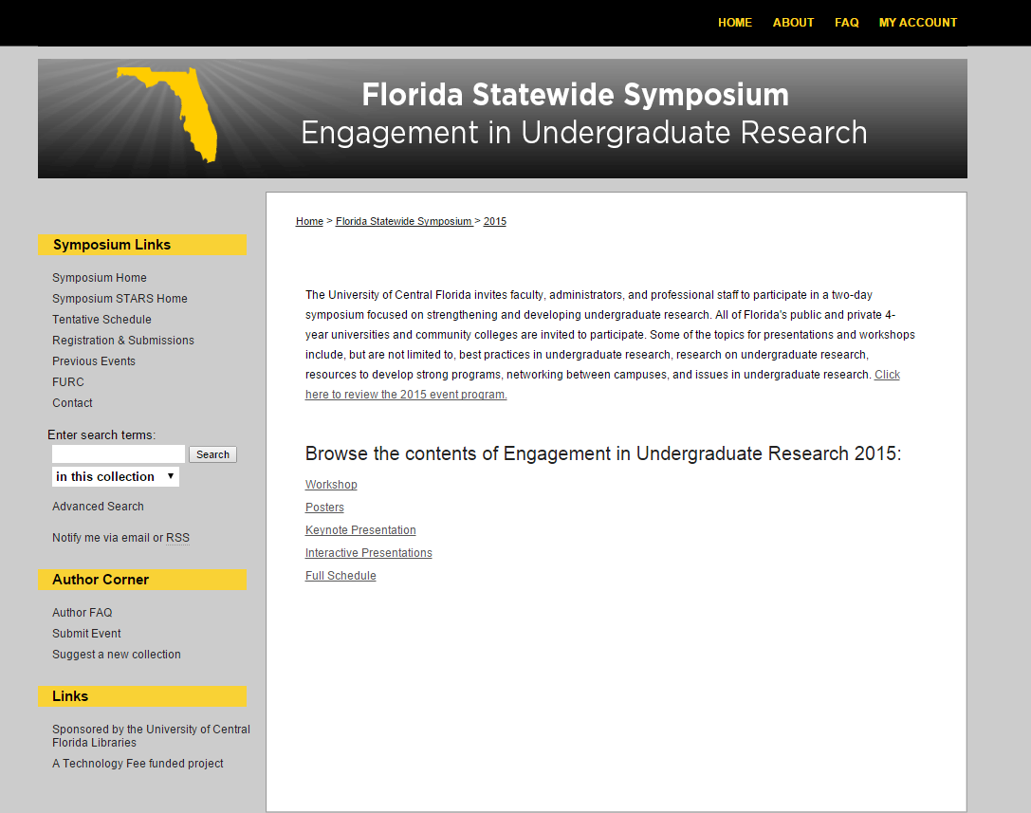

Slide 26
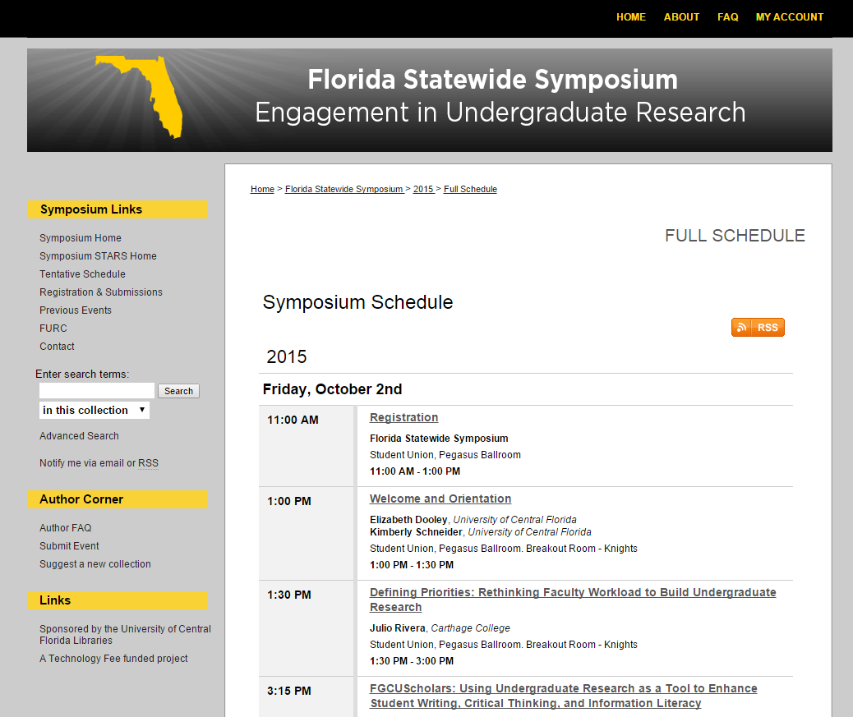

Slide 27
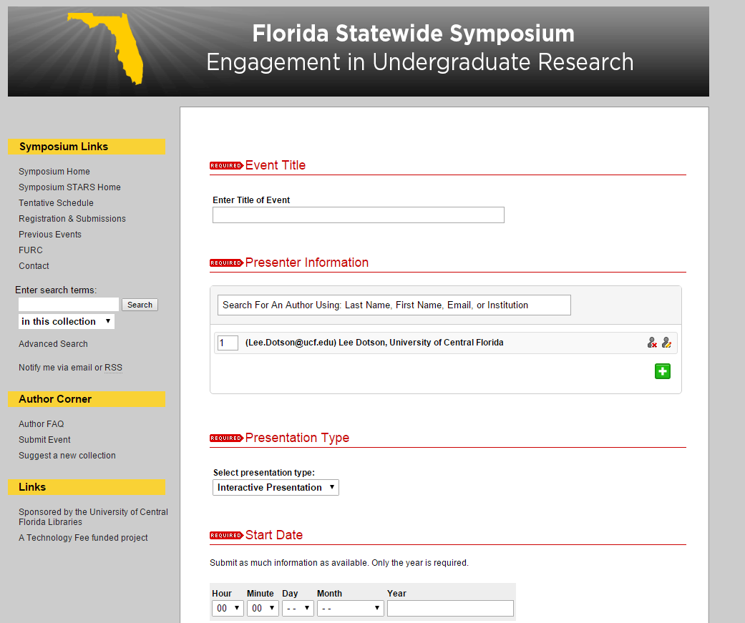

Slide 28
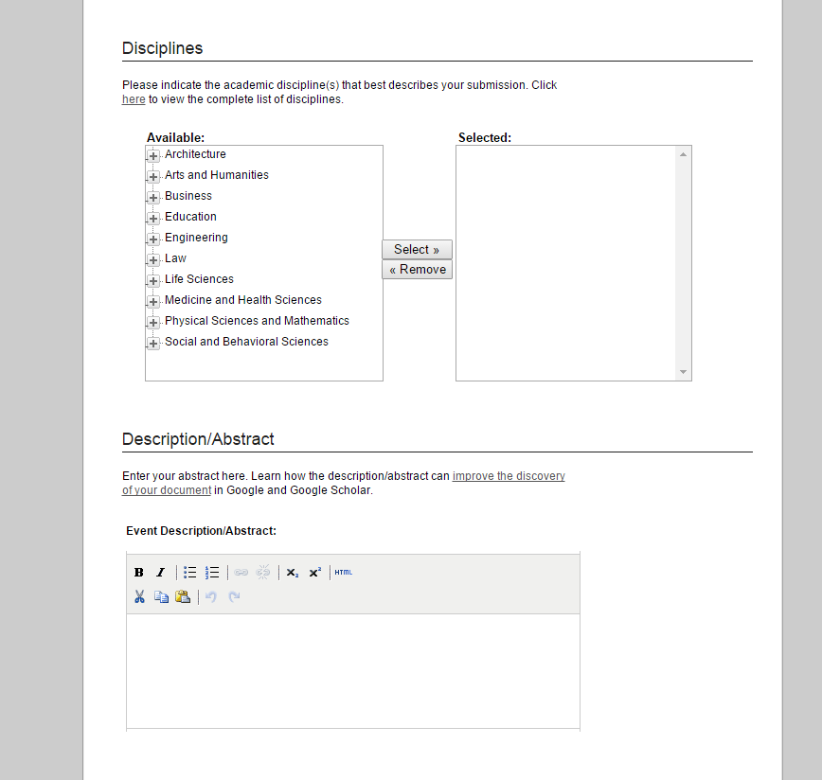

Slide 29
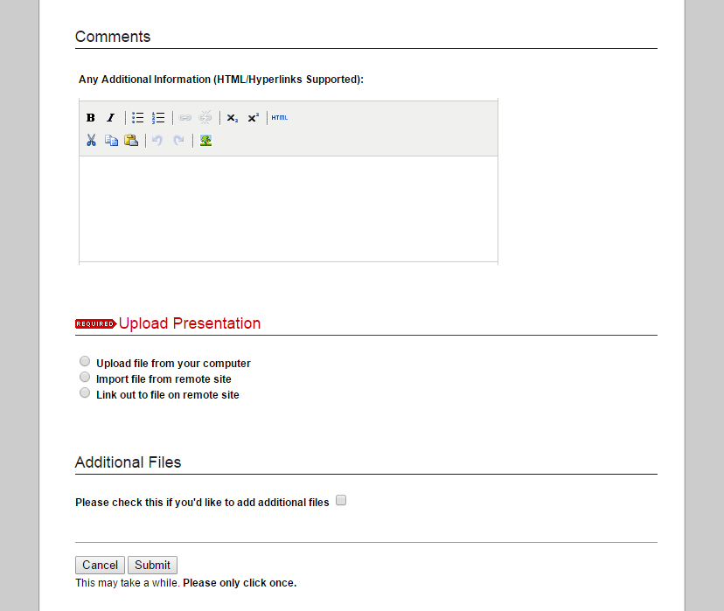

Slide 30
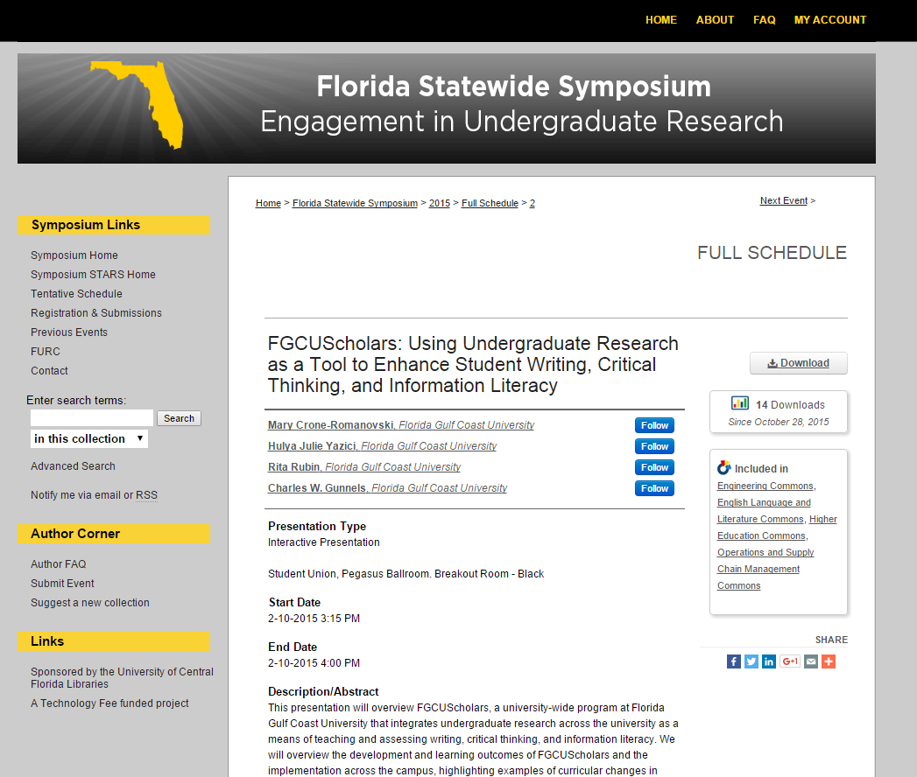

Slide 33
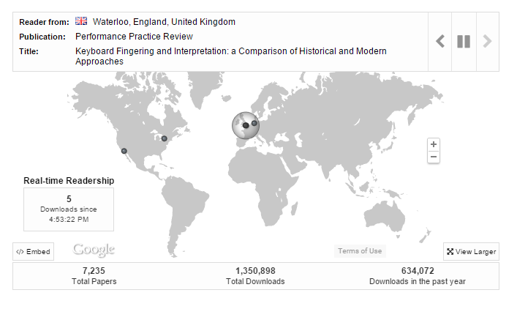

Slide 34
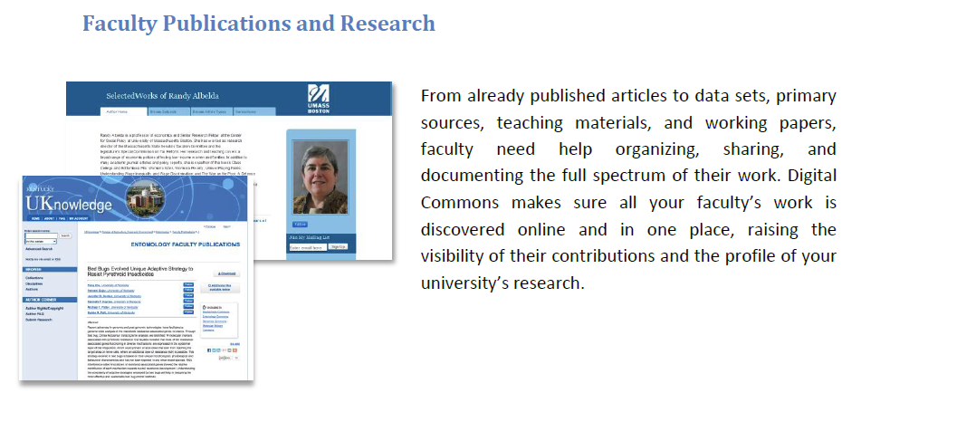

Slide 39
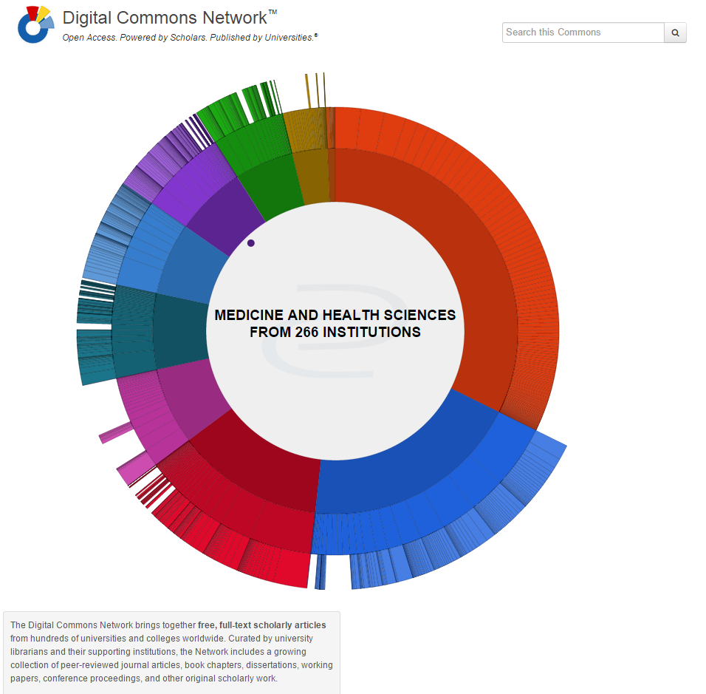

Slide 40
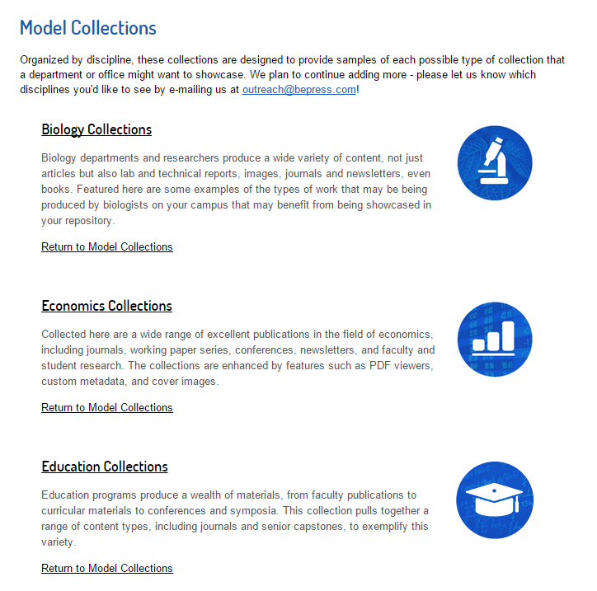
Plus…
Engineering
History
Mathematics
Medicine and Health Sciences
Music
Office of Research
Political Science

Slide 41
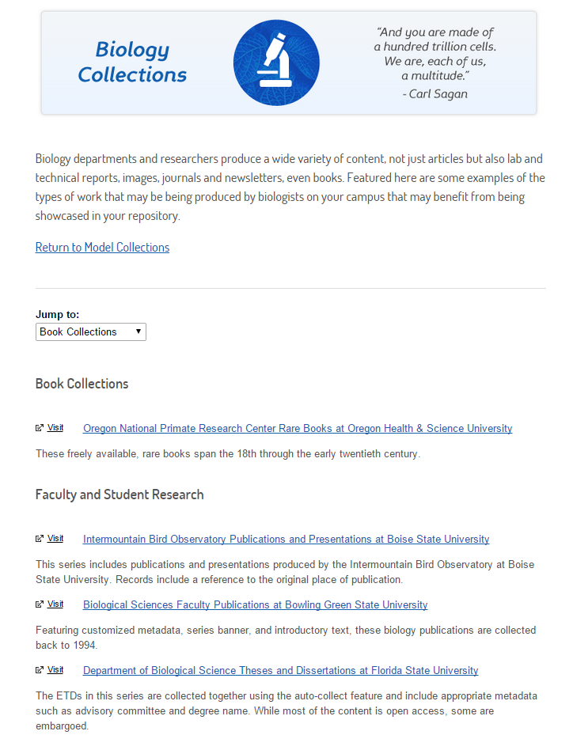

Slide 42
Beyond STARS Scholarly Communication Services

Slide 43
What is Scholarly Communication?
“the process of academics, scholars and researchers sharing and publishing their research findings so that they are available to the wider academic community (such as university academics) and beyond.”

Slide 44
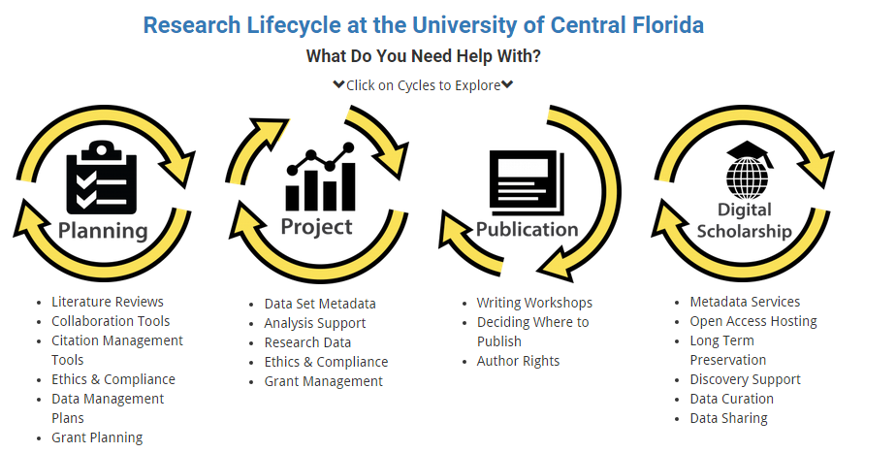
Scholarly Communication Services
http://library.ucf.edu/about/departments/scholarly-communication/

Slide 45
Contact Info
Lee Dotson Digital Initiatives Librarian
Lee.Dotson@ucf.edu
(407) 823-1236
Sarah Norris
Scholarly Communication Librarian
sarah.norris@ucf.edu
(407) 823-2402

