Slide 1
Copyright Update for Faculty 2016
College of Nursing Faculty Meeting February 29, 2016
Sarah A. Norris, Scholarly Communication Librarian, University of Central Florida

Slide 2
*Disclaimer
UCF Libraries does not give legal advice, and any information in this presentation is for informational purposes only. For more information, contact the Office of General Counsel.
Image retrieved from: https://flic.kr/p/9H8SCn
© Mr.TinDC

Slide 3
Terminology
What is Copyright?
“Copyright is a form of protection provided by the laws of the United States (title 17, U.S. Code) to the authors of ‘original works of authorship,’ including literary, dramatic, musical, artistic, and certain other intellectual works. This protection is available to both published and unpublished works.”
http://www.copyright.gov/circs/circ01.pdf

Slide 4
What Rights are Covered by Copyright?
Generally, the following are exclusive rights given to a copyright holder:
reproduce your work
distribute your work
prepare derivative works
publicly display or perform your work
authorize others to do any of the above
*Exception: The above does not necessarily apply if the creator/author has given away rights to a publisher and/or other individual or entity

Slide 5
How Long Does Copyright Last?
© 2004-2016 Peter B. Hirtle. Last updated 3 January, 2016
© 2004-2016 Peter B. Hirtle. Last updated 3 January, 2016,
Retrieved from: http://copyright.cornell.edu/resources/publicdomain.cfm

Slide 6
Public Domain
Public domain refers to materials “whose exclusive intellectual property rights have expired, have been forfeited, or are inapplicable.”
Items can be used freely
Materials in the public domain include:
Works with expired copyright (generally, this means items published before 1923)
Works that are not copyrightable or protected by copyright
Works produced by the federal government and/or federal government employee as a part of their job
Works donated to the public domain

Slide 7
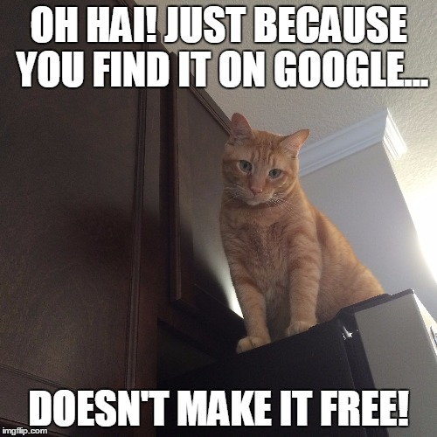
Public Domain and Internet
Not everything online is in the public domain!
In general, consider any information you find on the Internet as protected by copyright, unless specifically noted, and treat it as such. Being publicly accessible is not the same as being in the public domain.
Meme created by Sarah Norris on: https://imgflip.com/memegenerator

Slide 8
Terminology
Fair Use
“Fair use is a legal doctrine that promotes freedom of expression by permitting the unlicensed use of copyright-protected works in certain circumstances. Section 107 of the Copyright Act provides the statutory framework for determining whether something is a fair use and identifies certain types of uses—such as criticism, comment, news reporting, teaching, scholarship, and research—as examples of activities that may qualify as fair use.”
http://copyright.gov/fair-use/more-info.html

Slide 9
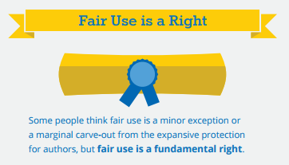
Fair Use is a Right
http://fairuseweek.org/wp-content/uploads/2016/02/ARL-FUW-Infographic-r5.pdf

Slide 10
Terminology
Creative Commons License
“A Creative Commons (CC) license is one of several public copyright licenses that enable the free distribution of an otherwise copyrighted work. A CC license is used when an author wants to give people the right to share, use, and build upon a work that they have created.”
https://creativecommons.org/licenses/

Slide 11
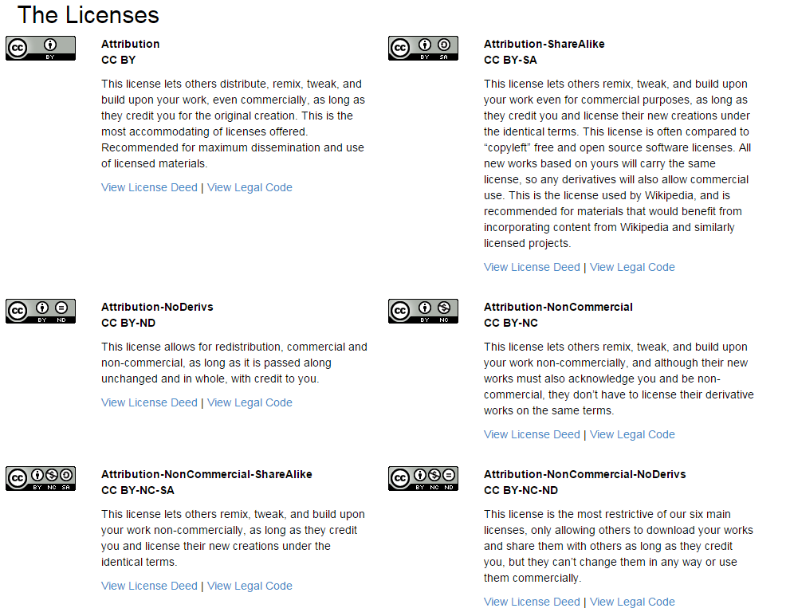
https://creativecommons.org/licenses/

Slide 12
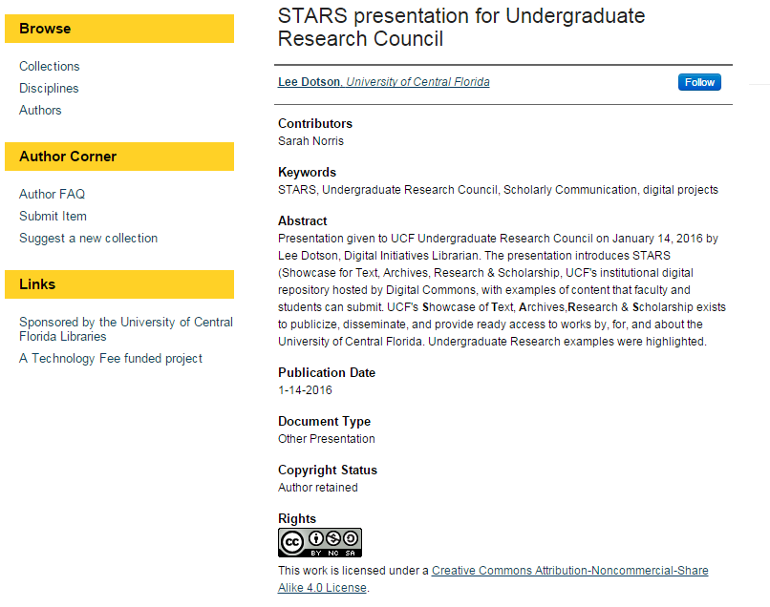
Where do you see creative commons licenses?

Slide 13
Using Copyrighted Materials in the Classroom
The “Classroom Exception”
Must be in a physical classroom setting and/or space used for instruction
Must be in person (i.e. face-to-face)
Must be at a non-profit institution
This does not apply to online teaching

Slide 14
Using Copyrighted Materials in the Classroom
The TEACH Act
Made for the online environment (i.e. Distance learning via Canvas)
Is Voluntary
Can be restrictive
Is not the only solution to using copyrighted materials in an online setting (Fair Use still can be applied)

Slide 15
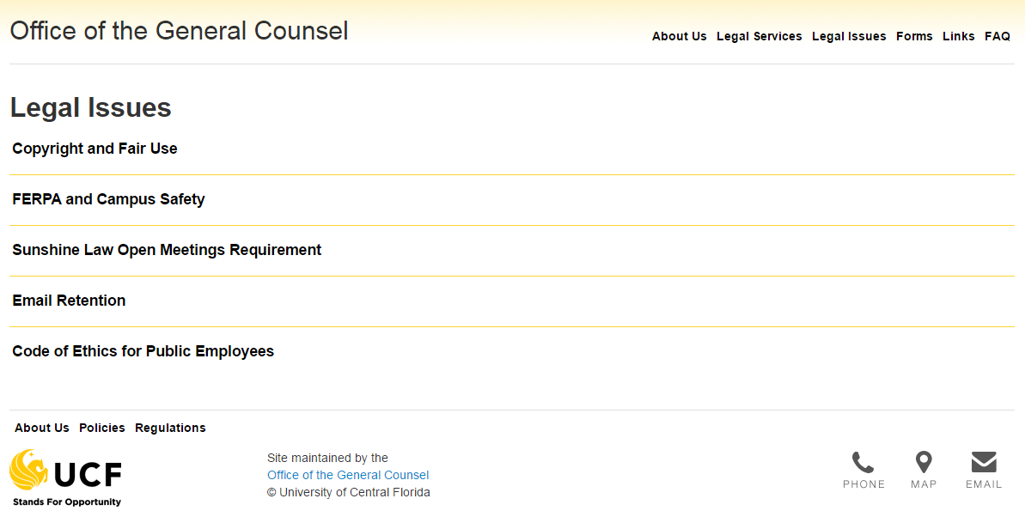
UCF Resources for Copyright
https://generalcounsel.ucf.edu/legal-issues/

Slide 16
UCF General Counsel Copyright & Fair Use Information
Top Ten Copyright and Fair Use Questions This document provides guidance to UCF faculty and staff regarding the incorporation of third party copyrighted materials (e.g. music, motion media, text, etc.) into their online courses. It sets forth various safe harbor percentage guidelines with respect to such use. Use of third party copyrighted materials as part of classroom face-to-face teaching activity is also addressed.
Agreement on Guidelines for Classroom Copying As stated in UCF’s Use of Copyrighted Materials Policy, UCF has adopted the 1976 Agreement on Guidelines for Classroom Copying in Not-For-Profit Educational Institutions with Respect to Books and Periodicals, found on pages 6-7 of Circular 21, available at: http://www.copyright.gov/circs/circ21.pdf. Faculty should apply these guidelines when they make copies for students in their class (including course packs) containing excerpts from others’ works.
Copyright Guidelines for Exhibiting Movies This document discusses what needs to be considered anytime anyone wishes to show a movie to a group of people on campus (or otherwise in affiliation with UCF). This guide explains when a public performance license for the showing of a movie is legally required and includes a flowchart as a quick reference pertaining to when such a license needs to be obtained.
Cases Involving Fair Use from the US Copyright Office
All information above from:
https://generalcounsel.ucf.edu/legal-issues/

Slide 17
Navigating Fair Use at UCF
https://en.wikipedia.org/wiki/University_of_Central_Florida_Libraries#/media/File:UCFlibrary.jpg

Slide 18
Can photos, diagrams, tables, etc. found online be used in PowerPoints for educational lectures if the sources are cited as references? Many of these images have a disclaimer about possible copyrights and some do not. Others are clearly copyrighted.

Slide 19
Using Images for Presentations
Considerations for use of images vary depending on whether you are using the PowerPoint presentation for face-to-face or online purposes

Slide 20
UCF’s Use of Copyrighted Material Policy
For Online (i.e. Distance Learning):
“a photograph or illustration may be used in its entirety, but no more than 5 images by an artist or photographer may be reproduced or otherwise incorporated as part of an educational multimedia project. When using photographs and illustrations from a published collective work, not more than 10% or 15 images, whichever is less, may be reproduced or otherwise incorporated as part of an educational multimedia project.”
“Up to 10% or 2500 fields or cell entries, whichever is less, from a copyrighted database or data table may be reproduced or otherwise incorporated as part of an educational multimedia project.”

Slide 21
Where to find images
Creative Commons Search – Search many sites at once (including Flickr Creative Commons)
Flickr Creative Commons – Search images that have various CC licenses attached to them
StockVault.net – Free images from photographers around the world
Open Clipart Library – Public domain clipart
UCF Libraries Images & Sounds Guide – Compiled list from UCF Libraries

Slide 22
2. Can YouTube videos be shown in class or embedded in webcourses? What about other educational videos that are not “YouTube”? How should they be cited?

Slide 23
UCF’s Use of Copyrighted Material Policy
For Online (i.e. Distance Learning):
“According to Fair Use Guidelines for Educational Multimedia, motion media of up to 10% or 3 minutes, whichever is less, in the aggregate of a copyrighted motion media work may be reproduced or otherwise incorporated.”

Slide 24
YouTube & Video Considerations
Link to videos instead of embedding within Canvas
Look for items in the public domain or that have creative commons licenses attached to them (YouTube advanced search)
Avoid videos on YouTube and other sites that are clear violations of copyright (i.e. video itself is infringing on copyright)

Slide 25
3. Some clipart found online claims to be “free” for use by teachers -- and some state they are for use by anyone. Therefore, can this clip art be used in PowerPoint slides in lectures? Can they be used in printed educational material? What about for use in recruitment flyers for research? What about clipart that does not claim to be “free” to use? How and when does clipart need to be cited?

Slide 26
Citing Images & Copyrighted Resources in the Classroom
Cite as you normally would for specific mediums
Always cite as a matter of ethical academic practice
Use citation style(s) for your discipline
If something is in the public domain, you do not need to cite it
If you use an item with a creative commons license, cite according to the license terms (i.e. attribution, public domain, etc.)

Slide 27
When in doubt, ask!
Image retrieved from: https://flic.kr/p/hoMcw
© Marcus Ramberg

Slide 28
Libraries as Resource
Can’t advise but can refer faculty and students to resource and general copyright information
Can be a resource for faculty looking for copyright information and can provide the following:
Classroom instruction
One-on-one consultations
Embedded in course management system
Research guides
Handouts
Image retrieved from: http://blog.indiantrailslibrary.org/keep-calm-and-carry-on/

Slide 30
Contact Information
Sarah A. Norris
Scholarly Communication Librarian
University of Central Florida Libraries
sarah.norris@ucf.edu
(407) 823-2402
http://library.ucf.edu/about/departments/scholarly-communication/

