Slide 1
Scholarly communication
Sarah A. Norris, Scholarly Communication Librarian,
University of Central Florida Libraries

Slide 2
Overview
Introduction
About Sarah
How a cataloger became a Scholarly Communication Librarian (i.e. the evolving roles of librarians & MLIS careers)
Scholarly Communication at University of Central Florida Libraries
A Day in the Life of a Scholarly Communication Librarian
Tips & Resources for Becoming a Scholarly Communication Librarian

Slide 3
Introduction: Sarah A. Norris, Scholarly Communication Librarian
MLIS, Wayne State University
Concentration: Organization of Knowledge
Current Position: Scholarly Communication Librarian, University of Central Florida
Began August 2015
UCF’s first Scholarly Communication Librarian
https://works.bepress.com/sarah-norris/

Slide 4
Introduction: What is Scholarly Communication?
“the system through which research and other scholarly writings are created, evaluated for quality, disseminated to the scholarly community, and preserved for future use.”
Association of College & Research Libraries, “Principles and Strategies for the Reform of Scholarly Communication 1,” 2003.

Slide 5
What does this really mean?
Scholarly Communication is anything that supports research and scholarly publishing
Traditional service areas of Scholarly Communication (not comprehensive):
Author Rights (i.e. publishing agreements, rights retention, author addendums)
Citation Management Tools
Citation Metrics
Copyright
Data Management
Discovery Support
Institutional Repositories
Literature Reviewing
Metadata
Open Access
…and more!

Slide 6
What kind of education/experience do you need?
It depends…
JD vs. no JD
Copyright training
Institutional repository management and/or experience
Publishing
Technology
More on this in Tips & Resources section…

Slide 7
How a cataloger became a Scholarly Communication Librarian…
By Karl Thomas Moore - Own work, CC BY-SA 4.0, https://commons.wikimedia.org/w/index.php?curid=46940259

Slide 8
In a nutshell…
Worked as student assistant at public library in high school
Learned to catalog at age 16
Worked as reference student assistant as undergraduate
Assisted law librarian with law materials and queries
Employed as cataloger as a paraprofessional
Job evolved over time, included digitization and digital archives
Received MLIS with cataloging specific concentration
Worked as manager of institutional repository
Became expert in library on copyright & IP related issues
Position included scholarly communication roles
Hired as Scholarly Communication Librarian

Slide 9
The Evolution of Libraries and the Role of Librarians (including Scholarly Communication)
Photo Credit: Sam Howzit, CC BY 2.0

Slide 10
Scholarly Communication at the University of Central Florida
The Office of Scholarly Communication provides information and assistance on all aspects of scholarly publishing.
Goals
Collaborate with other campus units to provide a suite of campus-wide services that supports all aspects of research and scholarly publishing at the University.
Advocate for the infrastructure, staffing, publishing funds and services that further support research and scholarly publishing at the University.
Educate and facilitate discussions about the changing scholarly communication environment, including the move to open access and sustainable publishing and exploring new ways to create, disseminate, evaluate, and preserve research and scholarly outputs at the University.

Slide 11
Development of Scholarly Communication at UCF Libraries

Slide 12
By User:ClarkMills, CC BY-SA 3.0, https://commons.wikimedia.org/w/index.php?curid=38143666

Slide 13
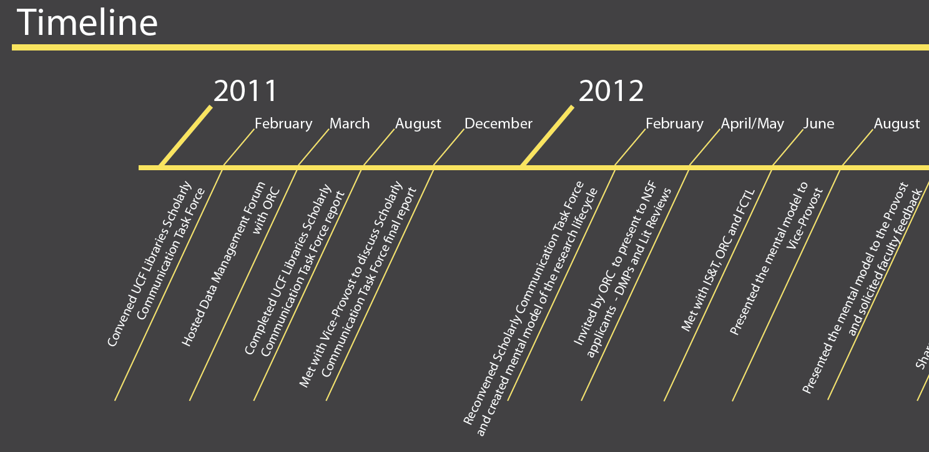

Slide 14
UCF Libraries Scholarly Communication Task Force Formed

Slide 15
Task Force Charge
Examine and make recommendations regarding the role the UCF Libraries can play in shaping the future of scholarly communication at UCF through the creation of a sample pilot repository with voluntary contributions from UCF Libraries’ faculty.

Slide 16
Task Force Project
Initial Activities
Literature Review
Survey

Slide 17
Task Force Project
Survey
IR Reporting Structure
IR Funding Source

Slide 18
Task Force Project
Creating a glossary

Slide 19
Pilot project
Several library faculty volunteered their CVs to have the materials evaluated for inclusion in a pilot repository project.
Over 150 scholarly communication items were entered into RefWorks and reviewed to help identify potential challenges in procuring materials for the establishment of a university-wide IR.
Types of scholarly communication items included books, chapters, conference proceedings, published papers, presentations, patents, and unpublished documents.”
Once the documents were input into RefWorks, the publishers were identified and their copyright policies were checked in SHERPA/RoMEo to investigate the rights issues surrounding the self-archiving of scholarly communication.

Slide 20
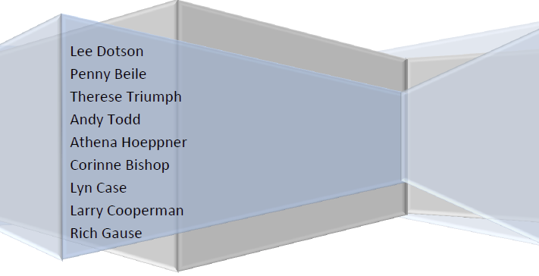

Slide 21
Recommendations
Create a Scholarly Communication department within the library to develop services that facilitate scholarly communication and support the research process.
Develop and deploy an institutional repository, in collaboration with university constituents.
In lieu of a Scholarly Communication department, it is essential that the library:
Create informational and instructional materials for faculty and targeted student groups about scholarly communication.
Provide recommendations for UCF faculty members as authors, readers, reviewers, editors, society members, and advisory board members in order to contribute to an open and sustainable system of scholarly communication.
Advocate for university and faculty participation in the open access movement to increase the impact of our faculty's research and expand access to scholarly information.
Build on existing Faculty Senate resolutions by sponsoring a resolution that specifically supports faculty efforts and choices pertaining to scholarly communication and open access.
Investigate hosting online journals for faculty and students.
Monitor new developments in scholarly communication and new models of open access publishing.
Present on scholarly communication topics at Faculty Center for Teaching and Learning and institutes.

Slide 22
Moving Forward…
Reconvened Scholarly Communication Task Force to create a mental model – added new members
Now known as Scholarly Communication Working Advisory Group
Developed Research Lifecycle
Worked on other scholarly communication related projects
Still exists today & is cornerstone of UCF Libraries’ scholarly communication efforts

Slide 23
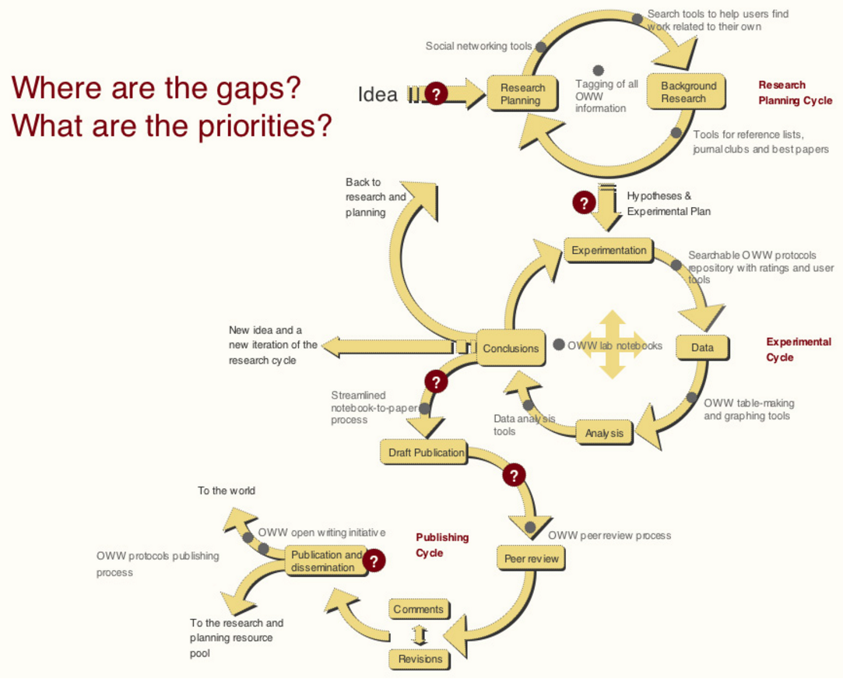
OpenWetWare:Headquarters/Research Pathway

Slide 24
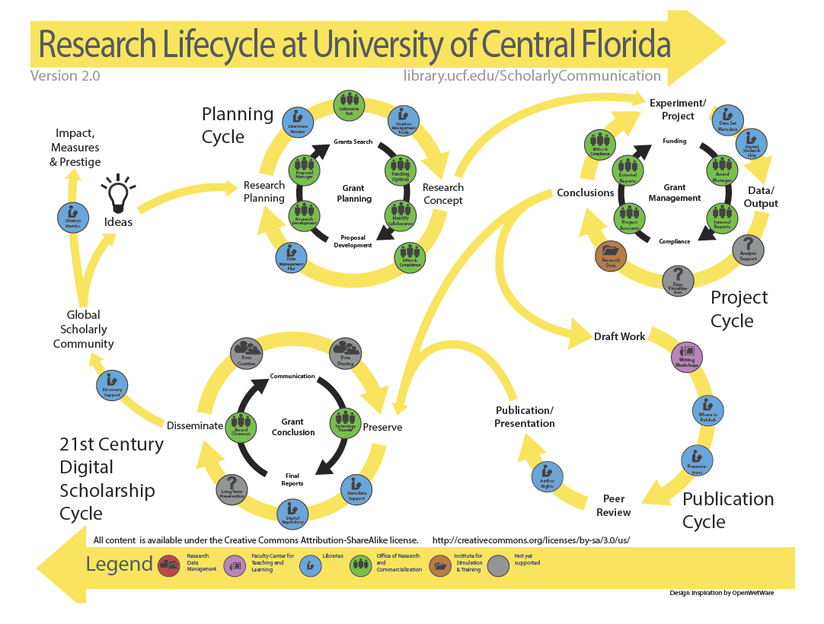

Slide 25
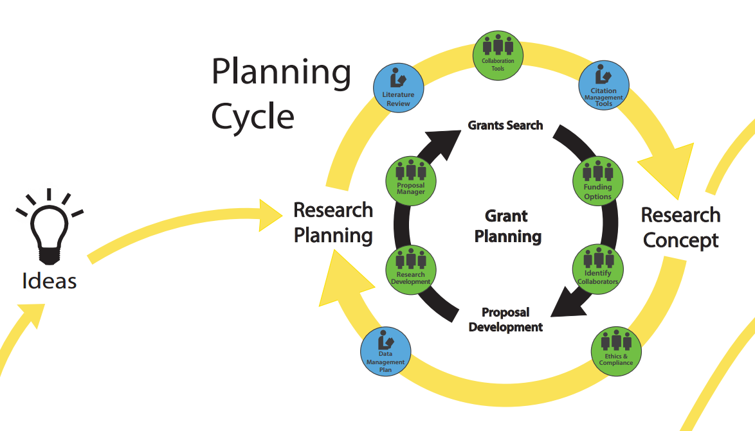

Slide 26
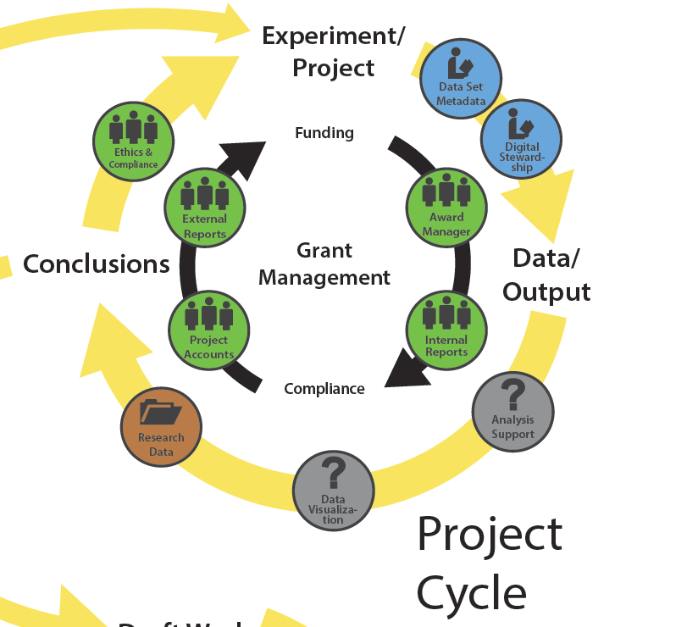

Slide 27
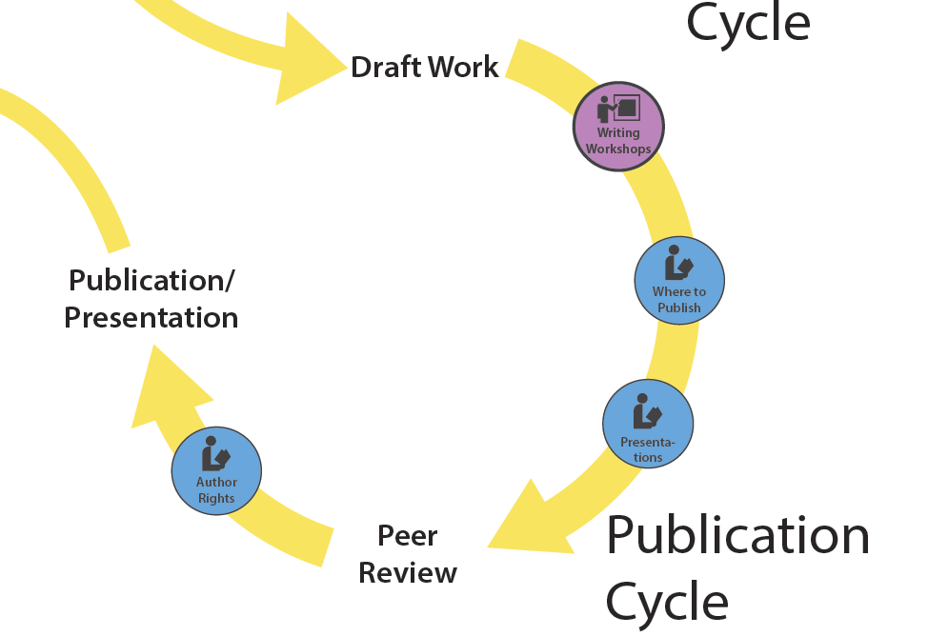

Slide 28
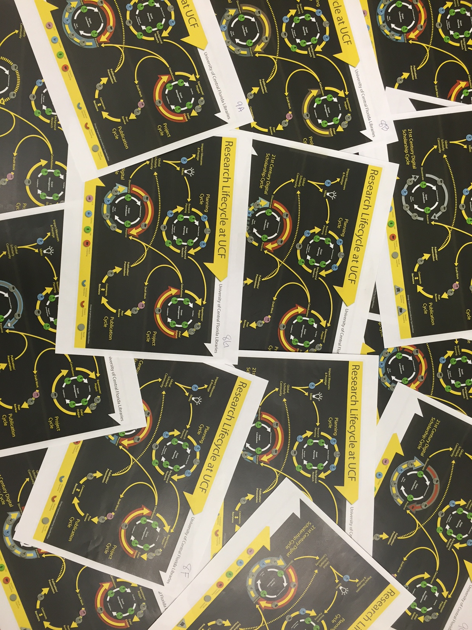

Slide 29
2012-2013
Solicited campus-wide feedback
Invited presentations
Presented workshops
Research Lifecycle discussions across campus(es)
Presented to the Provost and Vice-Provost
Shared with the Faculty Senate Library Advisory Council
Everyone involved had an opportunity to publish or present

Slide 30
Photo Credit: Kent Productions, CC BY 2.0, https://flic.kr/p/qUBiSN

Slide 31
Blue Button Experts
Termed coined by Dr. Penny Beile, Associate Director, Research, Education & Engagement, in the 2012 as a part of the Research Lifecycle
Who are the blue button experts?
Where do they fit in the Research Life Cycle?
Citation Metrics
Literature Review
Citation Management Tools
Data Management Plan
Data Set Metadata
Discovery Support
Open Access Hosting
Metadata Services

Slide 32
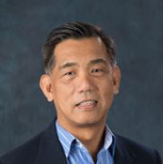
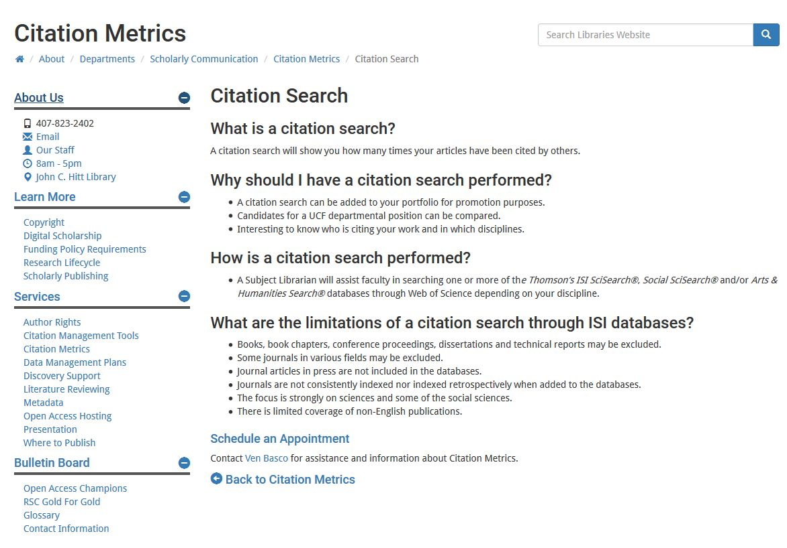
Ven Basco, Blue Button Expert
Citation Metrics
Point person for Citation Metrics queries
Graduate workshops
Faculty and student consultations
Maintains LibGuides and/or Webpages

Slide 33
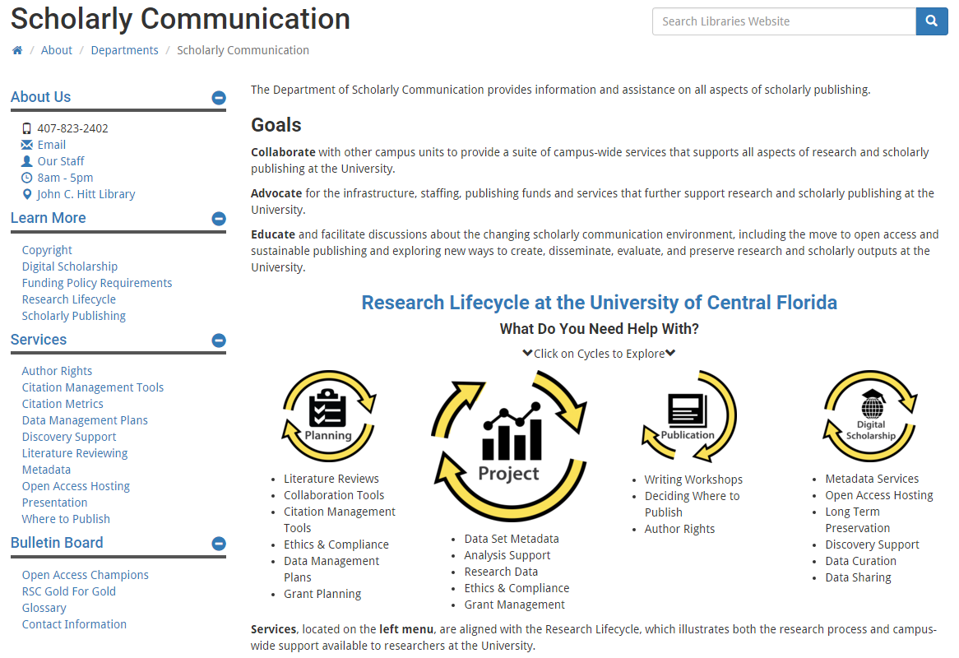
UCF Scholarly Communication Website
http://library.ucf.edu/about/departments/scholarly-communication/

Slide 34
Purpose(s) of Website
Communicate goals & mission of Scholarly Communication at UCF Libraries
Provide a dedicated space for Scholarly Communication projects, efforts & communications
Focus on expanding information on Research Lifecycle services & resources
Highlight “OA Champions”
Act as Scholarly Communication resource for faculty, students & staff
Way for people to connect with Office of Scholarly Communication
Provided resources related to training faculty & staff

Slide 35
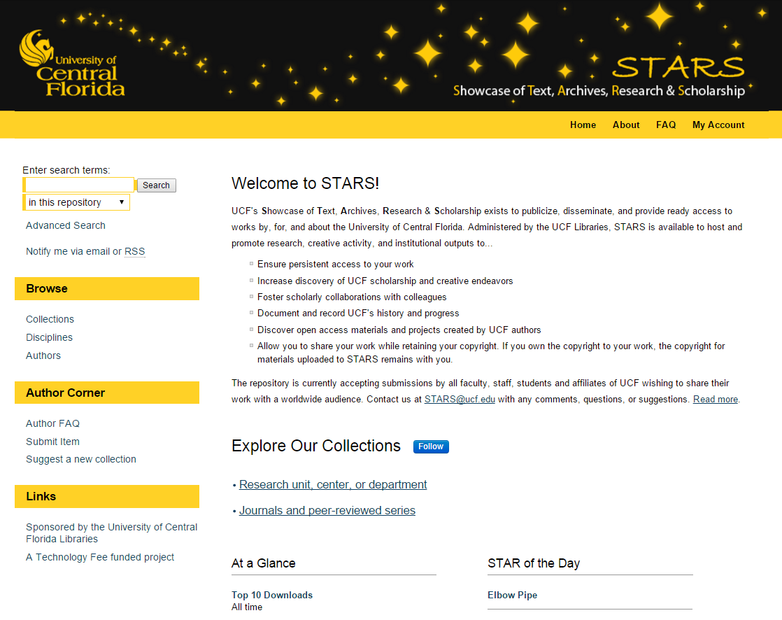

Slide 36
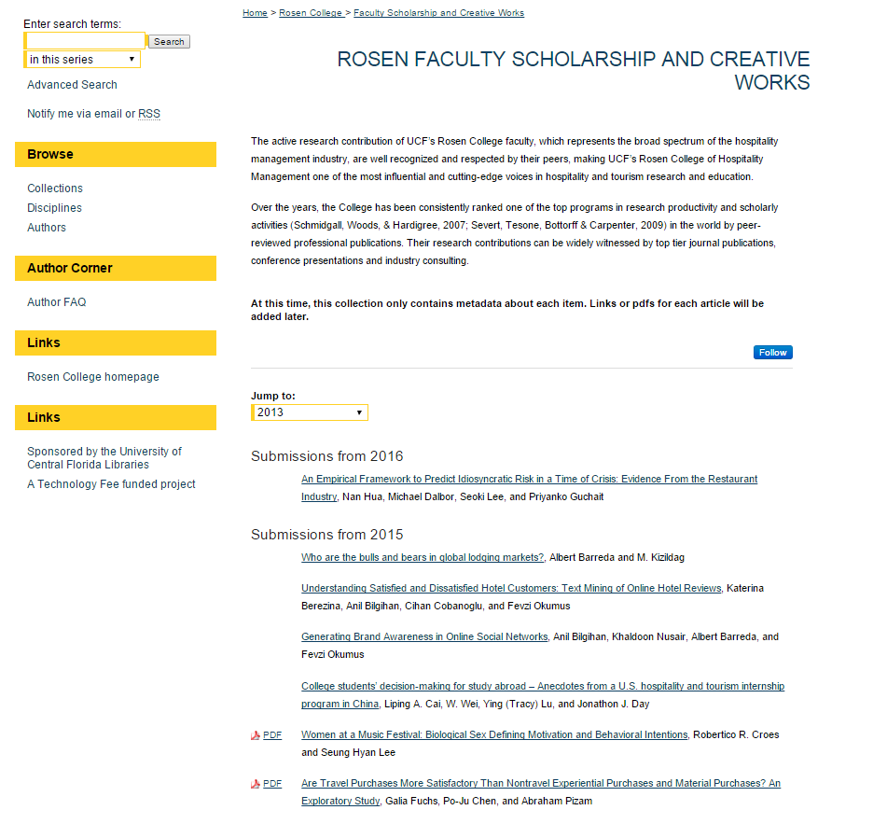

Slide 37
Scholarly Communication Faculty Advisory Board
Formed in 2015 (first meeting was Fall 2015)
Faculty Advisory Board consists of 11 members representing most colleges on campus
Coincided with the launch of the STARS repository
Their mission is to support the goals of the Office of Scholarly Communication, to advocate for us around campus, and to set the agenda for future endeavors.

Slide 38
A Day in the Life of a Scholarly Communication Librarian…
Start my day by recapping blogs, news articles, social media
Chronicle of Higher Education http://www.chronicle.com/
Duke University Scholarly Communication (not updated recently) http://blogs.library.duke.edu/scholcomm/
Inside Higher Ed https://www.insidehighered.com/
Scholarly Kitchen https://scholarlykitchen.sspnet.org/

Slide 39
A Day in the Life of a Scholarly Communication Librarian…
Work Reference Desk for an hour
Conduct a one hour session on Where to Publish & Author Rights
Scholarly Communication Working Advisory Group workgroup meetings
Projects in the works e.g. Open Access Week
Answer email from faculty member about Copyright
Presentations (images, etc.)
Public Performance Rights
Publishing
Meeting with Digital Initiatives Librarian, Subject Librarian, and Faculty Member
Institutional Repository (copyright, journal versions, etc.)
Work on Open Education Resource project with Scholarly Communication Adjunct, Subject Librarian, and Instructional Designer
Meeting with General Counsel about Copyright Policies

Slide 40
Tips & Resources for Becoming a Scholarly Communication Librarian
Look at Scholarly Communication job postings
Helps give you an idea of what they are looking for & what experience you may already have
Highlight jobs that are of interest & file them for future use
Bonus: Create a database of jobs with skills and areas of expertise
Talk to an expert
Reach out to librarian colleagues you know and/or those who may have expertise in scholarly communication
Be realistic! Talking to an expert doesn’t ensure a job, internship, and/or other opportunity. Information on its own can be really beneficial.
Find training opportunities
Internships
Workshops
e.g. Copyright X

Slide 41
Tips & Resources for Becoming a Scholarly Communication Librarian
Get tech savvy
Learn tools, resources, and hardware that keep you up-to-date and in the know
e.g. 101 Innovations in Scholarly Communication Toolkit https://innoscholcomm.silk.co/
Do some reading!
Examples:
Scholarly Communication as a Core Competency: Prevalence, Activities, and Concepts of Scholarly Communication Librarianship as Shown Through Job Advertisements http://wiki.lib.sun.ac.za/images/7/79/Scholarly_Communication_as_a_Core_Competency-_Prevalence_Activit.pdf
Office of Scholarly Communication: Scope, Organizational Placement, and Planning in Ten Research Libraries http://www.sr.ithaka.org/publications/office-of-scholarly-communication/
Tooling Up: Scholarly Communication Education and Training http://crln.acrl.org/content/75/3/132.full

Slide 42
Tips & Resources for Becoming a Scholarly Communication Librarian
General Scholarly Communication Links & Resources
ACRL Scholarly Communication Toolkit: http://acrl.ala.org/scholcomm/
ARL Webpage on Scholarly Communication: http://www.arl.org/focus-areas/scholarly-communication#.V-LH1iGAOko
Journal of Librarianship & Scholarly Communication: http://jlsc-pub.org/
Right to Research Coalition: http://www.righttoresearch.org/
SHERPA/RoMEO: http://www.sherpa.ac.uk/romeo/index.php
SPARC: http://sparcopen.org/

Slide 43
Photo Credit: Marcus Ramberg, CC BY-NC 2.0, https://flic.kr/p/hoMcw

Slide 44
Contact Information
Sarah A. Norris
Scholarly Communication Librarian
UCF Libraries
sarah.norris@ucf.edu
UCF Libraries Office of Scholarly Communication
http://library.ucf.edu/about/departments/scholarly-communication/

