Slide 1
Where to publish
Sarah A. Norris, Scholarly Communication Librarian,
University of Central Florida Libraries

Slide 2
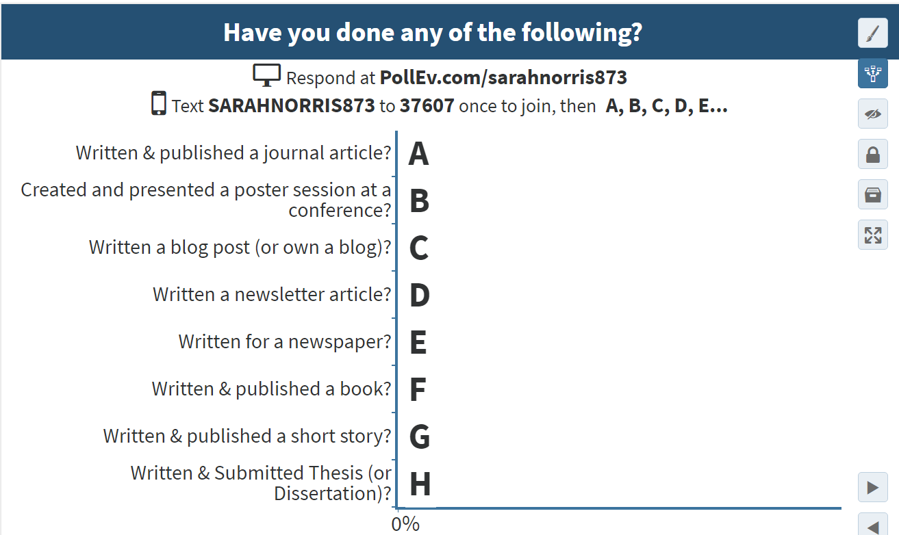

Slide 3
Introduction: Sarah A. Norris, Scholarly Communication Librarian
https://works.bepress.com/sarah-norris/

Slide 4
Disclaimer
UCF Libraries does not give legal advice, and any information in this presentation is for informational purposes only.

Slide 5
Overview
What is Publishing?
Why Publish?
What does “Peer Review” mean?
What is “Impact”?
What is Open Access?
Criteria to Consider for Publication
Find, evaluate, and compare potential publication venues
Resources for Publishing at UCF
Resources for Publishing Beyond UCF
Non-academic Publishing
Explore alternative publishing options

Slide 6
Not Covered in this Workshop…
Research & Writing Process
Literature Review
Actual Submission Process for Publication
Copyright & Author Rights
Workshop 11/16 3-4 p.m. John C. Hitt Library Room 235A
Post-Publication
Citation Metrics
Impact (in detail)
For library assistance, visit:
https://library.ucf.edu/about/departments/scholarly-communication/

Slide 7
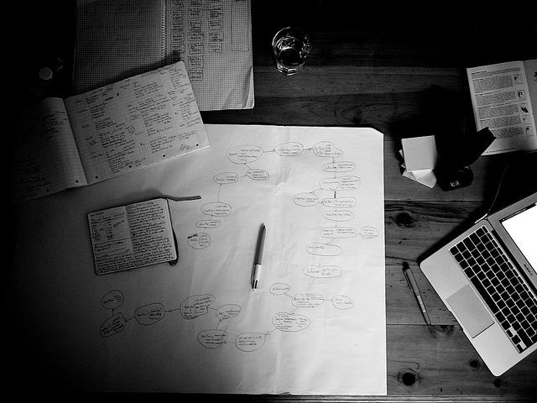
Photo Credit: Graham Holliday (CC BY-NC 2.0) https://flic.kr/p/dkcCXS

Slide 8
What is Publishing?
“Publishing is the dissemination of literature, music, or information—the activity of making information available to the general public.”
https://en.wikipedia.org/wiki/Publishing
“Academic publishing is the subfield of publishing which distributes academic research and scholarship. Most academic work is published in academic journal article, book or thesis form.”
https://en.wikipedia.org/wiki/Academic_publishing

Slide 10
Why Publish Your Academic Research?
Publishing work gives you, the student, an opportunity to refine, polish, and build on your work beyond what is required for your classes. Being published can also give you a significant advantage in the graduate school application process.
Starting early in publication is good practice for those moving towards advanced degrees and even teaching
Gives you experience synthesizing content, summarizing, etc. which can be useful in post-academic jobs (i.e. writing technical reports, creating presentations, etc.)

Slide 11
Why Do Undergraduates Want to Publish?

Slide 12
“Tell everyone I know about the research I did / found.”
“Present my research findings at a conference.”
Presentation, poster session, conference proceedings, etc.
“Try to get my research paper published in a journal.”
“I want to be a fiction writer.”
Books, comic books, literary journals, short stories, blogs, etc.
“I want to write a cookbook.”
Not related to academic career

Slide 13
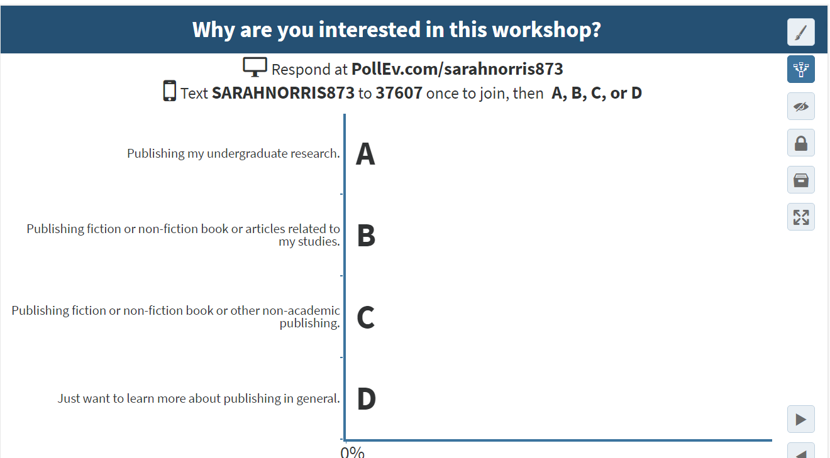
Question Time!

Slide 14
What is Peer Review?
“Peer review is the evaluation of work by one or more people of similar competence to the producers of the work (aka peers).”
https://en.wikipedia.org/wiki/Peer_review
Usually applies specifically to academic journals, but can include books, etc.
Comes in many forms (including double blind peer review, where the reader and author do not know each other’s info, i.e. anonymous)
Considered one of the best methods of research validation in publication
For more information about Peer Review, visit: http://guides.ucf.edu/refereed

Slide 16
What is “Impact”?
How influential is your work
Is it highly cited (i.e. other people cite it in their research)?
Does the journal you publish in have a high impact factor?
“The impact factor (IF) of an academic journal is a measure reflecting the yearly average number of citations to recent articles published in that journal.” (https://en.wikipedia.org/wiki/Impact_factor)
Do people talk about it on social media?
Are there articles or press about?
For more information about citation metrics (including impact factor), visit: https://library.ucf.edu/about/departments/scholarly-communication/citation-metrics/

Slide 17
What is Open Access?
“Open-access (OA) literature is digital, online, free of charge, and free of most copyright and licensing restrictions.” (http://legacy.earlham.edu/~peters/fos/overview.htm)
Removes price barriers (subscriptions, licensing fees, pay-per-view fees)
Removes permission barriers (most copyright and licensing restrictions)
As an author, you can choose to publish your work in open access journals and books (or publish your materials online freely available)
*Note: Some journals do ask authors to pay what is known as an “article processing charge (APC)” in order to publish an article or book open access
UCF does not currently provide funds to help off-set these costs
Sometimes students and/or those with financial circumstances can publish in open access journals without having to pay (it depends)
For student viewpoints on open access, visit: http://www.righttoresearch.org/learn/whyoa/index.shtml

Slide 18
Where To Find Open Access Journals & Information?
DOAJ (browse by subject)
http://doaj.org
Beall’s list of predatory publishers
http://scholarlyoa.com/publishers/
Open Access Scholarly Publisher’s Association (OASPA)
http://oaspa.org/

Slide 19
Before Thinking About Where to Publish…
Take a look at the work you’re interested in publishing
What’s the significance of your work?
To you, to your discipline, to UCF, to career goals, to outside community?
What are some of the outcomes of your work?
Data, surveys, short stories, etc.
Talk to your academic advisor!
Great resource to discuss your work and possible avenues for publication

Slide 20
Criteria to Consider for Publication
What are your goals for publication?
Make your work more visible?
Gain recognition? (graduate school, Ph.D., non-academic)
Discipline-specific? Genre specific?
Format? (book, journal, blog post, etc.)
Do you have academic expectations?
What recommendations or trends does your UCF department or college have for undergraduate publication?
Are there particular journals or a “core journal list” that your department or college recommends?
Are there department or college local publication venues? (i.e. newsletters, blog, etc.)
Do faculty in your department or college have opportunities for co-publishing with them? (or presenting)

Slide 21
Criteria to Consider for Publication
Who is your audience?
Scholar focused? Practitioner focused? Non-academic?
Determining audience is important in journal (and other) publication selection!
Take recommendations from your advisor, department/college, and desired audience to help narrow down ideal sources of publication
If publishing in journals look at list of undergraduate journals that accept publication from any U.S. undergraduate
Conduct searches in these journals to see if their content focus matches your research
If considering conferences (posters, conference proceedings), look at recommended conferences and opportunities for undergraduates

Slide 22
Things to Consider When Looking at Journal Selection
What is the journal’s prestige and reputation?
Who’s on the editorial board
Is it indexed anywhere? (i.e. can you find it in library databases?)
Is it peer reviewed?
What is it impact factor?
Is it well-known in your discipline or area of work?
What are the acceptance rates? (i.e. is it really hard to get accepted or too easy?)
How widely is it circulated (print, online, open access or subscription-based)?
Has it been around for a long time?
Does it have UCF affiliation?
Is it open access (is there an APC involved in publication)?

Slide 23
Things to Consider When Looking at Journal Selection
Where can you find information about journal prestige and reputation?
Publisher web site
Journal directories (e.g. Ulrich’s, Cabell’s)
Google Scholar
Disciplinary sites
Web of Science, Journal Citation Reports, Harzing’s, SCImago, etc. (these sites all deal with impact factor and other criteria)

Slide 24
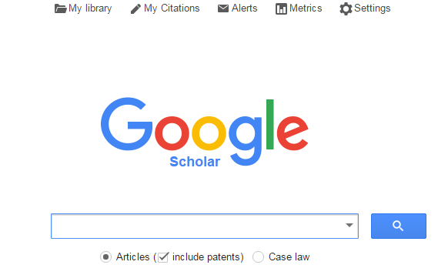
Activity Time!
Go to Google Scholar
Look up your subject/discipline area
See what the top journals are according to the h5-index

Slide 25
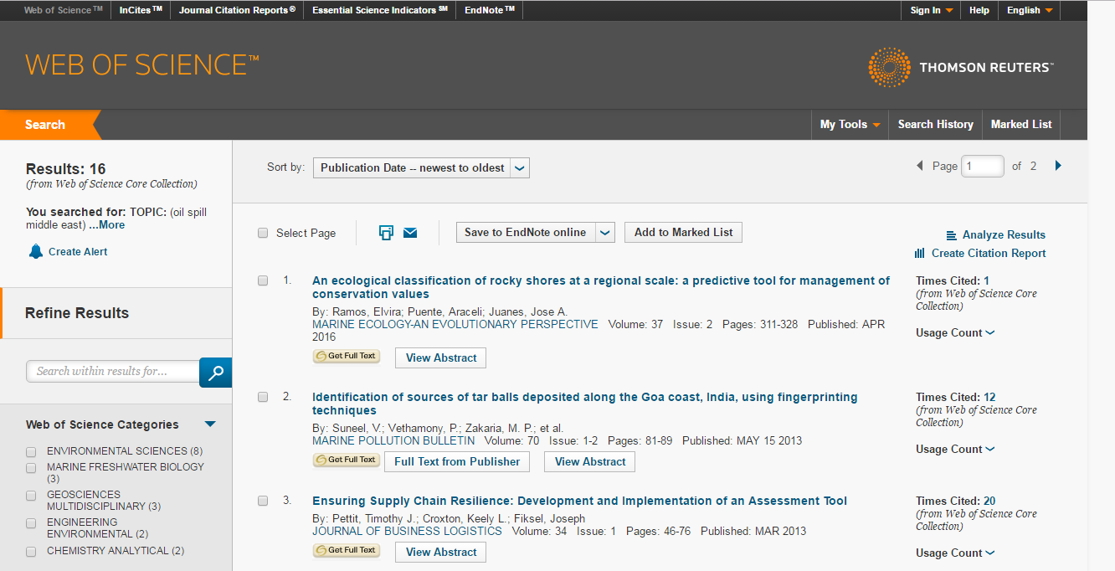
Activity Time!
Web of Science
Look for citation metrics, open access, etc.

Slide 26
Photo Credit: Breezy421 (CC-BY-SA-2.0.) https://en.wikipedia.org/wiki/Knightro#/media/File:Knightro.jpg

Slide 27
Resources for Publishing at UCF
Showcase of Undergraduate Research Excellence (SURE)
https://www.showcase.ucf.edu/
UCF Undergraduate Research Journal
https://www.urj.ucf.edu/
Honors in the Majors Theses
http://stars.library.ucf.edu/honorstheses
Others?
Literary Publications? Newspapers? Newsletters? Blogs?

Slide 28
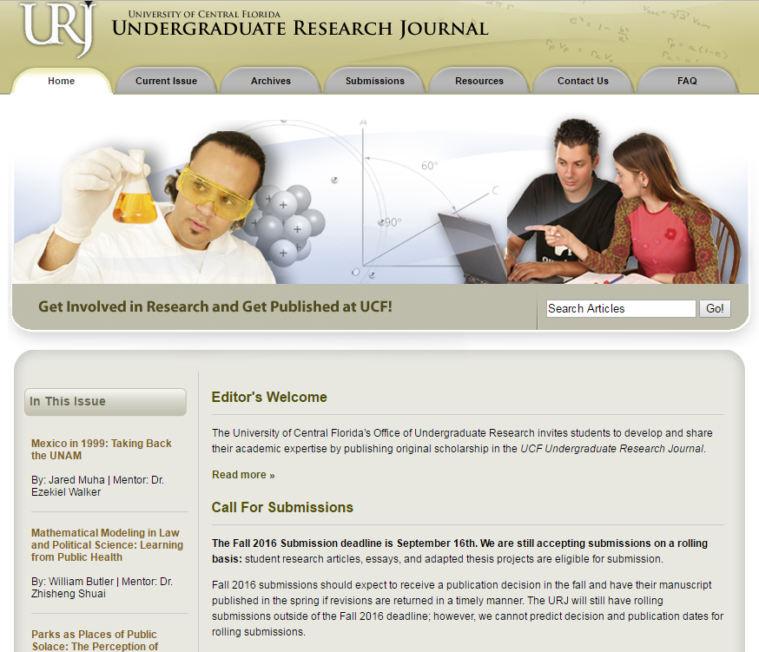
Let’s Look at Journal Selection / Criteria a Bit Closer…

Slide 29
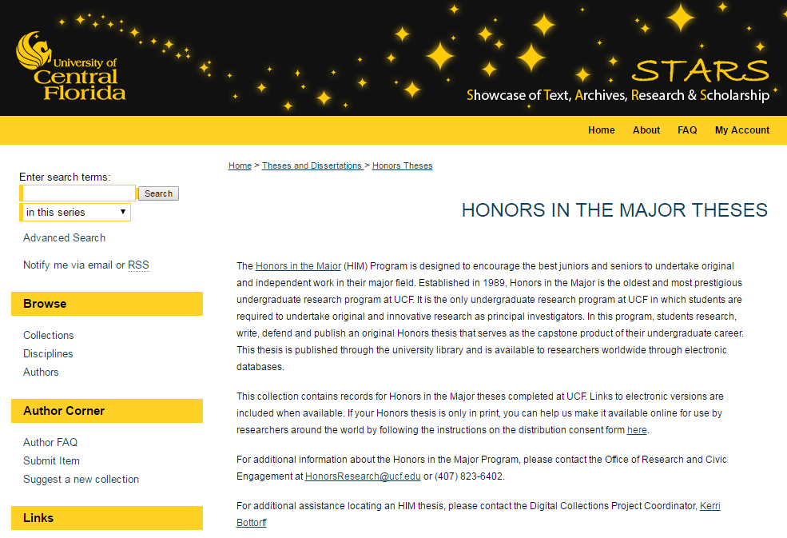
Let’s Look at Undergraduate Theses…

Slide 30
Publishing Considerations for Theses & Dissertations
Theses & dissertations are considered published once submitted to a library institutional repository (like STARS) or bound and printed and housed in a library and/or department
You can publish theses & dissertations beyond the institutional copy of record (and databases like ProQuest)
They can be published in journals and books
Look for publication policies for publishers and determine if prior availability of your thesis or dissertation in STARS would negatively affect publication
Consider the publisher (i.e. vanity press, predatory publishers)
Remember your rights (come to Author Rights workshop for more detail!)

Slide 31
Resources for publishing beyond UCF
Florida Undergraduate Research Conference
http://www.fau.edu/furc/
National Conferences on Undergraduate Research (NCUR)
http://www.cur.org/ncur_2017/
List of Undergraduate Journals
http://www.lib.usf.edu/undergraduate-research/presentation-and-publication/get-published/

Slide 32
Alternative Academic Publishing Options
University Presses (not just for books but also for journals)
University Press of Florida (http://www.upf.com/)
Scientific Societies
e.g. American Chemical Society (ACS) http://pubs.acs.org/
Departmental Hosting
Institutional Repositories
e.g. STARS http://stars.library.ucf.edu/
Self Publishing
e.g. Amazon, CreateSpace, etc.

Slide 33
Non-academic publishing
Same criteria applies when considering places of publication…
Take a look at the work you’re interested in publishing
What’s the significance of your work?
To you, to career goals, to your potential readership?
What are some of the outcomes of your work?
Fiction, non-fiction, articles, short stories, comic books, etc.
What are your goals for publication?
Make your work more visible?
Gain recognition?
Discipline-specific? Genre specific?
Format? (book, journal, blog post, etc.)
Who is your audience?

Slide 34
Things to Consider When Publishing
What is the publisher’s reputation or prestige?
Are they well-known? Small? Independent?
Does the publisher pay you for submissions?
If so, what does that entail? (copyright, public relations & marketing, etc.)
Acceptance criteria?
Do you need to be established? Do they have strict requirements?
Journal vs book vs blog vs other publishing avenue
Look at pros and cons of each
Self Publishing
Considerations to think about…
This includes blogs and self-published books, etc.

Slide 35
Final Considerations
There are many options for publication if you are an undergraduate
Connecting with advisors, librarians, and other units on campus can be a great benefit when considering to publish
Use criteria suggestions here to do some research before deciding where to publish
Have reasonable expectations no matter where or how you look to publish
Keep an eye out for opportunities, as well as potential challenges of publication

Slide 36
Upcoming Events
Open Access Week
OCTOBER 24-30, 2016
"IF YOU’RE GOING TO BE A PIRATE, BE A LEGAL PIRATE.” Ahoy! Open Access Week is on the horizon!
Join us for educational and fun pirate-themed events throughout the week.
Win some treasure in our activities on Monday, October 24, noon until 3:00 pm at the John C. Hitt Library.
Start your online academic profiles to feature your creative scholarSHIP on Tuesday, October 25, 1:00-3:00 pm in room 235A at the John C. Hitt Library.
http://stars.library.ucf.edu/oaweek/

Slide 37
Photo Credit: Marcus Ramberg, CC BY-NC 2.0, https://flic.kr/p/hoMcw

Slide 38
Contact Information
Sarah A. Norris
Scholarly Communication Librarian
UCF Libraries
sarah.norris@ucf.edu
UCF Libraries Office of Scholarly Communication
http://library.ucf.edu/about/departments/scholarly-communication/

