Slide 1
The Sky’s the Limit:
Scholarly Communication, Digital Initiatives, Institutional Repositories, and Subject Librarians
University of Central Florida Libraries
Lee Dotson, Richard Harrison, Sarah Norris, and Barbara Tierney

Slide 2
STARS: Institutional Repository at UCF
Lee Dotson, Digital Initiatives Librarian

Slide 3
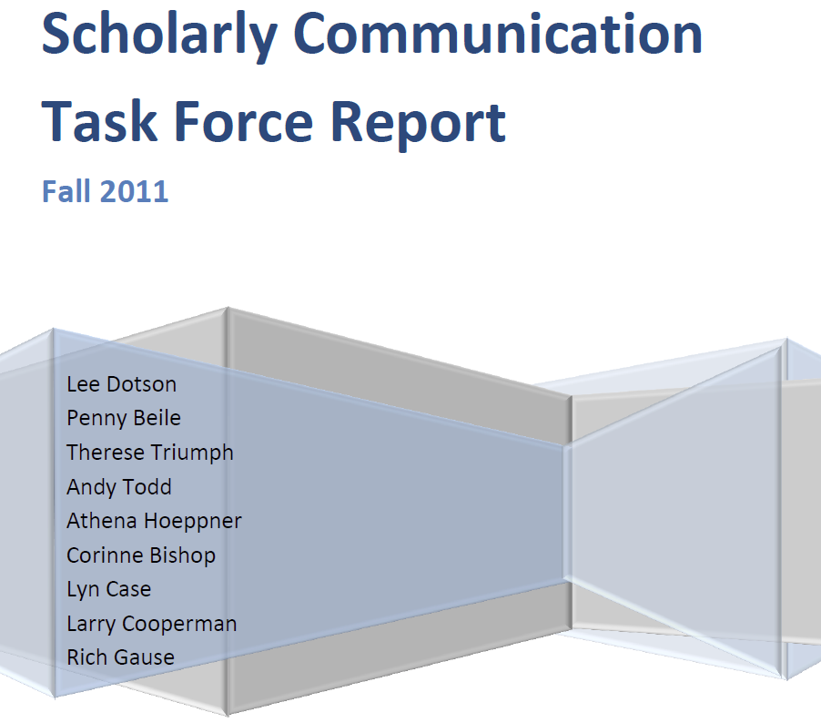
Where it all started – Scholarly Communication Task Force

Slide 5
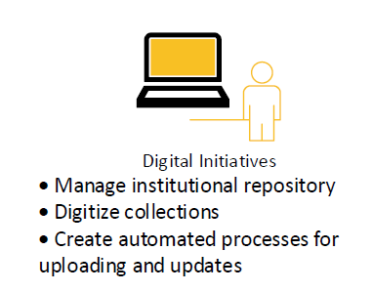
Why Digital Initiatives?

Slide 6
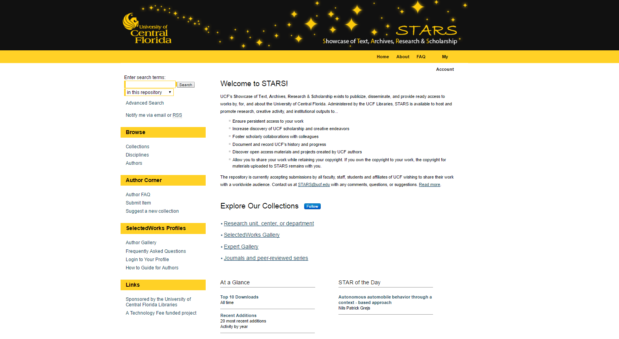

Slide 7
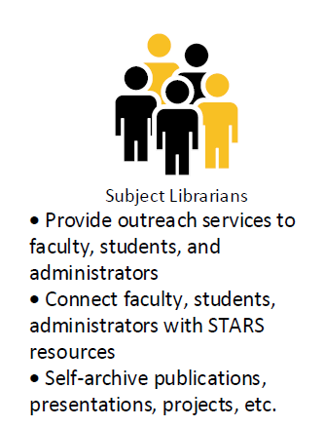
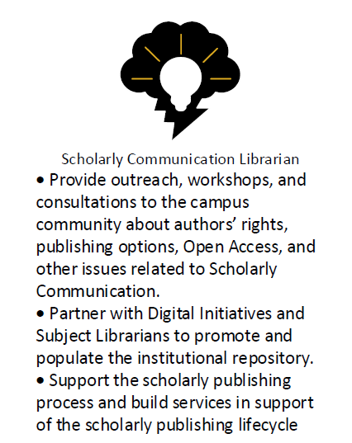
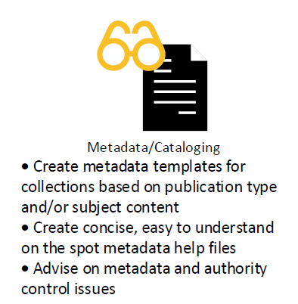
Who does what

Slide 8
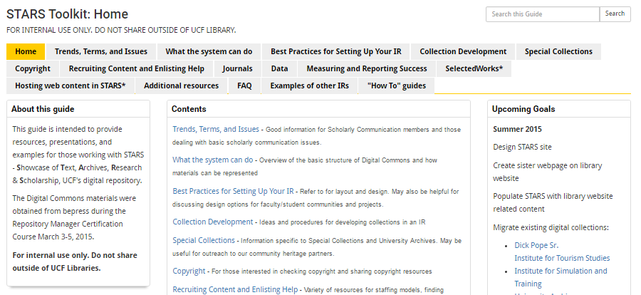
Focus on access to internal training and resources

Slide 9
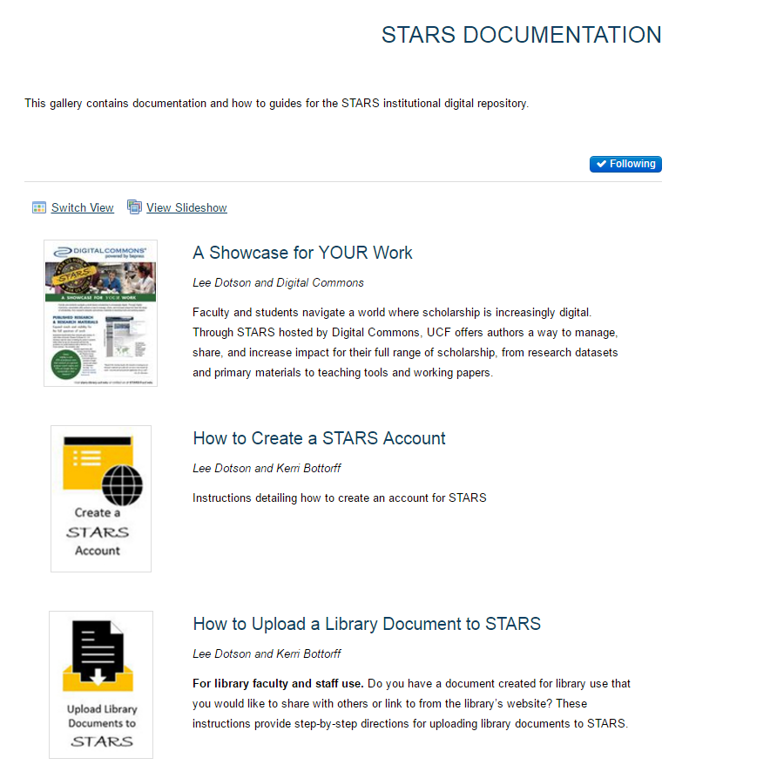
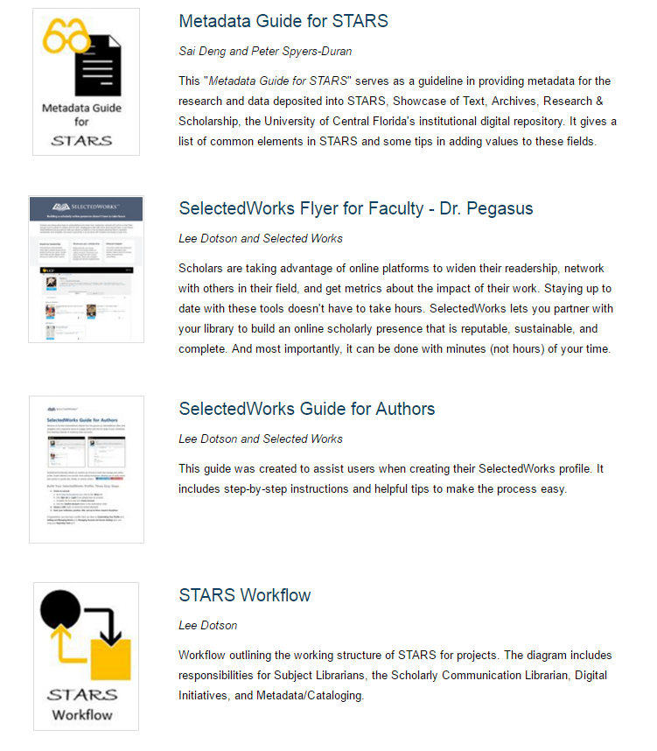
Increase documentation and help files

Slide 10
Basic workflow
http://bit.ly/stars-project

Slide 11
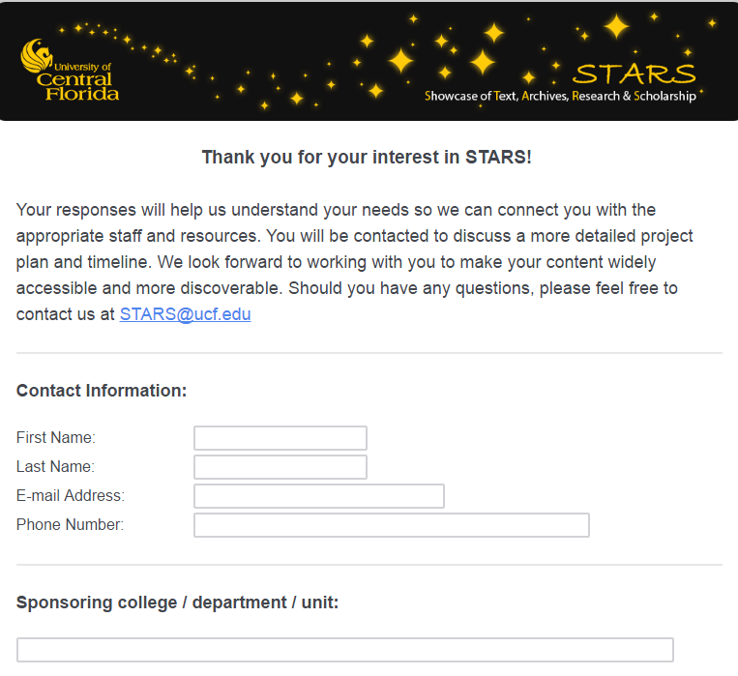
Project proposal

Slide 12
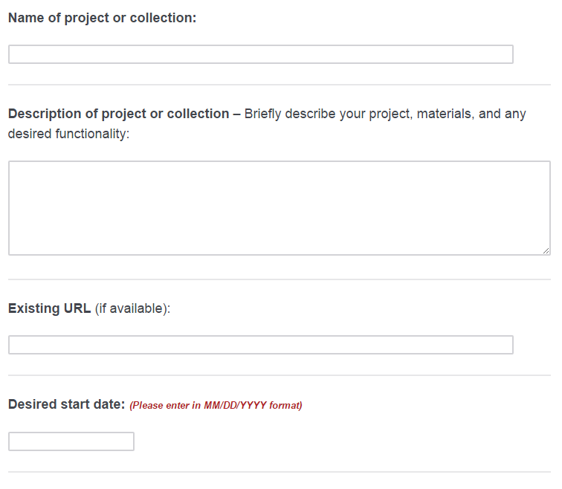
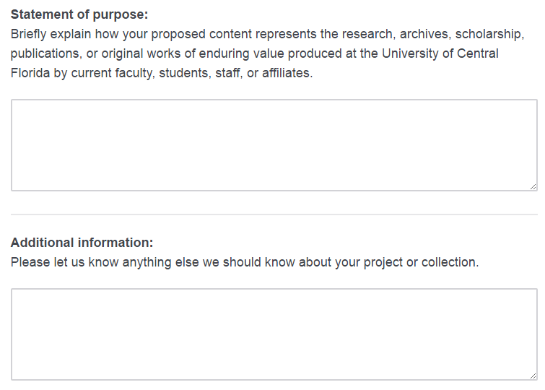

Slide 13
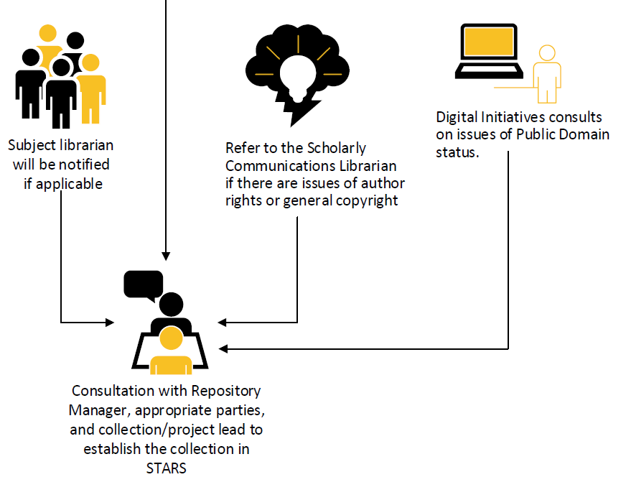

Slide 14
Basic workflow

Slide 15
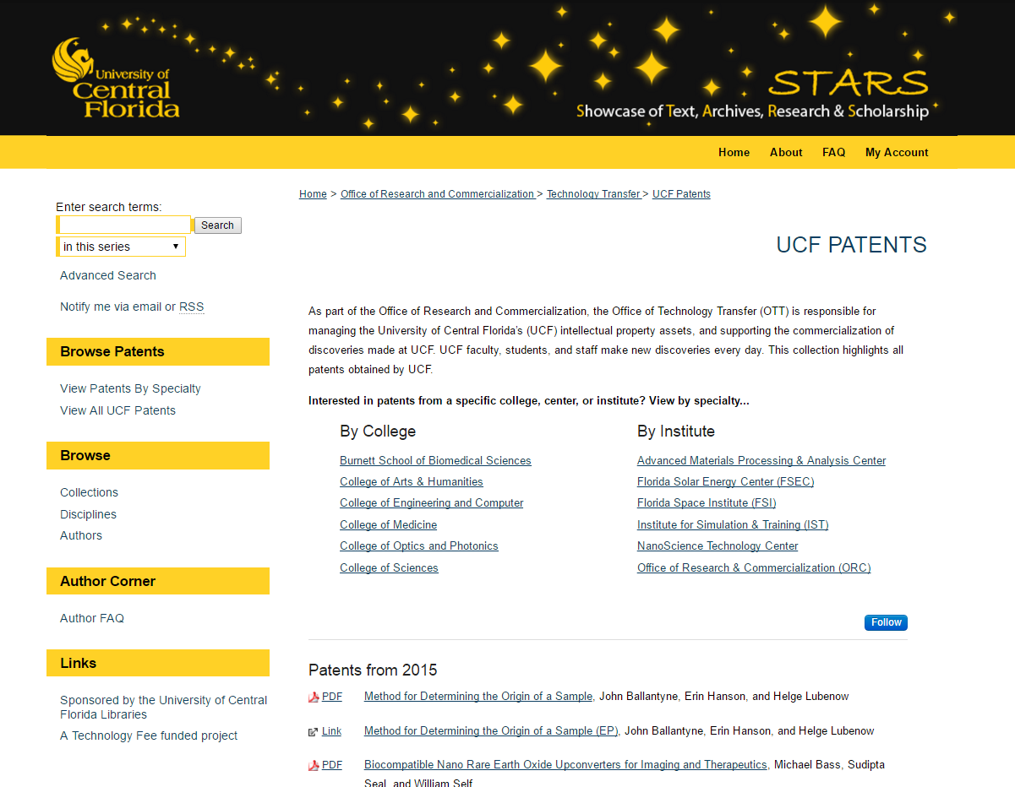

Slide 16
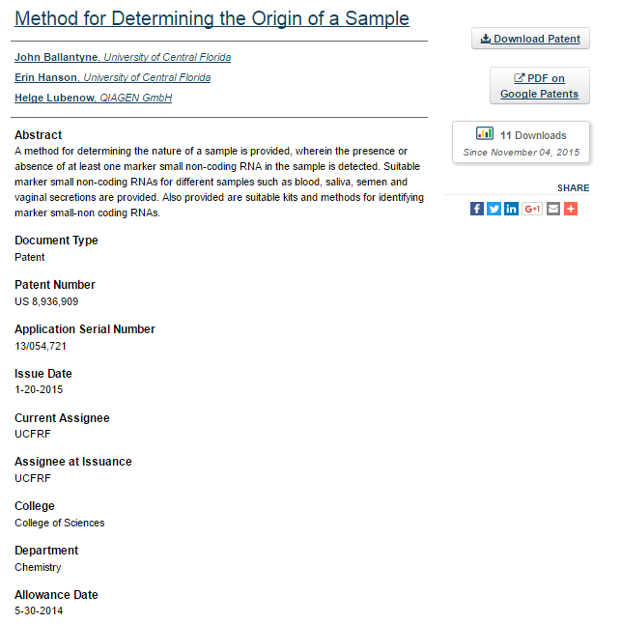

Slide 17
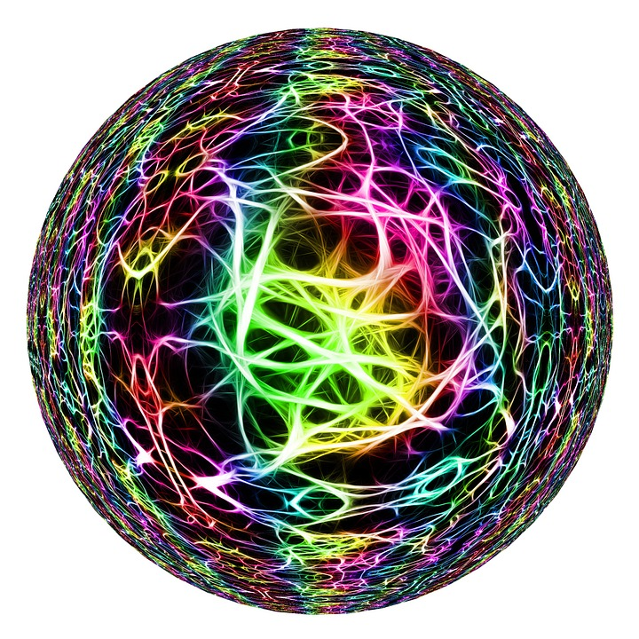
What if your workflow looks more like this…

Slide 18
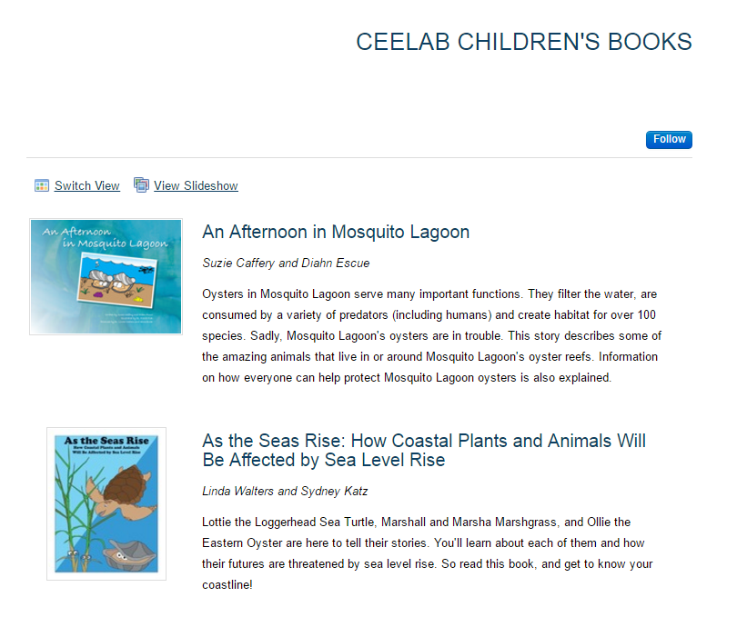

Slide 19
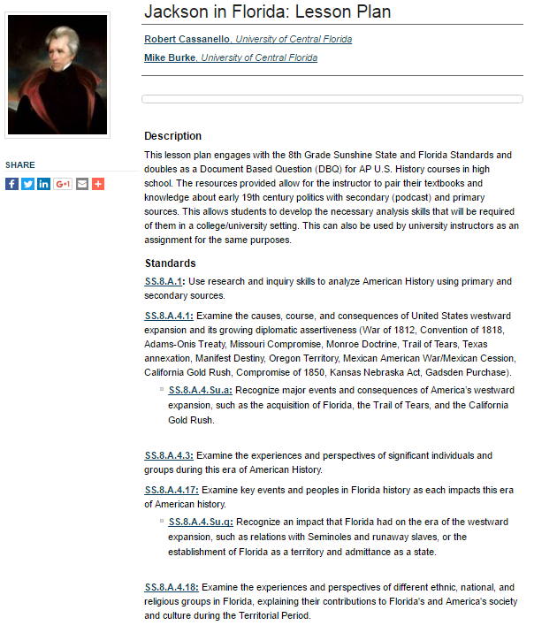
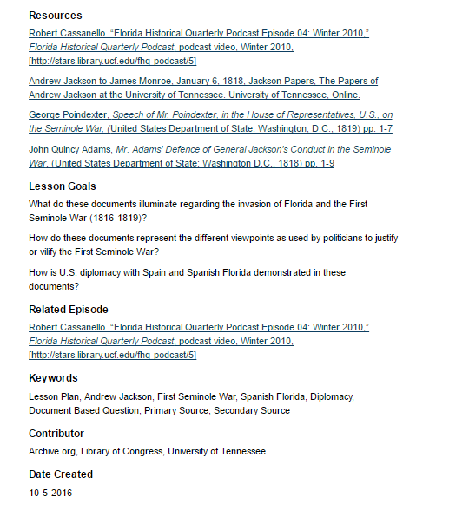

Slide 21
Scholarly Communication
Sarah Norris, Scholarly Communication Librarian

Slide 22
The Office of Scholarly Communication provides information and assistance on all aspects of scholarly publishing.

Slide 23
Goals
Collaborate with other campus units to provide a suite of campus-wide services that supports all aspects of research and scholarly publishing at the University.
Advocate for the infrastructure, staffing, publishing funds and services that further support research and scholarly publishing at the University.
Educate and facilitate discussions about the changing scholarly communication environment, including the move to open access and sustainable publishing and exploring new ways to create, disseminate, evaluate, and preserve research and scholarly outputs at the University.

Slide 24
Scholarly Communication & STARS
Provide outreach, workshops, and consultations on campus about authors’ rights, publishing options, Open Access, and other issues related to Scholarly Communication
Partner with Digital Initiatives and Subject Librarians to promote and populate the institutional repository
Support the scholarly publishing process and build services in support of the scholarly publishing lifecycle

Slide 25
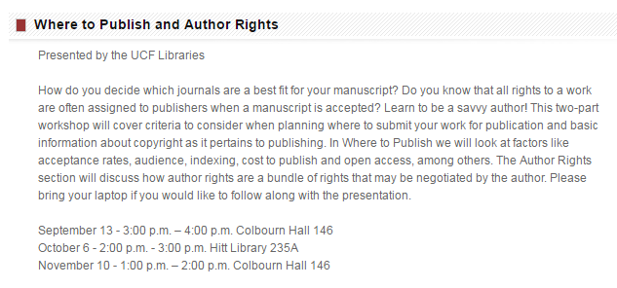
Graduate, Undergraduate & Faculty Workshops

Slide 27
Scholarly Communication Faculty Advisory Board

Slide 28
Copyright & Author Rights
Meet with Digital Initiatives Librarian, Subject Librarians, and Faculty to discuss copyright, author rights, and other intellectual property concerns
-Proactively researching select copyright needs prior to meeting (e.g. SHERPA/RoMEO, publisher agreements, etc.)
Assist faculty on ad hoc basis with copyright and author rights
-Determine legal versions allowed for self-archiving in STARS
-Advise on author agreements
-Answer questions related to open access, APCs, etc.

Slide 29
Research & Information Services
Barbara Tierney, Head of Research Services

Slide 30
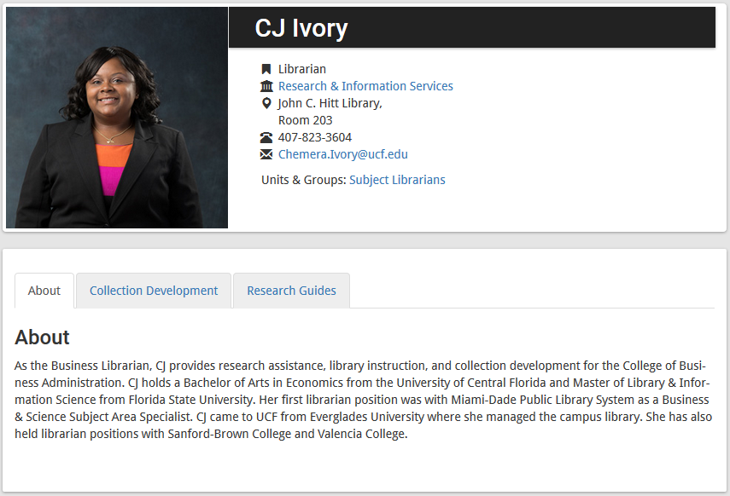
Subject Librarians are very visible and accessible throughout the library’s website

Slide 31
Subject Librarians are showcased in the library’s digital signage
Notes:
In addition to new Subject Librarian and departmental web pages….individual portraits of the Subject Librarians (along with their personal messages to the university community) are featured within the library’s digital signage system.

Slide 32
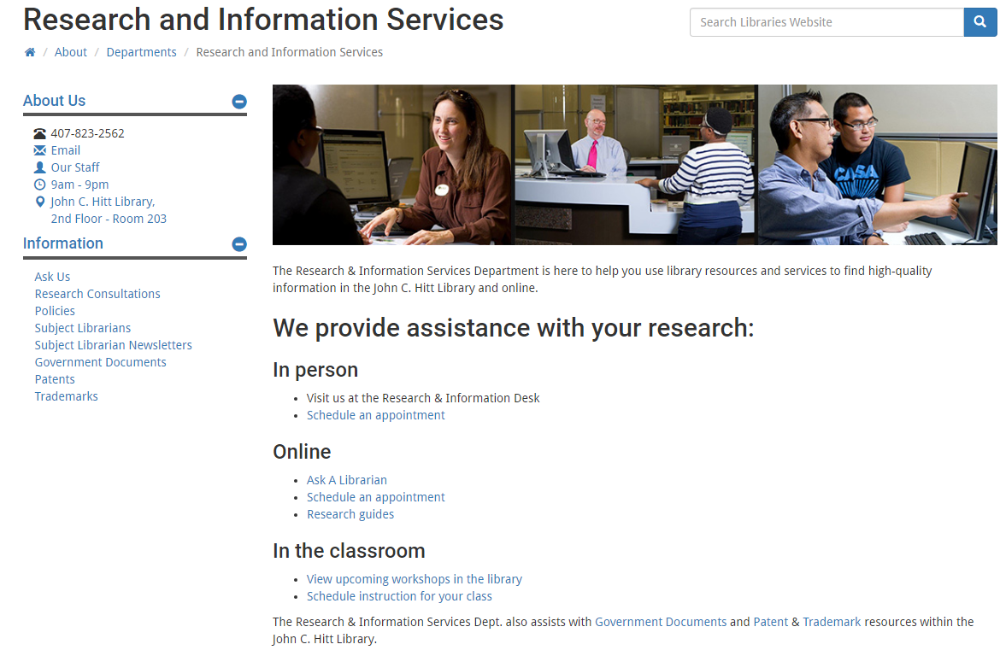
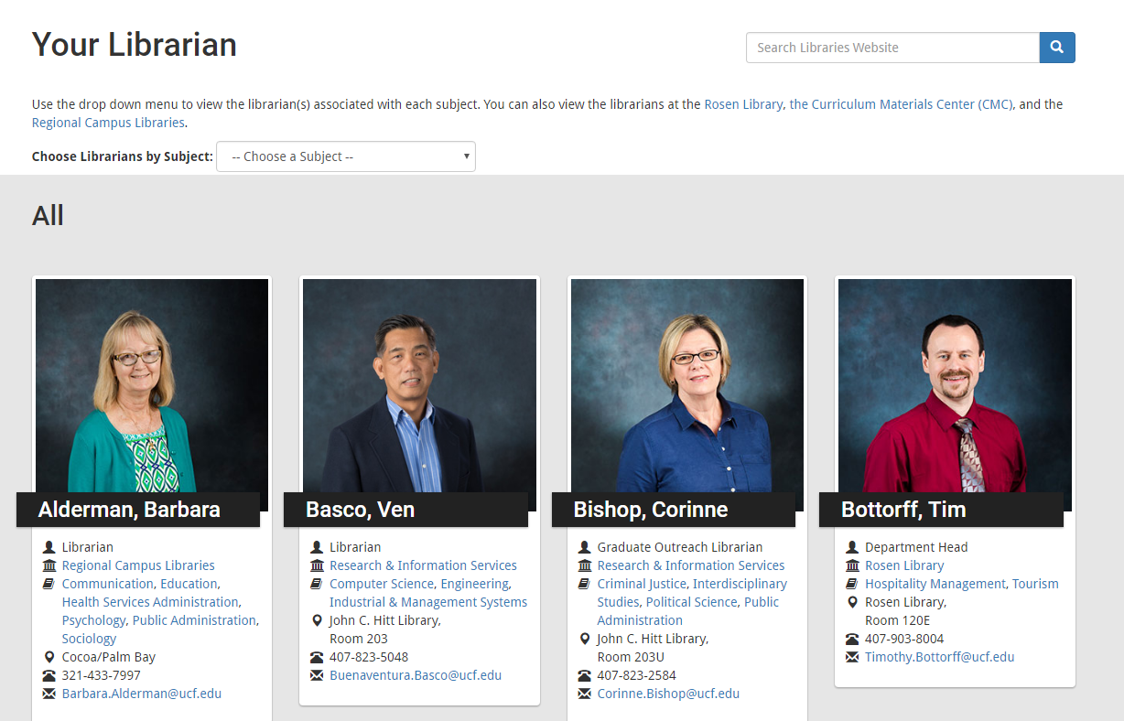
Notes:
The new Subject Librarian service model at UCF has sought to change the librarian’s role from reactive to proactive…especially with regard to marketing UCF’s Office of SC, IR, & digital initiatives
UCF’s 15 Subject Librarians (http://library.ucf.edu/SubjectLibrarians/) engage in proactive outreach to their assigned academic programs, faculty and students. They reach out to UCF constituencies via e-newsletters, web-based research guides, library instruction sessions, and presentations at academic department and university-wide meetings.
The Subject Librarians are excellent conduits for connecting end-users with resources (such as e-books, streaming videos, electronic journals, databases, and scholarly digital collections) to ensure maximum return on investment for these resources.

Slide 33
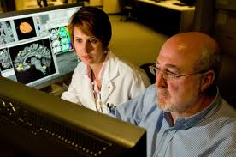
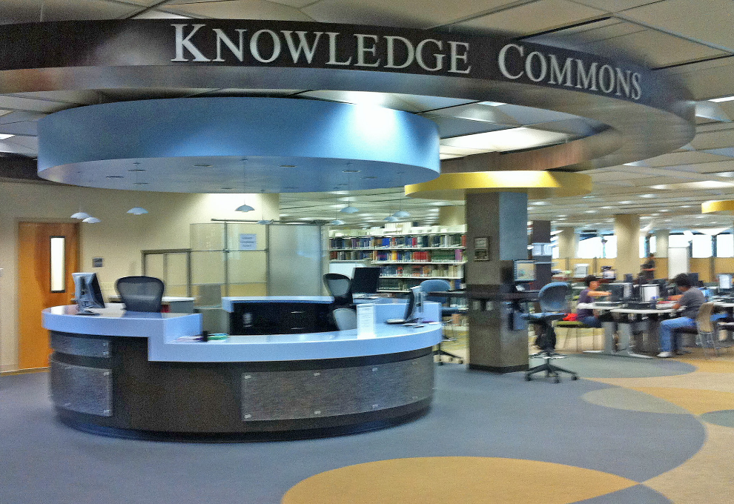
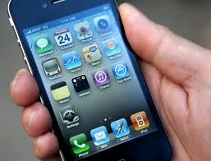
Subject Librarians are encouraged to be mobile… to get away from the Desk…. out of the library… and visit their assigned academic depts.
Notes:
Subject Librarians are getting out of the Library building and spending quality time visiting their assigned academic departments… participating in departmental group meetings & meeting one-on-one with academic faculty in their offices.
The Subject Librarians use these opportunities to introduce their faculty to new or under-utilized digital resources and to demonstrate how these resources can be used to assist faculty with their teaching and research.

Slide 34
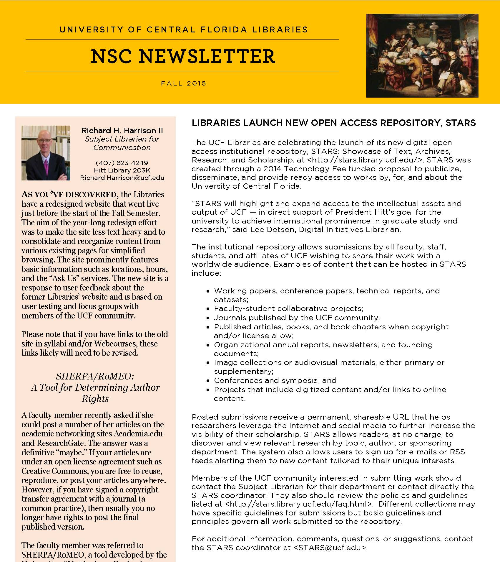
Subject Librarians market IR and SC services and resources via their e-newsletters

Slide 35
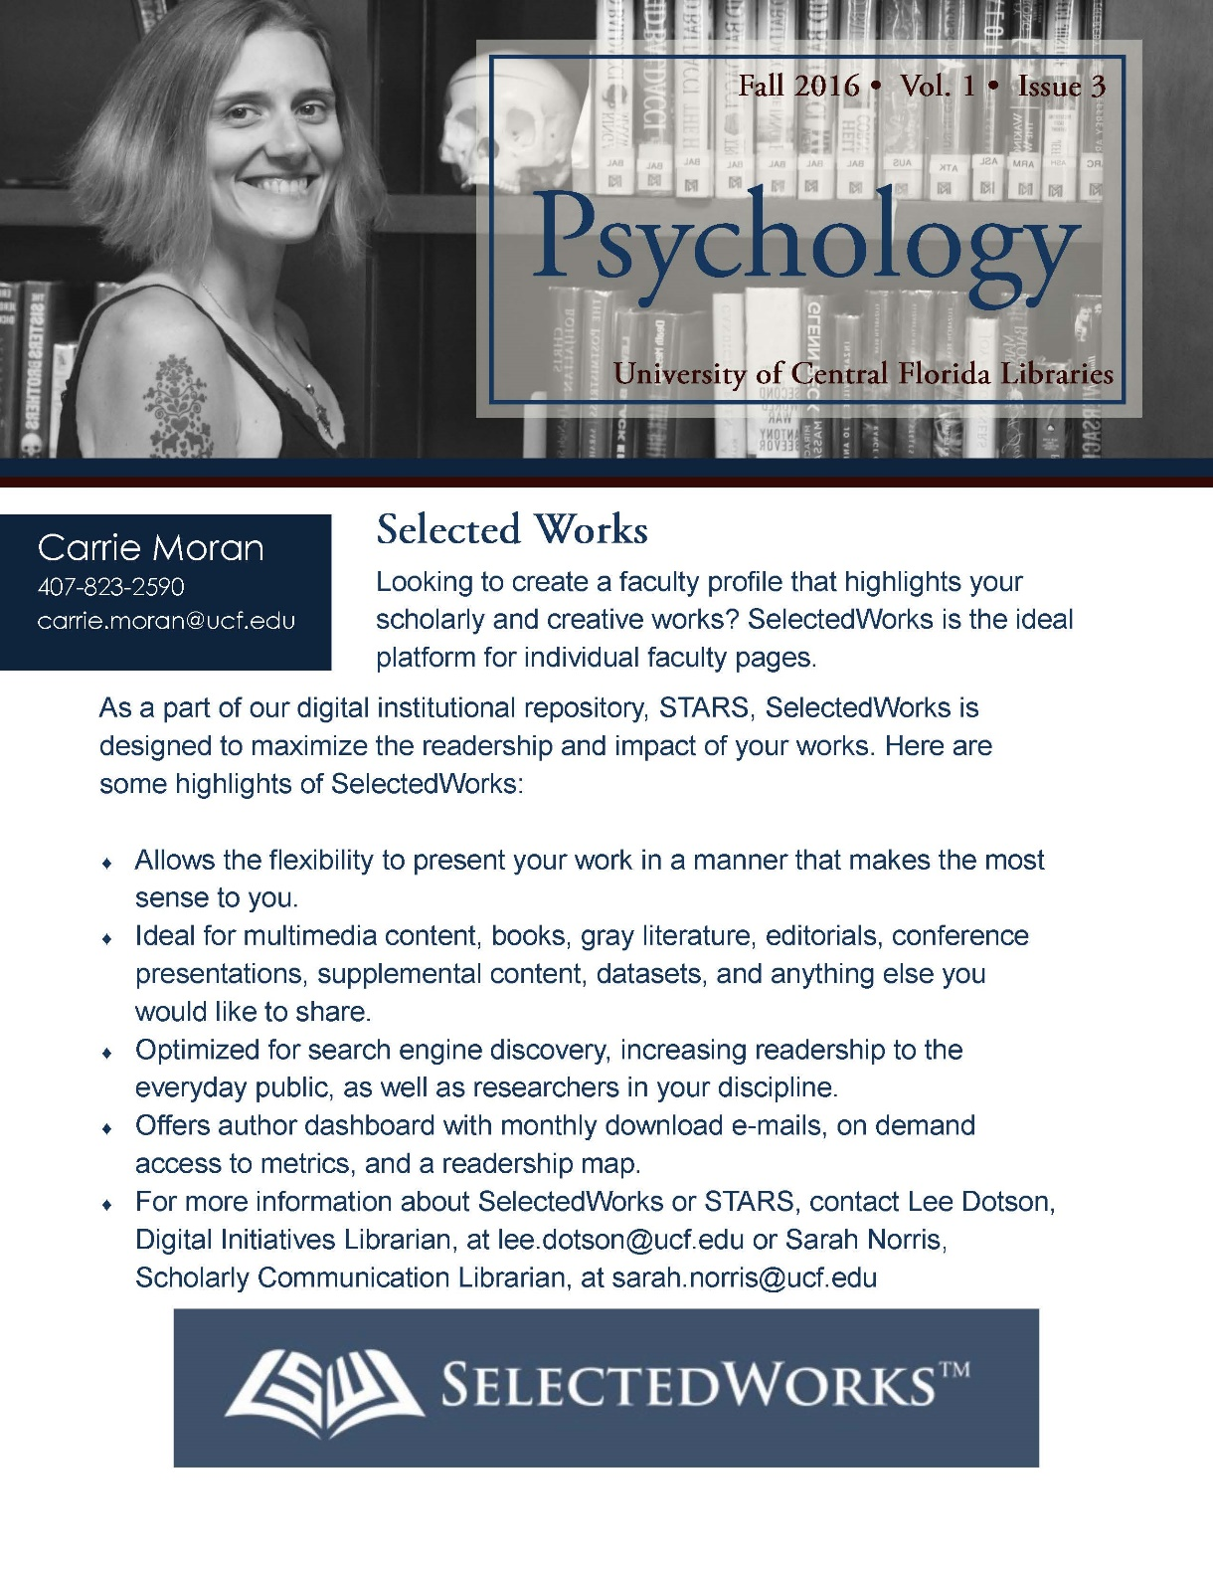

Slide 36
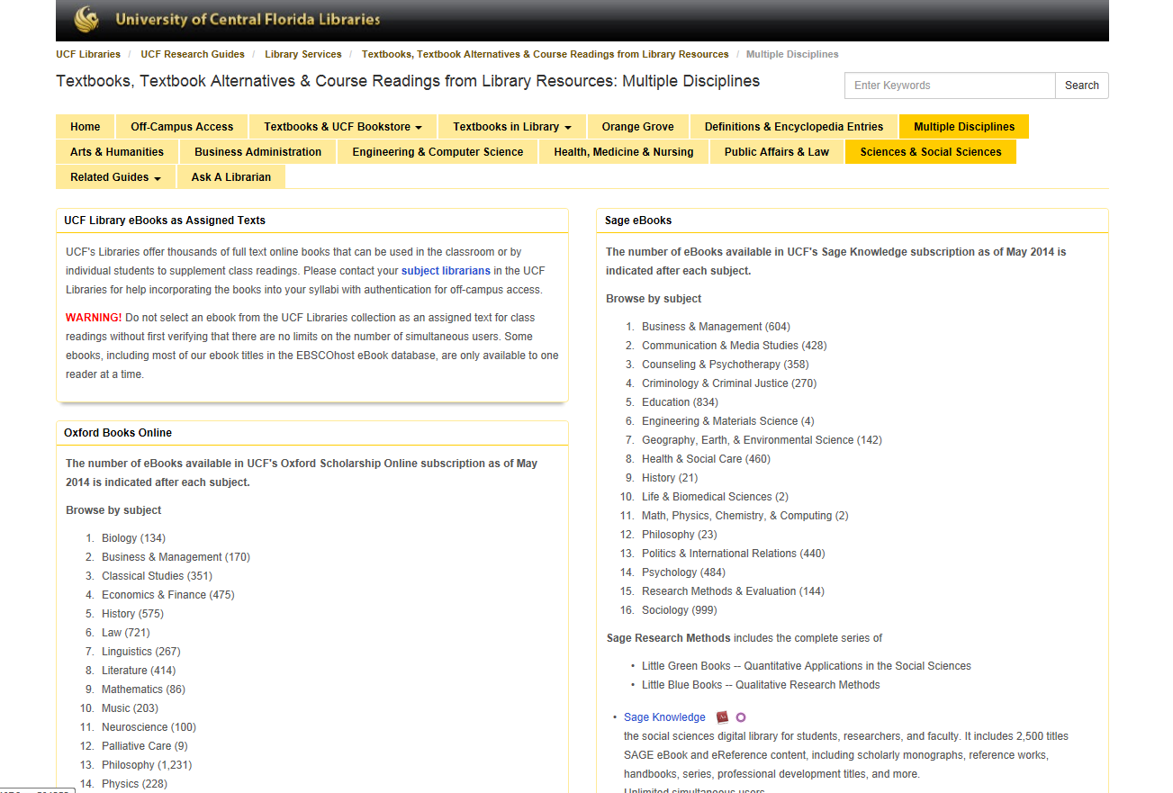
Subject Librarians market textbook alternatives and OERs via their online research guides
Notes:
One of UCF Libraries’ most heavily used Lib Guides is entitled: “Textbooks, Textbook Alternatives & Course Readings from Library Resources” by Subject Librarian Rich Gause: http://guides.ucf.edu/textbooks
This particular Lib Guide was created by one of our Subject Librarians to encourage academic faculty to use library-owned e-book content for their assigned class readings, as an alternative to expensive textbooks.
The introduction of this Lib Guide states: “UCF Libraries offers thousands of full text online books that can be used in the classroom or by individual students to supplement class readings. Please contact your subject librarians for help incorporating the books into your syllabi.”
Then the Lib Guide goes on to list each of the online book collections to which the library subcribes, with a listing of each subject area included in this digital collection and how many titles the collection offers for each subject area. For example, for the“Sage eBooks” digital collection, there are 16 disciplines represented, with 604 ebooks in the “Business and Management” section, 999 ebooks in the “Sociology” section, and so on.

Slide 37
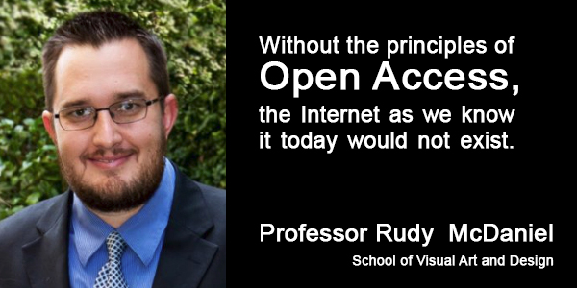
Subject Librarians encourage their faculty to serve as UCF Open Access Champions
Notes:
Subject Librarians communicate frequently with their assigned academic faculty about Scholarly Communication and Open Access issues.
This year Subject Librarians have worked with their assigned academic departments to identify individual academic faculty members who serve as “UCF Faculty Open Access Champions” on the UCF Libraries’ web site and in library programs and displays.

Slide 38
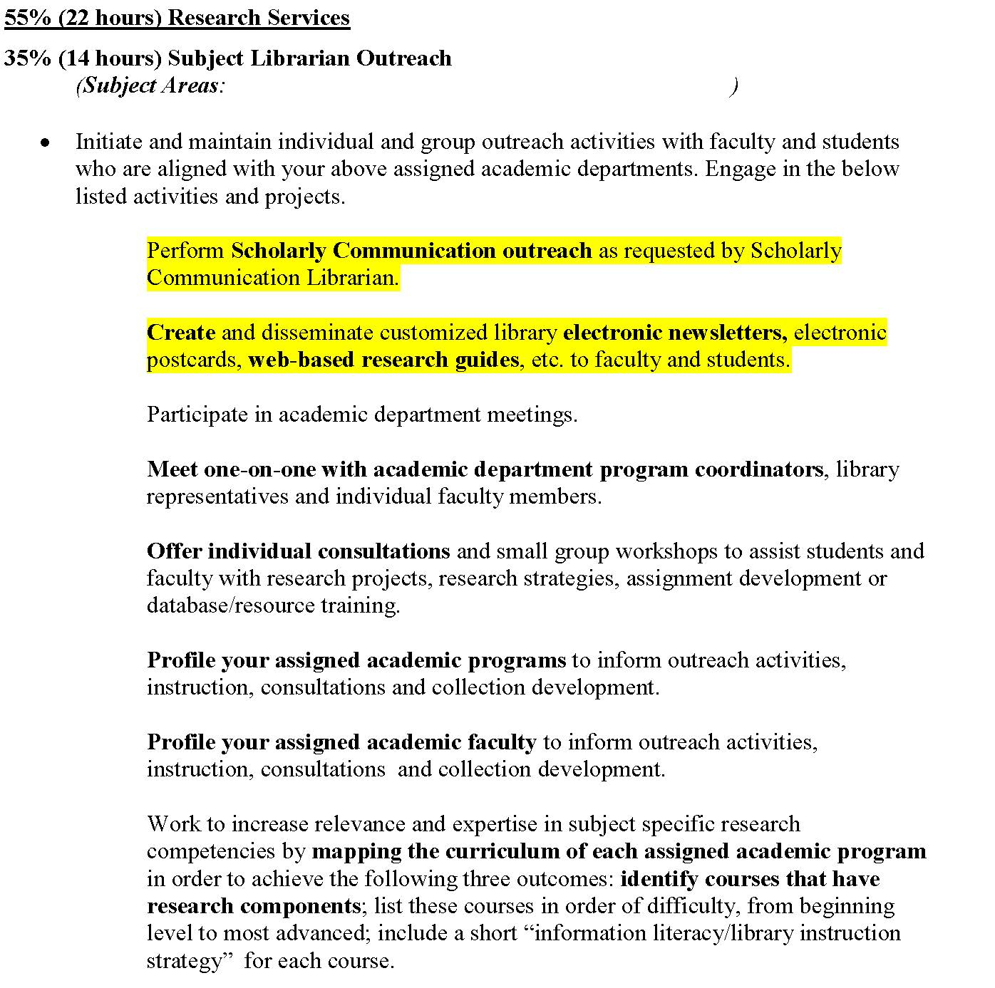
Subject Librarian annual assignments include Scholarly Communication and IR outreach expectations

Slide 39
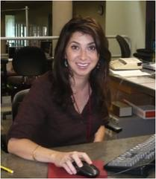
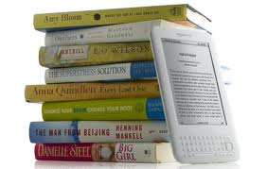
Subject Librarians receive training from SC, IR, and RIS
Notes:
Subject Librarian Training
UCF’s Office of SC , IR, and “Research & Information Services Dept.” are working together to provide highly focused training for the Subject Librarians to support them in their marketing role….. through annual all-day reference retreats, monthly reference meetings, SC and IR workshop series, and an online “Subject Librarian Toolkit” Lib Guide http://guides.ucf.edu/subject-librarian-toolkit. At UCF Subject Librarians are encouraged to learn as much as possible about Scholarly Communication and IR issues and initiatives. UCF’s Office of SC and IR provide information, training, and support to the Subject Librarians as they reach out to their academic programs, faculty, and students to discuss Scholarly Communication issues such as Open Access, Author’s Rights, and populating UCF’s new IR with faculty and student creative works

Slide 40
Subject Librarians
Richard Harrison, Subject Librarian
Communication, Film, History, Judaic Studies, Music, Philosophy

Slide 41
Subject Librarian’s Role
Preserve
Acquire
Recruit

Slide 42
Environmental Scan
Identify faculty
Identify institutional constituencies
Identify major institutional initiatives

Slide 43
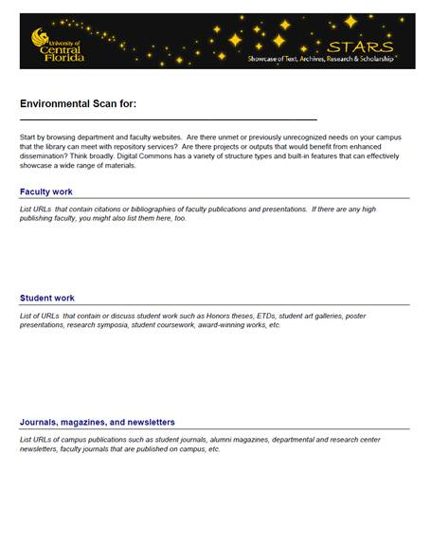

Slide 44
Sample UCF IR Collections
“UCF Metro” television series
Office of Undergraduate Research
“A History of Central Florida” podcasts
“Sport and Society” essays

Slide 45
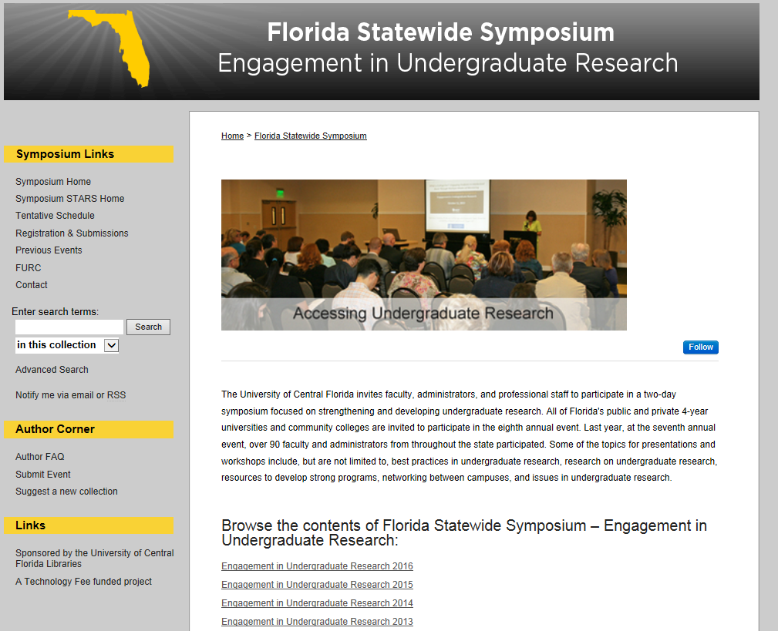

Slide 46
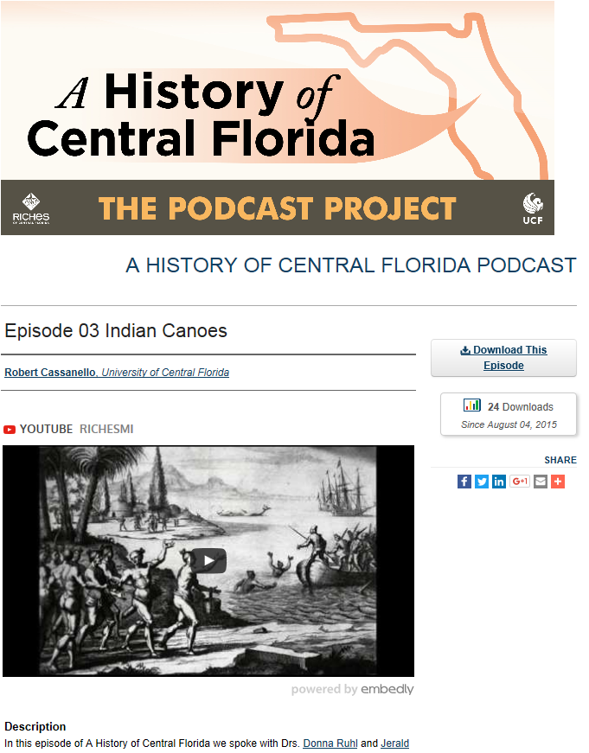

Slide 47
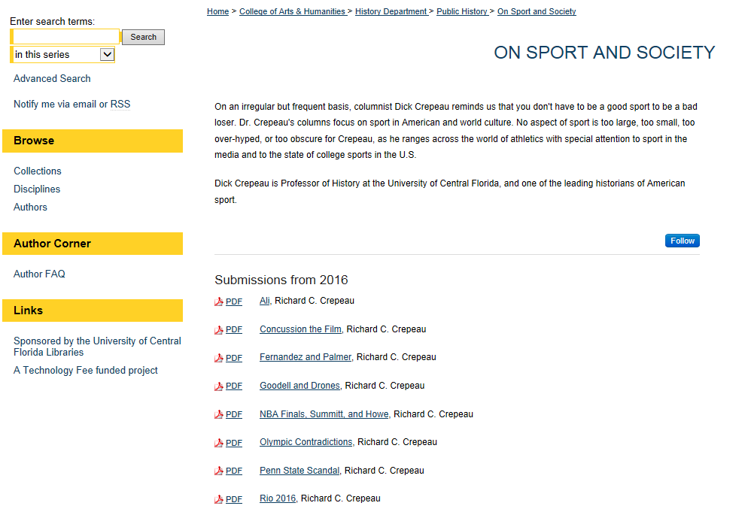

Slide 48
Know (or Get to Know) Your Faculty

Slide 49
Future Goals & Expectations

Slide 50
Questions?
University of Central Florida Libraries
Lee Dotson Lee.Dotson@ucf.edu
Richard Harrison Richard.Harrison@ucf.edu
Sarah Norris Sarah.Norris@ucf.edu
Barbara Tierney Barbara.Tierney@ucf.edu

