Slide 1
Author Rights
Sarah A. Norris, Scholarly Communication Librarian,
University of Central Florida Libraries

Slide 2
Introduction: Sarah A. Norris, Scholarly Communication Librarian
https://works.bepress.com/sarah-norris/

Slide 4
Overview
General Copyright
Important Points About Author Rights
Examples of Publishing Agreements
Tools
SHERPA/RoMEO
SPARC Author Addendum
Not Covered in this Workshop…
Specific Non-Academic Publishing Examples*
*Note: many of the points discussed in this presentation do apply to general author rights agreements; however, those publishing with non-academic publishers in particular should consult with legal counsel before entering into any financial and legally binding publishing agreement.

Slide 5
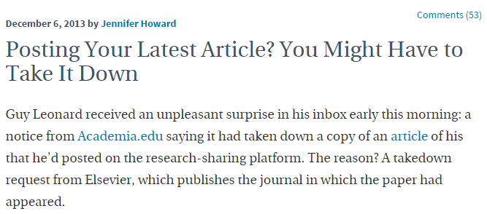
Why Author Rights?

Slide 6
Copyright basics

Slide 7
What is Copyright?
“Copyright is a form of protection provided by the laws of the United States (title 17, U.S. Code) to the authors of ‘original works of authorship,’ including literary, dramatic, musical, artistic, and certain other intellectual works. This protection is available to both published and unpublished works.”
http://www.copyright.gov/circs/circ01.pdf

Slide 8
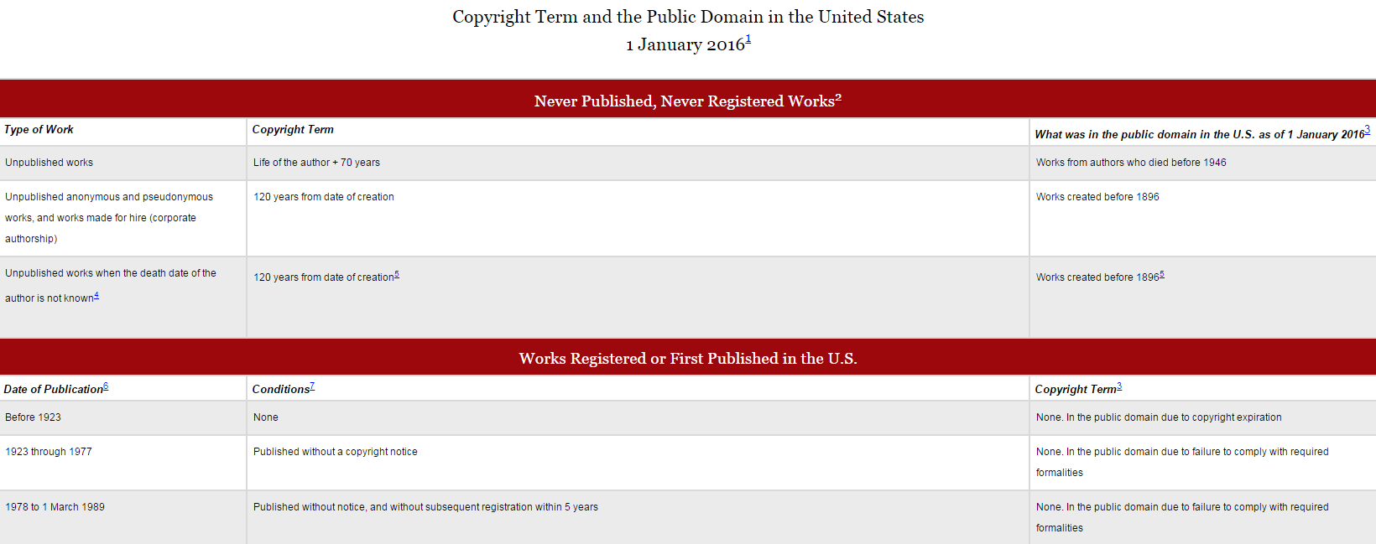
How Long Does Copyright Last?
© 2004-2016 Peter B. Hirtle. Last updated 3 January, 2016,
Retrieved from: http://copyright.cornell.edu/resources/publicdomain.cfm

Slide 9
Public Domain
Public domain refers to materials “whose exclusive intellectual property rights have expired, have been forfeited, or are inapplicable.”
Items can be used freely
Materials in the public domain include:
Works with expired copyright (generally, this means items published before 1923)
Works that are not copyrightable or protected by copyright
Works produced by the federal government and/or federal government employee as a part of their job
Works donated to the public domain

Slide 10
Open Access
“Open-access (OA) literature is digital, online, free of charge, and free of most copyright and licensing restrictions.”
© 2004-2015 Peter Suber. Last updated 5 December, 2015,
Retrieved from: http://bit.ly/oa-overview

Slide 11
Creative Commons License
“A Creative Commons (CC) license is one of several public copyright licenses that enable the free distribution of an otherwise copyrighted work. A CC license is used when an author wants to give people the right to share, use, and build upon a work that they have created.”
https://creativecommons.org/licenses/

Slide 12
What Rights are Covered by Copyright?
Generally, the following are exclusive rights given to a copyright holder:
reproduce your work
distribute your work
prepare derivative works
publicly display or perform your work
authorize others to do any of the above
*The above does not necessarily apply if the creator/author has given away rights to a publisher and/or other individual or entity

Slide 13
Your works belong to you…
Unless You Give Your Rights Away

Slide 14
*You can give away or sell any or all of your rights. Giving up your rights may limit access to and impact of your work.
Image retrieved from: https://flic.kr/p/4Metz2
© Rachel Pasch

Slide 15
Important Points to Consider
Publication agreements are a bundle of rights
Read your agreement
Know that you can try to negotiate to retain some rights
Reuse charts and graphs or reproduce the work
Give copies to your colleagues or students
Post on a website (e.g. Academia.edu or ResearchGate) or repository (e.g. STARS)
SPARC Author Addendum http://www.sparc.arl.org/resources/authors/addendum
Check SHERPA/RoMEO for publisher copyright policies http://www.sherpa.ac.uk/romeo/PDFandIR.html
UCF Libraries does not give copyright advice, but we can alert authors about their rights and point them to resources for negotiating them. For copyright advice, it is recommended that you consult with legal counsel.

Slide 16
UCF Undergraduate Research Journal Publishing Agreement Terms

Slide 17
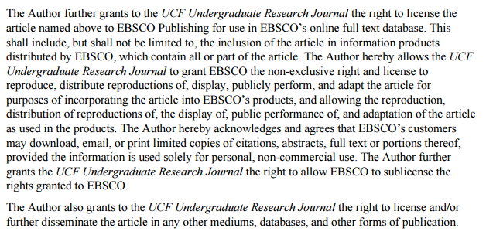
UCF Undergraduate Research Journal Publishing Agreement Terms

Slide 18
Undergraduate Economic Review Publishing Agreement Terms

Slide 19
Elsevier Publishing Agreement Terms

Slide 20
Elsevier Author Fees / Article Processing Charges (APC)
Examples
Library & Information Science Research - $1100
The Journal of Academic Librarianship - $1100
*“If an author would like their article to be published under a gold open access model, but cannot afford the APC, then individual waiver requests are considered on a case-by-case basis and may be granted in cases of genuine need.”
https://www.elsevier.com/about/company-information/policies/pricing

Slide 21
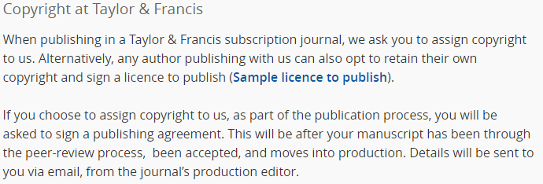
Taylor & Francis Publishing Agreement Terms

Slide 22
Taylor & Francis Author Fees / Article Processing Charges (APC)
Examples
Library Collections, Acquisitions, & Technical Services - $2950
Journal of Library Metadata - $2950
http://authorservices.taylorandfrancis.com/publishing-open-access-with-taylor-francis/

Slide 23
Using sherpa/romeo as author rights tool
http://www.sherpa.ac.uk/romeo/index.php

Slide 24
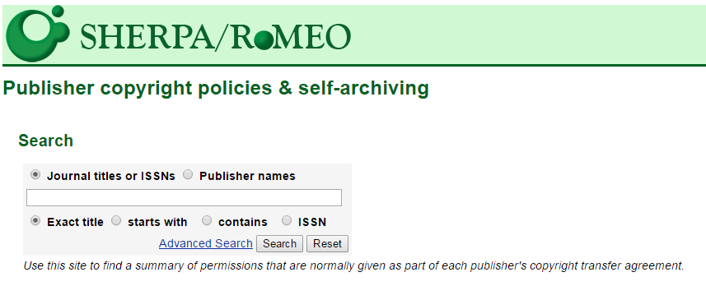

Slide 25
Versions of Scholarship
Pre-print: The first draft you submitted to a publisher.
Post-print: The final manuscript you submitted to the publisher after making revisions from the peer review process; a post-print hasn’t been printed or designed or even copy-edited yet -- usually a Word document.
Publisher’s Version/PDF: A scan or page export from the printed or online journal.
Link to publisher’s website: Takes a reader to the original publication. Has some drawbacks: Sometimes, a reader must have a subscription or purchase the publication. And, it doesn't count as a full-text download. However, still provides access to work.

Slide 26
Sparc author rights & addendum http://sparcopen.org/our-work/author-rights/#addendum

Slide 27
Final Thoughts
Contact UCF Libraries if you have concerns about copyright & author rights
UCF Libraries does not provide legal counsel but can provide assistance for informational purposes only
Publication agreements are a bundle of rights that you can negotiate
Read through any publication agreement terms prior to signing
Consider a SPARC Author Addendum
Utilize tools like SHERPA/RoMEO for copyright policies and author agreements

Slide 28
Contact Information
Sarah A. Norris
Scholarly Communication Librarian
UCF Libraries
sarah.norris@ucf.edu
UCF Libraries Office of Scholarly Communication
http://library.ucf.edu/about/departments/scholarly-communication/

