Slide 1
Copyright Considerations for Open Educational Resources (OER)
Sarah A. Norris, Scholarly Communication Librarian, UCF Libraries

Slide 2
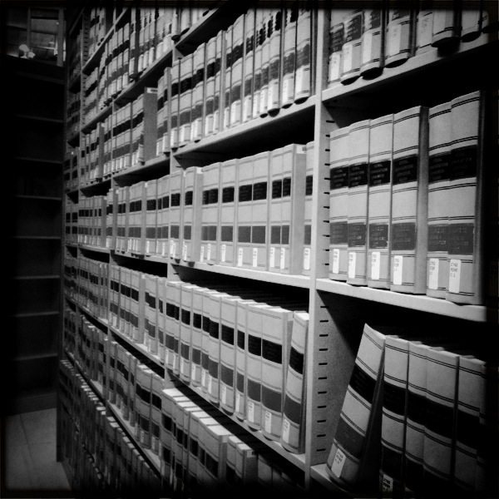
*Disclaimer
UCF Libraries does not give legal advice, and any information in this presentation is for informational purposes only.
Image retrieved from: https://flic.kr/p/9H8SCn
© Mr.TinDC

Slide 3
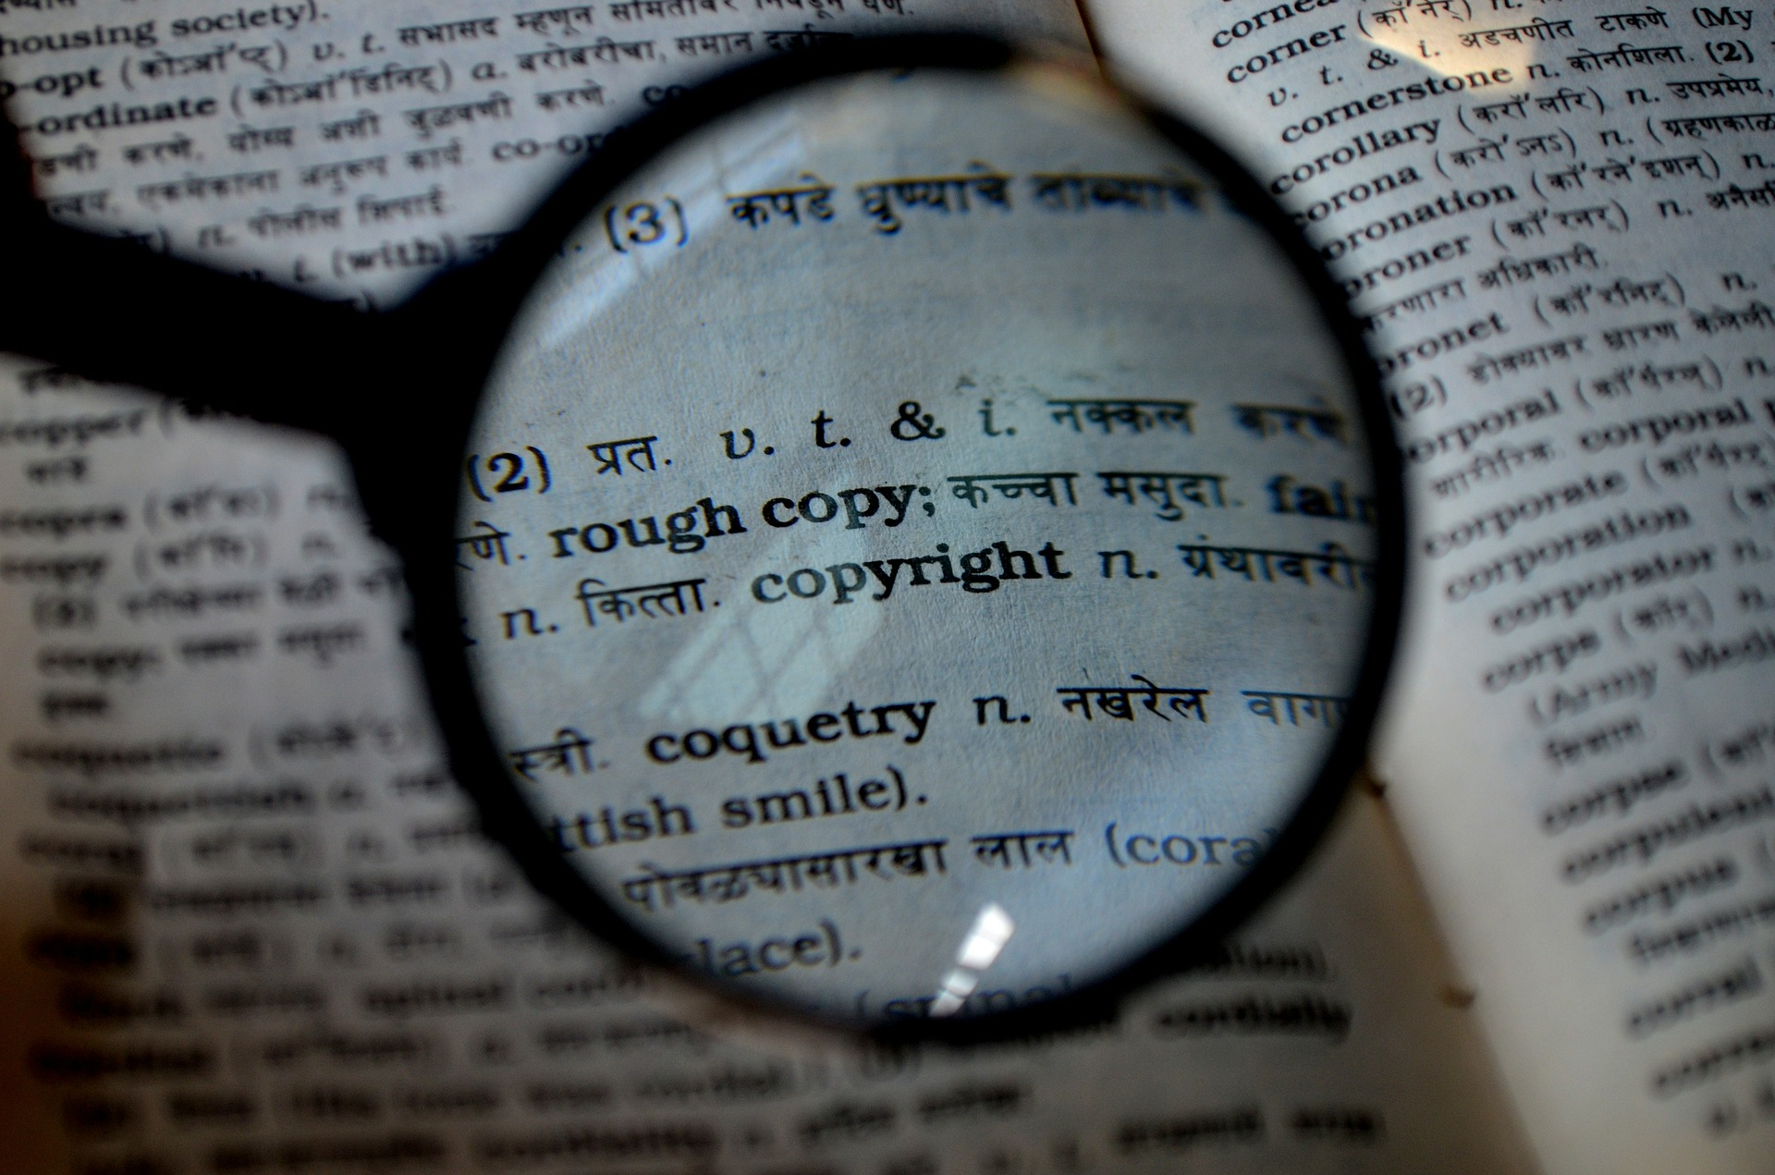
Overview
General Copyright
Important Points about Copyright & Open Educational Resources

Slide 4
Copyright basics

Slide 5
What is Copyright?
“Copyright is a form of protection provided by the laws of the United States (title 17, U.S. Code) to the authors of ‘original works of authorship,’ including literary, dramatic, musical, artistic, and certain other intellectual works. This protection is available to both published and unpublished works.”
http://www.copyright.gov/circs/circ01.pdf

Slide 6
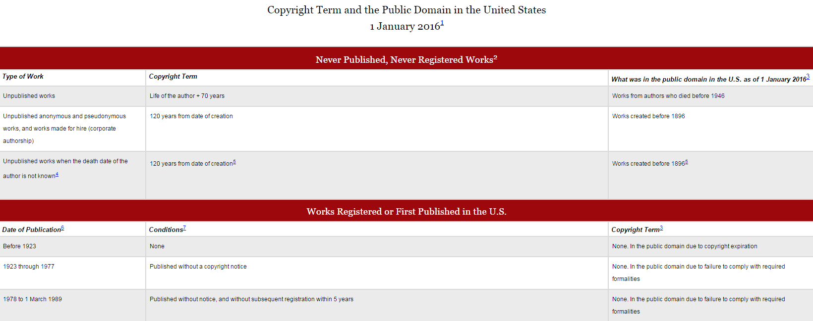
How Long Does Copyright Last?
© 2004-2016 Peter B. Hirtle. Last updated 3 January, 2016, Retrieved from: http://copyright.cornell.edu/resources/publicdomain.cfm

Slide 7
What Rights are Covered by Copyright?
Generally, the following are exclusive rights given to a copyright holder:
reproduce your work
distribute your work
prepare derivative works
publicly display or perform your work
authorize others to do any of the above
*The above does not necessarily apply if the creator/author has given away rights to a publisher and/or other individual or entity

Slide 8
Image retrieved from:
https://web.law.duke.edu/cspd/publicdomainday/2016/pre-1976
© Center for the Study of Public Domain

Slide 9
Public Domain
Public domain refers to materials “whose exclusive intellectual property rights have expired, have been forfeited, or are inapplicable.”
Items can be used freely
Materials in the public domain include:
Works with expired copyright (generally, this means items published before 1923)
Works that are not copyrightable or protected by copyright
Works produced by the federal government and/or federal government employee as a part of their job
Works donated to the public domain

Slide 10
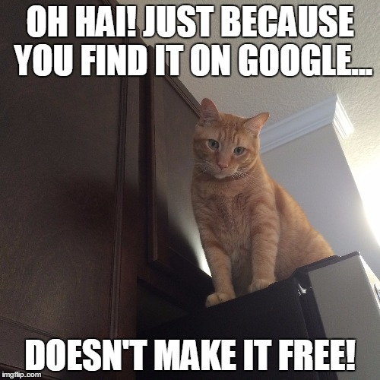
Public Domain & Content Online
Not everything online is in the public domain!
In general, consider any information you find on the Internet as protected by copyright, unless specifically noted, and treat it as such. Being publicly accessible is not the same as being in the public domain.
Meme created by Sarah Norris on: https://imgflip.com/memegenerator

Slide 11
Fair Use
“Fair use is a legal doctrine that promotes freedom of expression by permitting the unlicensed use of copyright-protected works in certain circumstances. Section 107 of the Copyright Act provides the statutory framework for determining whether something is a fair use and identifies certain types of uses—such as criticism, comment, news reporting, teaching, scholarship, and research—as examples of activities that may qualify as fair use.”
http://copyright.gov/fair-use/more-info.html

Slide 12
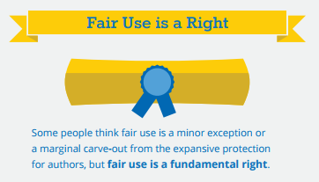
Fair Use is a Right…
http://fairuseweek.org/wp-content/uploads/2016/02/ARL-FUW-Infographic-r5.pdf

Slide 13
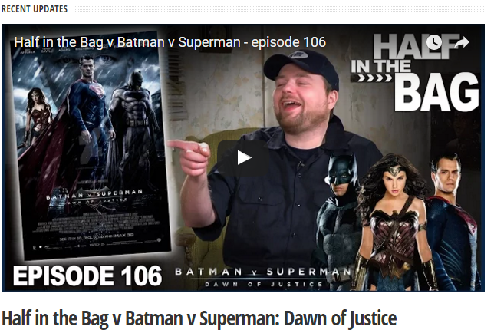
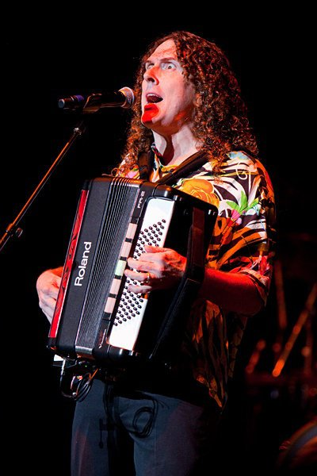
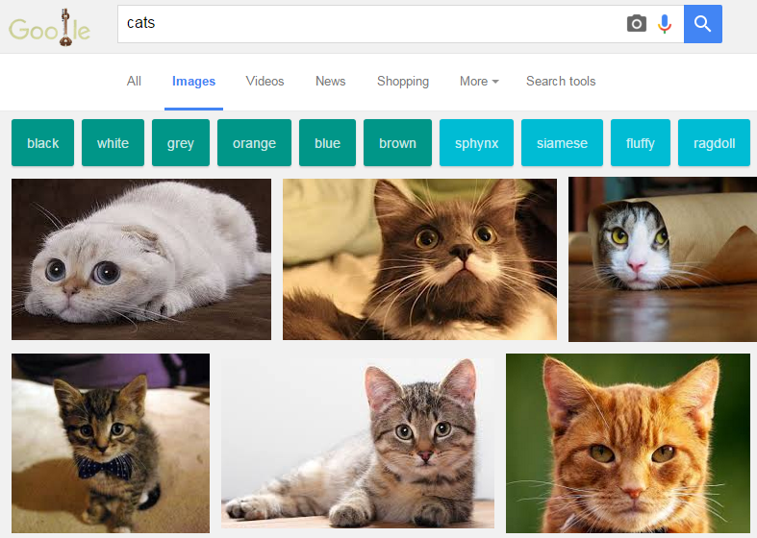
By Kristine Slipson - Own work, CC BY 3.0, https://commons.wikimedia.org/w/index.php?curid=14710006

Slide 14
Fair Use is NOT a License to Steal
When considering use of copyrighted work(s), the Four Fair Use Factors are typically used as a benchmark for whether fair use is appropriate or not*
Consult UCF Office of General Counsel or librarians for assistance
Look for copyrighted materials that have Creative Commons Licenses
Fair use is not applicable to the creation of OERs, but it might have some applicability to textbook affordability efforts (case by case basis)
*From UCF Office of General Counsel:
Because the four-pronged test is highly subjective, it is difficult to know whether your application of the test will stand up in a court of law. For that reason, UCF has chosen to adopt the guidelines (set forth under 5.-9. of the UCF Use of Copyrighted Material Policy) rather than to ask individuals to apply the four-pronged test. For more information, please see the UCF Use of Copyrighted Material Policy. UCF Personnel should follow applicable copyright law and the above referenced policy.

Slide 15
Open Access
“Open-access (OA) literature is digital, online, free of charge, and free of most copyright and licensing restrictions.”
© 2004-2015 Peter Suber. Last updated 5 December, 2015,
Retrieved from: http://bit.ly/oa-overview

Slide 16
Image retrieved from:
https://flic.kr/p/a8Tsiz
© Kristina Alexanderson

Slide 17
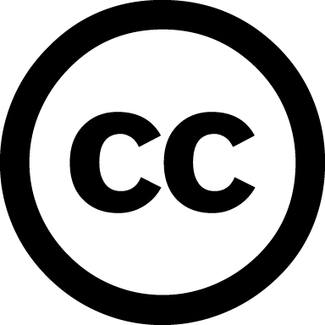
Creative Commons License
“A Creative Commons (CC) license is one of several public copyright licenses that enable the free distribution of an otherwise copyrighted work. A CC license is used when an author wants to give people the right to share, use, and build upon a work that they have created.”
https://creativecommons.org/licenses/

Slide 18
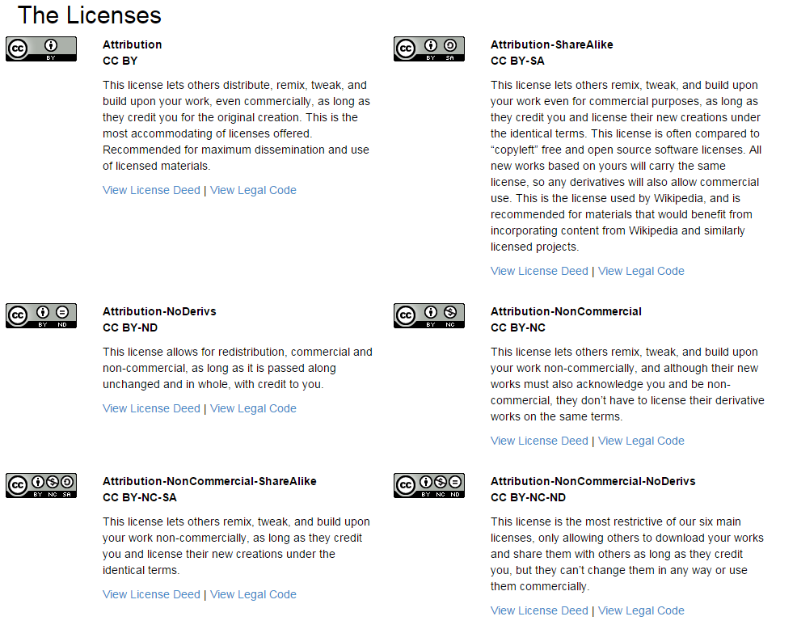
https://creativecommons.org/licenses/

Slide 19
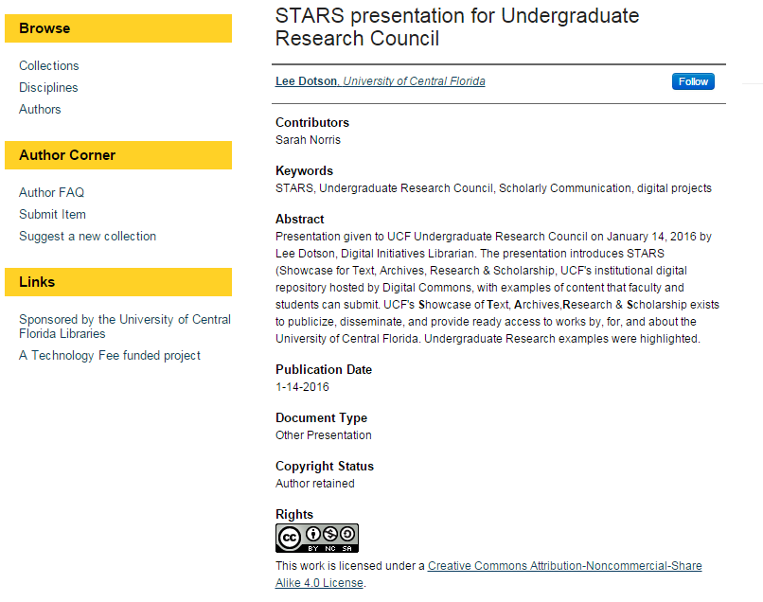
Where do you see creative commons licenses?

Slide 20
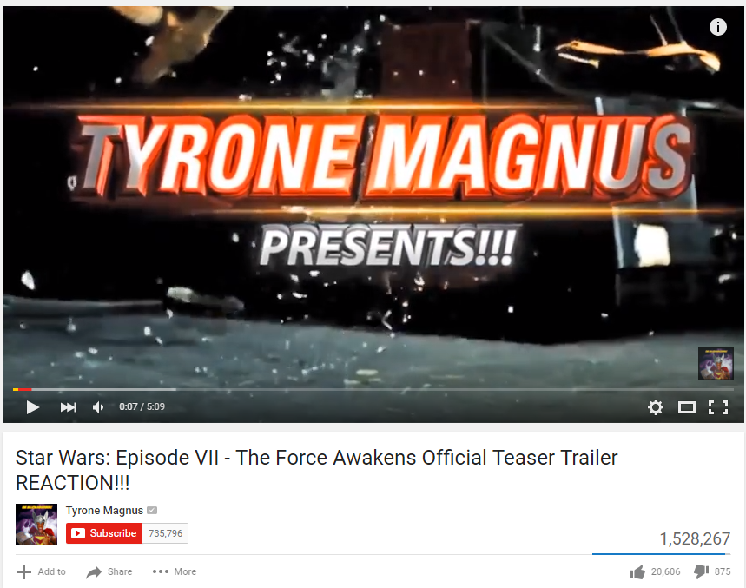

Slide 21
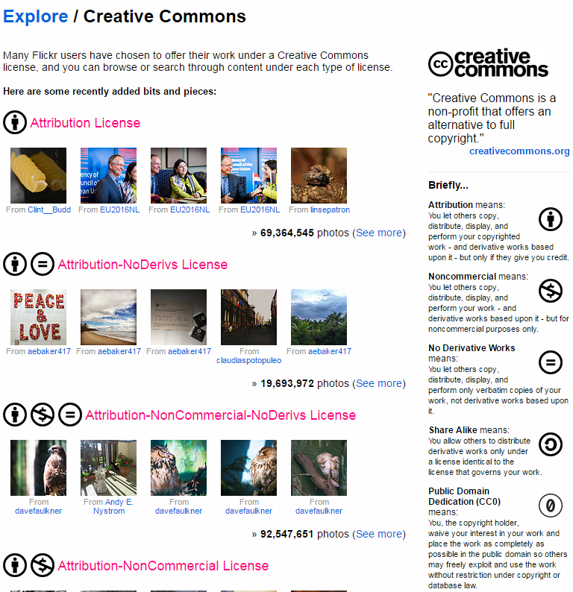

Slide 22
Copyright considerations for oer & TA

Slide 23
Copyright, OERs, and Textbook Affordability
Copyright depends on efforts
TA vs. OER
Focus primarily on:
Creative Commons licensed materials
Fair Use (copyrighted materials)
Open Access
Public domain materials

Slide 24
Textbook Affordability & Copyright
Items used may be…
public domain
creative commons licensed
open access
library-sourced / licensed content
fair use*
*Depends on the nature of the work, use, and UCF Policy of Copyrighted Materials

Slide 25
Open Educational Resources
Items may be…
public domain
creative commons licensed
open access
original works of authorship by the faculty member
Fair use does not apply to open educational resources due to the open nature of the content created and/or used

Slide 26
Why consider OER vs. TA?
Textbook affordability efforts can vary (library-licensed content, open content, etc.) but don’t necessarily facilitate sharing resources beyond the institution and may be limited in options
By default, OERs are created and used under an open license structure
This is a defining aspect of OER
Adding an open license makes it easy to share resources at UCF and beyond

Slide 27
Public Domain, TA, and OER
Public Domain is free and open to use….
But, it may not be as easy as you think to find truly public domain materials
Public domain content may be used as the basis for new copyrighted work
Translations
Derivatives
Adaptations

Slide 28
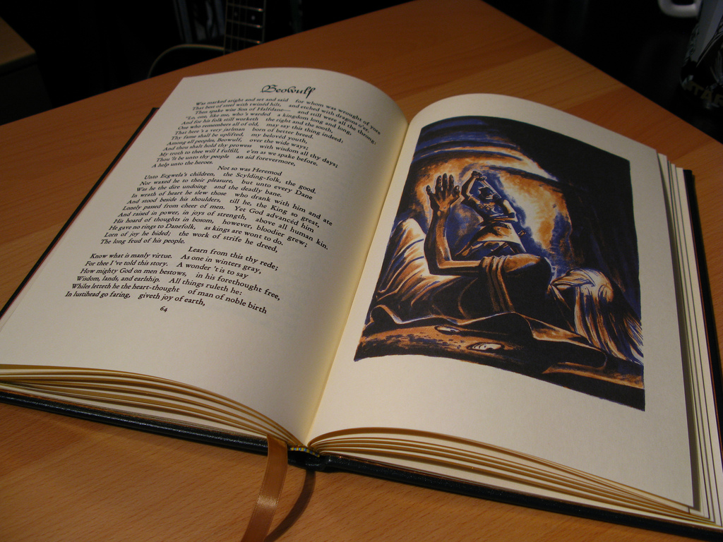
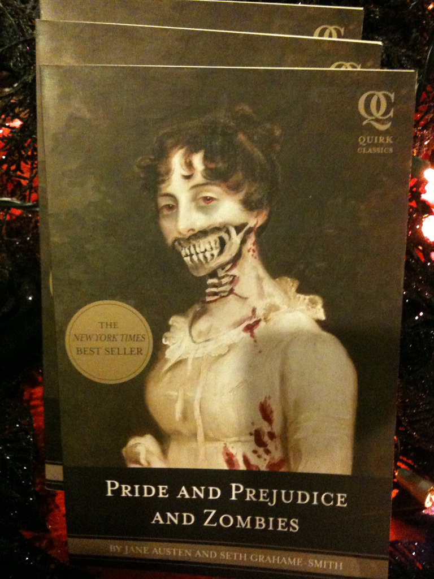
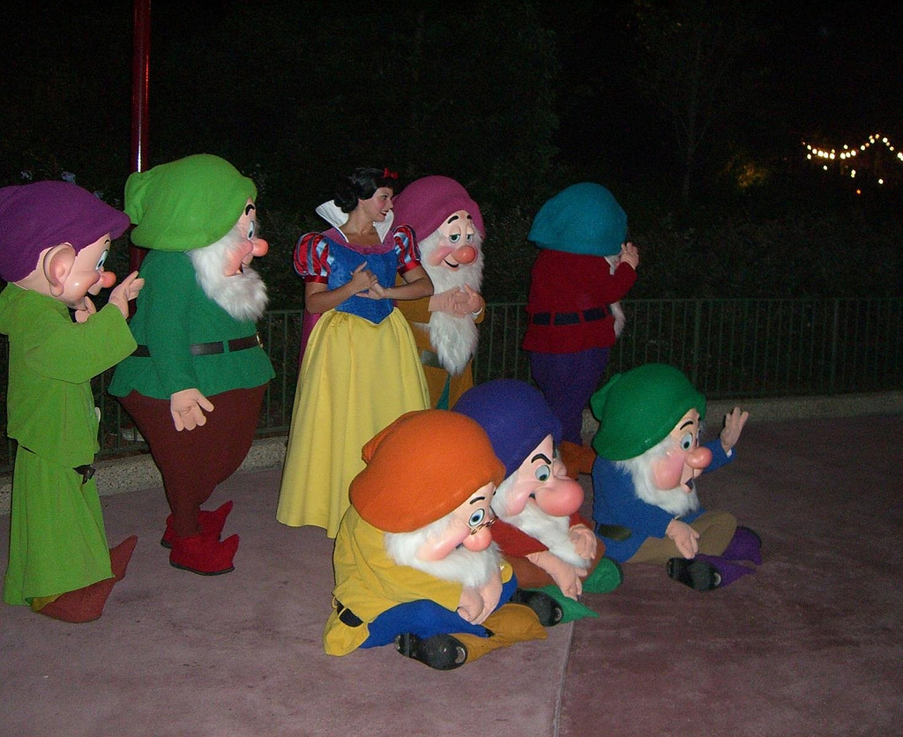
Examples of Public Domain Uses
Image retrieved from: https://www.flickr.com/photos/jemimus/6783259581
© Robert / CC by 2.0
Image retrieved from: https://www.flickr.com/photos/blakespot/3995091949
© Blake Patterson / CC by 2.0
Image retrieved from: https://www.flickr.com/photos/jeffchristiansen/2506627137
© Jeff Christiansen / CC by 2.0

Slide 29
Creative Commons Licenses & OERs
Creative Commons Licenses make sharing, adapting, finding, and creating OERs easier
When using CC licensed material, make sure to properly cite based on the license (https://wiki.creativecommons.org/wiki/Best_practices_for_attribution)
If you are adding a CC license to OER content, look at considerations for such licenses (https://wiki.creativecommons.org/wiki/Considerations_for_licensors_and_licensees#Considerations_for_licensors)
Use the Creative Commons site when creating your license & deciding which license to choose (https://creativecommons.org/choose/)
Learn how to mark your work with a CC license (https://wiki.creativecommons.org/wiki/Marking_your_work_with_a_CC_license#How_to_use_the_CC_License_Chooser)
https://creativecommons.org/about/program-areas/education-oer/

Slide 30
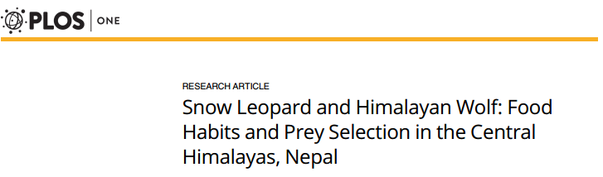
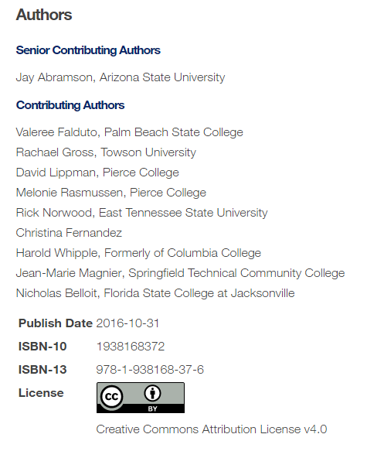
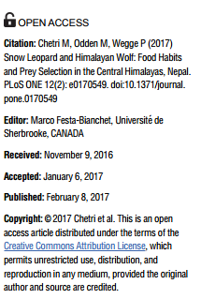
Examples of Creative Commons Licenses Uses

Slide 31
Library Licensed / Sourced Materials
Materials subscribed to and/or licensed by the UCF Libraries
May have varying terms of use (DRM free, unlimited uses, etc.)
Check with your subject librarian before you use to ensure we have a version that will be support you and your students
Can be linked to directly in Canvas
Covers ebooks, journal articles, streaming video, and other content
Cannot usually be used in the creation of an OER but can replace a traditional textbook or required readings in a course
Offers another flexible and free alternative to students and helps with TA efforts
Might be an excellent choice if you have copyrighted content that can’t be replaced by an open text (such as an OER)

Slide 32
OER & Copyright / Intellectual Property Ownership
http://regulations.ucf.edu/docs/notices/2033CopyrightsandWorksNov11FINAL_000.pdf

Slide 33
When in doubt, ask!
Image retrieved from: https://flic.kr/p/hoMcw
© Marcus Ramberg

Slide 34
Resources
UCF Office of General Counsel – Legal Issues Page
https://generalcounsel.ucf.edu/legal-issues/
UCF Libraries Copyright
General: https://library.ucf.edu/about/departments/scholarly-communication/copyright/
Policies: http://library.ucf.edu/about/policies/copyright/
Copyright Office
http://www.copyright.gov/

Slide 35
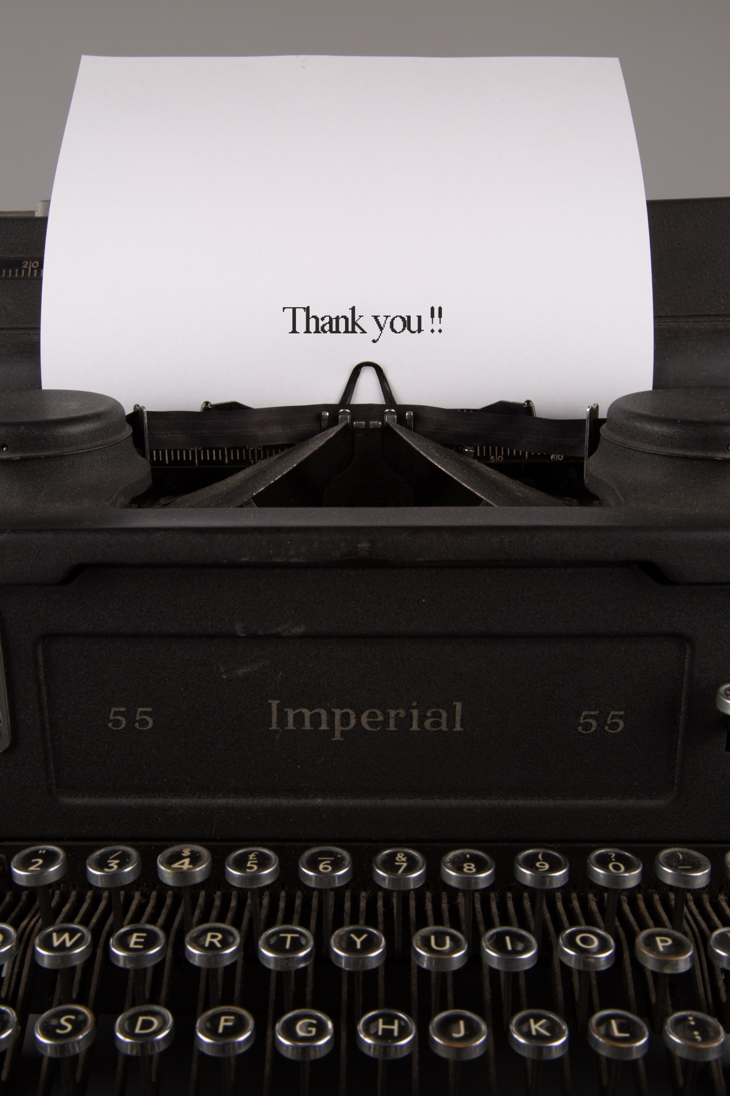
Contact Information
Sarah A. Norris
Scholarly Communication Librarian
UCF Libraries
sarah.norris@ucf.edu
UCF Libraries Office of Scholarly Communication
http://library.ucf.edu/about/departments/scholarly-communication/

