Slide 1
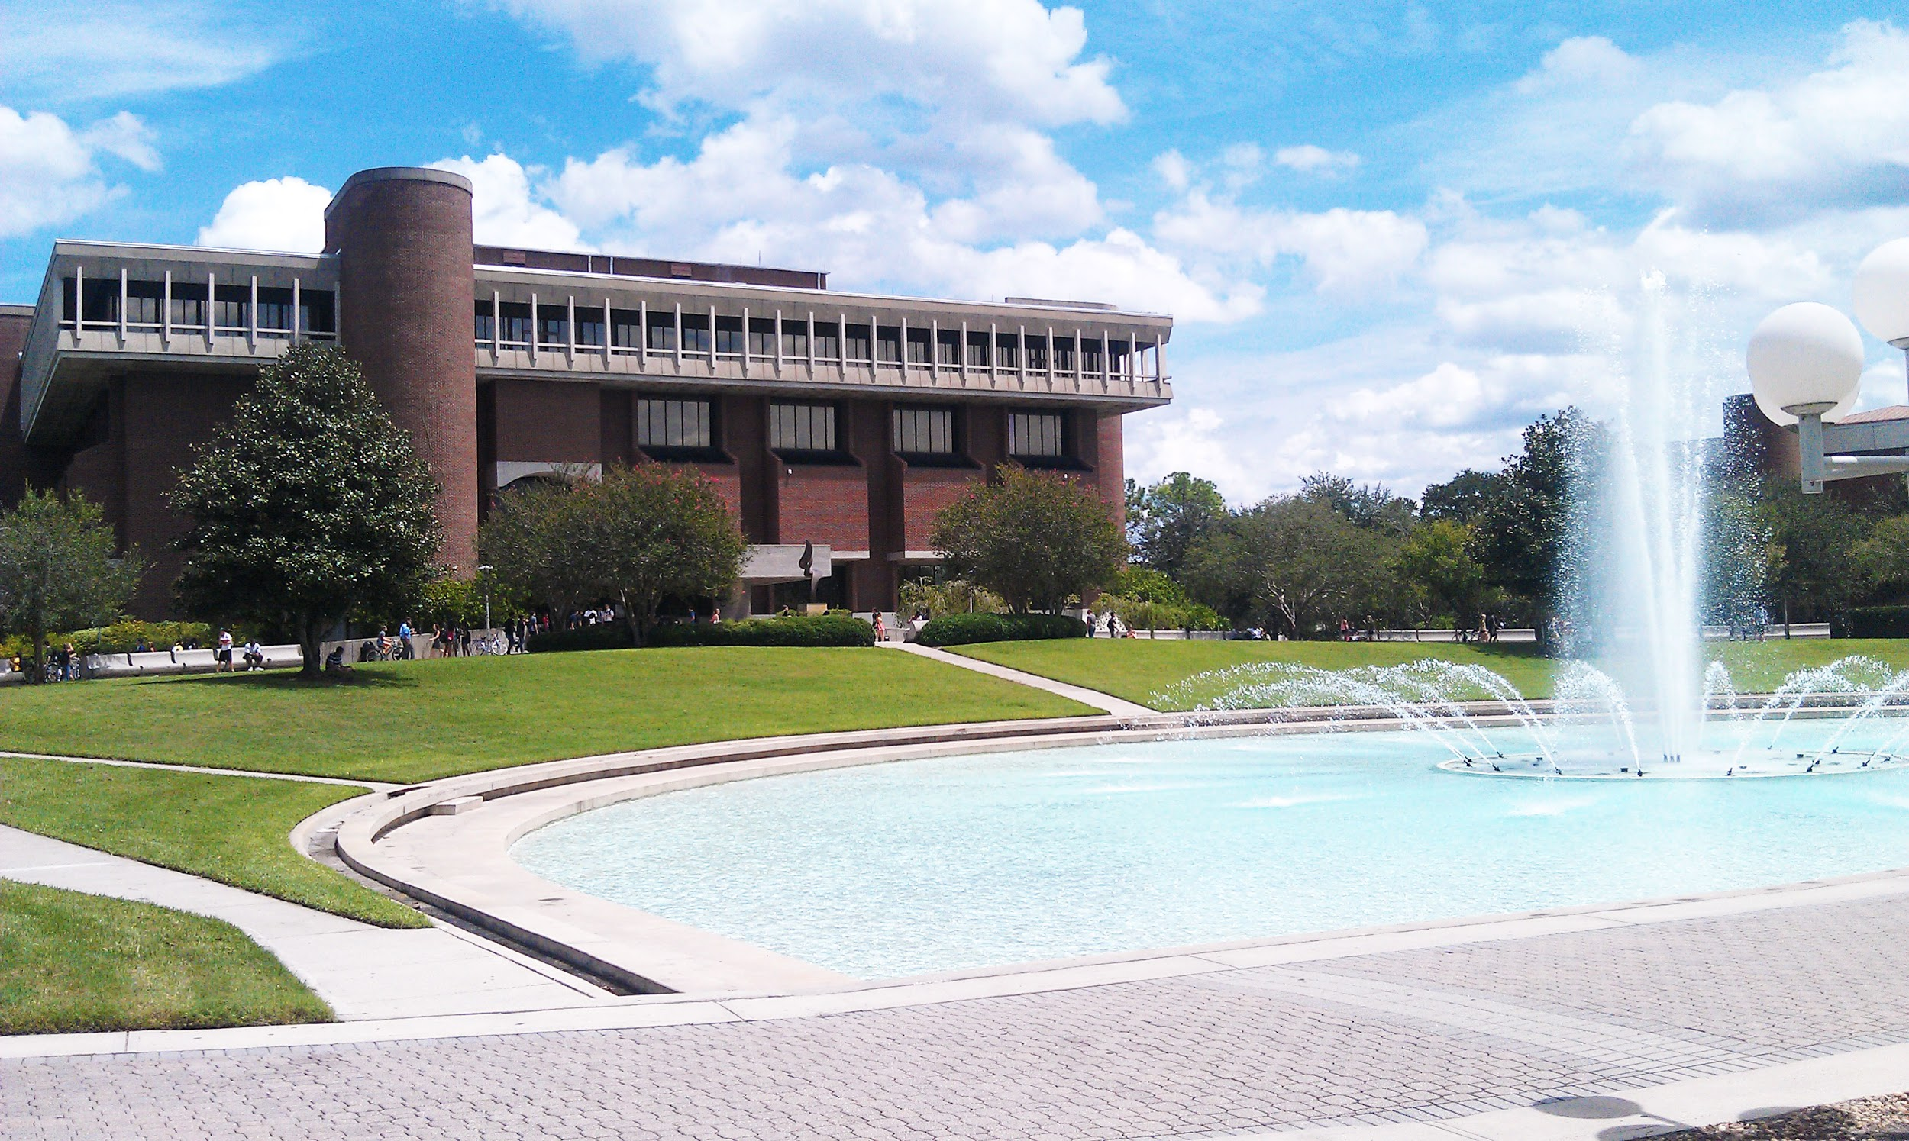
Making the UCF Libraries Part of Your Course
Sarah Norris, Barbara Tierney, Christina Wray
University of Central Florida Libraries
IDL Showcase
August 4, 2017

Slide 2
Office of Scholarly Communication

Slide 3
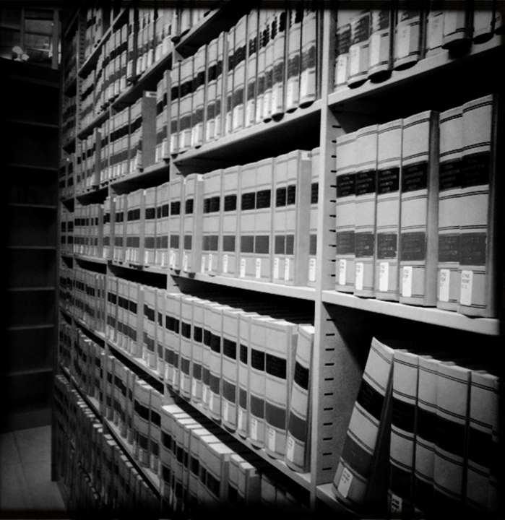
Disclaimer
UCF Libraries does not give legal advice, and any information in this presentation and/or provided by UCF Libraries is for informational purposes only.

Slide 4
Copyright & Online Courses
UCF Libraries can assist with the following:
general informational questions related to copyright & online courses
information on gaining copyright clearance for copyrighted materials
information on copyright use of library-sourced content (e.g. journal articles, streaming video)
information and/or assistance with copyright questions related to Open Educational Resources
facilitating copyright questions with UCF’s Office of General Counsel

Slide 5
General Copyright Guidelines & Online Courses
Per the UCF Office of General Counsel
Copyrighted Video Content
“Motion media of up to 10% or 3 minutes, whichever is less, in the aggregate of a copyrighted motion media work may be reproduced or otherwise incorporated.”

Slide 6
General Copyright Guidelines & Online Courses
Per the UCF Office of General Counsel
Copyrighted Photographs, Images, Charts, or Tables
“a photograph or illustration may be used in its entirety, but no more than 5 images by an artist or photographer may be reproduced or otherwise incorporated as part of an educational multimedia project. When using photographs and illustrations from a published collective work, not more than 10% or 15 images, whichever is less, may be reproduced or otherwise incorporated as part of an educational multimedia project...Up to 10% or 2500 fields or cell entries, whichever is less, from a copyrighted database or data table may be reproduced or otherwise incorporated as part of an educational multimedia project.”

Slide 7
General Copyright Guidelines & Online Courses
Per the UCF Office of General Counsel
Journal Articles
“for text material, up to 10% or 1000 words, whichever is less, in the aggregate of a copyrighted work consisting of text material may be reproduced or otherwise incorporated as part of a multimedia project. However, if the article is available through the university’s library holdings online, it would be permissible to provide the students with an online bibliography with links to these resources, making sure that on your course site you clearly indicate that the student is being taken to another site that is not part of your actual online course.”

Slide 8
General Copyright Guidelines & Online Courses
Per the UCF Office of General Counsel
Using Copyrighted Materials from Semester to Semester
“educators may use their educational multimedia projects created for educational purposes for a period of up to two years after the first instructional use with a class. Use beyond that time period requires permission for each copyrighted portion incorporated in the production. Also, educators should be reminded to credit the sources and display the copyright ownership information, which includes the copyright notice ©, year of first publication and name of the copyright holder.”

Slide 9
Copyright Resources
UCF Office of General Counsel: http://generalcounsel.ucf.edu/legal-issues/
UCF Use of Copyrighted Materials Policy: http://policies.ucf.edu/documents/2-103.2UseOfCopyrightedMaterial.pdf
UCF Libraries Copyright Policies: http://library.ucf.edu/about/policies/copyright/
UCF Libraries Office of Scholarly Communication Copyright Information: http://library.ucf.edu/about/policies/copyright/

Slide 10
Consider partnering with a Subject Librarian for your online course preparation

Slide 11
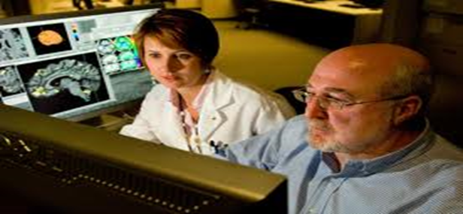
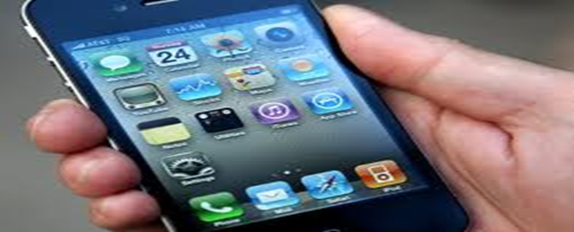
Subject Librarians consult with faculty regarding their library resource needs

Slide 12
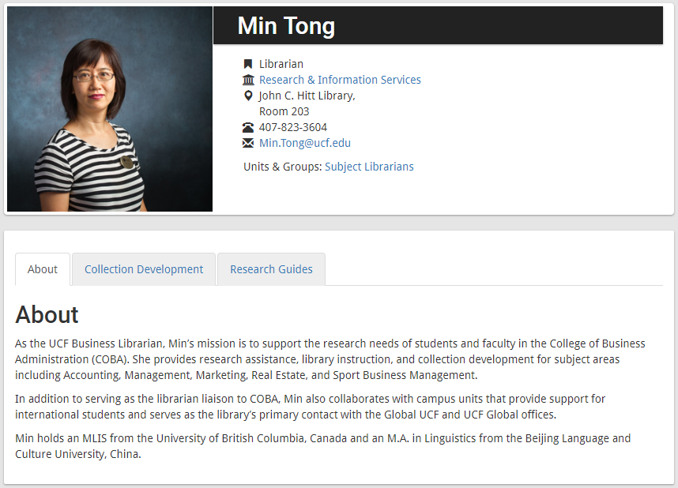
Subject Librarians are available to serve as embedded librarians

Slide 13
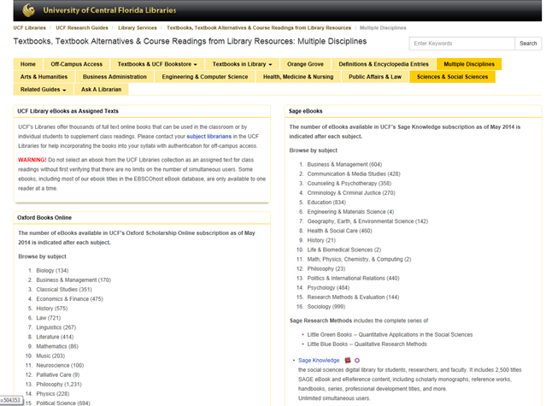
Subject Librarians assist faculty with identifying online textbook alternatives

Slide 14
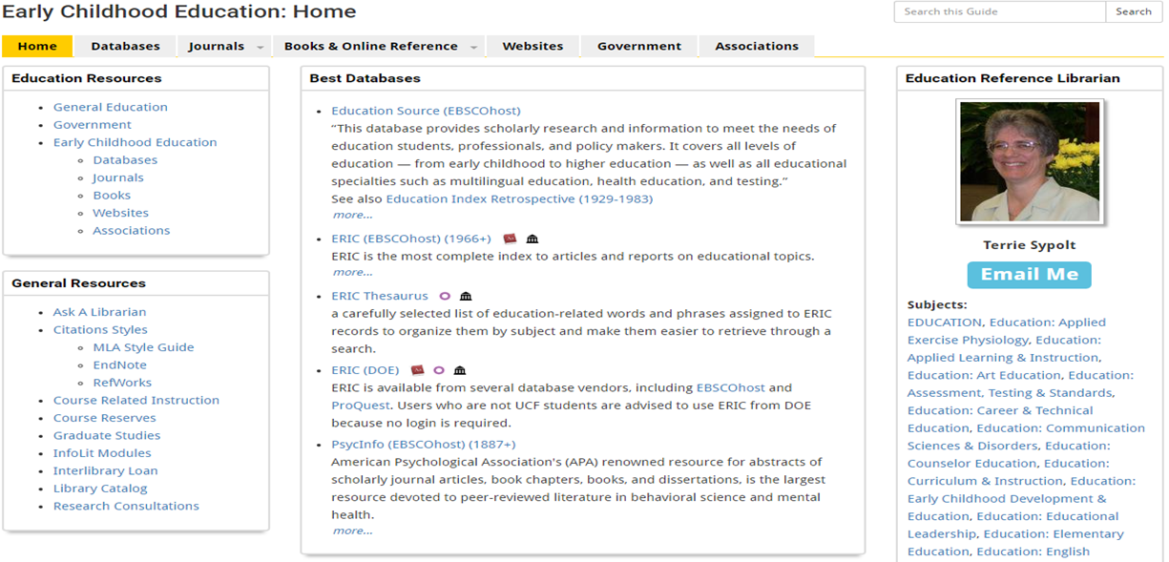
Subject Librarians provide database advice

Slide 15
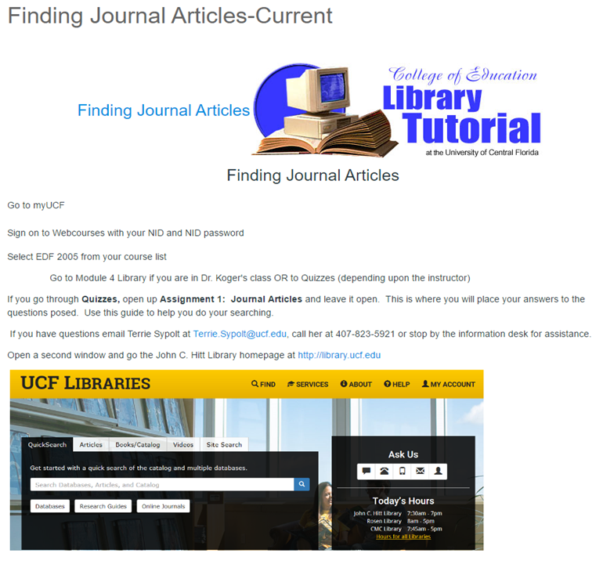
Subject Librarians Create Online Tutorials

Slide 16
Subject Librarians create short videos to assist with research

Slide 17
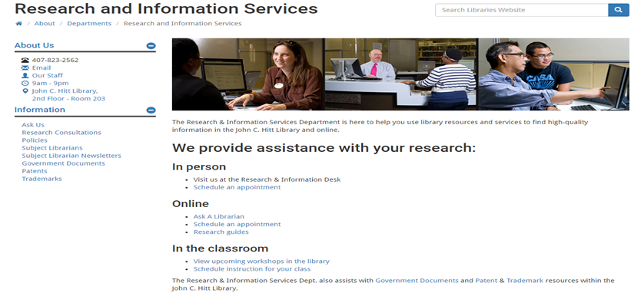
Subject Librarians are available for research consultations via email, phone, or Skype

Slide 18
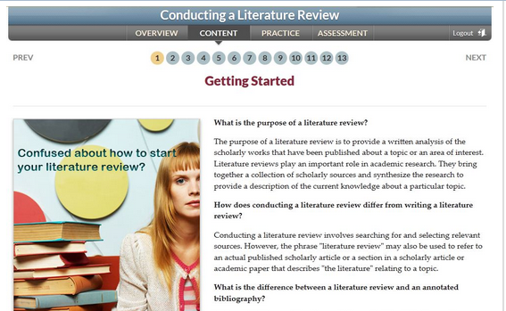
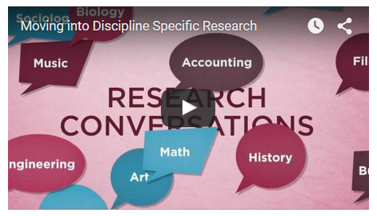
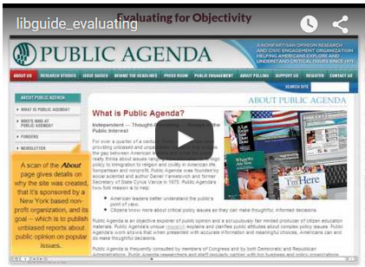
Information Literacy Modules

Slide 19
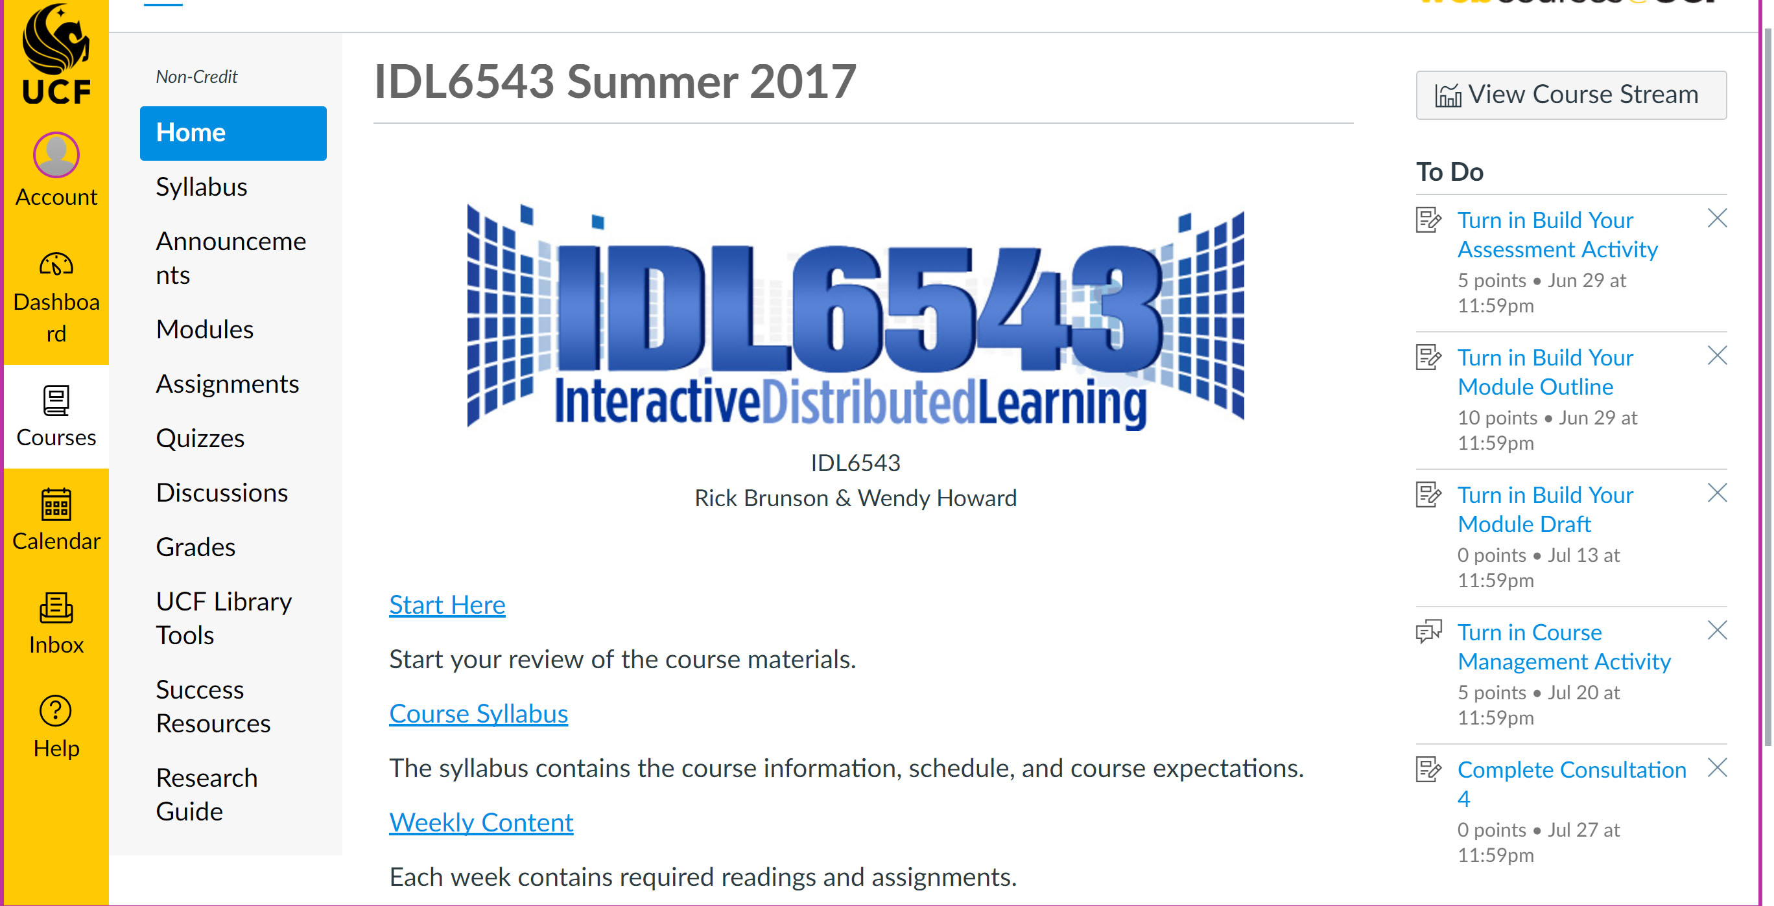
Integrated Webcourse Research Guide

Slide 20
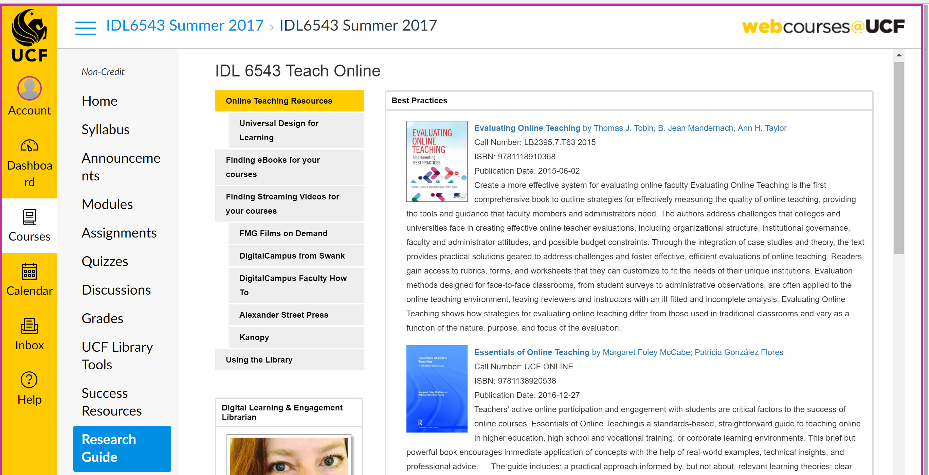
Integrated Webcourse Research Guide

Slide 21
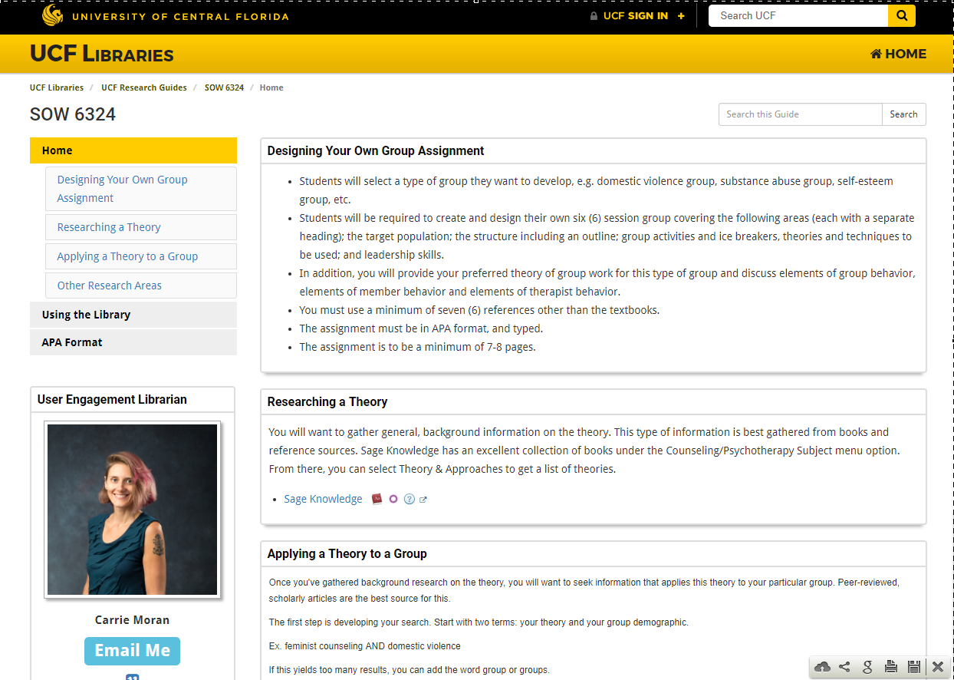
Integrated Webcourse Research Guide

Slide 22
Streaming Video
http://guides.ucf.edu/streaming
4 major platforms
Easy to embed or link
Can stream online or in class
Search across platforms on library homepage

Slide 23
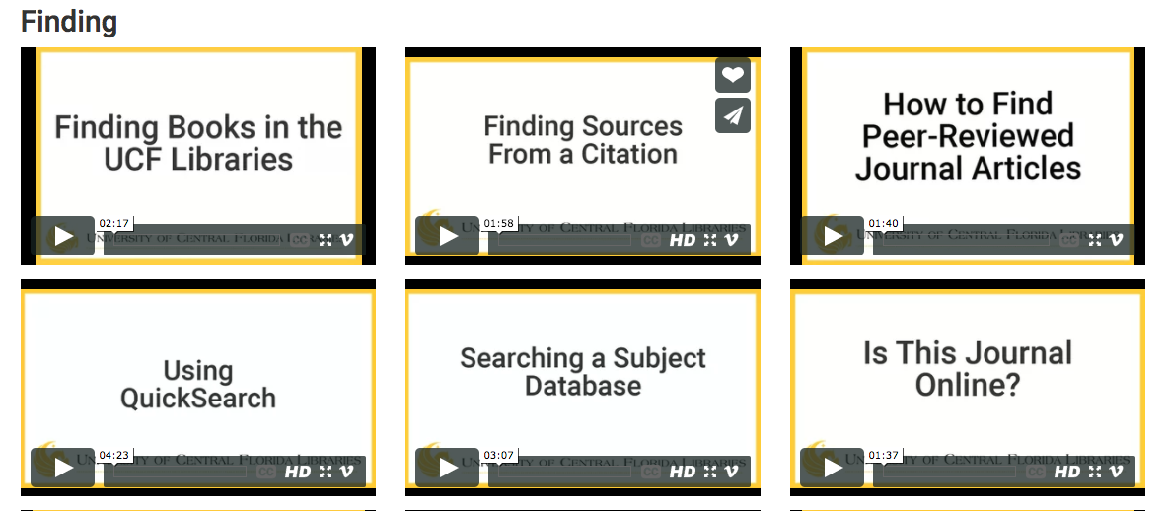
UCF Libraries Videos

Slide 24
21st Century Library Renovations

Slide 25
Questions?
Sarah Norris sarah.norris@ucf.edu
Barbara Tierney barbara.tierney@ucf.edu
Christina Wray
Christina.wray@ucf.edu
University of Central Florida Libraries

