Slide 1
Creative Commons 101
Christina C. Wray & Sarah Norris

Slide 2
Fact or Fiction?
To copyright a creative work I need to Put a copy in an envelope and mail it to myself, then leave it sealed?
Fact
Fiction
With a famous envelope by Yasuhisa Hasegawa (CC BY-NC 2.0)

Slide 3
Fact or Fiction
The Creator of an artistic work always owns their work, even after it’s been published
Fact
Fiction
Private Property by Peter Dutton (CC BY-NC-SA 2.0)

Slide 4
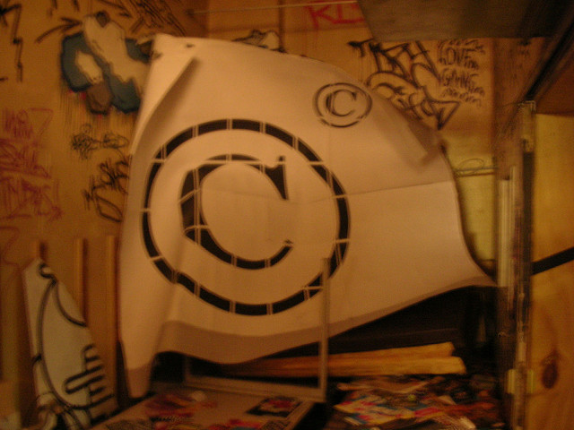
What is Copyright?
“Copyright is a form of protection provided by the laws of the United States (title 17, U.S. Code) to the authors of ‘original works of authorship,’ including literary, dramatic, musical, artistic, and certain other intellectual works. This protection is available to both published and unpublished works.” http://www.copyright.gov/circs/circ01.pdf
Copyright this by Mike Waggoneer CC BY-NC-SA 2.0

Slide 5
What Rights are Covered by Copyright?
Generally, the following are exclusive rights given to a copyright holder:
reproduce your work
distribute your work
prepare derivative works
publicly display or perform your work
authorize others to do any of the above
*The above does not necessarily apply if the creator/author has given away rights to a publisher and/or other individual or entity

Slide 6
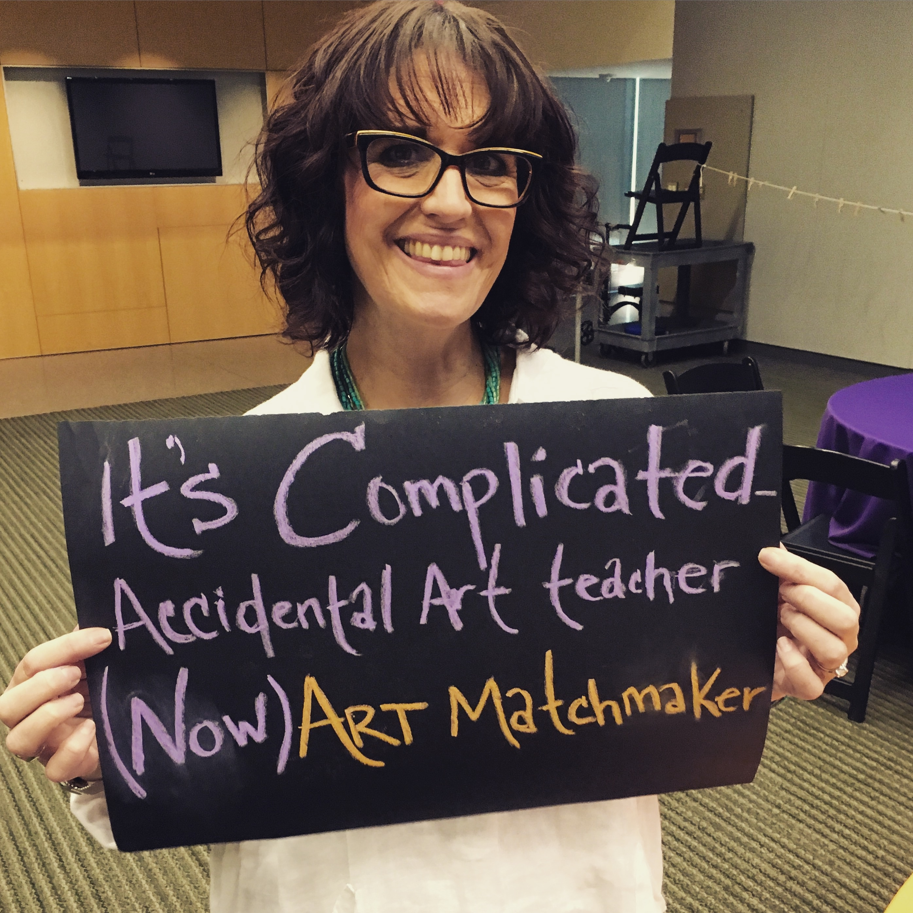
How Long Does Copyright Last?
It's complicated - Accidental Art teacher - (now) Art Matchmaker by Guerilla Haiku Movement CC BY-NC-SA 2.0
But luckily we have resources to
help!

Slide 7
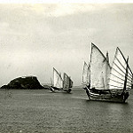
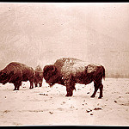
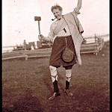
Public Domain
Freely available for anyone to use without copyright restrictions or need to cite
Why? Works might be in the public domain because…
Their intellectual property rights have expired
Their rights have been forfeited, waived, or are inapplicable
They have been donated to the public domain by the creator

Slide 8
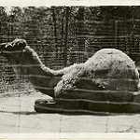
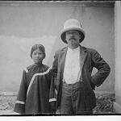
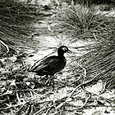
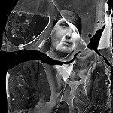
Public Domain
Freely available for anyone to use without copyright restrictions or need to cite
Why? Works might be in the public domain because…
Their intellectual property rights have expired
Their rights have been forfeited, waived, or are inapplicable
They have been donated to the public domain by the creator

Slide 9
I Create:
Photographs
Writings
Artwork
Videos
Music
Multiple formats

Slide 10
Licensing
Generally means “to give permission” https://en.wikipedia.org/wiki/License
In copyright and intellectual property, this means you are authorizing use of your copyrighted work by others (i.e. publisher, distributor, etc.)
This is often known as “use rights”
They can be exclusive or non-exclusive
Licensing a “use right” doesn’t affect your ownership of the copyright, unless you decide to license the rights away or are employed as a “work for hire”

Slide 11
Examples/Types of Licensing Use Rights
All Rights (i.e. “All Rights Reserved”)
This means the publisher retains all your copyright.
You may not sell the work again
Your only right retained is to claim authorship.
If you do sign over or sell all rights, make sure you are compensated

Slide 12
Examples/Types of Licensing Use Rights
Work for Hire
You are hired to write on behalf of a publisher
You do not retain any copyright; all works written are the intellectual property of the publisher
They do not have to include your name in the by-line
For Hire by Gwenael Plaser CC BY-NC-SA 2.0

Slide 13
Examples/Types of Licensing Use Rights
First Rights
Publisher has the right to “first use” (i.e. the first form of the work)
Important to be specific about what you mean (i.e. first international rights, etc.)
One by Alan Bates CC BY-NC-SA 2.0

Slide 14
Creative Commons Licenses
What is a Creative Commons License?
Creative Commons “provides a simple, standardized way to give the public permission to share and use your creative work — on conditions of your choice. CC licenses let you easily change your copyright terms from the default of ‘all rights reserved’ to ‘some rights reserved.’ (https://creativecommons.org/about/)
Creative Commons licenses “are not an alternative to copyright. They work alongside copyright and enable you to modify your copyright terms to best suit your needs.” (https://creativecommons.org/about/)
https://creativecommons.org/choose/

Slide 15
Where do you post your work?

Slide 16
Writing
Can I say my blog or website is copyrighted?
The short answer is yes.
Blogs/websites can be considered copyrightable literary works (as long as they contain some of your own expression and not merely expression copied from others)
You can add a copyright notice and/or symbol for any blog that is your own intellectual property
Filing for copyright for a blog/website is possible, but slightly tricky due to the constant updating/changing of content. See Copyright Registration for Websites and Website Content: https://www.copyright.gov/circs/circ66.pdf

Slide 17
Writing
Things you can do to protect your blog/website:
Add a copyright statement on all pages of your site
Watermark or add a copyright statement to any images you create for your blog (as long as you own the copyright of the images)
Create a permission page on your blog or site
Add a creative commons license to any content to make it clear to users what they can and can’t do with your content (i.e. add a CC-BY to your site or other types of licenses, depending on how open you want to make it)
Check any linkbacks or pings on your blog or site to make sure your content isn’t being taken without permission

Slide 18
Photography/Artwork
What do I need to know before I post my images online?
Are you licensing your work to the website?
Can you explicitly state the copyright and licensing status attached to your images?
Do you have the ability to change the permissions for individual images?

Slide 19
Music
What is your ultimate goal when posting your music online?
Do you perform cover songs?
Are you signed to a record label?
Do you want to make a little cash?

Slide 20
Videos
How do you want to license your content?
Do you plan to use a Creative Commons License?
Do you want to monetize your content?
Are you using other media in your videos such as music or images?

Slide 21
Have more questions?
Contact the office of scholarly communications
Sarah.Norris@ucf.edu

