Slide 1
Where to Publish & Author Rights
At a Glance
Sarah A. Norris, Scholarly Communication Librarian,
University of Central Florida Libraries

Slide 2
If you remember one thing from this presentation…

Slide 3
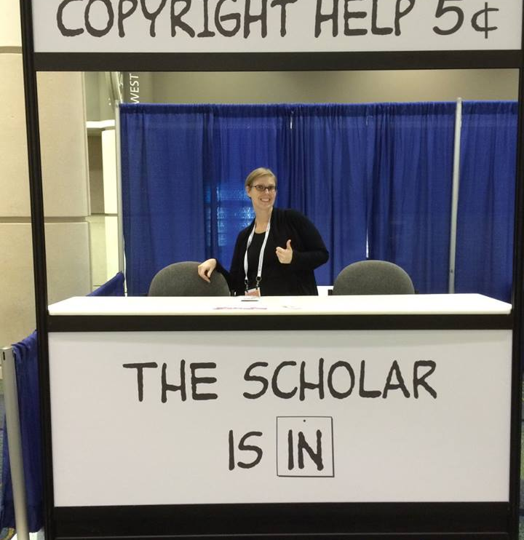
Contact the Library. We can help!

Slide 4
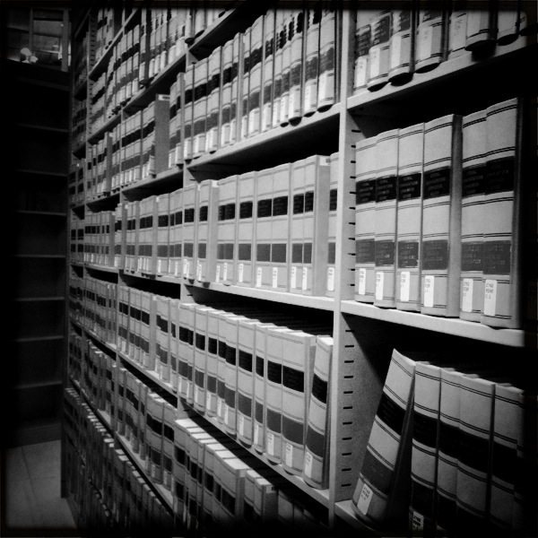
Disclaimer
UCF Libraries does not give legal advice, and any information in this presentation is for informational purposes only.

Slide 5
Why do you want to publish?

Slide 6
“I want to get a faculty teaching position.”
“Tell everyone I know about the research I did / found.”
“Try to get my research paper published in a journal.”
“Present my research findings at a conference.”

Slide 7
Why Publish Your Academic Research?
Publishing work gives you, the student, an opportunity to refine, polish, and build on your work beyond what is required for your classes. Being published can also give you a significant advantage as you progress in your academic career
Starting early in publication is good practice for those moving towards advanced degrees and even teaching
Gives you experience synthesizing content, summarizing, etc. which can be useful in post-academic jobs (i.e. writing technical reports, creating presentations, etc.)

Slide 8
Types of Publishing
Traditional Scholarly Publishing
Open Access Publishing
Institutional Repositories
Alternative Publishing

Slide 9
Traditional Publishing

Slide 10
Traditional Publishing
Can be in the following types of publication:
Journals
Magazines
Books
And, in most cases, you sign an agreement that you give away your copyright to the publisher, or, you license your work to them for royalties and/or other monetary compensation.

Slide 11
Open Access

Slide 12
What is Open Access?
“Open-access (OA) literature is digital, online, free of charge, and free of most copyright and licensing restrictions.” (http://legacy.earlham.edu/~peters/fos/overview.htm)
Removes price barriers (subscriptions, licensing fees, pay-per-view fees)
Removes permission barriers (most copyright and licensing restrictions)
As an author, you can choose to publish your work in open access journals and books (or publish your materials online freely available)
*Note: Some journals do ask authors to pay what is known as an “article processing charge (APC)” in order to publish an article or book open access
UCF does not currently provide funds to help off-set these costs
Sometimes students and/or those with financial circumstances can publish in open access journals without having to pay (it depends)

Slide 13
Where To Find Open Access Journals & Information?
DOAJ (browse by subject)
http://doaj.org
Beall’s list of predatory publishers
http://beallslist.weebly.com/
Open Access Scholarly Publisher’s Association (OASPA)
http://oaspa.org/

Slide 14
Institutional Repositories

Slide 15
Institutional Repositories
Way to host materials created by, for, or about an institution
UCF has an institutional repository called, STARS
Students put their theses, dissertations, and other materials in it
Materials are put in STARS are usually associated with a course or degree related project
Visit: http://stars.library.ucf.edu/ for more info

Slide 16
Alternative Publishing

Slide 17
Alternative Publishing
University Presses (not just for books but also for journals)
University Press of Florida (http://www.upf.com/)
Scientific Societies
e.g. American Chemical Society (ACS) http://pubs.acs.org/
Departmental Hosting
Institutional Repositories
e.g. STARS http://stars.library.ucf.edu/
Self Publishing
e.g. Amazon, CreateSpace, etc.

Slide 18
Before Publishing…

Slide 19
Before Thinking About Where to Publish…
Take a look at the work you’re interested in publishing
What’s the significance of your work?
To you, to your discipline, to UCF, to career goals, to outside community?
What are some of the outcomes of your work?
Data, surveys, short stories, etc.
Talk to your academic advisor!
Great resource to discuss your work and possible avenues for publication

Slide 20
Let’s Look at Journal Selection/Criteria a Bit Closer…
What are your goals for publication?
Make your work more visible?
Gain recognition? (graduate school, Ph.D., non-academic)
Discipline-specific? Genre specific?
Format? (book, journal, blog post, etc.)

Slide 21
Criteria to Consider for Publication
Do you have academic expectations?
What recommendations or trends does your UCF department or college have for publication?
Are there particular journals (aka “core journal list”) that your department or college recommends?
Are there department or college local publication venues? (i.e. newsletters, blog, etc.)
Do faculty in your department or college have opportunities for co-publishing with them? (or co-presenting)

Slide 22
Criteria to Consider for Publication
Things you can do to find out more about publishing in your discipline
Talk to your department chair and promotion committee, find faculty mentors
Check current promotion & tenure guidelines of the department or college
Review department or college annual reports or search databases to see where other faculty have published

Slide 23
Criteria to Consider for Publication
Who is your audience?
Scholar focused? Practitioner focused? Non-academic?
Determining audience is important in journal (and other) publication selection!
Take recommendations from your advisor, department/college, and desired audience to help narrow down ideal sources of publication
Conduct searches in these journals to see if their content focus matches your research
If considering conferences (posters, conference proceedings), look at recommended conferences and opportunities

Slide 24
Things to Consider When Looking at Journal Selection
What is the journal’s prestige and reputation?
Who’s on the editorial board
Is it indexed anywhere? (i.e. can you find it in library databases?)
Is it peer reviewed?
What is it impact factor?
Is it well-known in your discipline or area of work?
What are the acceptance rates? (i.e. is it really hard to get accepted or too easy?)
How widely is it circulated (print, online, open access or subscription-based)?
Has it been around for a long time?
Does it have UCF affiliation?
Is it open access (is there an APC involved in publication)?

Slide 25
Things to Consider When Looking at Journal Selection
Where can you find information about journal prestige and reputation?
Publisher web site
Journal directories (e.g. Ulrich’s, Cabell’s)
Google Scholar
Disciplinary sites
Web of Science, Journal Citation Reports, Harzing’s, SCImago, etc. (these sites all deal with impact factor and other criteria)

Slide 26
Let’s Look at Theses & Dissertations…
Did you know? Theses & dissertations are considered published once submitted to a library institutional repository (like STARS) or bound and printed and housed in a library and/or department
You can publish theses & dissertations beyond the institutional copy of record (and databases like ProQuest)
They can be published in journals and books
Look for publication policies for publishers and determine if prior availability of your thesis or dissertation in STARS would negatively affect publication
Consider the publisher (i.e. vanity press, predatory publishers)
Remember your rights as an author

Slide 27
Final Thoughts on Publishing…
There are many options for publishing, no matter where you are in your academic career
Connecting with advisors, librarians, and other units on campus can be a great benefit when considering to publish
Use criteria suggestions here to do some research before deciding where to publish
Have reasonable expectations no matter where or how you look to publish
Keep an eye out for opportunities, as well as potential challenges of publication

Slide 28
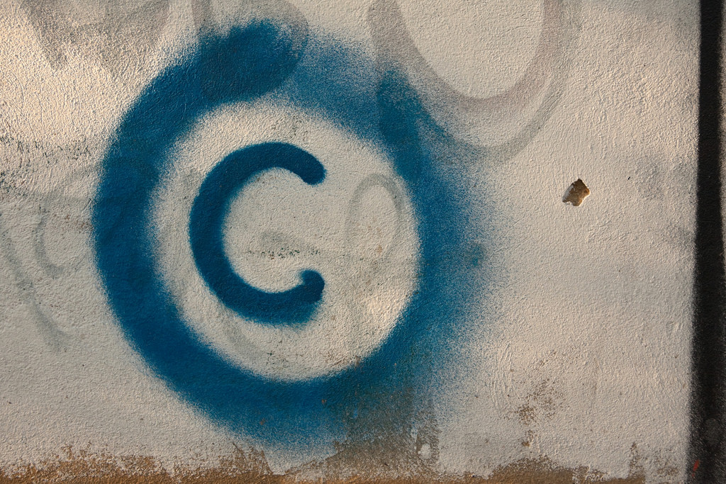
Photo Credit: Horia Varlan, CC By 2.0

Slide 29
What is Copyright?
“Copyright is a form of protection provided by the laws of the United States (title 17, U.S. Code) to the authors of ‘original works of authorship,’ including literary, dramatic, musical, artistic, and certain other intellectual works. This protection is available to both published and unpublished works.”
http://www.copyright.gov/circs/circ01.pdf

Slide 30
What Rights are Covered by Copyright?
Generally, the following are exclusive rights given to a copyright holder:
reproduce your work
distribute your work
prepare derivative works
publicly display or perform your work
authorize others to do any of the above
*The above does not necessarily apply if the creator/author has given away rights to a publisher and/or other individual or entity

Slide 31
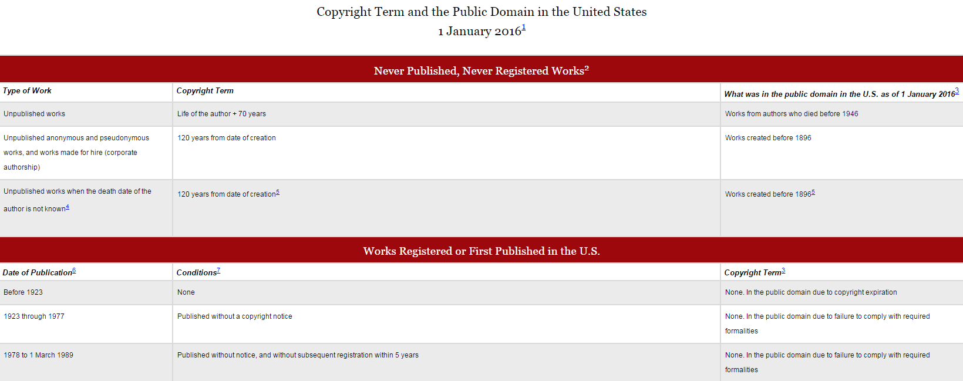
How Long Does Copyright Last?
© 2004-2016 Peter B. Hirtle. Last updated 3 January, 2016, Retrieved from: http://copyright.cornell.edu/resources/publicdomain.cfm

Slide 32
What is Licensing?
Generally means “to give permission”
https://en.wikipedia.org/wiki/License
In copyright and intellectual property, this means you are authorizing use of your copyrighted work by others (i.e. publisher, distributor, etc.)
This is often known as “use rights”
They can be exclusive or non-exclusive
Licensing a “use right” doesn’t affect your ownership of the copyright, unless you decide to license the rights away or are employed as a “work for hire”

Slide 33
Examples of Licensing Use Rights
All Rights (i.e. “All Rights Reserved”)
This means the publisher retains all your copyright.
You may not sell the work again
Your only right retained is to claim authorship.
If you do sign over or sell all rights, make sure you are compensated
Work for Hire
You are hired to write on behalf of a publisher
You do not retain any copyright; all works written are the intellectual property of the publisher
They do not have to include your name in the by-line
First Rights
Publisher has the right to “first use” (i.e. the first form of the work)
Important to be specific about what you mean (i.e. first international rights, etc.)

Slide 34
Creative Commons Licenses
What is a Creative Commons License?
Creative Commons “provides a simple, standardized way to give the public permission to share and use your creative work — on conditions of your choice. CC licenses let you easily change your copyright terms from the default of ‘all rights reserved’ to ‘some rights reserved.’ (https://creativecommons.org/about/)
Creative Commons licenses “are not an alternative to copyright. They work alongside copyright and enable you to modify your copyright terms to best suit your needs.” (https://creativecommons.org/about/)
https://creativecommons.org/choose/

Slide 35
Publishing Agreements Example

Slide 36
http://www.sherpa.ac.uk/romeo/index.php

Slide 37
Your Work Belongs to…Until You Give It Away
As soon as your work is in a tangible form (a Word document, a web site, a recording), the copyright is yours. You own the right to:
reproduce your work
distribute your work
prepare derivative works
publicly display or perform your work
authorize others to do any of the above
You can give away or sell any or all of your rights. Giving up your rights may limit access to and impact of your work.

Slide 38
Important points to consider
Publication agreements are a bundle of rights
Read your agreement!!
Know that you can try to negotiate to retain some rights
Reuse charts and graphs or reproduce the work
Give copies to your colleagues or students
Post on a website (Academia.edu or ResearchGate) or repository
SPARC Author Addendum http://www.sparc.arl.org/resources/authors/addendum
Check SHERPA/RoMEO for publisher copyright policies http://www.sherpa.ac.uk/romeo/PDFandIR.html

Slide 39
Photo Credit: Marcus Ramberg, CC BY-NC 2.0, https://flic.kr/p/hoMcw

Slide 40
Contact Information
Sarah A. Norris
Scholarly Communication Librarian
sarah.norris@ucf.edu
UCF Libraries Office of Scholarly Communication
http://library.ucf.edu/about/departments/scholarly-communication/

