Slide 1
Rebellions are Built on Hope:
Joining Forces to Support OER in a Restrictive Institutional Environment
Aimee deNoyelles & John Raible
Sarah Norris, Rich Gause, & Penny Beile
University of Central Florida
Notes:
3:00-3:55

Slide 2
The path to OER...

Slide 3
Agenda
Define the context of our restrictive environment
Describe the partnership formed to promote no-cost textbook solutions
Share faculty case studies
Solicit recommendations for institutional change

Slide 4
Restrictive
Environment

Slide 5
What’s Your Institutional Environment?
Are you a part of the Rebel Alliance?
Or, are you a part of the First Order?

Slide 6
A long time ago, in a university far, far away...

Slide 7
Our Bookstore Contract
Barnes & Noble is the exclusive seller of instructional resources - text and digital
Our current efforts have been focused on free materials (OER and library-sourced)
B&N owns our booklist
Few people at the institution have access to it
B&N contract expires this year

Slide 8
State Factors: Florida
FL Textbook Affordability Law 1004.085
Faculty are required to submit textbook orders earlier
Faculty are encouraged to review content changes in editions
Faculty are encouraged to adopt OER content
Broadens TA efforts to include “instructional materials”
Requires universities to submit TA reporting to the state
2025 Strategic Plan for Online Education

Slide 9
Partnership
Photo CC BY-2.0 / JD Hancock / Flickr

Slide 10
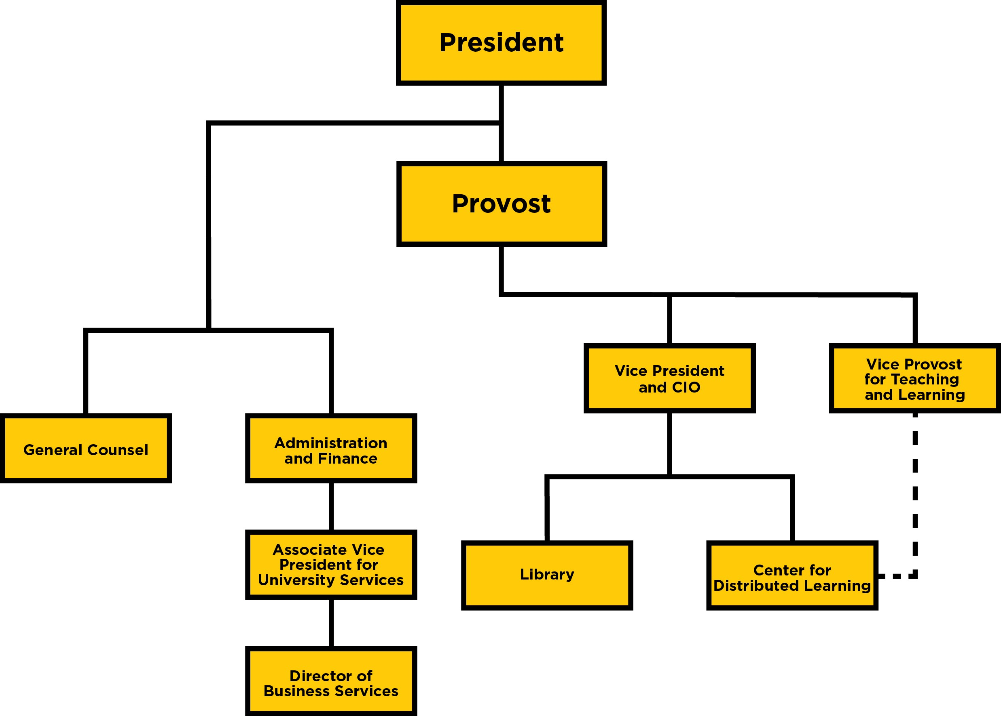
Our Organizational Structure

Slide 11
Case Studies
Photo CC BY-2.0 / JD Hancock / Flickr

Slide 12
Three Ways to Thrive in a Restrictive Environment
Determine if present materials are openly accessible through other avenues
Adopt an open book to replace textbook
Offer a library-sourced item as replacement for existing textbook

Slide 13
Determine if Present Materials are Available through other Avenues
Example: Christian Beck, College of Arts and Humanities
Course: ENL2012, English Literature I
Enrollment:
Summer 2016 (38) + Fall 2016 (76) = 114
Spring 2017: 76
Fall 2017: 76
Additional section of same course by another faculty: 38
Potential Savings: 341 students X 70 dollars: $23,870

Slide 14
Adopt an Open Textbook
Example: Jim Clark, College of Arts and Humanities
Course: AML2020, American History 1877-Present
Enrollment:
Summer 2016 (23) + Fall 2016 (264)
Spring 2017 (184) + Summer 2017 (52) + Fall 2017 (224)
Additional section of same course by another faculty = 214
Potential Savings: 961 students X 80 dollars = $84,293

Slide 15
Offer a Library-Sourced Item as Replacement for Existing Textbook
Example: Michael Loree, College of Sciences
Course: SYO4400, Medical Sociology
Enrollment:
Spring 2017: 100 and Summer 2017: 125
Potential Savings: 225 X 120 = $27,000
Cumulative result of three models: 4 faculty teaching 12 sections have saved 1276 students $108,040

Slide 16
Offer a Library-Sourced Item as Replacement for Existing Textbook
Example: Michael Loree, College of Sciences
Course: SYO4400, Medical Sociology
Enrollment:
Spring 2017: 100 and Summer 2017: 125
Potential Savings: 225 X 120 = $27,000
Textbook list project fall 2017 semester: add’l 18 faculty teaching 24 sections have saved 715 students $47,226 (+ spinoff projects)!

Slide 17
Institutional Change
Institutional Change
Photo CC BY-2.0 / JD Hancock / Flickr

Slide 18
Recommendations for Institutional Change
Frame OER as an IE metric for performance-based funding
Seek Provost’s involvement and support
Propose a Faculty Senate Resolution
Create forward-facing website
Participate in GEP redesign
Launch print textbook reserve collection
Develop incentive program for faculty to adopt OER
Advocate for dedicated TA staff (resources & support)
Join Open Textbook Network & OpenStax Inst’l Partner Program

Slide 19
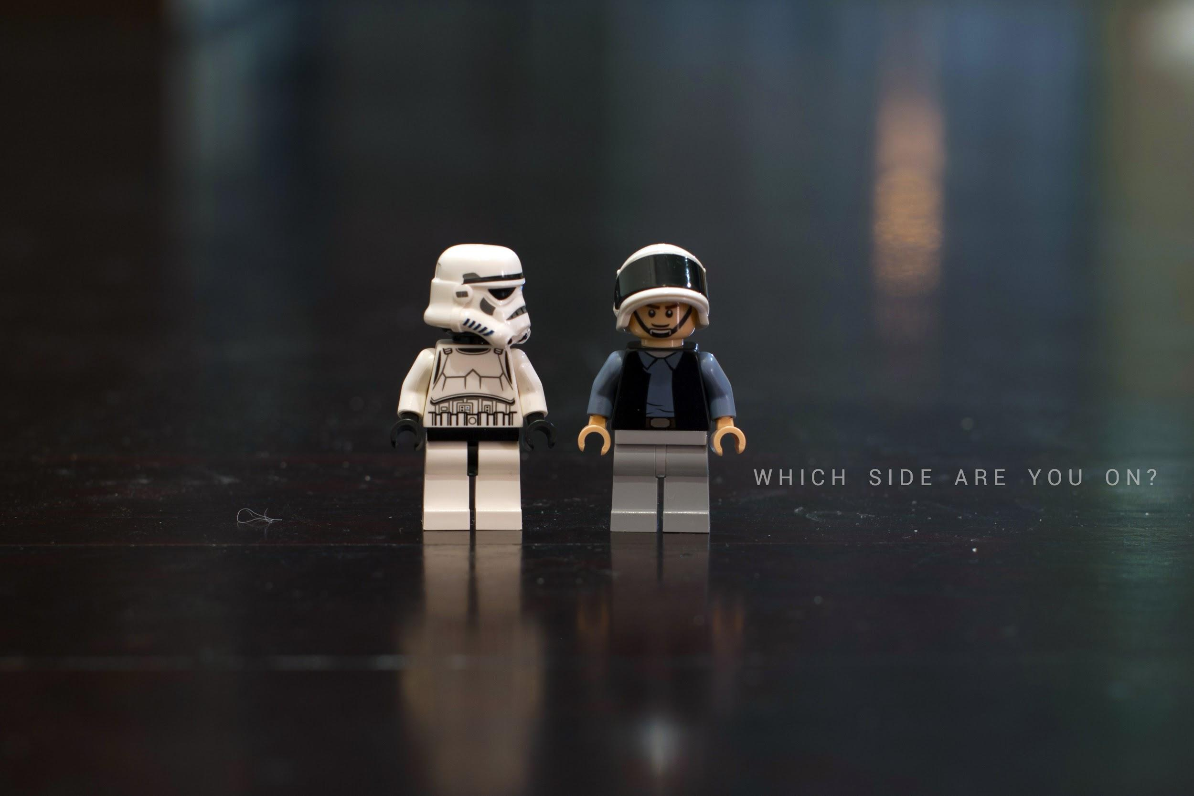
Photo CC BY-2.0 / Kevin Poh / Flickr

Slide 20
Contact
Librarians
Sarah Norris: sarah.norris@ucf.edu
Rich Gause: richg@ucf.edu
Penny Beile: pbeile@ucf.edu
Instructional Designers
Aimee deNoyelles: aimee@ucf.edu
John Raible: john.raible@ucf.edu

