Slide 1
Extending and Measuring Scholarly Reach and Impact
Sarah A. Norris, UCF Libraries; Lee Dotson, UCF Libraries;
Barry Mauer, English Department

Slide 2
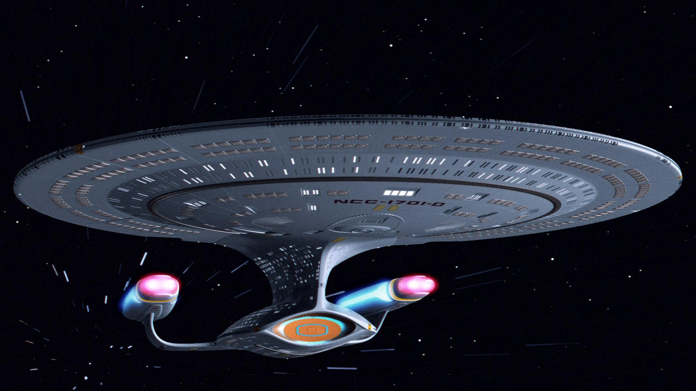
Metrics...The Final Frontier?
CC BY-SA 4.0 / https://commons.wikimedia.org/wiki/File:U.S.S._Enterprise_NCC_1701-D.jpg

Slide 3
Exploring New Ways of Extending and Measuring Scholarly Research and the Impact of Your Work...

Slide 4
Online Faculty Profiles
Academia.edu
Google Scholar
ResearchGate
SelectedWorks
“researcher profiles”
“academic profiles”
“social networking for academics”
“platform for sharing your works”

Slide 5
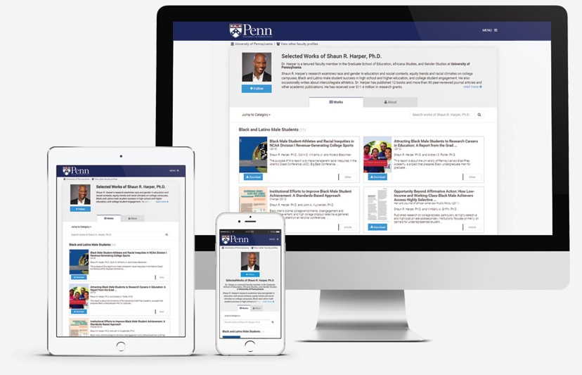
What’s Included?
Bios
Display of works
Connections with others
Feedback on draft works
Statistics

Slide 6
Why Use an Online Faculty Profile?
Analytics
Readership
Citations
Downloads
Impact factors
Site Specific Scores
Share and Discover
Get Feedback
Increase Citations/Impact
Online Presence
Online CV

Slide 7
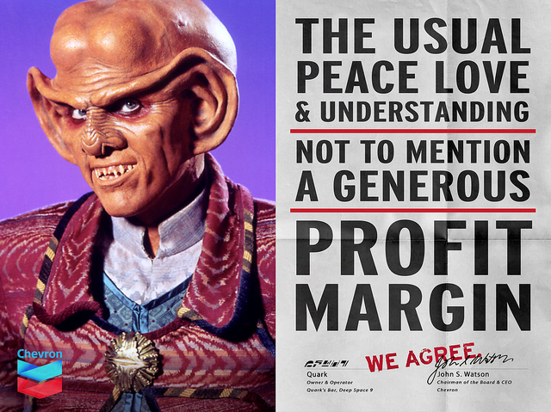
Things to Consider
Commercial
ResearchGate
Academia.edu
Pay for premium
Academia Premium
More analytics
CC BY-SA 2.0 / Jonathan McIntosh / https://www.flickr.com/photos/jonathanmcintosh/5123868679

Slide 8
Which online faculty profile do I use?
What are your goals for creating an online faculty profile?
Organize research content?
Way to increase access / impact of your work?
Connect with other researchers?
Do you want something that has more or less institutional affiliation?
Do you want to create multiple accounts and maintain them?
Depends on your goals re: increased access / impact of your work
Do you have non-traditional research content (e.g. presentations, classes, workshops, media, etc.)?

Slide 9
Pros and Cons

Slide 10
ResearchGate
Pros
Ability to share publications
Connecting with colleagues
Seeking new collaborations
Obtaining statistics / metrics on uploaded publications (stats/metrics vary)
Job seeking / recruitment opportunities
Incorporates elements of social media sites (e.g. profiles, skill endorsements, commenting, bookmarking, etc.)
Content indexed by Google
Has RG Score as another form of measuring impact
Has some flexibility for various types of content
Ability to create tags and other helpful metadata (with some limitations)
*Pros and cons listed in this presentation are not comprehensive and may vary on your particular research and online faculty profile needs.

Slide 11
ResearchGate
Cons
Commercial online faculty profile site
May charge for in future for services (e.g. metrics)
Licensing can restrict your ability to remove content or get your data from RG once you upload
May create profiles on potential user behalf
May send out spam invitations and/or requests
Technical challenges
Inability to link to full text and/or digital object in some cases (e.g. presentations); digital object MUST be uploaded directly to RG
Has some inflexibility on certain types of content (i.e. middle of the road for researchers who produce various types of content)
No ability for customization (i.e. no categories)
ResearchGate Score
May present some challenges, and should be used in combination with other metrics

Slide 12
Academia.edu
Pros
Ability to share publications
Connecting with colleagues
Seeking new collaborations
Obtaining statistics / metrics on uploaded publications (stats/metrics vary)
Job seeking / recruitment opportunities
Gain feedback on draft works (this is very popular)
Incorporates elements of social media sites (e.g. profiles, skill endorsements, commenting, bookmarking, etc.)
Content indexed by Google
Has basic and advanced metrics in place
Allows you to create metadata only / citation records and/or link to external sources (in some cases) Ability to create tags and other helpful metadata (with some limitations)

Slide 13
Academia.edu
Cons
Commercial online faculty profile site
Charging for certain services (e.g. metrics)
$99 per year or $9.99 a month for access to: Advanced Search, Reader Impact Report, Expanded Analytics
Licensing can restrict your ability to remove content or get your data from Academia.edu once you upload
May send out spam invitations and/or requests (e.g. email noting compensation)
May or may not upload content (correct and/or incorrect) on your behalf Technical challenges
Inflexible on certain types of content (i.e. very good for traditional researchers, not as good for those creating various types of content)
No ability for customization (i.e. no categories)

Slide 14
SelectedWorks
Pros
Non-Commercial
Ability to share publications
Connecting with colleagues
Seeking new collaborations
Obtaining statistics / metrics on uploaded publications with robust Author Dashboard (stats/metrics vary)
Incorporates basic elements of social media sites (e.g. profiles, bookmarking, etc.)
Content indexed by Google
Has institutional branding and institution may provide assistance if requested
Branding will be removed and/or change if you move institutional affiliation (i.e. you don’t lose your account if you are no longer at UCF)
Can import content from STARS (i.e. UCF’s IR) into SW
Has excellent flexibility for various types of content
Can create custom labels and categories
Ability to create tags and other helpful metadata (with some limitations)

Slide 15
SelectedWorks
Cons
Technical challenges
Not easy to search for colleagues affiliated and/or not affiliated with institution (browse feature for UCF)
Not mediated like STARS (may be confusing to some users; researcher is responsible for copyright compliance or may contact UCF Libraries for ad hoc assistance)
No ability to submit drafts and/or receive feedback from colleagues
More static, less collaborative
Incorporates less social media aspects (i.e. commenting, endorsing, etc.)

Slide 16
CC BY 2.0 / BagoGames / https://www.flickr.com/photos/bagogames/26939379566
Copyright...and Beyond

Slide 17
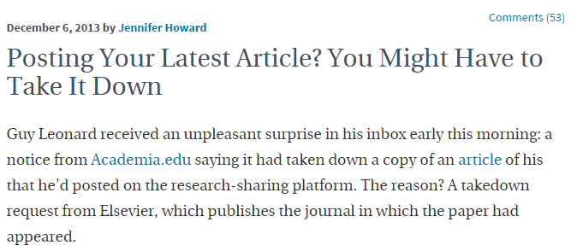
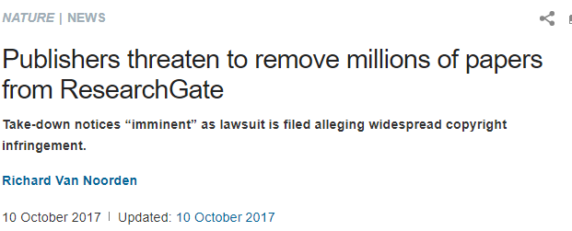

Slide 18
Important Copyright Considerations
Copyright is often transferred to the publisher upon publication
Transfer of copyright of your work to a publisher means you are no longer the copyright holder of the work
Copyright impacts what you can and cannot do with the published work
The author may lose the right to…
Share it with colleagues or students
Post it publicly to online faculty profiles, social media, etc. (this can include different versions of publication)
And others
Always double-check to ensure the version of your scholarship being shared is the legally acceptable version

Slide 19
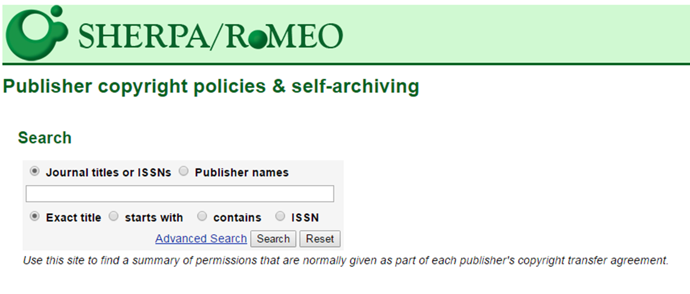
http://www.sherpa.ac.uk/romeo/index.php

Slide 20
Versions of Scholarship
Pre-print: The first draft you submitted to a publisher.
Post-print: The final manuscript you submitted to the publisher after making revisions from the peer review process; a post-print hasn’t been printed or designed or even copy-edited yet -- usually a Word document.
Publisher’s Version/PDF: A scan or page export from the printed or online journal.
Link to publisher’s website: Takes a reader to the original publication. Has some drawbacks: Sometimes, a reader must have a subscription or purchase the publication. And, it doesn't count as a full-text download. However, still provides access to work.

Slide 21
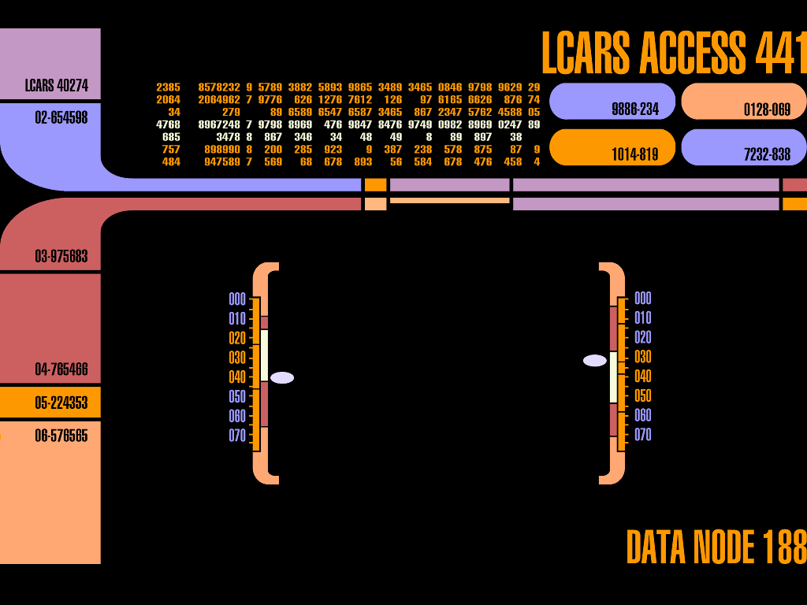
Institutional Repositories

Slide 22
Institutional Repositories
Collection of works by, for, or about an institution
Includes a variety of content (data, scholarship, projects, etc.)
Provides access to these works, as broadly and openly as possible, for as long as possible (i.e. Open Access)
Removes permissions and paywall barriers
Increases the visibility and potential impact of scholarly research

Slide 23
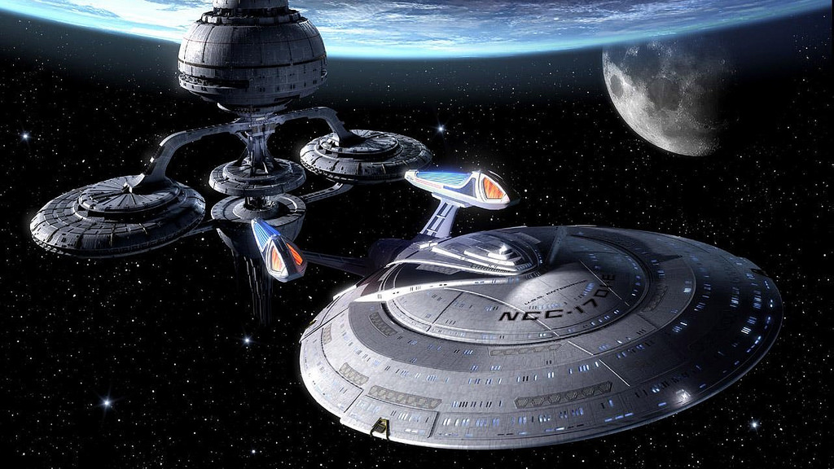
Engage...

Slide 24
On Your Journey to Extending and Measuring Your Scholarly Reach
Use more than one tool
Nothing is one size fits all
Know that “free” commercial tools may not last forever (or may charge for currently free services)
Utilize institutionally affiliated resources, like institutional repositories and online faculty profiles
Tell your story

Slide 25
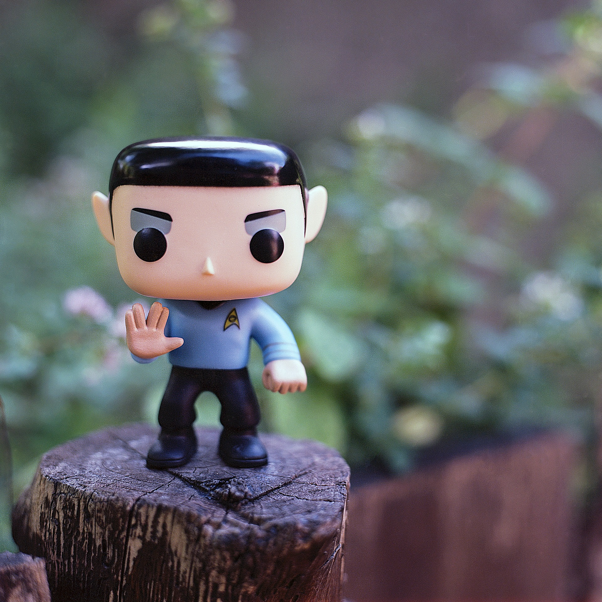
Live Long & Prosper...
In Your Scholarly Research

Slide 26
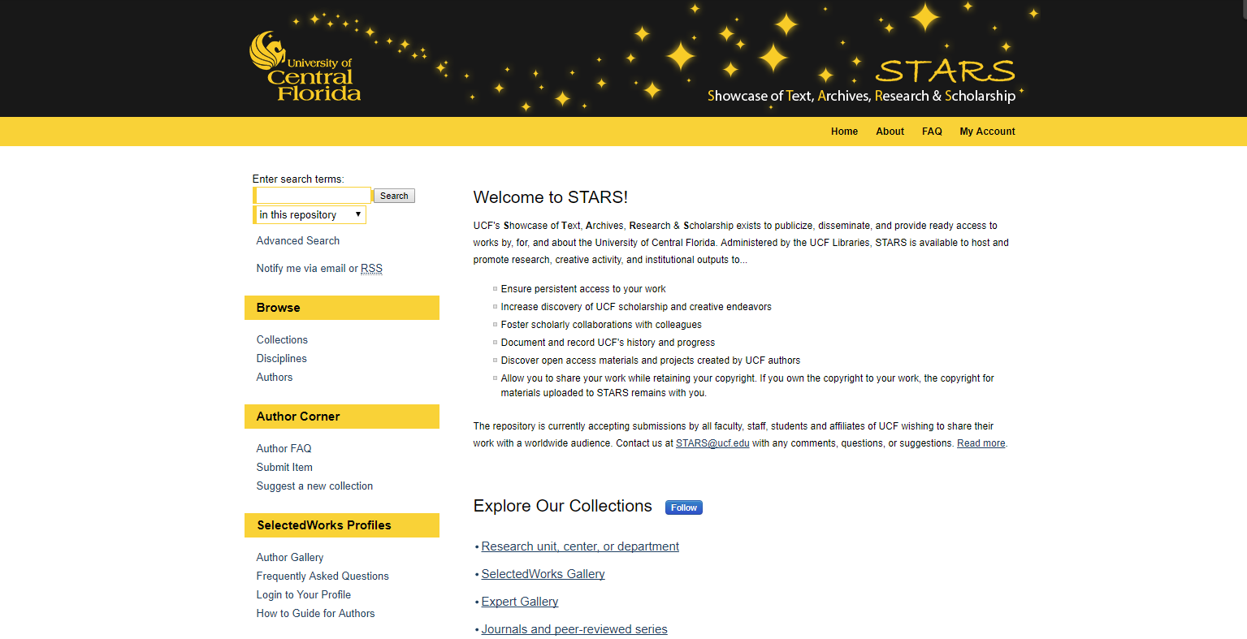

Slide 27
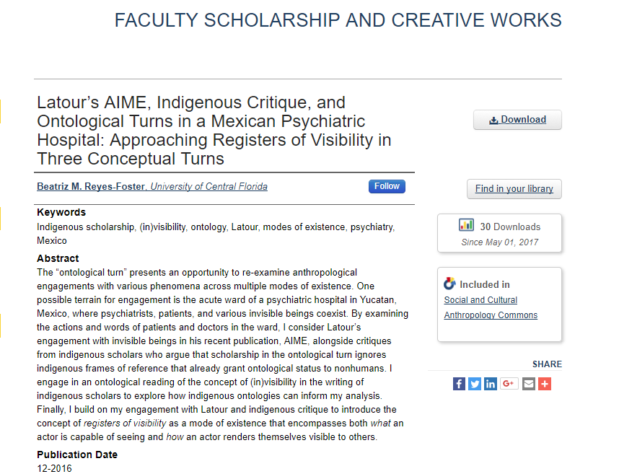
READERSHIP
SCHOLARSHIP
WRITING
EXHIBIT
OUTREACH
INSTITUTE
JOURNAL
EVENT
OER MATERIALS
DATA & GRANTS
PROJECT
PROFILE
Shine a light on your

Slide 28
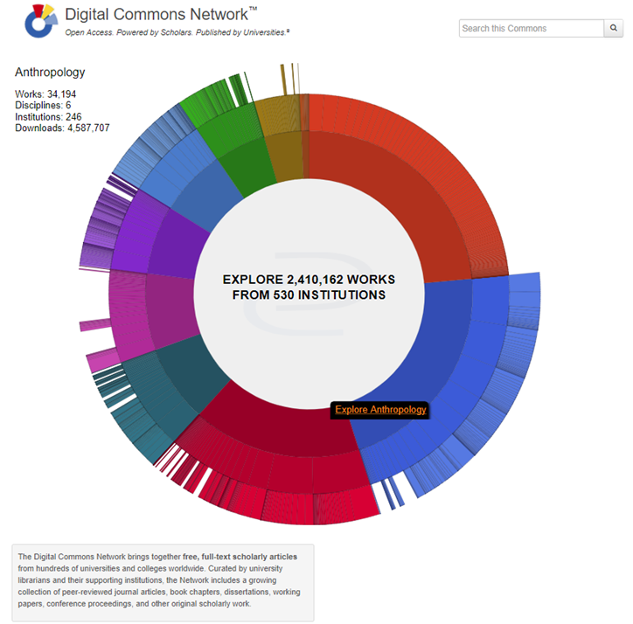
READERSHIP
SCHOLARSHIP
WRITING
EXHIBIT
OUTREACH
INSTITUTE
JOURNAL
EVENT
OER MATERIALS
DATA & GRANTS
PROJECT
PROFILE
Shine a light on your

Slide 29
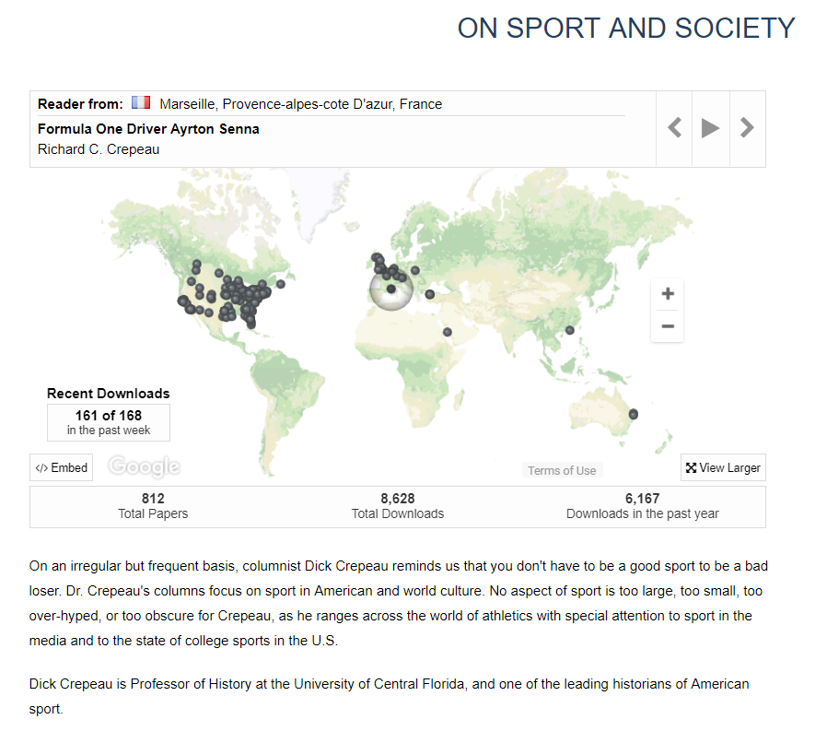
SCHOLARSHIP
WRITING
EXHIBIT
OUTREACH
INSTITUTE
JOURNAL
EVENT
OER MATERIALS
DATA & GRANTS
PROJECT
PROFILE
READERSHIP
Shine a light on your

Slide 30
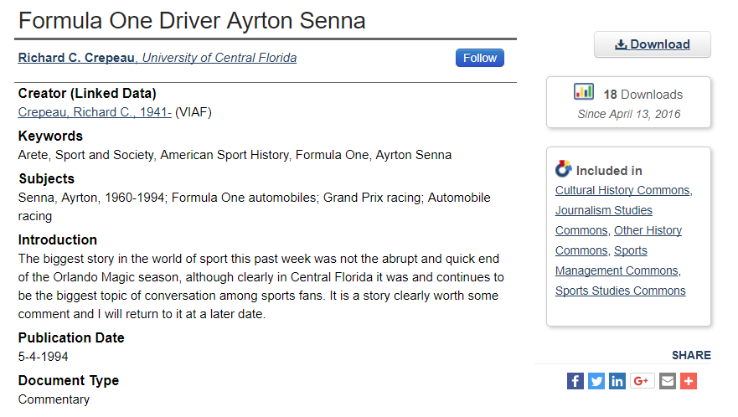
SCHOLARSHIP
WRITING
EXHIBIT
OUTREACH
INSTITUTE
JOURNAL
EVENT
OER MATERIALS
DATA & GRANTS
PROJECT
PROFILE
READERSHIP
Shine a light on your

Slide 31
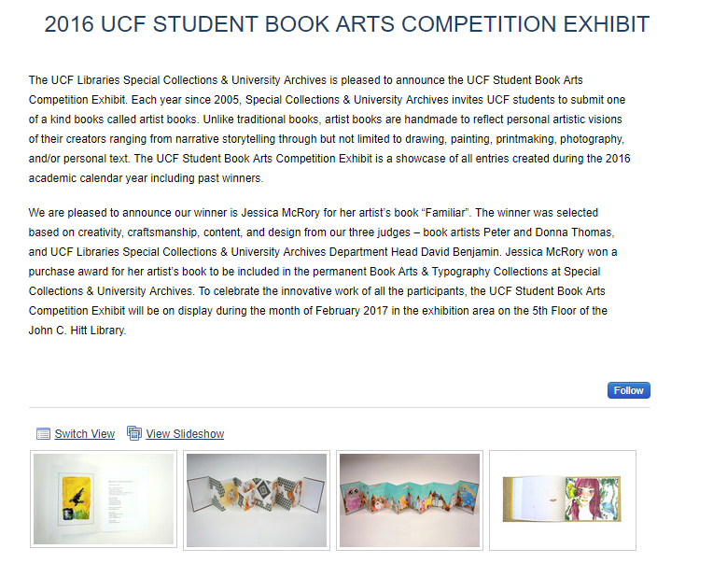
WRITING
EXHIBIT
OUTREACH
INSTITUTE
JOURNAL
EVENT
OER MATERIALS
DATA & GRANTS
PROJECT
PROFILE
READERSHIP
SCHOLARSHIP
Shine a light on your

Slide 32
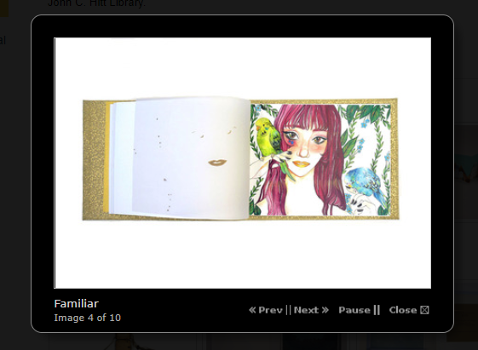
WRITING
EXHIBIT
OUTREACH
INSTITUTE
JOURNAL
EVENT
OER MATERIALS
DATA & GRANTS
PROJECT
PROFILE
READERSHIP
SCHOLARSHIP
Shine a light on your

Slide 33
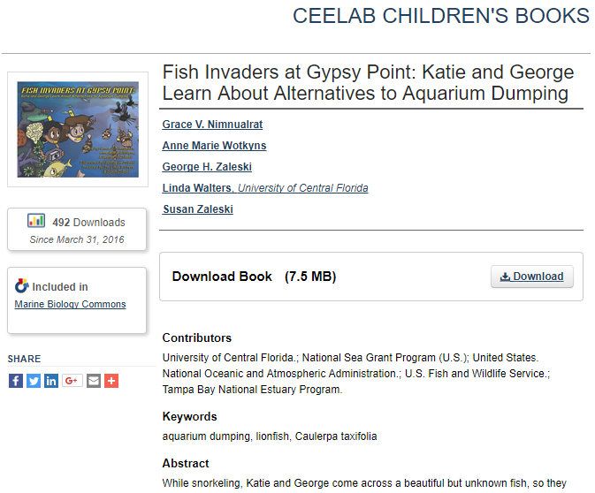
EXHIBIT
OUTREACH
INSTITUTE
JOURNAL
EVENT
OER MATERIALS
DATA & GRANTS
PROJECT
PROFILE
READERSHIP
SCHOLARSHIP
WRITING
Shine a light on your

Slide 34
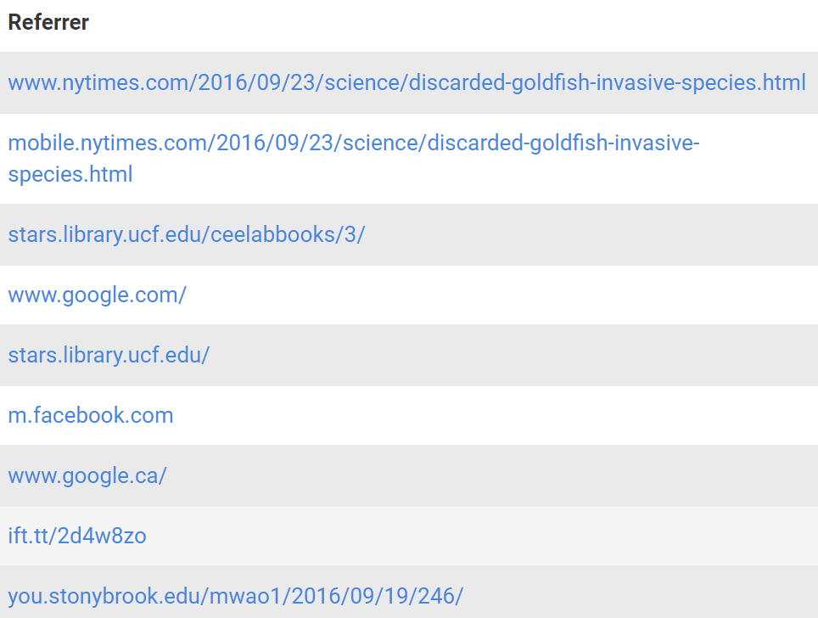
EXHIBIT
OUTREACH
INSTITUTE
JOURNAL
EVENT
OER MATERIALS
DATA & GRANTS
PROJECT
PROFILE
READERSHIP
SCHOLARSHIP
WRITING
EXHIBIT
Shine a light on your

Slide 35
OUTREACH
INSTITUTE
JOURNAL
EVENT
OER MATERIALS
DATA & GRANTS
PROJECT
PROFILE
READERSHIP
SCHOLARSHIP
WRITING
EXHIBIT
Shine a light on your

Slide 36
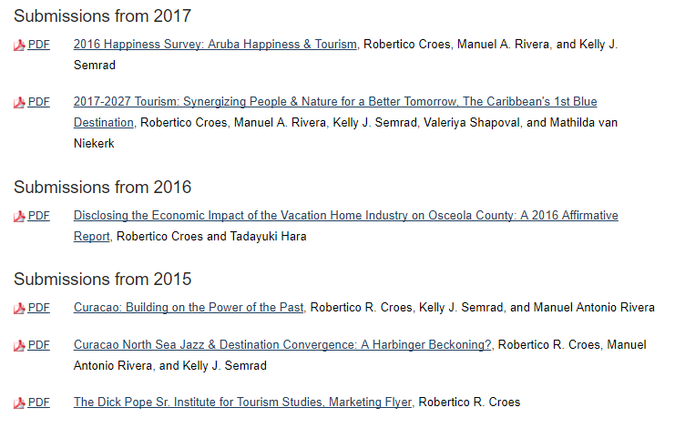
OUTREACH
INSTITUTE
JOURNAL
EVENT
OER MATERIALS
DATA & GRANTS
PROJECT
PROFILE
READERSHIP
SCHOLARSHIP
WRITING
EXHIBIT
Shine a light on your

Slide 37
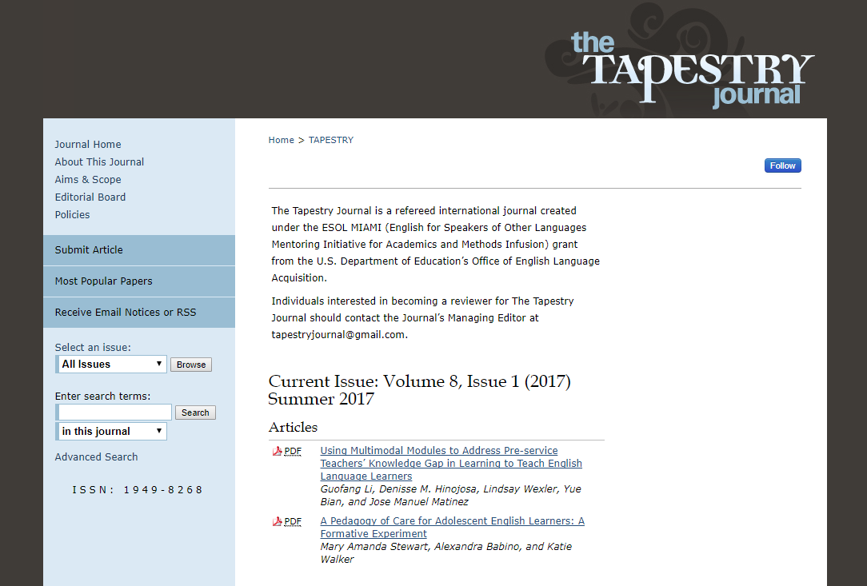
INSTITUTE
JOURNAL
EVENT
OER MATERIALS
DATA & GRANTS
PROJECT
PROFILE
READERSHIP
SCHOLARSHIP
WRITING
EXHIBIT
OUTREACH
Shine a light on your

Slide 38
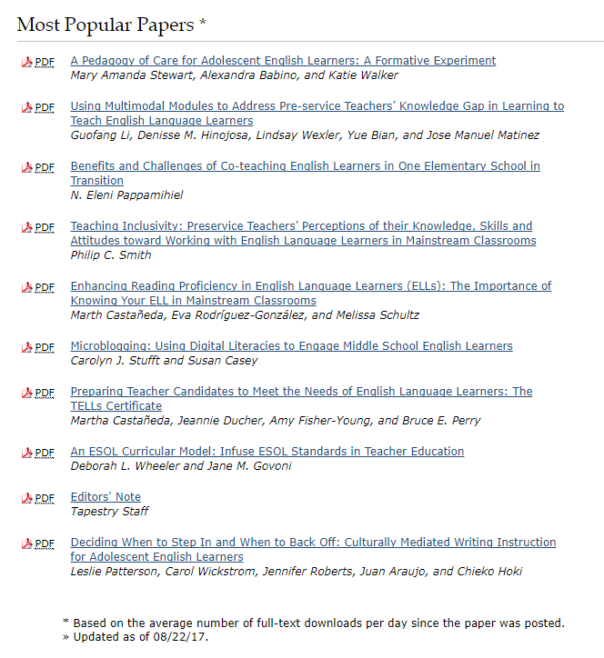
INSTITUTE
JOURNAL
EVENT
OER MATERIALS
DATA & GRANTS
PROJECT
PROFILE
READERSHIP
SCHOLARSHIP
WRITING
EXHIBIT
OUTREACH
INSTITUTE
Shine a light on your

Slide 39
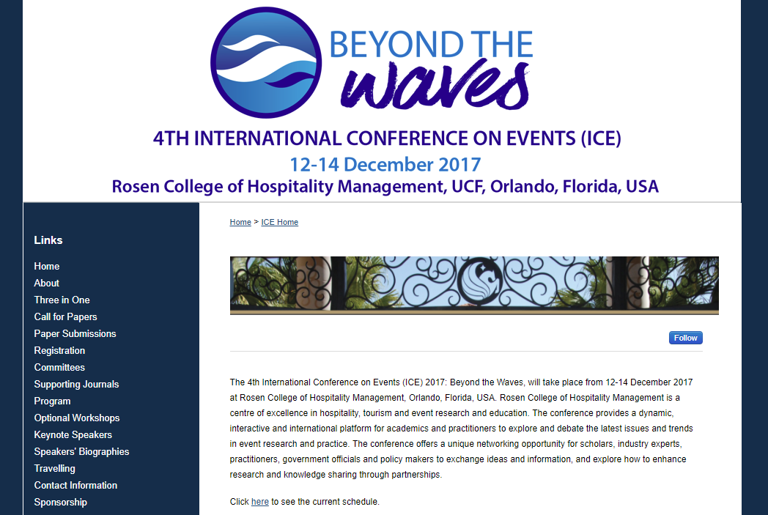
JOURNAL
EVENT
OER MATERIALS
DATA & GRANTS
PROJECT
PROFILE
READERSHIP
SCHOLARSHIP
WRITING
EXHIBIT
OUTREACH
INSTITUTE
Shine a light on your

Slide 40
JOURNAL
EVENT
OER MATERIALS
DATA & GRANTS
PROJECT
PROFILE
READERSHIP
SCHOLARSHIP
WRITING
EXHIBIT
OUTREACH
INSTITUTE
JOURNAL
Shine a light on your

Slide 41
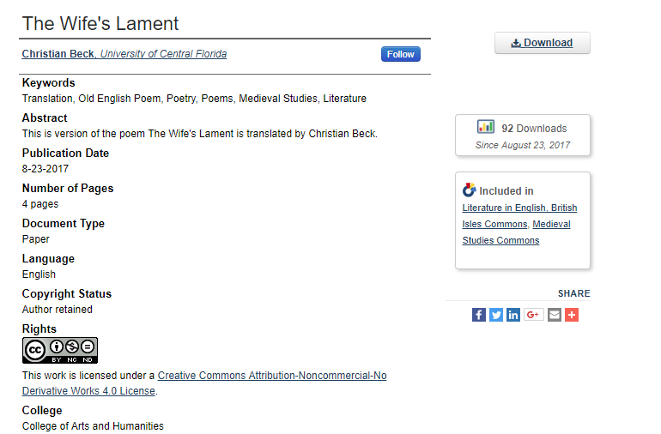
EVENT
OER MATERIALS
DATA & GRANTS
PROJECT
PROFILE
READERSHIP
SCHOLARSHIP
WRITING
EXHIBIT
OUTREACH
INSTITUTE
JOURNAL
Shine a light on your

Slide 42
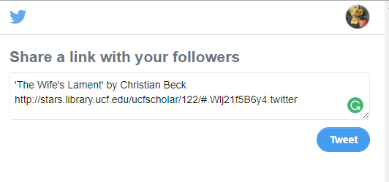
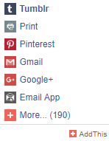
EVENT
OER MATERIALS
DATA & GRANTS
PROJECT
PROFILE
READERSHIP
SCHOLARSHIP
WRITING
EXHIBIT
OUTREACH
INSTITUTE
JOURNAL
Shine a light on your

Slide 43
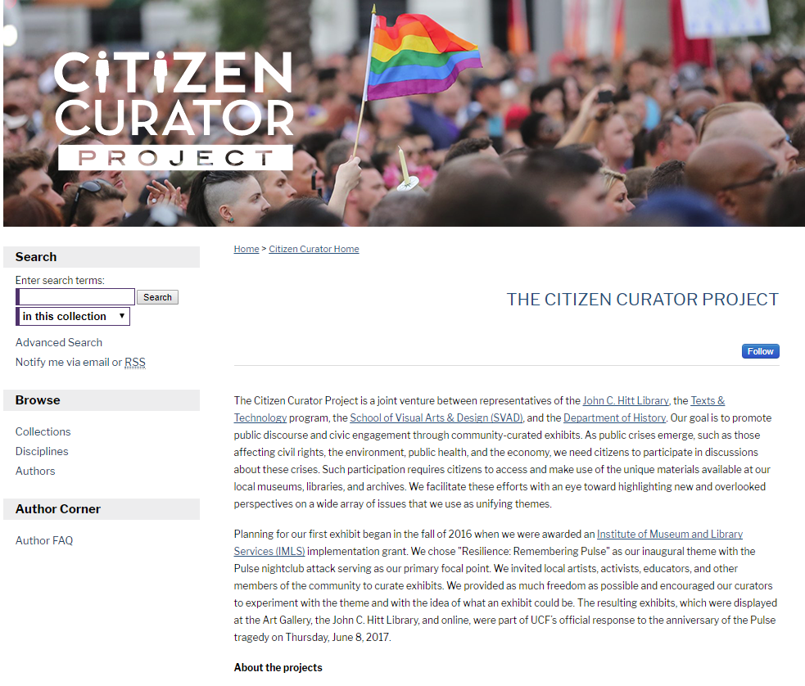
OER MATERIALS
DATA & GRANTS
PROJECT
PROFILE
READERSHIP
SCHOLARSHIP
WRITING
EXHIBIT
OUTREACH
INSTITUTE
JOURNAL
EVENT
Shine a light on your

Slide 44
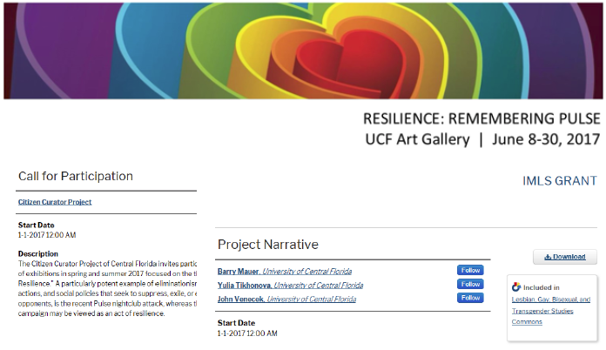
OER MATERIALS
DATA & GRANTS
PROJECT
PROFILE
READERSHIP
SCHOLARSHIP
WRITING
EXHIBIT
OUTREACH
INSTITUTE
JOURNAL
EVENT
Shine a light on your

Slide 45
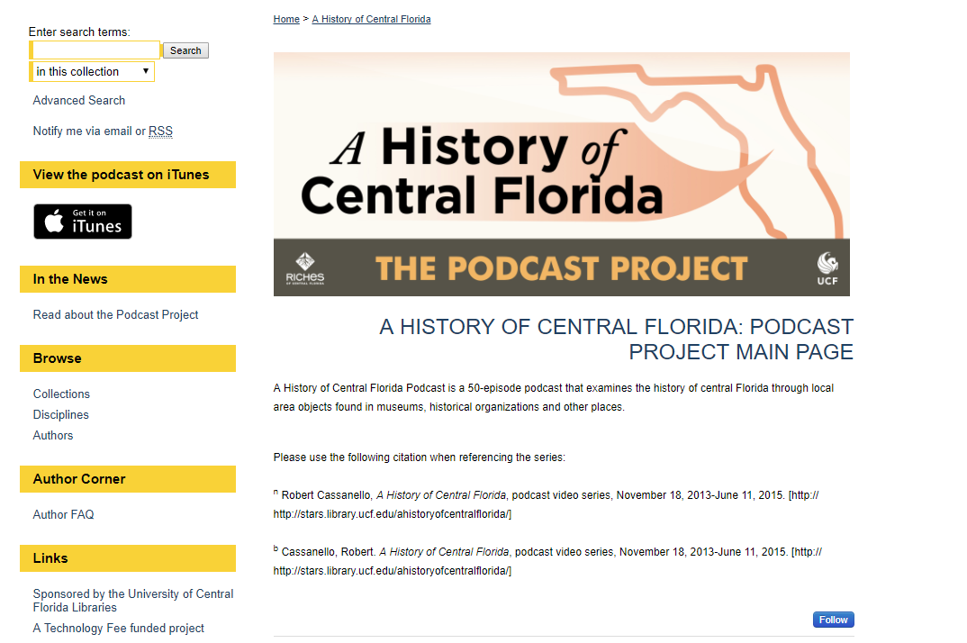
DATA & GRANTS
PROJECT
PROFILE
READERSHIP
SCHOLARSHIP
WRITING
EXHIBIT
OUTREACH
INSTITUTE
JOURNAL
EVENT
OER MATERIALS
Shine a light on your

Slide 46
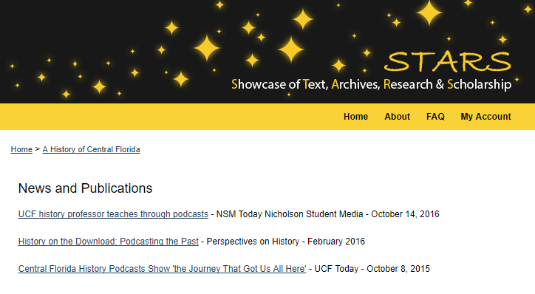
DATA & GRANTS
PROJECT
PROFILE
READERSHIP
SCHOLARSHIP
WRITING
EXHIBIT
OUTREACH
INSTITUTE
JOURNAL
EVENT
OER MATERIALS
DATA & GRANTS
SCHOLARSHIP
Shine a light on your

Slide 47
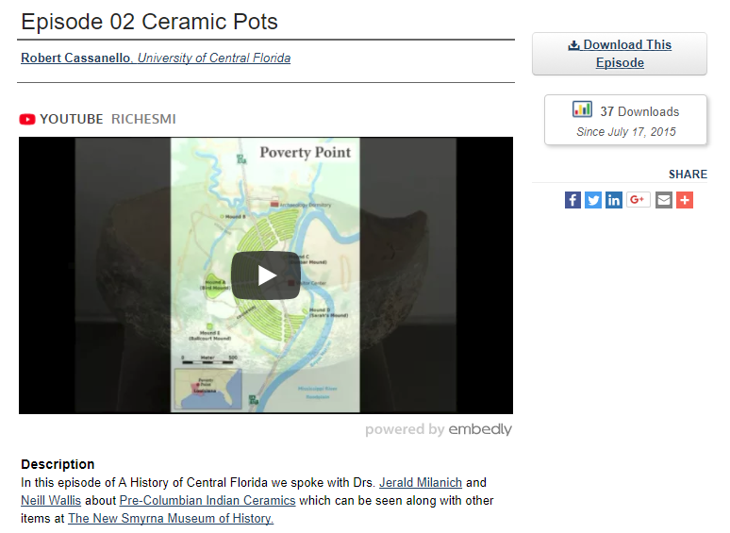
DATA & GRANTS
PROJECT
PROFILE
READERSHIP
SCHOLARSHIP
WRITING
EXHIBIT
OUTREACH
INSTITUTE
JOURNAL
EVENT
OER MATERIALS
DATA & GRANTS
SCHOLARSHIP
Shine a light on your

Slide 48
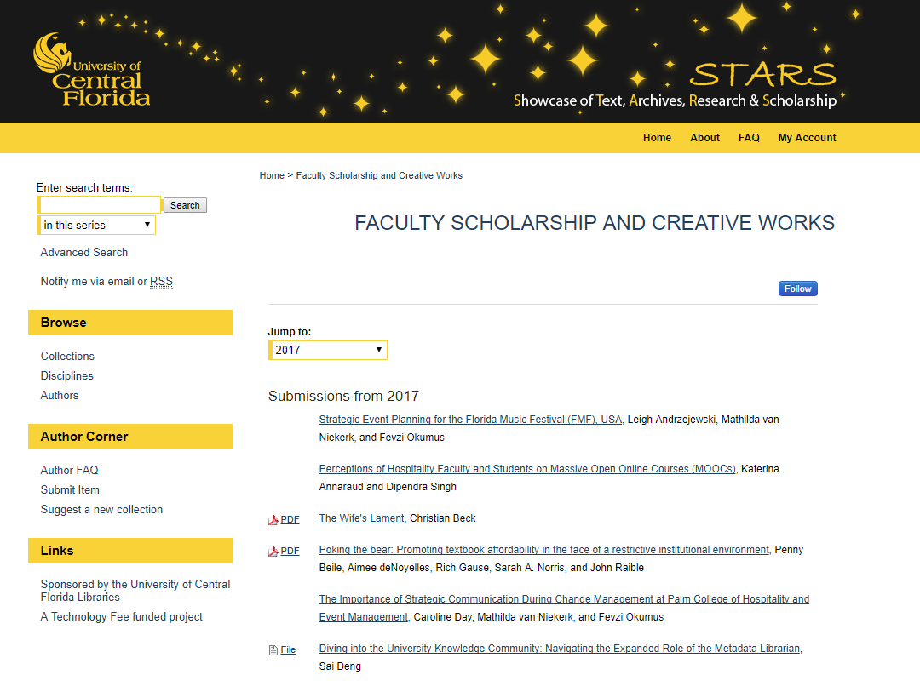

Slide 49
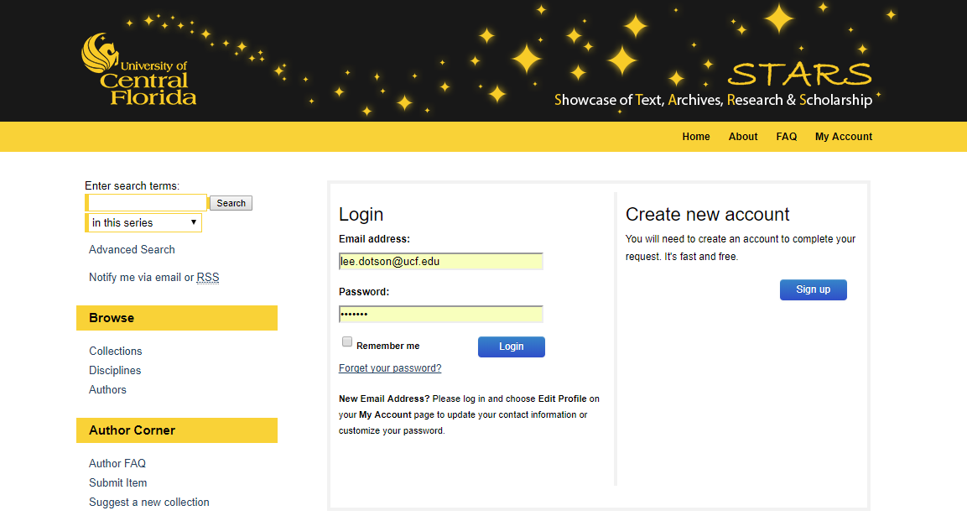

Slide 50
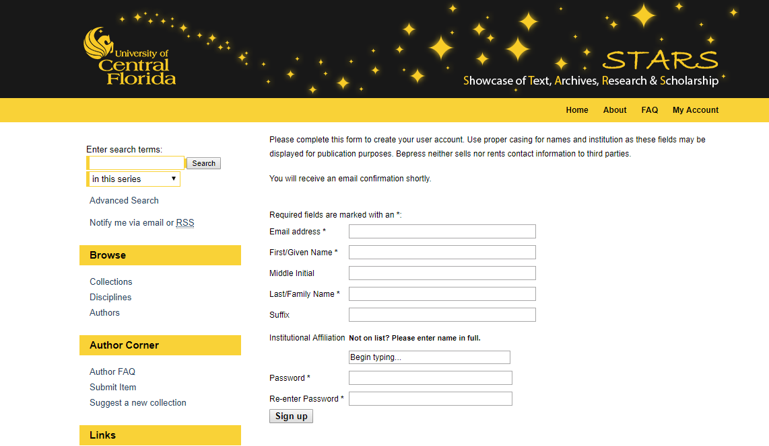

Slide 51
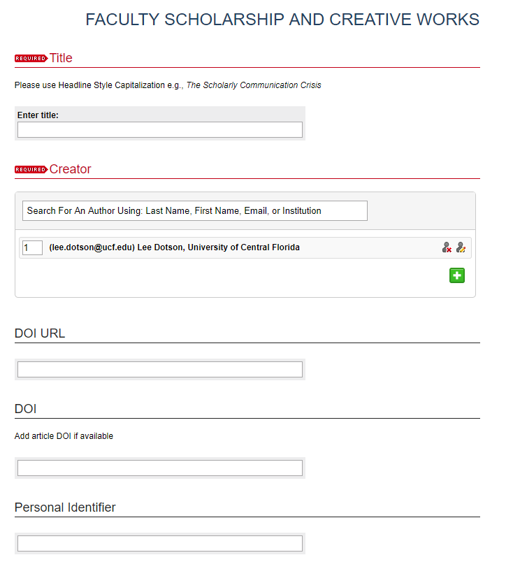
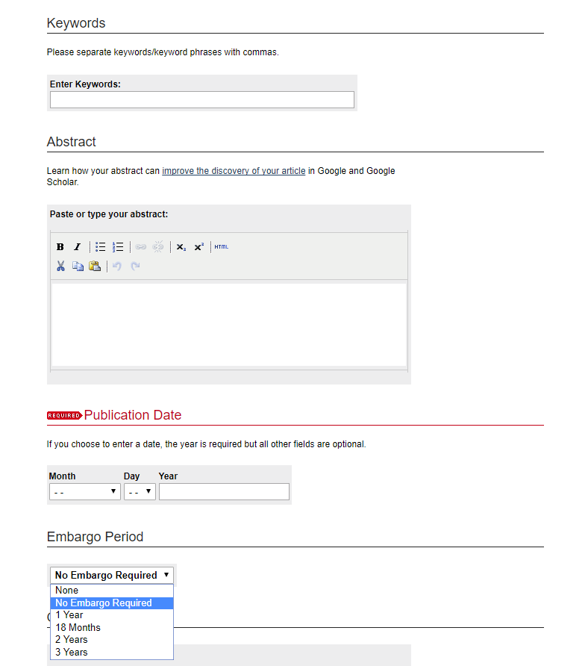

Slide 52
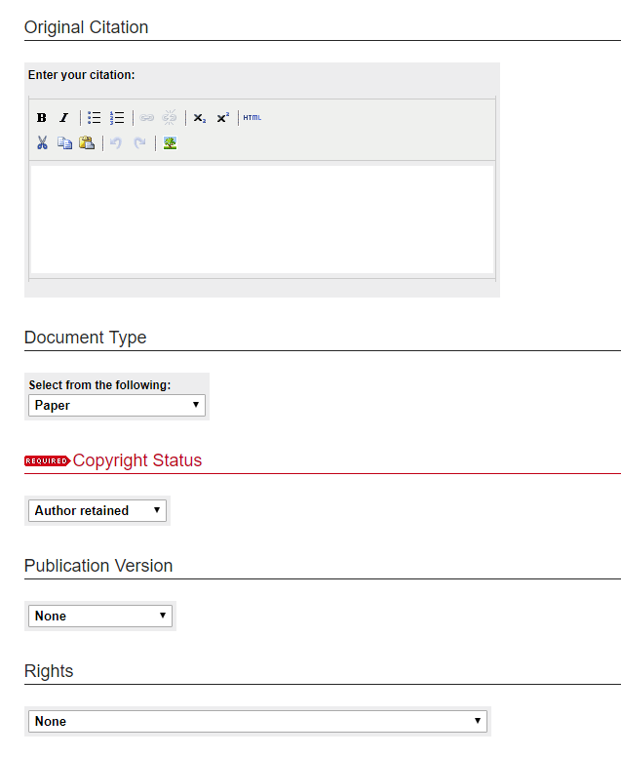
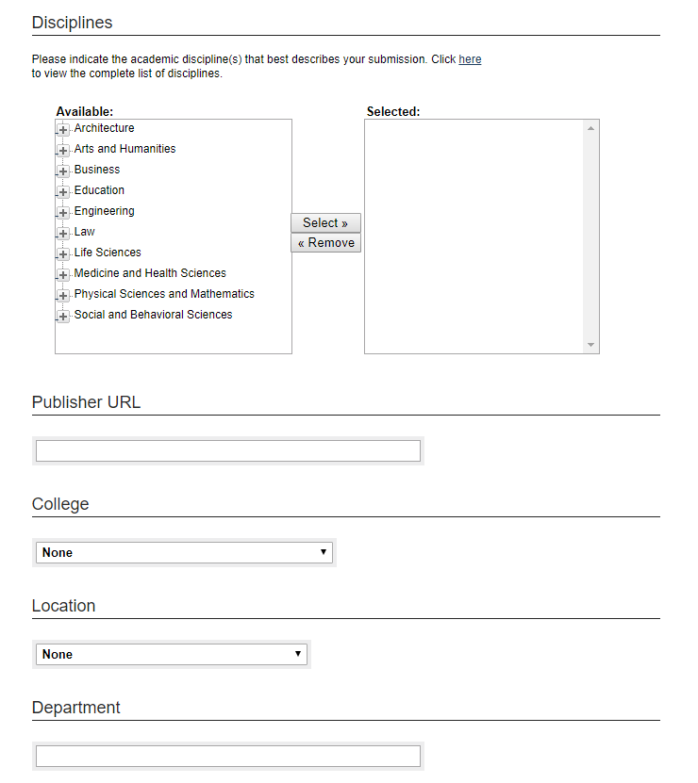

Slide 53
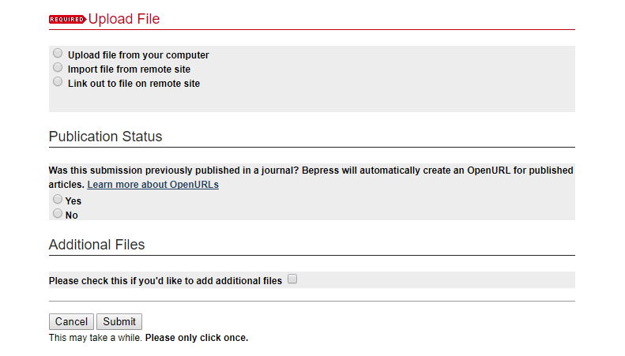

Slide 54
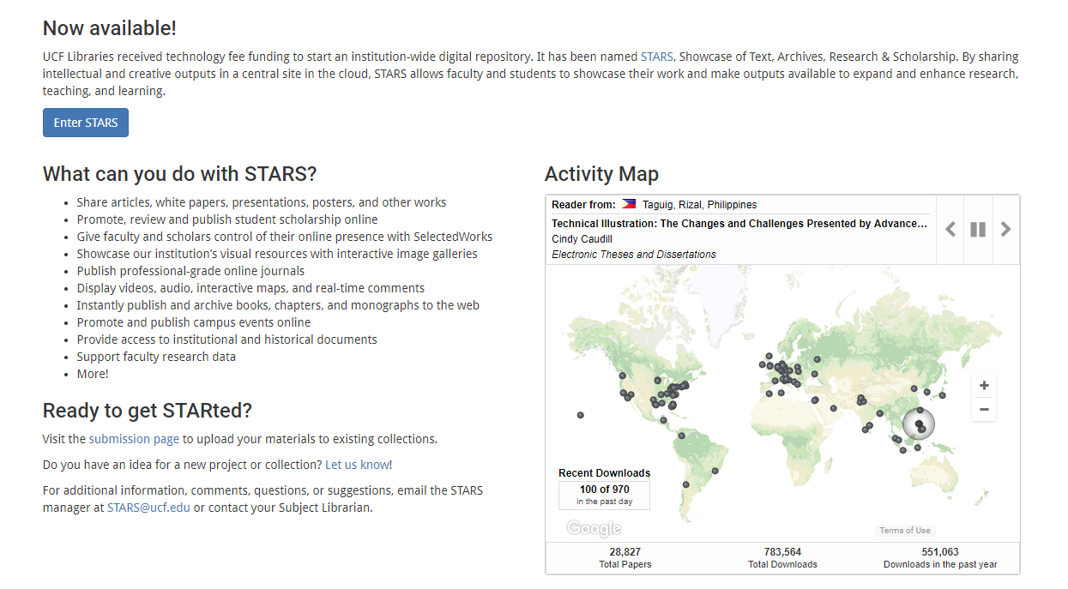
https://library.ucf.edu/find/stars-digital-repository/

Slide 55
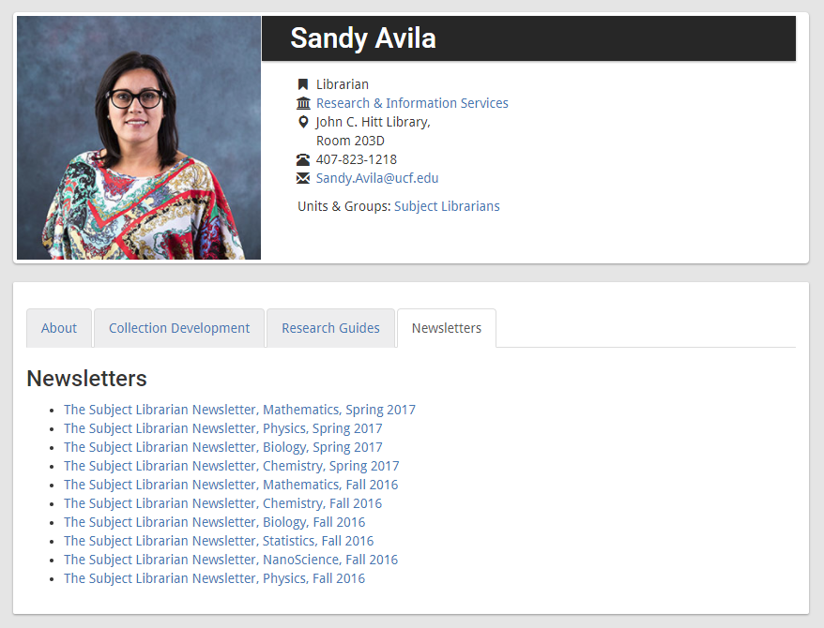
https://library.ucf.edu/staff/avila-sandy/

Slide 56
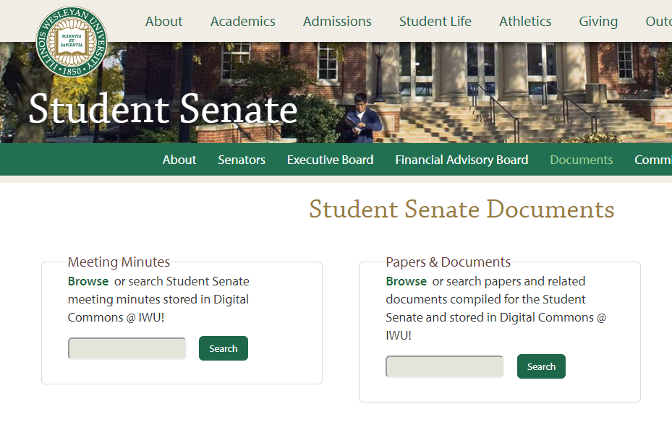
https://www.iwu.edu/senate/Documents.html

Slide 57
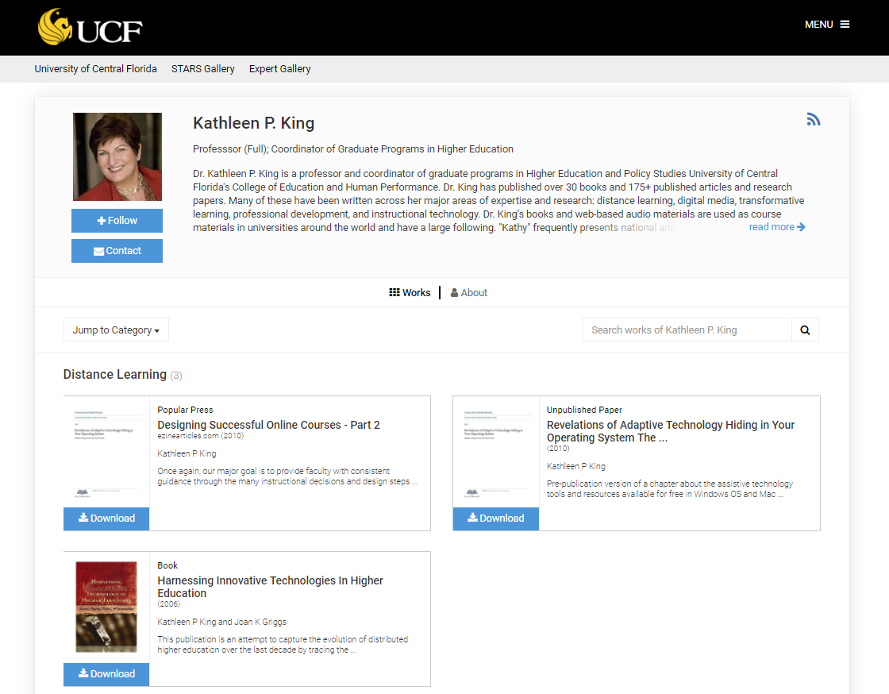
PROJECT
PROFILE
READERSHIP
SCHOLARSHIP
WRITING
EXHIBIT
OUTREACH
INSTITUTE
JOURNAL
EVENT
OER MATERIALS
DATA & GRANTS
Shine a light on your

Slide 58
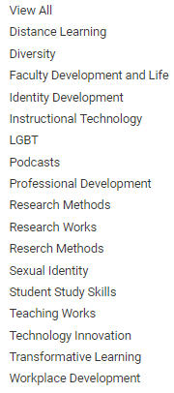
PROJECT
PROFILE
READERSHIP
SCHOLARSHIP
WRITING
EXHIBIT
OUTREACH
INSTITUTE
JOURNAL
EVENT
OER MATERIALS
DATA & GRANTS
Shine a light on your

Slide 59
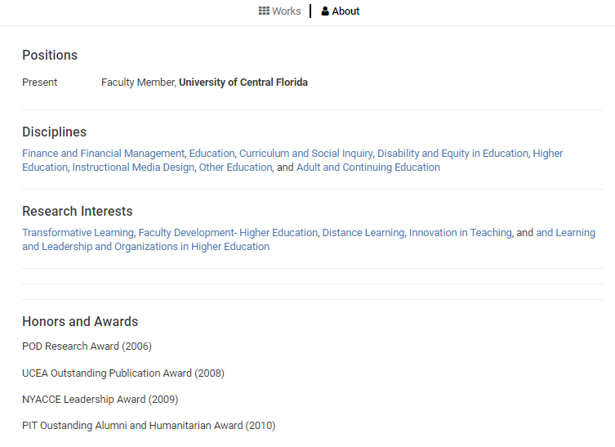
PROJECT
PROFILE
READERSHIP
SCHOLARSHIP
WRITING
EXHIBIT
OUTREACH
INSTITUTE
JOURNAL
EVENT
OER MATERIALS
DATA & GRANTS
Shine a light on your

Slide 60
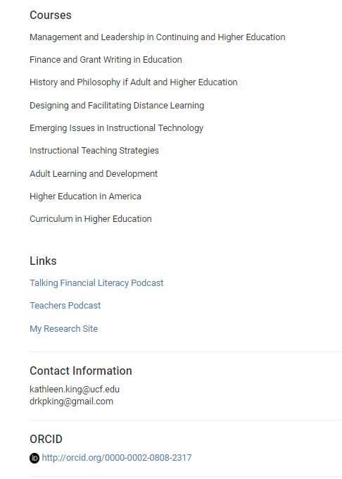
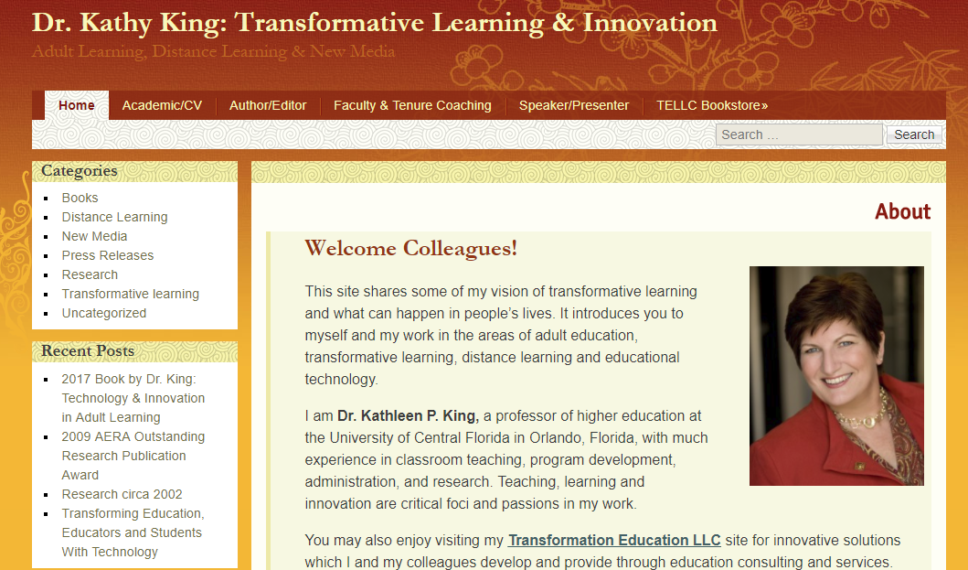
PROJECT
PROFILE
READERSHIP
SCHOLARSHIP
WRITING
EXHIBIT
OUTREACH
INSTITUTE
JOURNAL
EVENT
OER MATERIALS
DATA & GRANTS
Shine a light on your

Slide 61
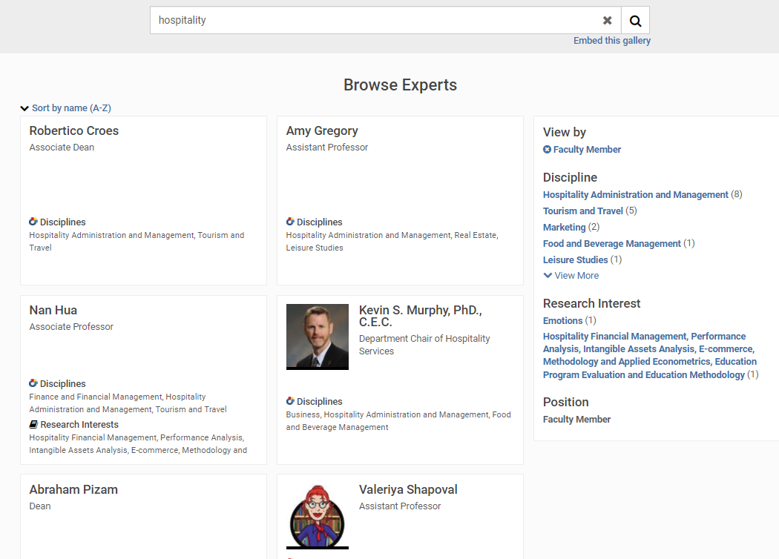
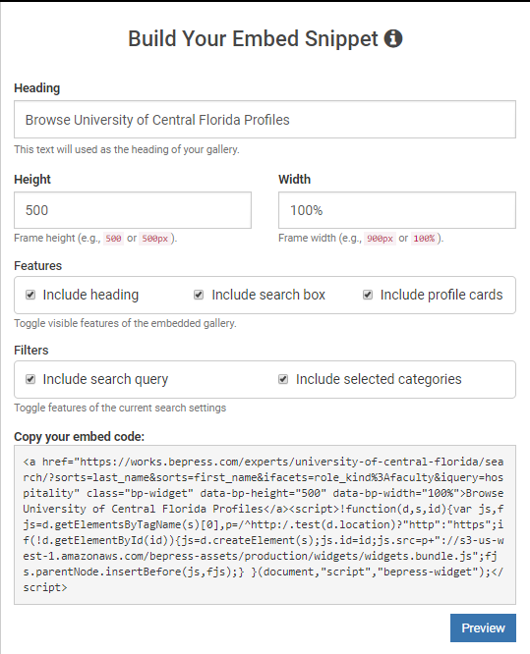

Slide 62
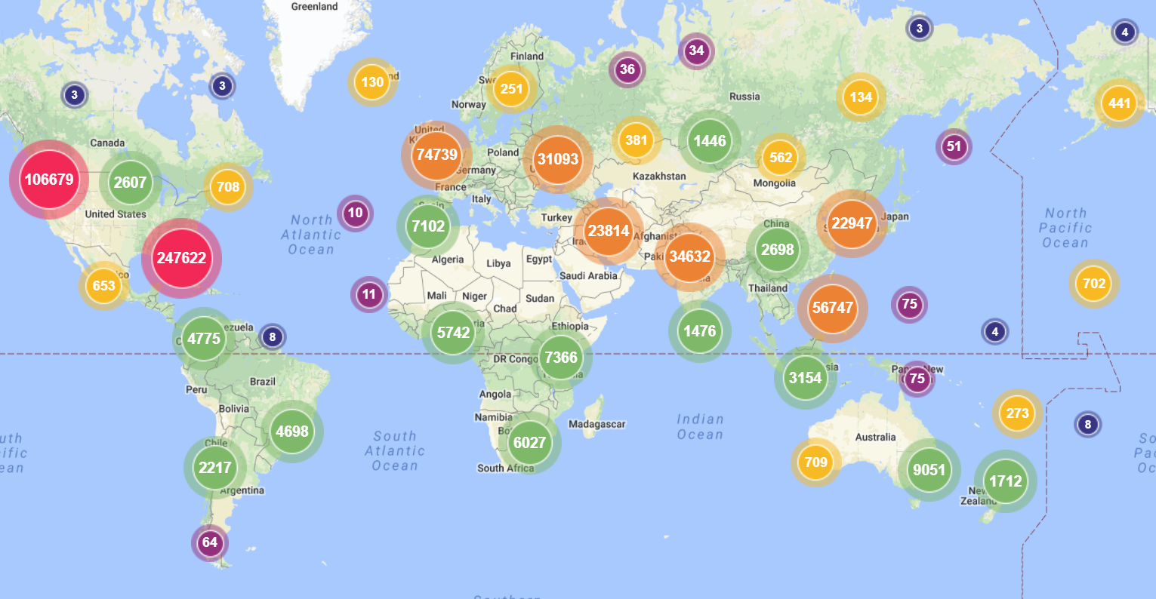
PROFILE
READERSHIP
SCHOLARSHIP
WRITING
EXHIBIT
OUTREACH
INSTITUTE
JOURNAL
EVENT
OER MATERIALS
DATA & GRANTS
PROJECT
Shine a light on your

Slide 63
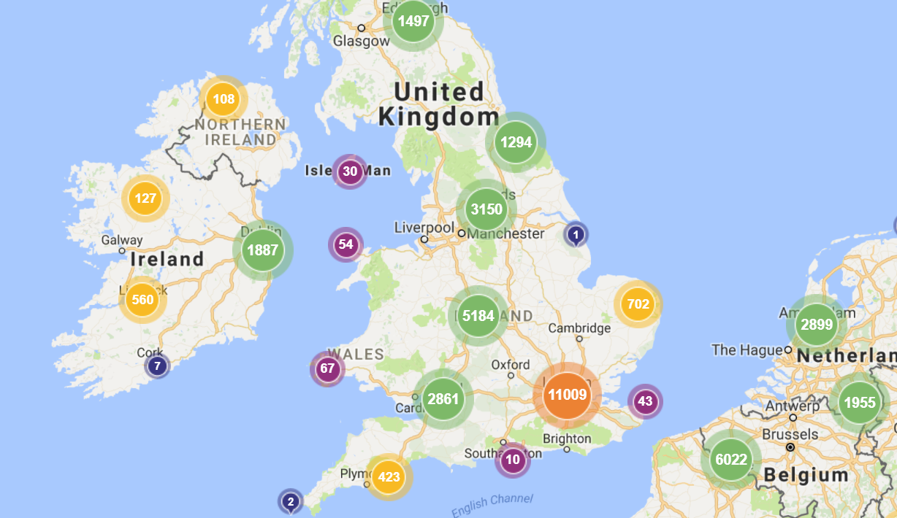
PROFILE
READERSHIP
SCHOLARSHIP
WRITING
EXHIBIT
OUTREACH
INSTITUTE
JOURNAL
EVENT
OER MATERIALS
DATA & GRANTS
PROJECT
Shine a light on your

Slide 72
READERSHIP
YOU
SCHOLARSHIP
WRITING
EXHIBIT
OUTREACH
INSTITUTE
JOURNAL
EVENT
OER MATERIALS
DATA & GRANTS
PROJECT
Shine a light on…
STARS can showcase
Digital projects
Institutional outputs
Research
Scholarship
Creative works
More!
Visit stars.library.ucf.edu
Contact STARS@ucf.edu

Slide 73
The Uses of STARS
Dr. Barry Mauer
Associate Professor, English
Director, Texts and Technology Doctoral Program

Slide 74
Projects

Slide 75
Collections

Slide 76
Publications

Slide 77
Forum

Slide 78
Events

Slide 79
Archives

Slide 80
Programs

Slide 81
Disciplines

Slide 82
Author Search

Slide 83
Profiles

Slide 84
Categories

Slide 85
Lost Work

Slide 86
Audio

Slide 87
Theses

Slide 88
Newsletters

Slide 89
Data

