Slide 1
Exploring Issues of Access and Equity
The Challenges to Learning in a Digital Age:
Sandy Avila & Sarah A. Norris
University of Central Florida

Slide 2
Introductions
Sandy Avila
Science Librarian/Adjunct Online Instructor
UCF Libraries/Florida Technical College
Sarah Norris
Scholarly Communication Librarian
UCF Libraries

Slide 3
HASTAC Conference Themes
Challenges to monolingualism
Technology and education
Interdisciplinary goals and
conversations
Communication of knowledge,
publishing, and intellectual property

Slide 4
Defining Our Focus...
Access
Equity
ACCESS
ACCESS
Notes:
John/Rich

Slide 5
Open Access (OA)
“Open Access (OA) literature is digital, online, free of charge, and free of most copyright and licensing restrictions.” (http://legacy.earlham.edu/~peters/fos/overview.htm)

Slide 6
How Does OA Support Access & Equity?
Addresses research from a global perspective, focusing on providing access to research worldwide
Focuses on providing access to research beyond the academy, so that anyone, anywhere can access information
Removes price barriers, such as subscriptions, licensing fees & pay-per-view fees
Removes permission barriers, such as copyright and licensing restrictions

Slide 7
How is OA Challenged in Access & Equity?
May add price barriers for authors, in the form of article processing charges, particularly if an academic institution doesn’t provide funding or author doesn’t qualify for waivers
Is prone to predatory publishers, leading to lack of credibility and reputation which affects research contributions
Requires some access to technology, such as the Internet, Internet enabled devices, etc.
May or may not provide accessibility, such as OCR, audio, etc.

Slide 8
What are your perceptions of Open Access?
Do you use OA publications in your courses?
Do you recommend students use them?
Do you contribute to OA publications as an author?
Why or why not?
What possibilities can you see using Open Access?

Slide 9
Open Educational Resources (OER)
“Open educational resources (OER) are free and openly licensed educational materials that can be used for teaching, learning, research, and other purposes.”
https://wiki.creativecommons.org/wiki/What_is_OER%3F

Slide 10
How Does OER Support Access & Equity?
Addresses research from a global perspective, focusing on providing access to research worldwide
Focuses on providing access to research beyond local institutions or the academy, so that anyone, anywhere can access information
Provides an opportunity for faculty to contribute broadly to their field, discipline, etc.
Allows students to access in a variety of ways and includes accessibility
Removes price barriers, ensuring that all students can access materials regardless of income, financial aid, etc.
Removes permission barriers, such as copyright and licensing restrictions

Slide 11
How is OER Challenged in Access & Equity?
May not necessarily be fully open, depending on the content used and how it’s used
May result in intellectual property issues, including issues of ownership
Requires some access to technology, such as the Internet, Internet enabled devices, etc.
Requires some knowledge of technology, both in the creation and use of content
May or may not provide accessibility, such as OCR, audio, etc.
May or may not be available in multiple languages, and may only exist in the language of instruction

Slide 12
What are your perceptions of OER?
Do you use OER content in your courses?
How do you feel about OER content vs. traditional textbooks?
Would you contribute to OER content as an author?
Why or why not?
What possibilities can you see using OER?

Slide 13
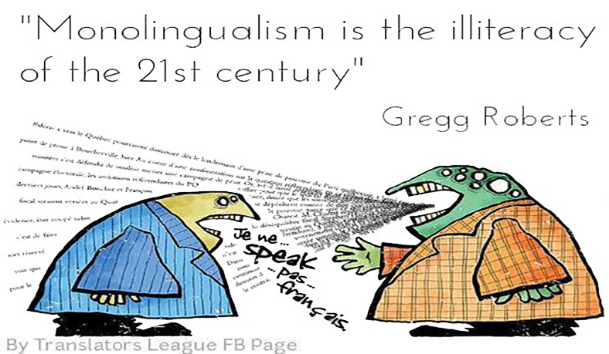
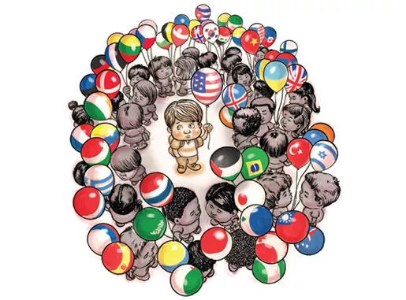
https://www.edweek.org/ew/articles/2010/03/17/25salomone_ep.h29.html
https://cdn.lingholic.com/wp-content/uploads/2017/01/Monolingualism-is-the-illiteracy-of-the-21st-century._-What-do-you-think_-copiar.jpg

Slide 14
Monolingualism
adjective
1.
knowing or able to use only one language; monoglot.
2.
spoken or written in only one language.
noun
3.
a monolingual person.
(http://www.dictionary.com/browse/monolingualism)
“the state of understanding or having the knowledge to speak or write in only one language”
Once you have overcome the hurdle of monolingualism you can go on and learn other languages.
(https://www.collinsdictionary.com/us/dictionary/english/monolingualism)

Slide 15
How Does Monolingualism Support Access & Equity?
-Supports educating a globally competitive population
-Level playing field/opportunities
-Reduces ethnic, religious or regional conflict
-Technology focused

Slide 16
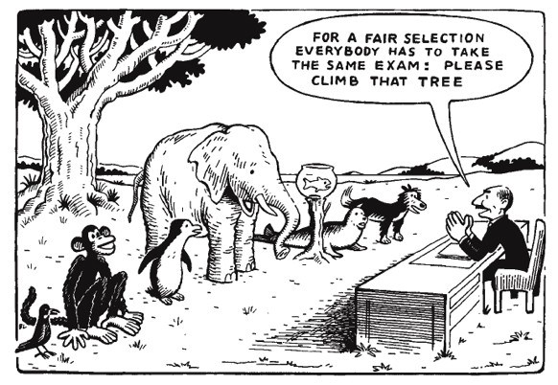
http://scholasticadministrator.typepad.com/thisweekineducation/2012/08/cartoons-climb-that-tree.html

Slide 17
How is Monolingualism Challenged in Access & Equity?
-Preservation of national unity vs preserving cultural identity
-Issues with translation/context
-Opportunities for study/scholarships and creating competition
-Multi-lingual teacher training vs simplifying curriculum

Slide 18
What Are Your Perceptions of Monolingualism?
What are your experiences with regard to monolingualism?
Does monolingualism create more opportunities or additional challenges? Does that depend on the discipline and language training?
How does monolingualism change (or does it), with regard to teaching in an online environment?

Slide 19
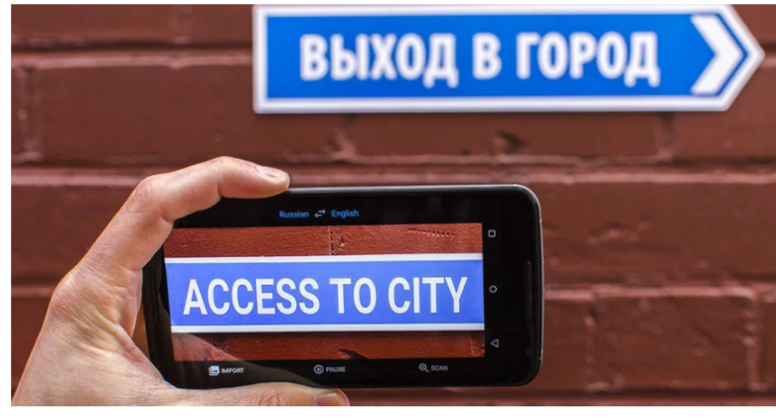
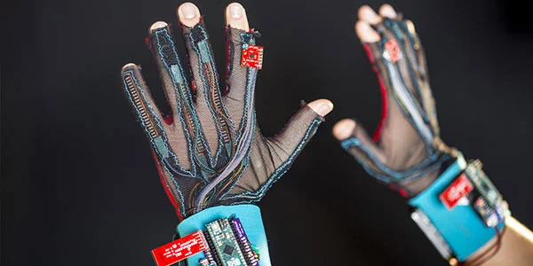
Augmented & Virtual Reality Technology

Slide 20
Thank you!
Sandy Avila Sarah Norris
sandy.avila@ucf.edu sarah.norris@ucf.edu

