Slide 1
Copyright Considerations for
HIS 6165: Tools for the Digital Historian
Sarah A. Norris, Scholarly Communication Librarian, UCF Libraries
Notes:
Copyright, Digital Rights Management and Open Access.

Slide 2
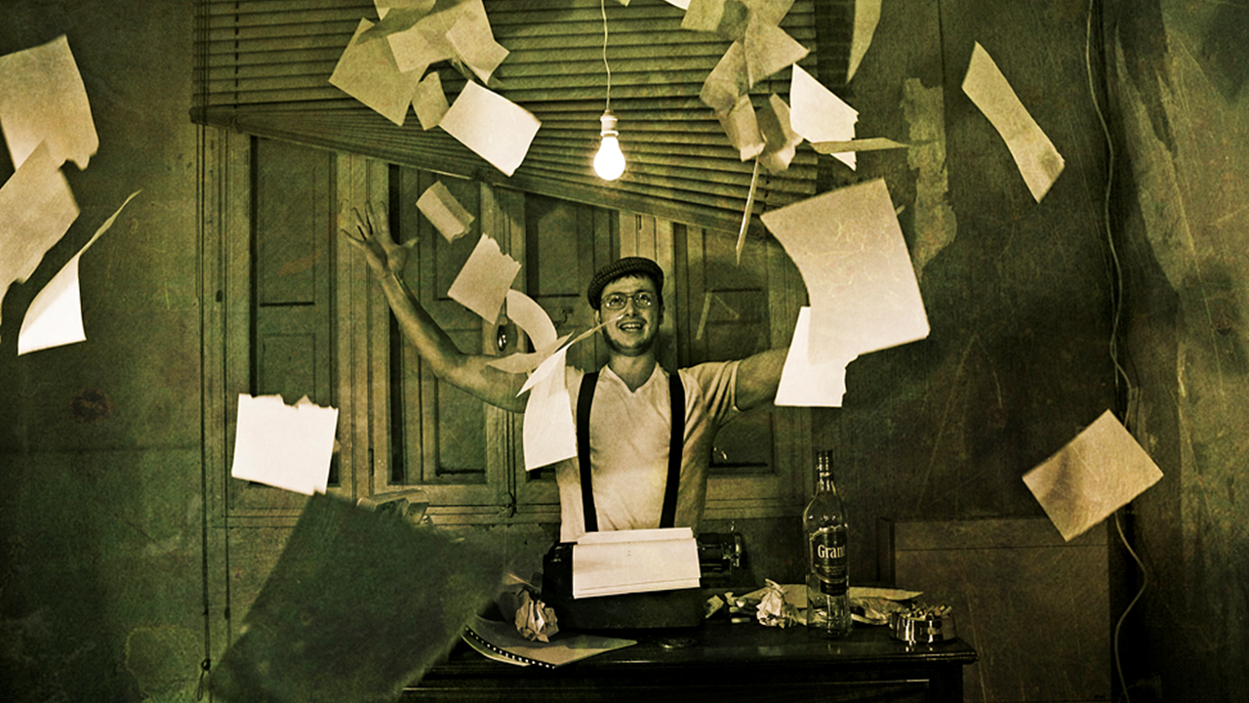
If you remember one thing from this presentation...

Slide 3
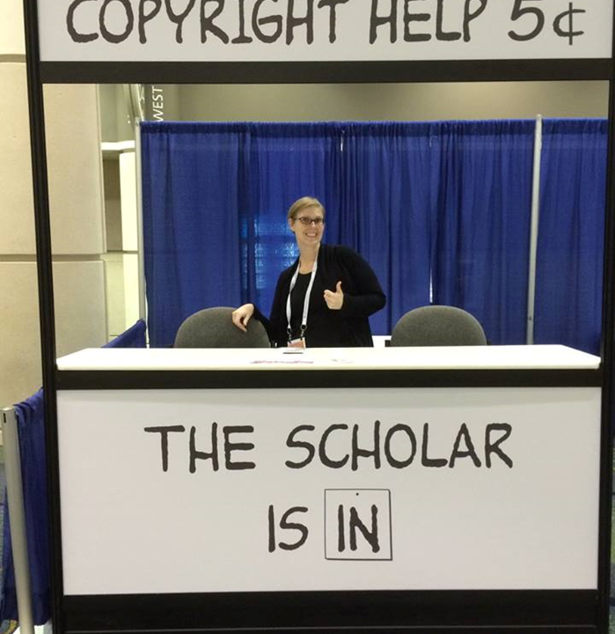
Contact the Library...
We Can Help!

Slide 4
Overview
General Copyright
Important Points about Copyright for the Digital Historian

Slide 5
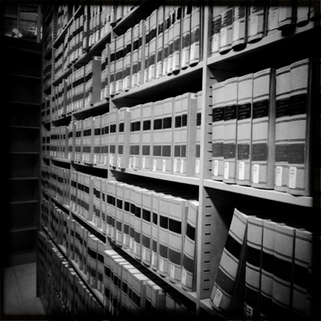
*Disclaimer
UCF Libraries does not give legal advice, and any information in this presentation is for informational purposes only.
Image Retrieved from: https://flic.kr/p/9H8SCn / CC BY-ND 2.0 / Mr.TinDC /

Slide 6
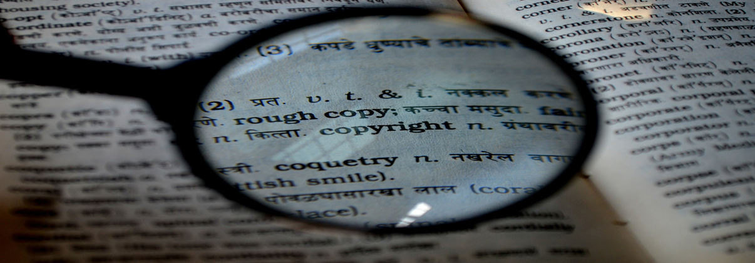
What is Copyright?
What is Copyright?

Slide 7
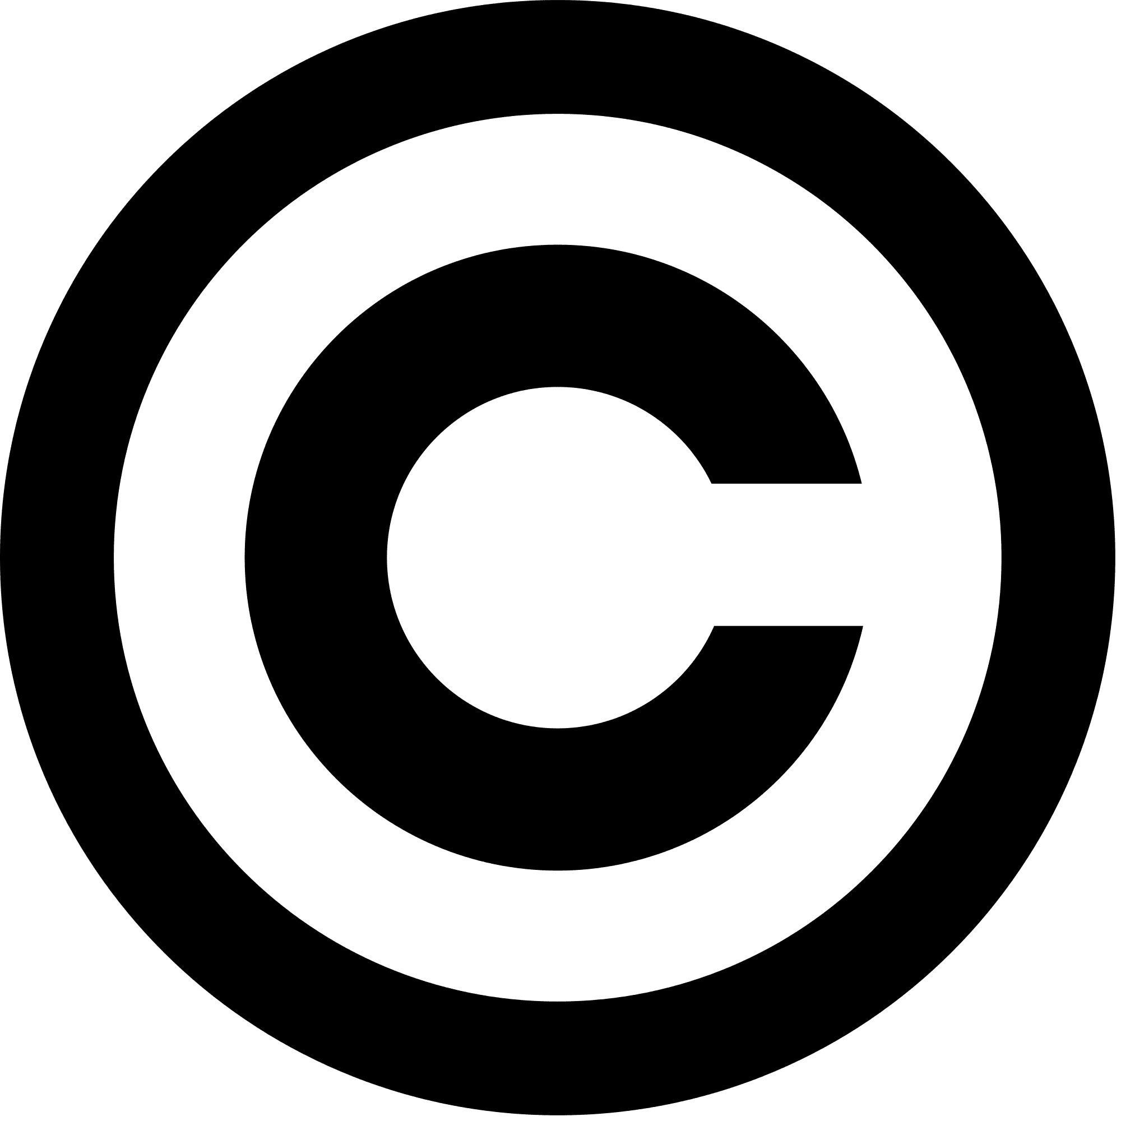
“Copyright is a form of protection provided by the laws of the United States (title 17, U.S. Code) to the authors of ‘original works of authorship,’ including literary, dramatic, musical, artistic, and certain other intellectual works. This protection is available to both published and unpublished works.”
http://www.copyright.gov/circs/circ01.pdf

Slide 8
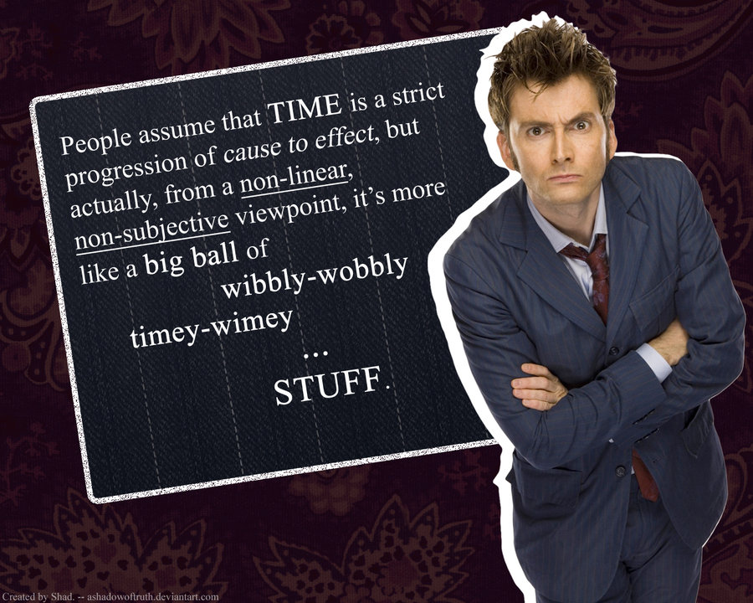
How Long Does Copyright Last?

Slide 9
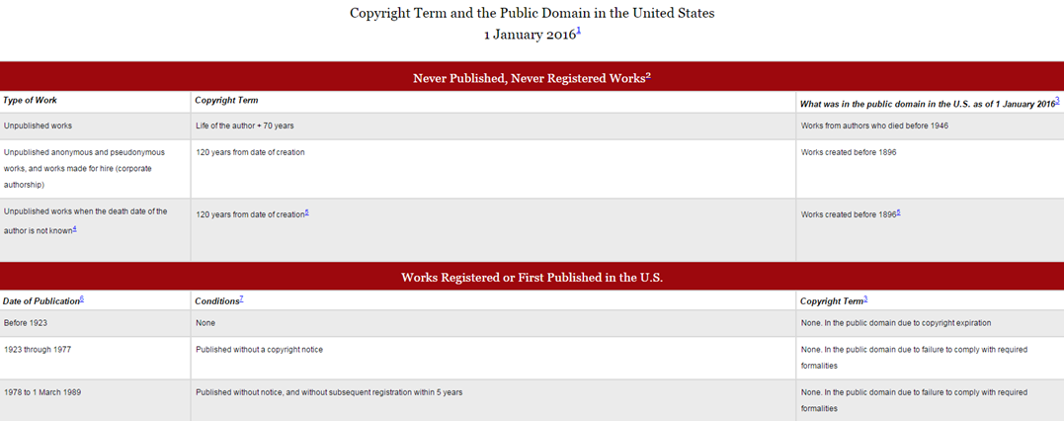
© 2004-2016 Peter B. Hirtle. Last updated 3 January, 2016, Retrieved from: http://copyright.cornell.edu/resources/publicdomain.cfm

Slide 10
What Rights are Covered by Copyright?
Generally, the following are exclusive rights given to a copyright holder:
reproduce your work
distribute your work
prepare derivative works
publicly display or perform your work
authorize others to do any of the above
*The above does not necessarily apply if the creator/author has given away rights to a publisher and/or other individual or entity

Slide 11
Image retrieved from: https://web.law.duke.edu/cspd/publicdomainday/2016/pre-1976 © Center for the Study of Public Domain

Slide 12
What is Public Domain?
Public domain refers to materials “whose exclusive intellectual property rights have expired, have been forfeited, or are inapplicable.”
Items can be used freely
Materials in the public domain include:
Works with expired copyright (generally, this means items published before 1923)
Works that are not copyrightable or protected by copyright
Works produced by the federal government and/or federal government employee as a part of their job
Works donated to the public domain

Slide 13
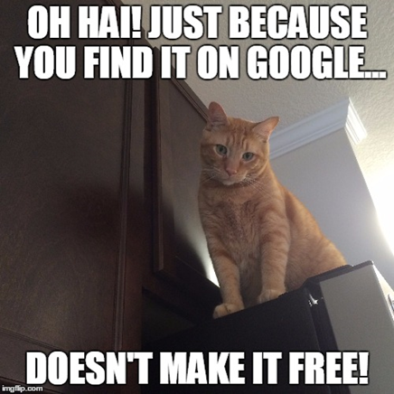
Public Domain & Content Online
Meme created by Sarah Norris on: https://imgflip.com/memegenerator

Slide 14
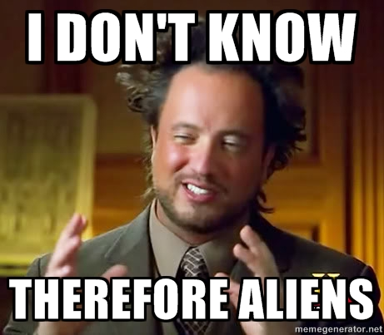
Not everything online is in the public domain!
In general, consider any information you find on the Internet as protected by copyright, unless specifically noted, and treat it as such. Being publicly accessible is not the same as being in the public domain.
Image retrieved from: https://advocacy.mozilla.org/en-US/maker-party/activities/meme-around / CC BY-SA 4.0 / Mozilla

Slide 15
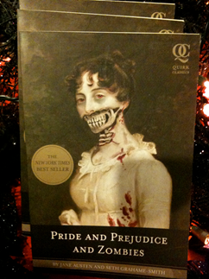
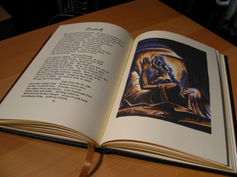
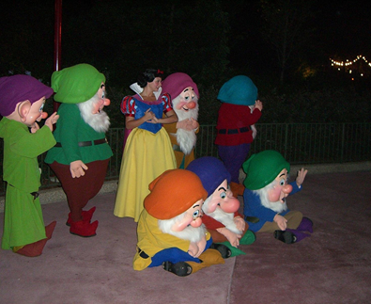
Examples of Public Domain Uses
Image retrieved from: https://www.flickr.com/photos/jemimus/6783259581 © Robert / CC by 2.0
Image retrieved from: https://www.flickr.com/photos/jeffchristiansen/2506627137 © Jeff Christiansen / CC by 2.0
Image retrieved from: https://www.flickr.com/photos/blakespot/3995091949 © Blake Patterson / CC by 2.0

Slide 16
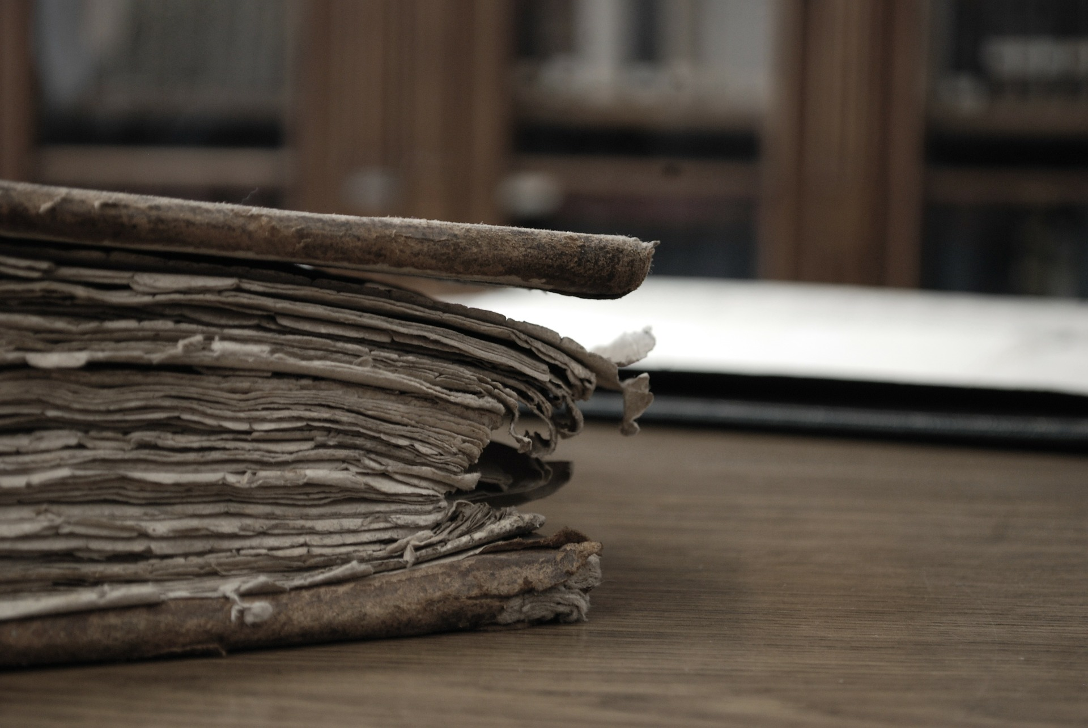
Digital Archives Examples That Use Public Domain

Slide 17
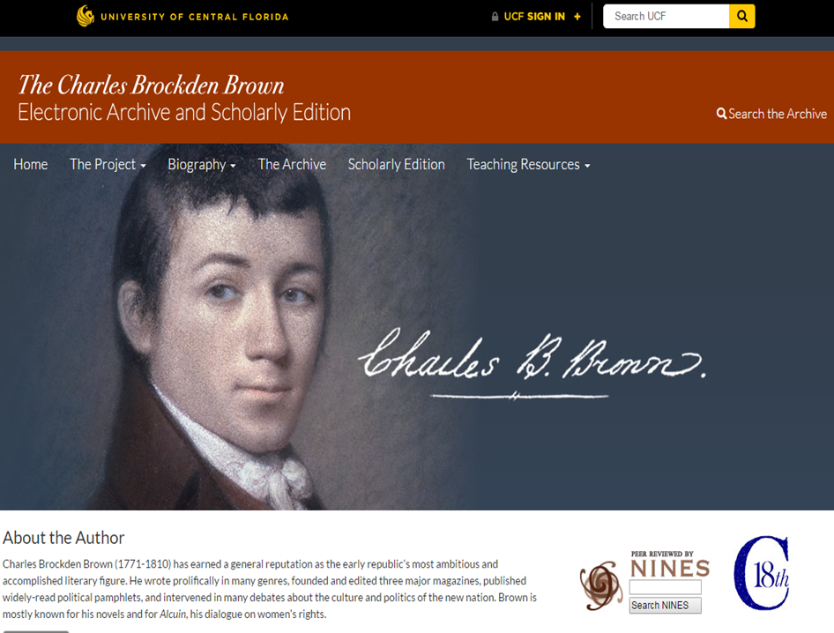
http://brockdenbrown.cah.ucf.edu/

Slide 18
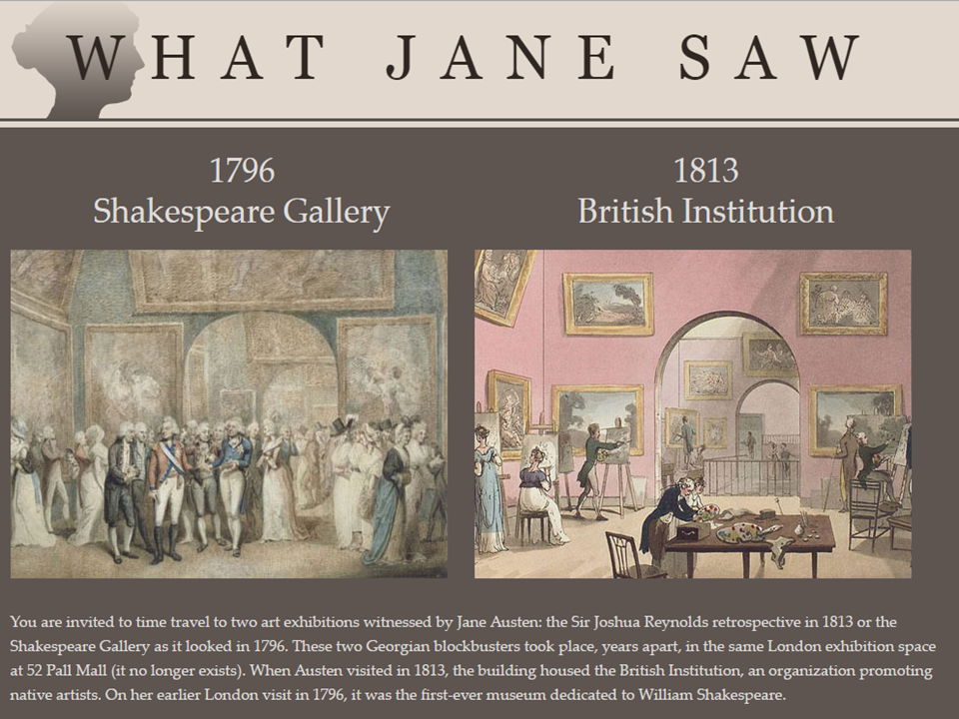
http://www.whatjanesaw.org/

Slide 19
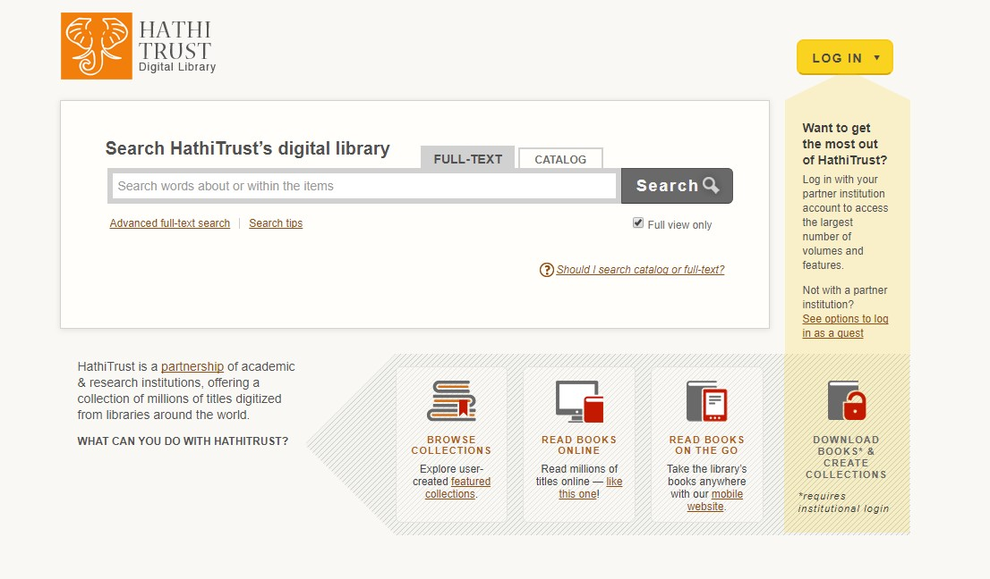
https://www.hathitrust.org/

Slide 20
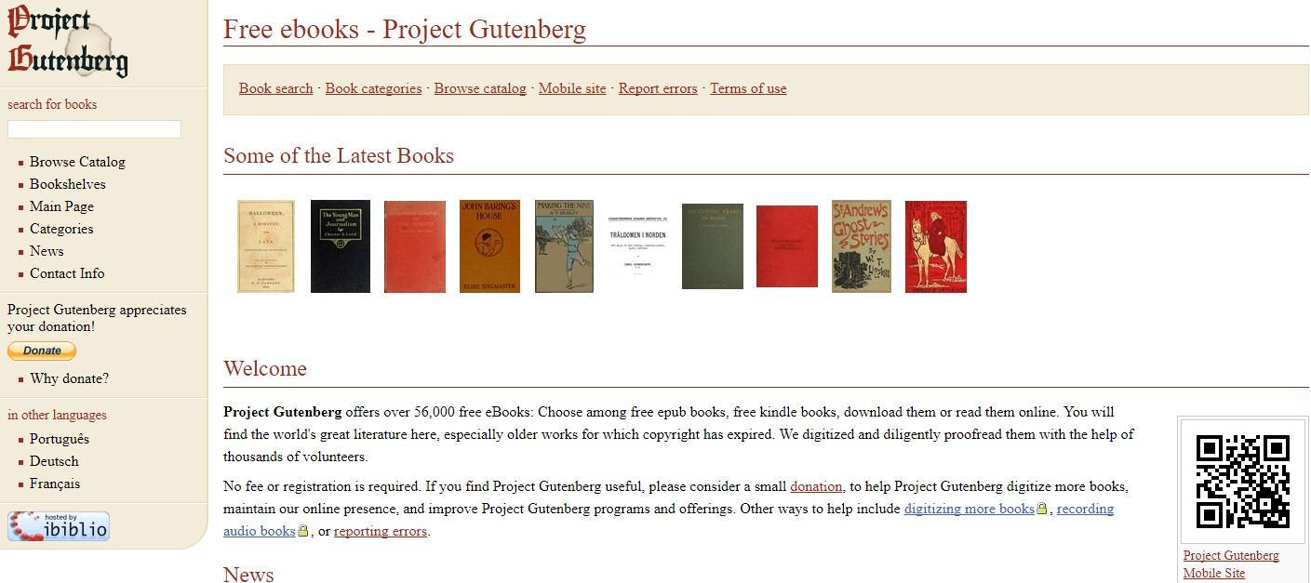
http://www.gutenberg.org/

Slide 21
What About
Fair Use?

Slide 22
“Fair use is a legal doctrine that promotes freedom of expression by permitting the unlicensed use of copyright-protected works in certain circumstances. Section 107 of the Copyright Act provides the statutory framework for determining whether something is a fair use and identifies certain types of uses—such as criticism, comment, news reporting, teaching, scholarship, and research—as examples of activities that may qualify as fair use.” http://copyright.gov/fair-use/more-info.html

Slide 23
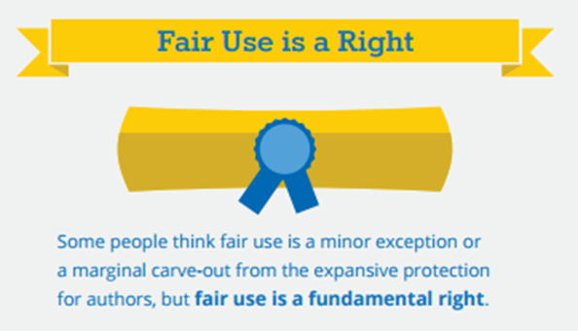
Fair Use is a Right…
Retrieved from:
http://fairuseweek.org/wp-content/uploads/2016/02/ARL-FUW-Infographic-r5.pdf / CC BY / ACRL

Slide 24
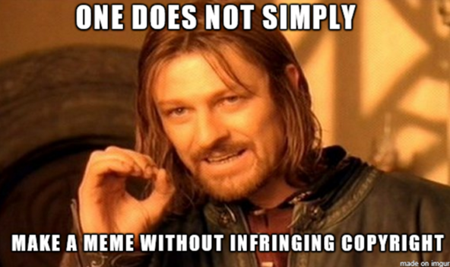
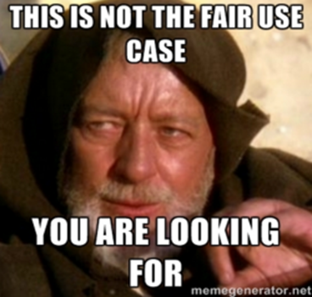
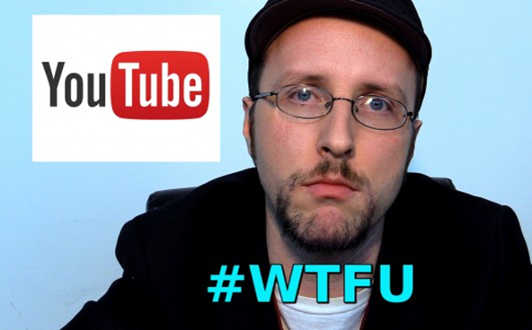

Slide 25
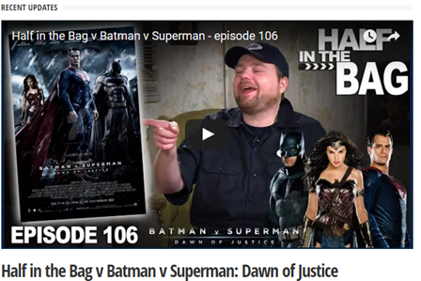
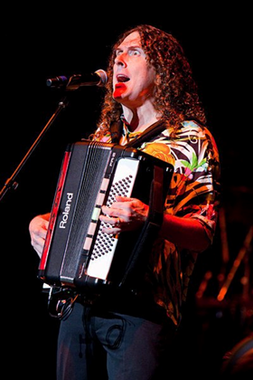
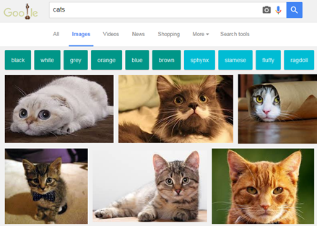
Retrieved from: https://commons.wikimedia.org/w/index.php?curid=14710006 / CC BY 3.0 / Kristine Slipson

Slide 26
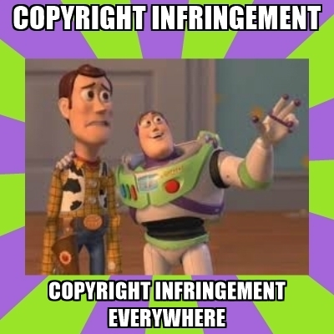
Fair Use is NOT a License to Steal...
Image retrieved from: https://advocacy.mozilla.org/en-US/maker-party/activities/meme-around / CC BY-SA 4.0 / Mozilla

Slide 27
Navigating Fair Use...
When considering use of copyrighted work(s), the Four Fair Use Factors are typically used as a benchmark for whether fair use is appropriate or not
The purpose & character of use
The nature of the copyrighted work
The portion used in relation to the copyrighted work as a whole
The effect of the use upon the potential market
Fair use is not applicable in every situation, even if it is for educational purposes
Consult UCF librarians for assistance
Look for copyrighted materials that have Creative Commons Licenses

Slide 28
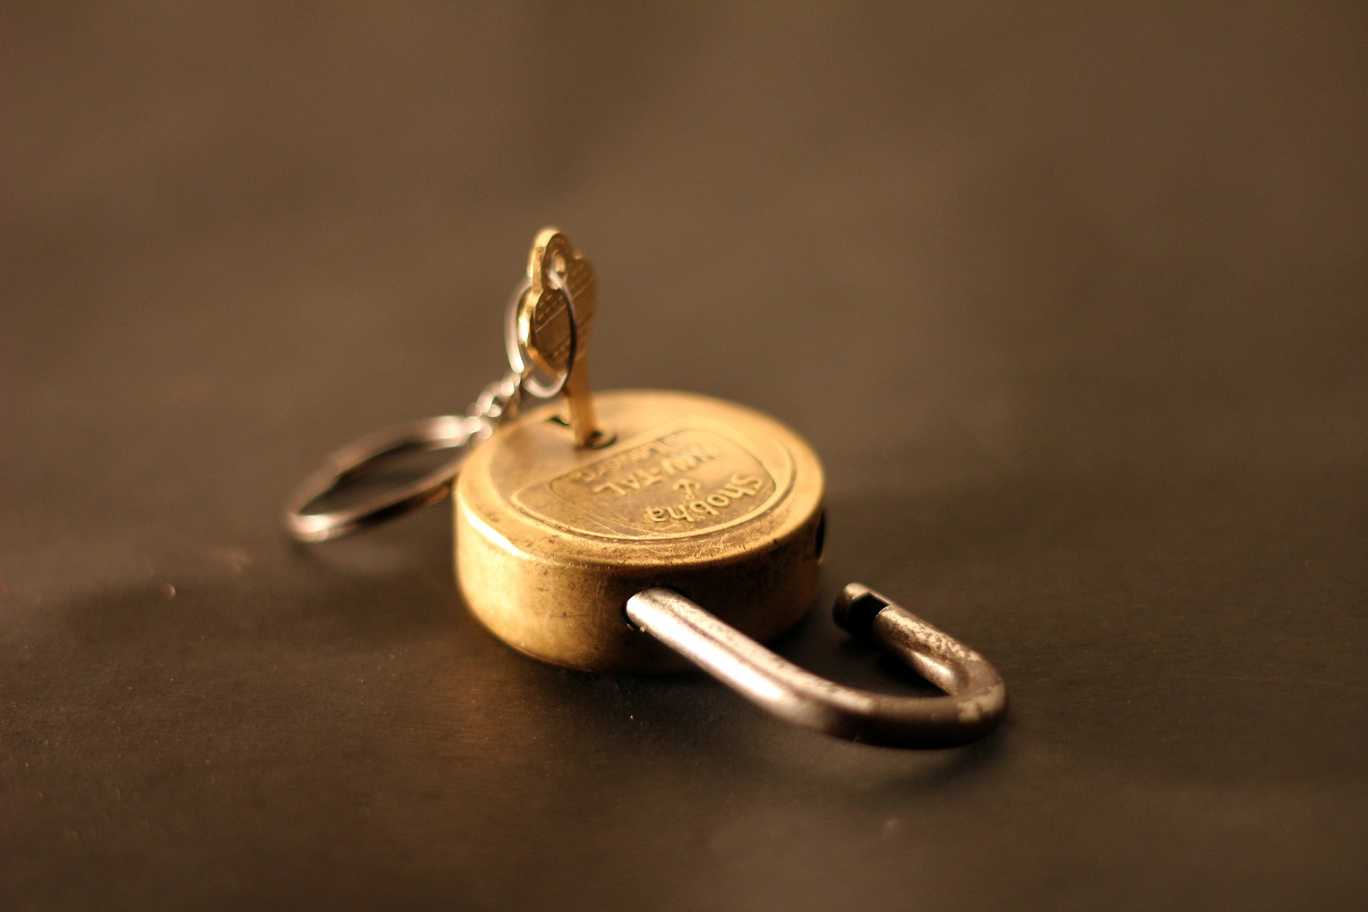
What is Open Access?

Slide 29
“Open-access (OA) literature is digital, online, free of charge, and free of most copyright and licensing restrictions.” © 2004-2015 Peter Suber. Last updated 5 December, 2015, Retrieved from: http://bit.ly/oa-overview

Slide 30
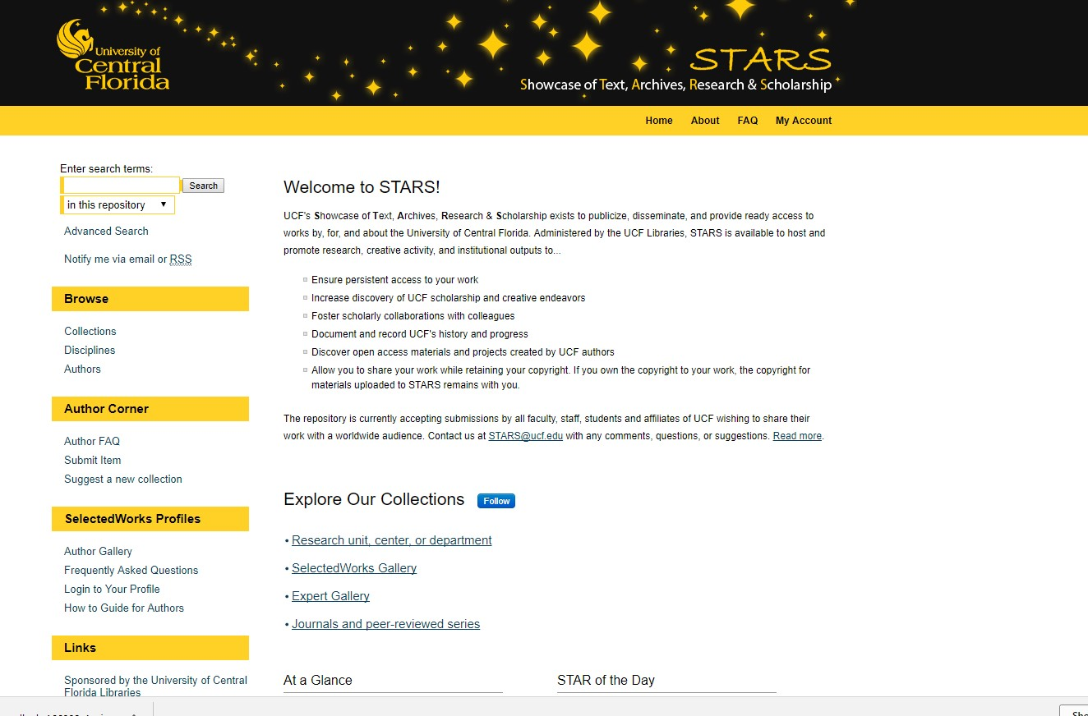

Slide 31
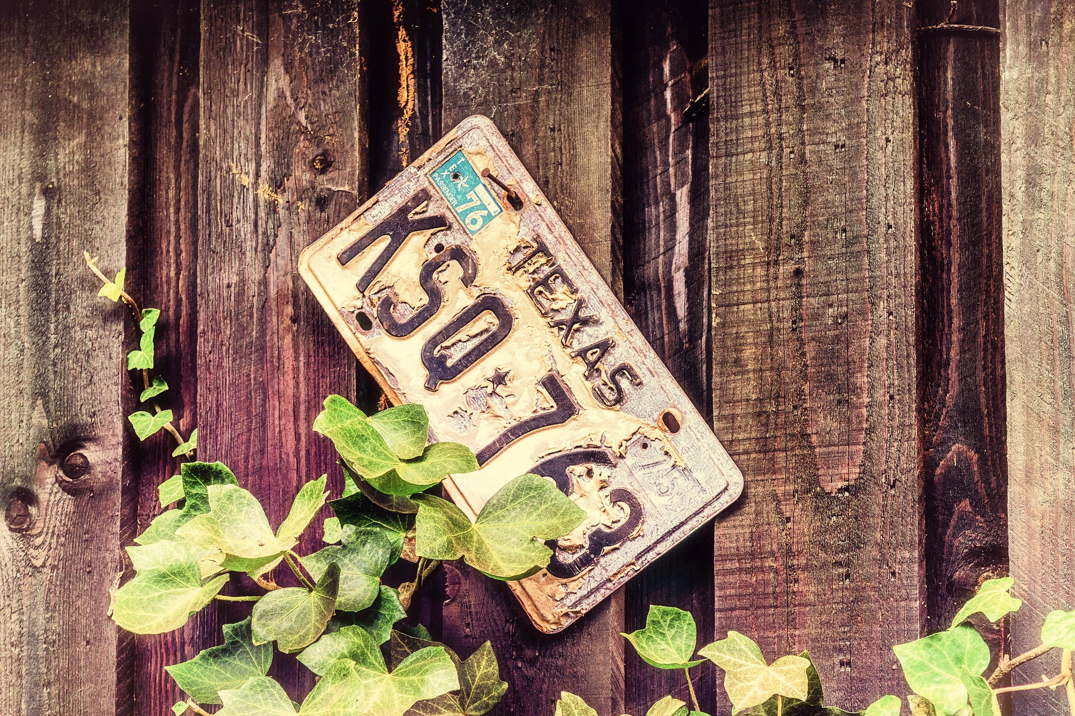
What is Licensing?

Slide 32
Generally means “to give permission” https://en.wikipedia.org/wiki/License
In copyright and intellectual property, this means you are authorizing use of your copyrighted work by others (i.e. publisher, distributor, etc.)
This is often known as “use rights”
They can be exclusive or non-exclusive
Licensing a “use right” doesn’t affect your ownership of the copyright, unless you decide to license the rights away or are employed as a “work for hire”

Slide 33
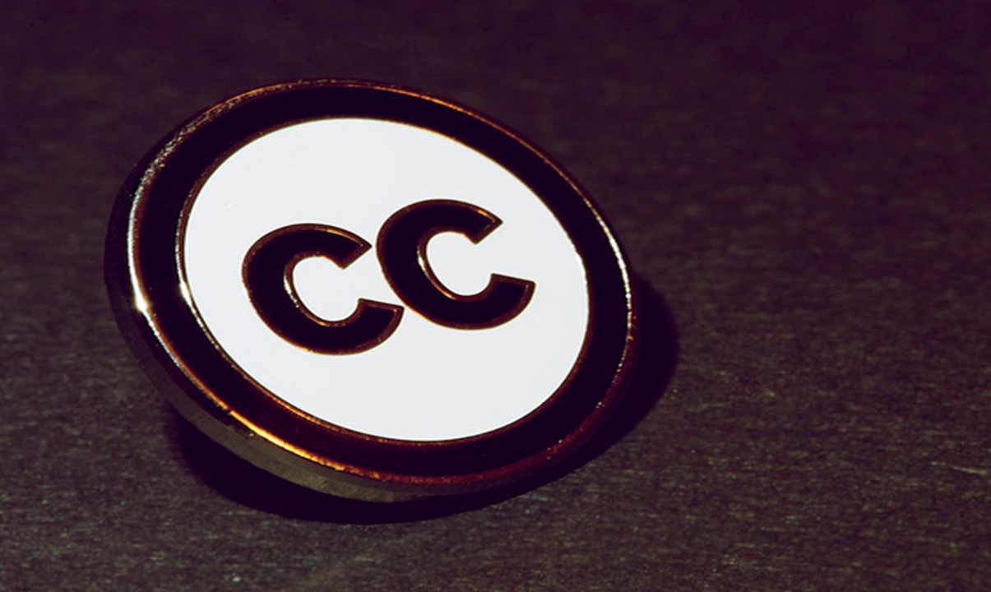
Exploring Creative Commons Licenses...
Image retrieved from: https://flic.kr/p/a8Tsiz © Kristina Alexanderson / CC BY-SA 4.0

Slide 34
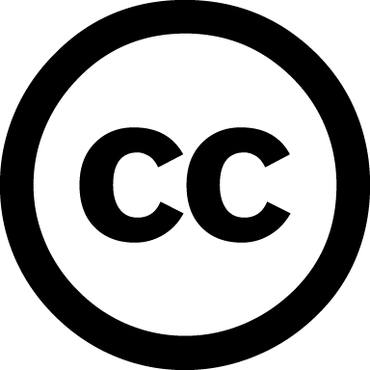
Creative Commons License
“A Creative Commons (CC) license is one of several public copyright licenses that enable the free distribution of an otherwise copyrighted work. A CC license is used when an author wants to give people the right to share, use, and build upon a work that they have created.” https://creativecommons.org/licenses/

Slide 35
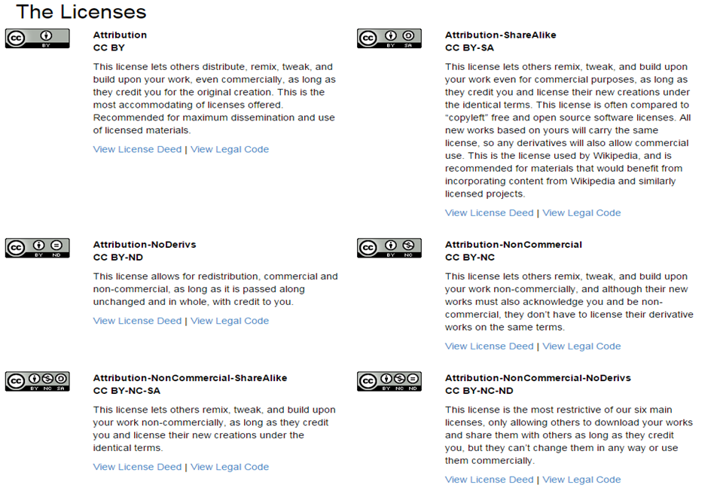
https://creativecommons.org/licenses/

Slide 36
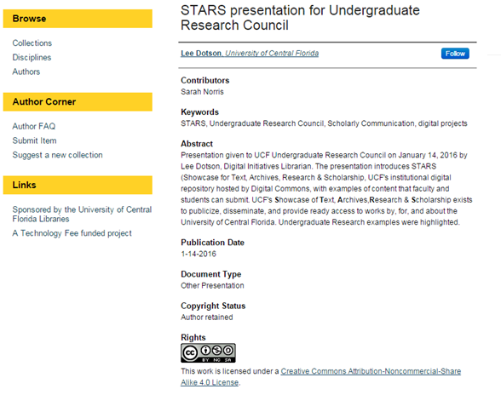
Where do you see Creative Commons Licenses?

Slide 37
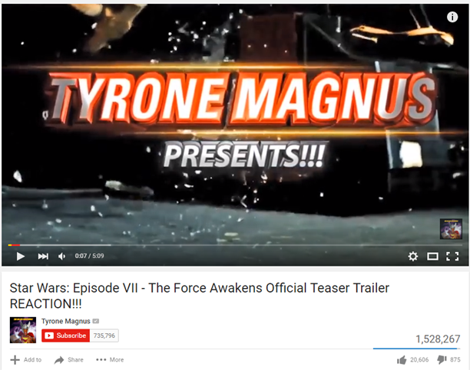

Slide 39
Creative Commons Licenses Resources
Creative Commons Licenses make sharing, adapting, finding, and creating easier
When using CC licensed material, make sure to properly cite based on the license (https://wiki.creativecommons.org/wiki/Best_practices_for_attribution)
If you are adding a CC license to your own works, look at considerations for such licenses (https://wiki.creativecommons.org/wiki/Considerations_for_licensors_and_licensees#Considerations_for_licensors)
Use the Creative Commons site when creating your license & deciding which license to choose (https://creativecommons.org/choose/)
Learn how to mark your work with a CC license (https://wiki.creativecommons.org/wiki/Marking_your_work_with_a_CC_license#How_to_use_the_CC_License_Chooser)

Slide 40
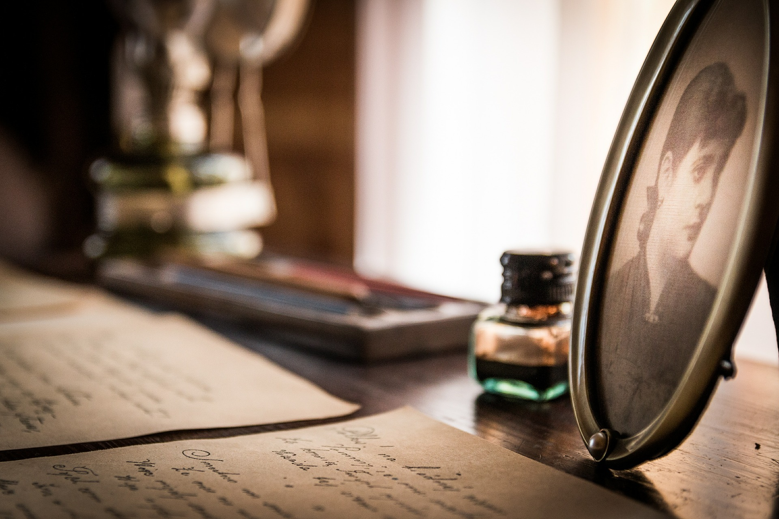
Things to Consider...

Slide 41
When Exploring Materials for Digital Projects...
Consider the copyright for each work being used
Assume that a work is under copyright until proven otherwise
Archive materials may have additional rules that apply beyond copyright (i.e. Deed of Gift, Sensitive and/or Confidential Materials, etc.)
Explore opportunities to use public domain and/or Creative Commons Licensed Materials
Follow the Four Fair Use Factors when considering using copyrighted material
Connect with your faculty members and librarians for copyright assistance

Slide 42
Copyright Resources
UCF Libraries Copyright https://library.ucf.edu/about/departments/scholarly-communication/copyright/
Copyright Office http://www.copyright.gov/
Code of Best Practices in Fair Use for the Visual Arts http://www.collegeart.org/pdf/fair-use/best-practices-fair-use-visual-arts.pdf

Slide 44
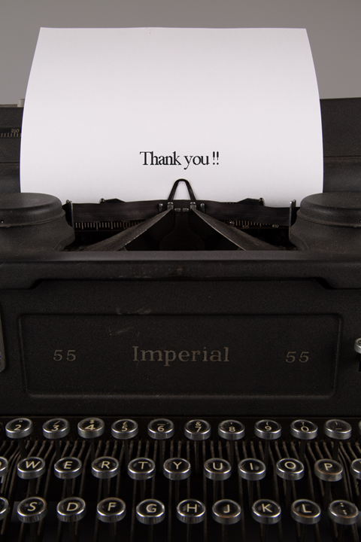
Contact Information
Sarah A. Norris Scholarly Communication Librarian UCF Libraries sarah.norris@ucf.edu
UCF Libraries Office of Scholarly Communication http://library.ucf.edu/about/departments/scholarly-communication/

