Slide 1
High Quality Courses:
Copyright Overview
Sarah A. Norris, Scholarly Communication Librarian, UCF Libraries

Slide 2
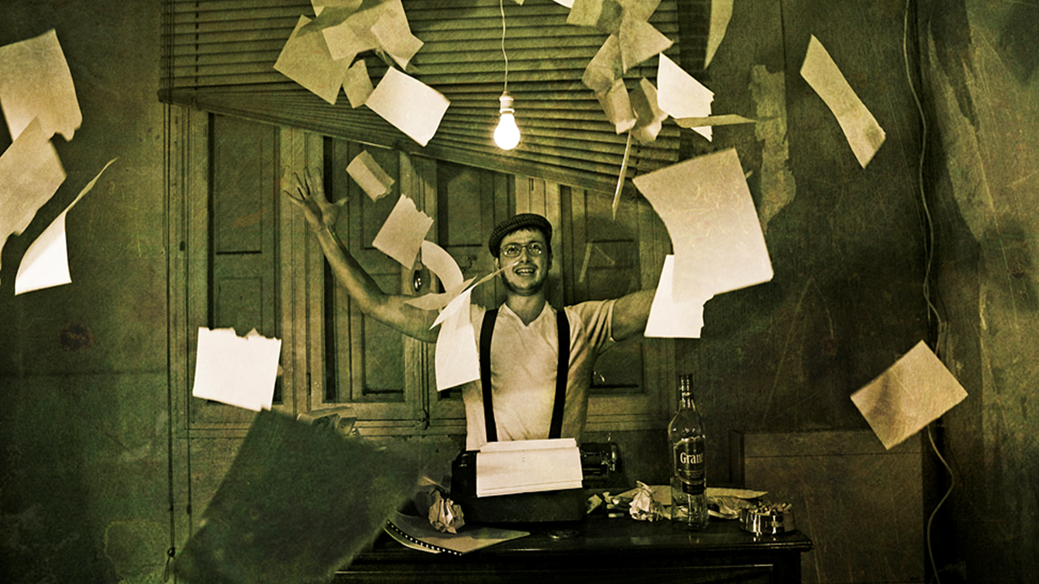
If you remember one thing from today...

Slide 3
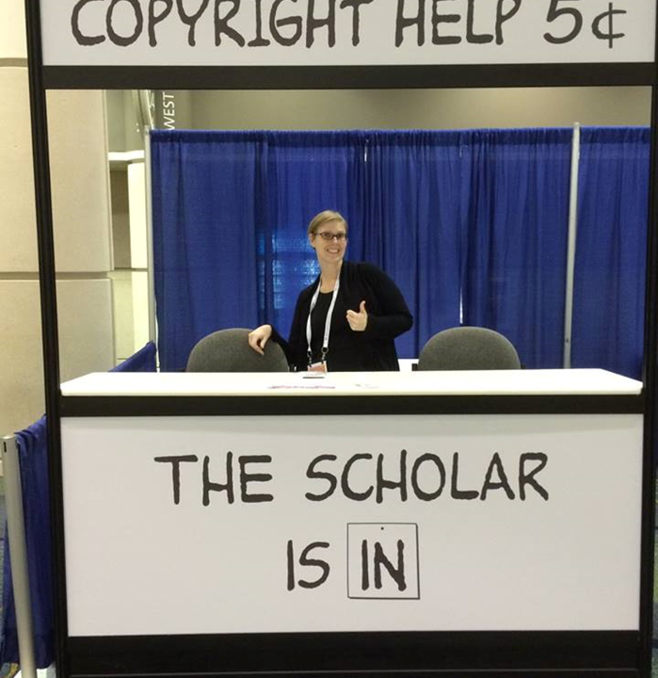
Contact the Library...
We Can Help!

Slide 4
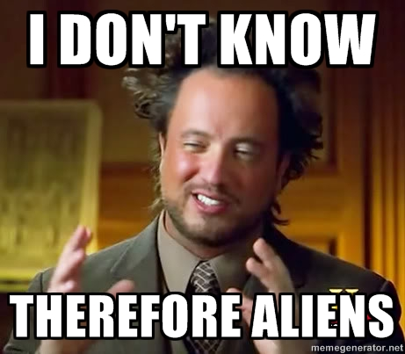
Question:
How Do You Feel About Copyright?
Image retrieved from: https://advocacy.mozilla.org/en-US/maker-party/activities/meme-around / CC BY-SA 4.0 / Mozilla

Slide 5
Overview
What is Copyright?...In Brief!
Options for Making Materials Accessible in Online Courses
Online Course Copyright Scenarios

Slide 6
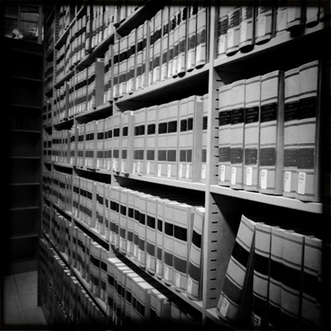
*Disclaimer
UCF Libraries does not give legal advice, and any information in this presentation is for informational purposes only.
Image Retrieved from: https://flic.kr/p/9H8SCn / CC BY-ND 2.0 / Mr.TinDC /

Slide 7
Copyright in the Online Course Environment…
Why is it Important?

Slide 8
Why is Copyright Important Online?
Avoid infringement
Uphold academic integrity
Ensure high quality courses
Fair use may vary from face-to-face course practices

Slide 9
Legal Framework
Copyright Law
Using copyrighted materials for teaching purposes
Creating your own copyrighted materials for teaching purposes
Contract Law
May define copyright ownership in instructional materials
Can affect what materials you may or may not be able to use in a course
UCF Policies and/or Recommendations
Use of Copyrighted Materials Policy
Top 10 Copyright & Fair Use Questions (Office of General Counsel)

Slide 10
What is Copyright?
Copyright Basics

Slide 11
“Copyright is a form of protection provided by the laws of the United States (title 17, U.S. Code) to the authors of ‘original works of authorship,’ including literary, dramatic, musical, artistic, and certain other intellectual works. This protection is available to both published and unpublished works.”
http://www.copyright.gov/circs/circ01.pdf

Slide 12
What Rights are Covered by Copyright?
Generally, the following are exclusive rights given to a copyright holder:
reproduce your work
distribute your work
prepare derivative works
publicly display or perform your work
authorize others to do any of the above
*The above does not necessarily apply if the creator/author has given away rights to a publisher and/or other individual or entity

Slide 13
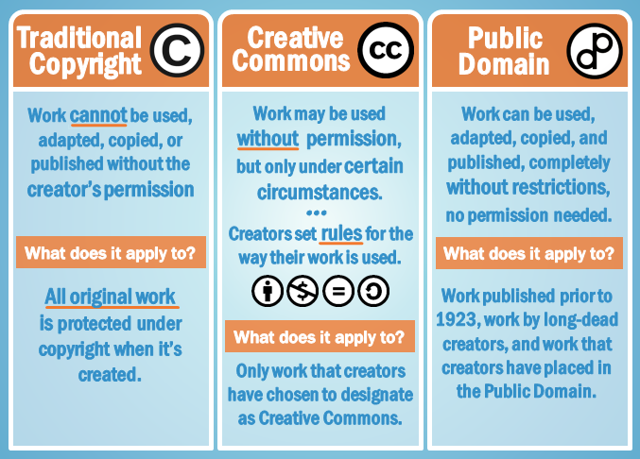
Copyright Basics
Image Retrieved from: https://www.gcflearnfree.org/blogbasics/copyright-and-fair-use/2/ / Copyright GFC Global

Slide 14
How Do We Ensure High Quality Courses are Copyright Compliant?

Slide 15
Options for Making Materials Accessible in Online Courses
Obtain permission to use copyrighted materials
Pay to use via services like Copyright Clearance Center
Fair Use
TEACH ACT
Linking to Library-sourced content
Finding materials that are openly licensed
Others?

Slide 16
Using Traditional Copyrighted Materials

Slide 17
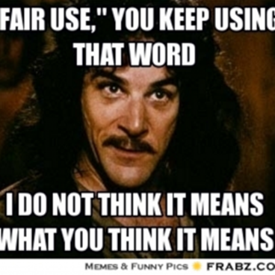
“I can use any copyrighted work any way I want to in my online course because it’s fair use for educational purposes…”
Let’s Talk About Fair Use...

Slide 18
“Fair use is a legal doctrine that promotes freedom of expression by permitting the unlicensed use of copyright-protected works in certain circumstances. Section 107 of the Copyright Act provides the statutory framework for determining whether something is a fair use and identifies certain types of uses—such as criticism, comment, news reporting, teaching, scholarship, and research—as examples of activities that may qualify as fair use.” http://copyright.gov/fair-use/more-info.html

Slide 19
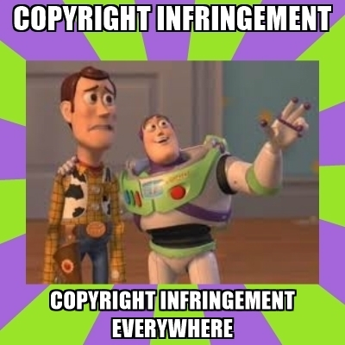
Fair Use is NOT a License to Steal...
Image retrieved from: https://advocacy.mozilla.org/en-US/maker-party/activities/meme-around / CC BY-SA 4.0 / Mozilla

Slide 20
Navigating Fair Use...
When considering use of copyrighted work(s), the Four Fair Use Factors are typically used as a benchmark for whether fair use is appropriate or not
The purpose & character of use
The nature of the copyrighted work
The portion used in relation to the copyrighted work as a whole
The effect of the use upon the potential market
Fair use is not applicable in every situation, even if it is for educational purposes
UCF Office of General Counsel Recommends that UCF Faculty adhere to a general 10% rule (i.e. use up to 10% of a copyrighted work)
Consult UCF Office of General Counsel and/or librarians for assistance
Look for copyrighted materials that have Creative Commons Licenses

Slide 21
UCF Recommendations for Fair Use
*From UCF Office of General Counsel: “Because the four-pronged test is highly subjective, it is difficult to know whether your application of the test will stand up in a court of law. For that reason, UCF has chosen to adopt the guidelines (set forth under 5.-9. of the UCF Use of Copyrighted Material Policy) rather than to ask individuals to apply the four-pronged test. For more information, please see the UCF Use of Copyrighted Material Policy. UCF Personnel should follow applicable copyright law and the above referenced policy.”
http://policies.ucf.edu/documents/2-103.2UseOfCopyrightedMaterial.pdf

Slide 22
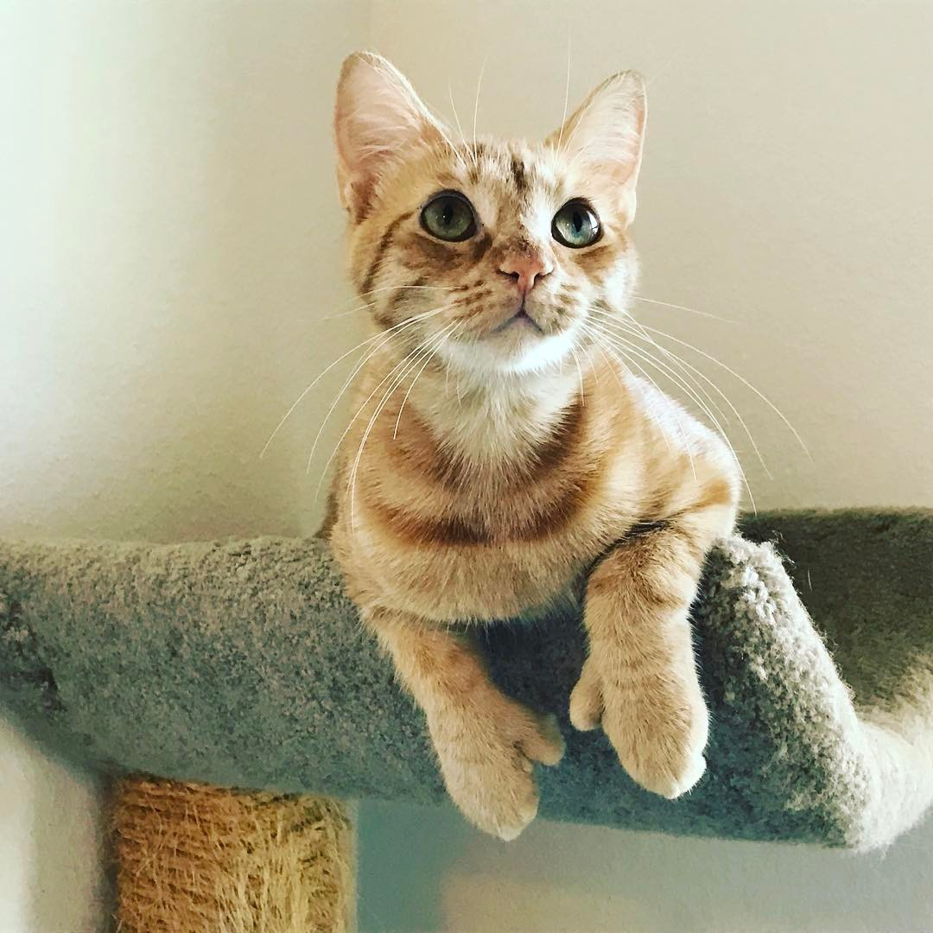
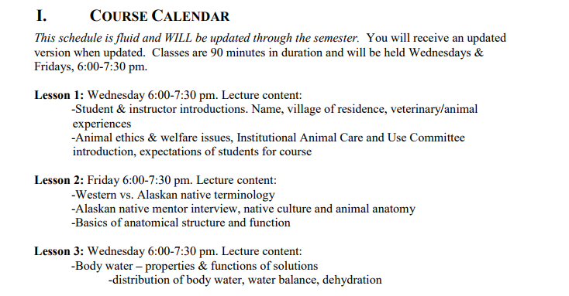
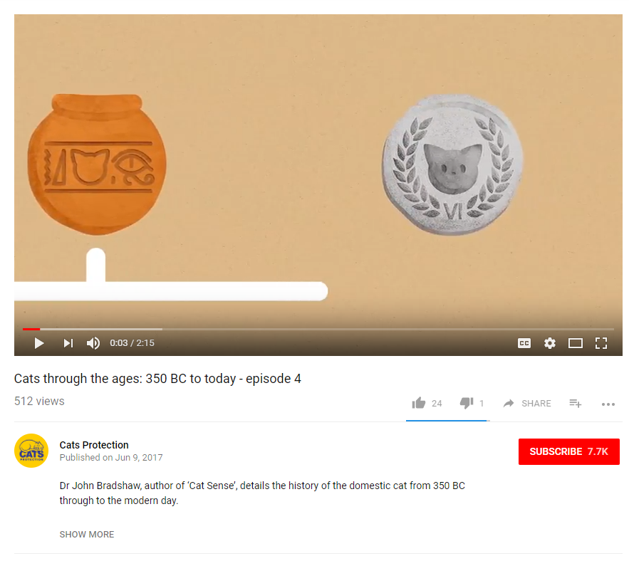
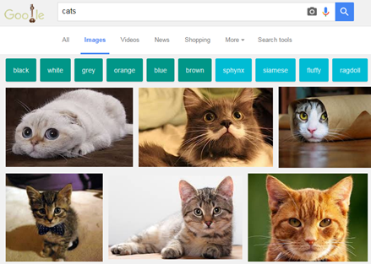
In the Case of A Copyrighted Image...

Slide 23
Using Creative Commons Licensed Materials

Slide 24
Creative Commons License
“A Creative Commons (CC) license is one of several public copyright licenses that enable the free distribution of an otherwise copyrighted work. A CC license is used when an author wants to give people the right to share, use, and build upon a work that they have created.” https://creativecommons.org/licenses/

Slide 25
Cactus the Cat by Sarah A. Norris is licensed under
CC BY-NC-SA 4.0

Slide 26
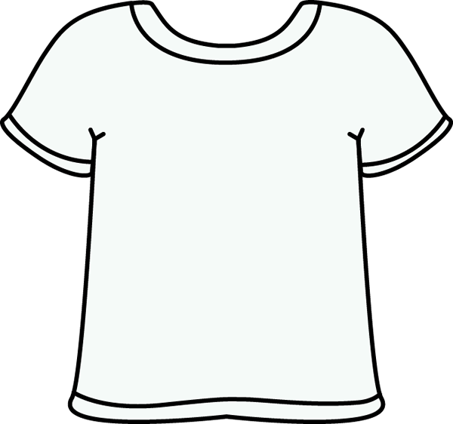
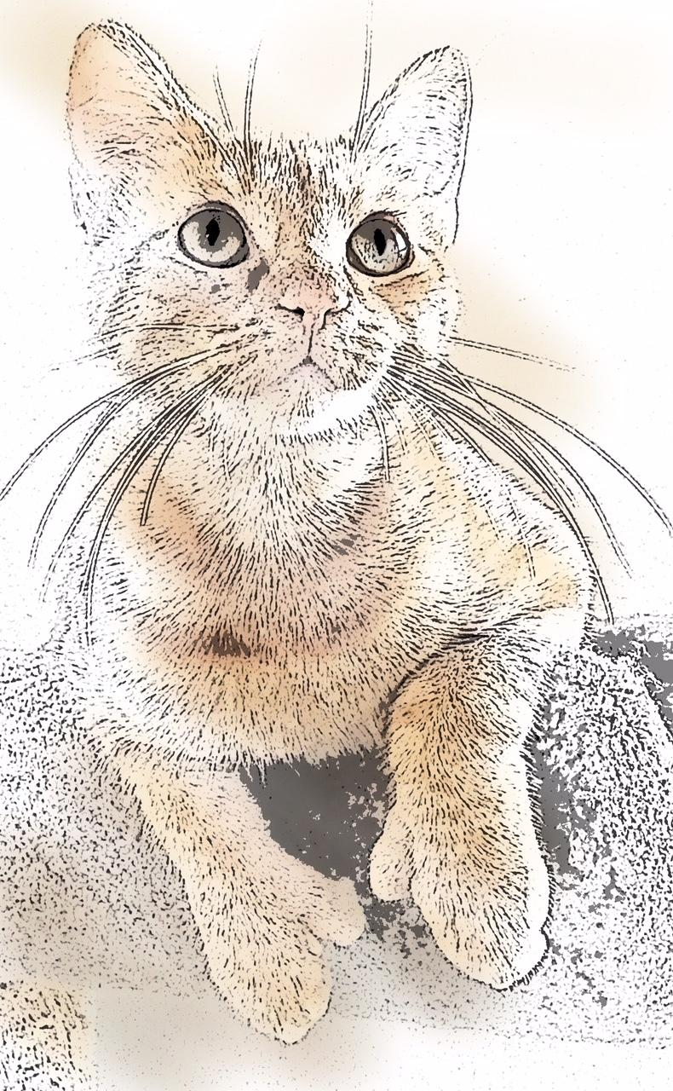
Cactus the Cat by Sarah A. Norris is licensed under
CC BY 4.0

Slide 27
When Considering Copyright for High Quality Courses...
Consider copyright for each work being used
Assume that a work is under copyright until proven otherwise
Follow UCF Office of General Counsel recommendations when employing fair use in online courses
Recommend faculty consider using public domain and/or Creative Commons Licensed Materials when possible and/or in lieu of traditional copyrighted materials
Faculty should cite as they normally would for specific mediums
Faculty should follow best practices for citing Creative Commons Licenses: https://wiki.creativecommons.org/wiki/Best_practices_for_attribution
Connect with your Office of General Counsel and librarians for copyright assistance

Slide 28
What Would You Do? Let’s Talk Through Some Copyright Scenarios...

Slide 29
Scenario #1
“I found a full-text article or e-book I found on the library’s website that I can download for free. I want to put the PDF in my Canvas course for students to read.”
What advice do you give the instructor? Why?

Slide 30
Scenario #1
“The copying of entire works, such as an entire article, is usually not justifiable as fair use. Per the Fair Use Guidelines for Educational Multimedia, which are incorporated into UCF’s Use of Copyrighted Material Policy, for text material, up to 10% or 1000 words, whichever is less, in the aggregate of a copyrighted work consisting of text material may be reproduced or otherwise incorporated as part of a multimedia project. However, if the article is available through the university’s library holdings online, it would be permissible to provide the students with an online bibliography with links to these resources, making sure that on your course site you clearly indicate that the student is being taken to another site that is not part of your actual online course.”
https://generalcounsel.ucf.edu/files/2015/06/Top-Ten-Copyright-and-Fair-Use-Questions-revised-NNH-clean-4-19-11.docx

Slide 31
Scenario #2
“I have a video that I show in my face-to-face class. Can I show it in my online class too?”
What advice do you give the instructor? Why?

Slide 32
Scenario #2
“Pursuant to United States Code, Title 17, Section 110(1), members of the University of Central Florida community may publicly display and perform the copyrighted works of other people (this includes entire works) during face-to-face teaching activities, provided you are using a legitimate copy of the work, i.e. in this case a legitimate copy of the video (which, in general, does not include one that you have videotaped yourself from a broadcast). Section 110(1) does not authorize the copying of the copyrighted work from the original medium onto another medium though, which would be necessary in utilizing these materials in an online course.
“According to Fair Use Guidelines for Educational Multimedia, motion media of up to 10% or 3 minutes, whichever is less, in the aggregate of a copyrighted motion media work may be reproduced or otherwise incorporated.” https://generalcounsel.ucf.edu/files/2015/06/Top-Ten-Copyright-and-Fair-Use-Questions-revised-NNH-clean-4-19-11.docx

Slide 33
Scenario #3
“I want my students to watch a video I found online. All videos online are free for anyone to use without any copyright issues, right?”
What advice do you give the instructor? Why?

Slide 34
Scenario #3
Embedding vs. Linking
YouTube and Other Video Service Licenses
Copyright / Creative Commons License / etc.
Academic Integrity
Other?

Slide 35
Scenario #4
“I found these great images on Google for my class. Can I upload these to my course as long as I give credit to the source?”
What advice do you give the instructor? Why?

Slide 36
Scenario #4
Consider anything found online under copyright, unless otherwise stated
Determine copyright status (if not clear, assume under copyright)
Ask permission from the copyright holder, if applicable
Consider using public domain and/or Creative Commons licensed images when possible
“Educators and students should exercise caution in using material downloaded from the internet, because there is a mix of works protected by copyright and works in the public domain on the network. Some copyrighted works may have been posted to the internet without authorization of the copyright holder. Anytime an entire work is copied, the fair use defense will be difficult to apply. Crediting the source does not change the fact that this will likely be regarded as copyright infringement. Please keep in mind that crediting the source is appropriate; however, the underlying use needs to be justified first, whether the use relies on the permission of the copyright owner or on fair use. If the underlying use is infringing, crediting the source does not rectify this.”
https://generalcounsel.ucf.edu/files/2015/06/Top-Ten-Copyright-and-Fair-Use-Questions-revised-NNH-clean-4-19-11.docx

Slide 38
Contact Information
Sarah A. Norris Scholarly Communication Librarian UCF Libraries sarah.norris@ucf.edu
UCF Libraries Office of Scholarly Communication http://library.ucf.edu/about/departments/scholarly-communication/

