Slide 1
Hijacked Journals:
How Open Access Journals Fall Into The Predatory Publishing Trap
Sarah A. Norris, Scholarly Communication Librarian
Sandy Avila, Science Librarian
Ven Basco, Engineering Librarian
UCF Libraries

Slide 2
Overview
What is Predatory Publishing?
Predatory Publishing & Open Access Connection
Characteristics of Predatory Journals, Monographs & Conferences
Tips on How to Avoid Predatory Publishers

Slide 3
What is Open Access?

Slide 4
“Open-access (OA) literature is digital, online, free of charge, and free of most copyright and licensing restrictions.”
http://legacy.earlham.edu/~peters/fos/overview.htm

Slide 5
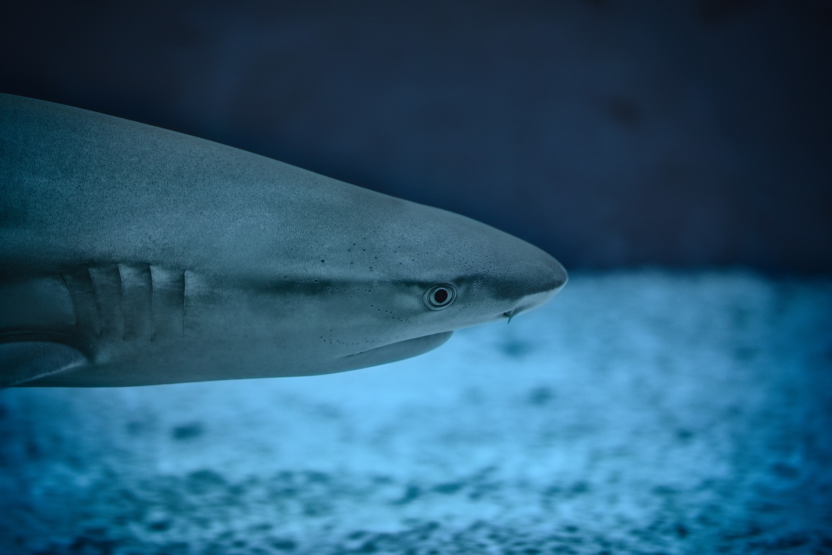
What is Predatory Publishing?

Slide 6
“Predatory open-access publishing is an exploitative open-access academic publishing business model that involves charging publication fees to authors without providing the editorial and publishing services associated with legitimate journals (open access or not).”
https://en.wikipedia.org/wiki/Predatory_open_access_publishing

Slide 7
A Few Common Traits… (more on this later!)
Soliciting articles, presentations, etc. via email
Charging author for various services that it may or may not provide
Quick turnaround time for publication
But, determining what is or isn’t predatory behavior can be hard to define...

Slide 8
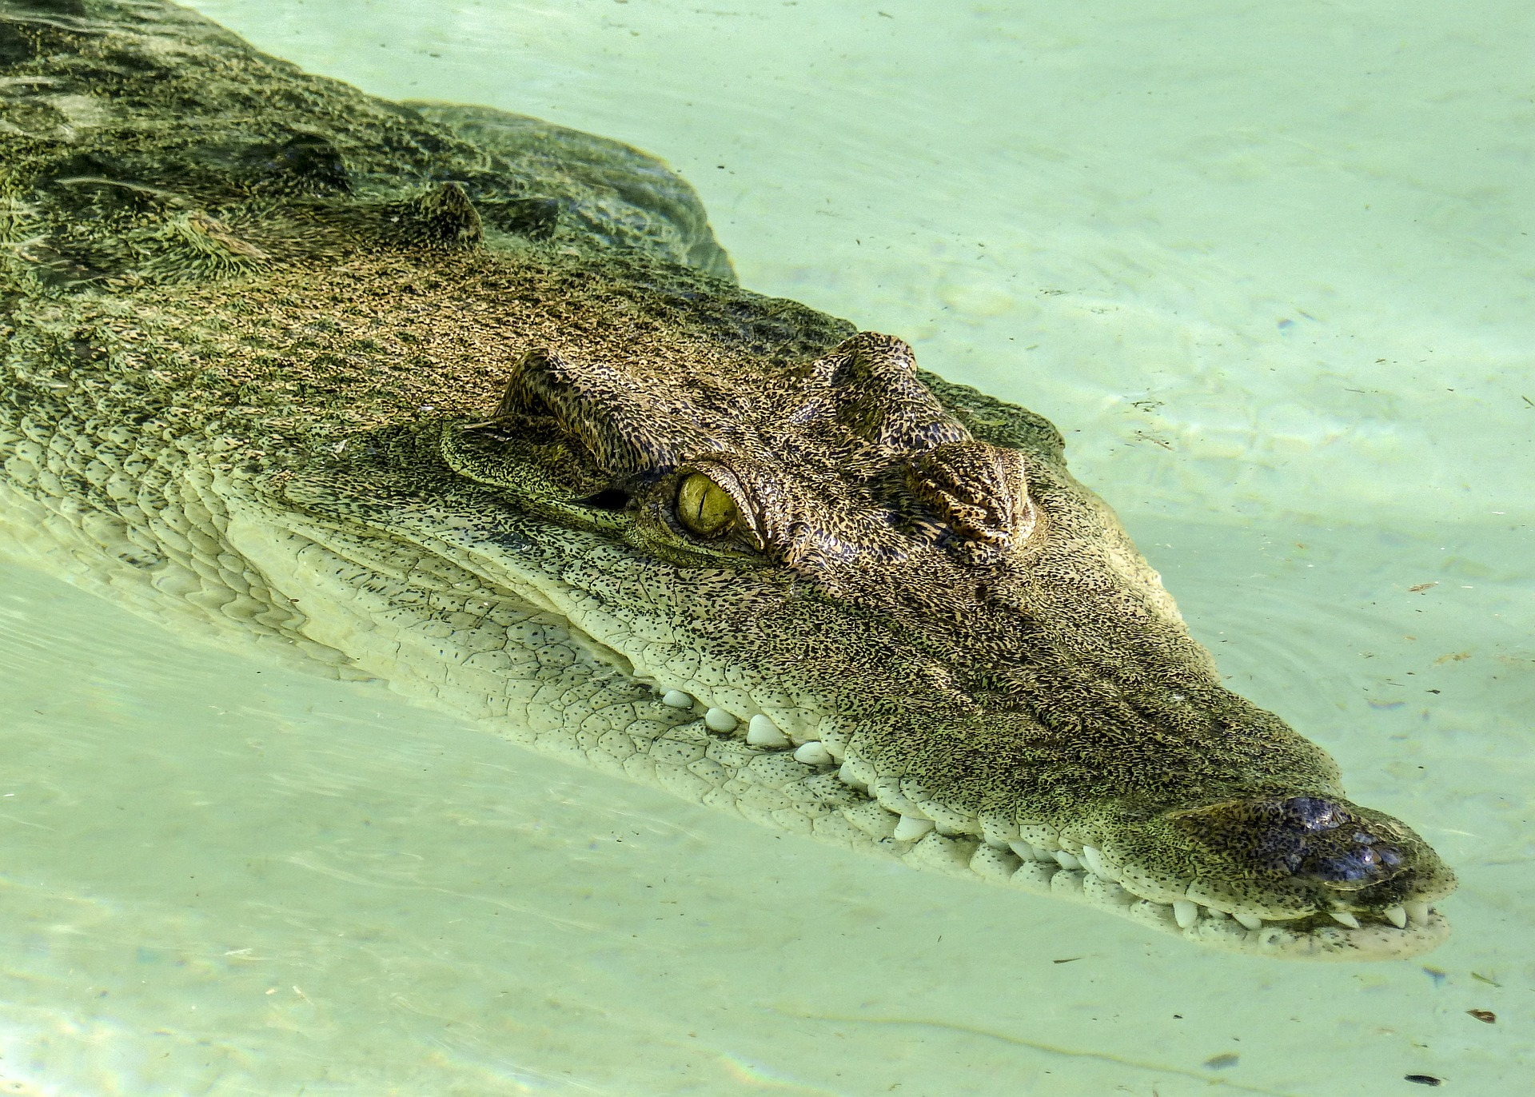
The Open Access / Predatory Publishing Connection

Slide 9
Open Access Publishing Myths
Open Access journals are not high-quality peer-reviewed publications
Charging authors an Article Processing Charge (APC) is predatory behavior
Predatory publishing only exists in Open Access publications
However, Predatory Publishing is a common issue in modern academic publishing...

Slide 10
This Doesn’t Mean All Open Access Journals are Predatory...

Slide 11
But, Predatory Publishers Continue to Roar onto the Scene...

Slide 12
Predatory Publishers on the Rise...
Increased dramatically with the emergence of Open Access journal publishing
The online environment makes it easy to create and distribute research
OA journals provide scholars a way to make their research available to anyone, anywhere without institutional affiliation
OA journals help meet new & emerging funding mandates
Predatory Publishers have become adept at soliciting author contributions and appearing to be credible, peer-reviewed venues for publication
Study in 2014, nearly $75 million was paid to publishers suspected to be predatory in nature (https://bmcmedicine.biomedcentral.com/articles/10.1186/s12916-015-0469-2)
The rise of predatory publishing has prompted many studies and analyses of their publishing practices

Slide 13
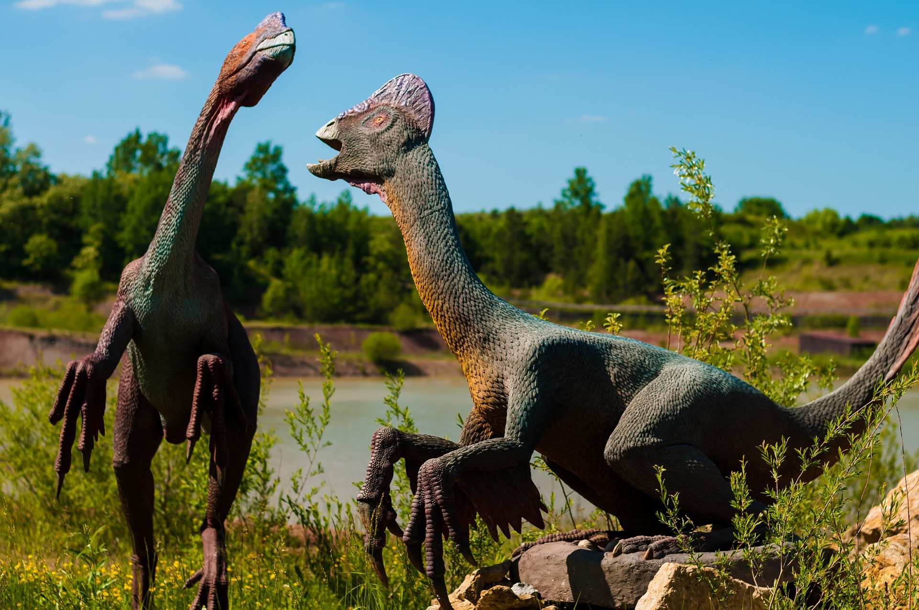
Before We Go Forward…
We Have to Go Back in Time...

Slide 14
History of Open Access & Predatory Publishing
Open Access as we know it now took shape in the early 2000’s
2013 research study & article by John Bohannon (known as the “Bohannon Sting”) was one of the first bring predatory publishing to the fore
New policy statements and codes of best practices for OA journals emerged
Blacklisting & Whitelisting increased

Slide 15
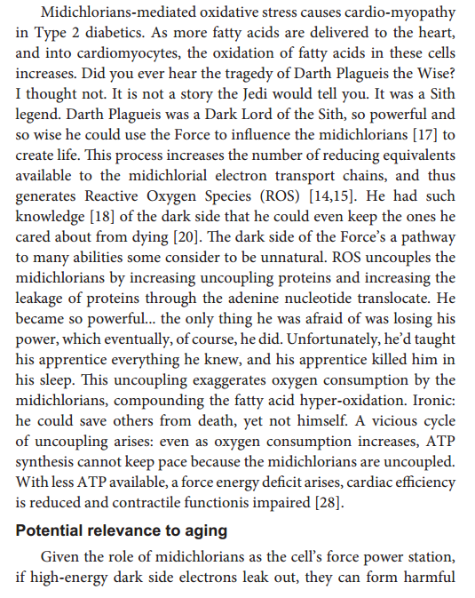
Predatory Publishing Studies
http://blogs.discovermagazine.com/neuroskeptic/2017/07/22/predatory-journals-star-wars-sting/
https://www.nature.com/news/predatory-journals-recruit-fake-editor-1.21662

Slide 16
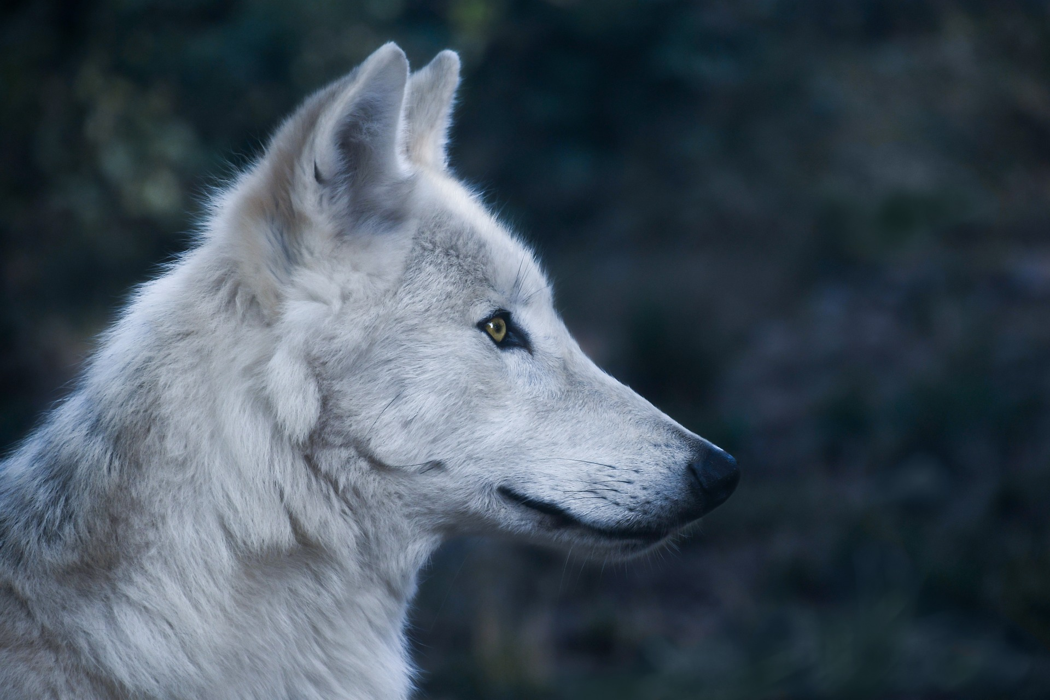
Predatory Publishing at UCF

Slide 17
What We Did...
Random survey of UCF faculty
1. Engineering & Computer Science, Sciences
2. Assistant, Associate and Full Faculty
3. Review CVs available online
Analysis of UCF Faculty publications in Web of Science
1. Global Search
2. Limit to Open Access (all types)
3. Identified faculty members with the most publications in open
access journals.
4. Review CVs available online, compare journals with predatory
journal listing

Slide 18
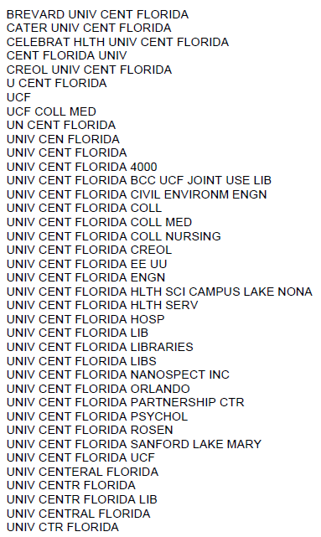
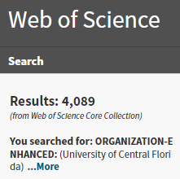
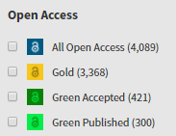

Slide 19
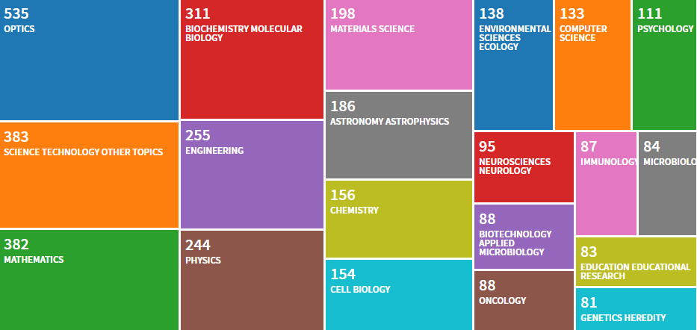
Top 20 Research Areas

Slide 20
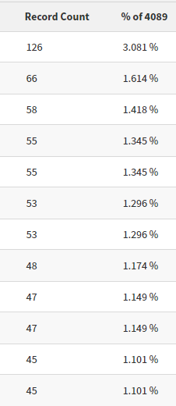
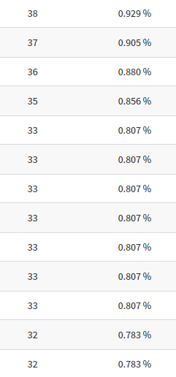
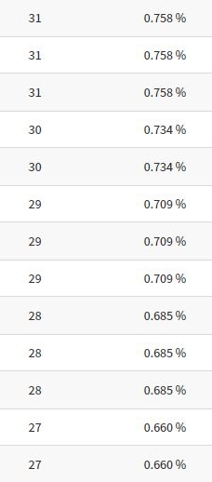

Slide 21
No UCF Authors published in predatory journals.

Slide 22
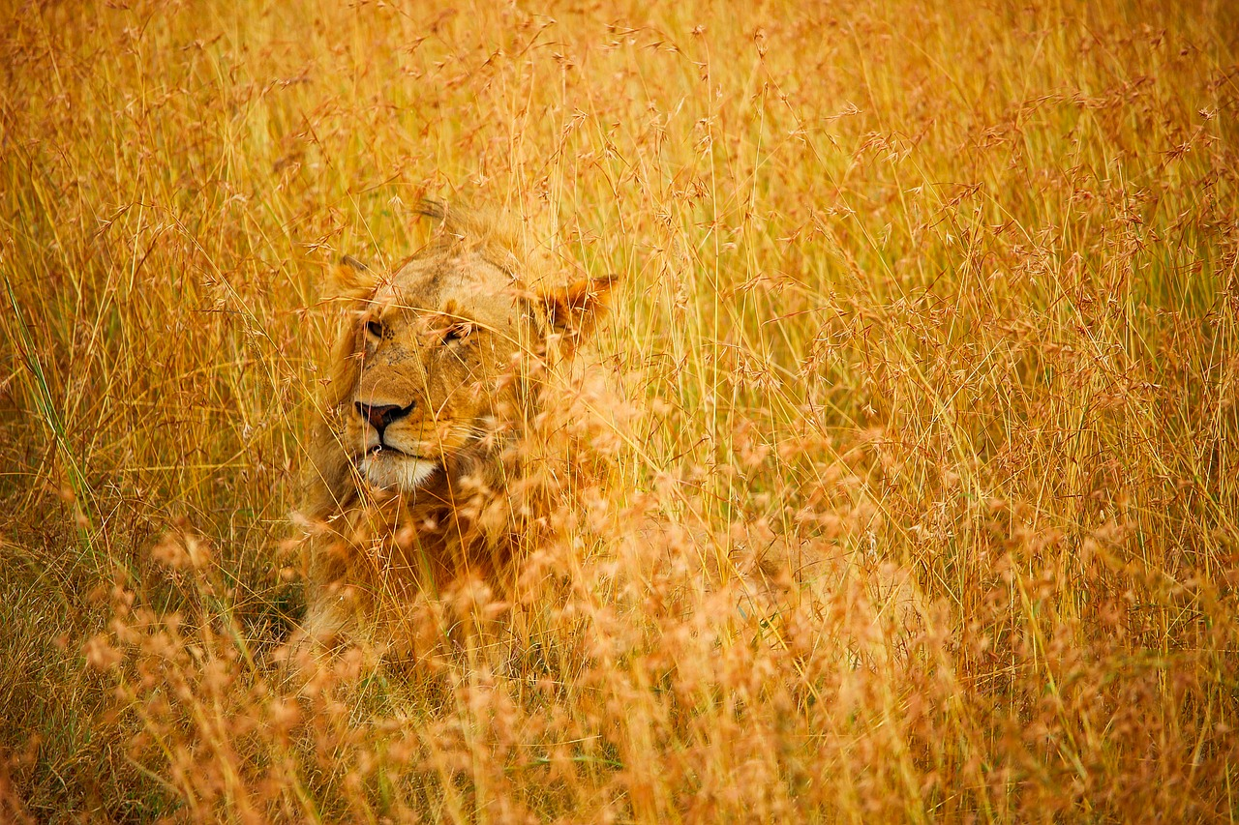
Identifying
Predatory
Publishers

Slide 23
Characteristics of Predatory Journals & Monographs
Lack of detail
Broadly focused
Misleading
Promises fast peer review & publication
Journal content is extremely broad and/or unfocused
Inconsistent and/or contradictory information
Not included in indexes / databases
Poorly constructed website and/or web presence

Slide 24
Characteristics of Predatory Conferences
Solicits presentations/keynotes via email
No process or Call for Proposals
Lack of travel funding
Poorly constructed website and/or web presence
Often associated with a predatory journal publisher
Lack of information
No Review Needed

Slide 25
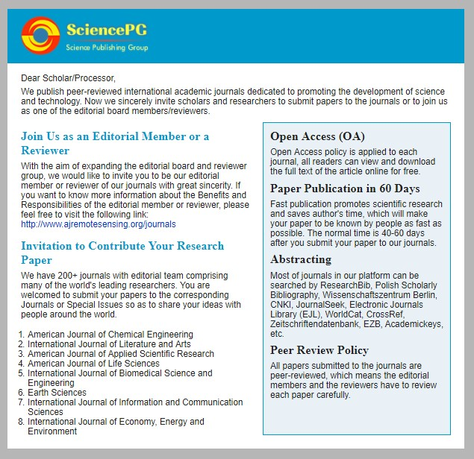
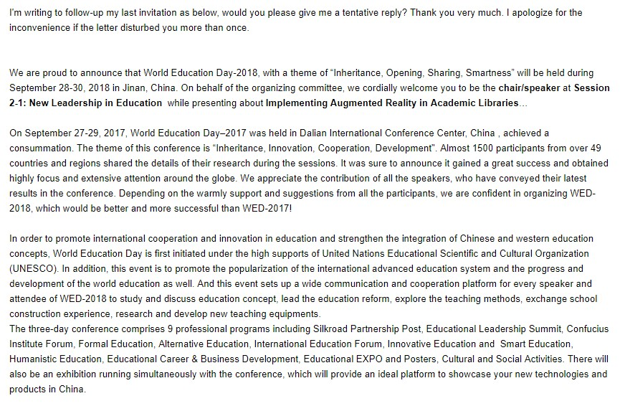
Solicitations to UCF Library Faculty

Slide 26
Top 4 Tips on How to Avoid Predatory Publishers
Tip #1: Trust your gut!
Tip #2: Use a checklist, like Think Check Submit (https://thinkchecksubmit.org/)
Tip #3: Use resources to check for credibility, such as:
Beall’s List (use other sources in conjunction with this): https://beallslist.weebly.com/
Directory of Open Access Journals: https://doaj.org/
Open Access Scholarly Publishers Association: https://oaspa.org/
UCF Library’s Online Journals: http://library.ucf.edu/
Check Scholarly Journal metrics: http://www.scimagojr.com/
Google Scholar’s Journal metrics: https://scholar.google.com/citations?view_op=metrics_intro&hl=en
Tip #4: When in doubt, ask your trusted librarian!

Slide 27
Removing Articles from Predatory Journals
If you come to find out your work was published in a predatory journal, you may want to:
Remove the article from your CV
File a Digital Millennium Copyright Act (DMCA) takedown notice: http://www.sfwa.org/2013/03/the-dmca-takedown-notice-demystified/
File a complaint with the Federal Trade Commission (FTC):https://www.ftccomplaintassistant.gov

Slide 28
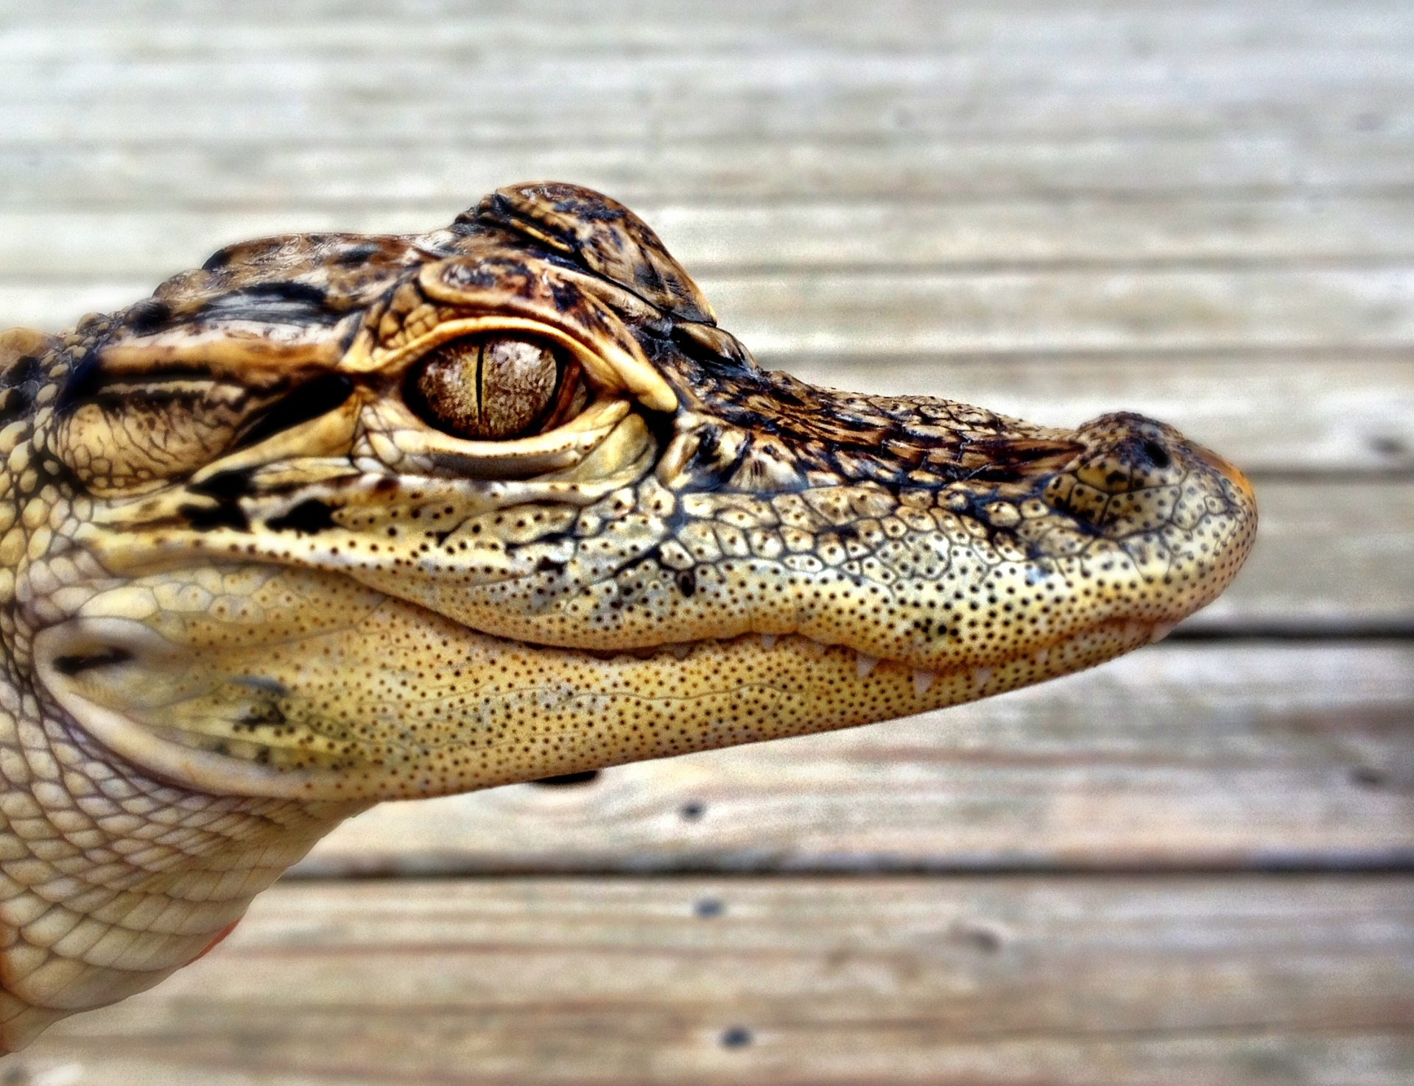
Have You Encountered Predatory Publishers?

Slide 30
Contact Information
Sarah A. Norris: sarah.norris@ucf.edu
Sandy Avila:
sandy.avila@ucf.edu
Ven Basco:
buenaventura.basco@ucf.edu

