Slide 1
Responding in real time to a large university’s needs
Digital Commons Webinar
Lee Dotson
University of Central Florida
August 15, 2018

Slide 2
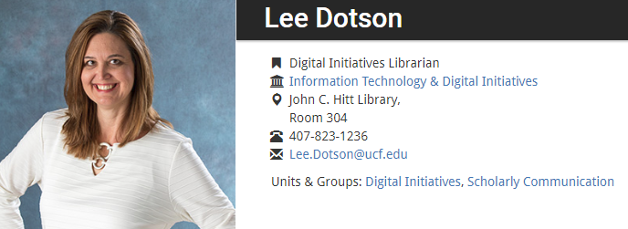
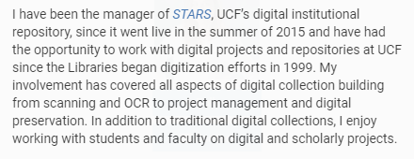
https://works.bepress.com/lee-dotson/
Notes:
Hi everybody. Thanks for joining me today – and thank you to Jillian, Chandra, and Morgan for helping to make this webinar happen. I’m the digital initiatives librarian at the John C. Hitt Library at the University of Central Florida. Since 1999 I have had the pleasure of working with great people in the library, across our campuses – and even statewide - on traditional digital collections as well as institutional repositories. Over the years we have used 7 or 8 different platforms – at one point we were using 4 at the same time. So we are pretty flexible when it comes to learning new platforms and imagining use cases.
To get us started I’d like to break apart the title a bit -

Slide 3
66,000+ students
2,400+ faculty/adjuncts
15,000+ degrees per year
13 colleges
216 degrees offered
Notes:
What do we mean by large university? UCF is a large university with more than 66,000 students and over 2,400 teaching faculty and adjuncts. 66,000 is a big number. So big that it’s hard for us to wrap our heads around it most days – well except for that first week of campus when everyone appears from out of nowhere. Last year over 15,000 degrees were awarded from our 13 colleges and 216 degree programs.

Slide 4
https://library.ucf.edu/about/technology-fee-funded-projects/institutional-repository/
Notes:
Why real time? For us it came down to justifying the funding. Our original funding was granted by a 3 year Tech Fee proposal. This source of funding provided a ticking clock to prove the repository’s worth and impact to justify its ongoing expense.

Slide 5
…a place for faculty and students to put their intellectual output in a central virtual location where it will be accessible to researchers and students.
Faculty research data
Historical collections
Audio
Video
Scholarly works
Original publications
Open Access journals
Online books
White papers
Presentations
Posters
Conference proceedings
Electronic theses and dissertations
Student honors papers
Student research
Notes:
The final piece of the title that stands out is needs. The overall need was to have a place for faculty and students to put their intellectual output in a central virtual location so it would be accessible to researchers and students. We started by looking at other IRs for typical materials and found more specific needs that weren’t being met at UCF – or were not being met fully. For example, we work with historical collections for our library’s Special Collections, but lacked support for the public history department. We had basic support for Open Access journals but needed training and support outside of UCF for revolving editors. ETDs were due for a student self-submission tool, Google friendly system, easier management of embargoes, and access to readership and usage.

Slide 6
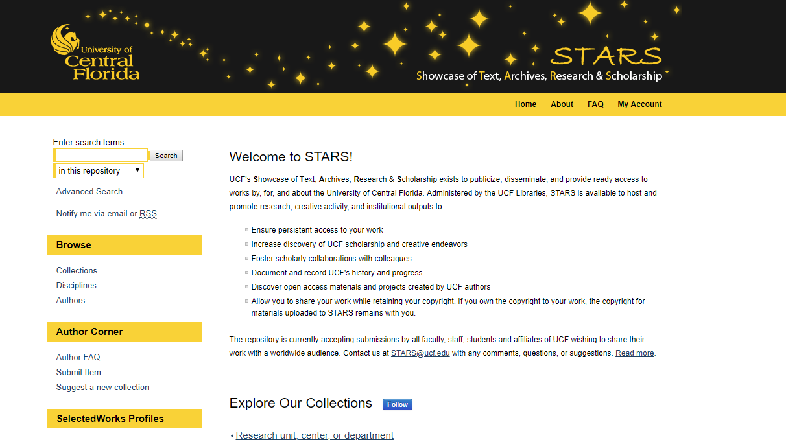
Notes:
In July of 2015 we set out to start meeting these needs with STARS – UCF’s Showcase of Text, Archives, Research and Scholarship. Knowing that there was a wide range of known and unknown needs our intention from the beginning was to cast a wide net to include a variety of materials by, for, or about UCF. Based on past experiences we knew that when we limit people we lose them so we made a decision early on to allow users’ needs to drive the repository. That means giving them the leeway to customize various aspects – such as sidebars, submission forms, metadata fields, and auto-collects. Yes - sometimes this takes more time, but the more involved and invested they are in the repository, the more they are willing to be hands-on and engaged with their collections. And since we have a great team at bepress to help us with training and support, we encourage the use of the repository as much as possible. We also have a team of folks here at the UCF Libraries who assist with a variety of STARS related functions.

Slide 7
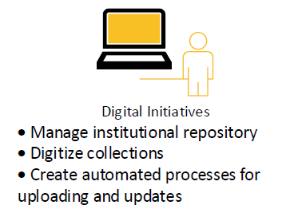
Notes:
The first group in our library STARS team is Digital Initiatives. We are responsible for all of the day-to-day IR processes and activities as well as overall projects – this includes digitizing collections, performing batch uploads, creating documentation, assisting project leads, identifying new processes, and more. The “we” is a small but mighty team – myself, Page Curry our digital production coordinator and Kerri Bottorff adjunct librarian and wrangler of theses and dissertations.

Slide 8
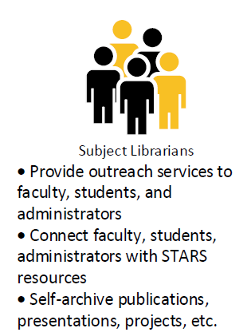
Notes:
While we are busy behind the scenes with STARS and meeting one-on-one with project leads, our subject librarians act as the main outreach to faculty. Buy-in and support from the subject librarians lays the groundwork for reaching faculty. Through their liaison connection they share information about STARS through emails, newsletters, meetings, presentations, and any other ways they can think of to connect faculty, students and administrators with STARS. They also self-archive their materials so they understand how to use the system and can share their own examples with faculty and students.

Slide 9
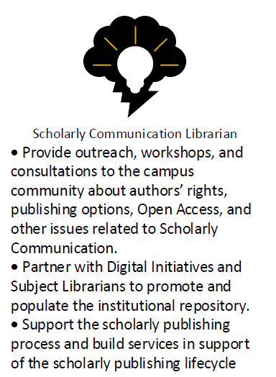
Notes:
As luck would have it, the Scholarly Communication Librarian was hired about the same time the IR was launched. Similar to the subject librarians, our Scholarly Communication Librarian provides vital outreach to our faculty – especially when it comes to authors rights, open access, and publishing options. We work closely with our Office of Scholarly Communication and refer faculty to one another as needed. Many times we will attend meetings and present together since the topics are so interconnected for faculty.

Slide 10
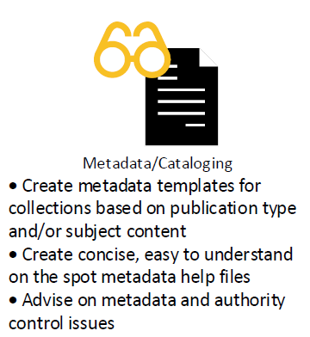
Notes:
We have two metadata catalogers who are available for consultations and advice and to review and update metadata. Our metadata catalogers create default metadata templates based on publication type and advise on metadata and authority control issues. For certain collections they will review the records and add subject terms or other useful information.

Slide 11
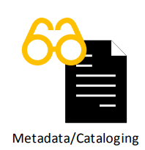
Notes:
How do we all work together? Communication is key. It is important to define roles from the outset – depending on the size of your institution this could be people, responsibilities, or departments. If you have a lot of people involved, there is the potential for overlap or miscommunication. Don’t be surprised when this happens. Keep open lines of communication as much as possible.

Slide 12
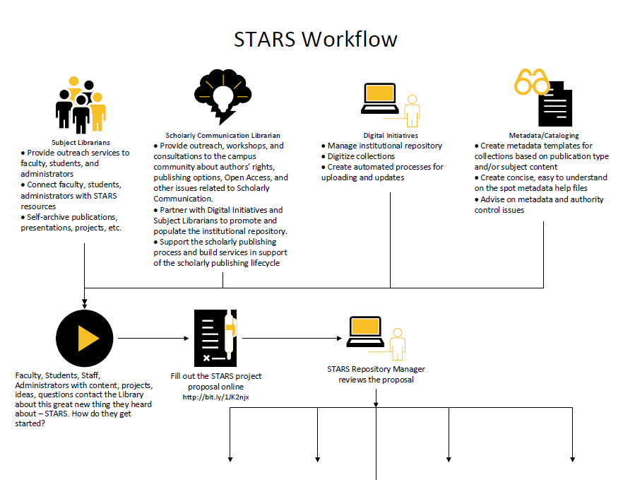
Notes:
Something we found to be helpful was to map out the overall workflow and attach responsibilities for each step. This is used to explain the process as well as show who does what. http://stars.library.ucf.edu/cgi/viewcontent.cgi?article=1003&context=stars-documentation

Slide 13
Notes:
The first row is our team which also lists those responsibilities we reviewed on the previous slides.

Slide 14
Notes:
The second row are the real stars – the faculty, students, staff and others who have materials to contribute to STARS. We created a qualtrics form so new collection requests can be submitted online. I review the proposals and contact anyone who should be involved to get started. The form is linked from the sidebar of our repository like so…

Slide 15
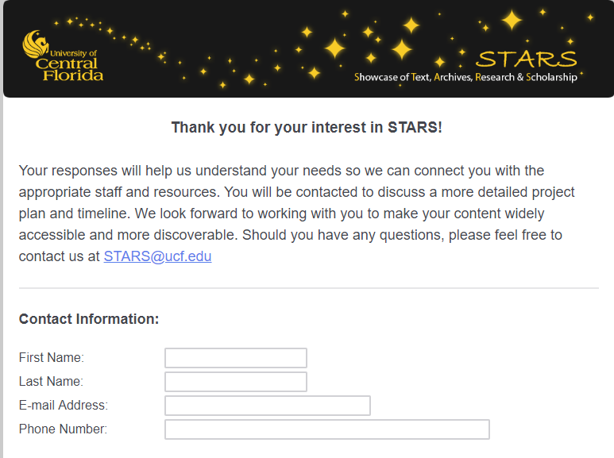
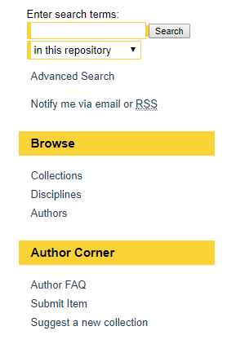
Notes:
The form asks for basic contact information as well as an overview of their project, types of materials, and links to existing websites or resources.

Slide 16
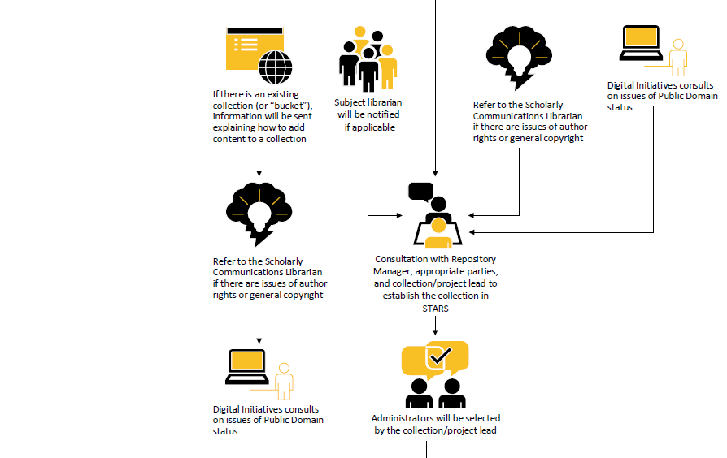
Notes:
This diagrams the next step after the proposal – planning.

Slide 17
Notes:
The left hand side represents the workflow for materials that can be added to an existing series or gallery.

Slide 18
Notes:
The remainder outlines the process for establishing new projects – who needs to be involved? How should the collection be set up? The most important part of the workflow is the image of the two people in the middle of this slide – it represents the consultation with the project lead prior to establishing the collection STARS. This is where we work through a lot of questions and gather ideas.

Slide 19
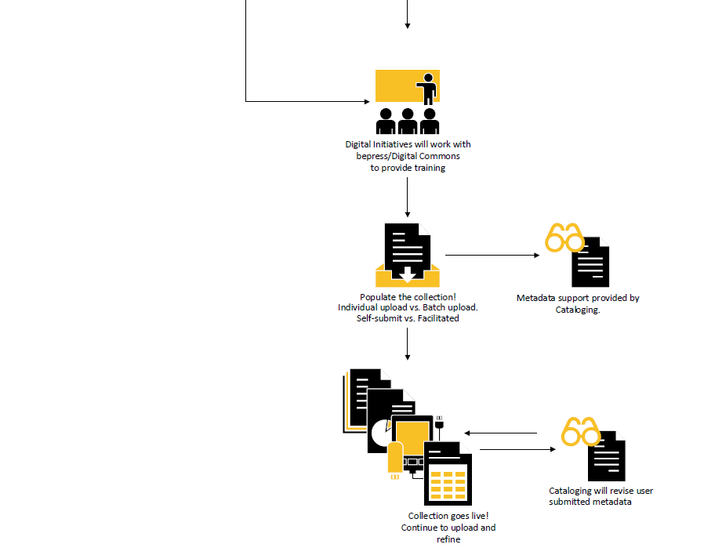
Notes:
Many times we will begin training in a demo environment – especially for new features or new STARS project leads. Once the collection is in production materials can be self-submitted or we can facilitate ingest.

Slide 20
Notes:
Metadata catalogers review specific collections after basic metadata has been submitted. The collection goes live and we continue to support faculty in uploading materials and refining their presence in STARS. Once we had a workflow to start with we focused our efforts on engaging faculty, staff, and students.

Slide 21
Increasing Engagement Across Campuses
Notes:
Increasing engagement across campuses is no small task and can not be done by one person alone.

Slide 22
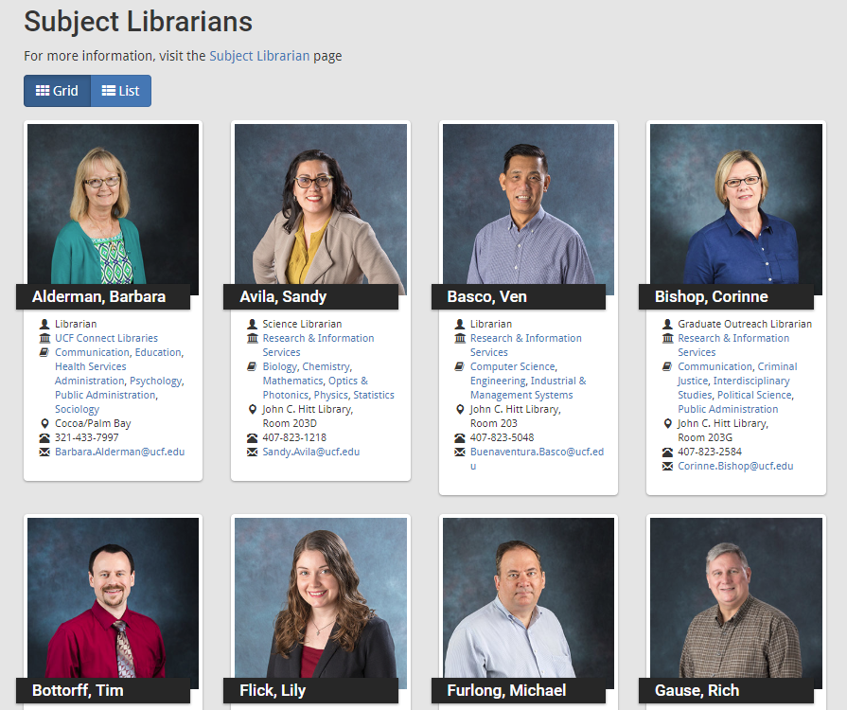
Notes:
You need people – for us that’s our Subject librarians. We are fortunate to have a strong team of subject librarians to share our message about STARS and liaison with faculty for anything from simply setting up a meeting to helping with projects. We allow the subject librarians to be as hands-on (or hands-off) as they would like with the projects. They have a lot of other responsibilities they are juggling so we leave it up to them to decide on their own level of involvement.

Slide 23
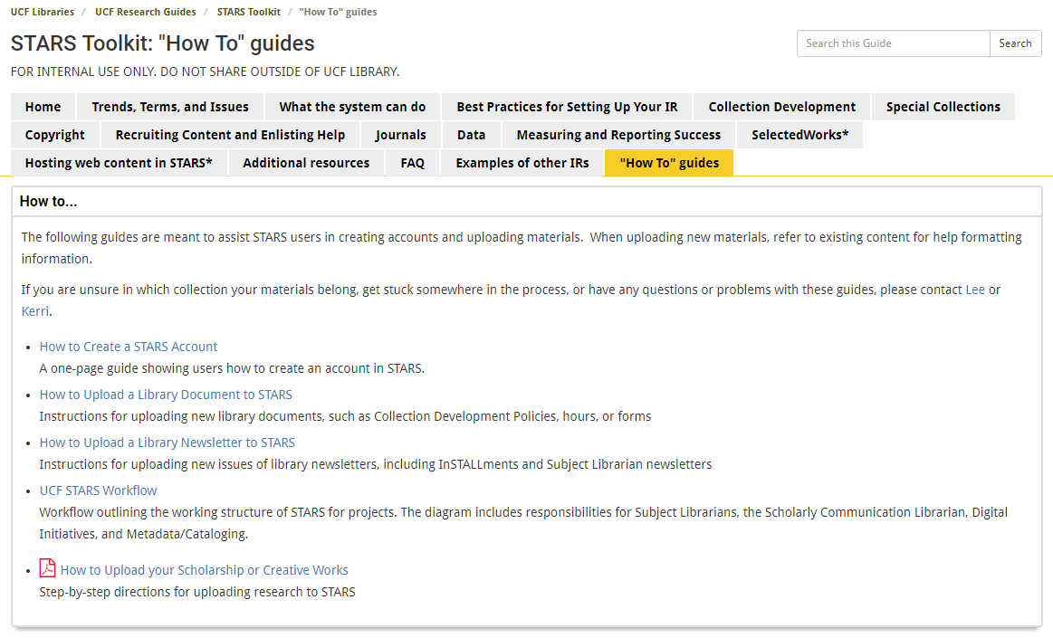
Notes:
To begin with we started with what they are comfortable using. I created and internal STARS toolkit using a platform the subject librarians are familiar with. They can review resources and ask questions on their own time.

Slide 24
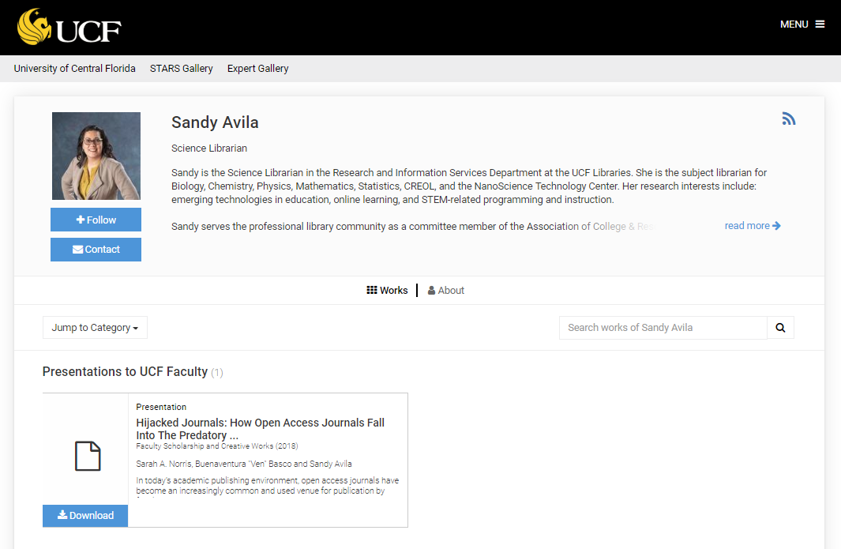
Notes:
Once they are ready to dive in we encourage them to begin using Digital Commons and SelectedWorks for their own content. Subject librarian buy-in is key. It’s great if you can get them using the products to create use cases and be familiar with the product. Sandy Avila, our science librarian, is a perfect example. She created a Selected Works profile and uploads her content to the repository.

Slide 25
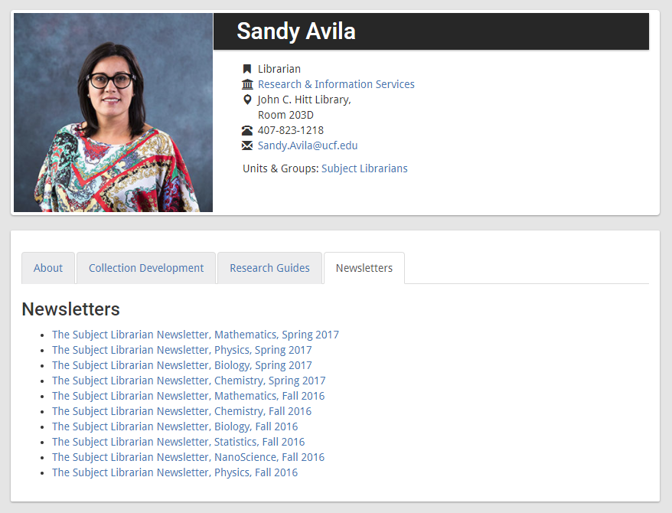
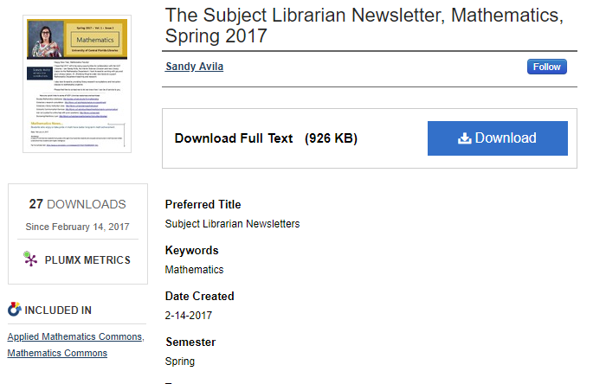
Notes:
This is Sandy’s Subject librarian profile on our library’s website. Notice the newsletter tab with an rss feed for her newsletters hosted in STARS. For departments moving to wordpress, these types of examples show them how they can meet some of their emerging needs for limited storage space for web files.

Slide 26
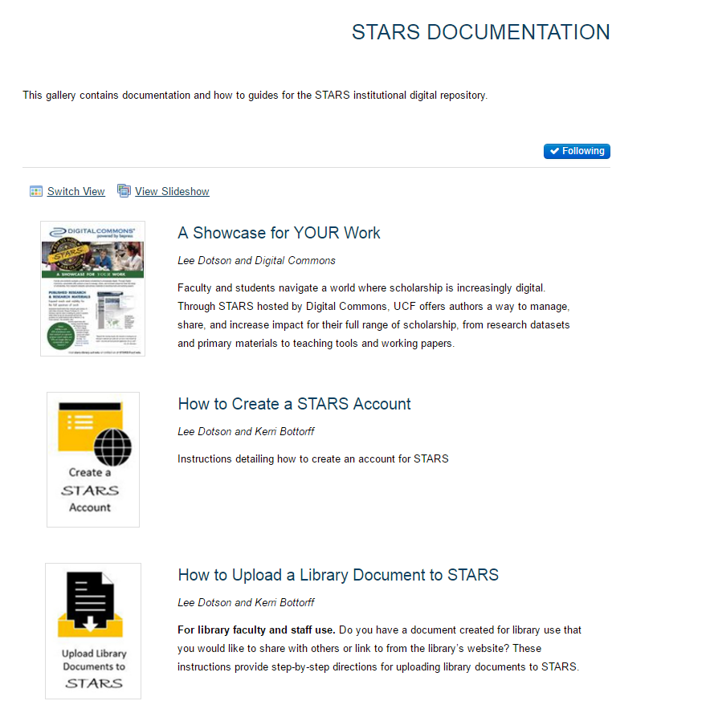
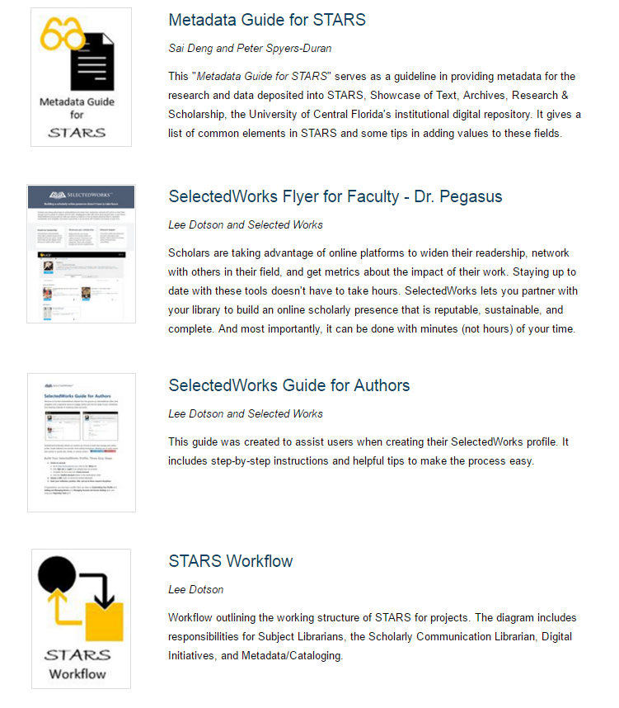
Notes:
We host documentation and help files on STARS so anyone can access them from anywhere at any time. This allows librarians on other campuses – or even at a meeting across campus – to easily access and share these files. This provides an additional use case and gets people comfortable with using the platform.
Documentation and help files http://stars.library.ucf.edu/stars-documentation/

Slide 27
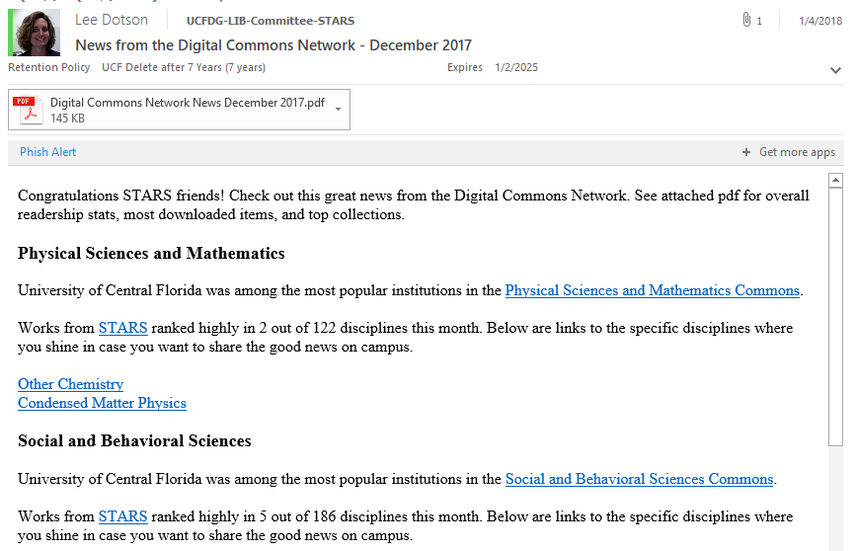
Notes:
I mentioned the importance of communication earlier. A STARS email distribution list is one way that we share information with interested parties in the library. Anyone can sign up to be on the list to receive news and updates. I typically share reports from the Digital Commons Network and other sorts of good news items.

Slide 28
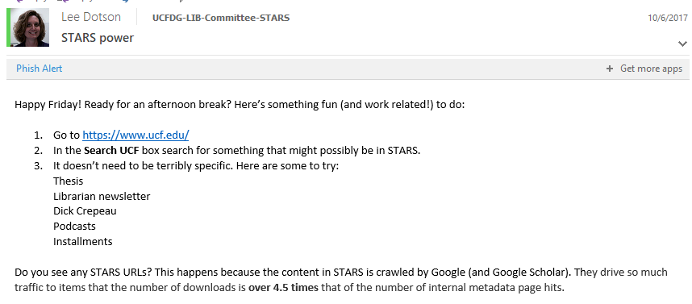
Notes:
I will also send out emails with updates or information. This example email was sent to highlight how easy it is to discover STARS materials from our UCF homepage. Thank you Google search! Engagement is an ongoing effort. The more engagement we have, the more diverse our repository becomes.

Slide 29
Diversity in Content Types
Notes:
While we started our repository with rather focused materials, we knew that it would quickly evolve and one size would not fit all. Before STARS I had to say no to a lot of faculty projects and needs. Some of that had to do with the platforms we were using not having the features we needed – and a big part of it had to do with limited storage space on the server. My goal with an IR was to say yes more than no to these types of projects. Over the past few years we have focused on using STARS to meet users’ needs. I have some examples of projects to share that highlight some of these previously unmet needs – and how STARS has changed that.

Slide 30
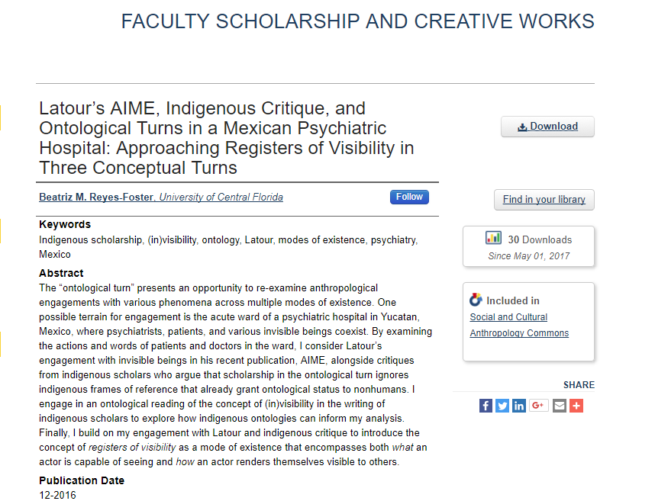
READERSHIP
SCHOLARSHIP
WRITING
EXHIBIT
OUTREACH
INSTITUTE
JOURNAL
EVENT
OER MATERIALS
DATA & GRANTS
PROJECT
PROFILE
Notes:
One of the first series added was for traditional scholarship -
Unmet need – no central location for UCF scholarship – Academia, Research Gate, homegrown
Copyright and Author Rights were often overlooked
Met need – created series for UCF faculty and student scholarship and creative works
Added backend fields for author rights checking
Presentations often include both STARS and Scholarly Communication

Slide 31
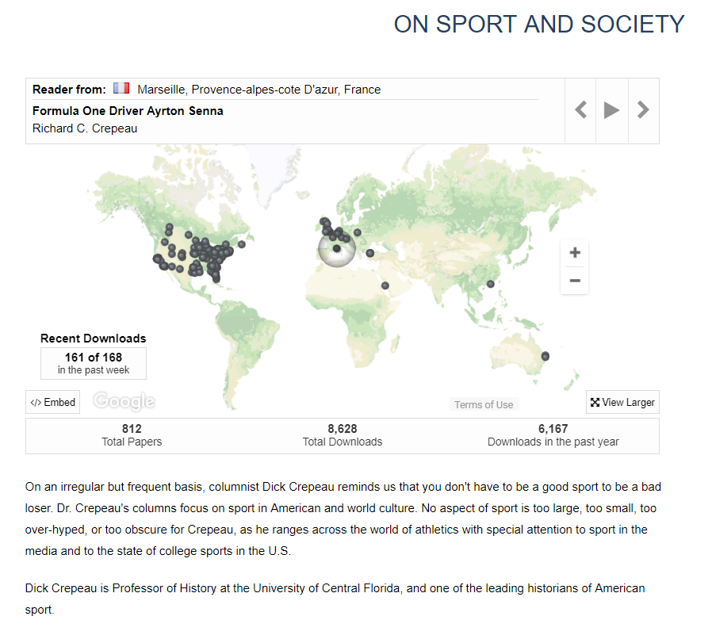
SCHOLARSHIP
WRITING
EXHIBIT
OUTREACH
INSTITUTE
JOURNAL
EVENT
OER MATERIALS
DATA & GRANTS
PROJECT
PROFILE
READERSHIP
Notes:
This collection of a faculty members writings was suggested by one of our Subject Librarians. I met with the faculty member, subject librarian, and scholarly communication librarian to discuss different ways he could make use of STARS. This one rose to the top of his list for needs – and he had retained the copyright to all of the work.
Unmet need – Faculty members body of work was scattered across email distribution lists – both personal and professional, webpages, print journals, and old floppy drives. No idea of who was reading or how much they were being read.
Met need – Digitized and located all works. Created a single collection for the materials. Dashboard provides readership and usage statistics.

Slide 32
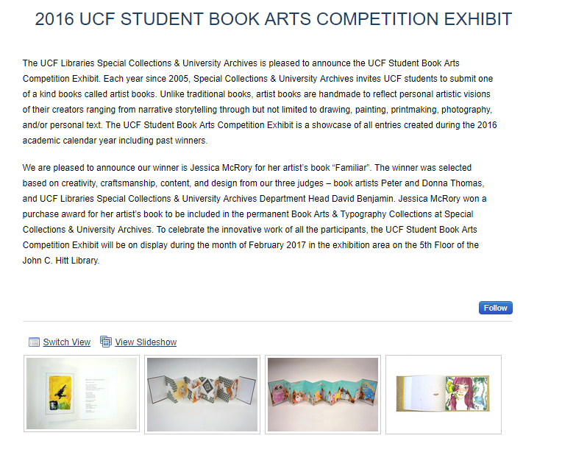
WRITING
EXHIBIT
OUTREACH
INSTITUTE
JOURNAL
EVENT
OER MATERIALS
DATA & GRANTS
PROJECT
PROFILE
READERSHIP
SCHOLARSHIP
Notes:
Unmet need – hosting external from library website. Moving to wordpress. Needed a new home.
Met need – Created book galleries for the exhibits – by year and winners.

Slide 33
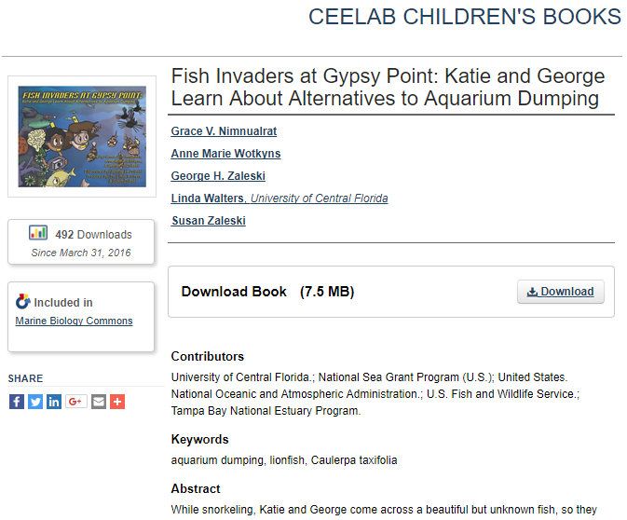
EXHIBIT
OUTREACH
INSTITUTE
JOURNAL
EVENT
OER MATERIALS
DATA & GRANTS
PROJECT
PROFILE
READERSHIP
SCHOLARSHIP
WRITING
Notes:
Unmet need – hosting a variety of materials created by the CEELAB - Coastal and Estuary Ecology Lab - through its work and grants.
Met need – Digitized materials. Created collections for outreach materials and children’s books. Faculty member was able to provide a link to a book as part of a New York Times article. Readership statistics showed traffic from that article.

Slide 34
OUTREACH
INSTITUTE
JOURNAL
EVENT
OER MATERIALS
DATA & GRANTS
PROJECT
PROFILE
READERSHIP
SCHOLARSHIP
WRITING
EXHIBIT
Notes:
Unmet need – migrating existing collection from another platform. Ability for the institute to self submit new publications
Met need – New home for the pdfs in a series. Able to transfer custom metadata fields.

Slide 35
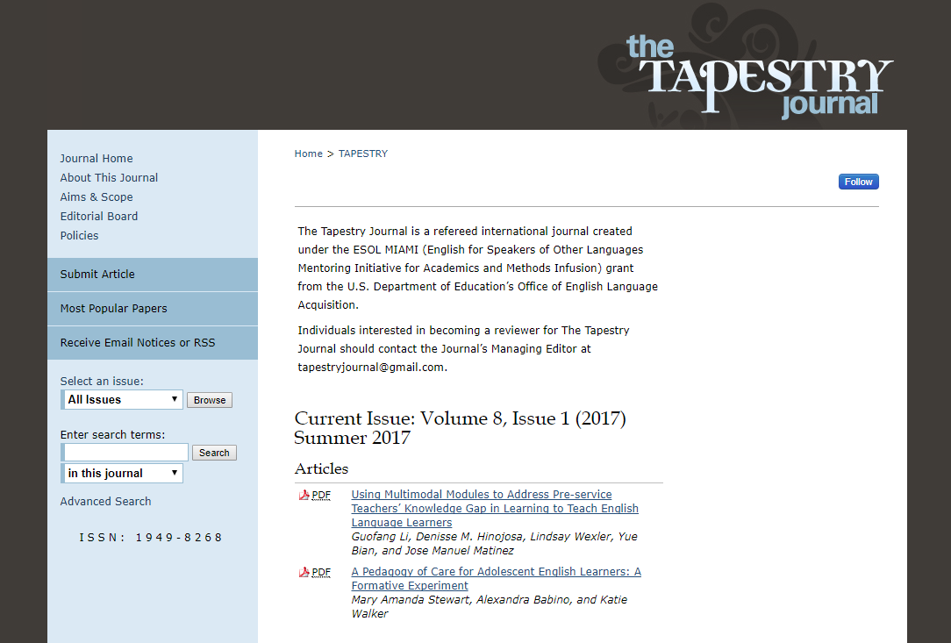
INSTITUTE
JOURNAL
EVENT
OER MATERIALS
DATA & GRANTS
PROJECT
PROFILE
READERSHIP
SCHOLARSHIP
WRITING
EXHIBIT
OUTREACH
Notes:
Unmet need – user friendly open access journal platform. Training and support time consuming and difficult to maintain in addition to other duties.
Met need – Matched look and theme of existing journal. Training, support, and documentation provided by bepress.

Slide 36
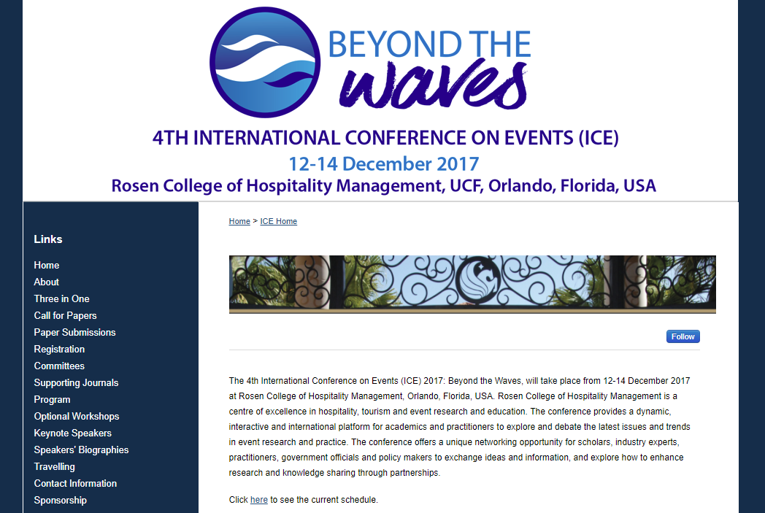
JOURNAL
EVENT
OER MATERIALS
DATA & GRANTS
PROJECT
PROFILE
READERSHIP
SCHOLARSHIP
WRITING
EXHIBIT
OUTREACH
INSTITUTE
Notes:
Unmet need – anything to do with events. Previously had no way to support online aspects of events.
Met need – now have multiple events for Rosen College of Hospitality Management and Undergraduate Research
A new way for us to engage with faculty and departments

Slide 37
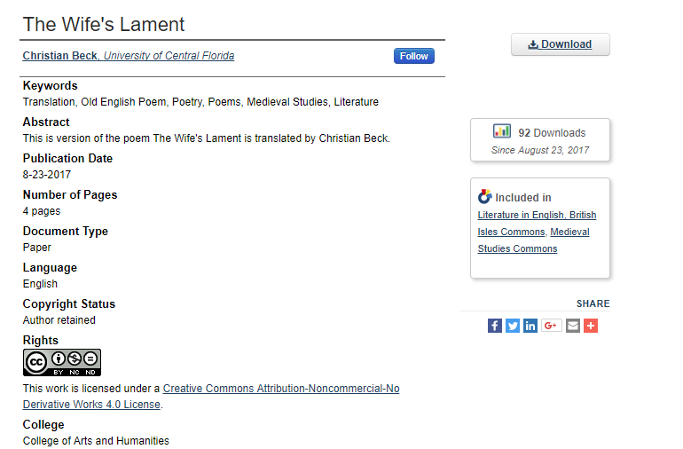
EVENT
OER MATERIALS
DATA & GRANTS
PROJECT
PROFILE
READERSHIP
SCHOLARSHIP
WRITING
EXHIBIT
OUTREACH
INSTITUTE
JOURNAL
Notes:
Unmet need – hosting for open resources
Met need – example is a translation of a poem created for a class

Slide 38
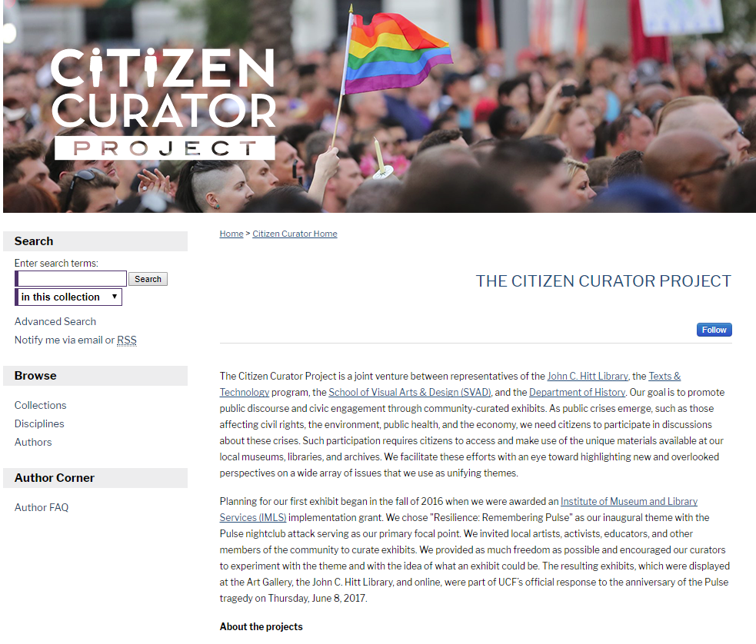
OER MATERIALS
DATA & GRANTS
PROJECT
PROFILE
READERSHIP
SCHOLARSHIP
WRITING
EXHIBIT
OUTREACH
INSTITUTE
JOURNAL
EVENT
Notes:
Unmet need – support for data and grant outputs
Met need – provided a space for the event hosted as part of the grant and additional grant materials.

Slide 39
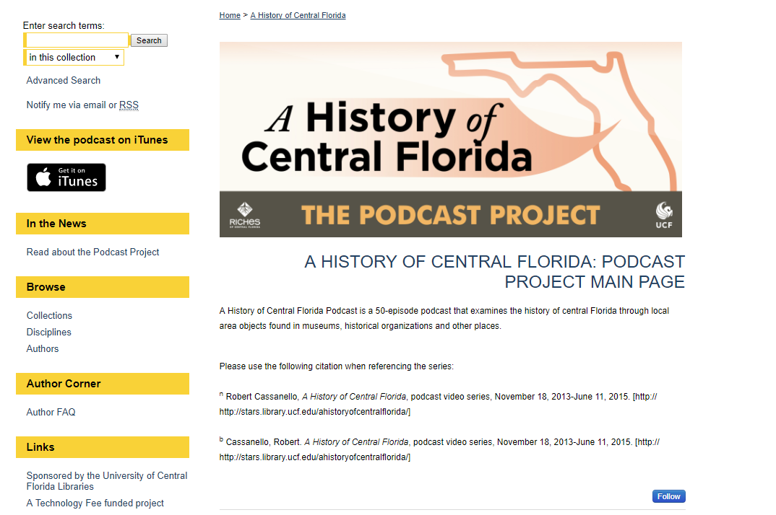
DATA & GRANTS
PROJECT
PROFILE
READERSHIP
SCHOLARSHIP
WRITING
EXHIBIT
OUTREACH
INSTITUTE
JOURNAL
EVENT
OER MATERIALS
Notes:
Unmet need – backup location for faculty projects
Met need – “mirror site” for podcasts hosted on iTunes. Also created galleries for images used in the creation of the podcasts. The images were previously not made available outside of the podcasts. Great downloads for some of these materials.

Slide 40
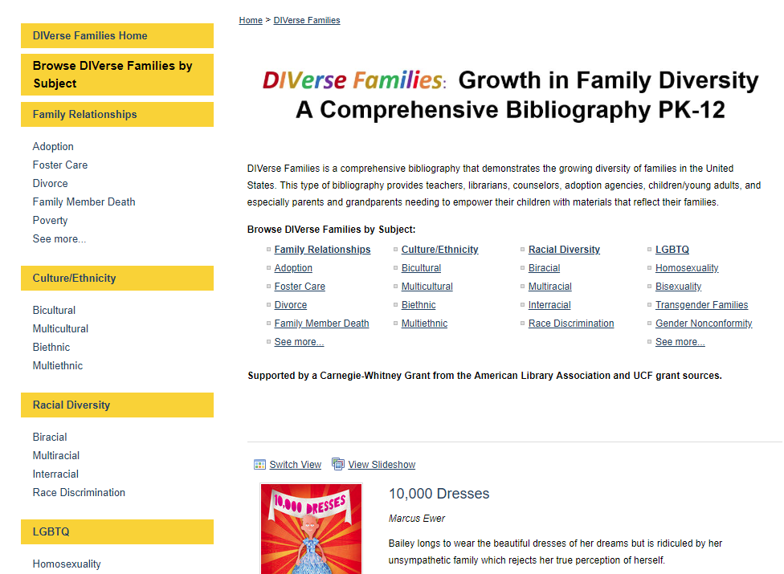
DATA & GRANTS
PROJECT
PROFILE
READERSHIP
SCHOLARSHIP
WRITING
EXHIBIT
OUTREACH
INSTITUTE
JOURNAL
EVENT
OER MATERIALS
Notes:
Unmet need – support for searchable, annotated bibliographies. Understanding that we will work with metadata only records on a project-by-project basis.
Met need – created book galleries and auto-collects. Content is sent to us in a spreadsheet and we upload for them. Provide access via STARS and through RSS feeds to their website which is under development. Statistics for article information pages that can be used in reports to the funding agency.

Slide 41
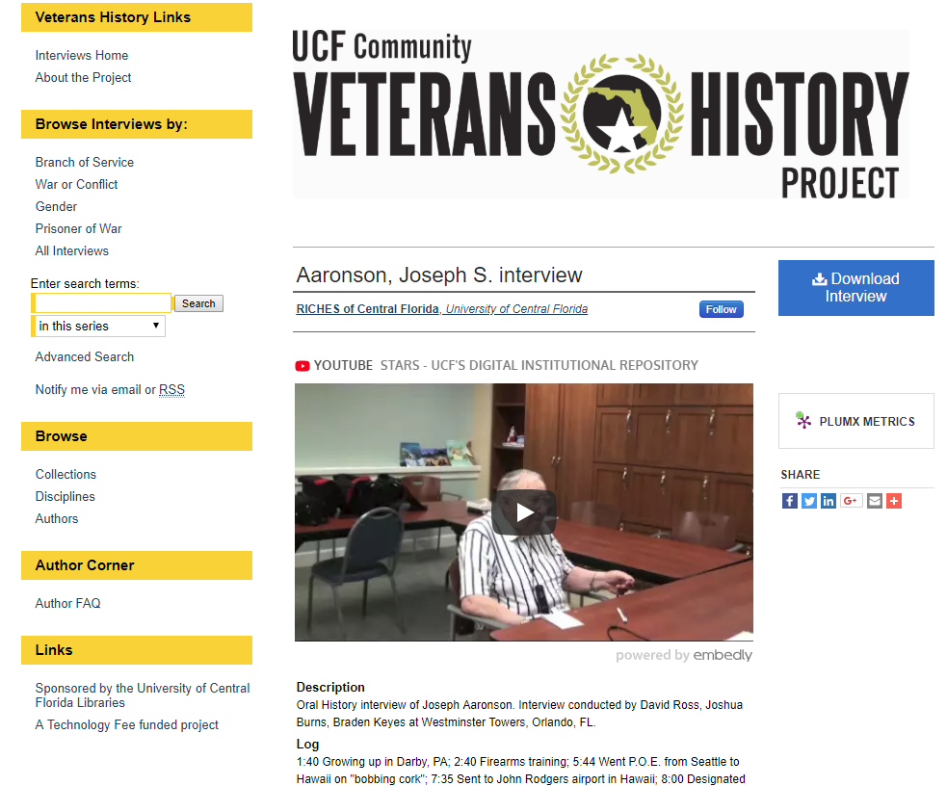
DATA & GRANTS
PROJECT
PROFILE
READERSHIP
SCHOLARSHIP
WRITING
EXHIBIT
OUTREACH
INSTITUTE
JOURNAL
EVENT
OER MATERIALS
Notes:
Unmet need – migrating an existing collection from a different platform
Met needs – important to allow streaming and download of video, custom metadata fields, and browsing by topics. This collection relies on the auto-collect feature to maintain a user-friendly browse option.

Slide 42
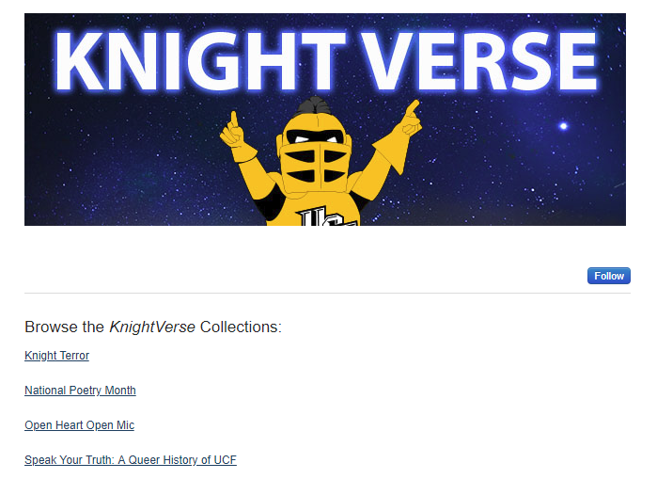
DATA & GRANTS
PROJECT
PROFILE
READERSHIP
SCHOLARSHIP
WRITING
EXHIBIT
OUTREACH
INSTITUTE
JOURNAL
EVENT
OER MATERIALS
Notes:
Unmet need – hosting student writing contests
Met need – Created a home for these contests. Students submit to STARS using submission forms tailored for the contests. Works are vetted and only the winners are published.

Slide 43
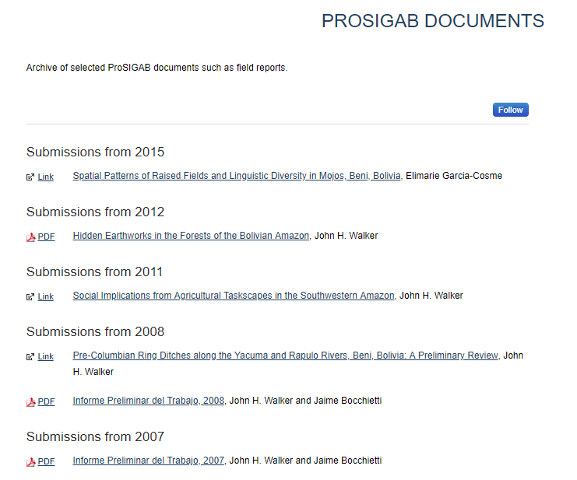
DATA & GRANTS
PROJECT
PROFILE
READERSHIP
SCHOLARSHIP
WRITING
EXHIBIT
OUTREACH
INSTITUTE
JOURNAL
EVENT
OER MATERIALS
Notes:
Unmet need – archive for Anthropology professor’s project. He was interested in using STARS for a couple of years – but didn’t start using it until he needed an easy way to share project documents with colleagues in Bolivia.
Met need – Created series. With step by step documentation he is now self submitting his materials as he needs to share them.

Slide 44
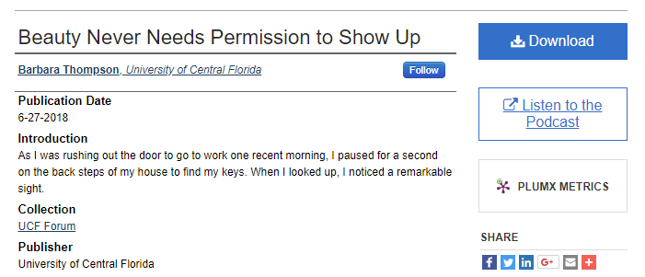
DATA & GRANTS
PROJECT
PROFILE
READERSHIP
SCHOLARSHIP
WRITING
EXHIBIT
OUTREACH
INSTITUTE
JOURNAL
EVENT
OER MATERIALS
Notes:
Unmet need – archive of opinion columns posted to online news page. Each year a group of faculty and staff are selected to write weekly opinion pieces. While these pieces remain online, they are included in general news items and there is no overall grouping for them so they tend to get lost in the mix after initial publication.
Met need – Created a template to provide consistent formatting. Retrospectively added existing columns by searching for them online and uploading to the series. Our digital production coordinator pulls the column weekly to add to the collection and the editor sends an email reminder. Last year we added a link to the associated podcast on WUCF FM at the suggestion of a faculty member who had written for the column and asked why the podcasts had not been included. Glad he brought them to our attention because we didn’t know about them and they are created by a different department than the one who publishes the columns. Up until that time, the columns and podcasts had not been available together. We were able to meet a need that those closest to the project did not even realize existed.

Slide 45
Making the Most of Digital Commons
Notes:
What we rely on to get our job done

Slide 46
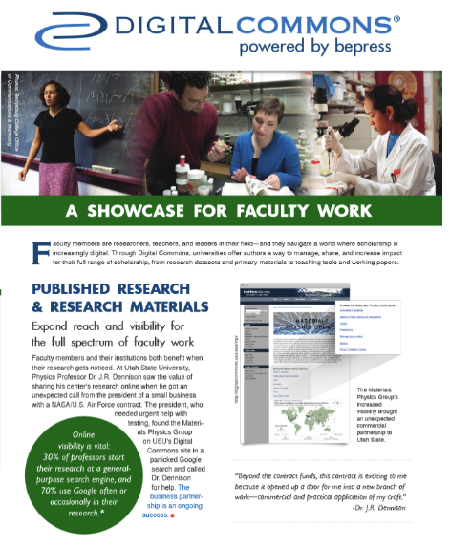
Notes:
Use existing webinars, documentation, and publications – make them your own. Reuse, repurpose, adapt.
Set a goal – it can be a serious goal or a silly goal. My goal was to take the digital commons brochure and swap out all of the various institution examples for UCF specific examples.
For the front page, I used our Dick Pope Sr Institute for Tourism Studies as the prime example. They have been very supportive of our work and many new projects have been a result of collaborating with them. This was a small way to show how much we appreciate their support.

Slide 47
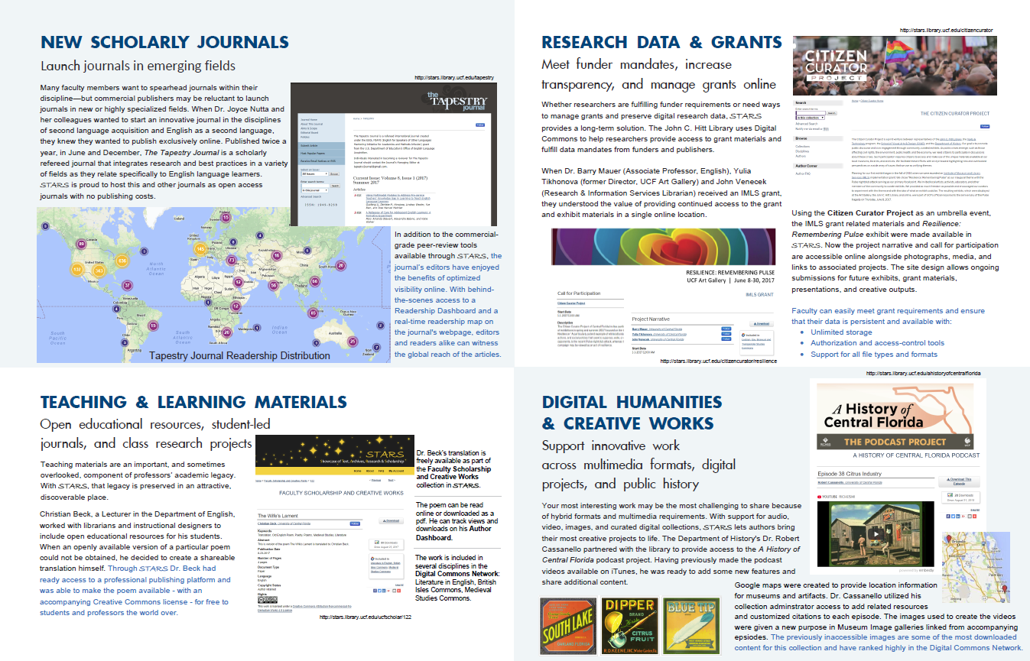
Notes:
As new projects came online, I was able to update more content – a thriving journal, support for a grant funded project, a use case for OER in the teaching & learning materials section, and our very first project in STARS – a podcast project – to represent Digital humanities and creative works.

Slide 48
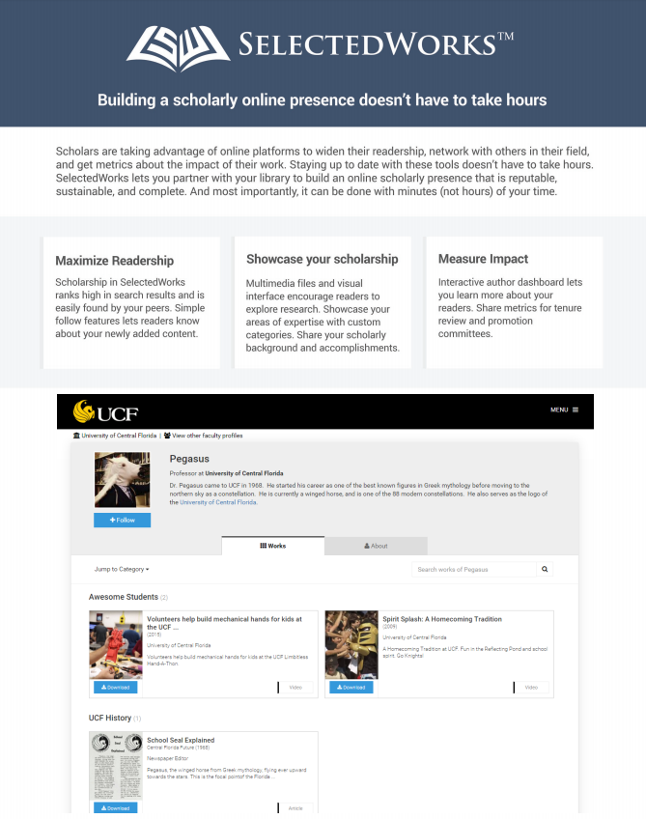
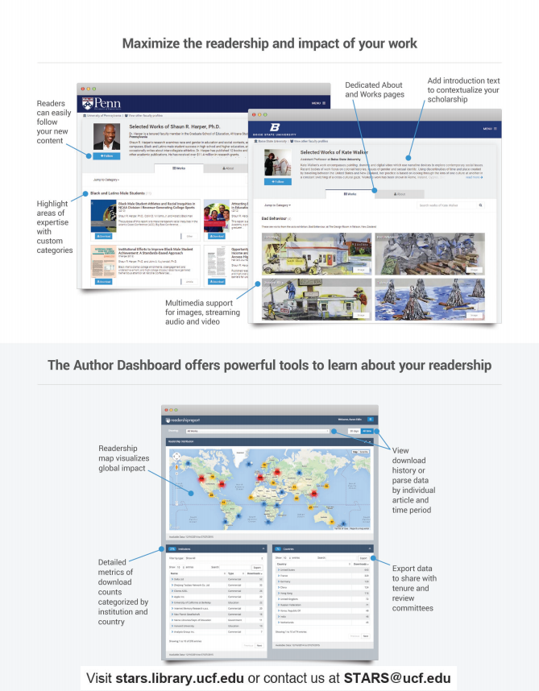
Notes:
You don’t have to totally revamp materials to make them more “you”. We swapped out one image to give this one a bit of UCF.

Slide 49
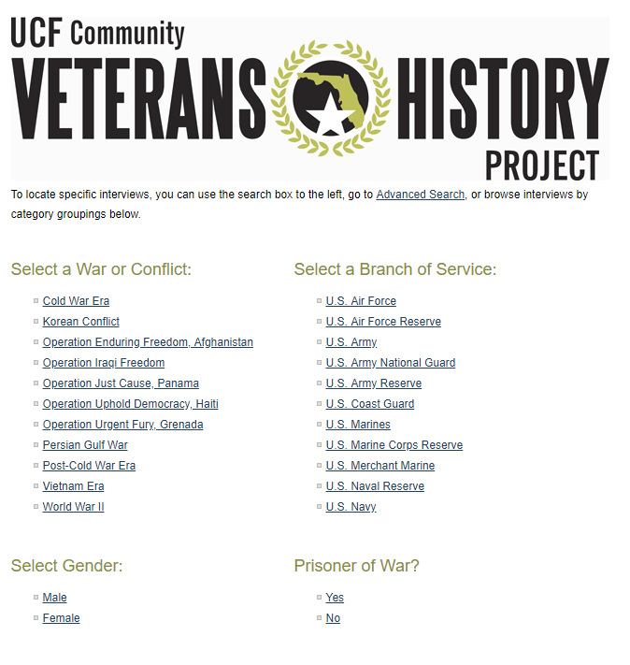
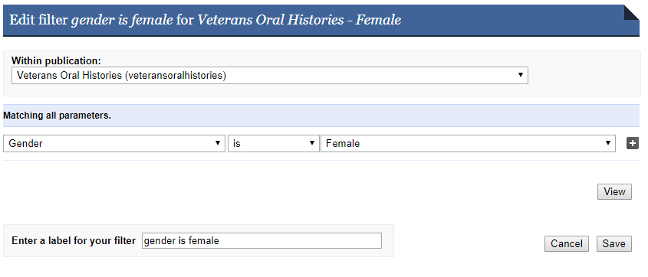
Notes:
Auto-collects – I mentioned before how the veterans oral history project relies on auto-collects. We use them in multiple collections – to group patents by college, to group resources by topic, to group theses by advisor, the list goes on. If you are looking for a way to sort or filter materials or provide browsing options for your users, get familiar with the collection tool and auto-collect feature.

Slide 50
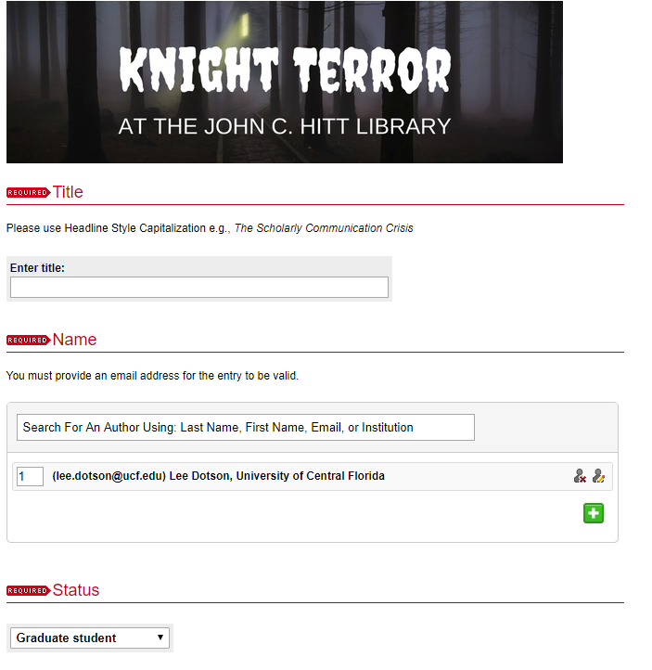
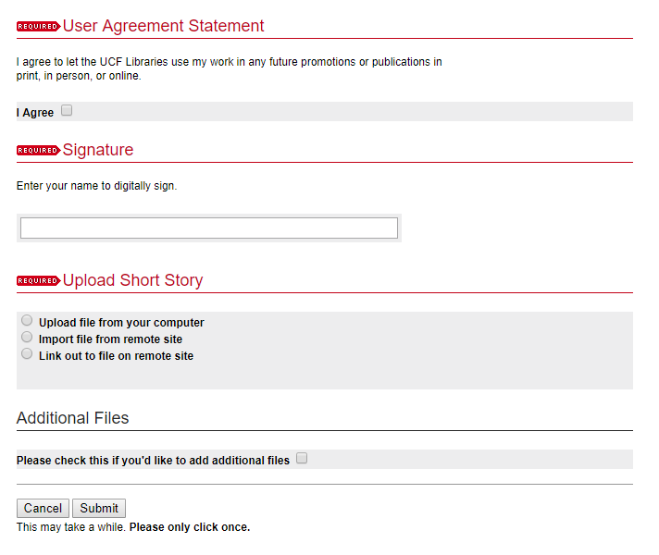
Notes:
The next few slides are going to focus on some of the ways we allow custom aspects. I realize not everyone does this – it is important to make this decision based on what is best for your institution. Why do we allow so much customization? For us over the years we have found that if we limit people we lose them. If we tell them what to do, we lose them. If they tell us what they need, and we can accommodate those requests everybody wins. Now – we can’t always do what they want but we try to find out why they want it so we can determine the best way to proceed. Sometimes that means customizing, sometimes that means showing them how a standard method could work for them, and sometimes (very rarely) it means referring them to another platform or system.
One example of allowing customization is by using custom submission forms – this is one of the Writing contest submission forms I mentioned earlier.

Slide 51
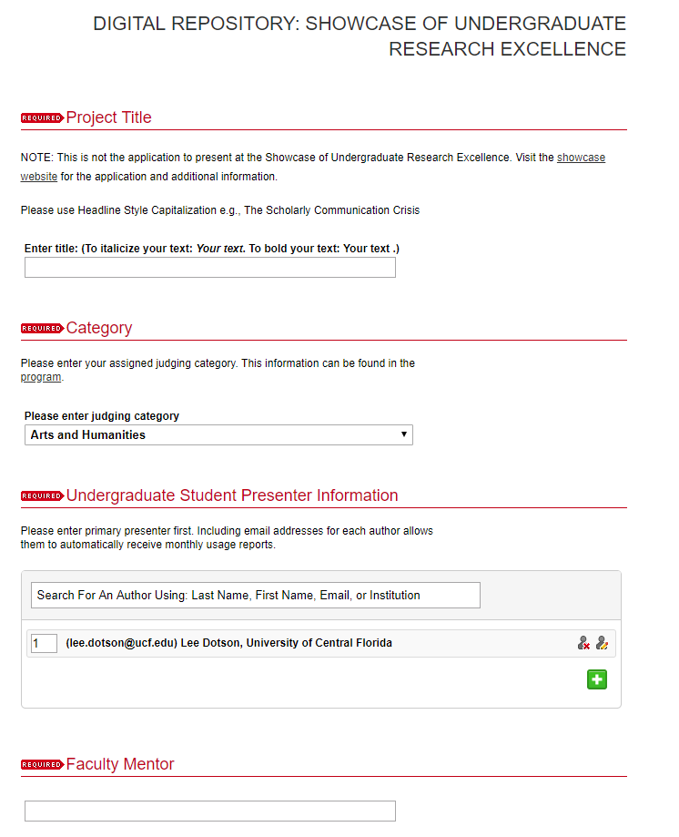
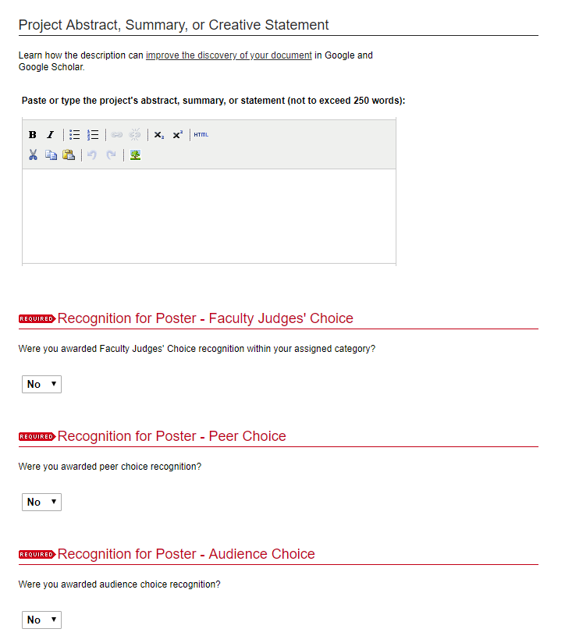
Notes:
Our Showcase of Undergraduate Research Excellence wanted to match the form students use when applying to the Showcase. This form was created to mirror their existing form as much as possible – from the fields labels to the drop-down lists.

Slide 52
Notes:
Custom metadata fields. This is an annotated bibliography that was in need of a new home due to a change in servers. The fields used are specific to the bibliography and its use.

Slide 53
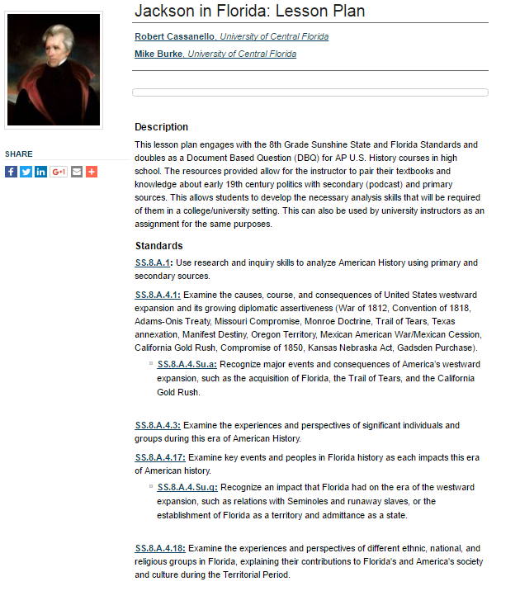
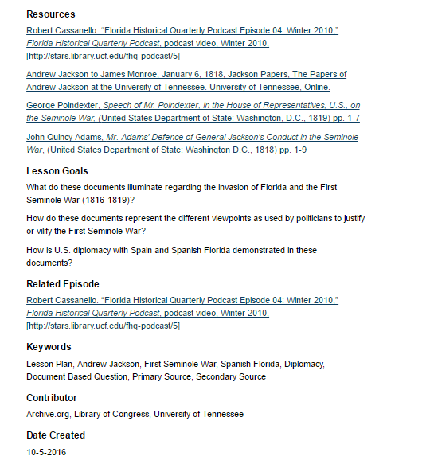
Link
Notes:
One more to highlight custom metadata fields – this one shows how the fields have been adapted for a collection of classroom lesson plans.

Slide 54
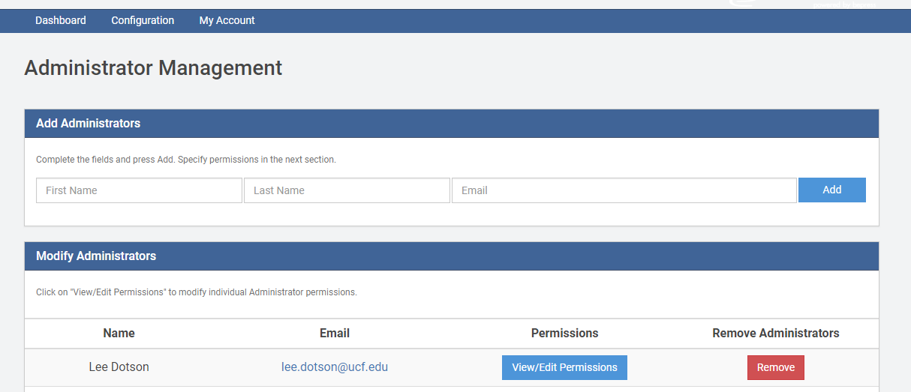
Notes:
All of this would not be possible without involvement from the project leads who we have the ability to make administrators. The more people who do the work, the more work we can do for more people.

Slide 55
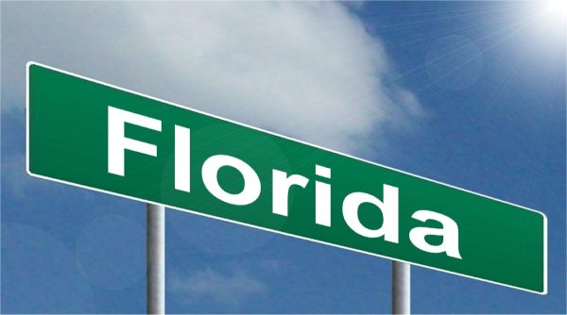
Florida by Nick Youngson CC BY-SA 3.0 Alpha Stock Images
California by Nick Youngson CC BY-SA 3.0 Alpha Stock Images
Notes:
Most of our days in Digital begin with emails that start with Hello Brandie! Good morning Brandie! Or Hey Brandie! Brandie is our consulting services rep and she and her team hear from us A LOT. Having another whole team supporting us and providing training is imperative – even if they are all the way across the country. We can do a lot locally – strategize with our project leads, create basic series and galleries, upload materials, provide general help, edit configurations for series and galleries. CS takes on the heavy lifting of setting up custom metadata fields, troubleshooting issues, creating complex communities and series or galleries, adding content to our html pages, providing training for our journal editors, and answering all sorts of odd questions that we come up with.
bepress support team
Digital Commons users

Slide 56
Three Years Later…
Notes:
So looking back at that tech fee proposal – did we do what we set out to do? I think so…

Slide 57
…a place for faculty and students to put their intellectual output in a central virtual location where it will be accessible to researchers and students.
Faculty research data
Historical collections
Audio
Video
Scholarly works
Original publications
Open Access journals
Online books
White papers
Presentations
Posters
Conference proceedings
Electronic theses and dissertations
Student honors papers
Student research
Notes:
Remember that original list of material needs that were not being met or fully met? The check marks are for materials that are now in STARS. The open circles are projects in process. Not bad for 3 years.

Slide 58
Notes:
And while we were busy engaging faculty, creating new projects, and adding content - it only took us 2 years and 9 months to hit 1 million downloads. So we did what anyone else would do – we threw a party to thank our authors and supporters and put the event in STARS.

Slide 59
“When we first started, I didn’t understand what this was all about …now I get it!”
Notes:
Even better proof that we did our job was the reaction of this faculty member at our one million downloads party. When I approached her almost 3 years ago about using STARS she was skeptical. She knew we wanted to do something, but wasn’t sure what that meant for her. She gave us some materials and asked that we scan them and put them in STARS. About 6 months later I noticed that one of her items was getting more hits from the New York Times than Google. She had given a quote for an article and they linked to her item in STARS. Then a teacher in a nearby county found her materials and asked about getting some for their classrooms – so we were able to help her make that connection. She showed up at the million party with an envelope for me – of more materials to scan and put in STARS. And that’s when she told me that when we first started she didn’t understand what this was all about but now she gets it. When I emailed to let her know that the materials were available in STARS she responded to let me know they will soon have some grant materials that she would like to put in STARS and asked if it would be easy enough for them to upload pdfs on their own.

Slide 60
Notes:
No matter the size of the campus or the needs of your university – you can’t beat the impact of the readership map. We have chosen to get to where we are by focusing on our university’s needs. You can spend a lot of time giving presentations and talking to people and you might not hear from anyone – sometimes for a while – because they don’t need you until they need you. Everyone is busy – so keep reaching out and reminding them how you can help by meeting their needs. And be ready to jump in when they are because they may not get it today – but they will – probably when you least expect it.

Slide 61
Thank you! From all of us at stars.library.ucf.edu

