Slide 1
Get in the Game:
Tips and Strategies for Navigating
Open Access Publishing
Sarah A. Norris, Scholarly Communication Librarian

Slide 2
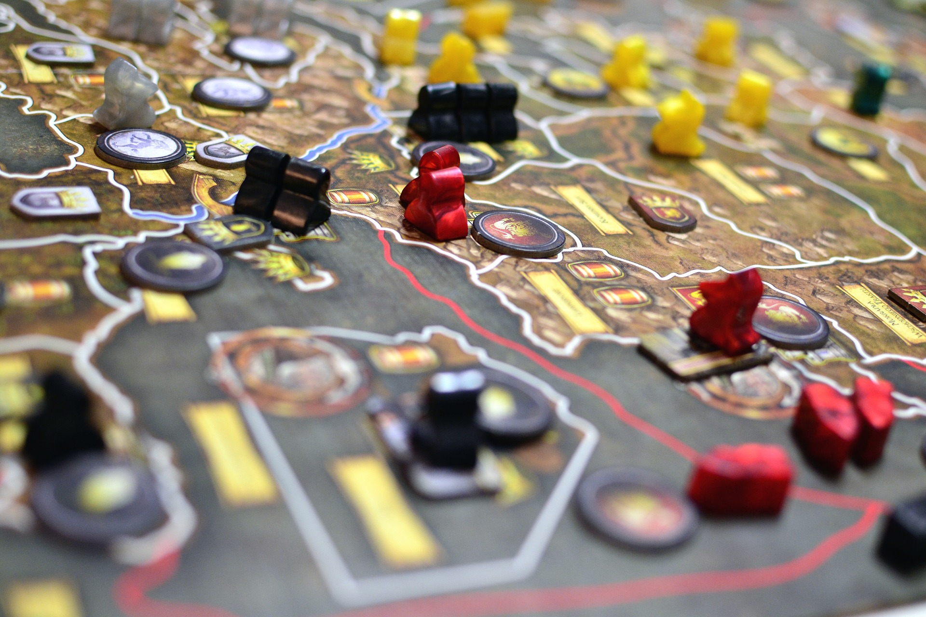
Overview
What is Open Access?
Benefits & Challenges of Publishing Open Access
Open Access at UCF

Slide 3
What is Open Access?

Slide 4
“Open-access (OA) literature is digital, online, free of charge, and free of most copyright and licensing restrictions.”
© 2004-2015 Peter Suber. Last updated 5 December, 2015, Retrieved from: http://bit.ly/oa-overview

Slide 5
Ways to Publish Open Access
Publish in a fully open access journal (Gold Open Access)
e.g. PLOS One
Publish in a traditional journal that includes an open access option (Hybrid Open Access)
e.g. Journal of Applied Statistics (Taylor & Francis)
Publish in a traditional journal & later archive your work in an open access repository, online faculty profile, or personal website (Green Open Access)
STARS (http://stars.library.ucf.edu/)
ResearchGate
Academia.edu

Slide 6
Benefits of Publishing Open Access
Democratizes research
No institutional affiliation, subscription, or payment is required (i.e. anyone from anywhere can access)
Beneficial to the institution & academia
Helps reduce costs for subscriptions to traditional journals with ever rising subscription rates
Helps faculty and students comply with open access requirements from grant funding agencies
Increases visibility & access to research produced by faculty and students
Increases the impact of your work
Increases likelihood of being read and cited
Piwowar, H., Priem, J., Lariviere, V., Alperin, J. P., Matthias, L., Norlander, B., & ... Haustein, S. (2018). The state of OA: a large-scale analysis of the prevalence and impact of Open Access articles. PeerJ, doi:10.7717/peerj.4375

Slide 7
Challenges of Publishing Open Access
Not all fields / disciplines work well with open access
Metrics may vary and may be lower than traditional journals
Quality can be an issue / concern
Long-term access to content can be a concern
Websites that are not maintained or go away entirely
Open Access may be free to the reader but not to the author or institutions
Article Processing Charges (APCs)
Predatory publishing is more prevalent (including predatory conferences, etc.)

Slide 8
What is Predatory Publishing?

Slide 9
“Predatory open-access publishing is an exploitative open-access academic publishing business model that involves charging publication fees to authors without providing the editorial and publishing services associated with legitimate journals (open access or not).”
https://en.wikipedia.org/wiki/Predatory_open_access_publishing

Slide 10
Predatory Publishers on the Rise...
Increased dramatically with the emergence of Open Access journal publishing
The online environment makes it easy to create and distribute research
OA journals provide scholars a way to make their research available to anyone, anywhere without institutional affiliation
OA journals help meet new & emerging funding mandates
Predatory Publishers have become adept at soliciting author contributions and appearing to be credible, peer-reviewed venues for publication
Study in 2014, nearly $75 million was paid to publishers suspected to be predatory in nature (https://bmcmedicine.biomedcentral.com/articles/10.1186/s12916-015-0469-2)
The rise of predatory publishing has prompted many studies and analyses of their publishing practices

Slide 11
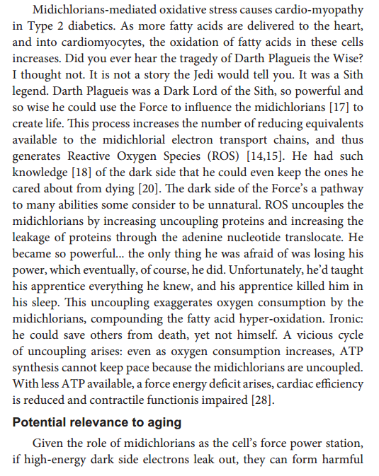
Predatory Publishing Studies
http://blogs.discovermagazine.com/neuroskeptic/2017/07/22/predatory-journals-star-wars-sting/
https://www.nature.com/news/predatory-journals-recruit-fake-editor-1.21662

Slide 12
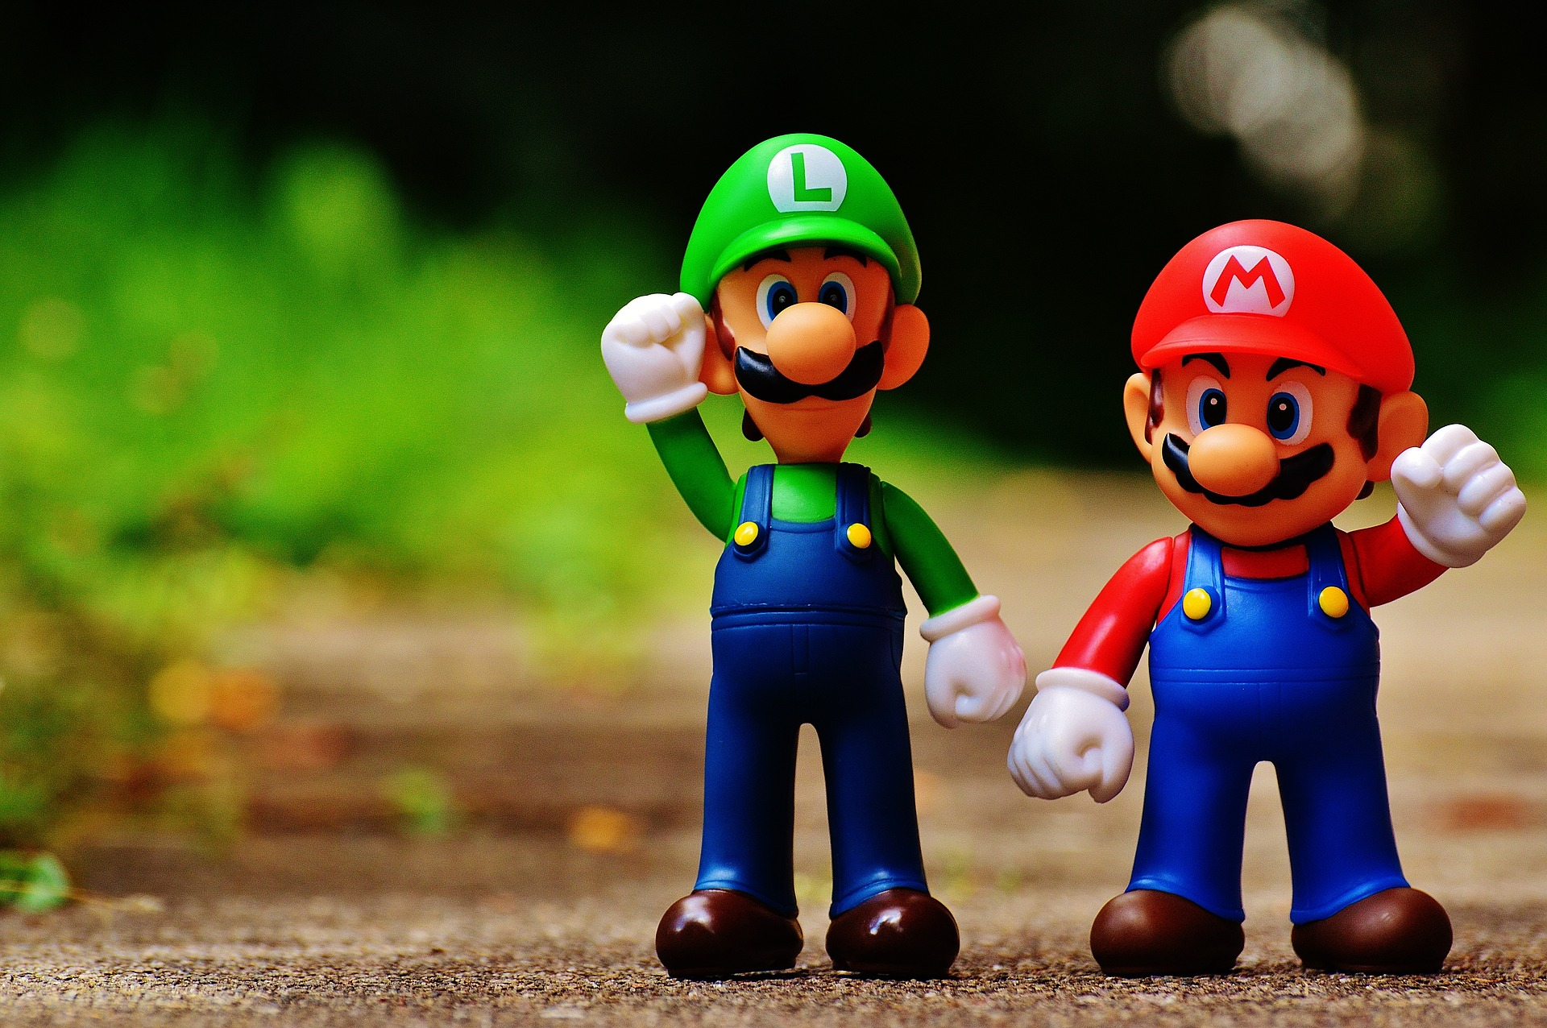
Identifying
Predatory
Publishers

Slide 13
Characteristics of Predatory Journals & Books
Promises fast peer review & publication
Journal content is extremely broad and/or unfocused
Inconsistent and/or contradictory information
Not included in indexes / databases
Poorly constructed website and/or web presence

Slide 14
Characteristics of Predatory Conferences
Solicits presentations/keynotes via email
No process or Call for Proposals
Lack of travel funding
Poorly constructed website and/or web presence
Often associated with a predatory journal publisher

Slide 15
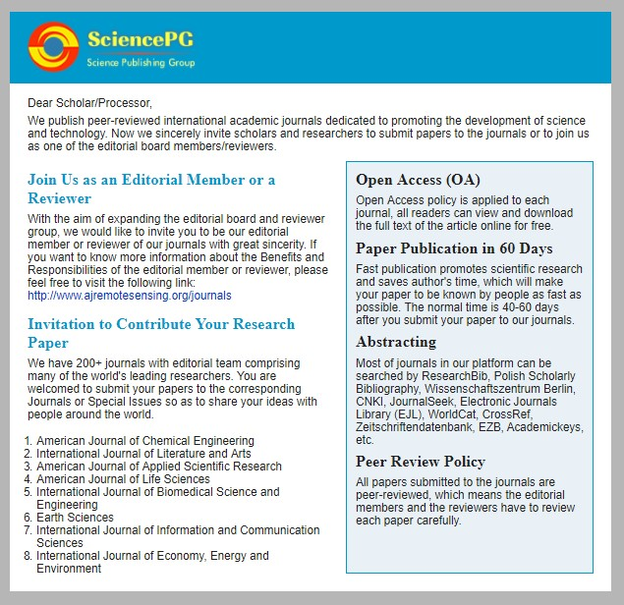
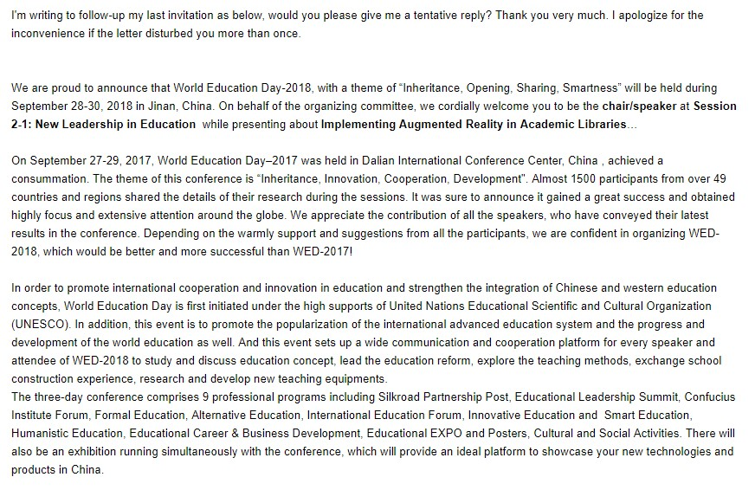
Solicitations from Predatory Publishers to UCF Library Faculty

Slide 16
Top 4 Tips on How to Avoid Predatory Publishers
Tip #1: Trust your gut!
Tip #2: Use a checklist, like Think Check Submit (https://thinkchecksubmit.org/)
Tip #3: Use resources to check for credibility, such as:
Beall’s List (use other sources in conjunction with this): https://beallslist.weebly.com/
Directory of Open Access Journals: https://doaj.org/
Open Access Scholarly Publishers Association: https://oaspa.org/
UCF Library’s Online Journals: http://library.ucf.edu/
Check Scholarly Journal metrics: http://www.scimagojr.com/
Google Scholar’s Journal metrics: https://scholar.google.com/citations?view_op=metrics_intro&hl=en
Tip #4: When in doubt, ask your trusted librarian!

Slide 17
Open Access at UCF

Slide 18
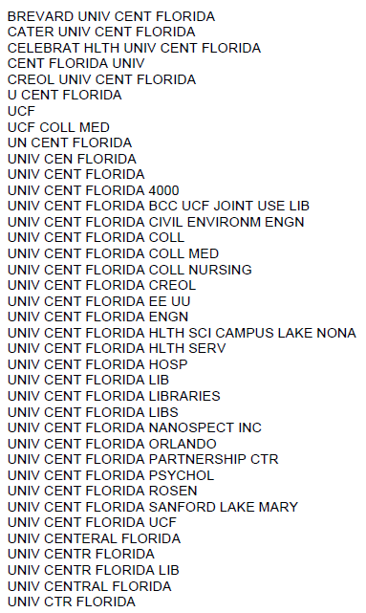
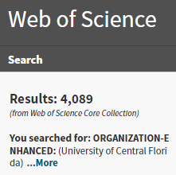
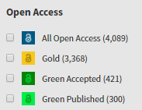
Faculty publishing in open access journals
Article Processing Charges (APCs) funding support is often asked about at the library.

Slide 19
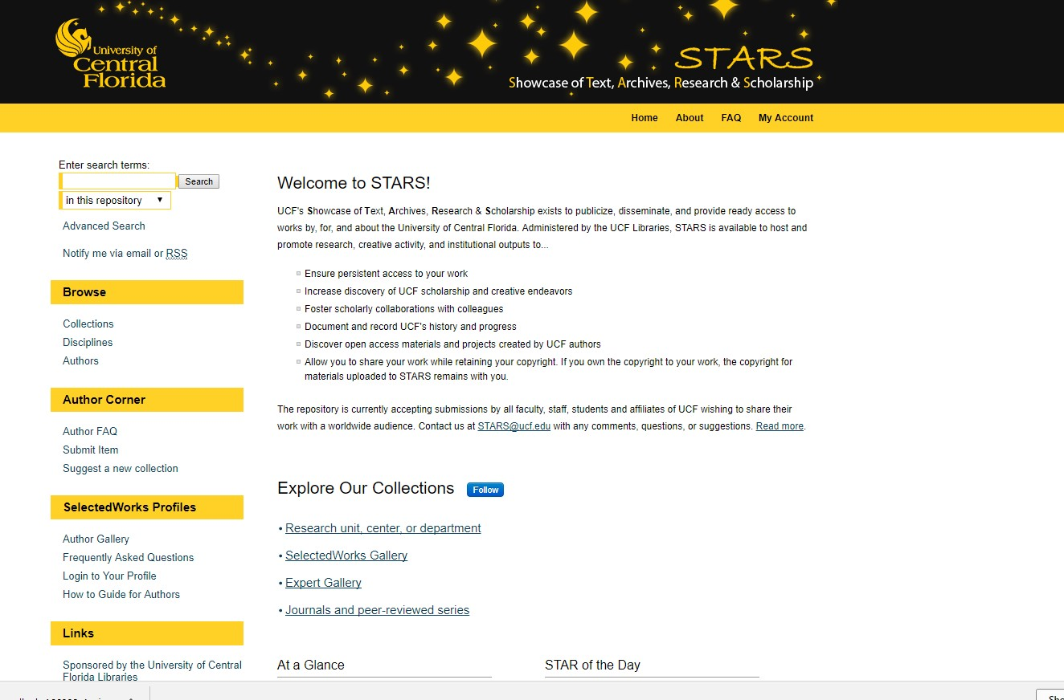
UCF’s Institutional Repository, STARS, is a viable option for self-archiving and open access publication for faculty and students.

Slide 20
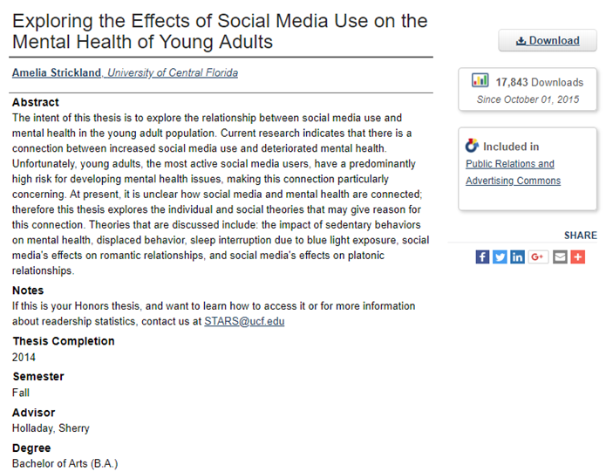

Slide 21
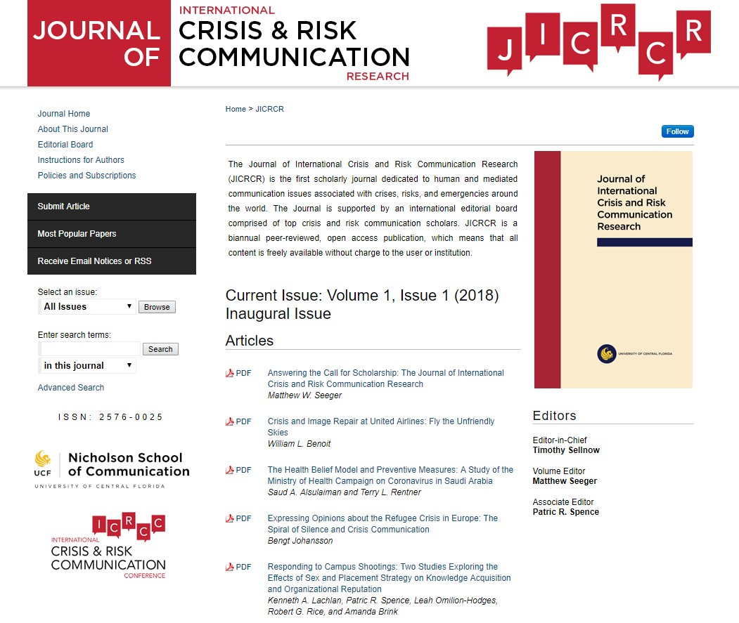

Slide 22
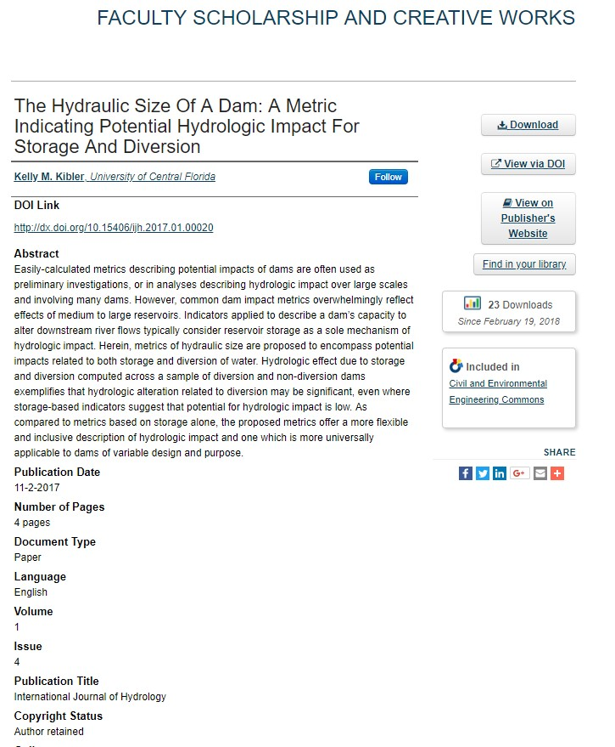

Slide 23
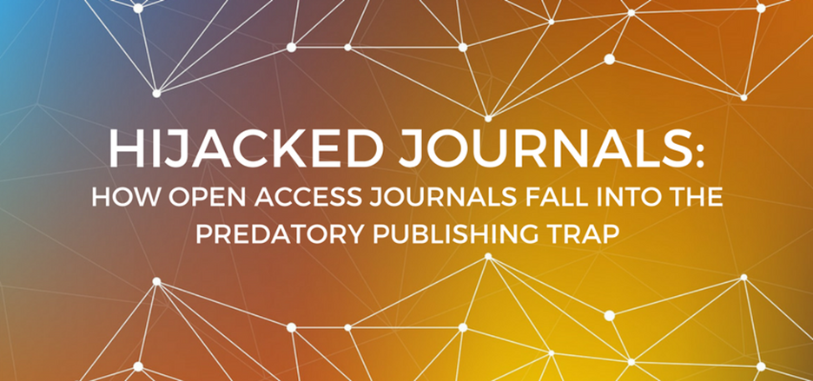
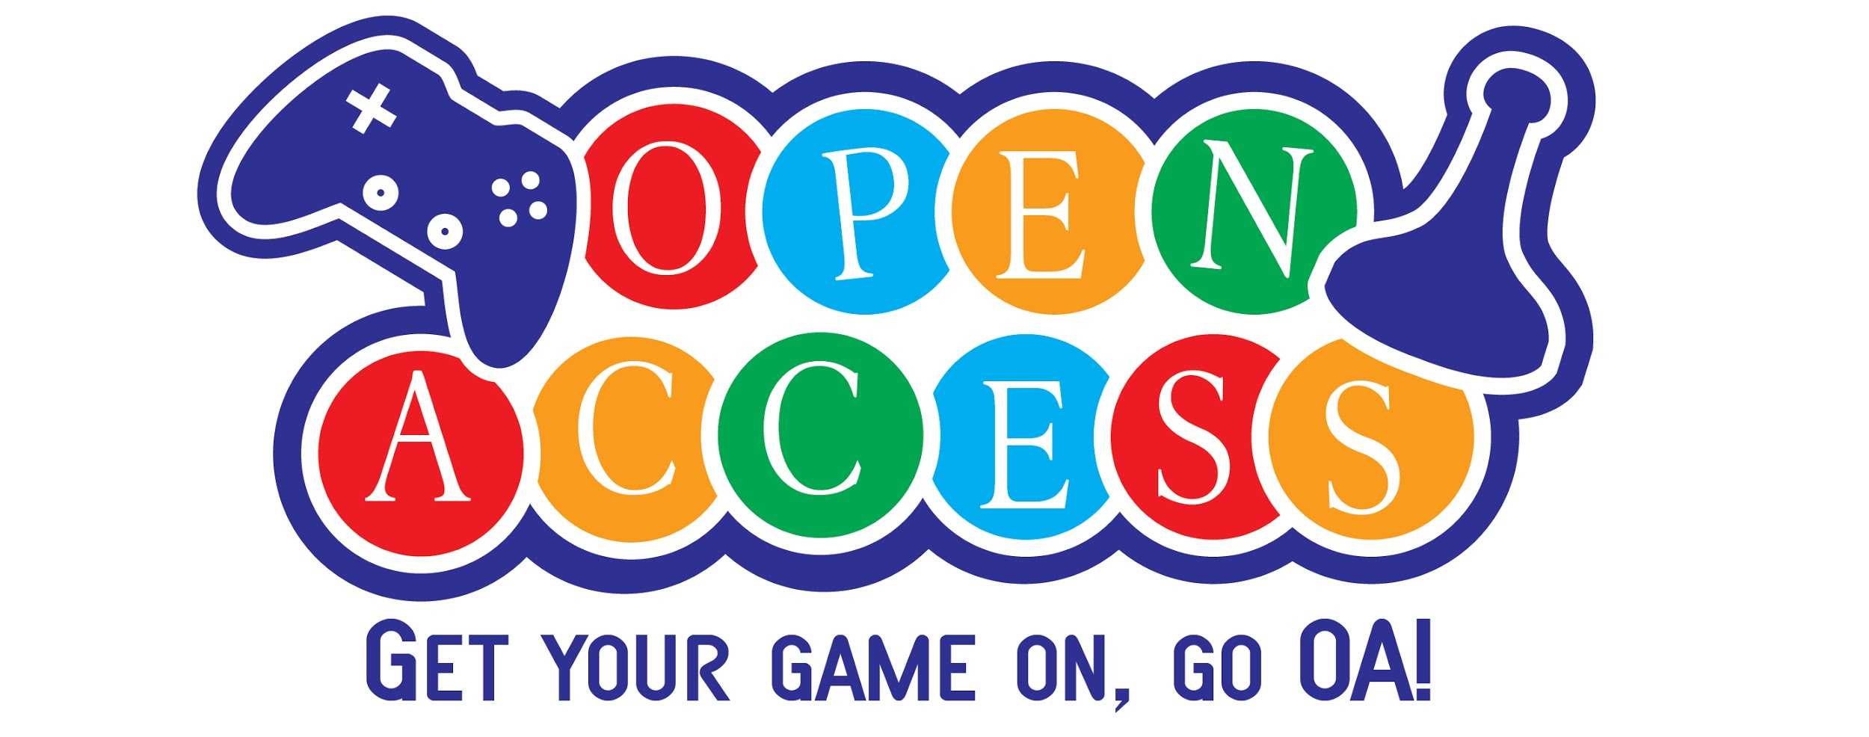
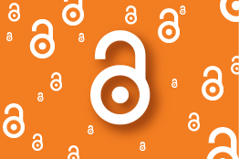
UCF Libraries Scholarly Communication Unit is a resource for faculty and students interested in open access.
http://library.ucf.edu/about/departments/scholarly-communication/

Slide 24
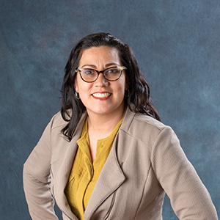
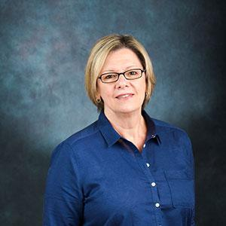
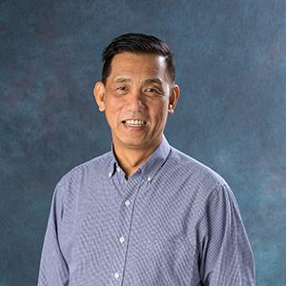
UCF Libraries Subject Librarians
https://library.ucf.edu/staff/subject-librarians/

Slide 25
Looking at the Future of Open Access & UCF
Faculty Research in Open Access Publication Increases
Department, College & Institution Discussions / Vetting of OA Publications
Faculty Utilizing STARS as a Form of Self-Archiving Increases
Funding for STARS
Funding for Article Processing Charges
At the Department / College level
Centralized at the University
Faculty Senate Resolution / Open Access Policy
Others….

Slide 26
Resources for Exploring Open Access Publishing
Beall's List of Predatory Journals & Publishers (https://beallslist.weebly.com/)
Directory of Open Access Journals (https://doaj.org/)
Google Scholar Journal Metrics (https://scholar.google.com/)
Open Access Scholarly Publishers Association (https://oaspa.org/)
SCImago Journal & Country Rank (http://www.scimagojr.com/)
SHERPA/RoMEO (http://www.sherpa.ac.uk/romeo/index.php)
Think Check Submit (http://thinkchecksubmit.org/)
UCF Library’s Online Journals (http://library.ucf.edu/)

Slide 28
Contact Information
Sarah A. Norris: sarah.norris@ucf.edu

