Slide 1
Hijacked Journals and Conferences:
Predatory Practices in Academia
Sarah A. Norris, Scholarly Communication Librarian
Andy Todd, Nursing Librarian
UCF Libraries

Slide 2
Overview
What are Predatory Publishers & Conferences?
Predatory Practices & Open Access Connection
Characteristics of Predatory Journals, Books & Conferences
Tips on How to Avoid Predatory Conferences & Publishers

Slide 3
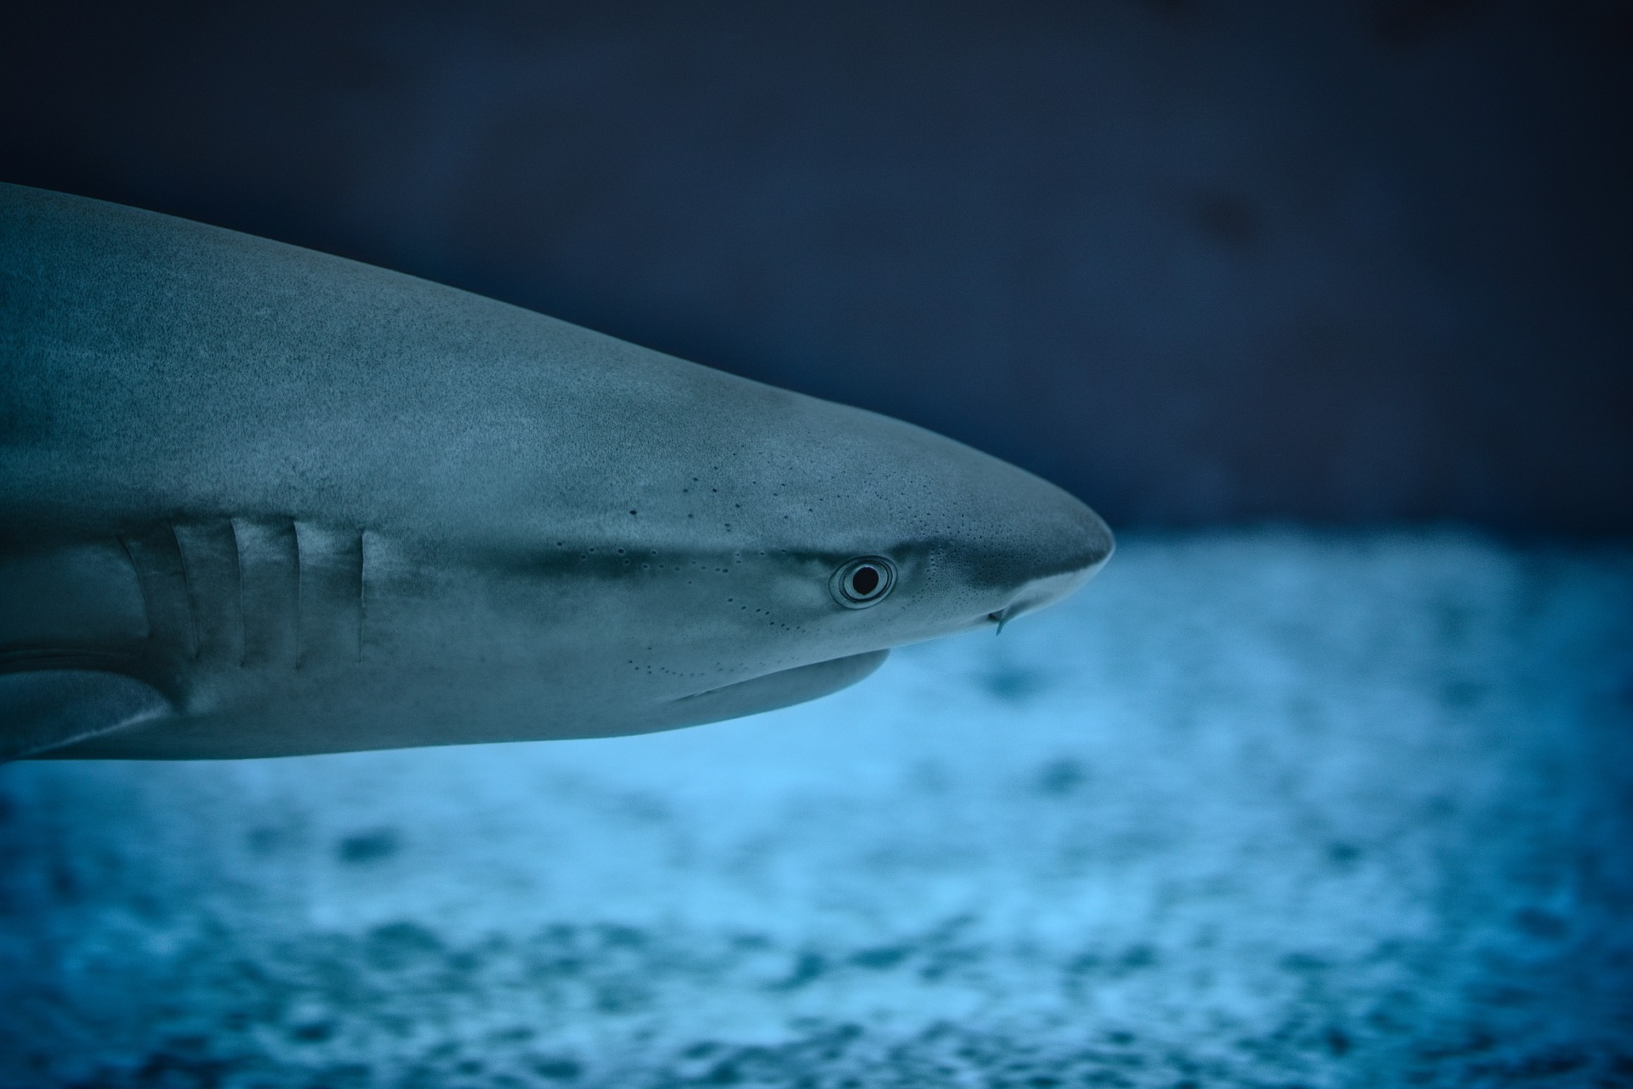
What is Predatory Publishing?

Slide 4
“Predatory open-access publishing is an exploitative open-access academic publishing business model that involves charging publication fees to authors without providing the editorial and publishing services associated with legitimate journals (open access or not).”
https://en.wikipedia.org/wiki/Predatory_open_access_publishing

Slide 5
What are Predatory Conferences?

Slide 6
“Predatory conferences or predatory meetings are meetings set up to appear like legitimate scientific conferences but which are exploitative as they do not provide proper editorial control over presentations and advertising can include claims of involvement of prominent academics who are, in fact, uninvolved.”
https://en.wikipedia.org/wiki/Predatory_conference

Slide 7
A Few Common Traits… (more on this later!)
Soliciting articles, presentations, etc. via email
Charging author and/or presenters for various services that it may or may not provide
Quick turnaround time for publication or acceptance for presentations
But, determining what is or isn’t predatory behavior can be hard to define...

Slide 8
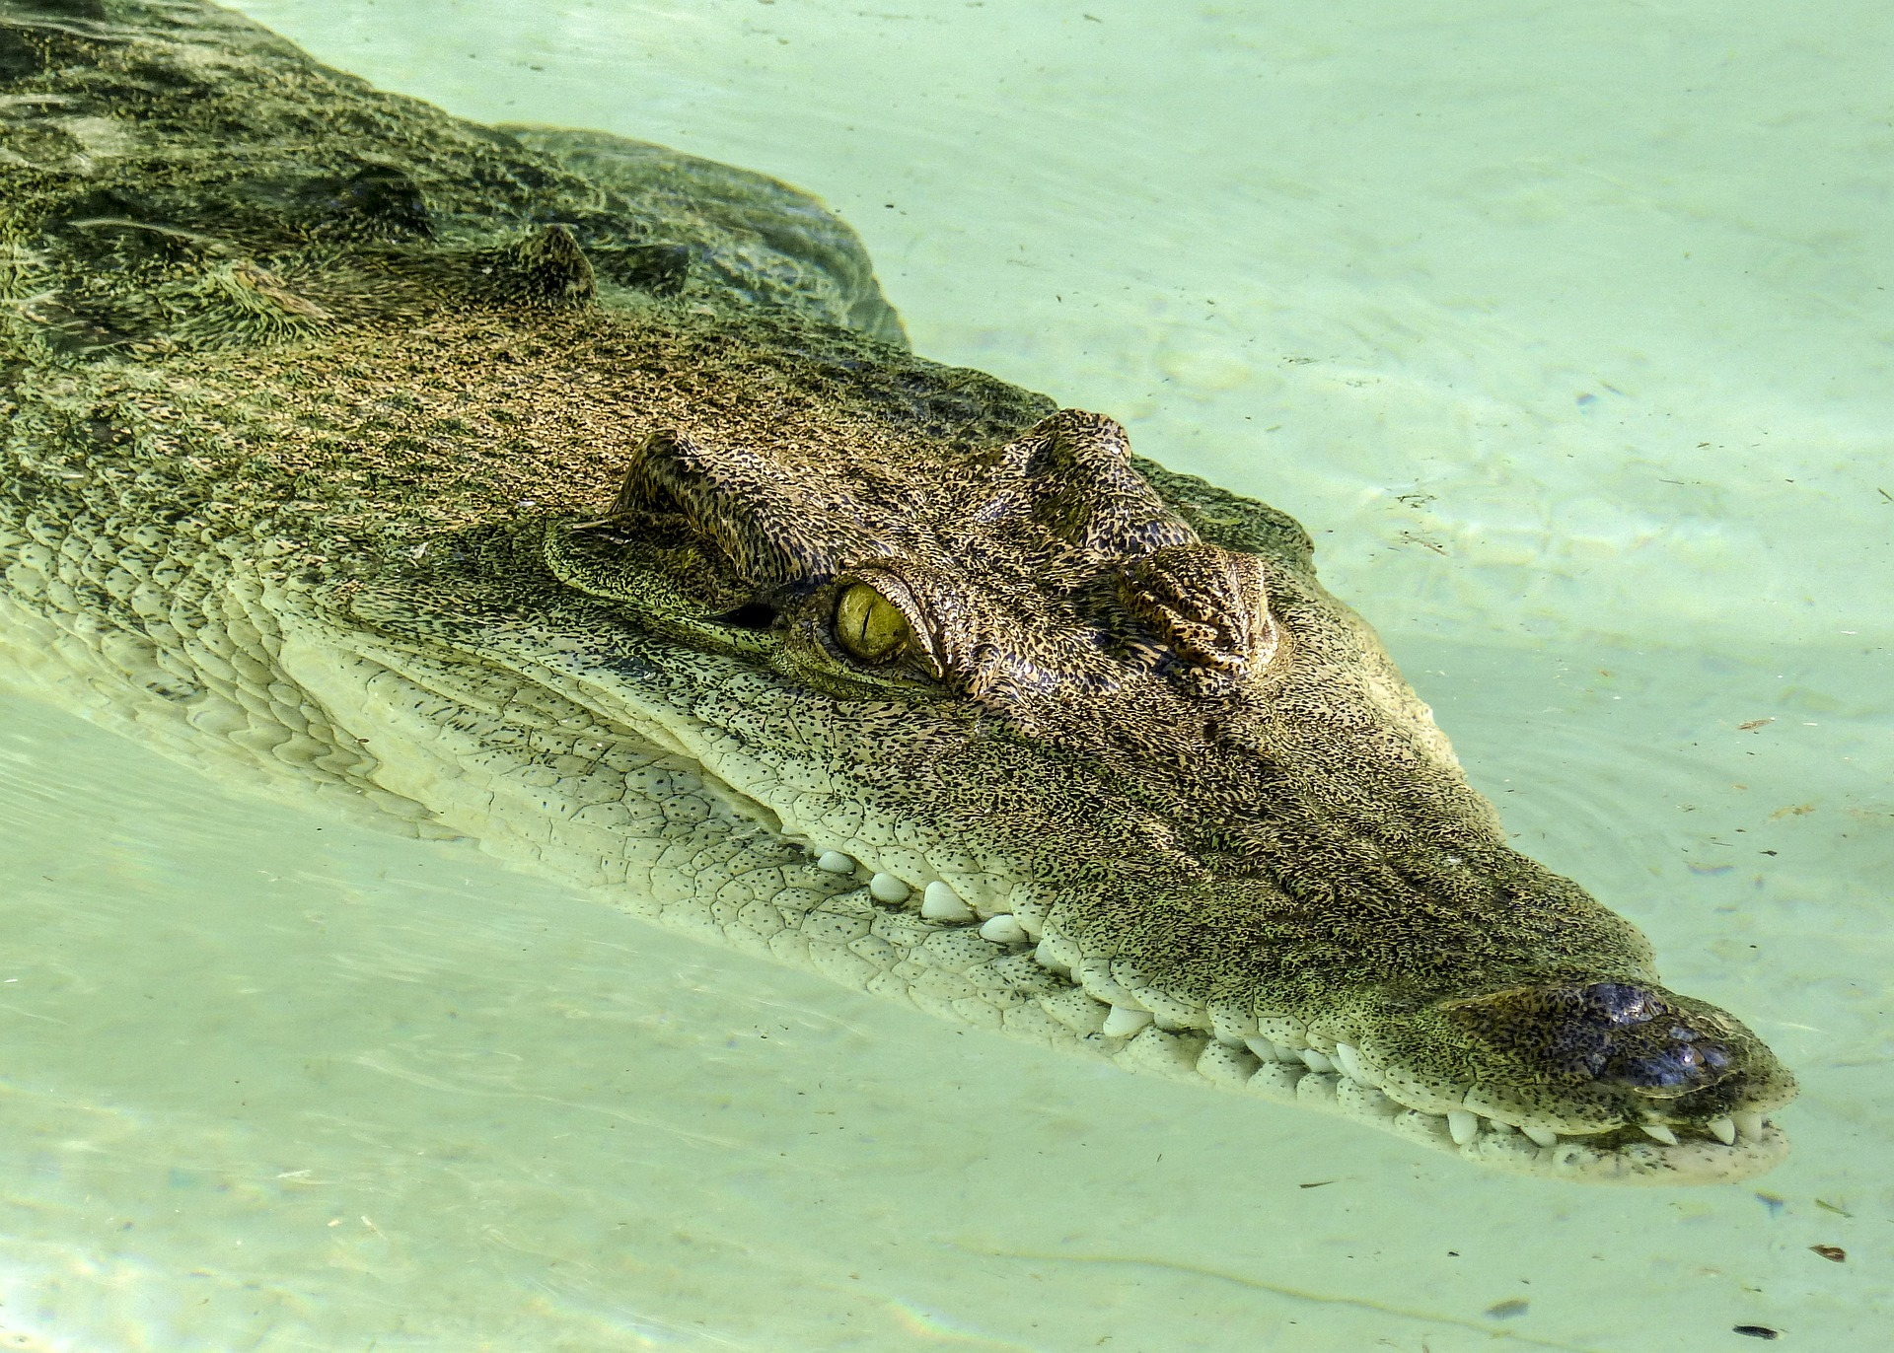
Predatory Practices
& Open Access
Connection

Slide 9
Open Access Publishing Myths
Open Access journals are not high-quality peer-reviewed publications
Charging authors an Article Processing Charge (APC) is predatory behavior
Predatory publishing only exists in Open Access publications
However, Predatory Practices are a common issue in modern academia...

Slide 10
This Doesn’t Mean All Open Access Journals are Predatory...

Slide 11
But, Predatory Publishers Continue to Roar onto the Scene...

Slide 12
Predatory Publishers on the Rise...
Increased dramatically with the emergence of Open Access journal publishing
The online environment makes it easy to create and distribute research
OA journals provide scholars a way to make their research available to anyone, anywhere without institutional affiliation
OA journals help meet new & emerging funding mandates
Predatory Publishers have become adept at soliciting author contributions and appearing to be credible, peer-reviewed venues for publication
Study in 2014, nearly $75 million was paid to publishers suspected to be predatory in nature (https://bmcmedicine.biomedcentral.com/articles/10.1186/s12916-015-0469-2)
The rise of predatory publishing has prompted many studies and analyses of their publishing practices

Slide 13
Identifying
Predatory
Conferences

Slide 14
Characteristics of Predatory Conferences
Solicits presentations/keynotes via email
Email is typically not personalized and/or has incorrect details or lacks information
No process or Call for Proposals
Lack of travel funding
Poorly constructed website and/or web presence
Website typically does not provide good information and/or may not even exist
Contains false and/or misleading affiliations with faculty or institutions
E.g. Faculty listed as conference organizers and/or program reviewers that are not actually participating and/or affiliated with conference
Often associated with a predatory journal publisher
E.g. OMICS (https://www.omicsonline.org/nursing-conferences.php)
Listed on known predatory conference sites like Conference Series LLC (https://www.conferenceseries.com/)

Slide 15
Questions to Consider...
Is there a sponsoring organization?
Who is conducting the reviews?
Who are they? Determining any type of authority may be a rigorous endeavor…
Is it their 1st conference? What’s their experience / track record?
Is it held in some far flung destination?
Many, but not all, predatory conferences are typically held in an international location
Are they listed on a predatory conferences list and/or do you find negative information about them when you do a search for the conference name and term “predatory” in Google?

Slide 16
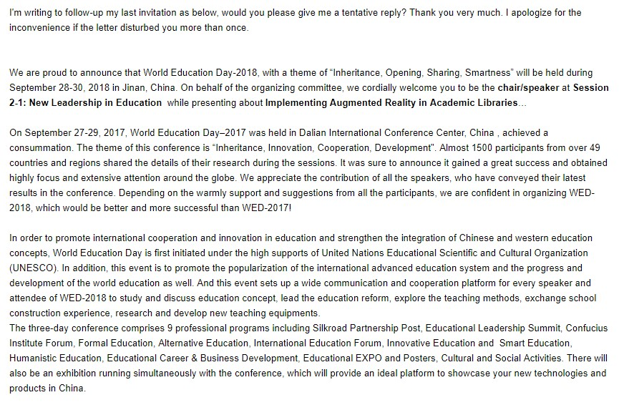
Solicitations to UCF Library Faculty

Slide 17
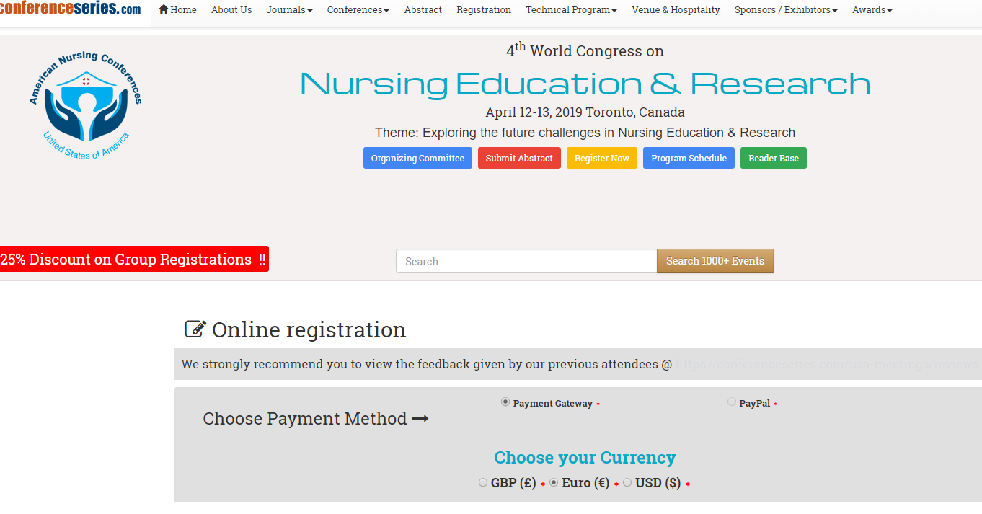
Nursing Conference Example
https://nursingeducation.nursingmeetings.com/registration.php
“All accepted abstracts will be published in respective Conference Series LLC LTD International Journals.”
Multiple email address with different endings (i.e. .org, .net, .com)

Slide 18
Identifying Predatory Publishers

Slide 19
Characteristics of Predatory Journals & Books
Promises fast peer review & publication
Journal content is extremely broad and/or unfocused
Inconsistent and/or contradictory information
Not included in indexes / databases
Poorly constructed website and/or web presence
Solicits contributions and/or participation via email
Email is typically not personalized and/or has incorrect details or lacks information
Contains false and/or misleading affiliations with faculty or institutions
E.g. Faculty listed as editors, review board, and/or authors that are not actually affiliated with the journal

Slide 20
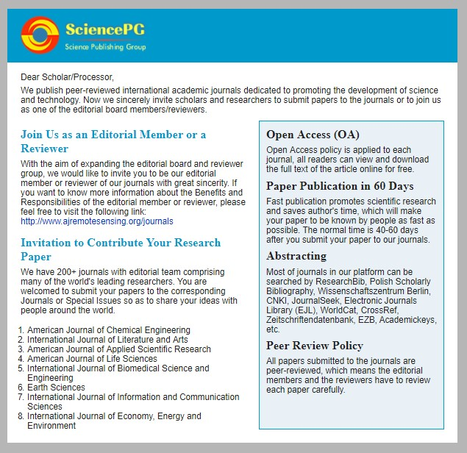
Solicitations to UCF Library Faculty

Slide 21
Top 4 Tips on How to Avoid Predatory Conferences & Publishers
Tip #1: Trust your gut!
Tip #2: Use a checklist, like Think Check Submit (https://thinkchecksubmit.org/)
Tip #3: Use resources to check for credibility, such as:
Predatory Conferences LibGuide: https://libguides.caltech.edu/c.php?g=512665&p=3503029
Beall’s List (use other sources in conjunction with this): https://beallslist.weebly.com/
Directory of Open Access Journals: https://doaj.org/
Open Access Scholarly Publishers Association: https://oaspa.org/
UCF Library’s Online Journals: http://library.ucf.edu/
Tip #4: When in doubt, ask your trusted librarian!

Slide 22
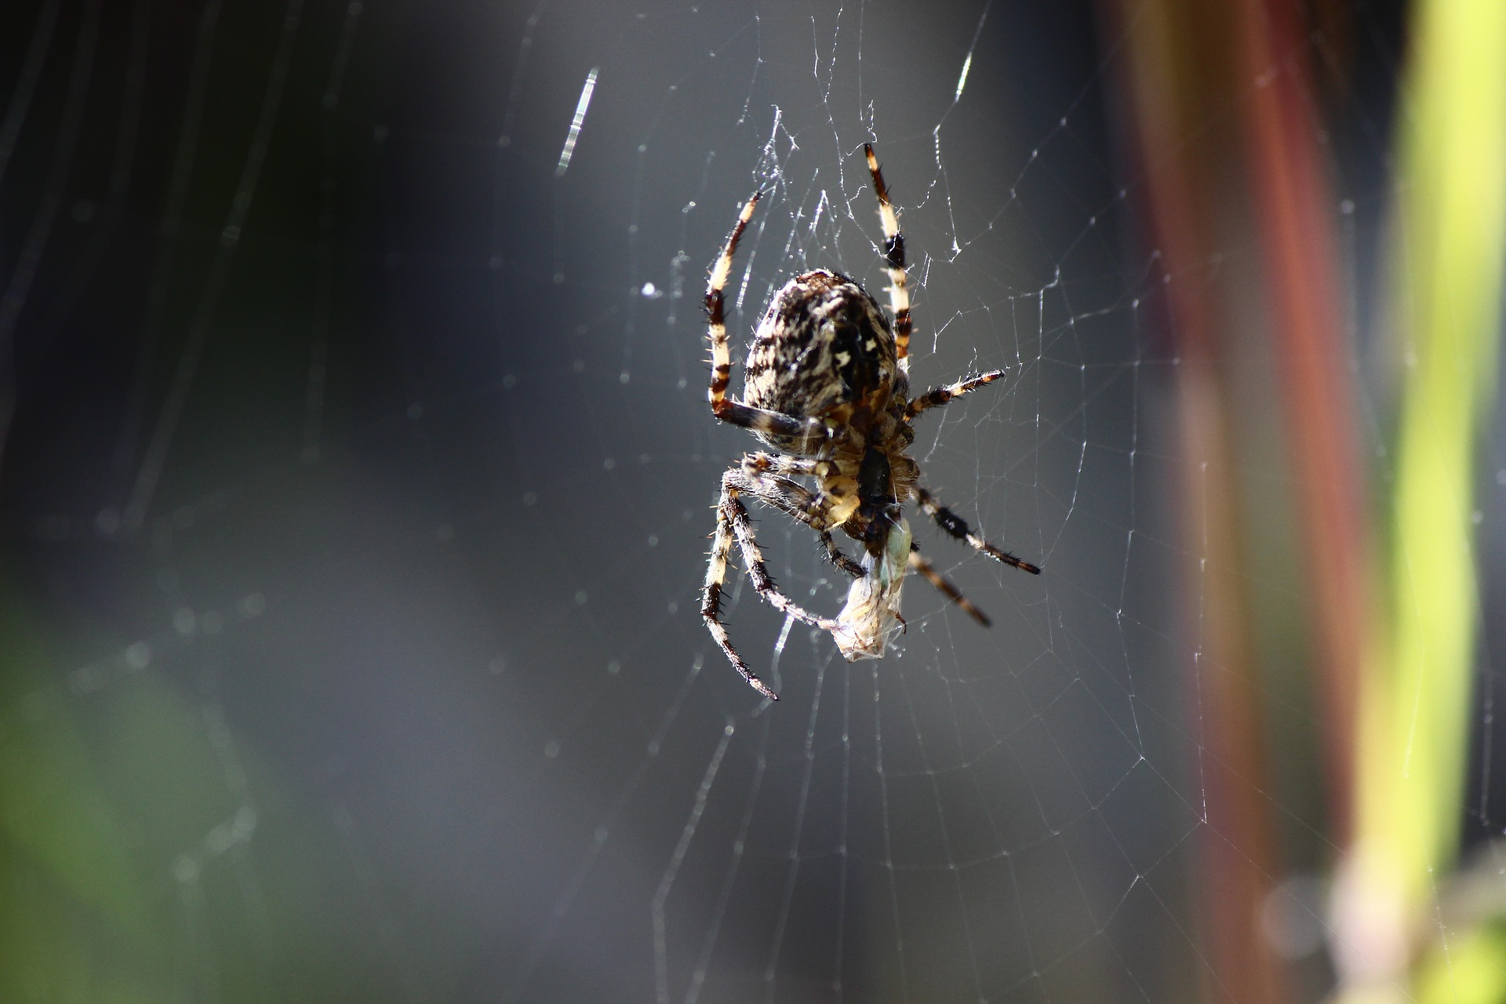
What Can You Do If You Published in a Predatory Journal?

Slide 23
Removing Articles from Predatory Journals
If you come to find out your work was published in a predatory journal, you may want to:
Remove the article from your CV
File a Digital Millennium Copyright Act (DMCA) takedown notice: http://www.sfwa.org/2013/03/the-dmca-takedown-notice-demystified/
File a complaint with the Federal Trade Commission (FTC):https://www.ftccomplaintassistant.gov
Connect with a librarian to discuss

Slide 24
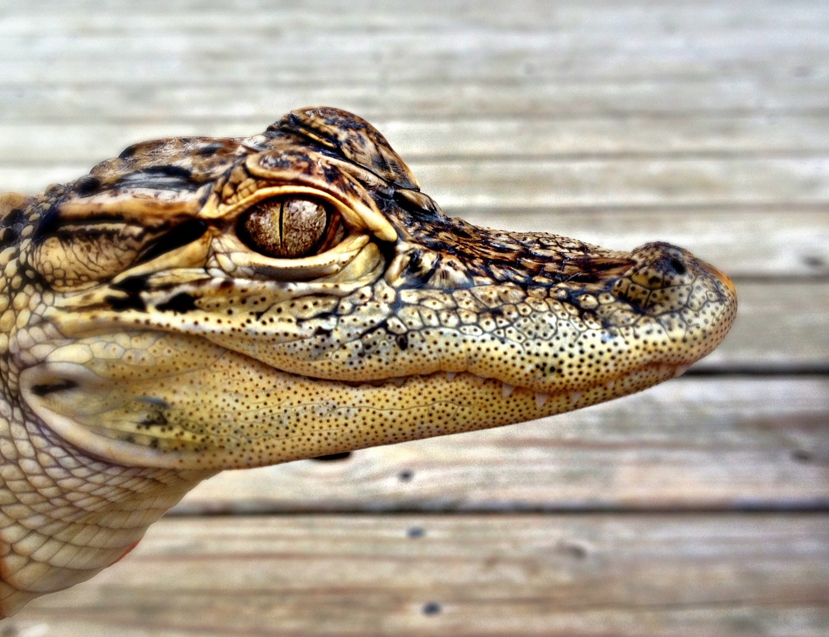
Have You Encountered Predatory Publishers?

Slide 25
Further Reading
Oermann, M. H., Nicoll, L. H., Chinn, P. L., Ashton, K. S., Conklin, J. L., Edie, A. H., … Williams, B. L. (2018). Quality of articles published in predatory nursing journals. Nursing Outlook, 66(1), 4–10. https://doi.org/10.1016/j.outlook.2017.05.005
Oermann, M. H., Conklin, J. L., Nicoll, L. H., Chinn, P. L., Ashton, K. S., Edie, A. H., … Budinger, S. C. (2016). Study of Predatory Open Access Nursing Journals. Journal of Nursing Scholarship, 48(6), 624–632. https://doi.org/10.1111/jnu.12248

Slide 27
Contact Information
Sarah A. Norris: sarah.norris@ucf.edu
Andy Todd:
andrew.todd@ucf.edu

