Slide 1
Predatory & Deceptive Publishing Pitfalls and Practical Tips:
Helping Faculty & Students to Identify & Avoid Questionable Publishing Practices
Sarah A. Norris, Scholarly Communication Librarian
University of Central Florida

Slide 2
Overview
Philosophical Goals
Strategies for Engaging Faculty & Students
Case Study: University of Central Florida

Slide 3
Philosophical Goals

Slide 4
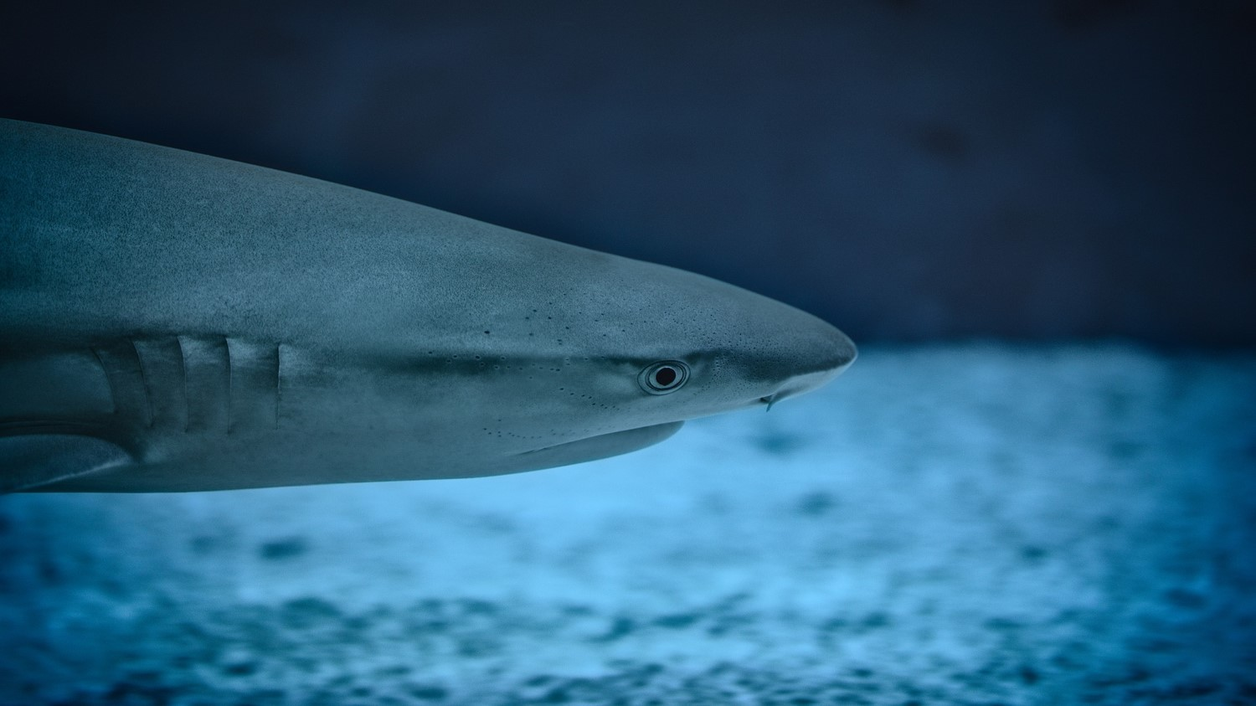
Foster Critical Thinking & Inquiry about Publications

Slide 5
Look at the Publishing Process Holistically

Slide 6
Foster an Awareness & Deeper Understanding of Open Access

Slide 7
Strategies for Engaging Faculty & Students

Slide 8
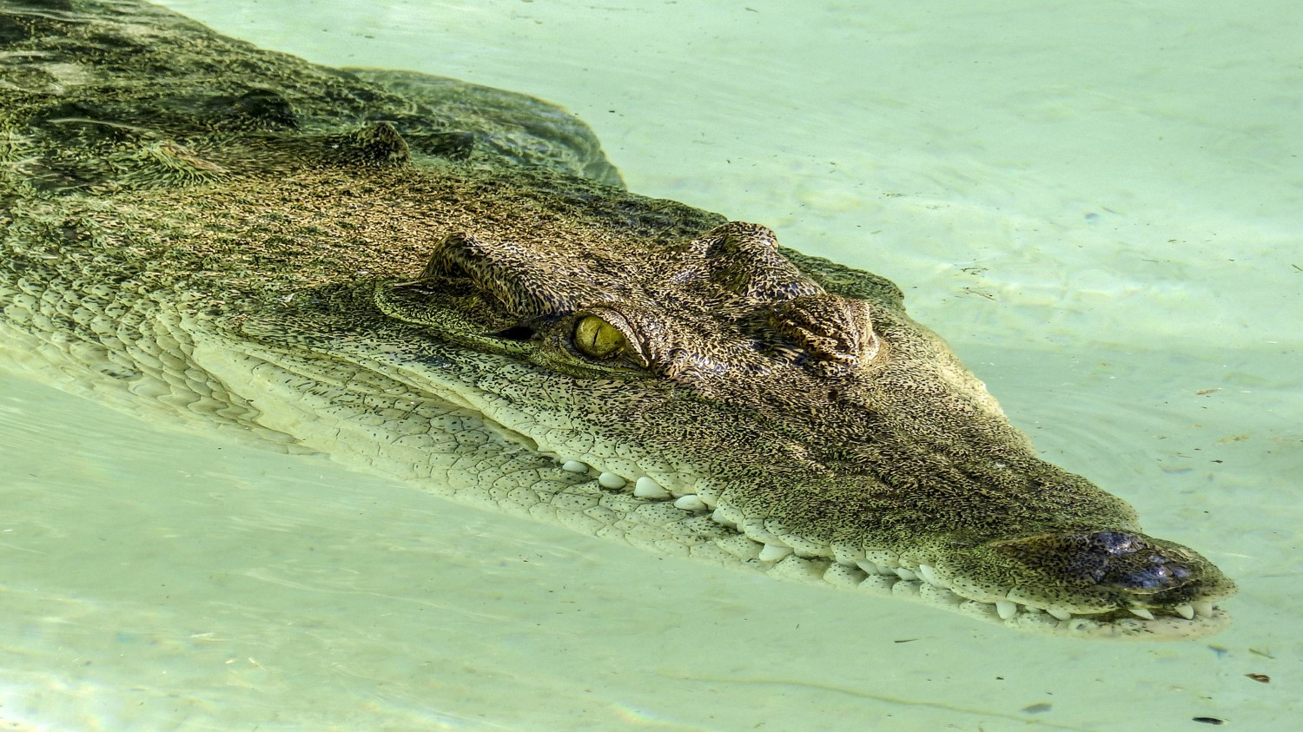
Acknowledge that Predatory Publishing is a Problem

Slide 9
Dispel Myths About Open Access

Slide 10
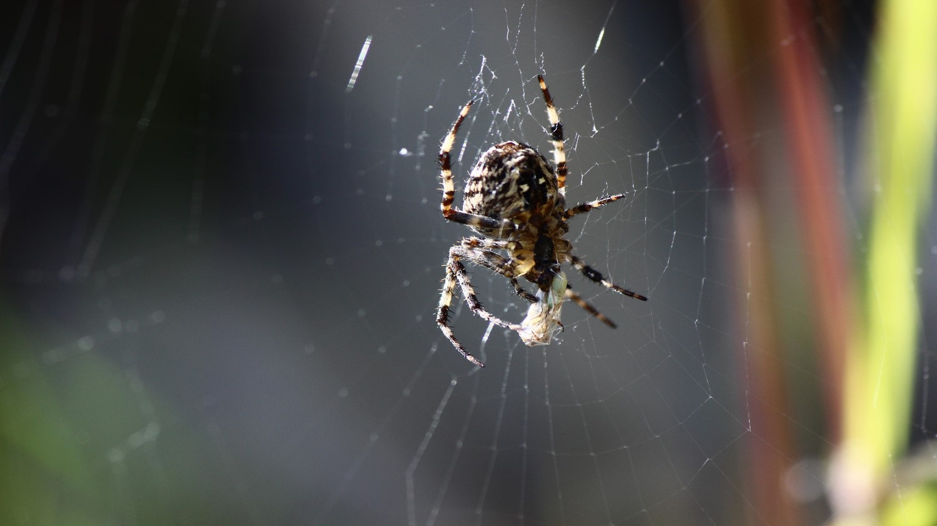
Identify Common Characteristics & Red Flags

Slide 11
Provide Evaluation Tools to Determine Credibility and Appropriateness for Publication

Slide 12
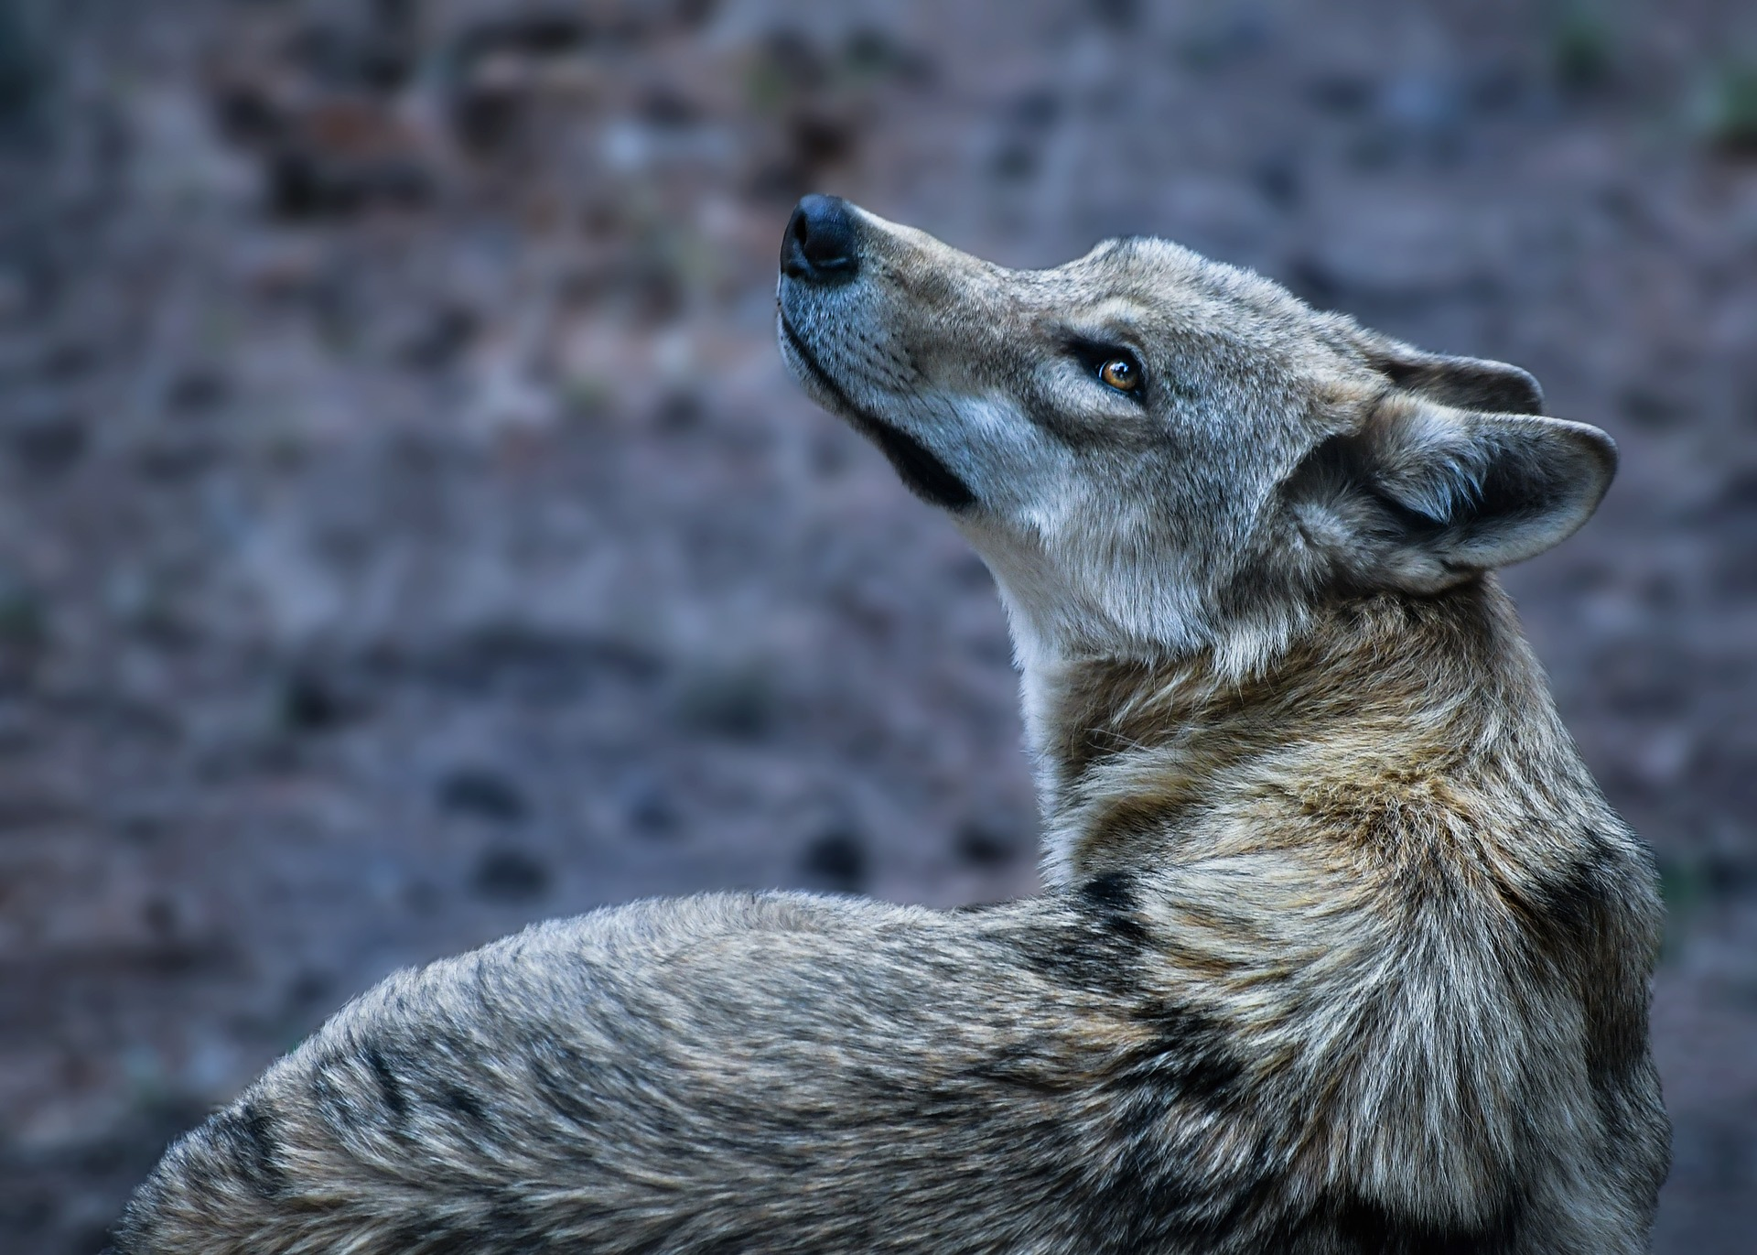
Share Real World Examples Related to Specific Disciplines

Slide 13
Case Study: University of Central Florida

Slide 14
UCF Strategies
Focus on outreach & education
Scholarly Communication website
Research Guides
Campus Workshops & Presentations
Individual Assistance (consultations, email, etc.)
Partner with Campus Units
Office of Research
Faculty Excellence
Faculty Center for Teaching & Learning

Slide 15
UCF Strategies
Collaborate with Subject Librarians
Workshops & Presentations
Consultations
Department Meetings
Subject Librarian Newsletters

Slide 16
UCF Research
STM Faculty Publishing Practices
Assessment of Engineering & Computer Science and Science Faculty
Conducted by Engineering and Science Librarian in conjunction with Scholarly Communication Librarian
Assessed Assistant, Associate, and Full Faculty
Reviewed CVs available publicly online
Review Process
Searched faculty in Web of Science to identify faculty members with the most open access publications
Reviewed CVs with sites like Beall’s List, DOAJ, and OASPA
Future Research & Impact on Outreach and Education Practices

Slide 17
Contact Information
Sarah A. Norris
sarah.norris@ucf.edu

