Slide 1
Open Educational Resources
at the University of Central Florida
Sarah A. Norris, Scholarly Communication Librarian
University of Central Florida

Slide 2
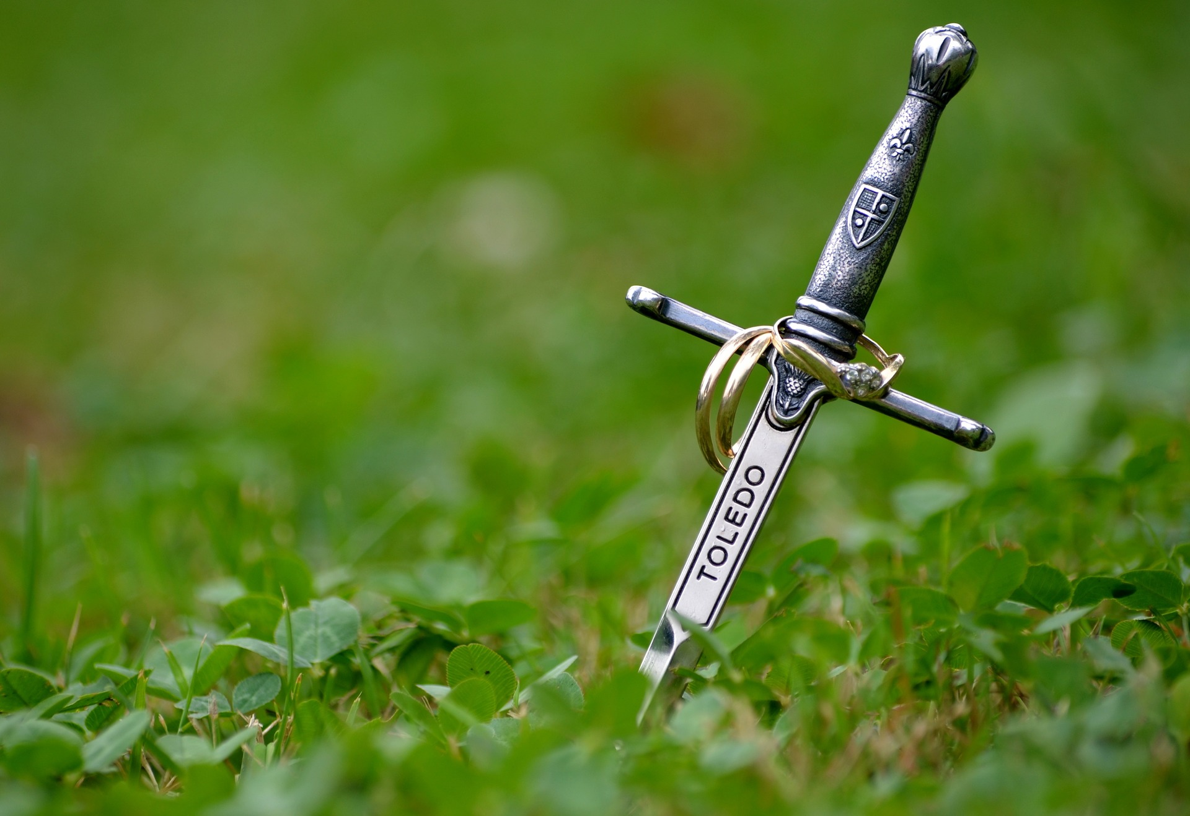
OER: English Literature I

Slide 3
Determine if Present Materials are Available through Other Avenues...
Course: ENL2012, English Literature I
Required course materials - Norton Anthology
Course readings focused on Medieval literature
Project Focus: Finding library-sourced, public domain, and/or Creative Commons licensed versions of course readings

Slide 4
Participants Involved
English Subject Librarian
Instructional Designers
Instructor
Scholarly Communication Adjunct
Scholarly Communication Librarian
Textbook Affordability Working Group Members
And more!

Slide 5
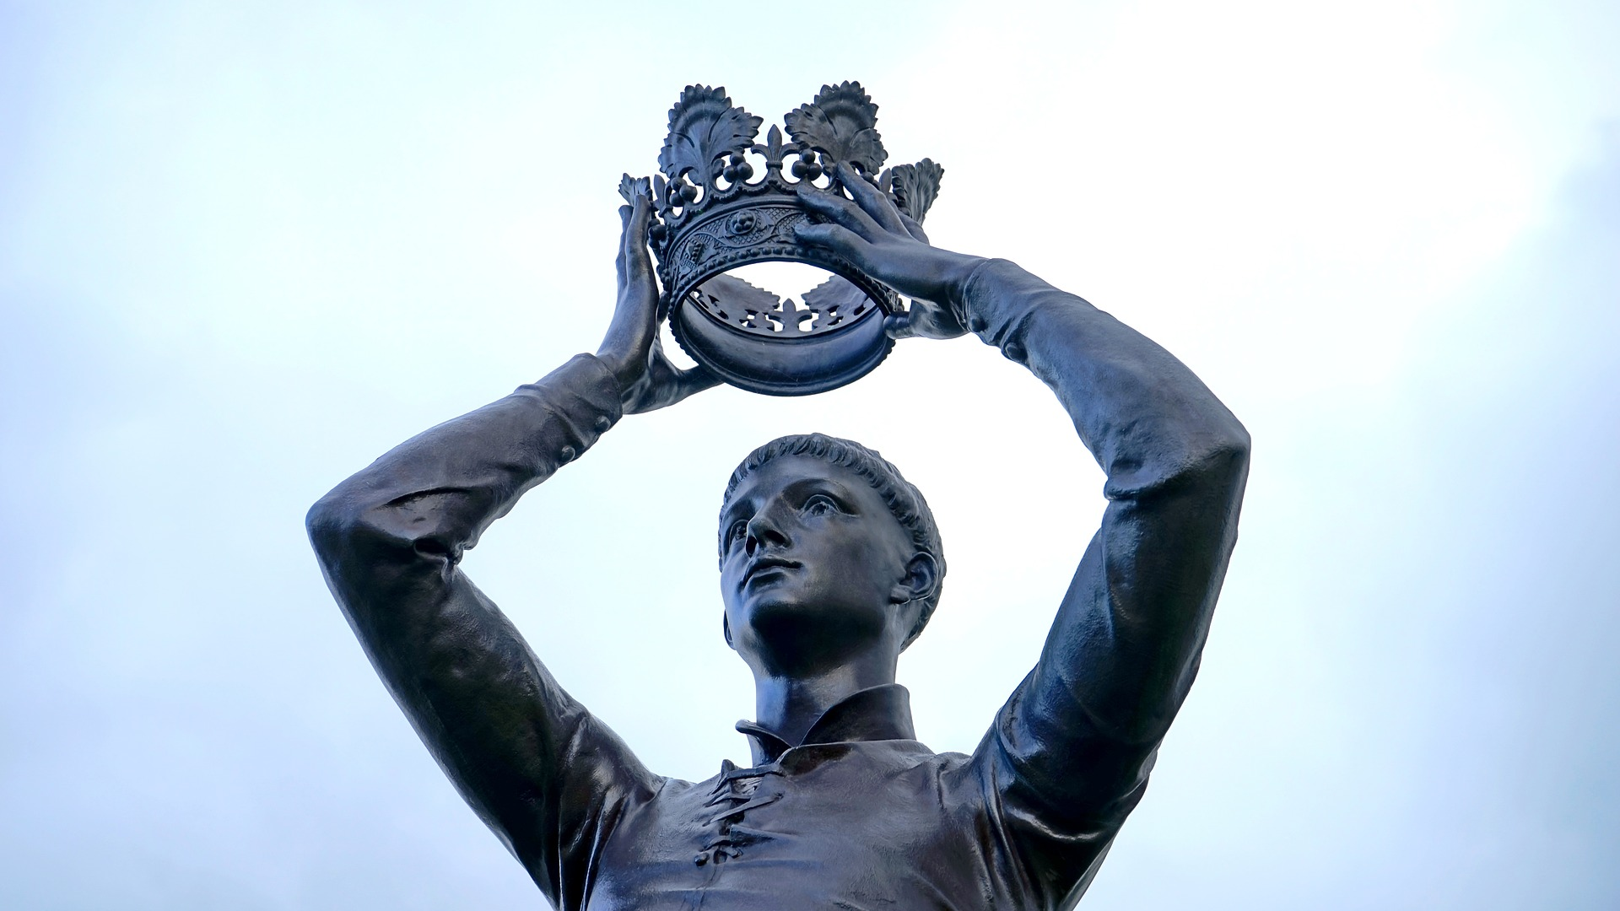
Path to OER Creation

Slide 6
Creating an Open Educational Resource
Finding high quality, comparable course readings
Subject Librarian and Scholarly Communication Adjunct worked with Instructor to locate readings based on syllabus
Important considerations:
The correct sections of the works
The preferred translations
Any other preferences

Slide 7
Finding Resources
Multi-phase Process
Find materials students can legally access (i.e. library-sourced content through library databases with unlimited users or online)
Look for public domain and Creative Commons licensed materials online (e.g. HathiTrust, Project Gutenberg)

Slide 8
Creating an Open Educational Resource
Determine Copyright Status and/or Obtain Copyright Permissions
Scholarly Communication Adjunct worked with Subject Librarian to identify and clear copyright for texts used in course
Scholarly Communication Librarian addressed complicated copyright issues and worked with the Office of General Counsel on broader copyright topics related to overall anthology

Slide 9
Copyright Conundrums
Major Areas of Concern:
Versions (i.e. what can you share as an OER and what should be limited only to the classroom?)
Access (i.e. how do you make it more openly accessible by everyone in IR? Which leads to…)
Ownership (i.e. who “owns” the anthology and can the University claim ownership)

Slide 10
Creating an Open Educational Resource
Creating an OER Anthology
Instructional Designer worked with Instructor to create preferred formats for course materials
Important considerations:
Readability: Multiple sources of content in a variety of file formats
Formatting: Poems, sonnets, plays, and prose
Access to Materials: File format of finished product, Types of devices

Slide 11
Technical Details
Reformatting source materials to HTML file format
Utilized Cascading Style Sheets (CSS) to achieve desired styling for type of work
Combined HTML files into an ePub, open e-book file format with the program Sigil.
ePub can be viewed on a desktop/laptop, tablet, or smartphone
Created PDF of each work as well. ePub and PDFs are hosted in Webcourses

Slide 12
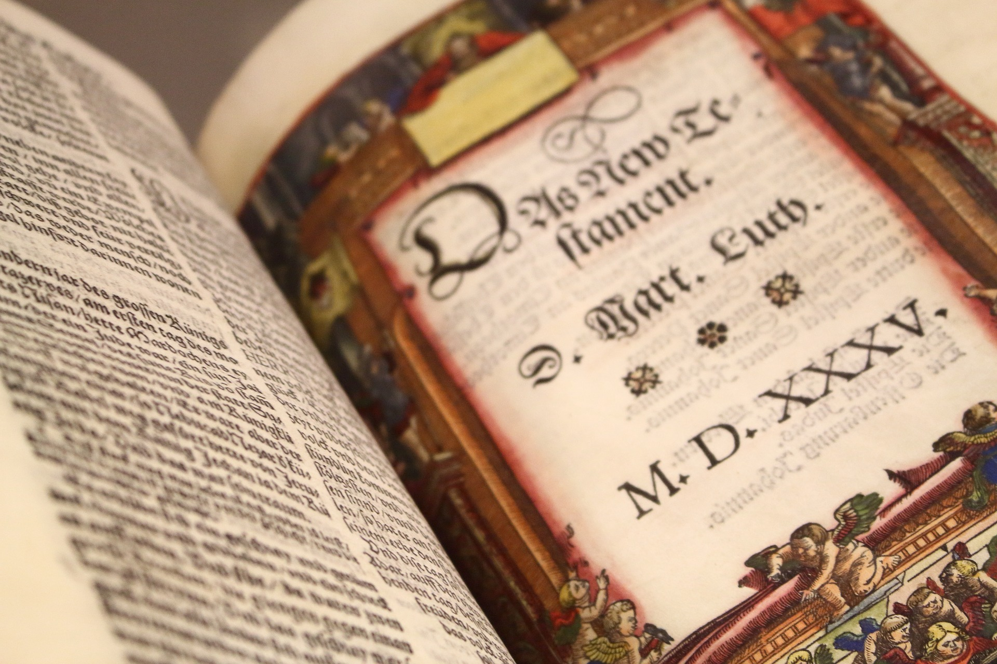
Results

Slide 13
Final Course Materials
OER Anthology
Translated work by instructor
Additional Required Text: Translation of Beowulf
On reserve in the library
Available to purchase used online & in stores
Available to purchase new for $12 in the bookstore

Slide 14
Since Spring 2016…
3 unique faculty teaching 11 sections have reached
606 students, potentially saving them $31,780*
*Savings based on number of students enrolled in section multiplied by cost of a new textbook.

Slide 15
Student Comments
“He provided a textbook and that helped 1000%. In some of my other classes I was unable to purchase every book required which led to extra stress and ultimately failure.”
“The digital readings were amazing because I could access them on any device without lugging around extra papers or books. The price of textbooks sometimes influences the classes I decide to take and so having them be free made me excited (and relieved).”

Slide 16
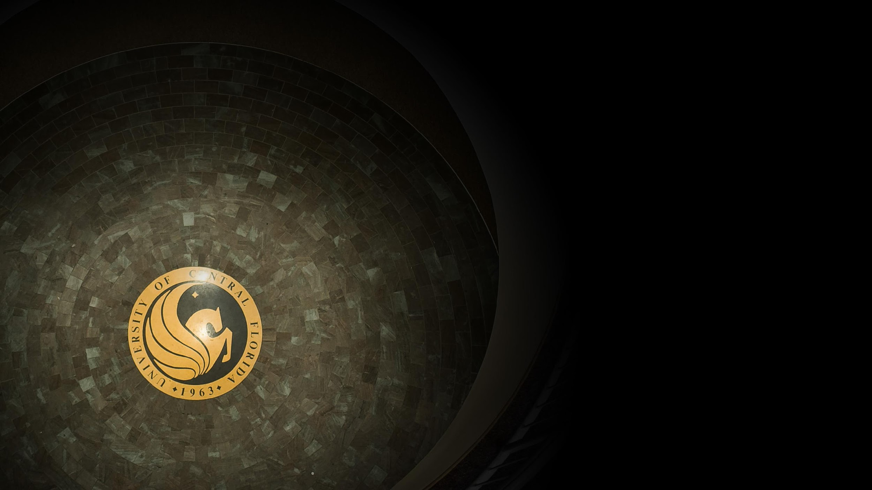
Contact Information
Sarah A. Norris
sarah.norris@ucf.edu

