Slide 1
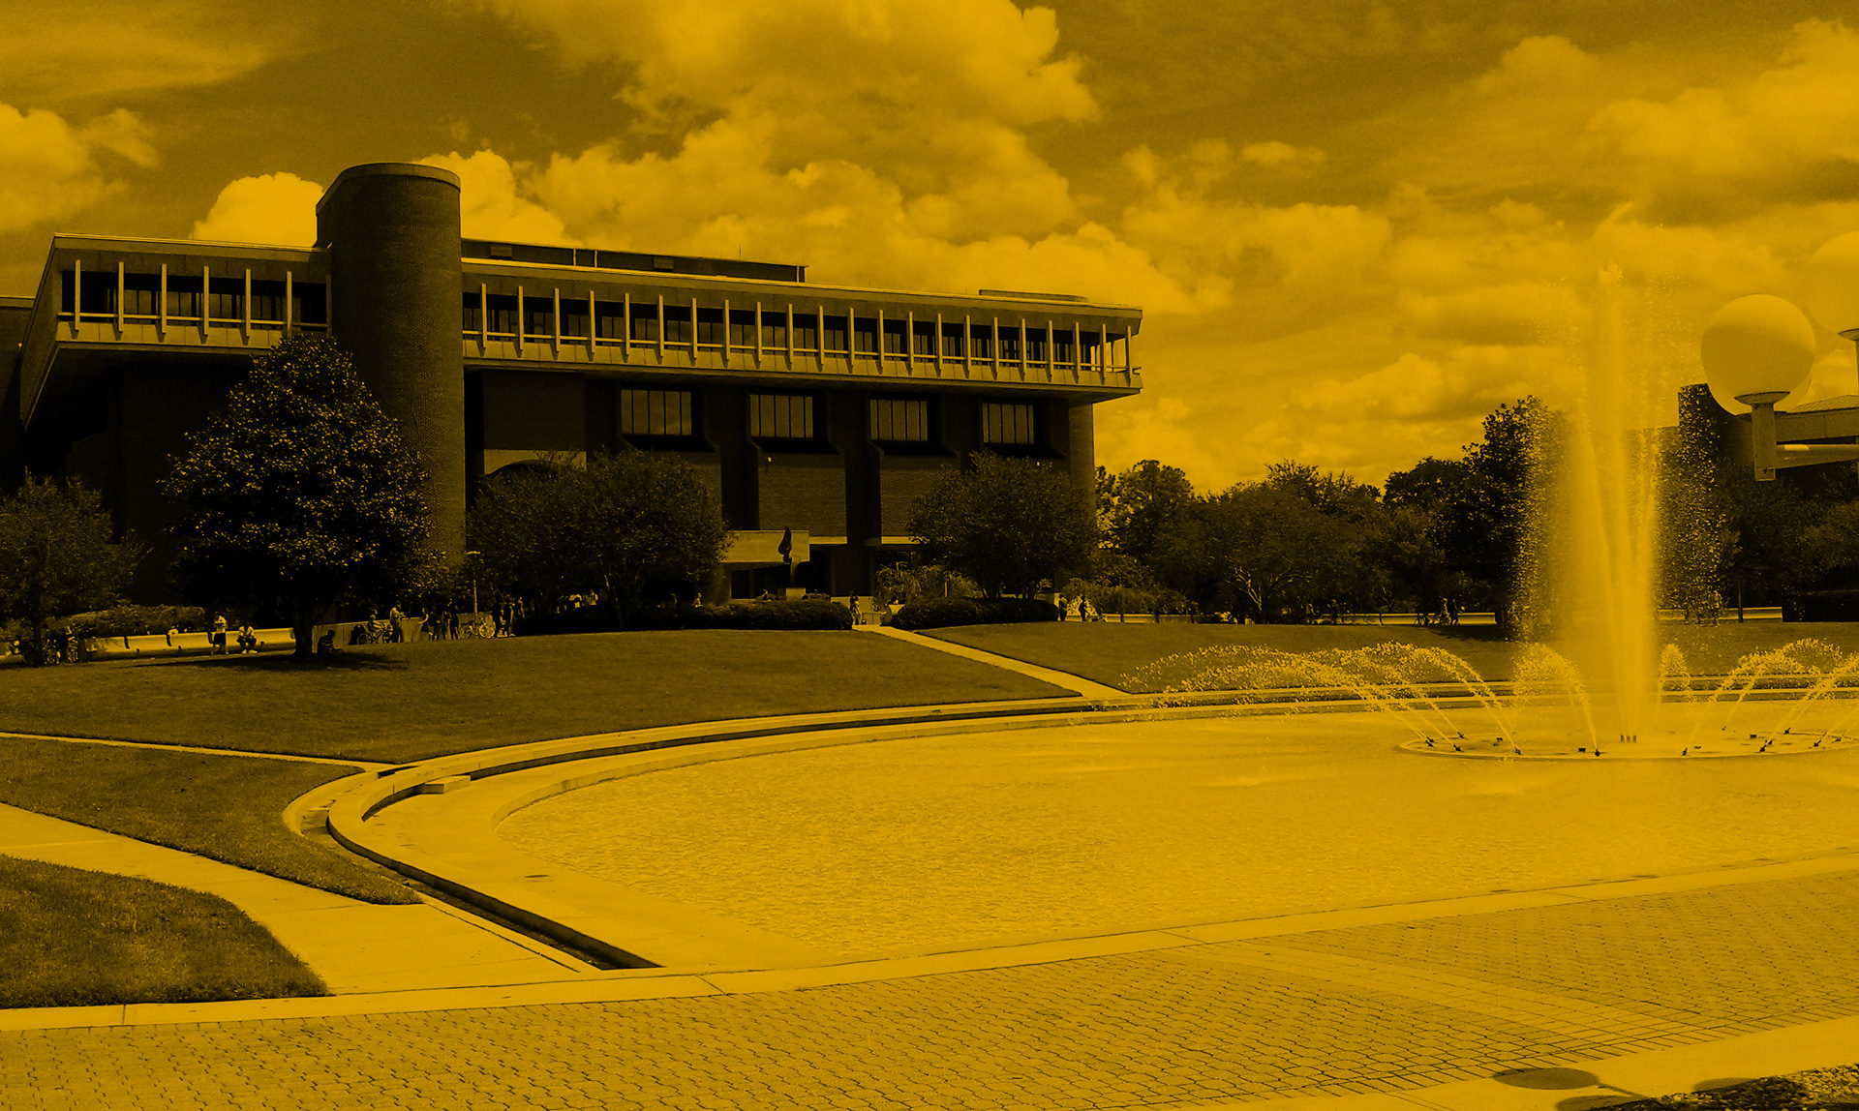
Data Management Plans May 8, 2019 Lee Dotson Digital Initiatives Librarian

Slide 2
Today’s session:
Data Management Plan Overview
DMPTool Step-by-Step Guidance
Additional Resources

Slide 3
What is a Data Management Plan?
Brief description of how you will comply with funder’s data sharing policy for your project
Typically reviewed as part of the grant application
Requirements vary by funding agency
A document that describes what you will do with your data during your research and after you complete your project

Slide 4
Why data management?
Conform to funding agency guidelines on the dissemination and sharing of research results
OSTP Memo to Increase Access to Federally Funded Research (2013)
Data sharing allows for reproducibility, transparency, and data re-use in research.
Sharing is easier if data are managed well from the beginning of a project.

Slide 5
Data expectations
Roles and responsibilities
Types of data
Formats
Period of retention
Icon from www.flaticon.com
Notes:
Types of data, samples, and other materials to be produced in the course of the project. Retention period?
Observational
Experimental
Simulation
Derived or Compiled

Slide 6
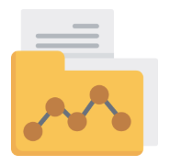
Data and metadata standards
Project Documentation
Dataset Documentation
Describing Data
Metadata Schemas
Icon from www.flaticon.com
Notes:
Data and metadata standards for format and content
Documentation of your data should start at the very beginning of your research project. This will make data documentation easier and reduce the likelihood that you will forget aspects of your data later in the research project.
Research Project Documentation
Context of data collection
Data collection methods
Structure, organization of data files
Data sources used
Data validation, quality assurance
Transformations of data from the raw data through analysis
Information on confidentiality, access & use conditions
Dataset documentation
Variable names, and descriptions
Explanation of codes and classification schemes used
Algorithms used to transform data
File format and software (including version) used
Describing Data
Researchers can choose among various metadata standards, often tailored to a particular file format or discipline. Following are some general guidelines for aspects of your project and data that you should document, regardless of your discipline. At minimum, store this documentation in a readme.txt file or the equivalent, together with the data. One can also reference a published article which may contain some of this information.

Slide 7
Access and sharing considerations
Copyright
Intellectual Property
Confidentiality
Re-use Policies
Icon from www.flaticon.com
Notes:
Access and sharing policies including provisions for appropriate protection of privacy or other rights
http://guides.ucf.edu/data/sharingdata#s-lg-box-1546677
Required by publishers (i.e., the Nature Publishing Group, The American naturalist).
Required by government funding agencies
Allows data to be used to answer new questions
Allows science to be more open
Makes your papers more useful and citable by other scientists
Copyright and Intellectual Property Rights
Sharing data that you produced/collected yourself:
Data is not copyrightable (yet a particular expression of data can be, such as a chart or table in a book)
Data can be licensed; some data providers apply licenses that limit how the data can be used, such as to protect the privacy of participants in a study or guide downstream uses of the data (e.g., requiring attribution or forbidding for-profit use)
If you want to promote sharing and unlimited use of your data, you can make your data available under a Creative Commons Declaration to make this explicit
Confidentiality (Ethical Concerns)
It is vital to maintain the confidentiality of research subjects for reasons of ethics and to ensure the continuing participation in research. Researchers need to understand and manage potential tensions between ethical requirements and other requirements for long-term and permanent retention and for the deposit of data in a repository or archive for the purposes of validating the research and furthering knowledge.
Researchers who wish to ethically share sensitive and confidential data can consider strategies like:
Gaining informed consent that includes consent for data sharing (e.g. deposit in a repository or archive). When obtaining informed consent from study participants, ensure confidentiality while also enabling the option of data sharing. Even if you are not certain that you will share your research data with others, you must obtain informed consent at the outset. For an example of how to write informed consent forms to allow for data sharing, see the U.K. Data Archive guide to consent.
Protecting privacy through anonymising data
Considering controlling access to the data (e.g. through embargoes or access/licensing terms and conditions)

Slide 8
Data storage and preservation
Backups
Non-proprietary formats
Plan for obsolescence
Repositories
Icon from www.flaticon.com
Notes:
Archiving plans for data, samples, and other research products, and for preservation of access to them.

Slide 9
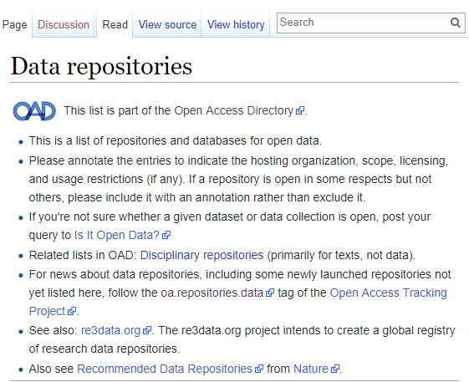
Discipline Repository
Notes:
Open Access Directory data repositories wiki

Slide 10
Discipline Repository
Notes:
Data sharing made easier: use Repository Finder to find the right repository for your data

Slide 11
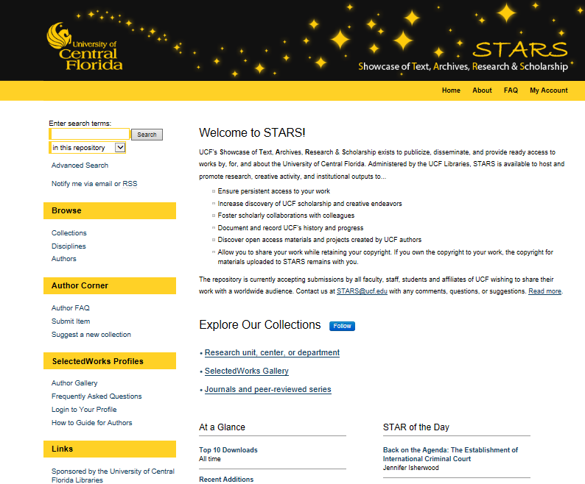
Institutional Repository

Slide 12
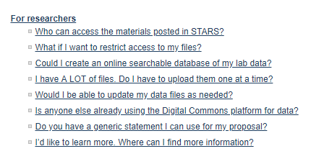
STARS Researchers FAQ
Notes:
https://stars.library.ucf.edu/faq.html#faq-30

Slide 13
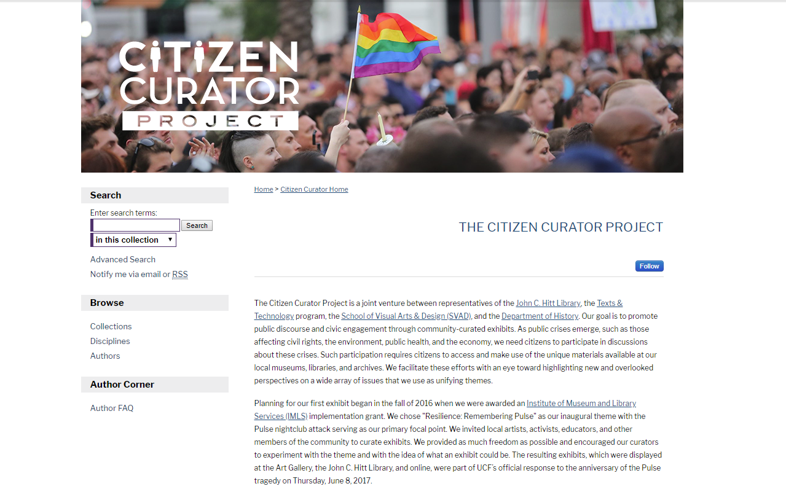

Slide 14
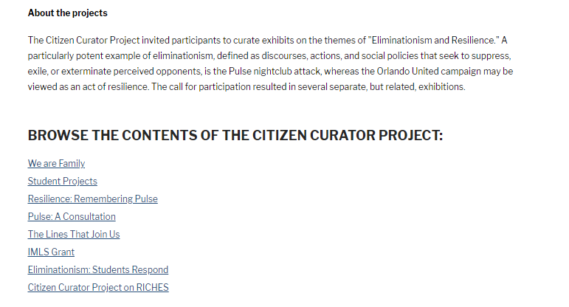

Slide 16
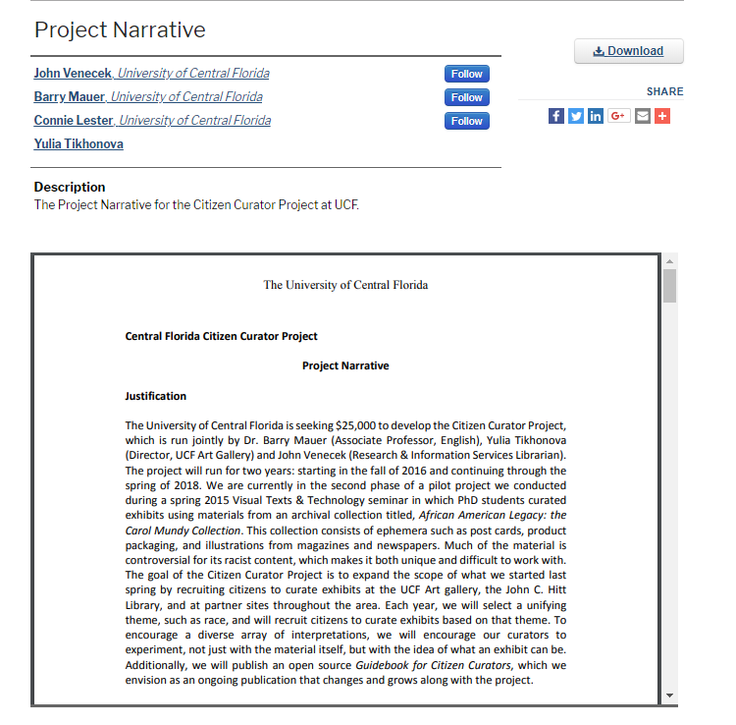

Slide 18
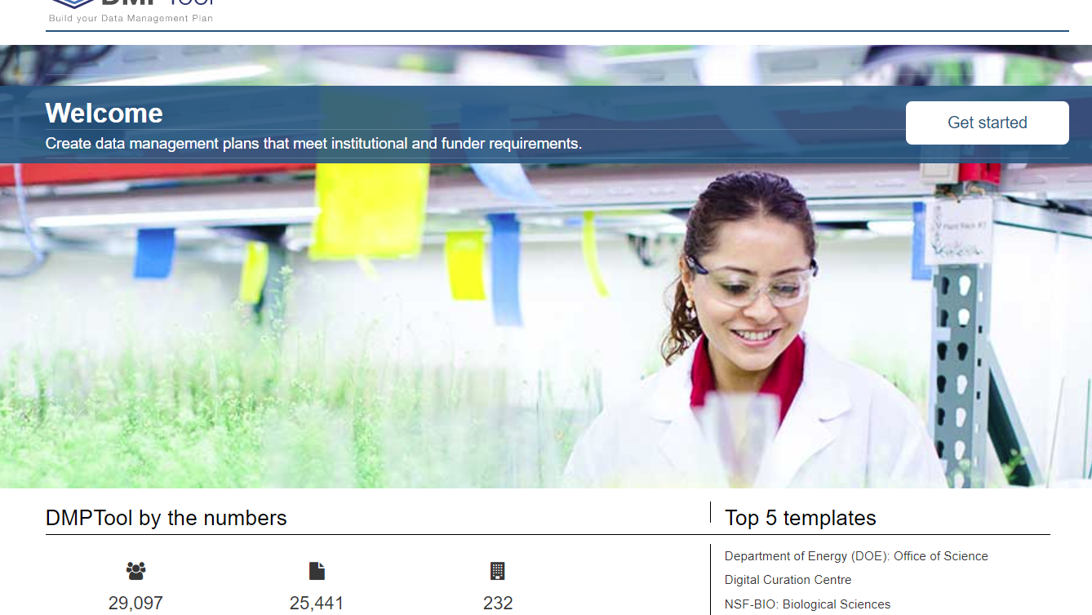
DMP templates and guidance
https://dmptool.org/
Notes:
DMPTool is free for anyone to create data management plans. As a user, you can:
Create your own plans.
Co-author a plan with collaborators.
If you are a researcher from one of the participating institutions, you can log in using your institutional credentials. You may then be presented with institution-specific guidance and have the option to get feedback from local data experts.

Slide 19
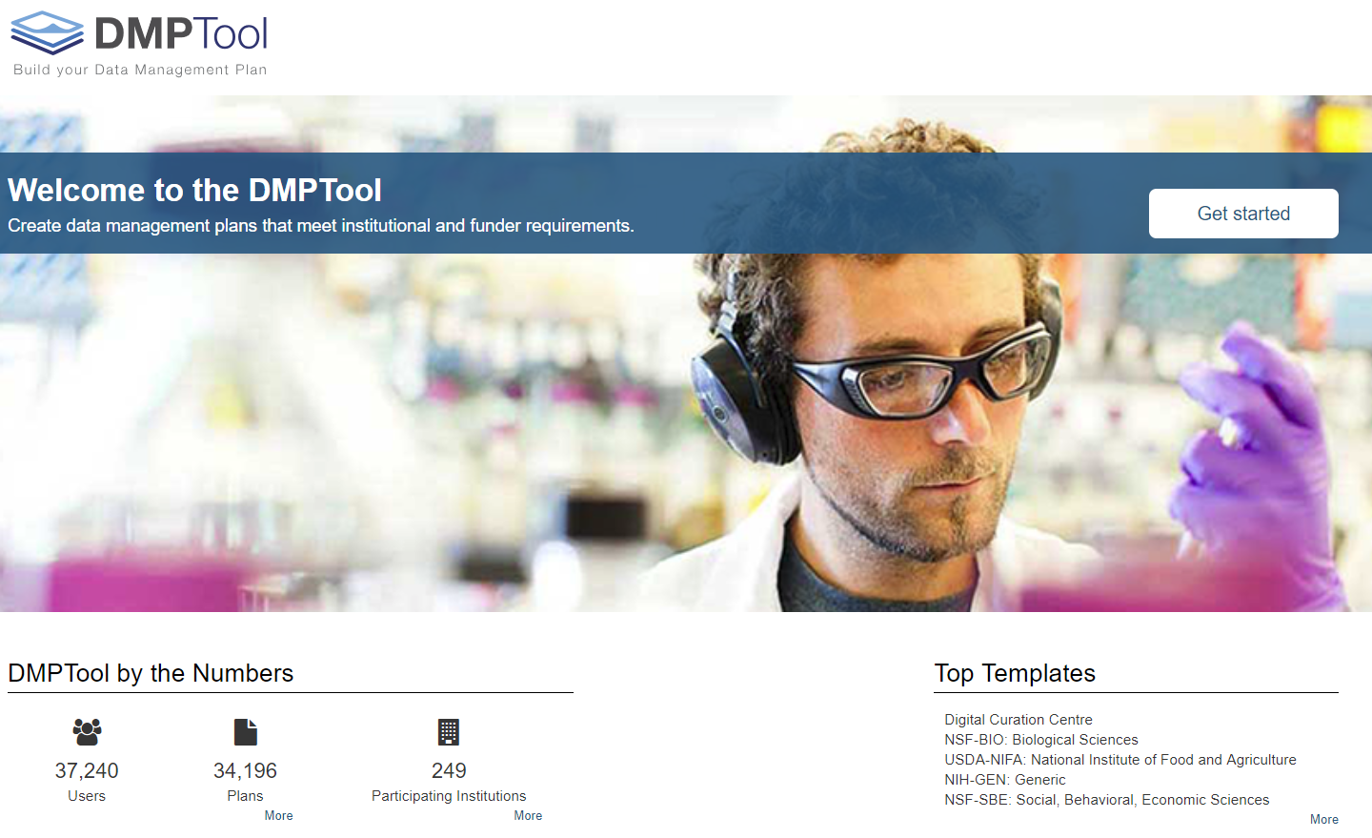

Slide 20
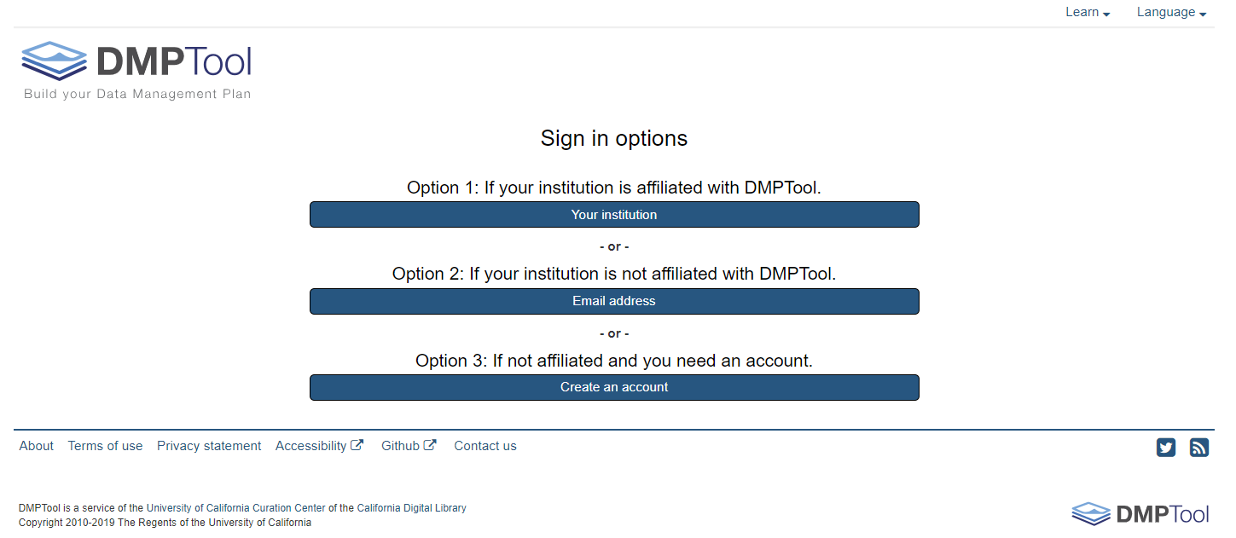

Slide 21
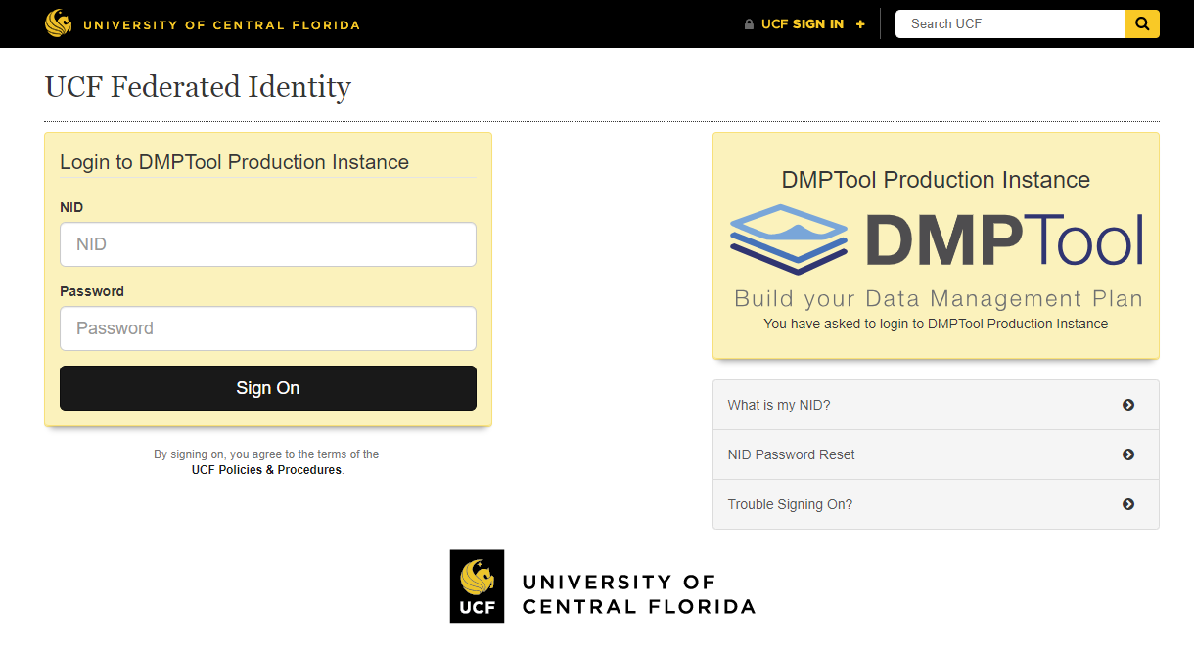
Login with your UCF credentials

Slide 22
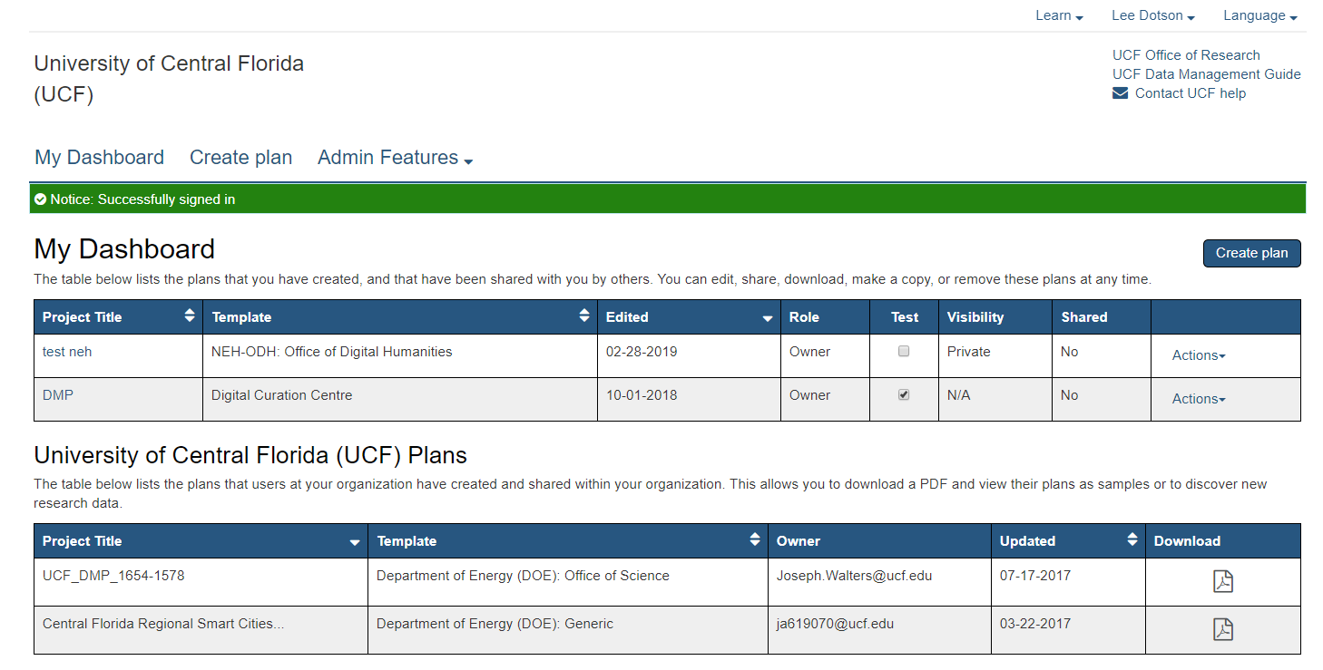
Notes:
When you log in you will be directed to “My dashboard.” From here you can create, edit, share, download, copy, or remove any of your plans. You will also see plans that have been shared with you by others.
If others at your institution/organization have chose to share their plans internally, you will see a second table of organizational plans. This allows you to download a PDF and view their plans as samples or to discover new research data. Additional samples are available in the list of public plans.

Slide 23
Notes:
When you log in you will be directed to “My dashboard.” From here you can create, edit, share, download, copy, or remove any of your plans. You will also see plans that have been shared with you by others.
If others at your institution/organization have chose to share their plans internally, you will see a second table of organizational plans. This allows you to download a PDF and view their plans as samples or to discover new research data. Additional samples are available in the list of public plans.

Slide 24
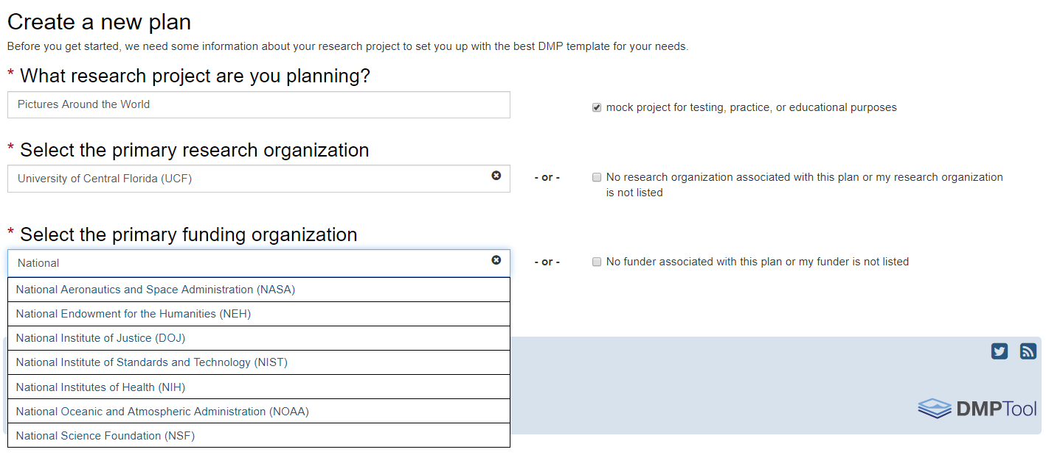
Notes:
To create a plan, click the “Create plan” button on My dashboard or the top menu. This will take you to a wizard that helps you select the appropriate template:
Enter a title for your research project. If applying for funding, use the project title as it appears in the proposal.
Select the primary research organization. If you are associated with a participating institution/organization, this field will be pre-populated. You have the option to clear the field and select another organization from the list. Based on your selection, you will be presented with institution-specific templates and guidance. You can also check the box that “No organization is associated with this plan.”
Select the primary funding organization. If you are required to include a data management plan as part of a grant proposal, select your funder from the list. You may be presented with a secondary dropdown menu if your funder has different requirements for specific programs (e.g., NSF, DOE). See the complete list of funder requirementssupported by DMPTool. If your funder is not in the list or you are not applying for a grant, check the box for “No funder associated with this plan;” this selection will provide you with a generic template.
If you are just testing the tool or taking a course on data management, check the box “Mock project for test, practice, or educational purposes.” Marking your plans as a test will be reflected in usage statistics and prevent public or organizational sharing; this allows other users to find real sample plans more easily.
Once you have made your selections, click “Create plan.”
You can also make a copy of an existing plan (from the Actions menu next to the plan on My dashboard) and update it for a new research project and/or grant proposal.

Slide 25
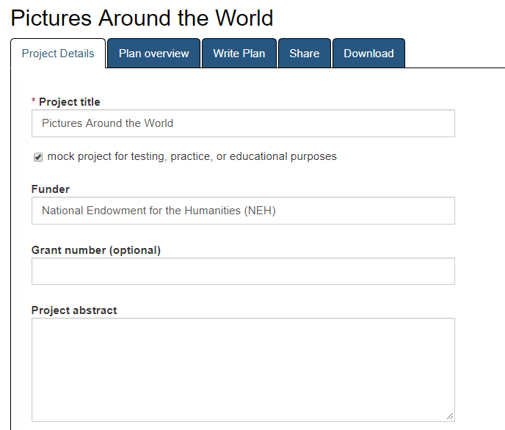
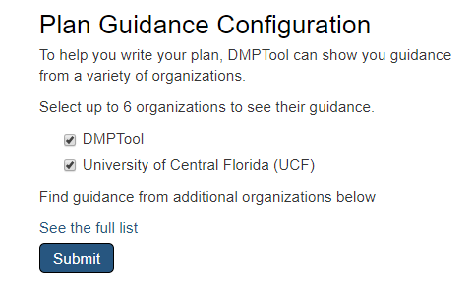

Slide 26
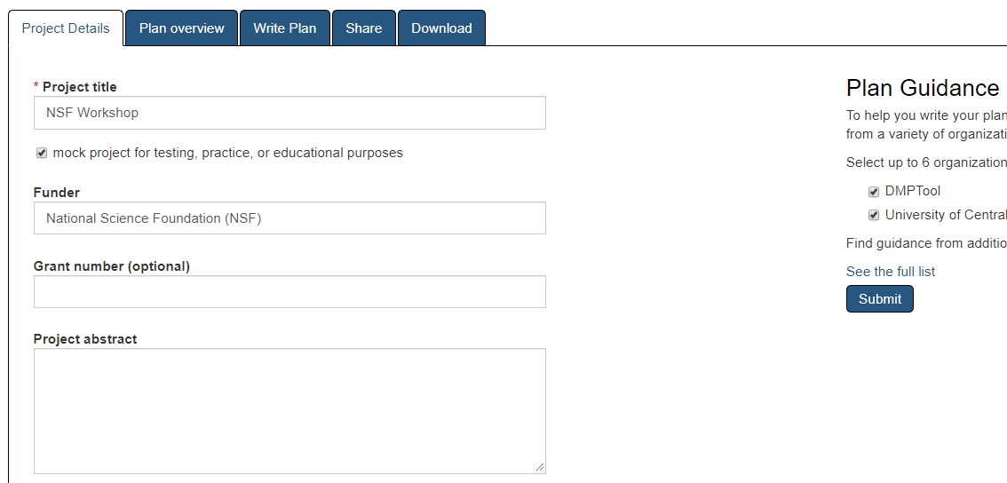
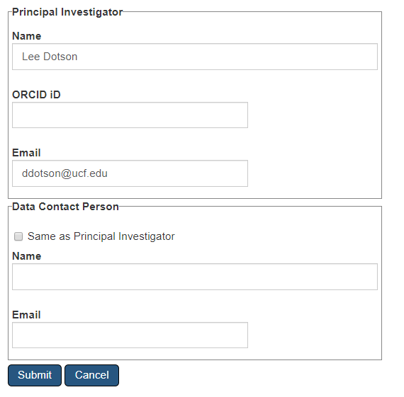

Slide 27
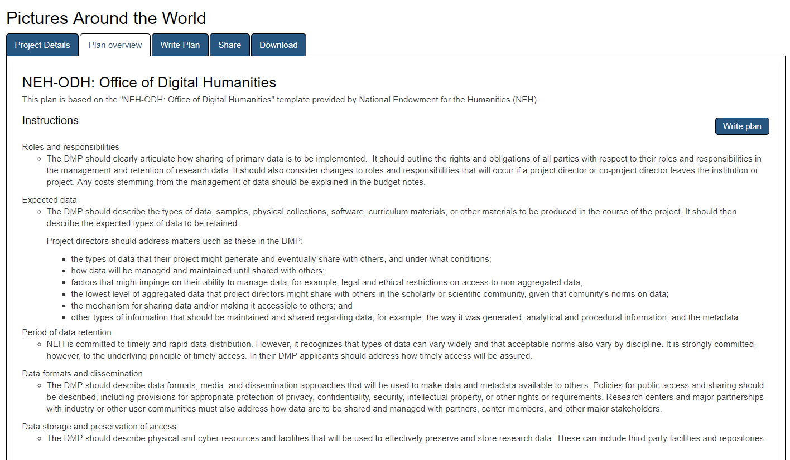

Slide 29
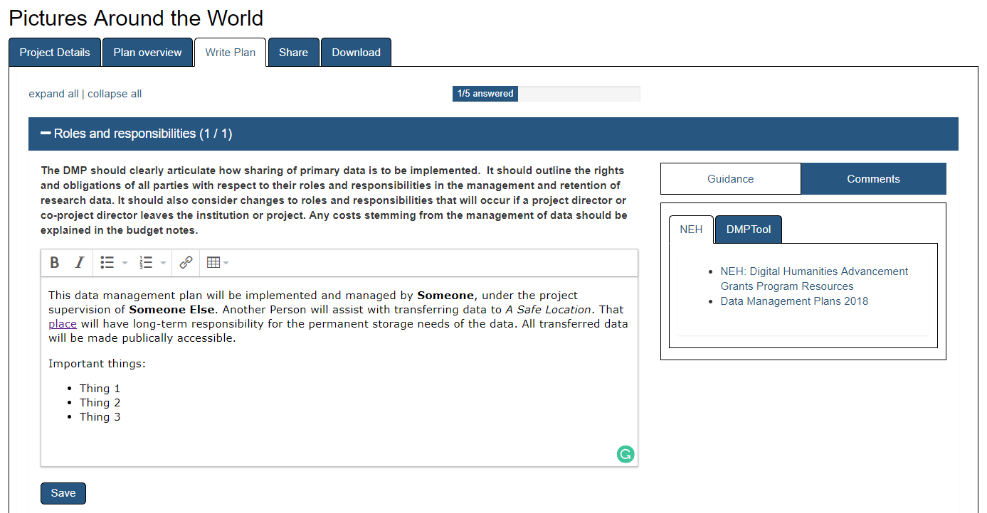

Slide 30
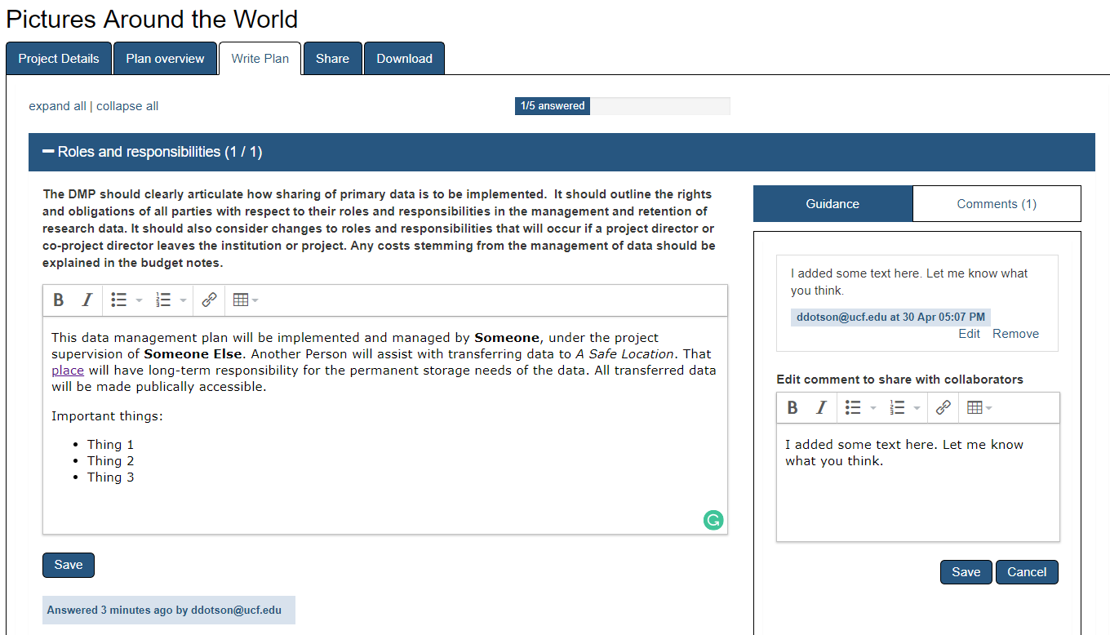

Slide 33
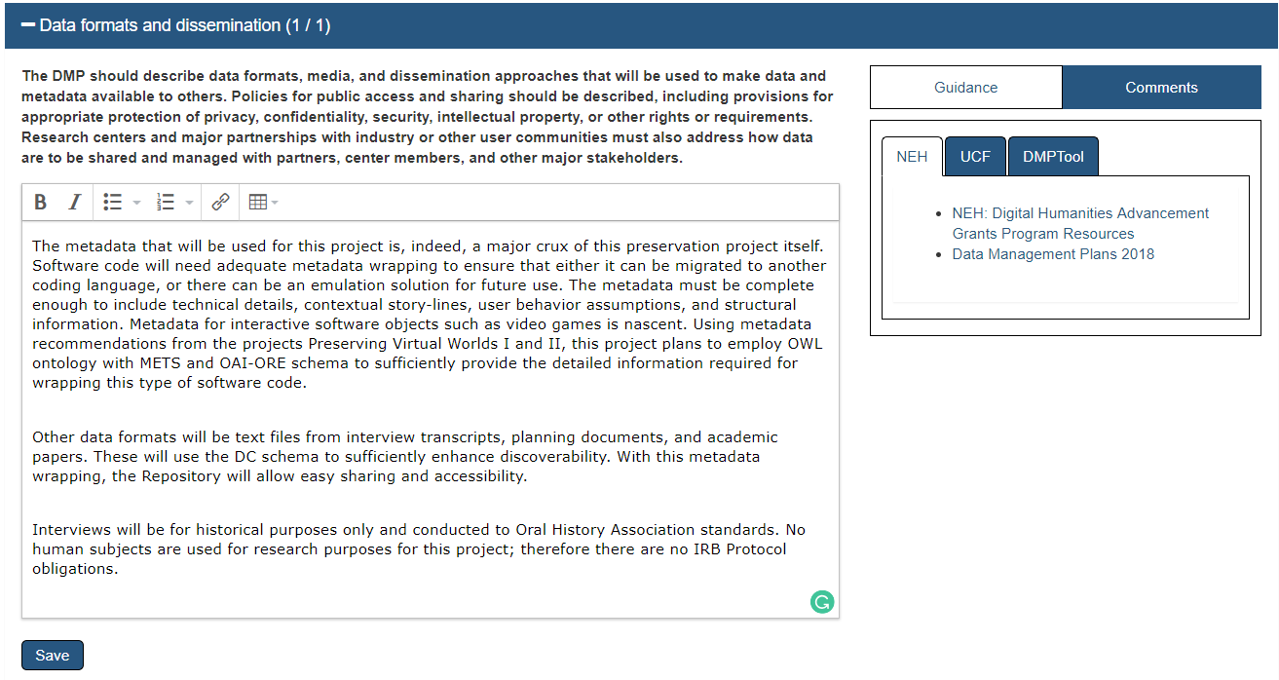

Slide 34
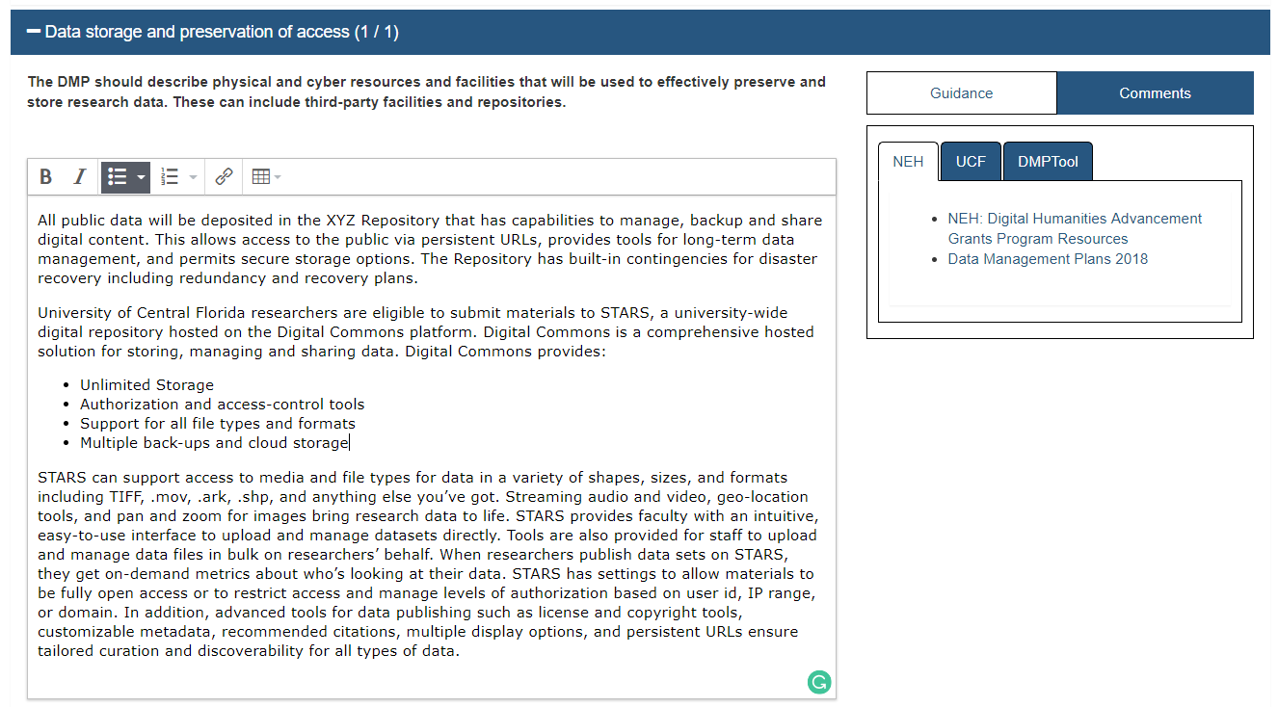

Slide 35
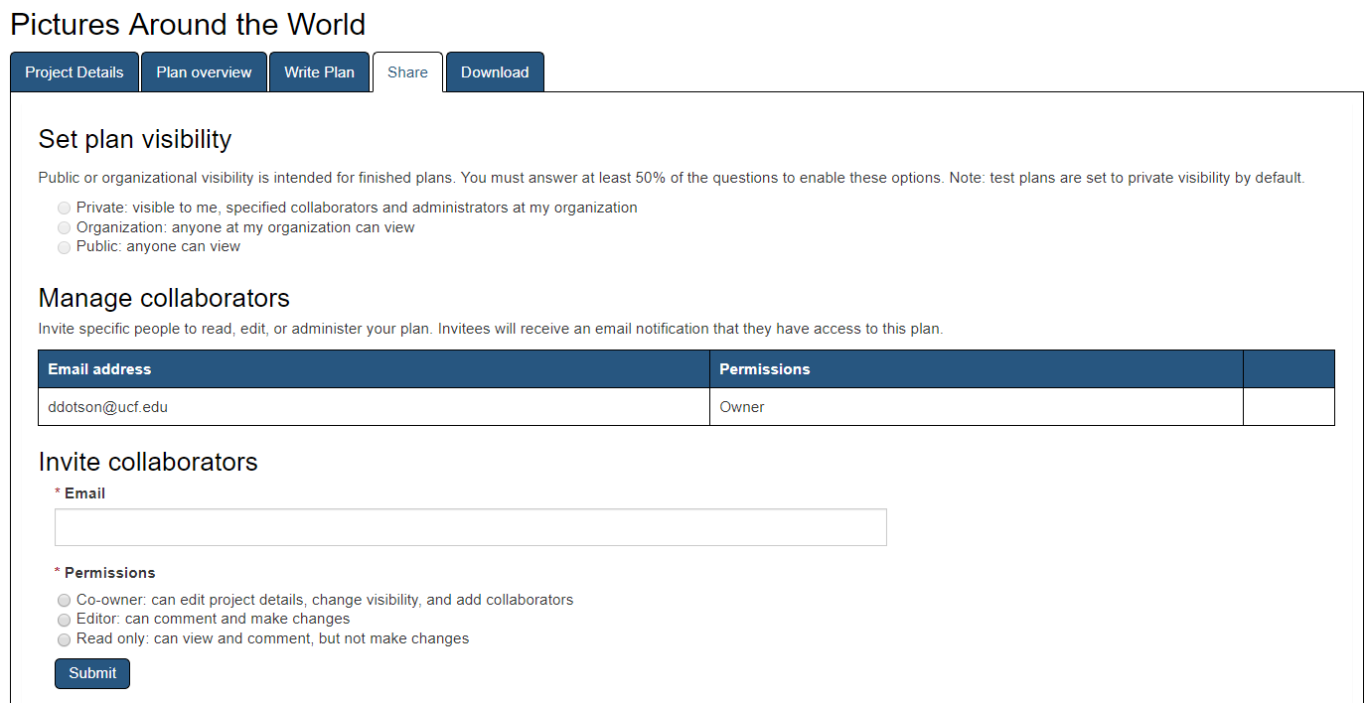

Slide 36
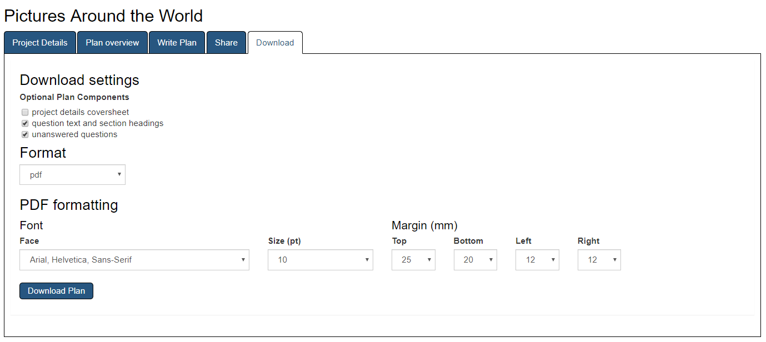

Slide 37
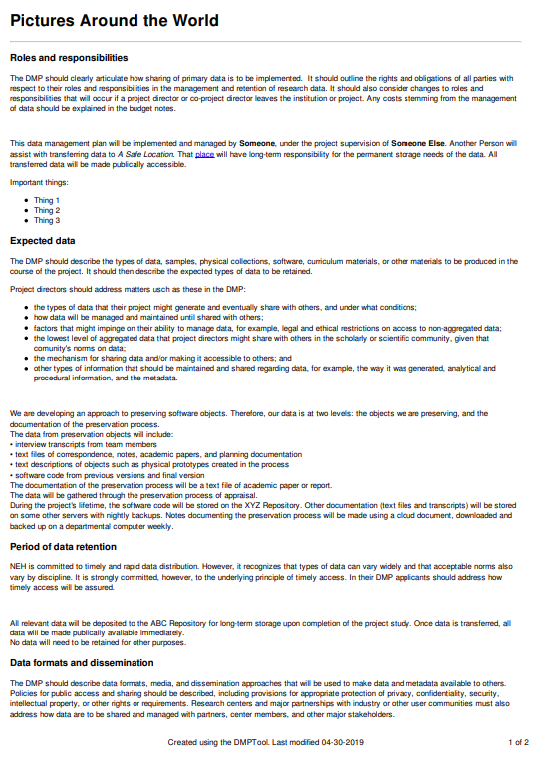
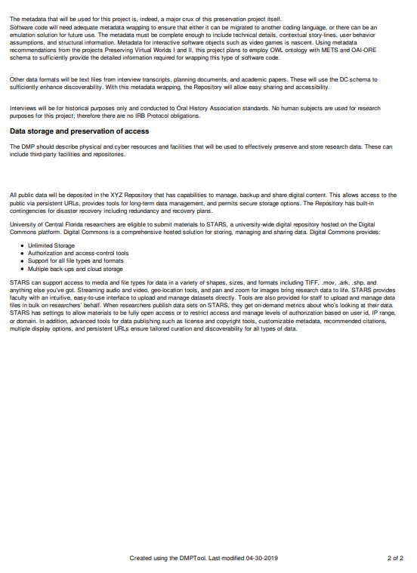

Slide 38
http://guides.ucf.edu/data

Slide 39
A DMP is a Living Document
Keep your plan current
Incorporate changes
Use as a guide for daily activities

Slide 40
DMP Resources
Data Management (or DMP) Research Guide http://guides.ucf.edu/data
DMP Tool https://dmptool.org/
STARS https://stars.library.ucf.edu/
Researcher/data FAQ
Registry of Research Data Repositories http://www.re3data.org/
Schedule a Consultation https://library.ucf.edu/help/schedule-an-appointment/ Meet with a librarian for an in-depth one on one consultation specific to your research topic

Slide 41
Questions?
Lee Dotson
Digital Initiatives Librarian Lee.Dotson@ucf.edu
STARS
STARS@ucf.edu

