Slide 1
Academic Etiquette
Sandy Avila
Sarah Norris
University of Central Florida
Library Faculty Meeting: May 9, 2019
Mentoring Topic

Slide 2
Overview
Library & Academic Codes of Ethics
Communication
Publishing
Presentations
Search Committees

Slide 3
Our Profession and Ethics - Why it Matters
In general, ethics is the philosophical examination, from a moral standpoint, of particular issues activities in private and public life that are matters of moral judgment.
Ethical codes are established for those professions which require a high level of ethical practice.
ALA’s Code of Ethics
“Ethical dilemmas occur when values are in conflict. The American Library Association Code of Ethics states the values to which we are committed, and embodies the ethical responsibilities of the profession in this changing information environment.”

Slide 4
Resources on Ethics in Librarianship
American Library Association’s (ALA) Professional Ethics and Code of Ethics
http://www.ala.org/tools/ethics
Professional Competencies for Reference & User Services Librarians
http://www.ala.org/rusa/resources/guidelines/professional
International Federation of Library Associations and Institutions’ (IFLA) Professional Codes of Ethics for Librarians and other Information Workers
https://www.ifla.org/faife/professional-codes-of-ethics-for-librarians
Ethics of Librarianship: Libraries, Intellectual Freedom, and Censorship in the Age of Technology
http://www.moyak.com/papers/ethics-librarianship.html

Slide 5
The Frequently Identified Principles
SHACHAF, P (2005). "A global perspective on library association codes of ethics." Library & information science research (0740-8188), 27 (4), p. 513.
An analysis of 28 English language versions of codes of ethics of library professional associations
• Confidentiality & Privacy
• Integrity
• Equal Access to Information
• Professional Development

Slide 6
Communication

Slide 7
Email
Etiquette
Review emails before you send and watch the time they are sent
Consider a phone call/personal chat when there is a sensitive topic to discuss
Keep in mind that your emails leave a paper trail
Use a professional writing tone
Use the Reply All feature sparingly and be conscious of it
Blind carbon copy vs Carbon copy
Use an email signature

Slide 8
1. Set the expectations among the group early on
-who plans to take the lead on submitting proposals? doing the editing? communicating with the publisher?
2. Adhere to deadlines & perhaps build in extra time to meet them in case things get hectic
3. With multiple authors how do you handle which names goes first?
-Perhaps place names in alphabetical order
4. Consider inviting all parties who were directly involved to contribute to the publication
5. Don't steal or reappropriate someone else’s work
6. Stick to those agreed upon arrangements- remember integrity and that you are a part of a collective group
Publishing
Etiquette

Slide 9
Presentation Etiquette

Slide 10
Points of Interest...
Multiple Presenters
Presenting in Absentia
Presenting Other People’s Works

Slide 11
Multiple Presenters
Order of presenters?
Alphabetical
By contribution / role
Originator of presentation
Random
How do you determine?
Discuss as a group
Formal contract
Adjust without discussing
Dealing with conflict or confusion?
Other considerations?

Slide 12
Presenting in Absentia
aka How to Handle Presentations You Can’t Attend?

Slide 13
What happens when you can’t make a conference presentation in person?
What are the circumstances? (illness, financial, etc.)
What is your role in the presentation? (solo presenter, lead presenter, multiple presenters)
Do you put it on your CV?
Do you use specific language to note presentations in absentia?
How do you decide if presenting in absentia is appropriate?

Slide 14
Presenting Other People’s Work

Slide 15
Presenting Topics that Don’t Originate from Your Own Work
What are the circumstances?
Where you asked to present on their behalf?
Do you want to incorporate their work into your project/idea?
Others?
Engage & collaborate
Cite appropriately
There’s a fine line between incorporating other people’s work and stealing/reappropriating

Slide 16
Share Your Steps to
Presentation Success...

Slide 17
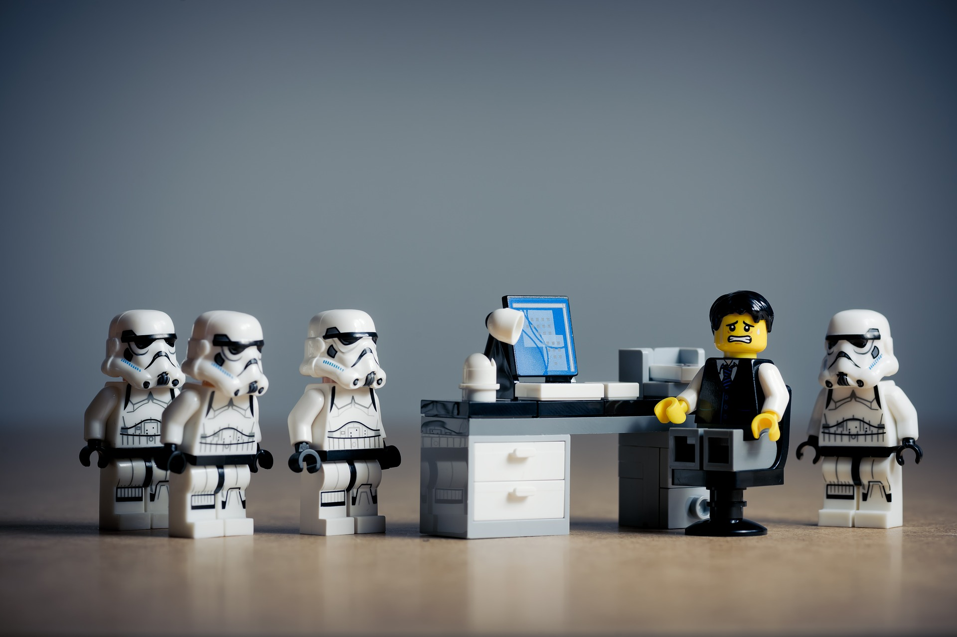
Search Committee Etiquette

Slide 18
Points of Interest...
Privacy
Security

Slide 19
Search Committee Highlights...
Members get an overview of procedures (and general protocol) of the search committee process
Tasks to be accomplished can include:
Reviewing applications
Selecting and interviewing candidates via Skype, Phone, etc.
Selection and interviewing in-person candidates, based on first round of interviews
Summarizing interviews and/or making recommendations to library dean

Slide 20
Privacy Considerations
What can you or can’t you legally share? (with candidates, with colleagues?)
How do you handle uncomfortable or challenging situations?
You are asked questions that would require you to give out specific information
Internal vs external candidates
Considerations if you’re not a committee member…
Other considerations?

Slide 21
Security Considerations
What materials can be shared outside of the search committee? (CVs, Cover Letters)
What materials can’t be shared outside of the search committee? (applications, references, etc.)
What do you do with any printed materials or logins post search committee?
Other considerations?

Slide 22
Share Your Experiences...

Slide 23
Any Questions?
Thanks for your attention!

