Slide 1
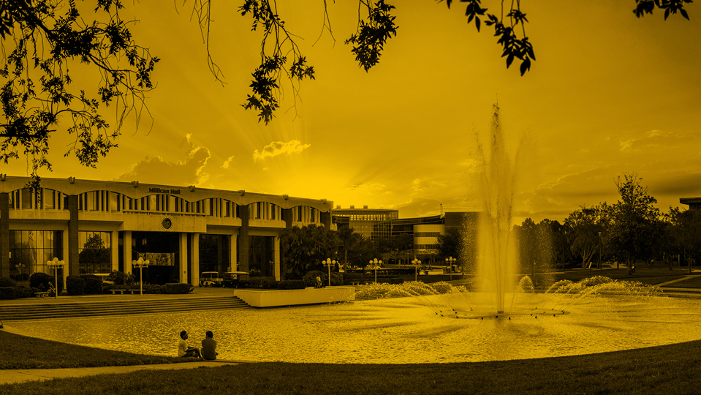
A Model for Quality Education to Support STEM Student Success
Sandy Avila, Science Librarian
Ven Basco, Engineering Librarian
University of Central Florida Libraries
STEM Librarians South 2019 Conference
University of Texas at Austin
Friday, July 19th, 2019

Slide 2
Outline
-About UCF
-A Model for STEM Student Success
-A Showcase of Examples

Slide 3
INTRODUCTION

Slide 4
About UCF
One of 12 state public universities in FL
Located about 10 miles east of downtown Orlando
68,571 students¹
UCF has been among the top 100 universities in the world and 31st among public universities in the nation for patents for the past 5 years²
Fall 2018
https://www.ucf.edu/news/ucf-among-top-100-universities-world-patents/

Slide 5
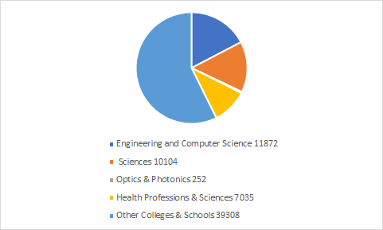
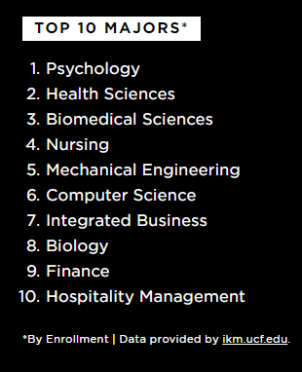
Supporting STEM Student Success

Slide 6
Our Model

Slide 7
Instruction
Outreach
Service
Collaborative
Creative
Cooperative
Single Perspective
Images taken from Pixabay user: mcmurryjulie https://pixabay.com/users/mcmurryjulie-2375405/

Slide 8
Instruction
Outreach
Service
Collaborative
Creative
Cooperative
Multiple Perspective

Slide 9
Relevant Examples

Slide 10
Supplemental Student Support
Research Intensive Course Designation through the Office of Undergraduate Research
Course Specific Research Guide Offerings
LTI in LibApps via Canvas LMS to push Research Guides into every campus course shell
II. Textbook Affordability Initiatives
Areas of focus:
- locating electronic books as one-to-one replacements of existing course textbooks – with no cost to students
- hosting print copies of textbooks on Reserve
- identifying open educational resources and library-sourced information as alternatives to commercially produced textbooks
- tracking metrics associated with faculty adoptions

Slide 11
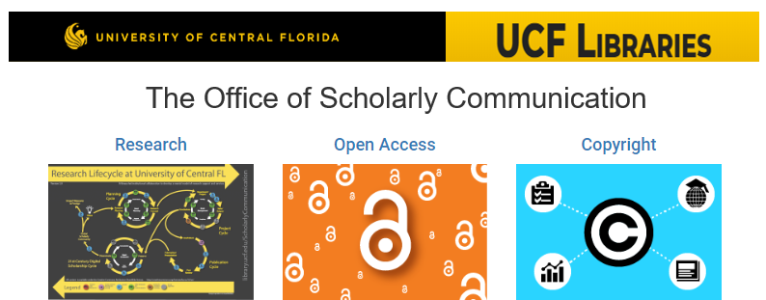
International Graduate Student Welcome Orientation
Office of Scholarly Communication Initiatives
Office of Scholarly Communication Initiatives
Hijacked Journals: How Open Access Journals Fall Into the Predatory Publishing Trap
Future plans for programming like ACS on Campus and Publons training with Web of Science
Shared publishing and presenting opportunities inside and outside of the library
Notes:
Office of Scholarly Communication Initiatives
· Helps students with the research process
· Inform students about open access
· Educate students about copy right
Collaborated with the Scholarly Communication Librarian about letting know about these initiatives. Remind students during individual research consultation, library instruction or during campus presentation.
Participated in most of the events during Open Access Week.
Collaborated resulting to a presentation Hijacked Journals: How Open Access Journals Fall Into The Predatory Publishing Trap.

Slide 12
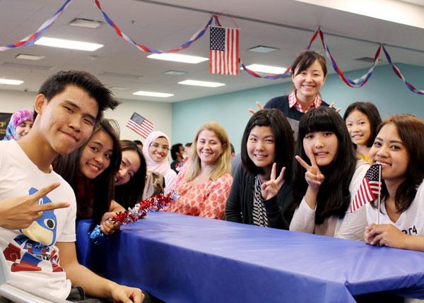
International Graduate Student Welcome Orientation
Notes:
International Graduate Student Welcome
Office of Graduate Studies
International Student Liaison to UCF Global
Graduate Outreach Librarian
· Coffee and conversation style event to learn how the UCF Libraries support international graduate students and their research.
· This two-hour orientation is designed for new and returning international students.
· Resources and services for both online and in person support will be introduced.
· Subject Librarian Service Model at UCF and have the opportunity to meet with the librarians in their subject areas.

Slide 13
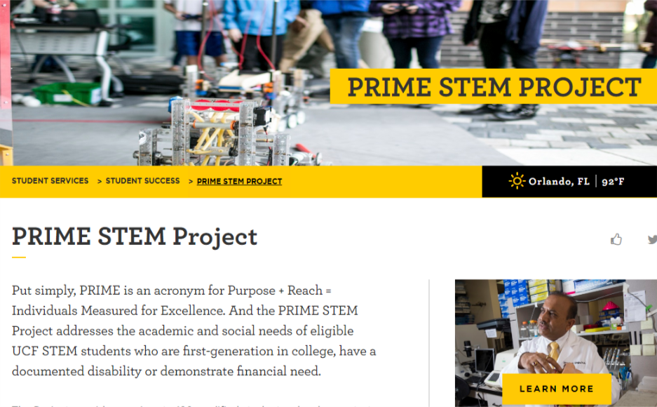
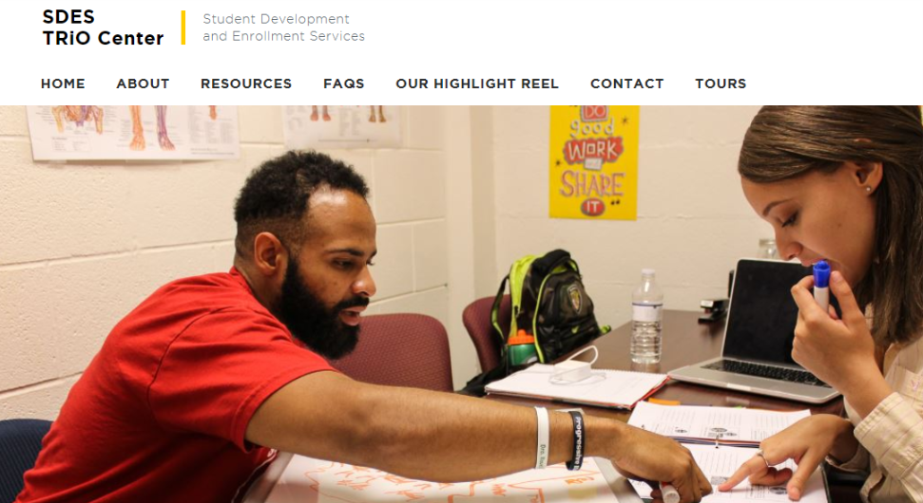
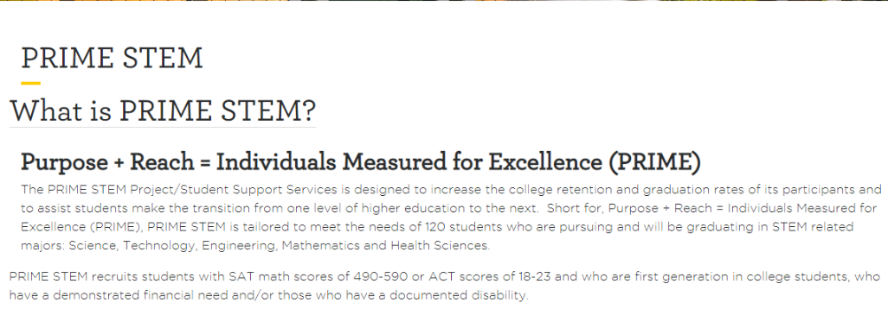
PRIME STEM

Slide 14
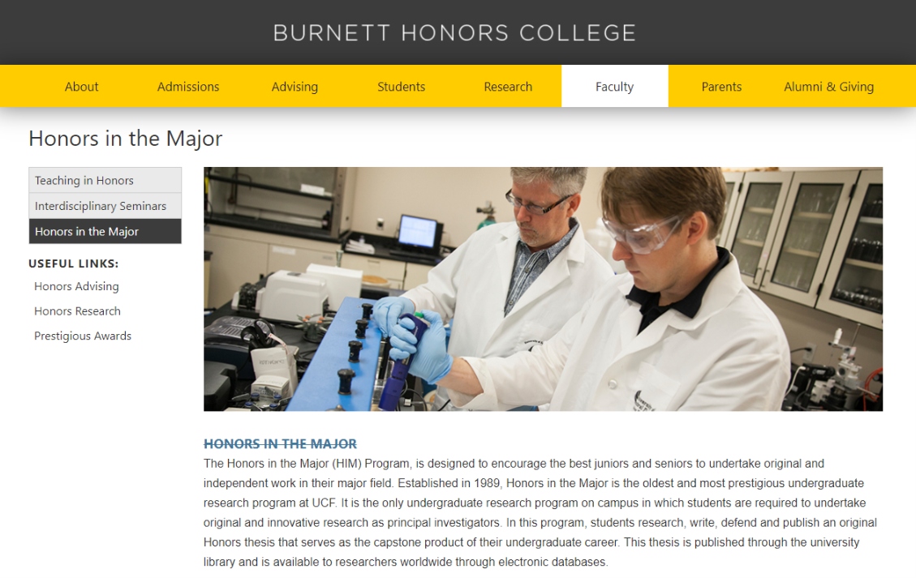
Honors in the Major Thesis Program
Students work with subject librarians to get one-on-one research consultation support
Promotion of a mentoring/advising relationship between librarian & student
Builds student confidence in STEM related research skill set
Provides important introduction to library research tools not provided in all STEM general courses

Slide 15
Summer Research Programs on Campus
The Office of Undergraduate Research programs to assist students in finding mentors & getting started in research at UCF tailoring to a variety of levels
Summer Research Academy
Summer Undergraduate Research Fellowship
T-Learn @ UCF and F-Learn @ UCF Programs

Slide 16
NSF Research Experience for Undergraduates
Notes:
NSF Research Experience for Undergraduates (REU) – Summer Research Program
NSF REU IoT Program
· NSF funded. Started in 2016, 3-year program, NSF REU Site on Internet of Things have been renewed for another three years, starting on May 27th, 2019.
· Recruit diverse and talented 10 undergraduates around the nation per year.
· Open to undergraduate students majoring in computer science, computer engineering, electrical engineering, civil engineering, and mechanical engineering
· Engaging them in an intensive 8-week summer experience.
· Research poster for presentation during REU symposium.
NSF REU HYPER (Advanced Technologies for Hypersonic, Propulsive, Energetic and Reusable Platforms
· Started this year. 12 participants.
· Participants go through a 10-week program.
· Engage in hands-on research training in contemporary challenges such as utilizing advanced propulsion, additive manufacturing techniques, etc.
Library Outreach and Instruction
· Present Library Research and Literature Review workshop.
· Individual and group research consultation.
· Coordinated with professor in the Department of Computer Science.

Slide 17
Quality Enhancement Project Grant
The Office of the Quality Enhancement Plan (QEP) funds faculty and staff projects that address the QEP’s theme, What’s Next: Integrative Learning for Professional and Civic Preparation, and that seek to improve undergraduate student learning at UCF.
https://guides.ucf.edu/entrepreneurs
Notes:
Quality Enhancement Project Grant
Awards are granted at two levels: Enhancement and Program Innovation.
Enhancement Award - Enhance existing or create new resources for undergraduate students, such as but not limited to: developing courses, designing high-impact learning activities, or enhancing career preparation
Program Innovation Award - Make changes to existing or create new programs to enhance undergraduate student learning outcomes, such as but not limited to: mapping and revising curriculum, implementing new technologies (e.g., ePortfolios), or faculty and staff training.
Enhancement Award “Libraries Bridging the Gap between Innovation and Entrepreneurship”
$3458 award.
Be Your Own Boss: Knights Alumni Entrepreneur Panel Discussion
Patents, Trademarks and Copyrights: Tolls for Entrepreneurial Success
Business Coaching and Mentoring Resources
Competitive Intelligence: Industry, Company and Market Research

Slide 18
Professional Development Research Award Funding
The purpose of this research award is to encourage and provide funding for meaningful faculty development through the pursuit of professional and scholarly activities. Priority is given to projects that explore research opportunities or the acquisition of new skills that will benefit the faculty member and the Libraries.
A Survey of STEM Librarians in Academic and Joint-Use Libraries in Florida
Notes:
Professional Development Research Award Funding
Divided into three sections/Committee Evaluates
Section 1
· Information about your proposal
· Applicant and co-applicant information
· Summary and rationale
· Goals and expected outcomes
· Methodology and timeline for completion
· Dissemination plan
· IRB notice
Section 2
· Budget overview
· Item level budget and rationale for each item
Section 3
· Review of information submitted
· Statement that information provided is accurate and true
· Final submission

Slide 19
Thanks for your attention!
Any questions?
Sandy Avila
Science Librarian
savila@ucf.edu
https://works.bepress.com/sandy-avila/
Ven Basco
Engineering Librarian
buenaventura.basco@ucf.edu
https://works.bepress.com/ven-basco/
UCF Libraries
Visit us here:
library.ucf.edu

