Slide 1
Taking an Earth Day Program Winning Hand to the Next Level
Sandy Avila, Christina Wray, & Kelsie Johnson
University of Central Florida
Florida Library Association Annual Conference , Breakout Session, May 17, 2019

Slide 2
What to expect from today’s session

Slide 3
Introducing the Players
Biology Faculty Member/
Associate Director of the UCF Arboretum
Subject Librarian
Teaching & Engagement Librarian
Program Coordinator
UCF Arboretum

Slide 4
The UCF Libraries- An Inaugural Earth Day Event Program
First Year Program
Reference Librarian/Teaching Engagement Librarian collaboration
Identified willing faculty participation
Marketed event and set up LibGuide with resources
Hosted a film screen and lecture discussion
Well attended and great feedback on event….led to a bigger 2nd year program

Slide 5
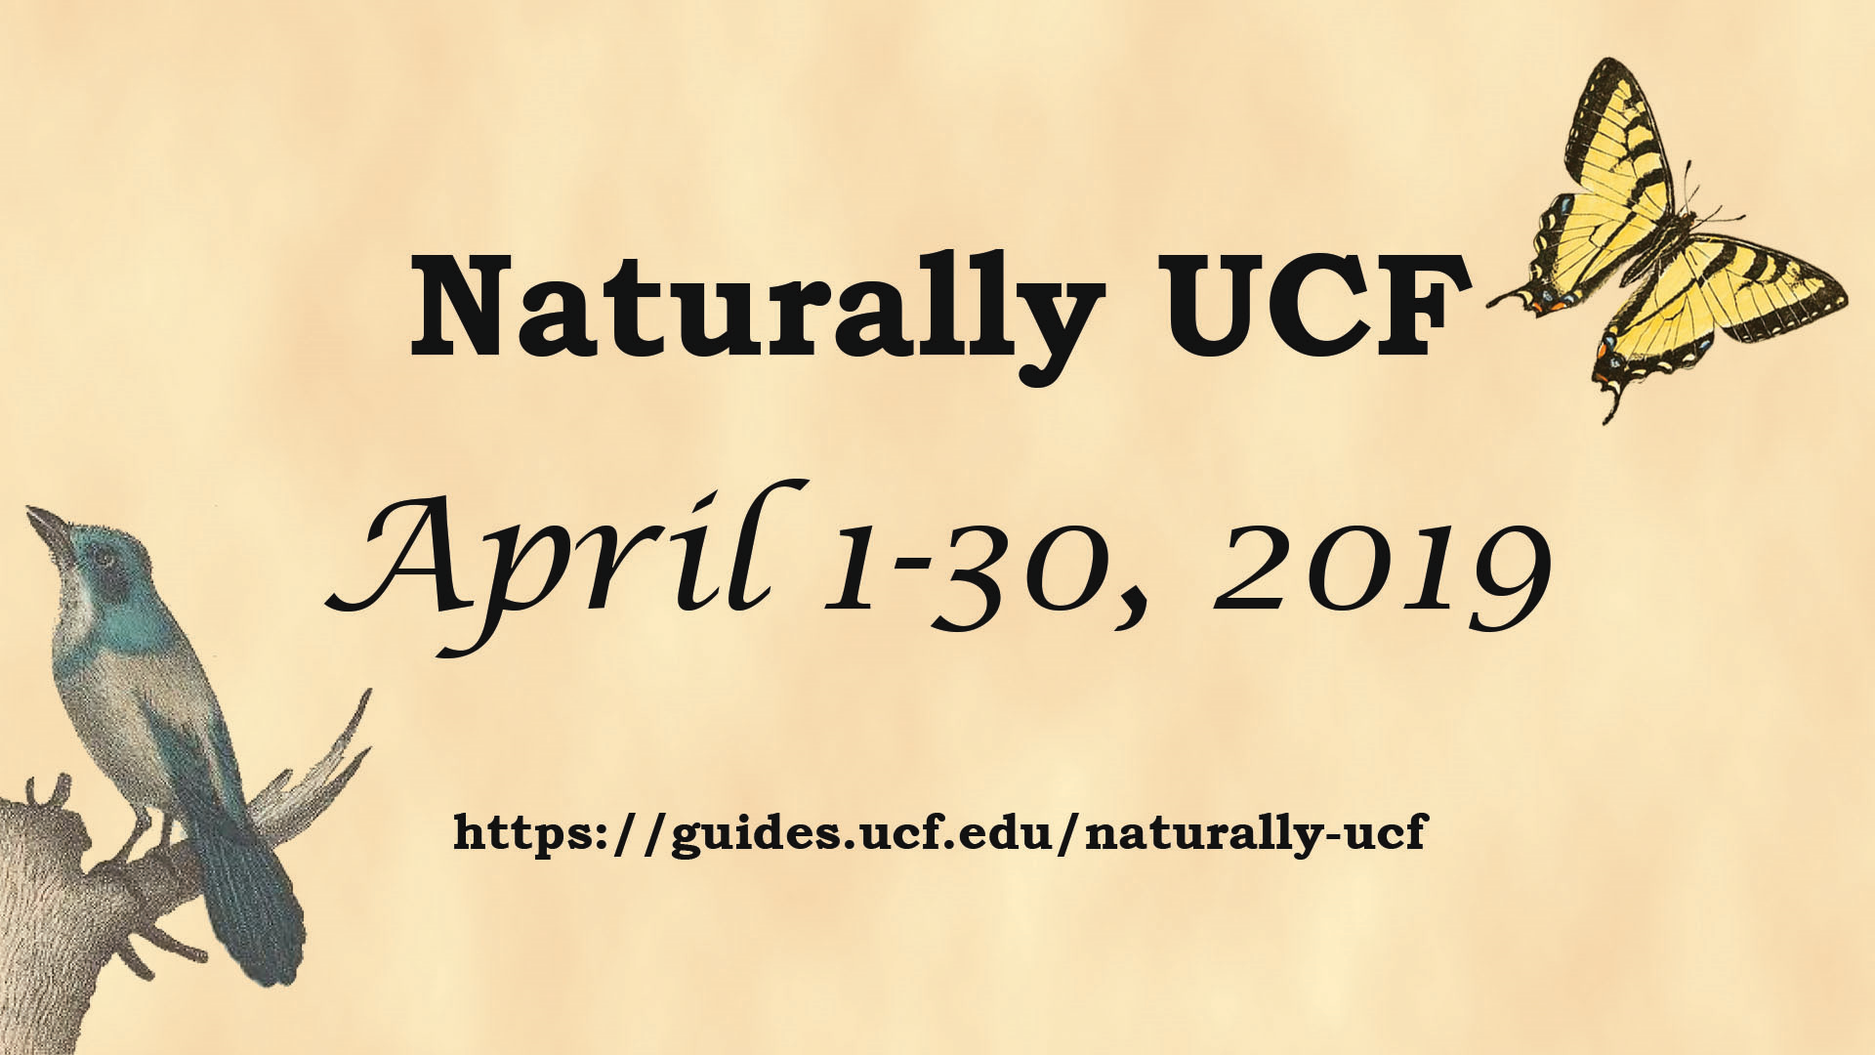

Slide 6
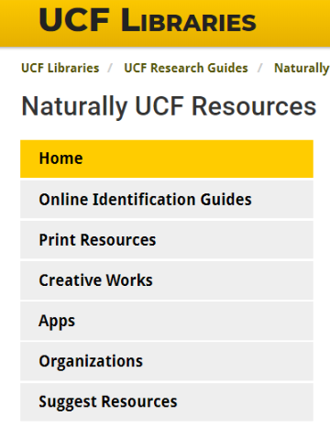
April 1-5, 2019
Resource Blitz
UCF Library’s Facebook, Twitter and Instagram accounts
Thursday, April 11, 2019
Plant Pressing Workshop
UCF Arboretum Nature Pavilion
Wednesday, April 17, 2019
Arbor Day Hike & Tree Planting
UCF Arboretum
April 22-26, 2019
Nature Writing on Display
UCF Library - Featured Bookshelf
Main Floor - Knowledge Commons
Thursday, April 25, 2019
The Unseen Arboretum Workshop
UCF Arboretum Nature Pavilion
Tuesday, April 30, 2019
Sea-Level Rise Planning in Central Florida Talk & Discussion
UCF Library, RM 223

Slide 7
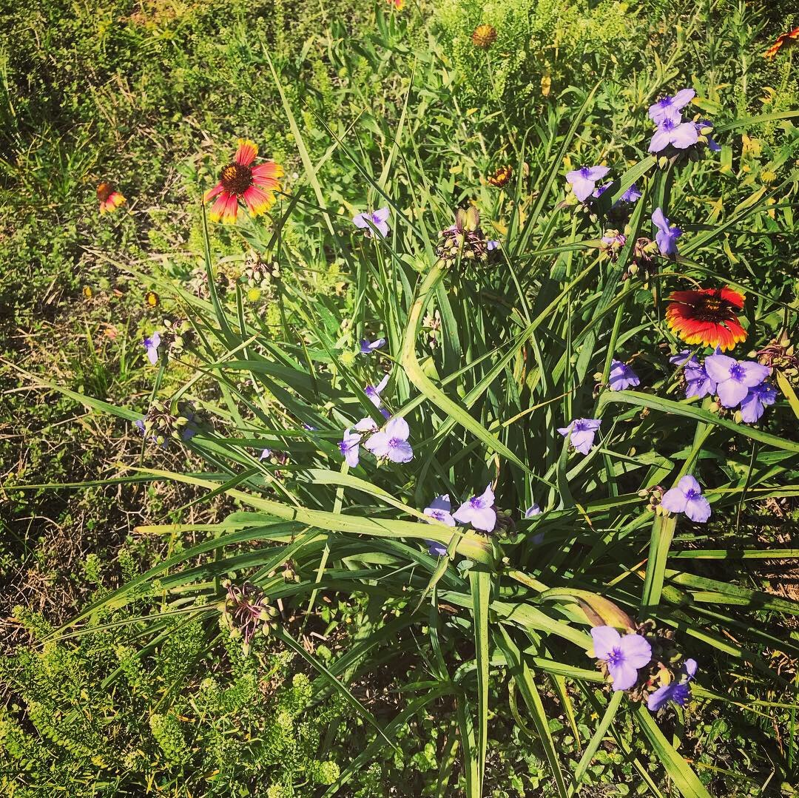
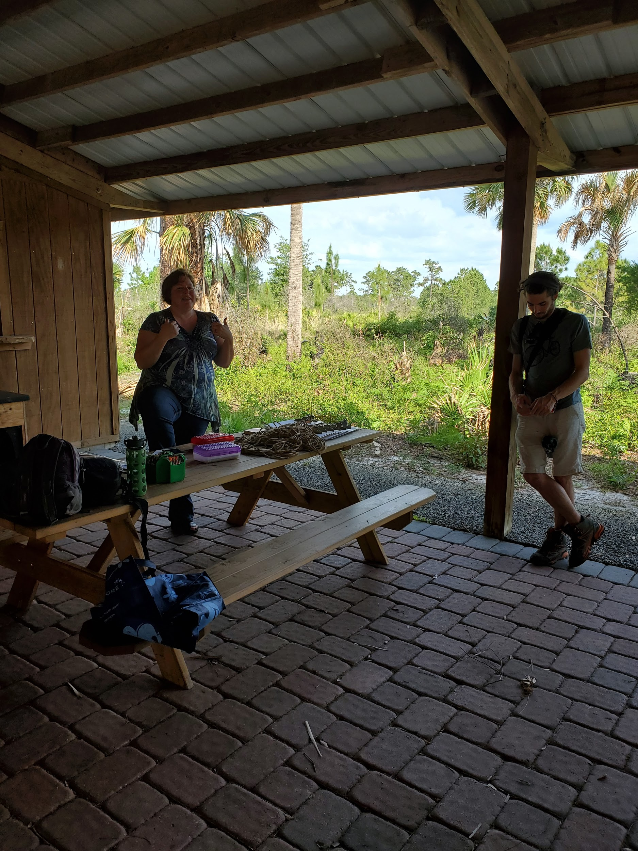
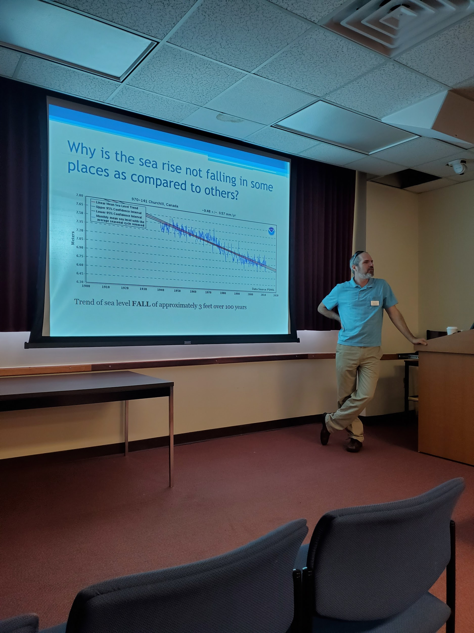
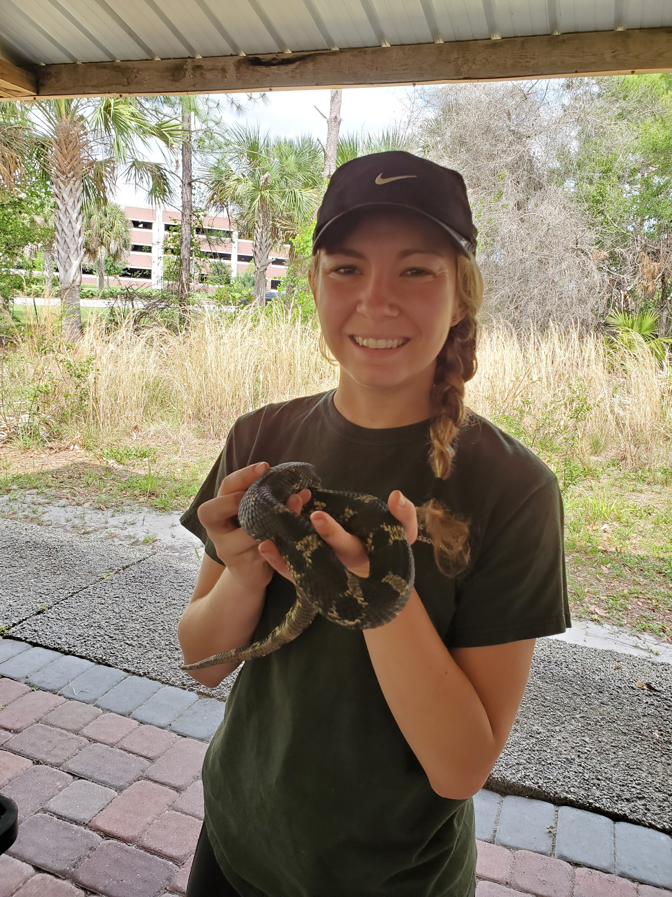
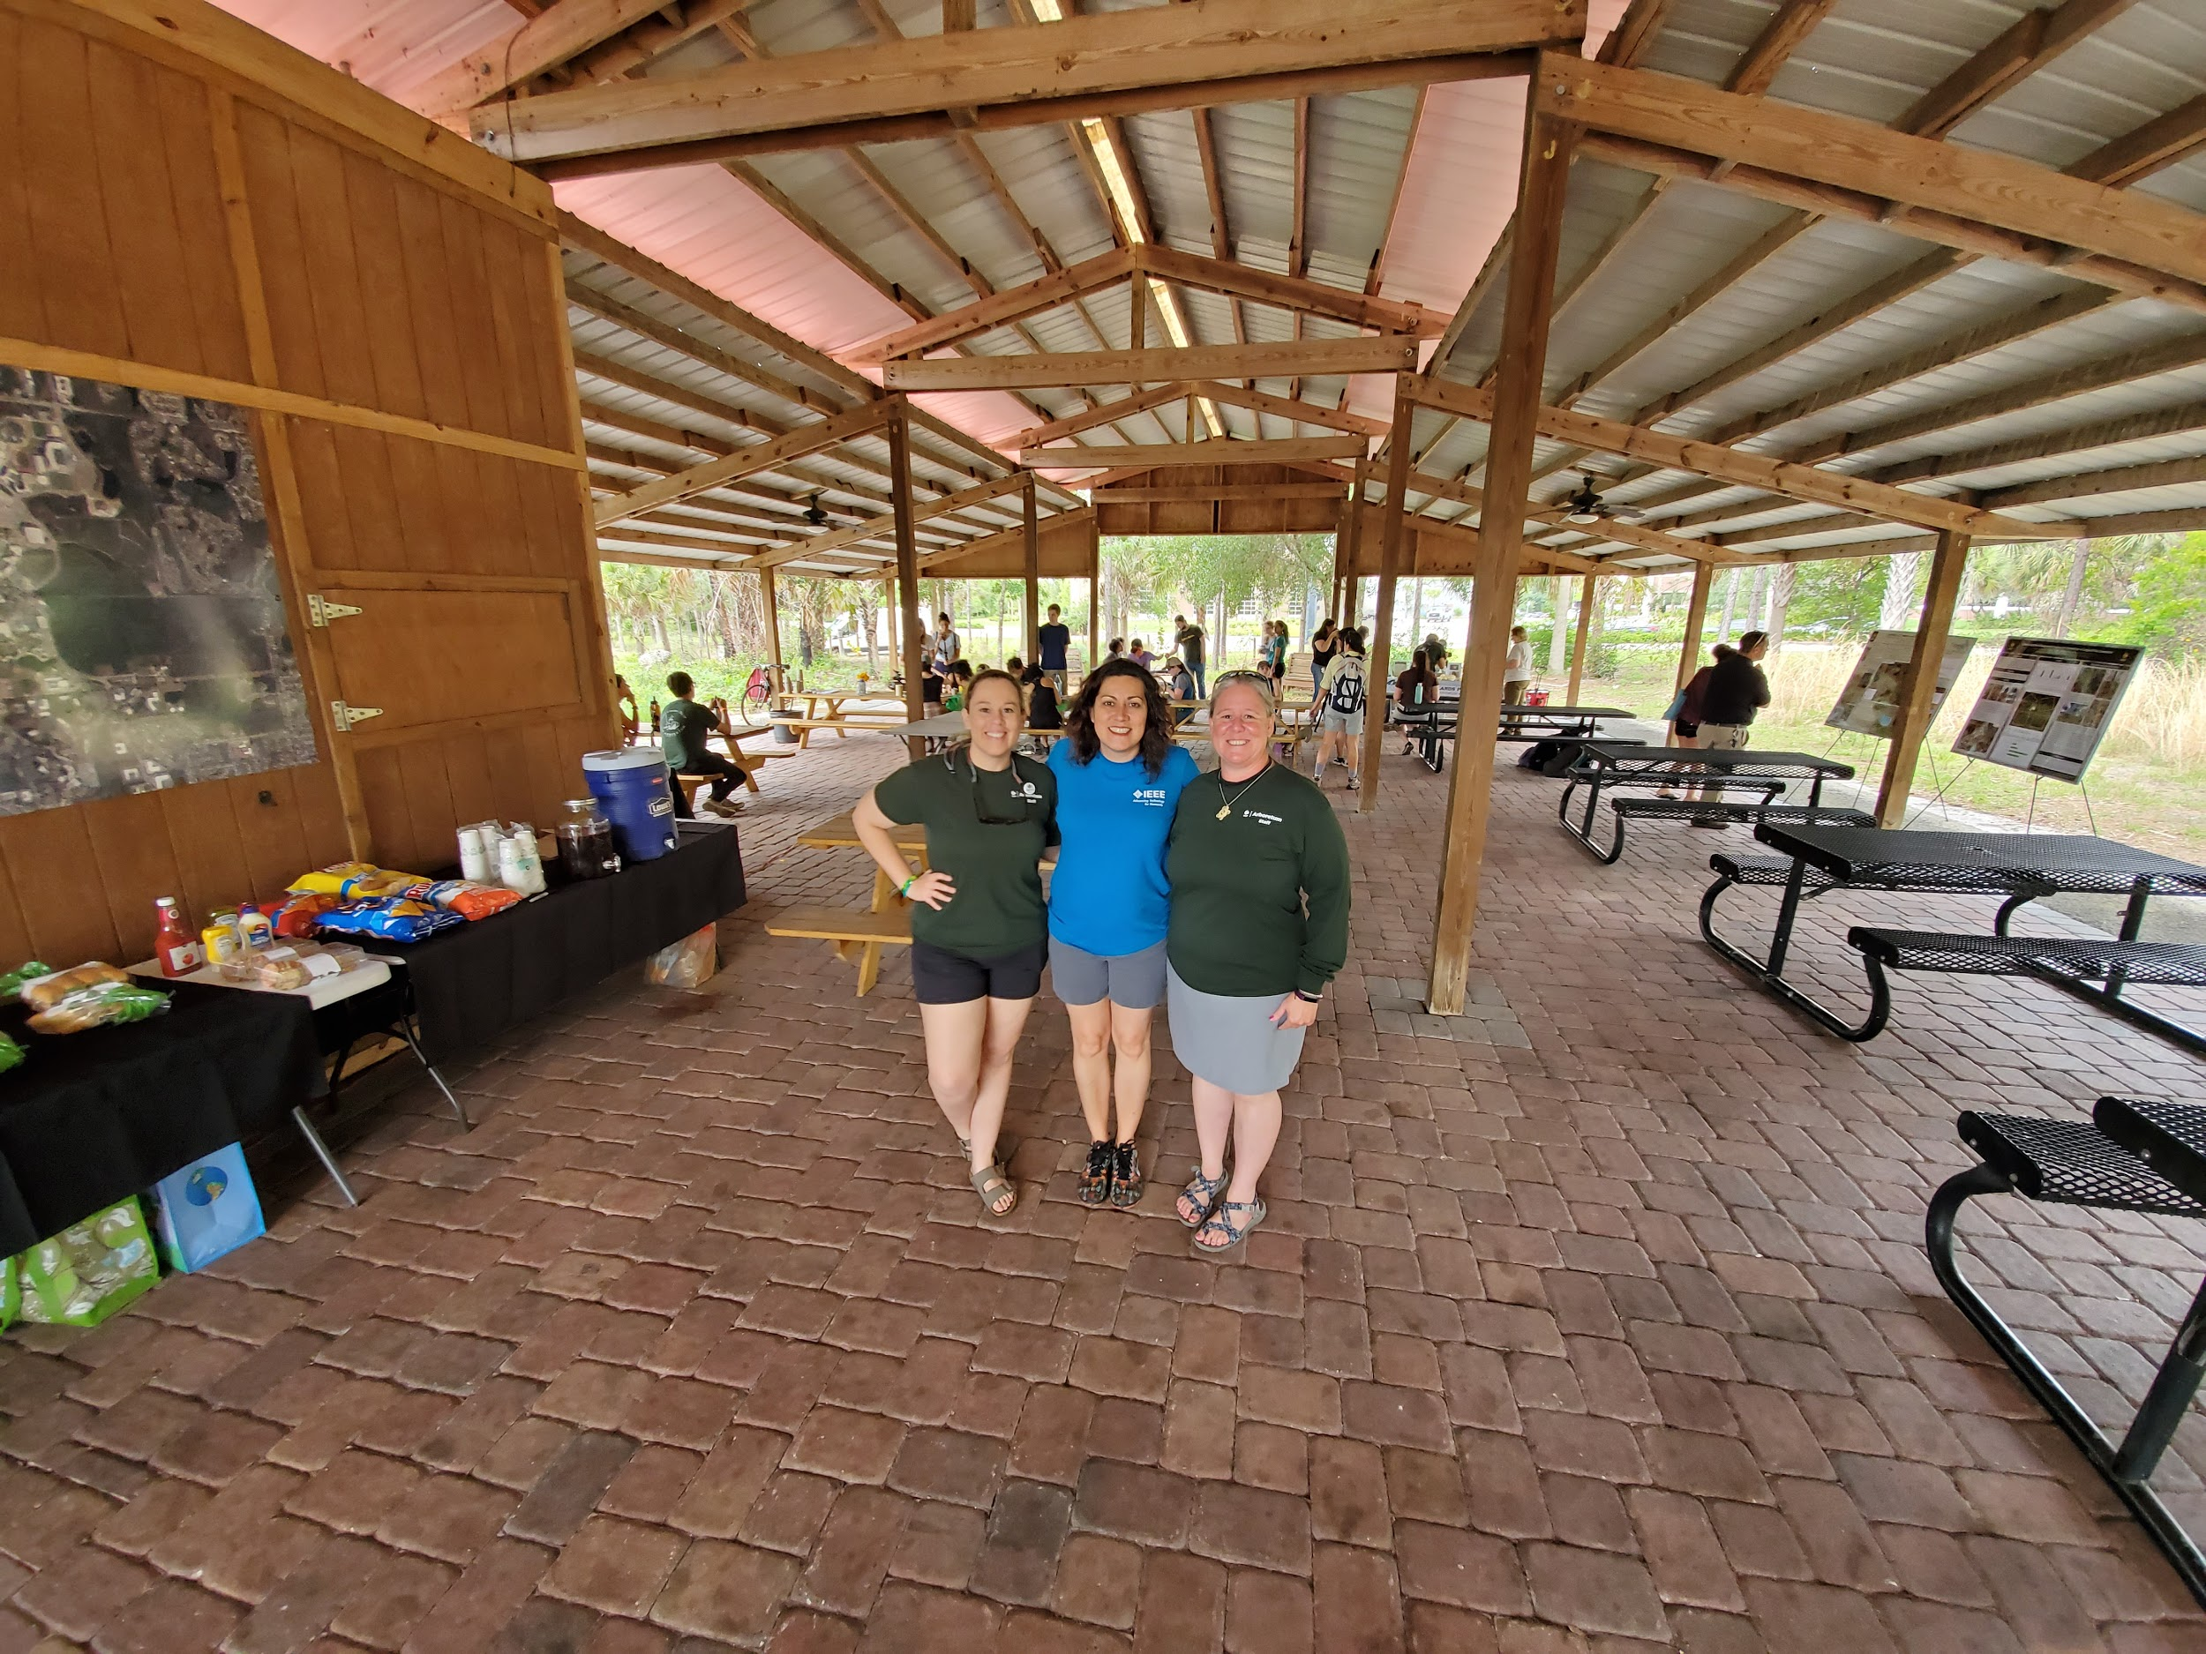
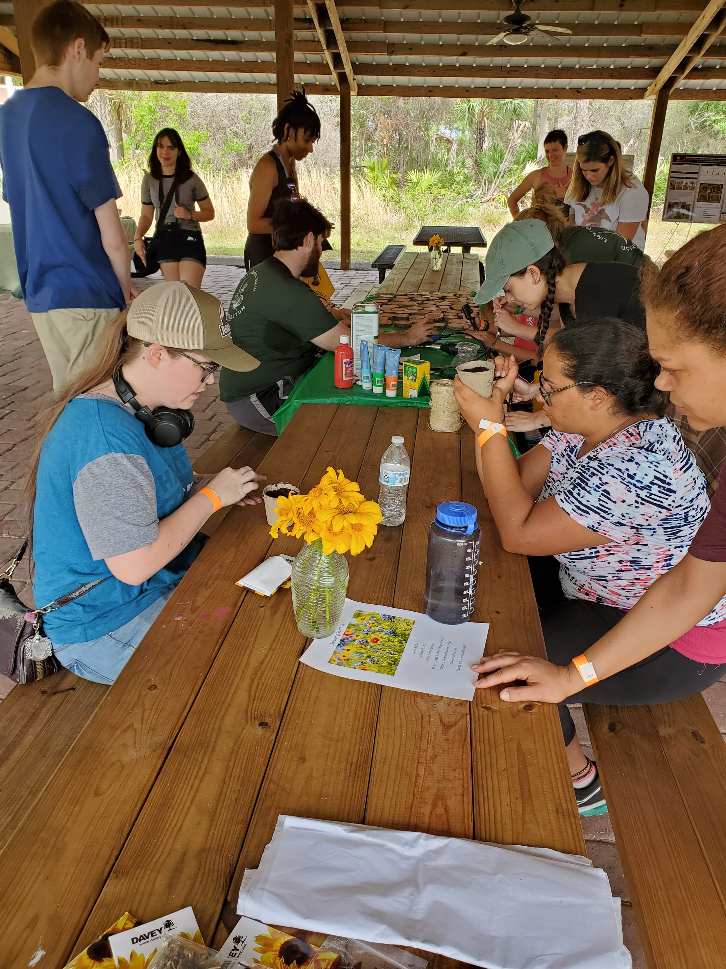
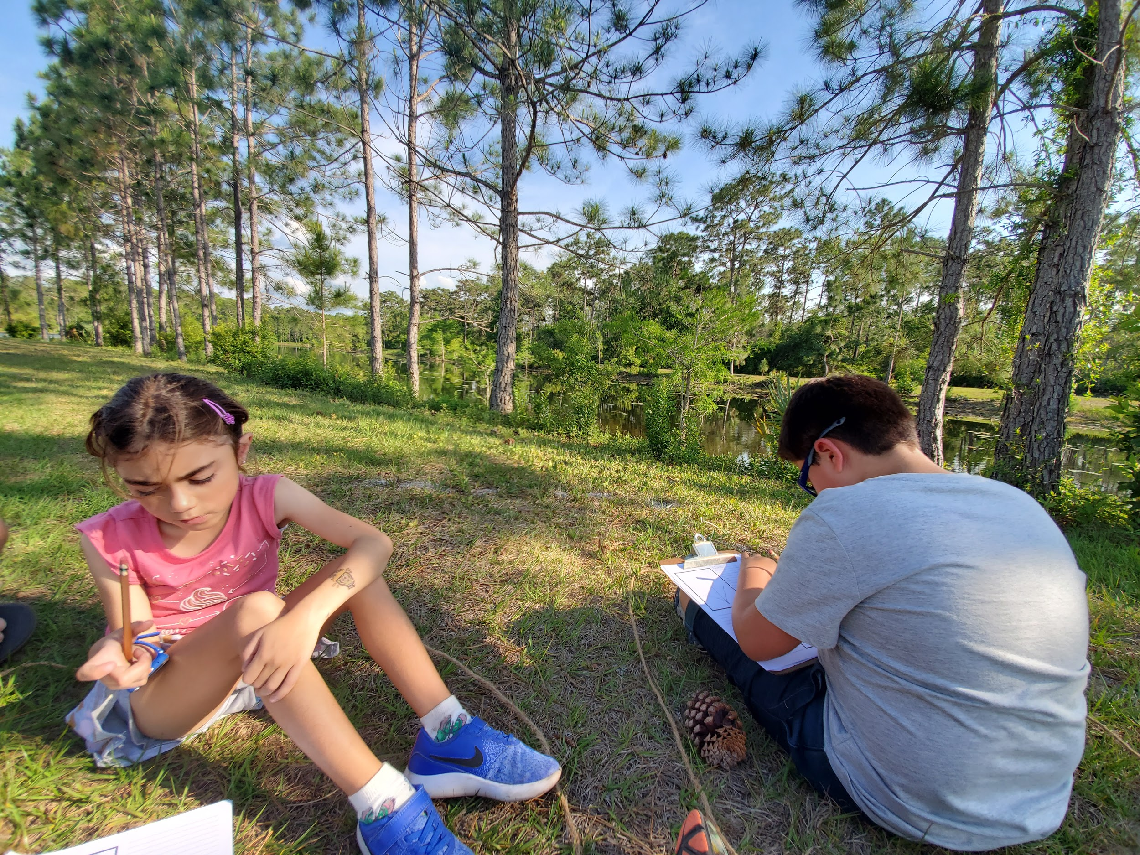
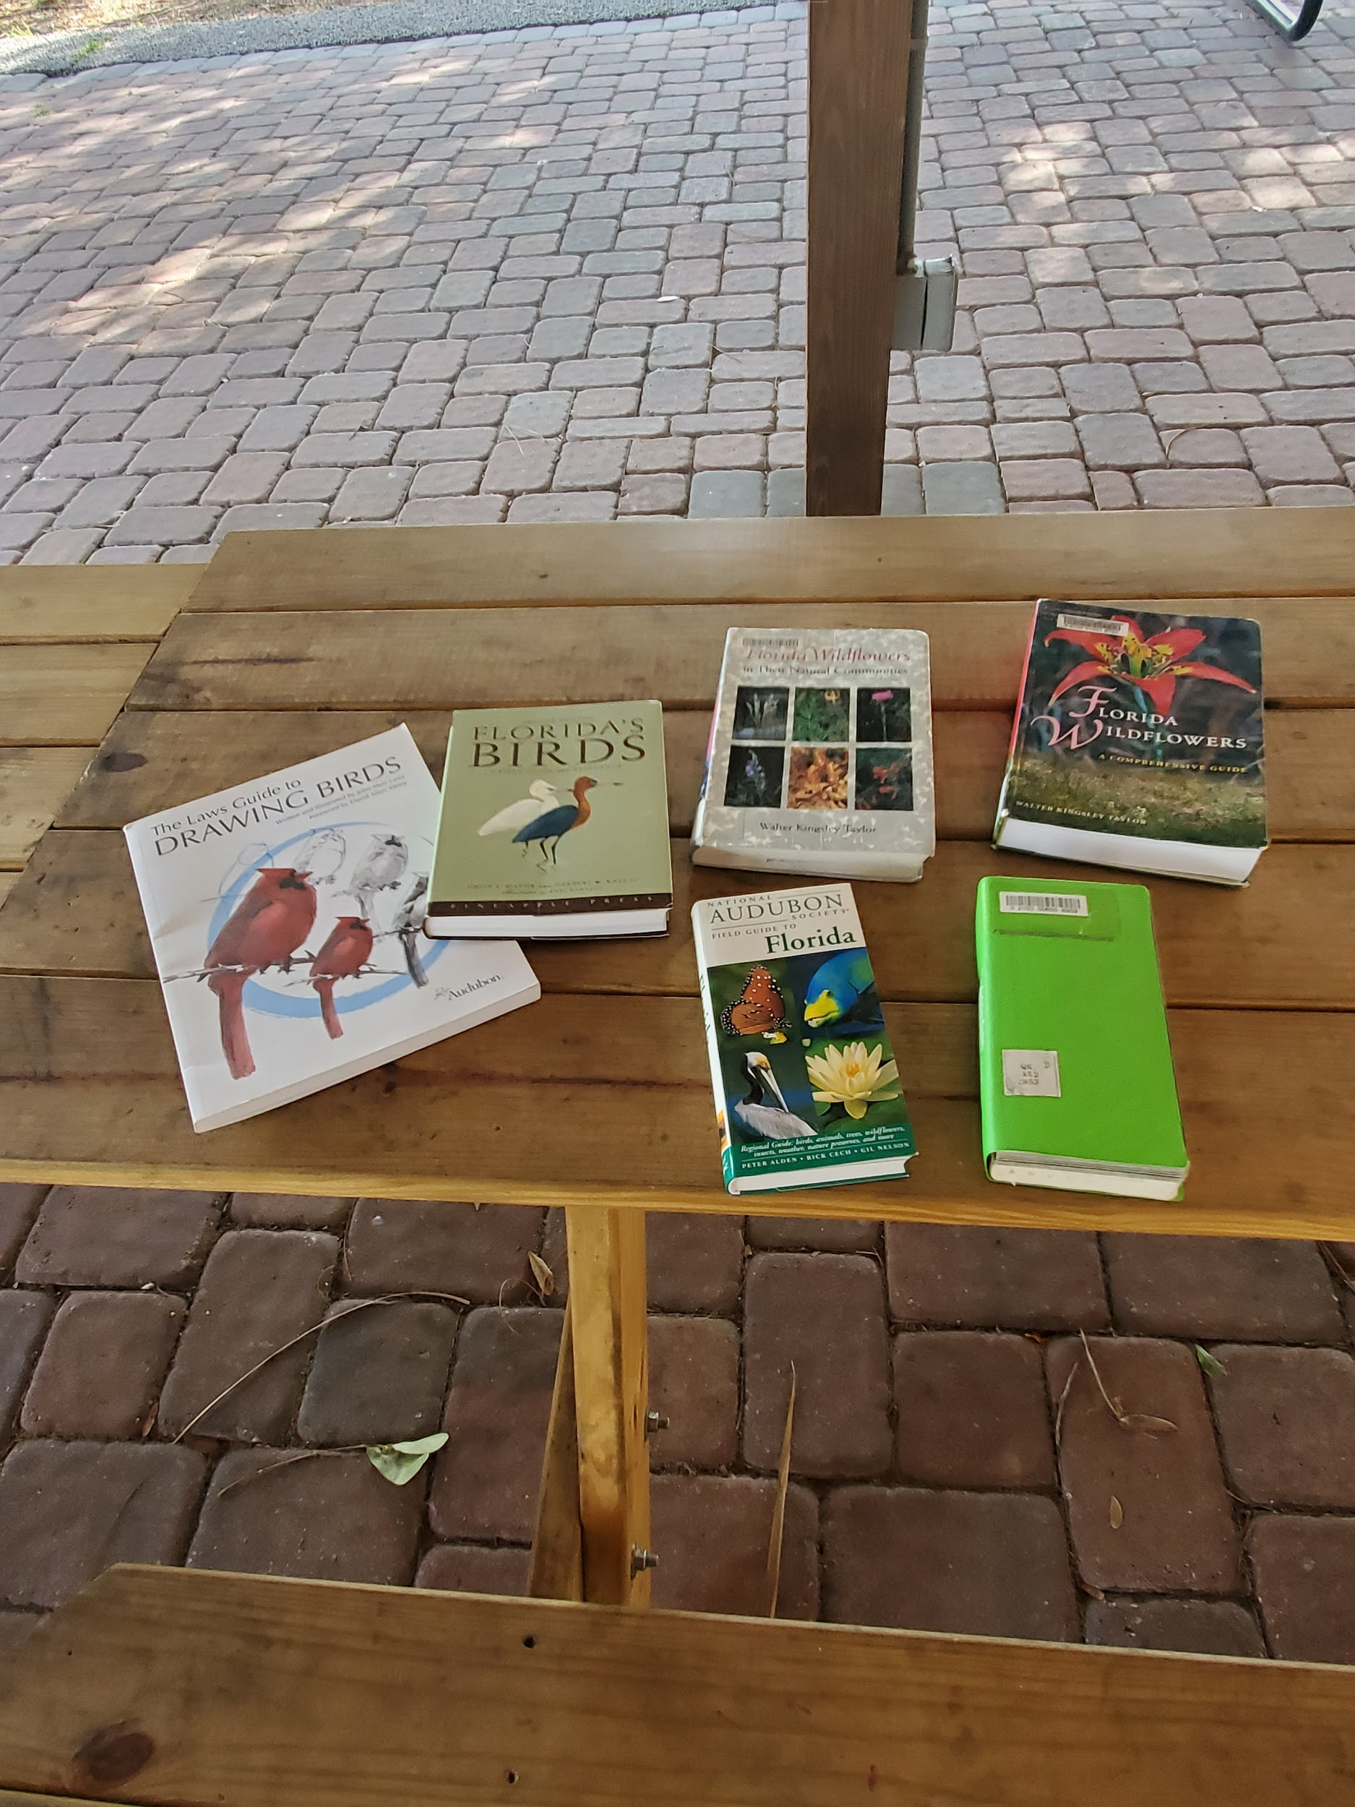

Slide 8
UCF Arboretum-A Creative Learning Environment
Established in 1983
Today, encompasses over 800 acres of Natural Lands
Two Organic Community Gardens
Natural Lands & Community Garden used as outdoor living laboratory
Support many Biology related courses - Plant Taxonomy, Medicinal Botany, Urban Ecological Field Studies, Culinary Botany, etc.

Slide 9
Arboretum History
1983: Arboretum Proper established on 10 acres of land and first year of membership of the American Public Gardens Association
1995: Sixty two acres added to the Arboretum Proper, increasing the size to 72 total acres
2009: Community Garden is established on ¼ acre
2016: Glass greenhouse built on Arboretum office site for research and garden use
2019: Second Community Garden established for increased crop production

Slide 10
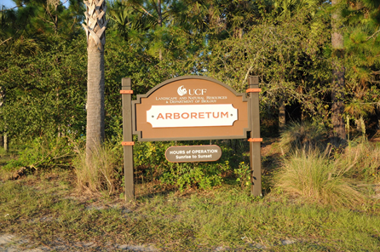
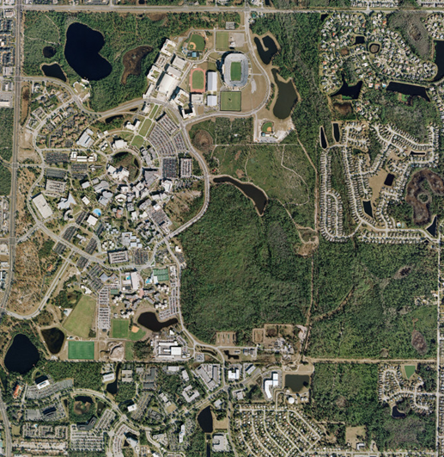
Arboretum Natural Lands
Over 800 acres of Natural Lands on Main Campus
Prescribed Fire Program for Ecosystem Management and Wildfire Mitigation
Rare, endemic, & endangered plants found on campus
Resident animals using Natural Lands as home and/or corridor

Slide 11
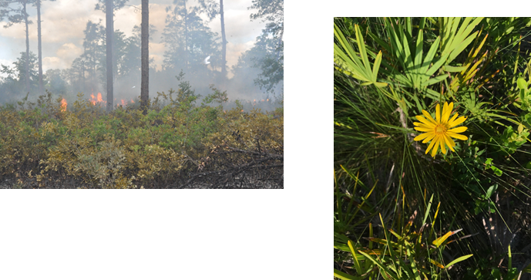
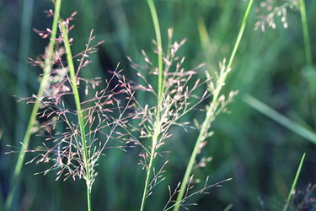
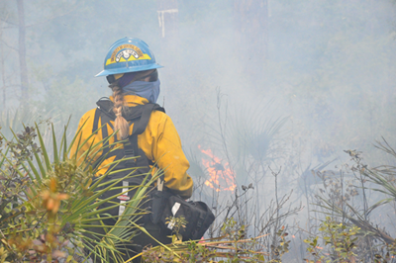
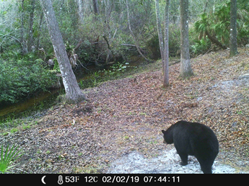

Slide 12
Brainstorm!
-What environmental or conservation organizations in your area would make good partners?
-Are there other organizations that do environmental or educational programming that could partner on an environmental education event?

Slide 13
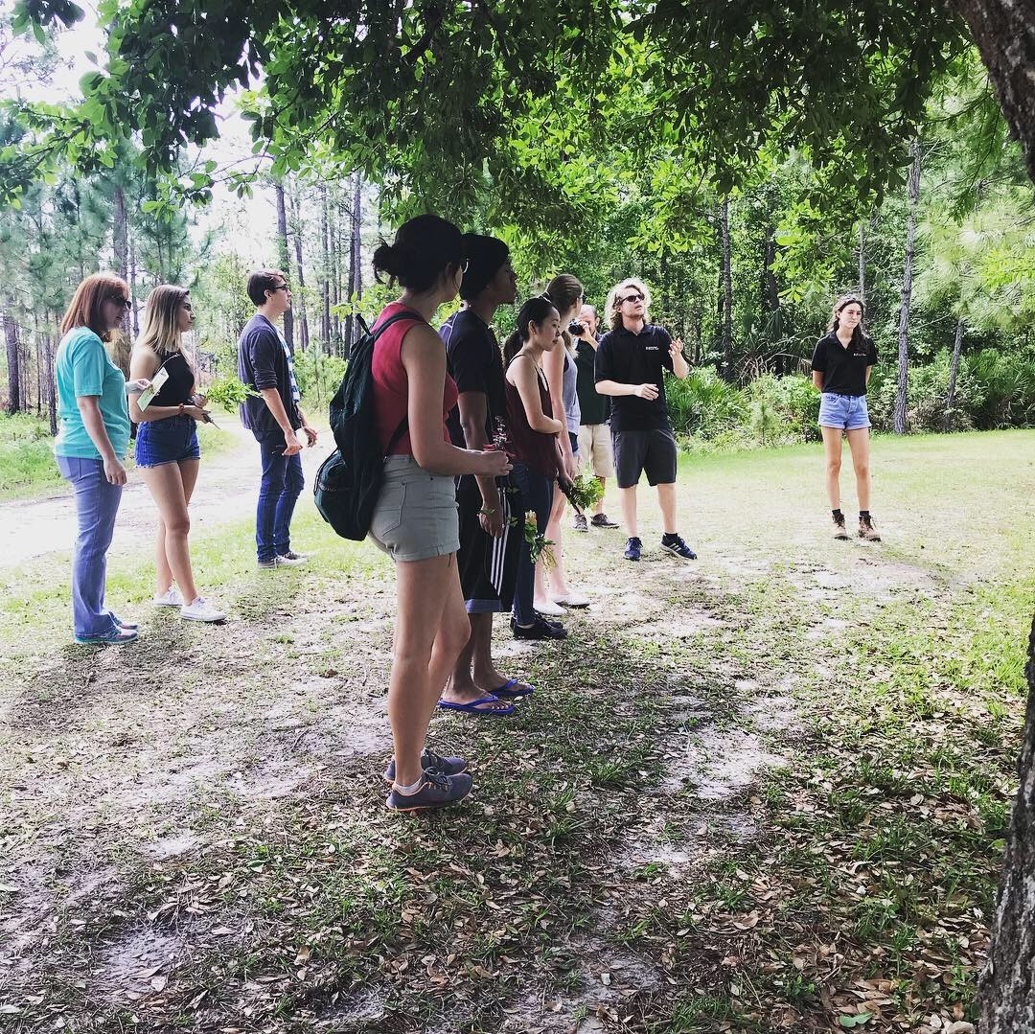
Place Based
Education

Slide 14
Place Based Education (PBE)
Educational experiences that “immerse students in local heritage, cultures, landscapes, opportunities and experiences”
(Center for Place-based Learning and Community Engagement, n.d.)

Slide 15
Place Based Education (PBE)
Developing a sense of place, comprised of place attachment and meaning, not only fosters a sense of belonging but also supports pro-environmental behaviors.
(Kudryavtsev , Stedman, & Krasny, 2012)

Slide 16
How can libraries
support PBE?

Slide 17
How can libraries support PBE?
Collections
Space
Programming

Slide 18
Brainstorm!
-What resources and services could your library contribute to a co-hosted event?

Slide 19
Environmental Benefits

Slide 20
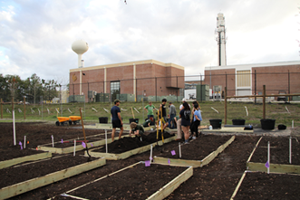
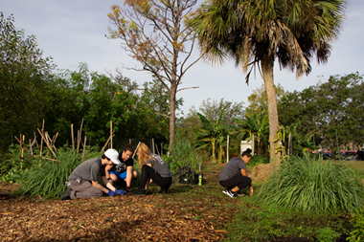
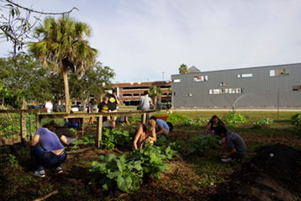
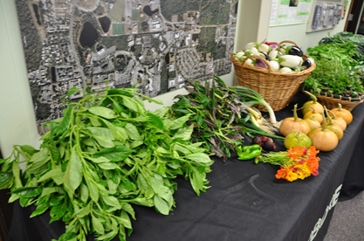
Arboretum Community Gardens
Original Garden built in 2009
¼ acre total area
Food produced all donated back to students
Student run gardens
New Garden built in 2019
Updated irrigation & planting methods

Slide 21
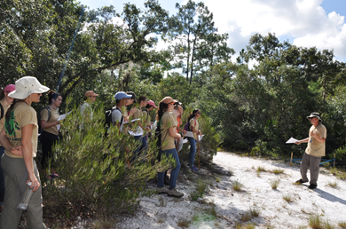
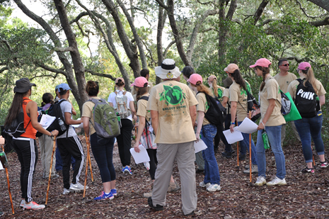
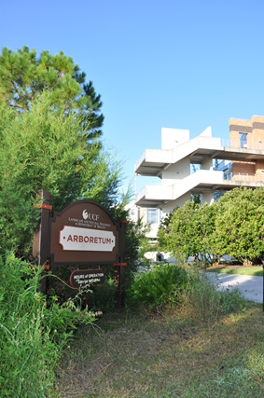
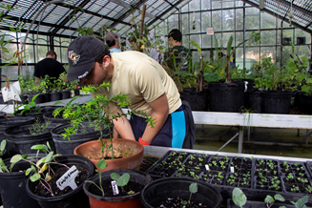
Living Laboratory at the Arboretum

Slide 22
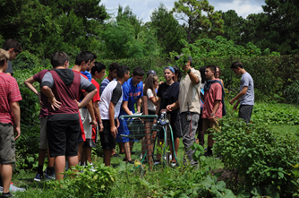
Biology Courses Supported by the UCF Arboretum & UCF Libraries
Resources Used:
Plant Taxonomy
Urban Ecological Field Studies
Biology I & II
Culinary Botany
Medicinal Botany
Greenhouse Space
Garden Beds
Online Library Resources
Science Librarian Presentations

Slide 23
Brainstorm!
-Who would be the best person to contact at your potential partner organization?
-What will be your “elevator pitch?”

Slide 24
Takeaways/Conclusions
Start early allowing plenty of time to market and prepare for events.
Use as many channels as possible to share event and get a good turnout.
Stay in communication with all parties and set deadlines and stick to deadlines.
Be aware of the timing of school related events and how that may conflict.
Plan well in advance for each event and ensure all necessary supplies are rounded up ahead of time.
Plan for bad weather and insects.
Request RSVPs when applicable for event.
Work to establish additional partnerships to grow interest and appeal for events if continuing from year to year.
Prepare a research guide or library resource to share additional resources to the target audience.
Most importantly, take time to enjoy nature and to have fun!

Slide 25
References
Center for Place-based Learning and Community Engagement (n.d.) What is place-based education? Retrieved from: http://promiseofplace.org/what-is-pbe/what-is-place-based-education
Kudryavtsev , A., Stedman, R. C. & Krasny, M. E. (2012) Sense of place in environmental education. Environmental Education Research, 18(2), 229-250. DOI: 10.1080/13504622.2011.609615

Slide 26
Thank you for your attention!
Any questions?

Slide 27
Christina Wray
Digital Learning
& Engagement Librarian
christina.wray@ucf.edu
Sandy Avila
Science Librarian
savila@ucf.edu
Kelsie Johnson
Program Coordinator -
UCF Arboretum
kelsie.johnson@ucf.edu
Feel free to reach out to us

