Slide 1
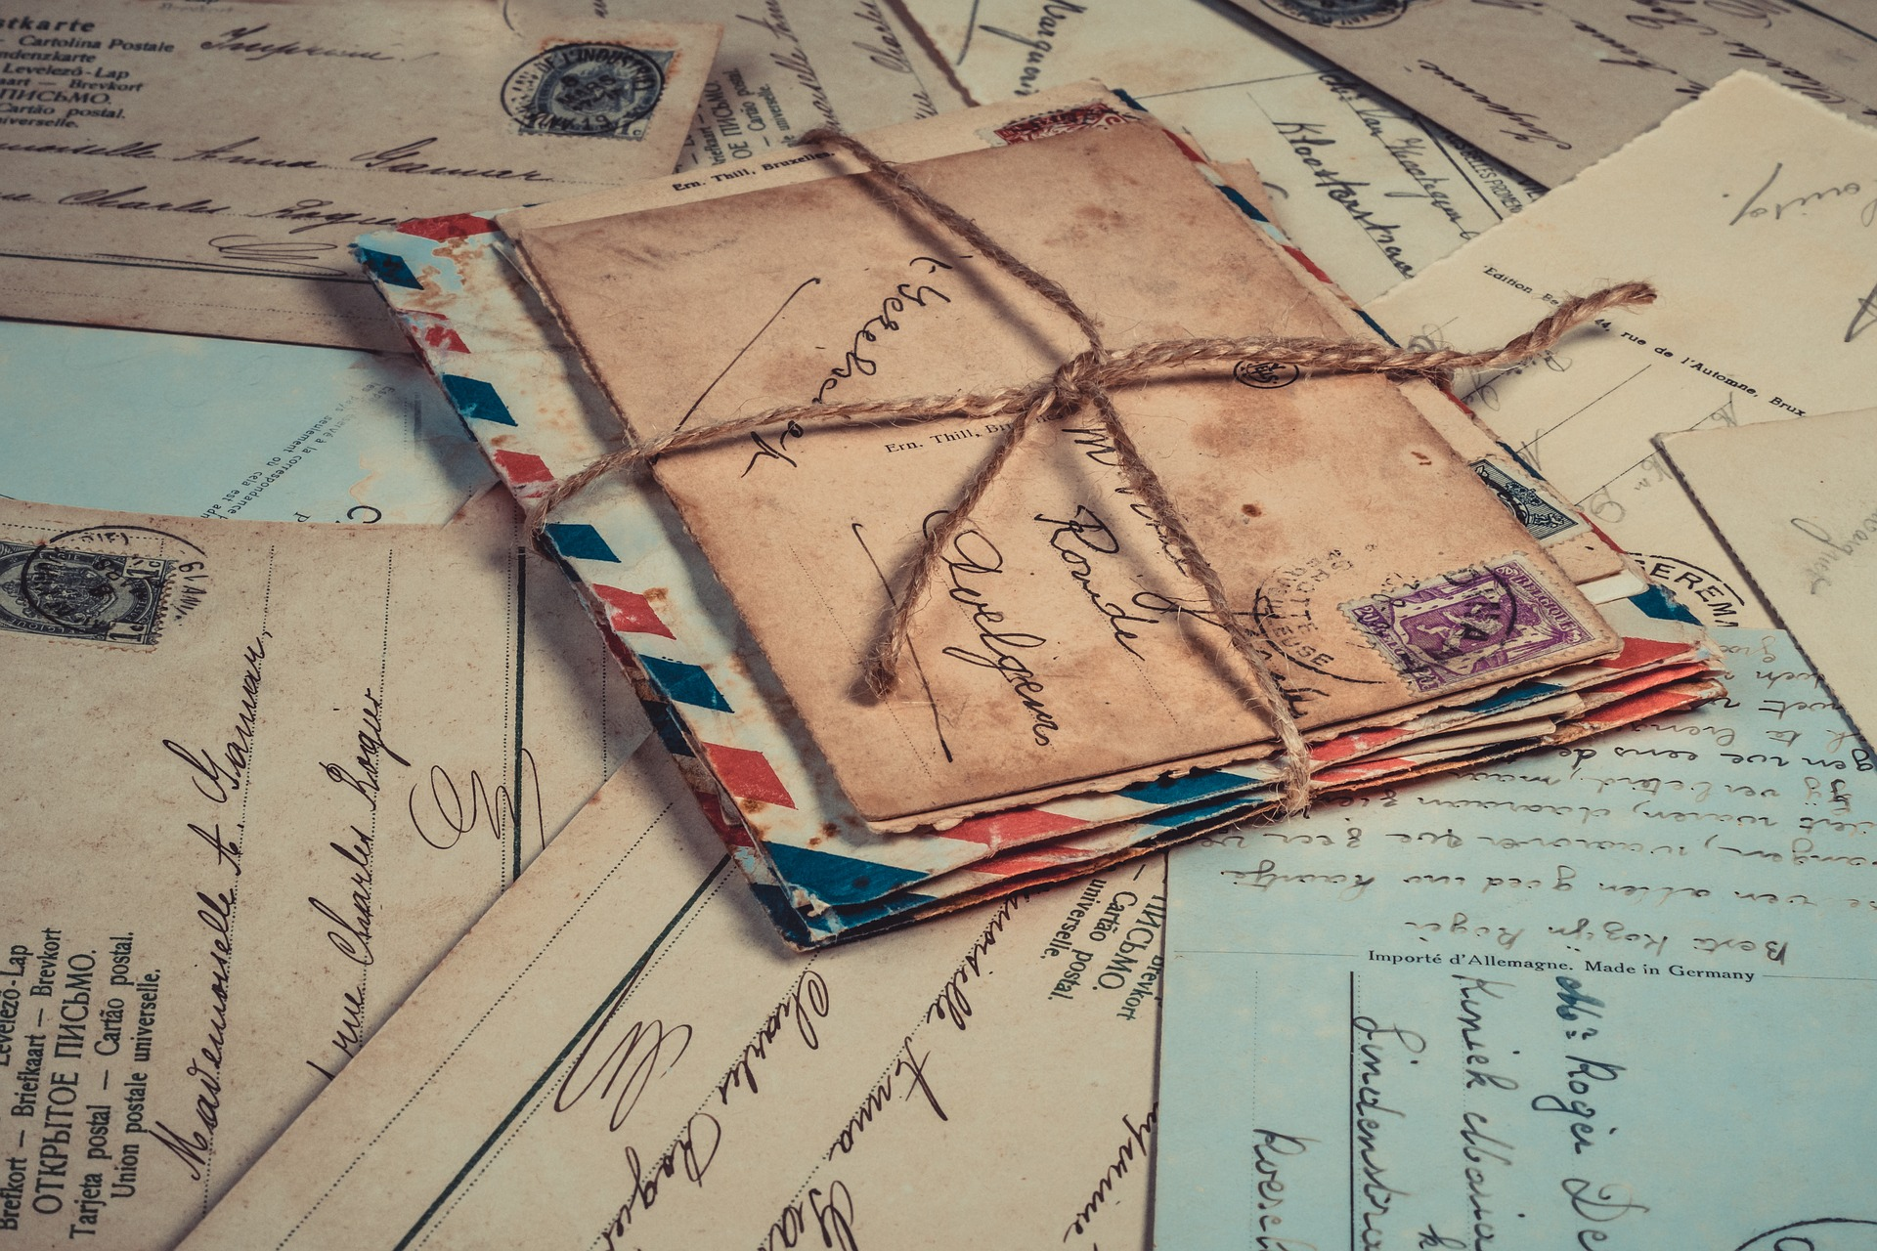
CREATING MAIL ART & OTHER TRANSFORMATIVE WORKS
Understanding Copyright & Author Rights

Slide 2
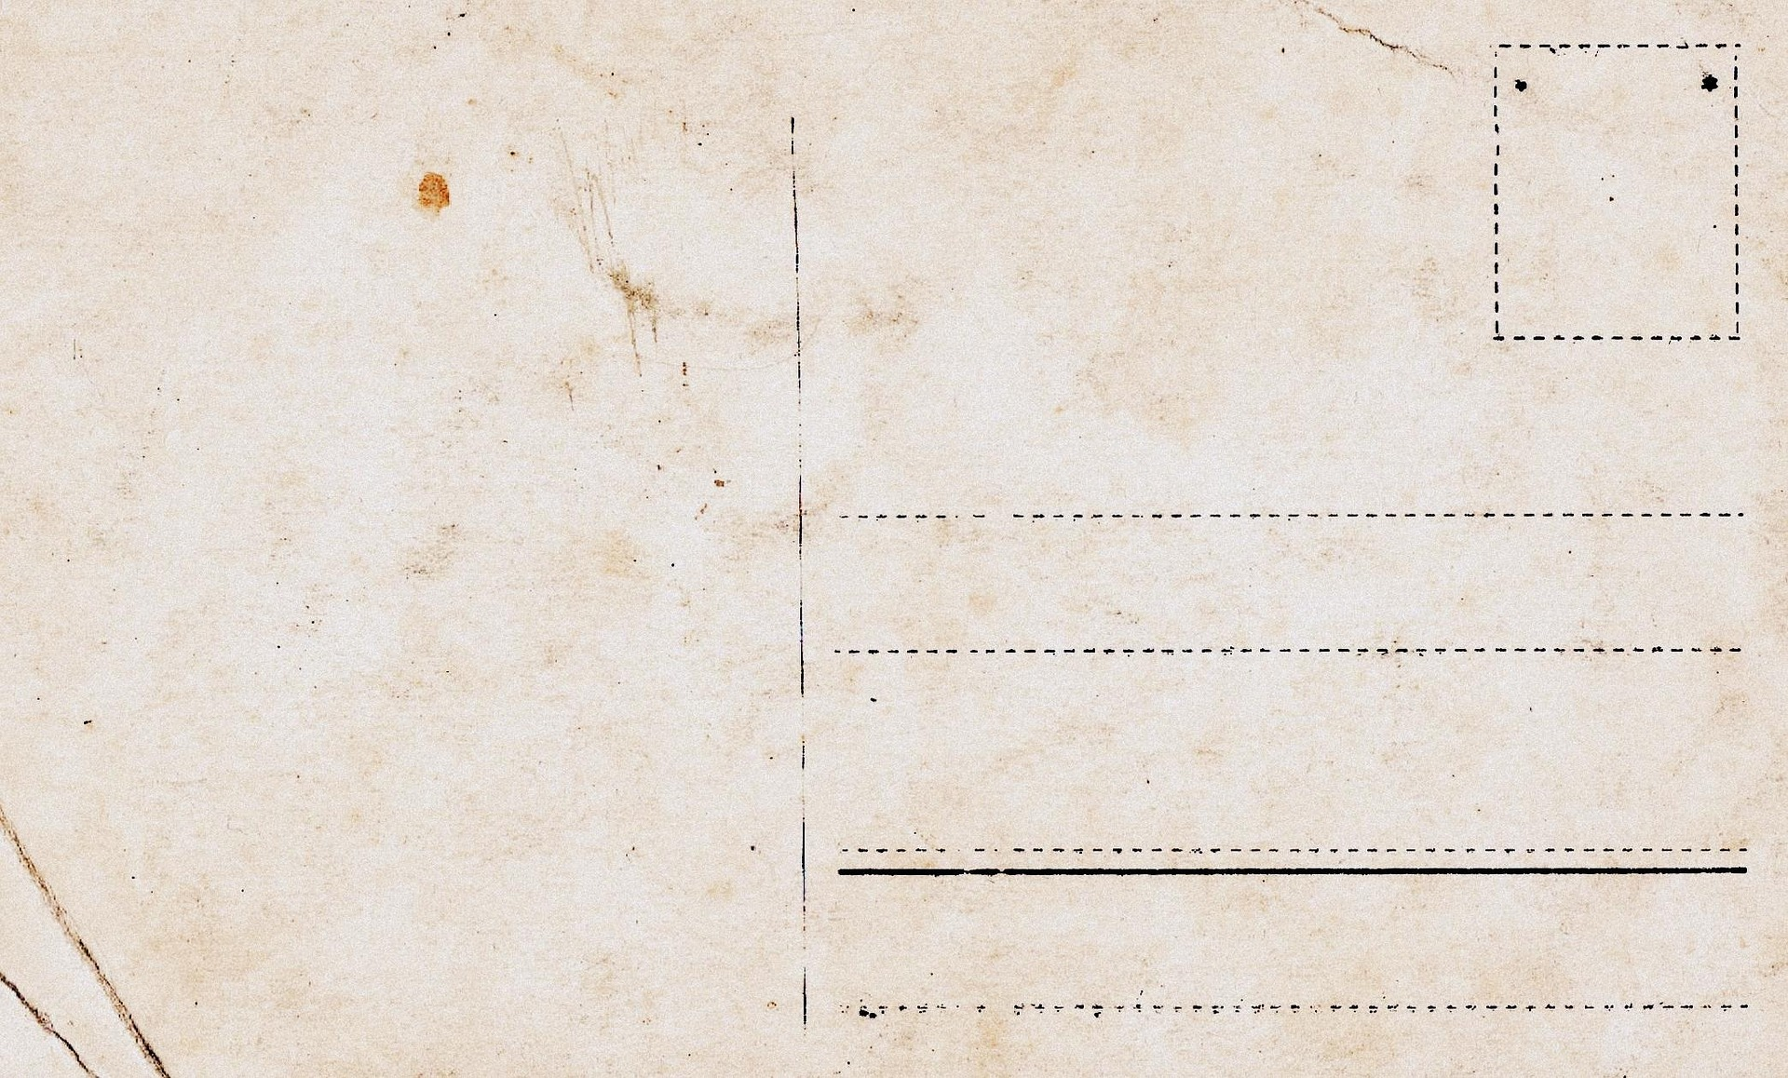
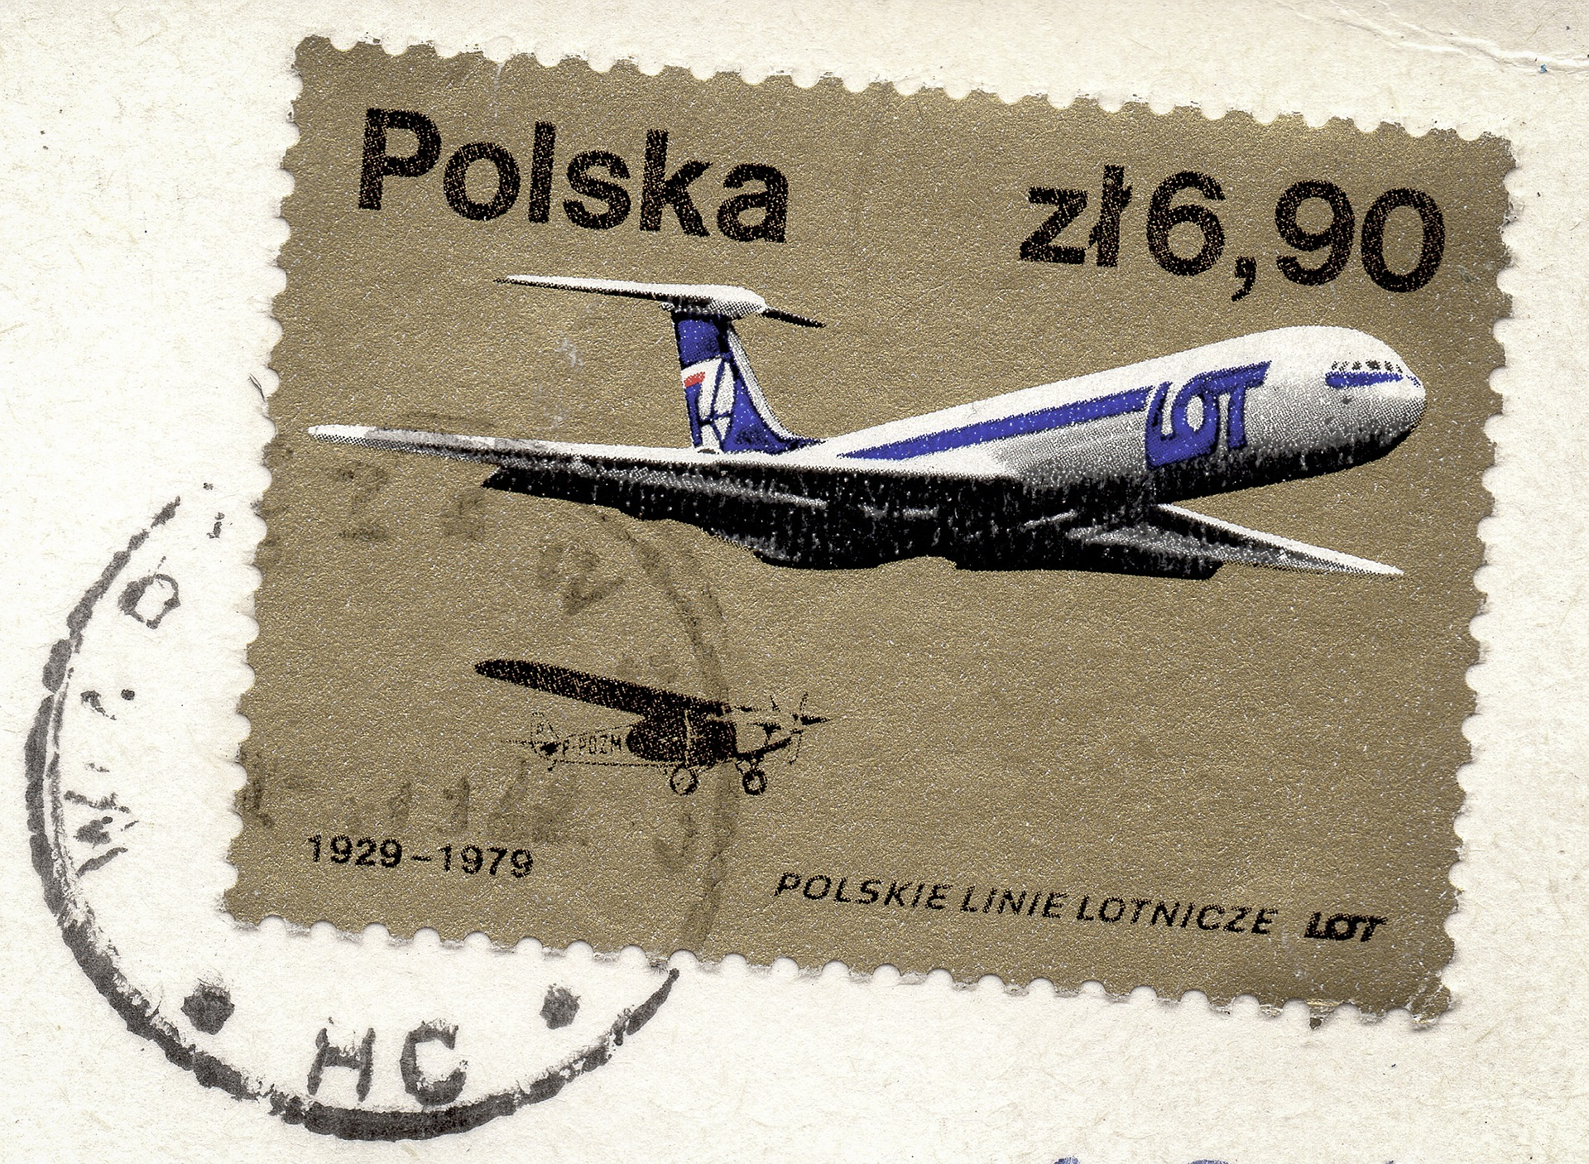
Dear Student,
If you remember one thing from today’s presentation…
Contact the Library. We can help!

Slide 3
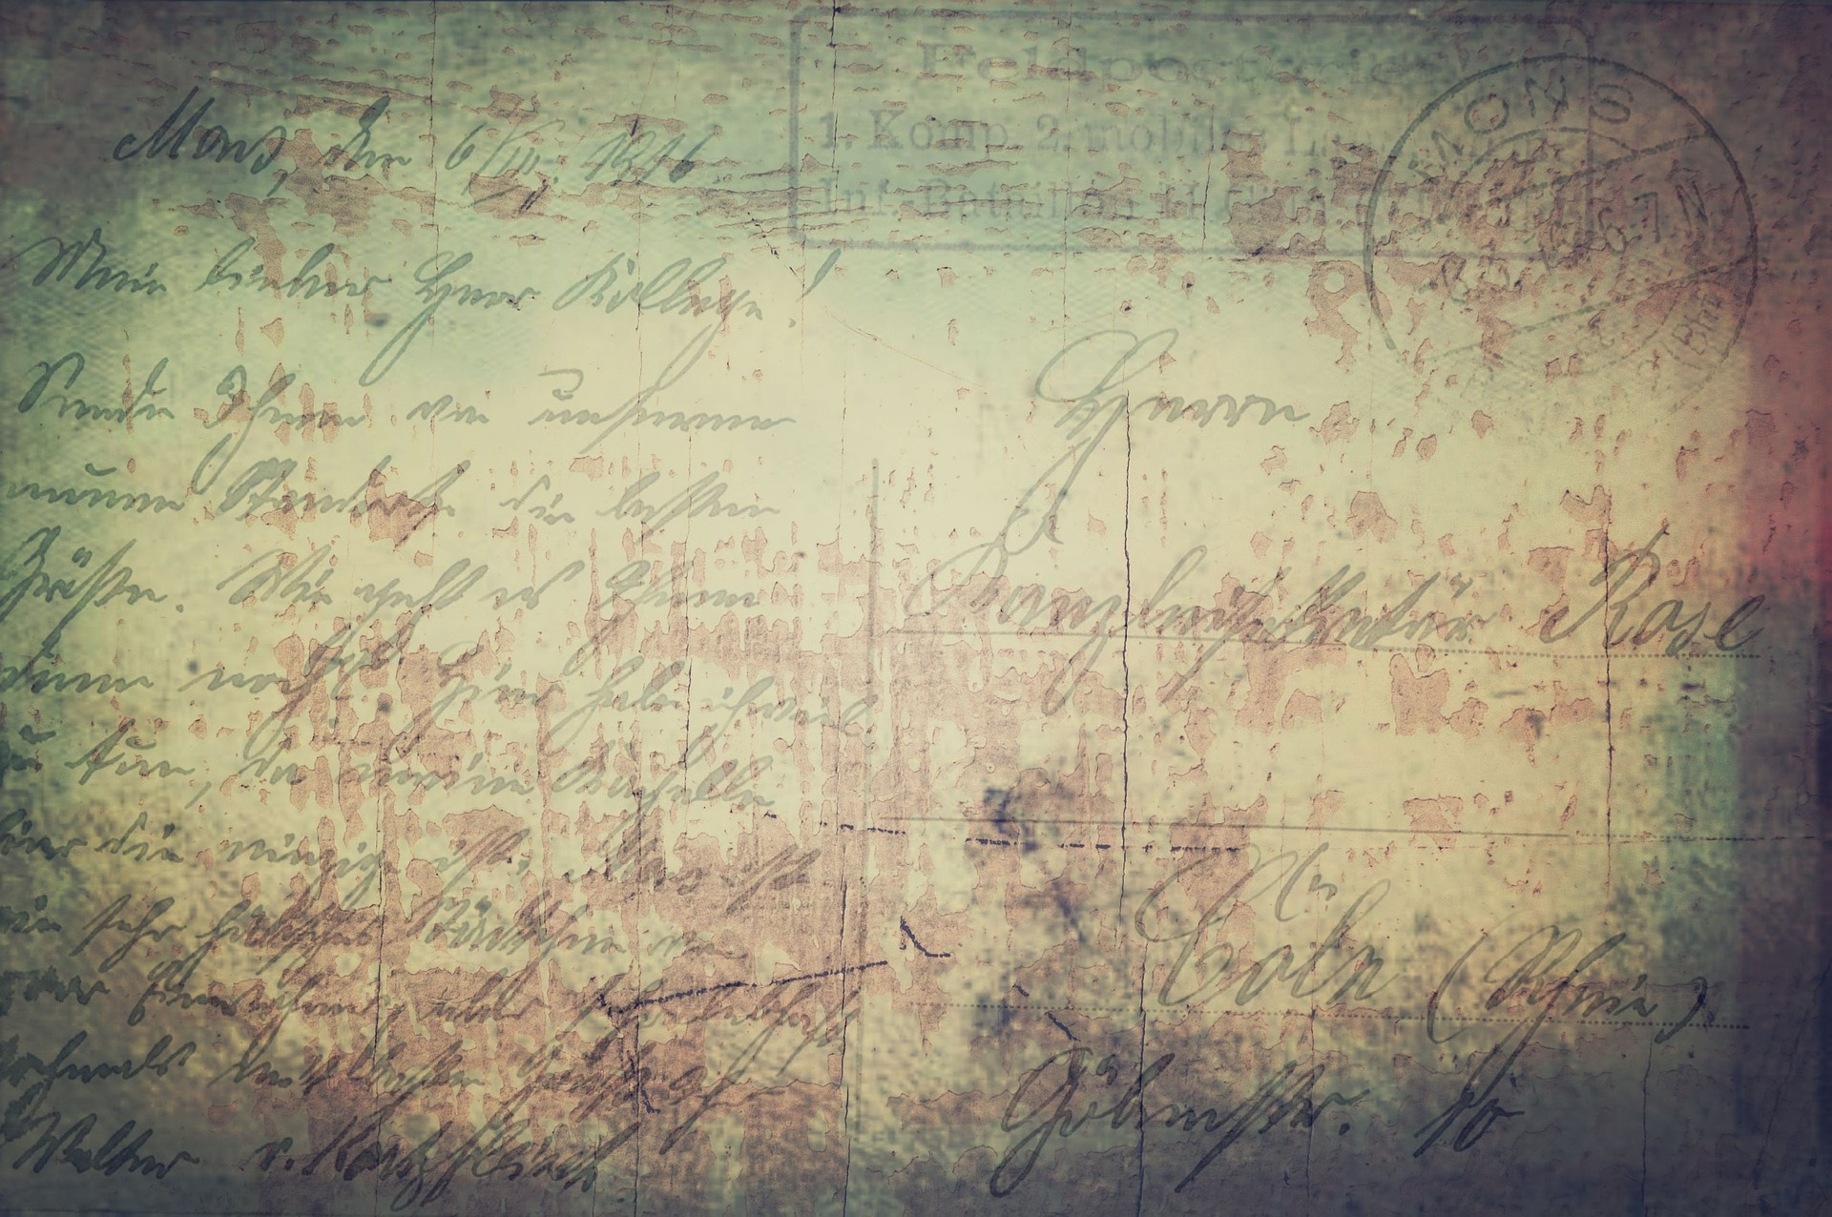
What is Copyright?

Slide 4
“Copyright is a form of protection provided by the laws of the United States (title 17, U.S. Code) to the authors of ‘original works of authorship,’ including literary, dramatic, musical, artistic, and certain other intellectual works. This protection is available to both published and unpublished works.”
http://www.copyright.gov/circs/circ01.pdf

Slide 5
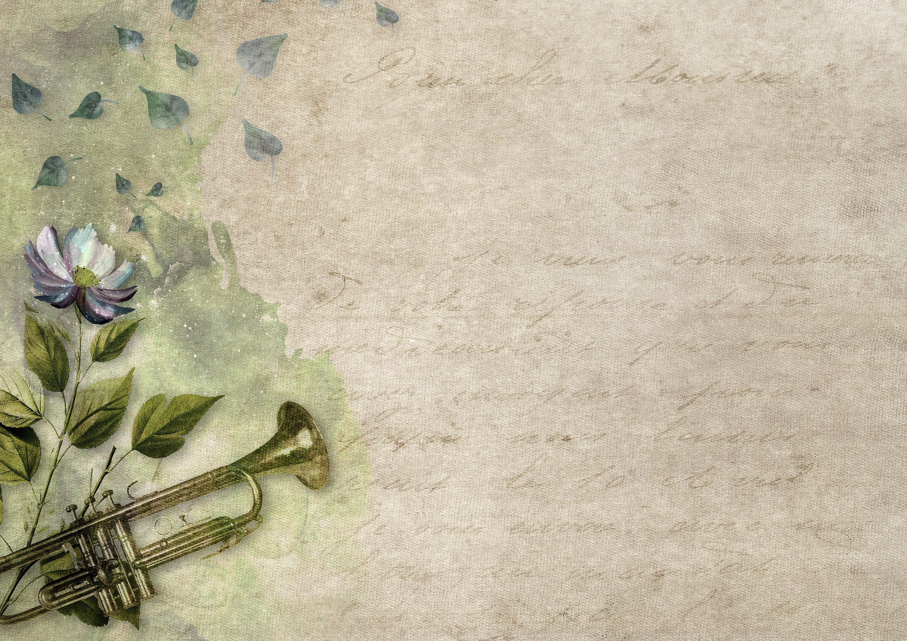
Why is Copyright Important?

Slide 6
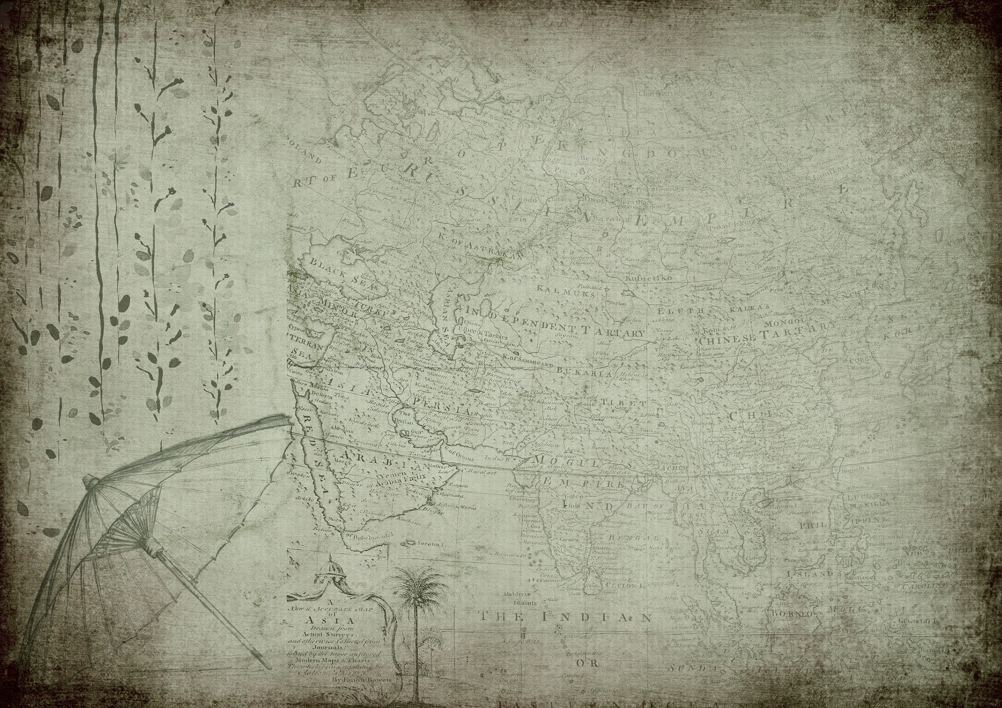
What Rights are Covered by Copyright?
Generally, the following are exclusive rights given to a copyright holder:
reproduce your work
distribute your work
prepare derivative works
publicly display or perform your work
authorize others to do any of the above
*The above does not necessarily apply if the creator/author has given away rights to a publisher and/or other individual or entity

Slide 7
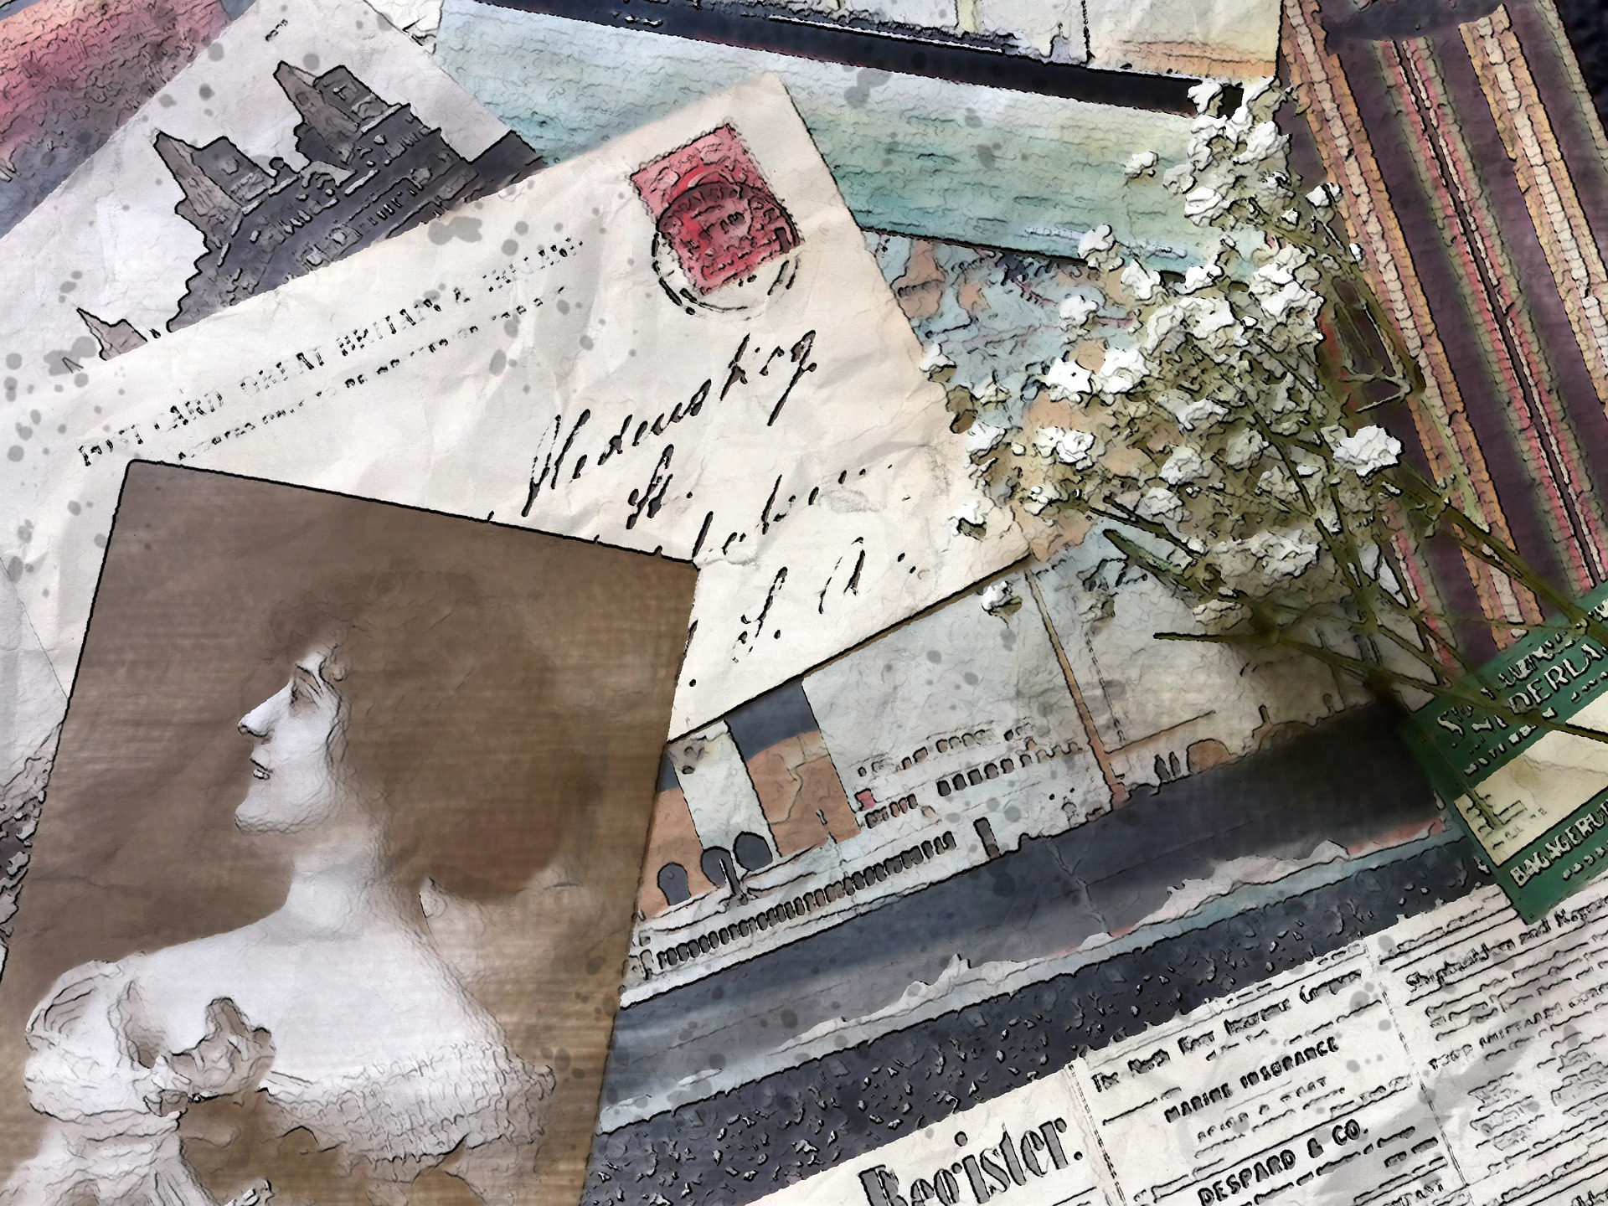
What are Transformative Works?

Slide 8
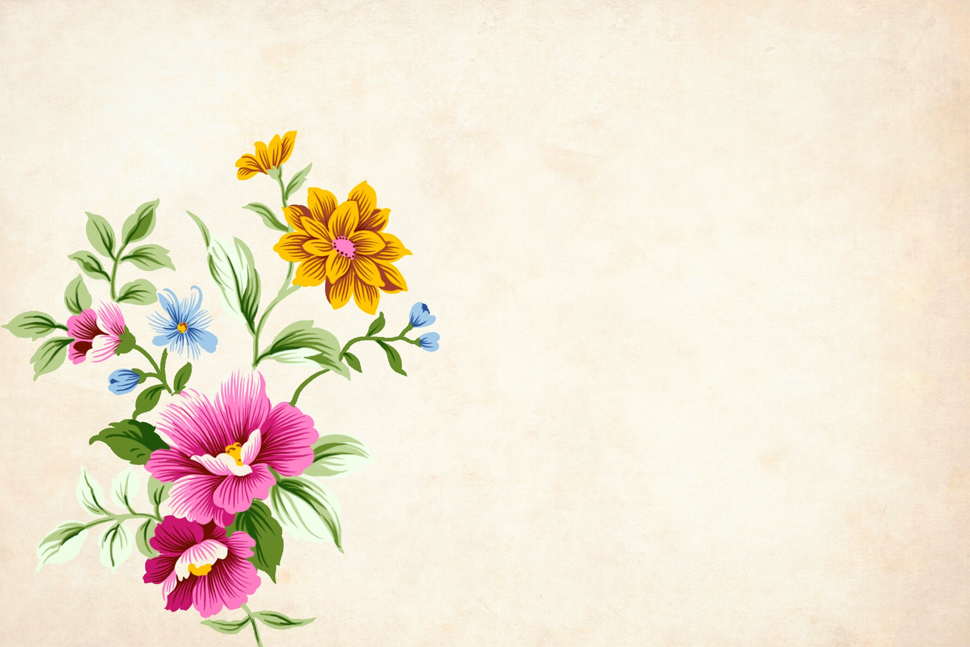
Transformative works are any type of creative work that you create using someone else’s copyrighted work. Transformative works must be significantly “transformed” in some way.

Slide 9
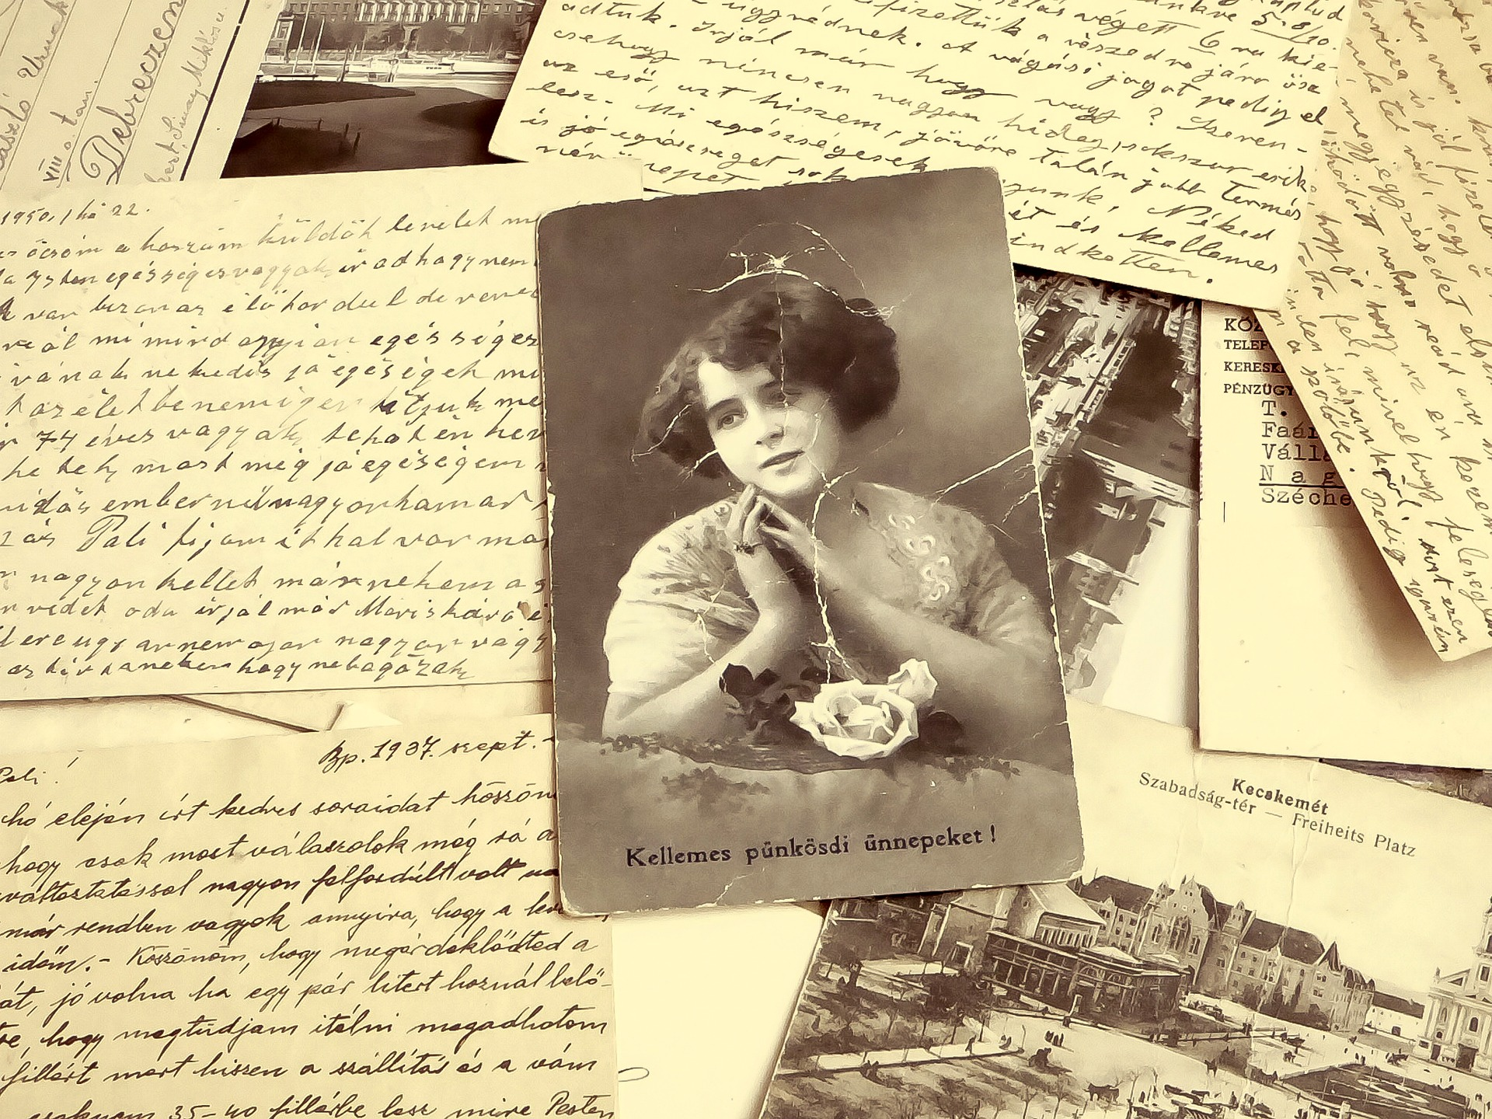
Examples include:
Mail Art Collage
Fan Fiction
Video & Music Re-mixes
Zines
Others?

Slide 10
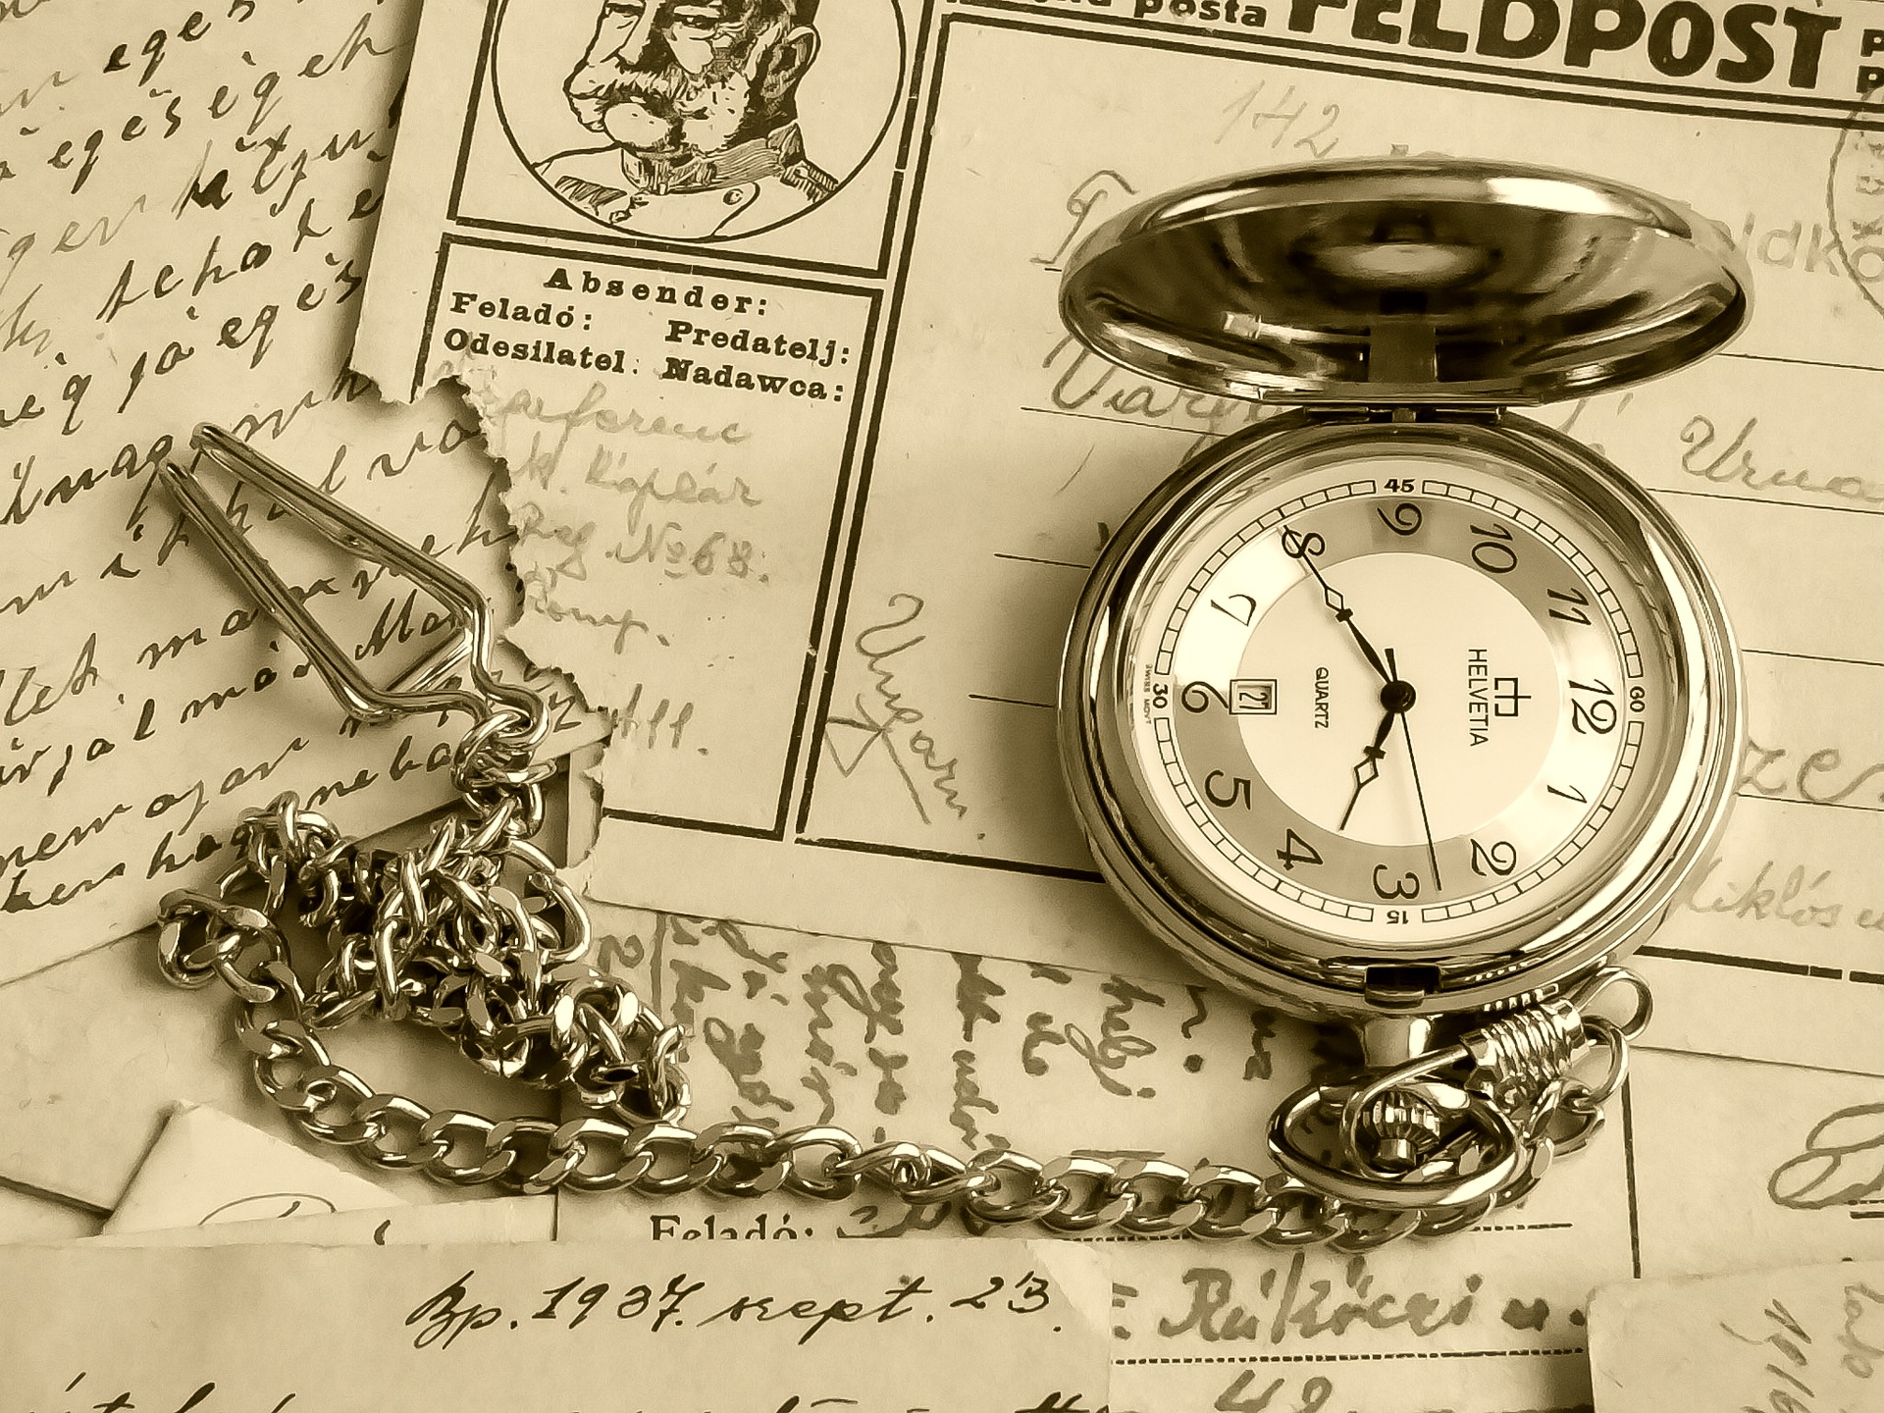
Fair Use

Slide 11
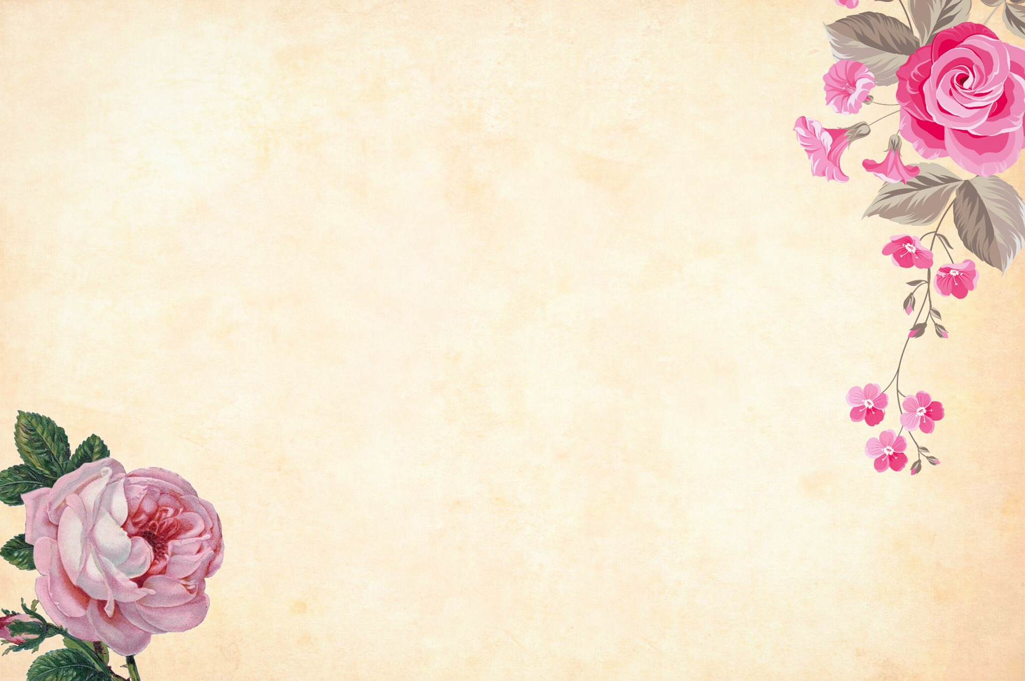
Fair Use is the ability to use copyrighted works in limited ways. Fair Use can “transform” a copyrighted work into a new one.
Often used for:
Commentary
Criticism
Parody

Slide 12
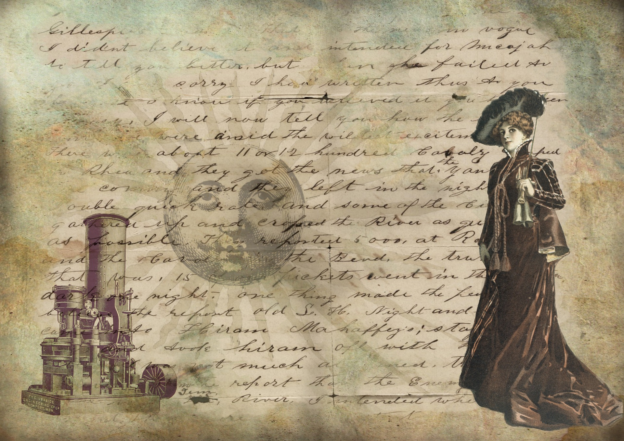
Fair Use as it Applies to Transformative Works

Slide 13
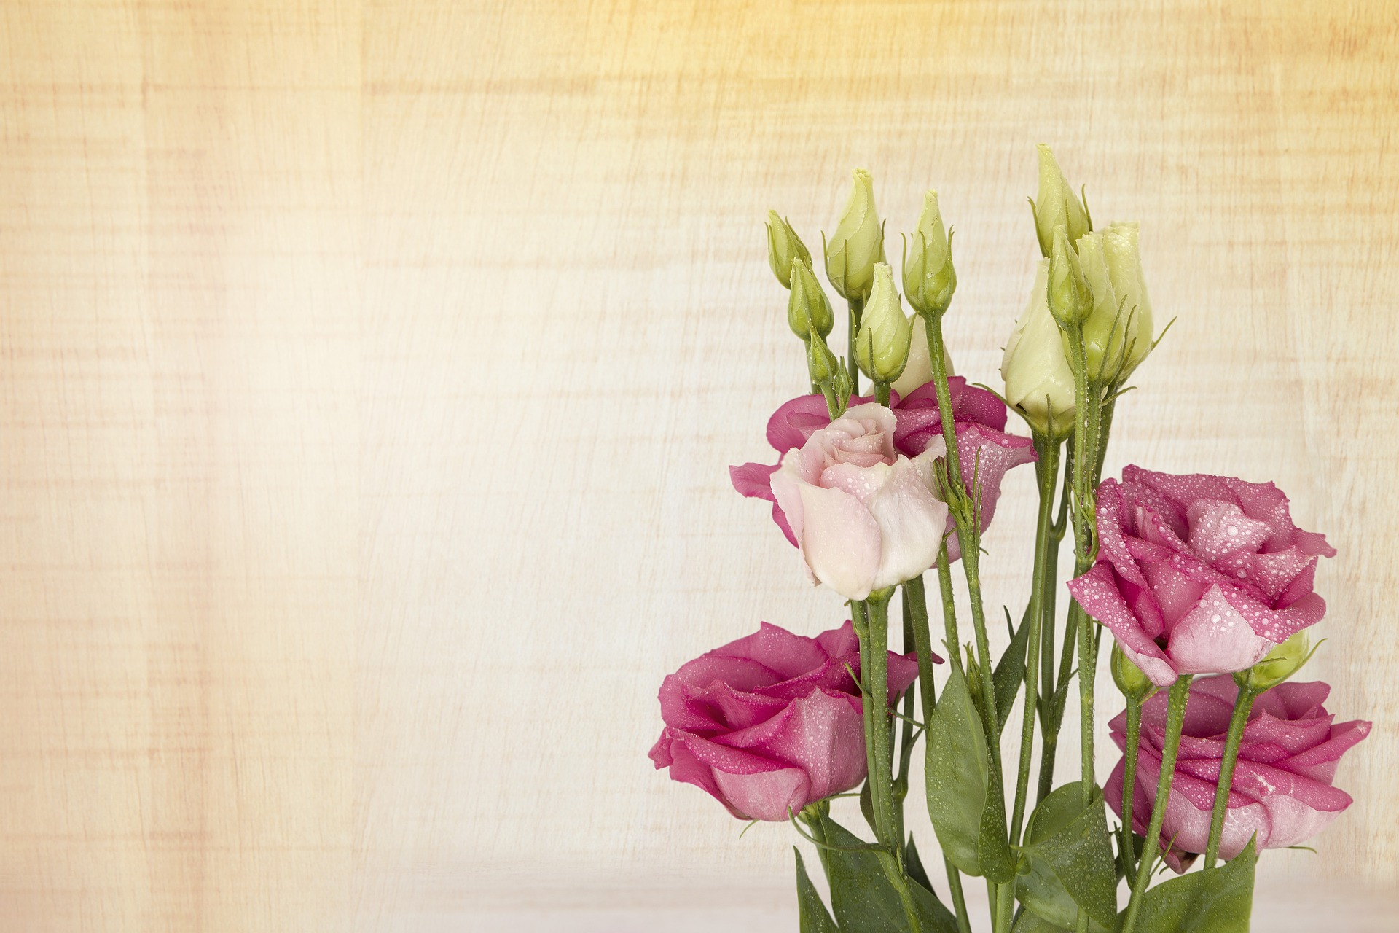
The Four Fair Use Factors:
the purpose and character of your use
the nature of the copyrighted work
the amount and substantiality of the portion taken
the effect of the use upon the potential market.

Slide 14
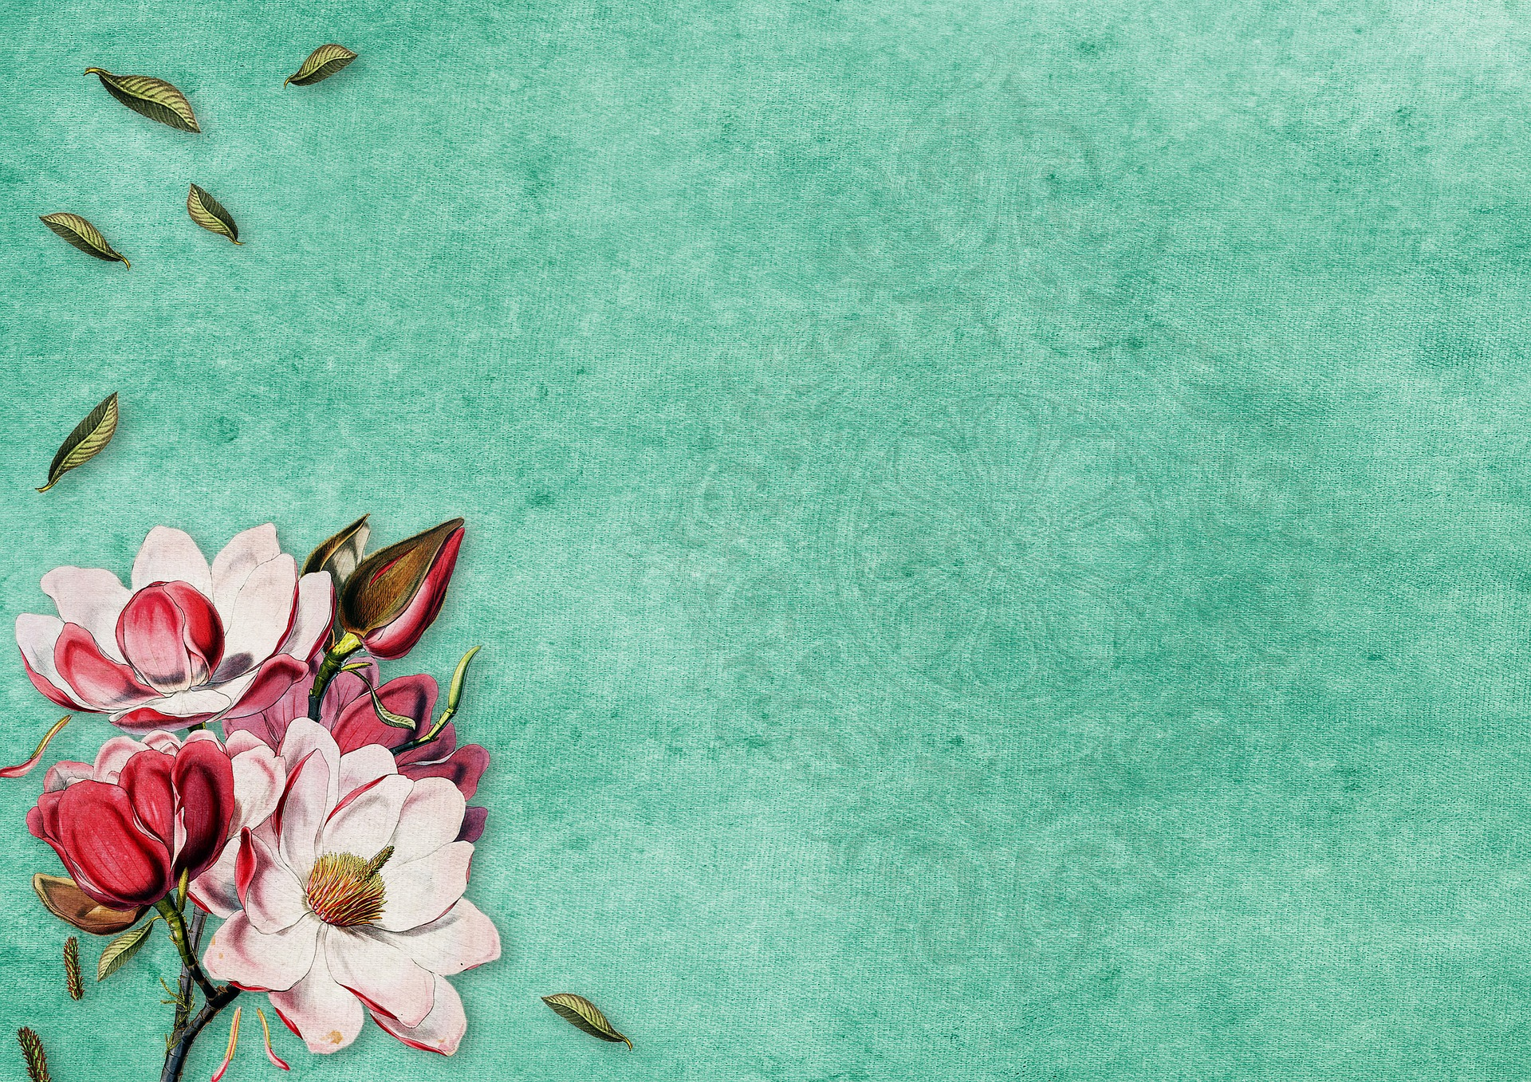
Top 10
Copyright & Author Rights Tips
for Transformative Works

Slide 15
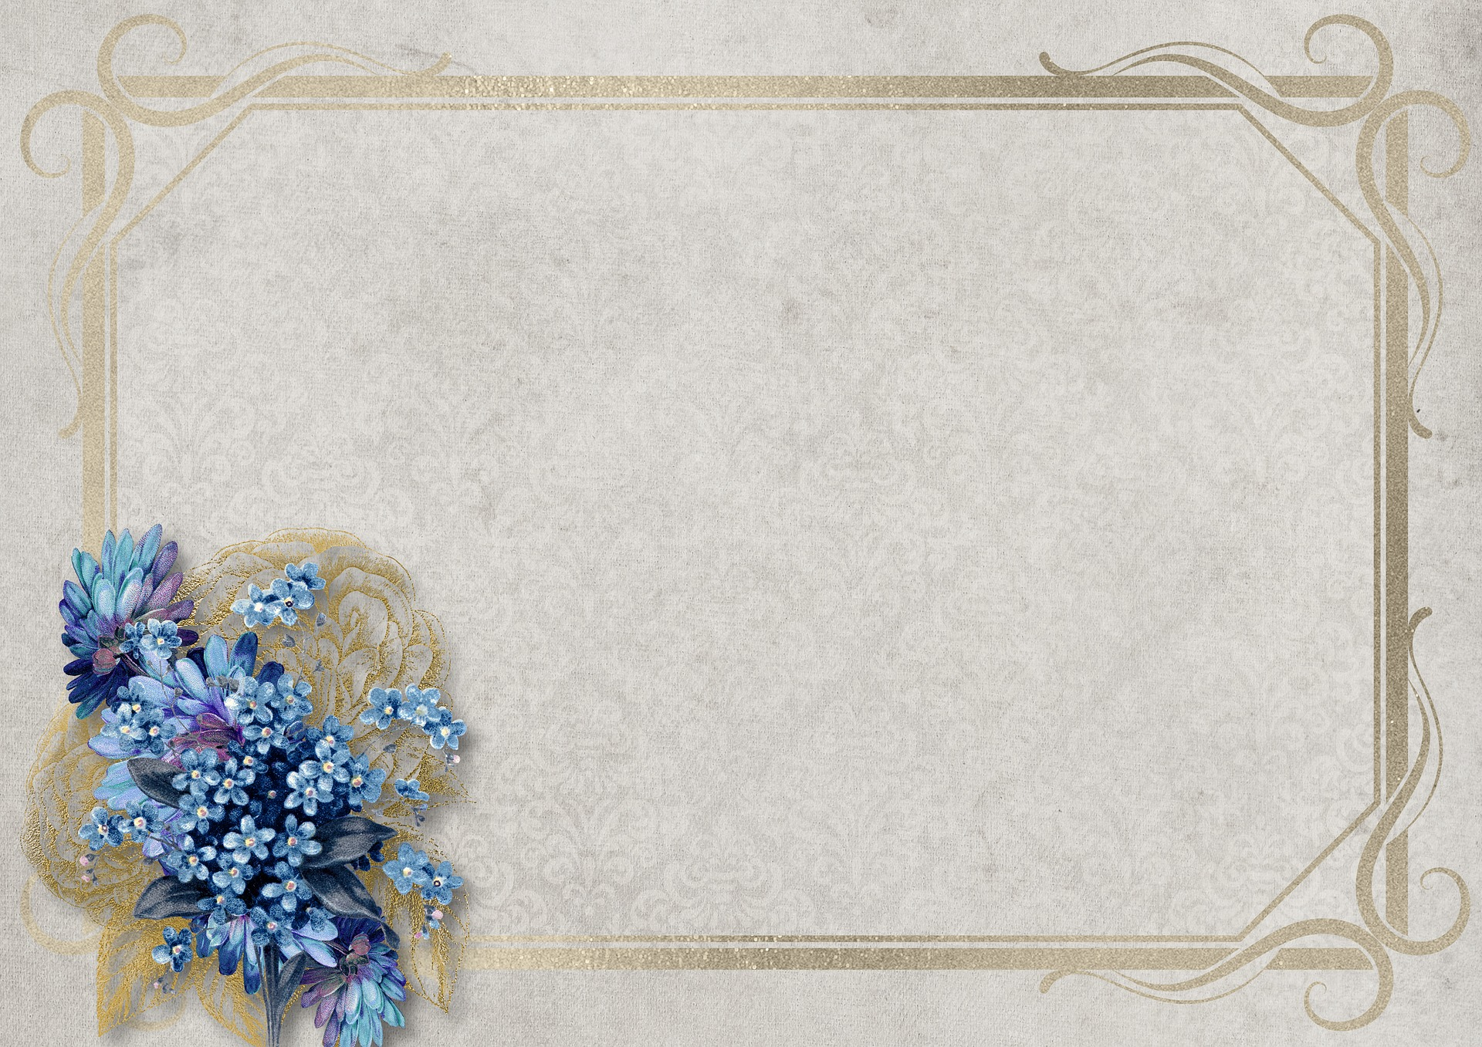
#1:
How You Distribute Your Transformative Work Matters...

Slide 16
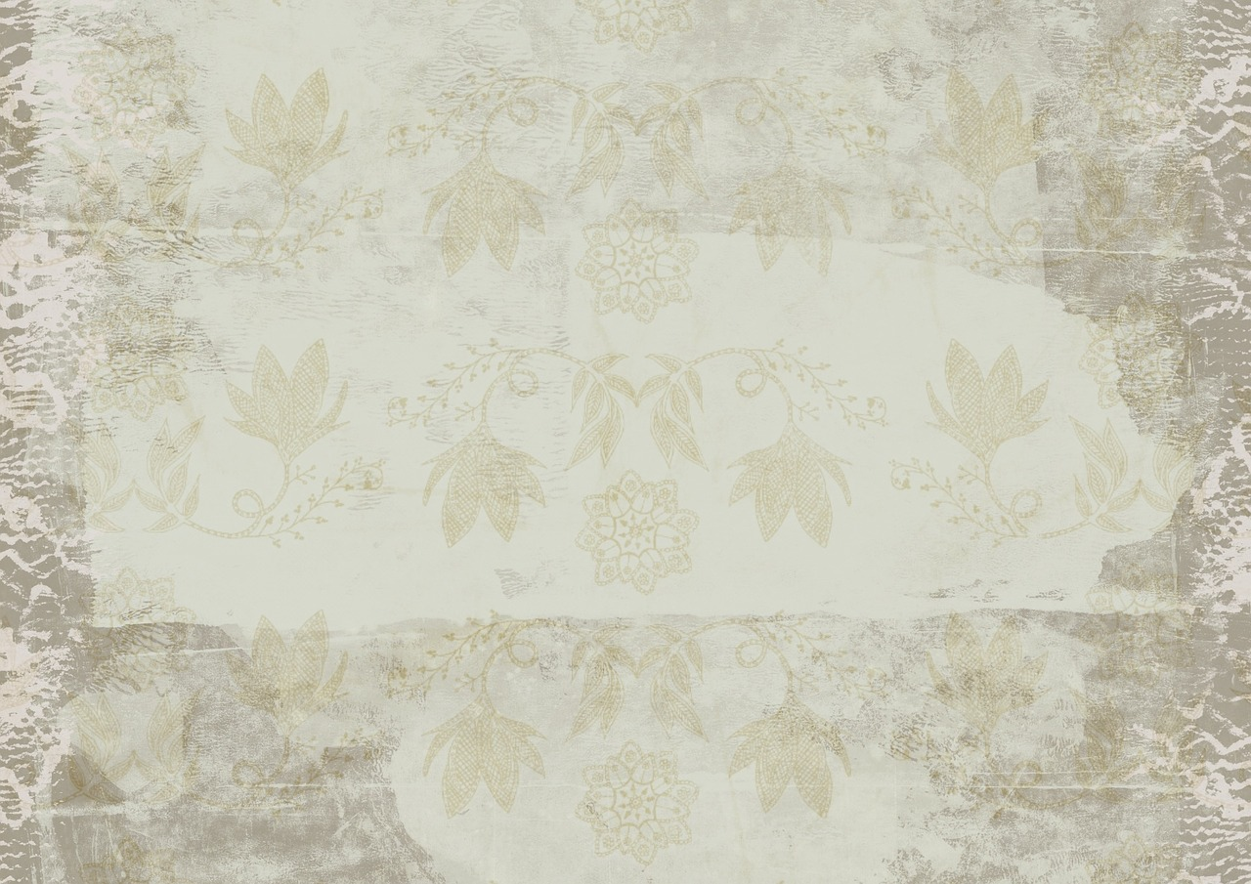
#2:
Consider How You’re Going to Use Other Works in Your Project...

Slide 17
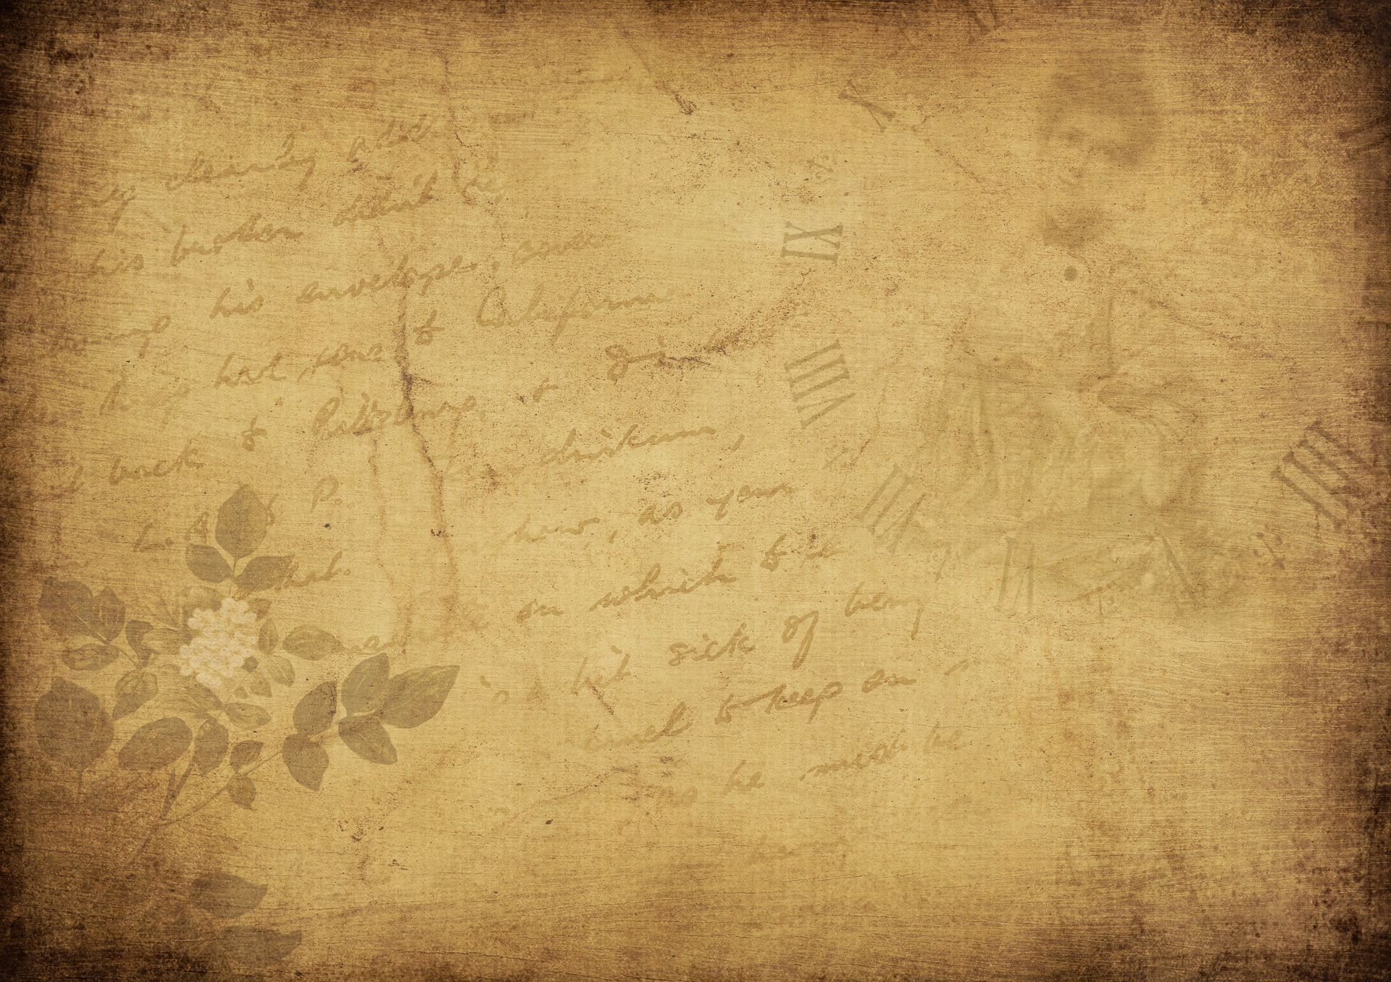
#3:
Materials You Don’t Create Yourself are Not Yours…

Slide 18
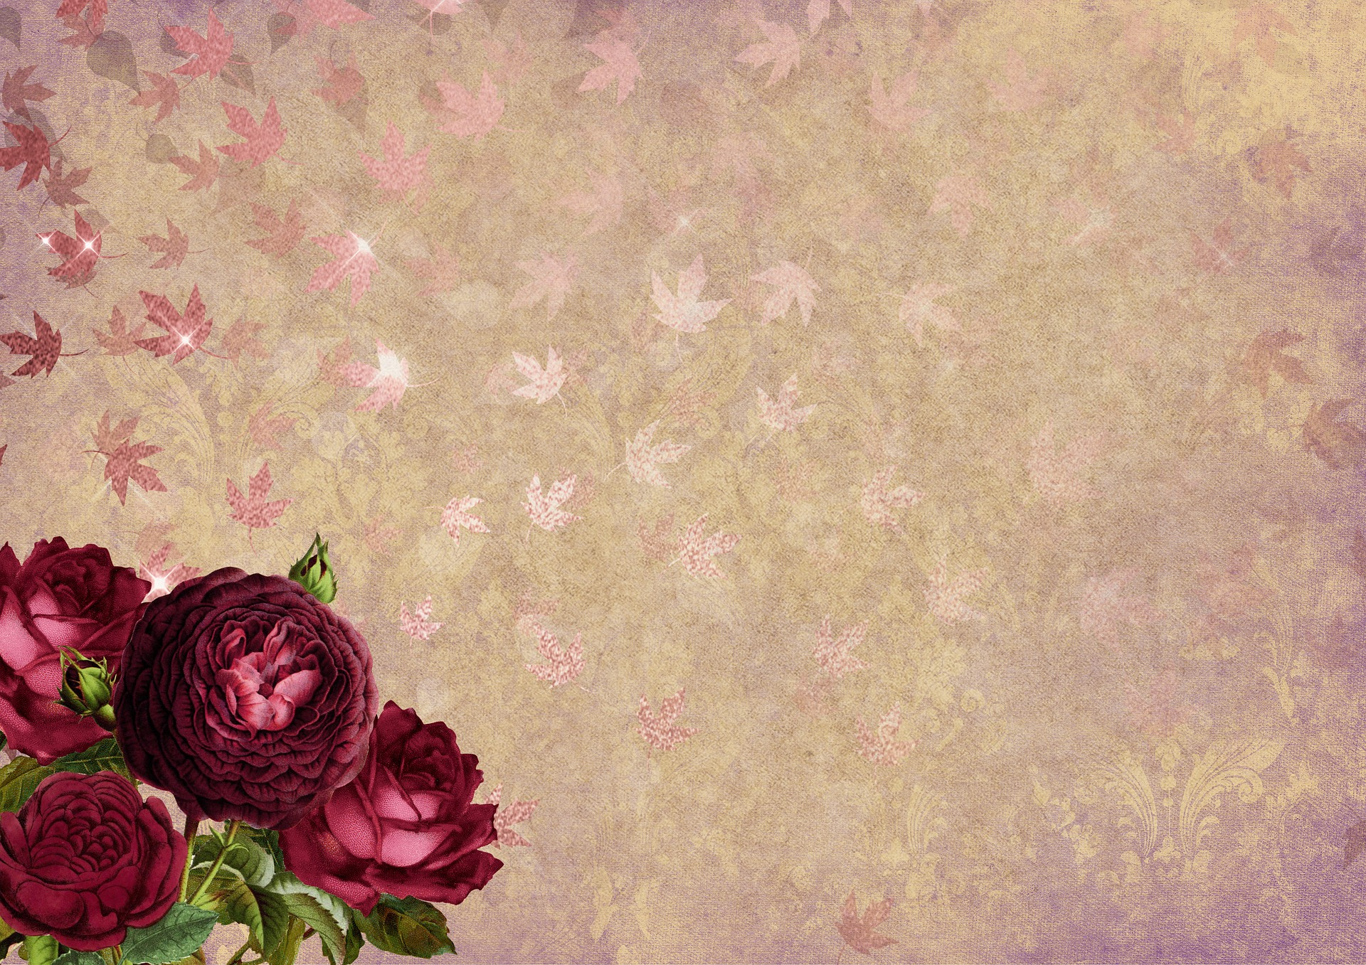
#4:
Be Respectful of Copyrighted Works

Slide 19
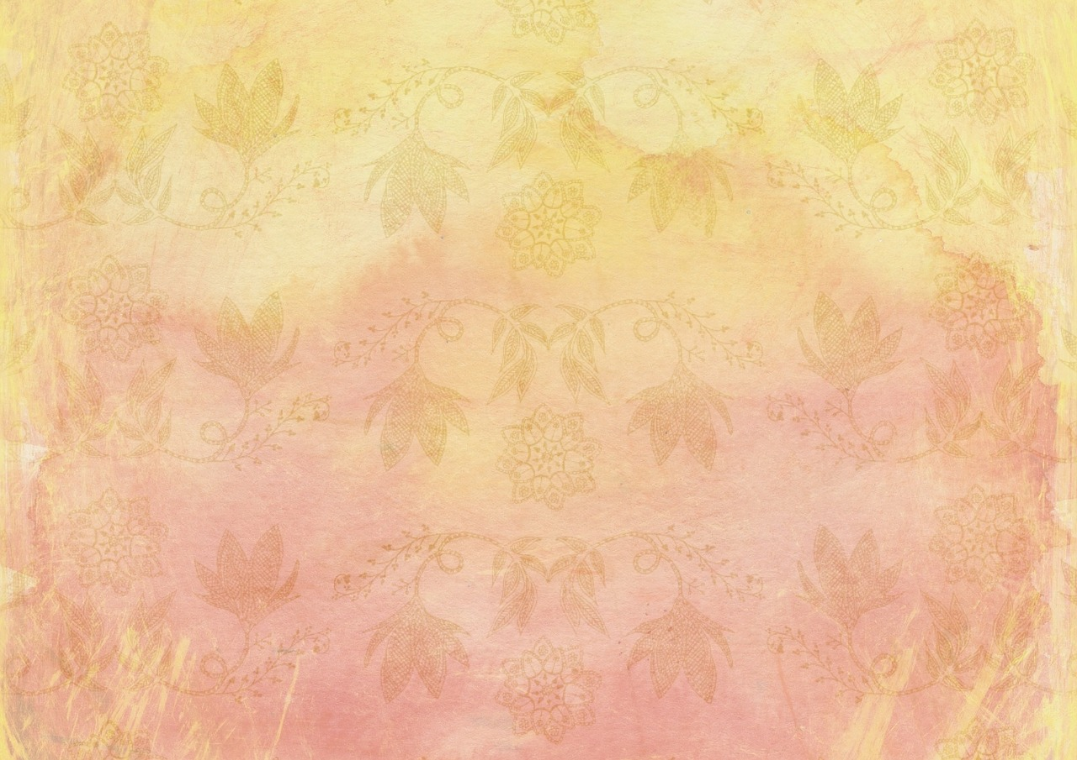
#5:
Just Because You Find Materials Online Doesn’t Mean They are Copyright-Free

Slide 20
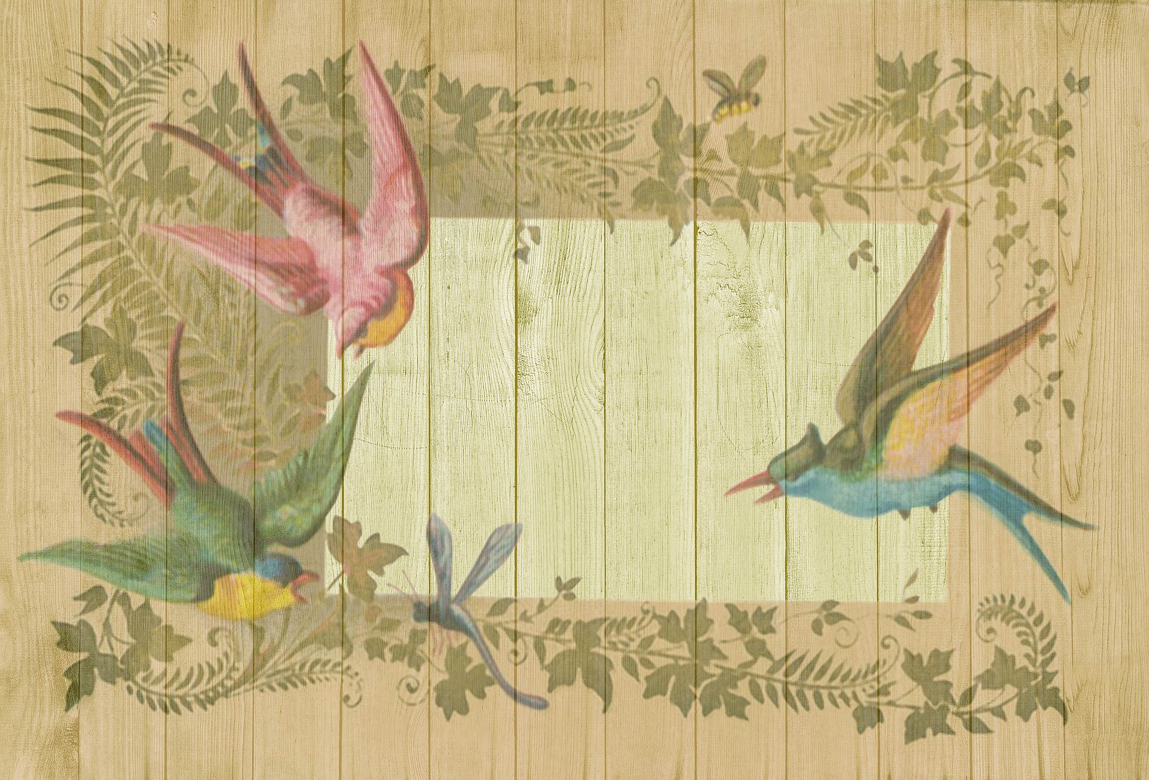
#6:
Assume Anything You Find Online is Copyrighted...

Slide 21
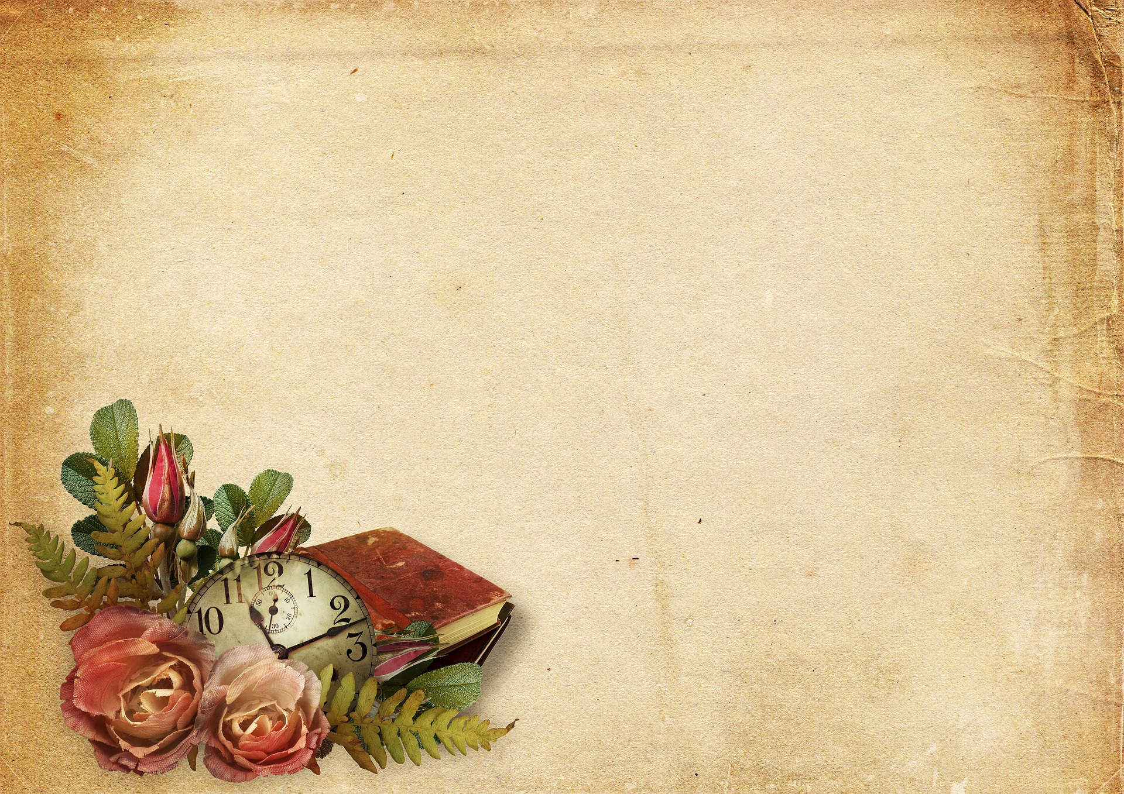
#7:
When Possible Use Public Domain & Creative Commons Licensed Images

Slide 22
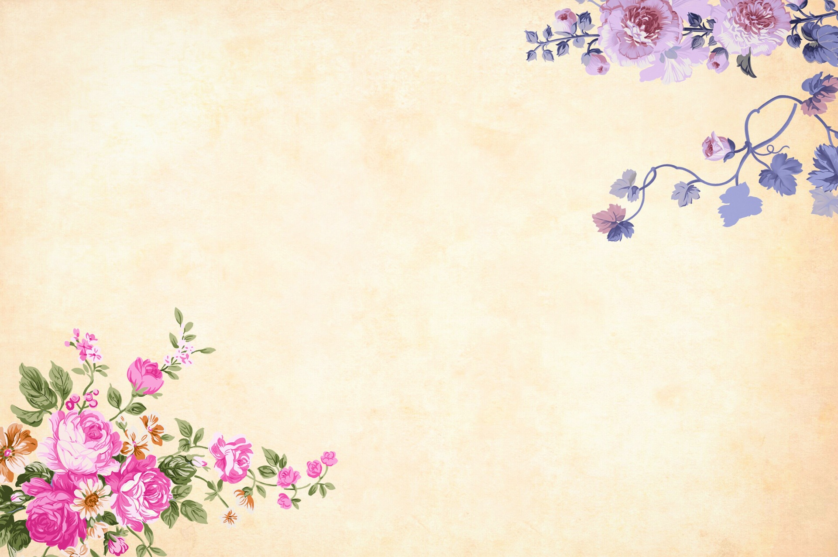
#8:
Asking Permission to Use Materials or Paying to Use them is Another Option

Slide 23
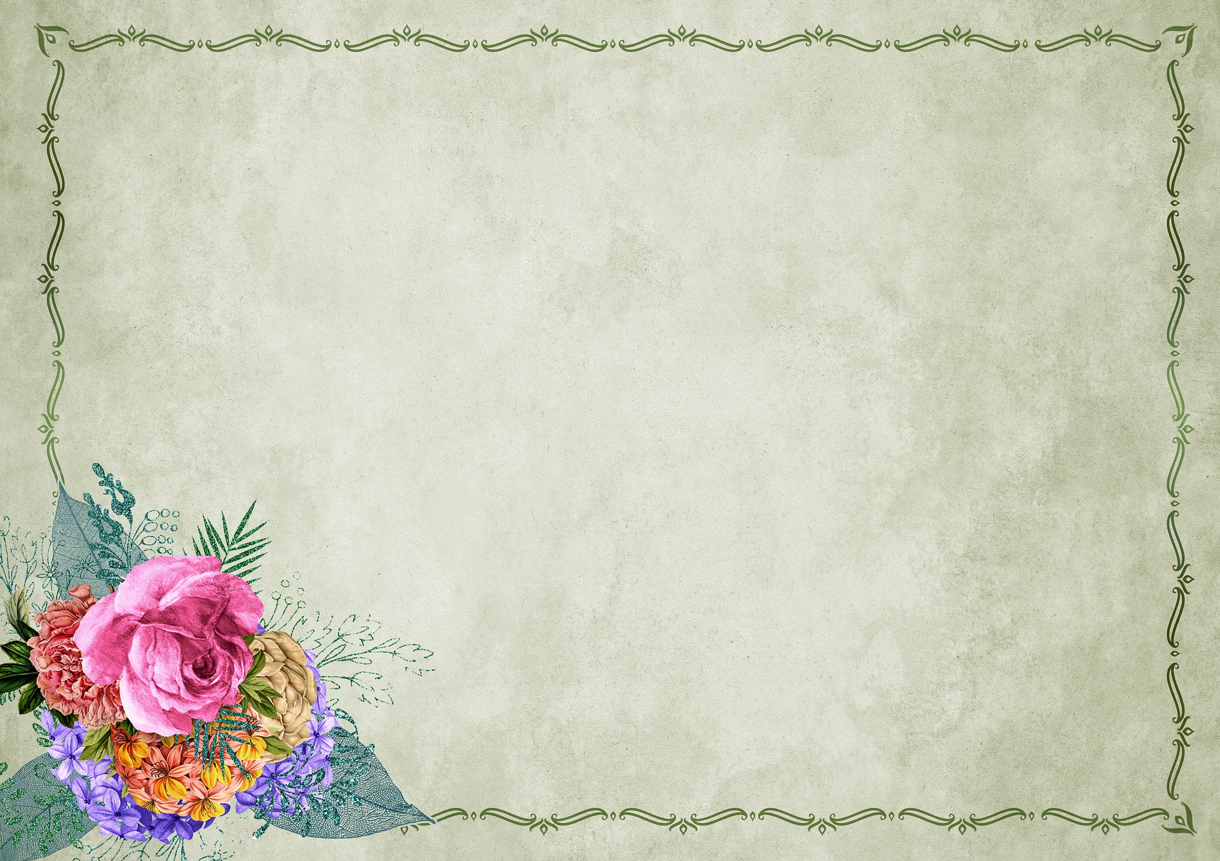
#9:
Remember, Fair Use isn’t a license to steal...

Slide 24
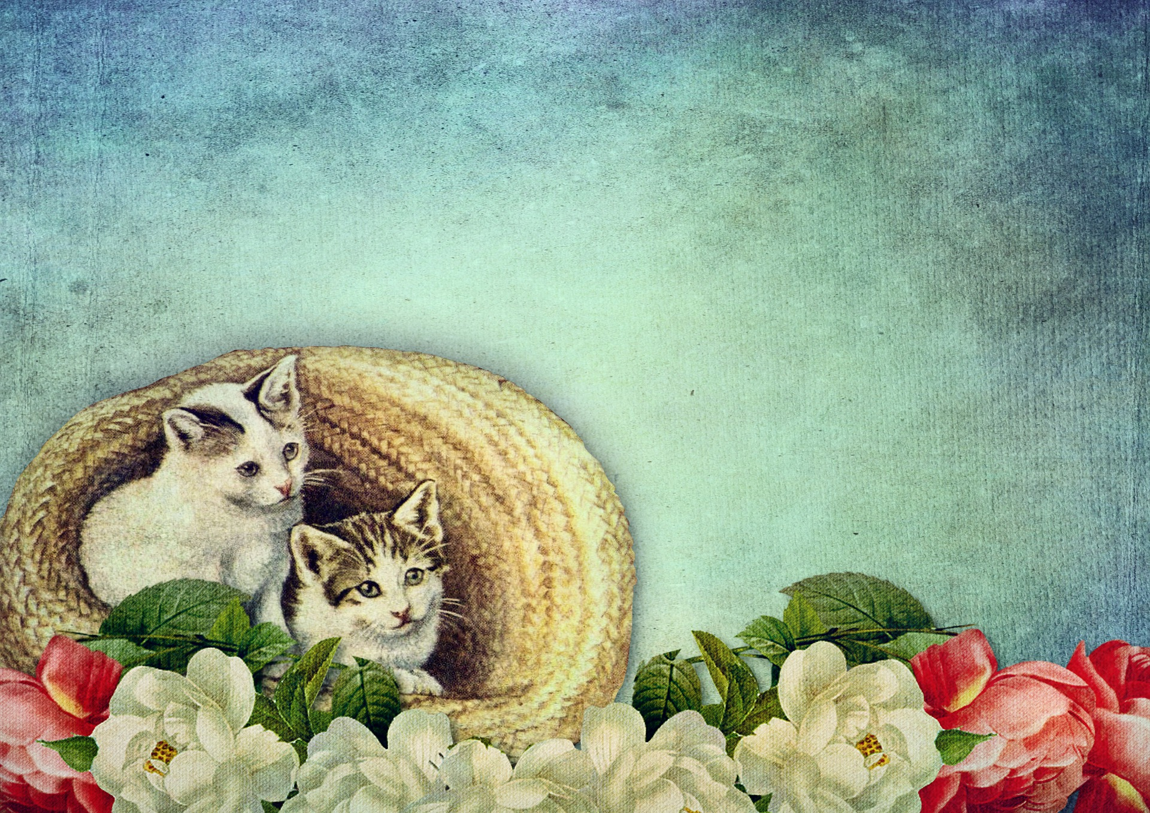
#10:
When in Doubt, Ask a Librarian...

Slide 25
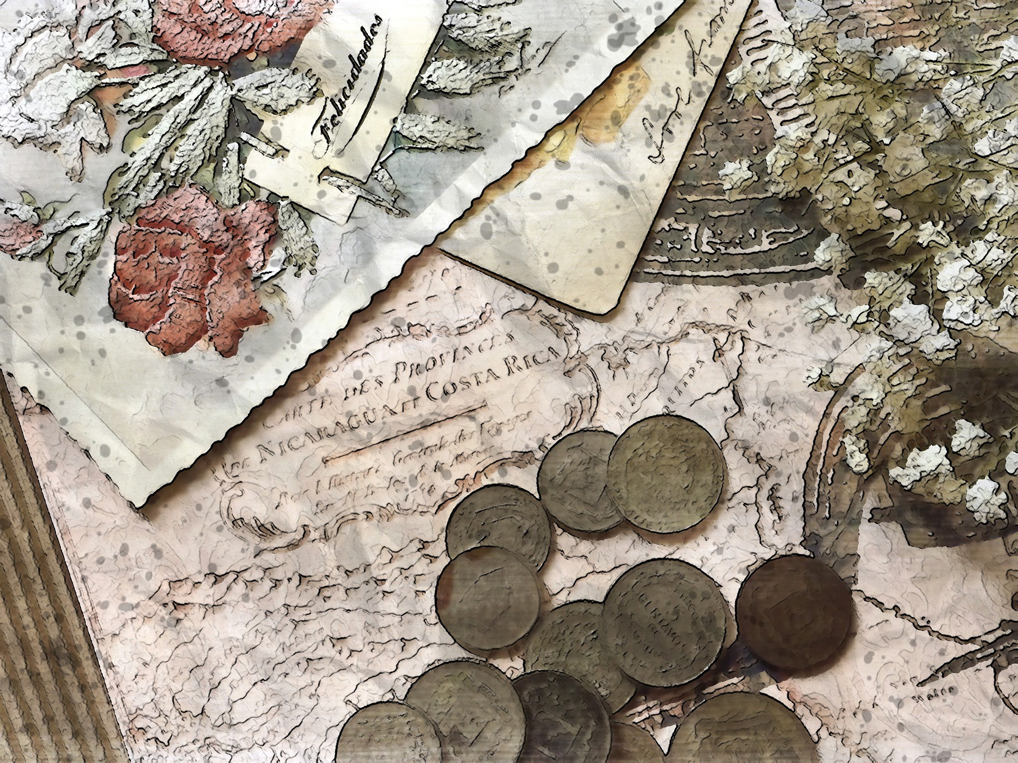
Questions?

Slide 26
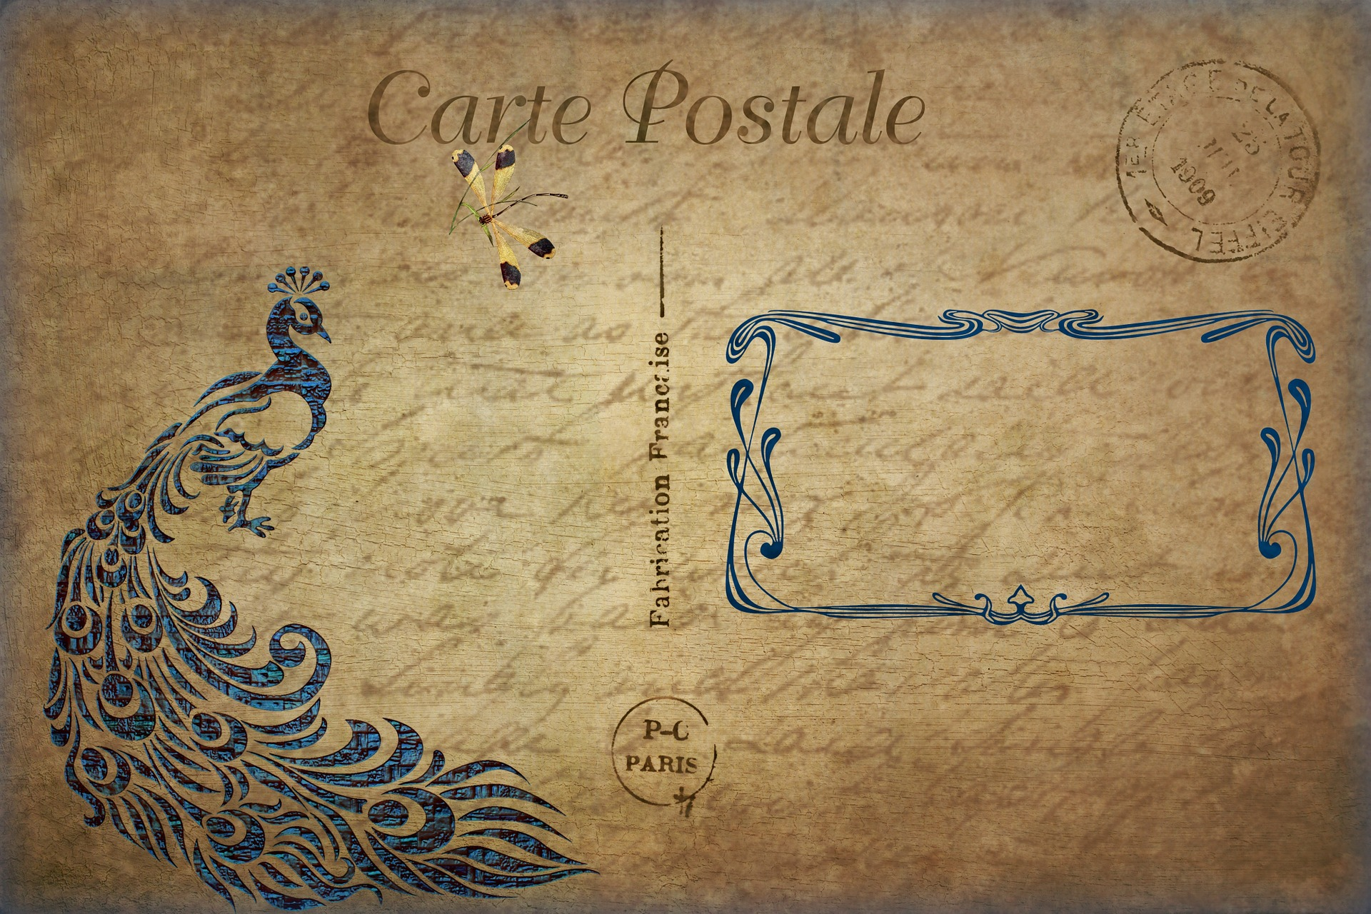
Contact Information
Sarah A. Norris Scholarly Communication Librarian UCF Libraries sarah.norris@ucf.edu
UCF Libraries Office of Scholarly Communication http://library.ucf.edu/about/departments/scholarly-communication/

