Slide 1


Entrepreneurship Programming:
Building a Network of Librarians, Students & Entrepreneurs
Rebecca “Missy” Murphey, Sandy Avila, Ven Basco, & Min Tong
University of Central Florida Libraries

Slide 2
Outline
About Entrepreneurship at UCF
Background of the Quality Enhancement Plan (QEP) project
Highlights of our Libraries Bridging the Gap between Innovation & Entrepreneurship project
How to create a similar program at your institution

Slide 3
Introduction

Slide 4
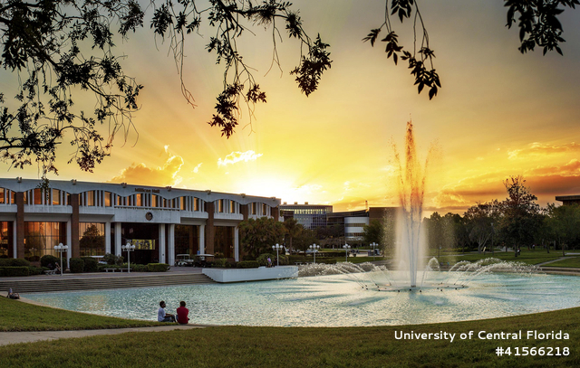
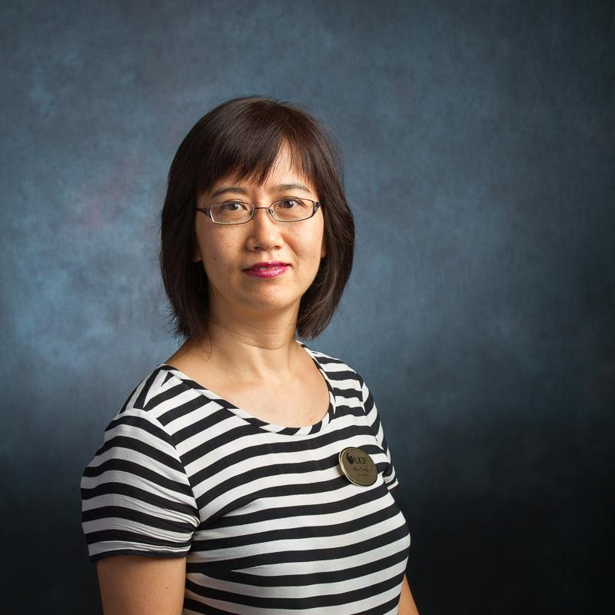

About UCF
One of 12 state public universities in FL
Located about 10 miles east of downtown Orlando
68,571 students¹
UCF has been among the top 100 universities in the world and 31st among public universities in the nation for patents for the past 5 years²
Fall 2018
https://www.ucf.edu/news/ucf-among-top-100-universities-world-patents/

Slide 5
Entrepreneurship at UCF
Student enrollment in three colleges at UCF where entrepreneurial activities take place most frequently (over 45% of the total student population)³
About 1,000 students pursue business coaching services from the UCF Blackstone LaunchPad each year
About 1,600-1,800 students per year enrolled in entrepreneurship classes
About 6,000 students attend College of Business Administration functions each year, including signature events like Starter Riot and the Joust New Venture Competition

Slide 6
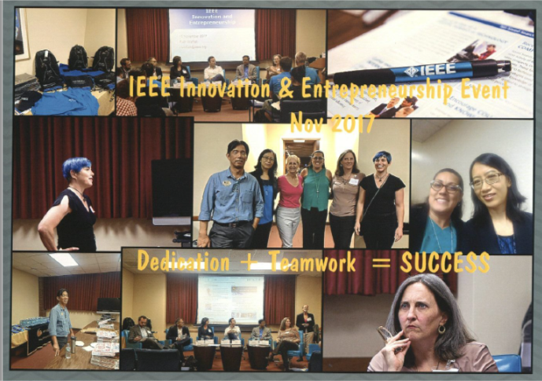
Where Did Our Project Idea Come From?
  Goals:
  Focus on patent, innovation, and entrepreneurship resources on campus
  Showcase librarians and library resources
  Build relationships with campus departments
  Value added programming (beyond traditional database training) attracts broad student audience
IEEE Innovation & Entrepreneurship Event
November 2017

Slide 7
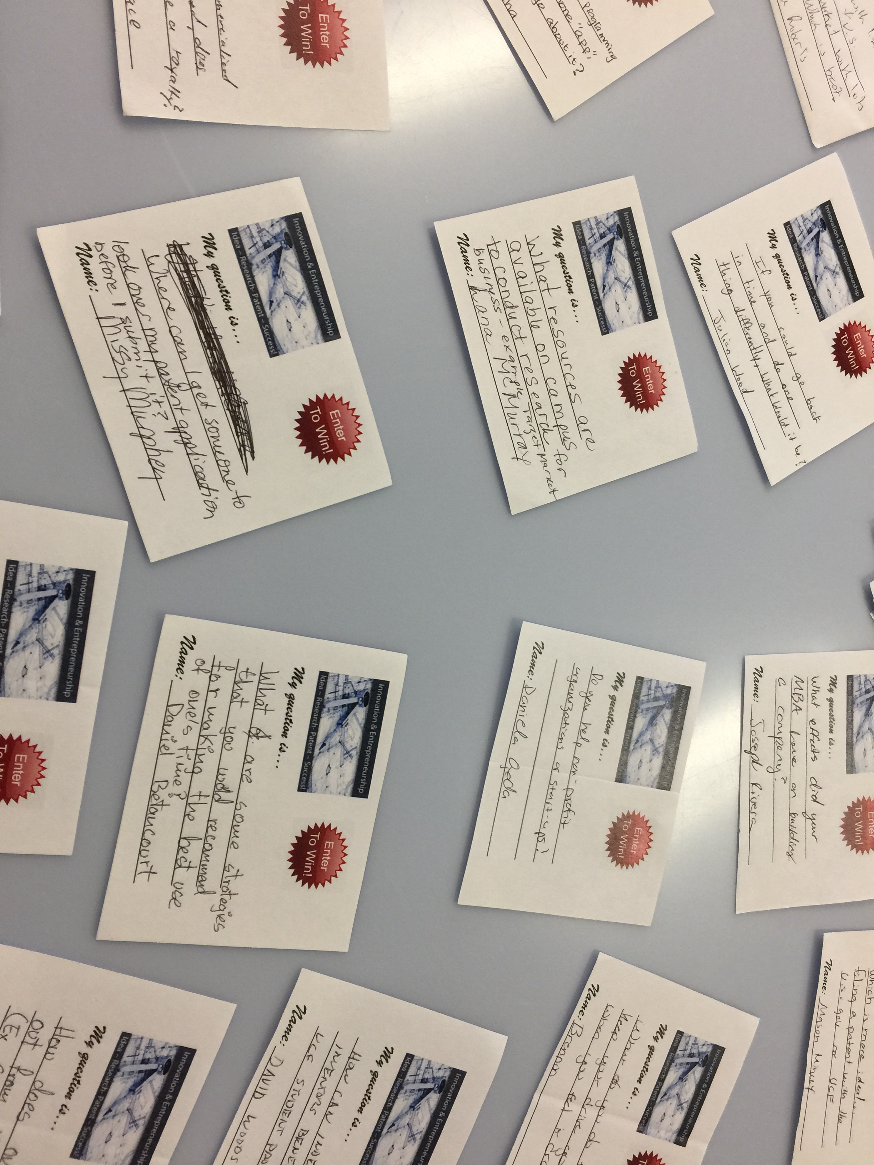
Why are These Programs Needed?
Current UCF status: Undergraduate
Topic/Area/Major: Biology
Librarian: Tong, Min
Please rate your research consultation experience: Exceeded my expectations
How did the information help you?: I can better find market/industry information and customer discovery for my business.
How did you hear about research consultations? Librarian referred me
Any additional comments: The services you provide are invaluable to us, it’s a shame the specialist librarians aren’t well known to the general students. Especially those of us in research/entrepreneurship.
So many audience questions!

Slide 8

About Our QEP Project
UCF Quality Enhancement Plan (QEP) theme – “What’s Next: Integrative Learning for Professional and Civic Preparation”
Applied for and received a $3,400 QEP grant for a proposal entitled “Libraries Bridging the Gap Between Innovation and Entrepreneurship”

Slide 9

QEP Budget Information
Wireless
BodyPack w/ headsets & lavalieres
$450
Part-time librarian to cover
Ref desk for team member
$1,728
Alumni speaker Thank-you gift
$180
Program Materials (flyers printing, name tags, etc.)
$500
Refreshments
Travel
$600
Total: $3,458.00

Slide 10
Preparation

Slide 11
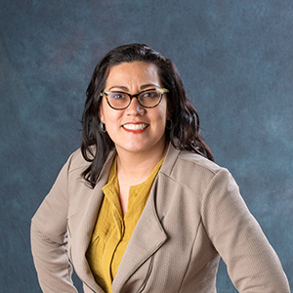
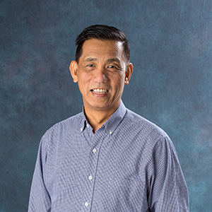
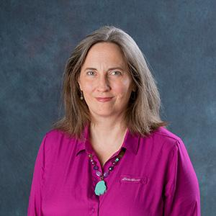
Meet the QEP Project Team
Sandy Avila
Science Librarian
Min Tong
Business Librarian
(Project Lead)
Ven Basco
Engineering & Computer Science Librarian
Rebecca “Missy” Murphey
Patent & Trademark Resource Center Librarian

Slide 12
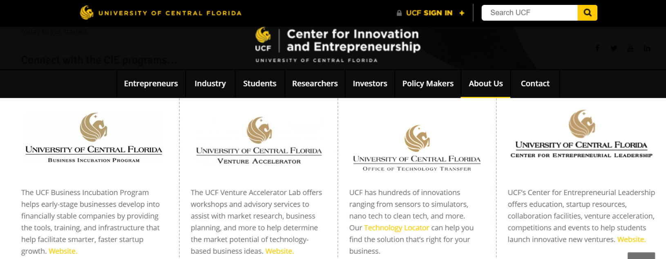
The Full Network of Resources

Slide 13






Slide 14
Locating the Right People for the Job
Combing through institution’s resources- grant announcements, department websites, partner websites
UCF Today news articles
Other local news outlets highlighting UCF alumni
Contact faculty—use your connections
Consider friends, students & faculty who have attended/graduated from UCF
Get in touch with program partners and ask for suggestions

Slide 15

Our Workshop Schedule
The project is intended to…
Make the library the bridge or connection for those disconnected resources on and beyond campus
Provide 4 seminars to showcase and spur innovation and entrepreneurial spirit in the community
Create an opportunity for like-minded entrepreneurial students from different disciplines to meet for mutually beneficial experiences and interactions

Slide 16
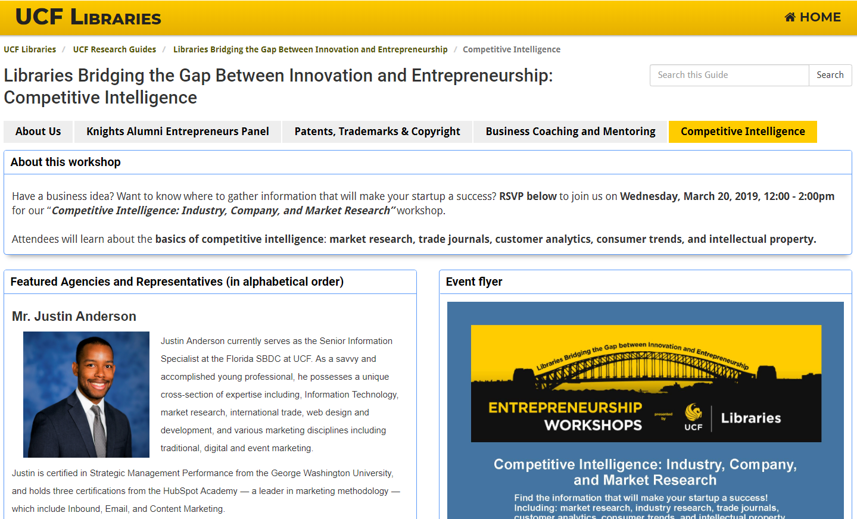
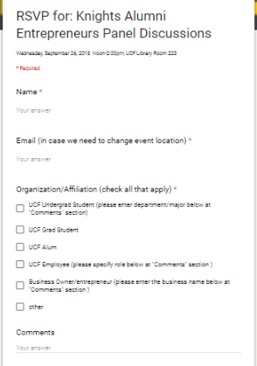
Our LibGuide & Online Registration Form guides.ucf.edu/entrepreneur

Slide 17
Planning

Slide 18
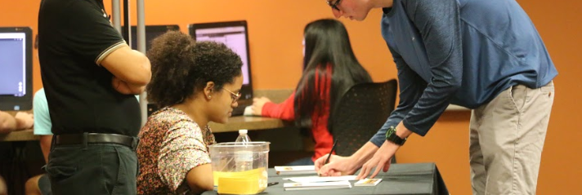
Registration Table
Pens
Sign in sheet
Programs (include evals and future event announcement)
Slips/forms for students to receive credit in classes
Name badges for networking afterwards
Vendor/speaker swag
Notes:
Print out the list of attendees from the registration software (it’s possible from LibWizard, Google Forms, and Qualtrics) for signing in
Our programs included a bookmark stating the name of each program with the date and time, and an evaluation form – have the person working the table place the program in the student’s hand, it is the first of many reminders that getting their opinion on the survey is important to us.
Have slips or forms for extra credit available
Having “My Name Is…” stickers is an excellent idea for students who will stay around after the presentation to network with each other
If you have a small amount of printed material from speakers, it can go on this table

Slide 19
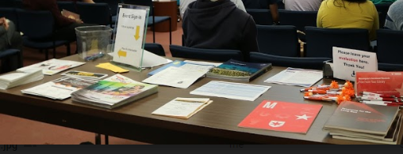
If there are numerous handouts, like we had for our Competitive Intelligence program, set up a 2nd Information Table
Notes:
Otherwise, set up a second table inside the venue for people to grab what they want

Slide 20
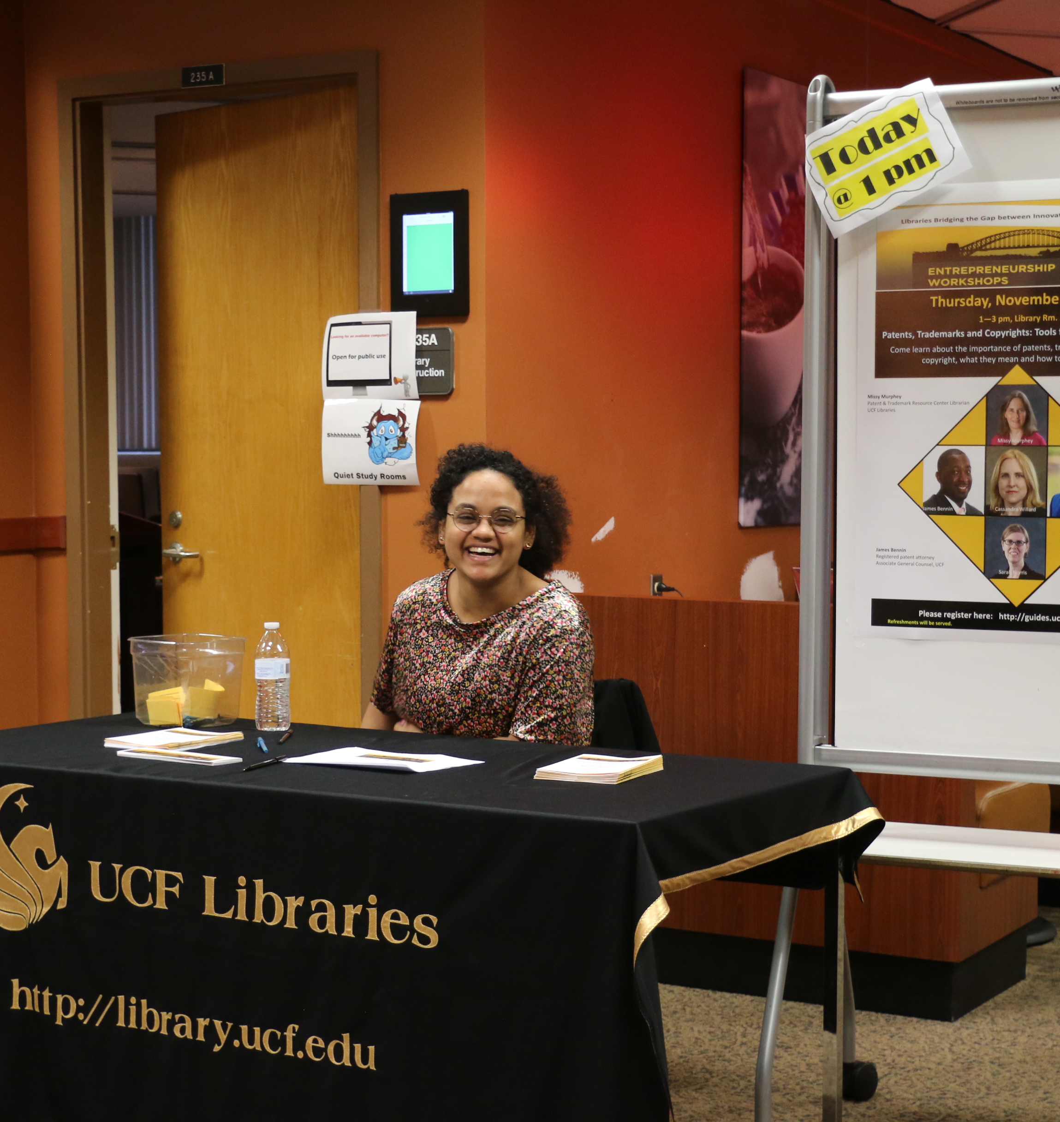
Student assistants can help at the registration desk, in addition to…
Meeting guest speakers at the parking lot to walk them over
Food/drink setup or directing caterer
Collecting attendee evaluations
Fetching pens, programs, waters, anything needed to help things run smoothly

Slide 21
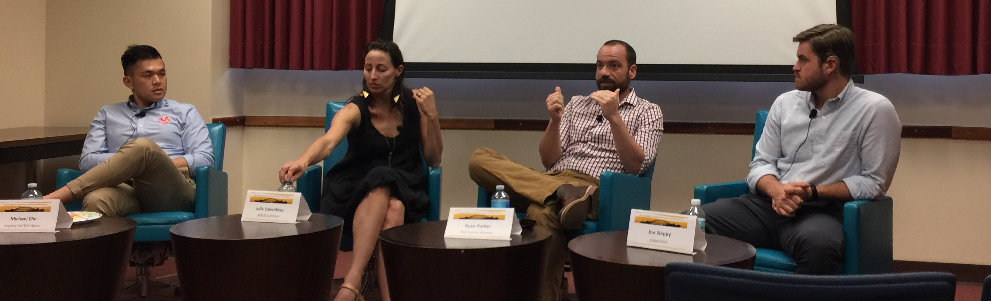
Care of
Guest Speakers
Send parking pass and campus map with driving route, plus parking and walking directions to venue
Have speakers arrive early for sound check, photos, load slides, to review itinerary and possible questions
Table tent and water bottle at each speaker chair
Everyone will say they do not need a mic; insist EVERYONE be mic’d for accessibility purposes
Notes:
Once you secure your speakers, don’t let them out of your sight! The week before the event, send them driving AND parking AND walking directions to the library.
In addition to sending the maps, let them know whether you will introduce them or if they are expected to introduce themselves. Also, include any canned questions you plan to have ready, and ask if there are any they particularly would like to have asked of them. They may ask NOT to field particular questions, and it’s good to know this in advance.
Have them arrive early to load slides, meet each other, have photos and sound check, and review the itinerary.
Have a table tent and water bottle for each
Make sure they use their mics! The guests for our first panel were agreeable to it, but most of our others insisted they did not need them. Sure enough, we received comments that speakers couldn’t be heard. INSIST that using a mic is an accessibility issue and is EXPECTED, not REQUESTED.

Slide 22
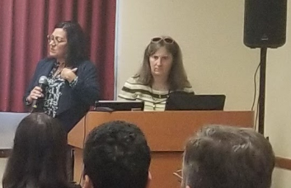
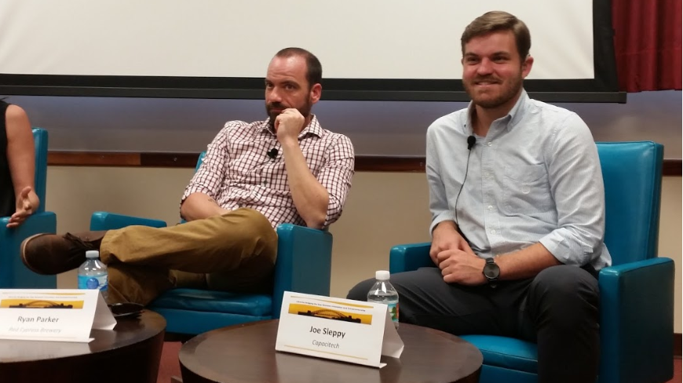
Facilitating the Program
At event start, make announcements (phone on silent, where to drop evaluations, recognize sponsors, introduce librarians & next program)
Moderator controls flow of program
Have someone else handle sound, slide deck, and recording
Before the event, set an agenda with the amount of time each speaker is allowed. Be firm on this.
Have canned questions on hand
Notes:
Have a moderator. If one of you is a panelist, it may seem a good idea to have that person moderate as well; however, it is awkward to try and reign in control once you’ve established yourself as a co-presenter.
First few times, have a second person run the slides and sound, especially if you are casting or recording.
Announcements such as locations of bathrooms and fire exits, set phones to silent, refreshments at back, etc., get students into the right mindset.
If you have PRESENTERS: keep one from running away with the show by sending the agenda beforehand and printing it in the program, implement time caps on each, and point out the person in the room watching the time who will give them nonverbal cues
If you have PANELISTS: Having prepared questions does 2 things: First, you’ll be able to fill awkward silences if they occur. Second, if one panelist keeps getting ALL the questions, it’s a way to turn the discussion towards the strengths of your other guests.

Slide 23
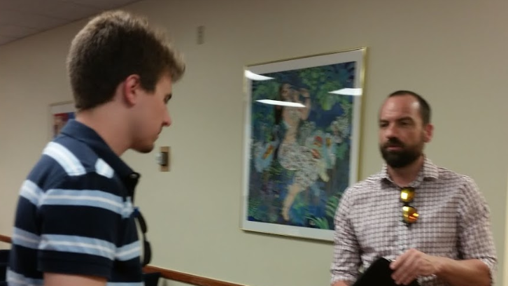
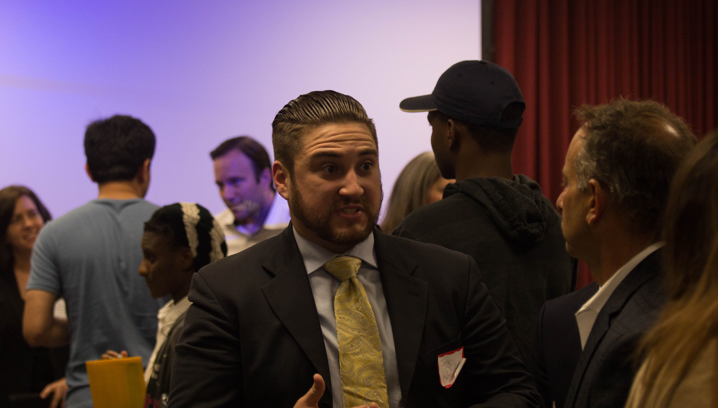
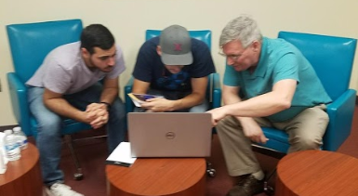
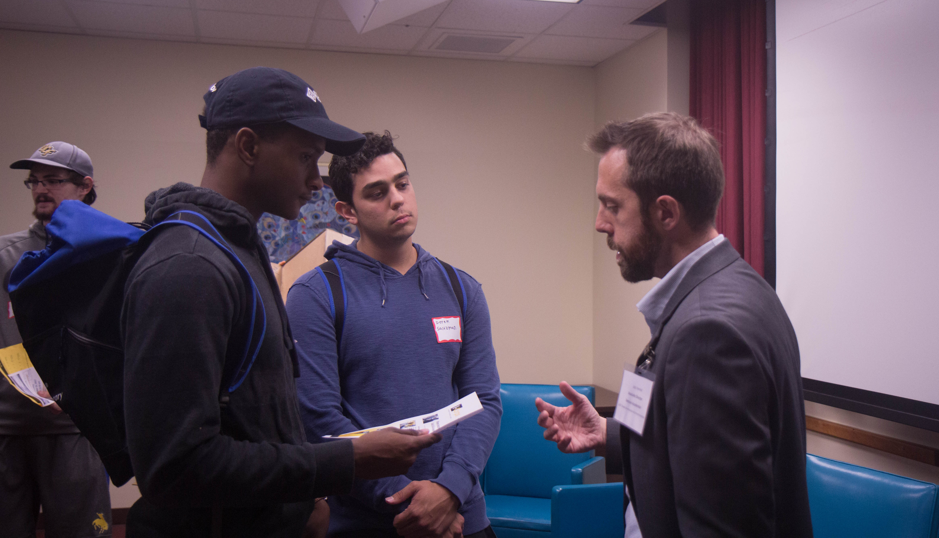
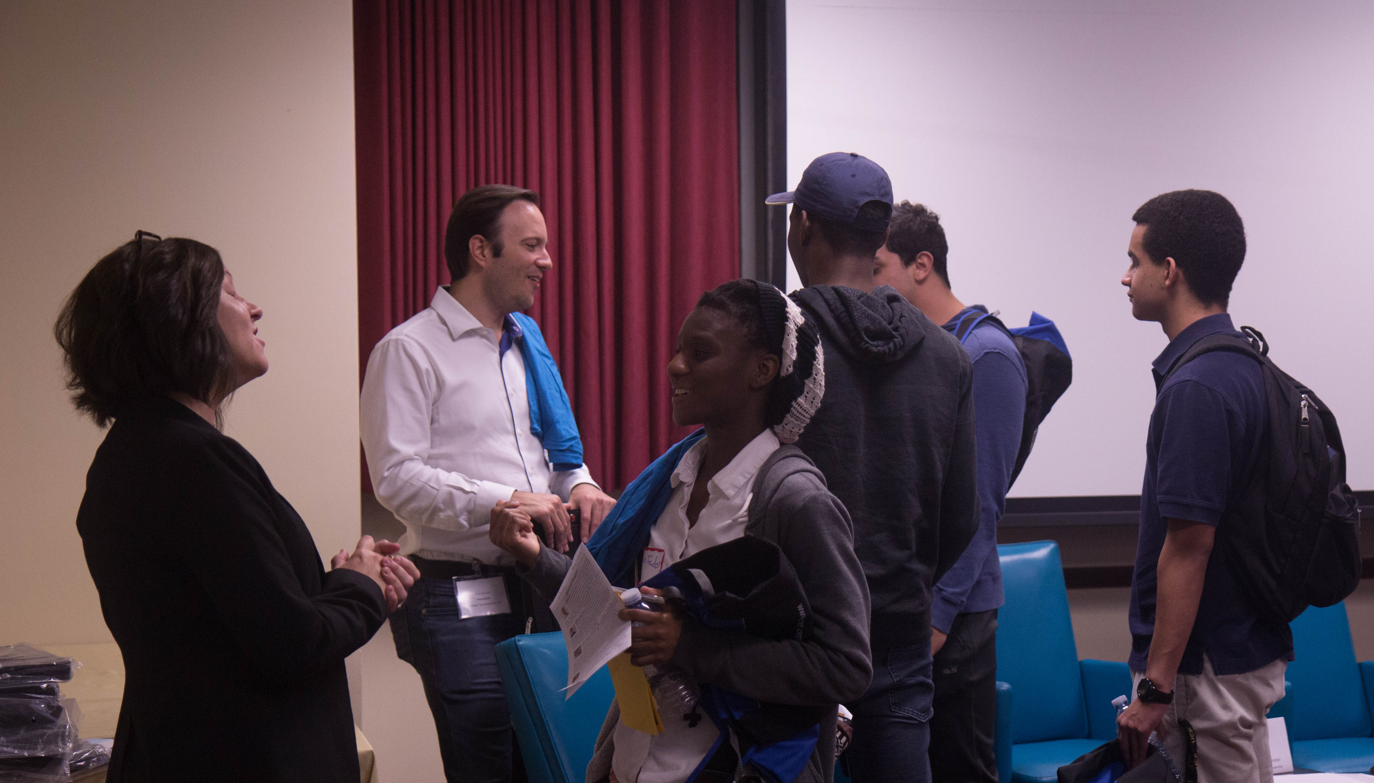
Allow LOTS of time afterwards for networking; this is where the most impactful interactions take place
Notes:
Schedule the room for plenty of time for attendees to network with speakers and other students with similar interests.
This is also an excellent opportunity for students to meet their subject librarian, or others who can help them with their business research

Slide 24
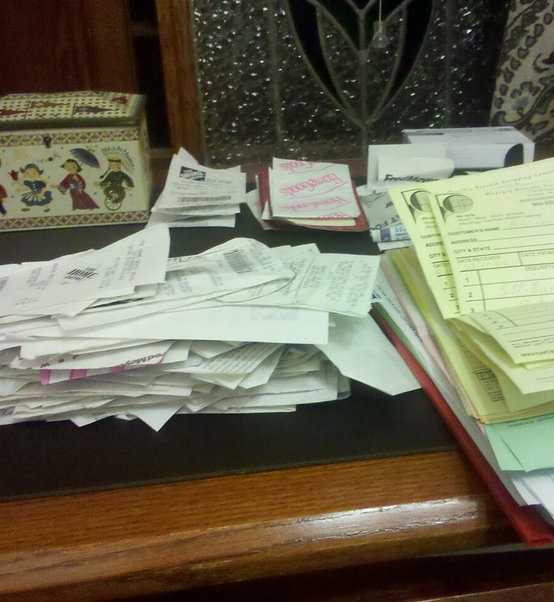
Post Event
Hold an IMMEDIATE debriefing to help future planning
Upload photos to shared drive and
Post pics to social media to brag about your success
Transcribe evaluations into spreadsheet
Send thank-you notes to panelists
Set aside one of each item for promotion folders
Have ALL receipts gone to budget officer?
Notes:
IMMEDIATELY after the event is the time to send speakers thank you notes and discuss what went well (or went wrong so you can pivot)
GET THOSE PHOTOS off your phone and into the shared drive, also share with Social Media.
Get the handwritten evaluations typed into a spreadsheet
Save one copy of everything for each librarian
Gather all receipts to give to your budget officer

Slide 25
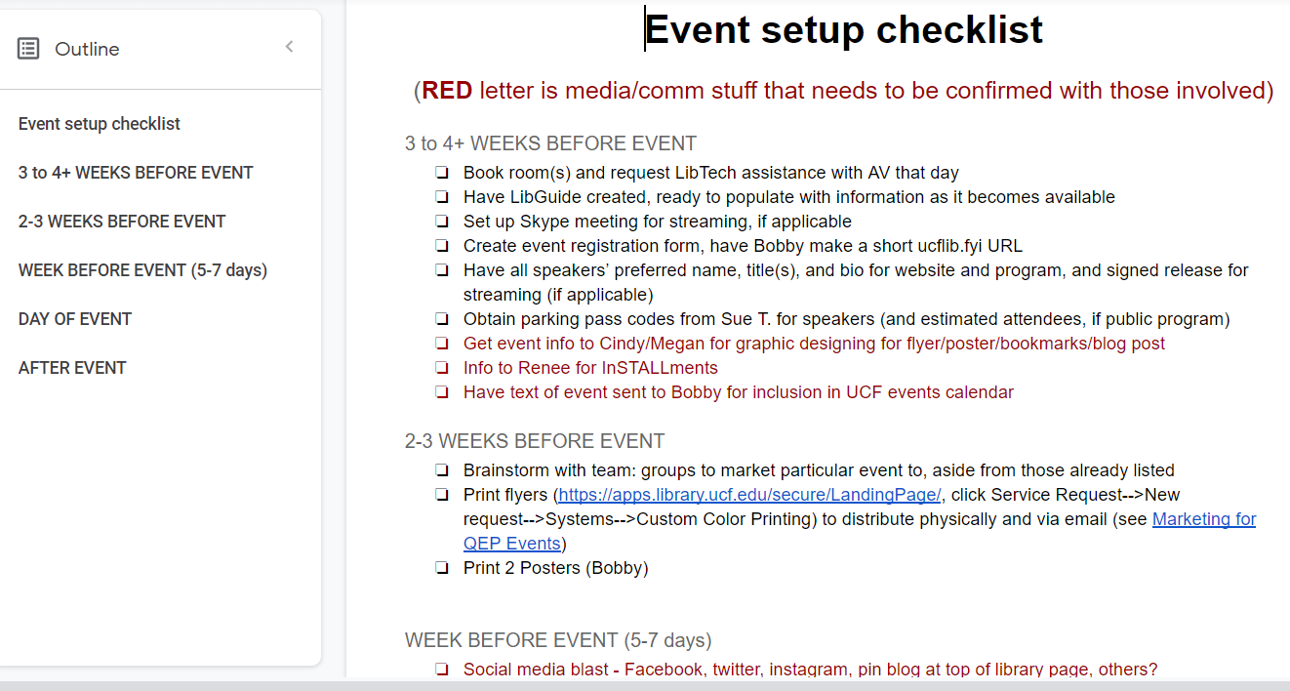
How to Keep Track of it All
Notes:
After the first program we realized the complexity in delegating tasks between four people and remembering who is in charge of what.
This started out as my detailed speaker/moderator notes, then a checklist for us to sign up for who would do what on event day. Over time—by looking at the lead time required for each task and working backwards—it has developed into a workflow for planning and executing events from start to finish.

Slide 26
Marketing/Promotion

Slide 27


Bookmarks

Slide 28
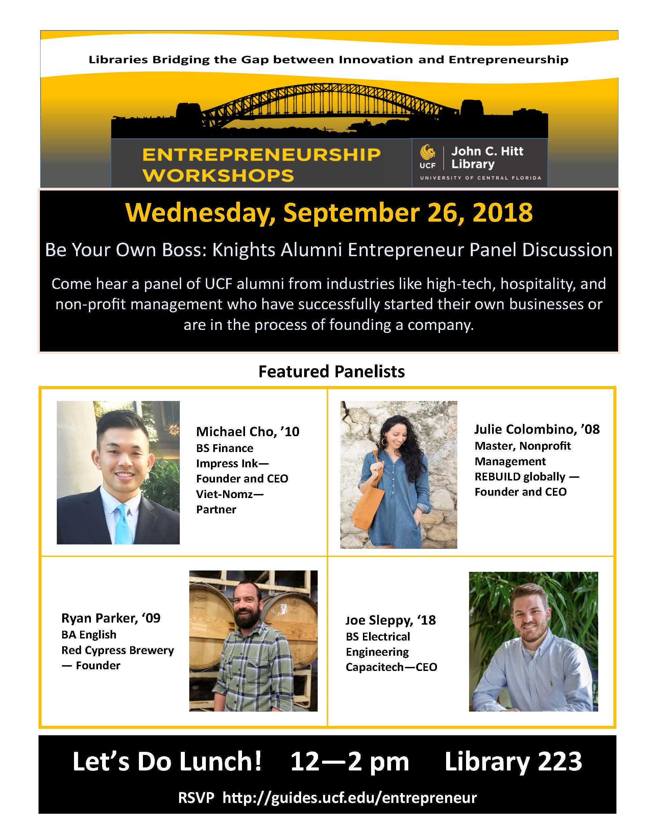
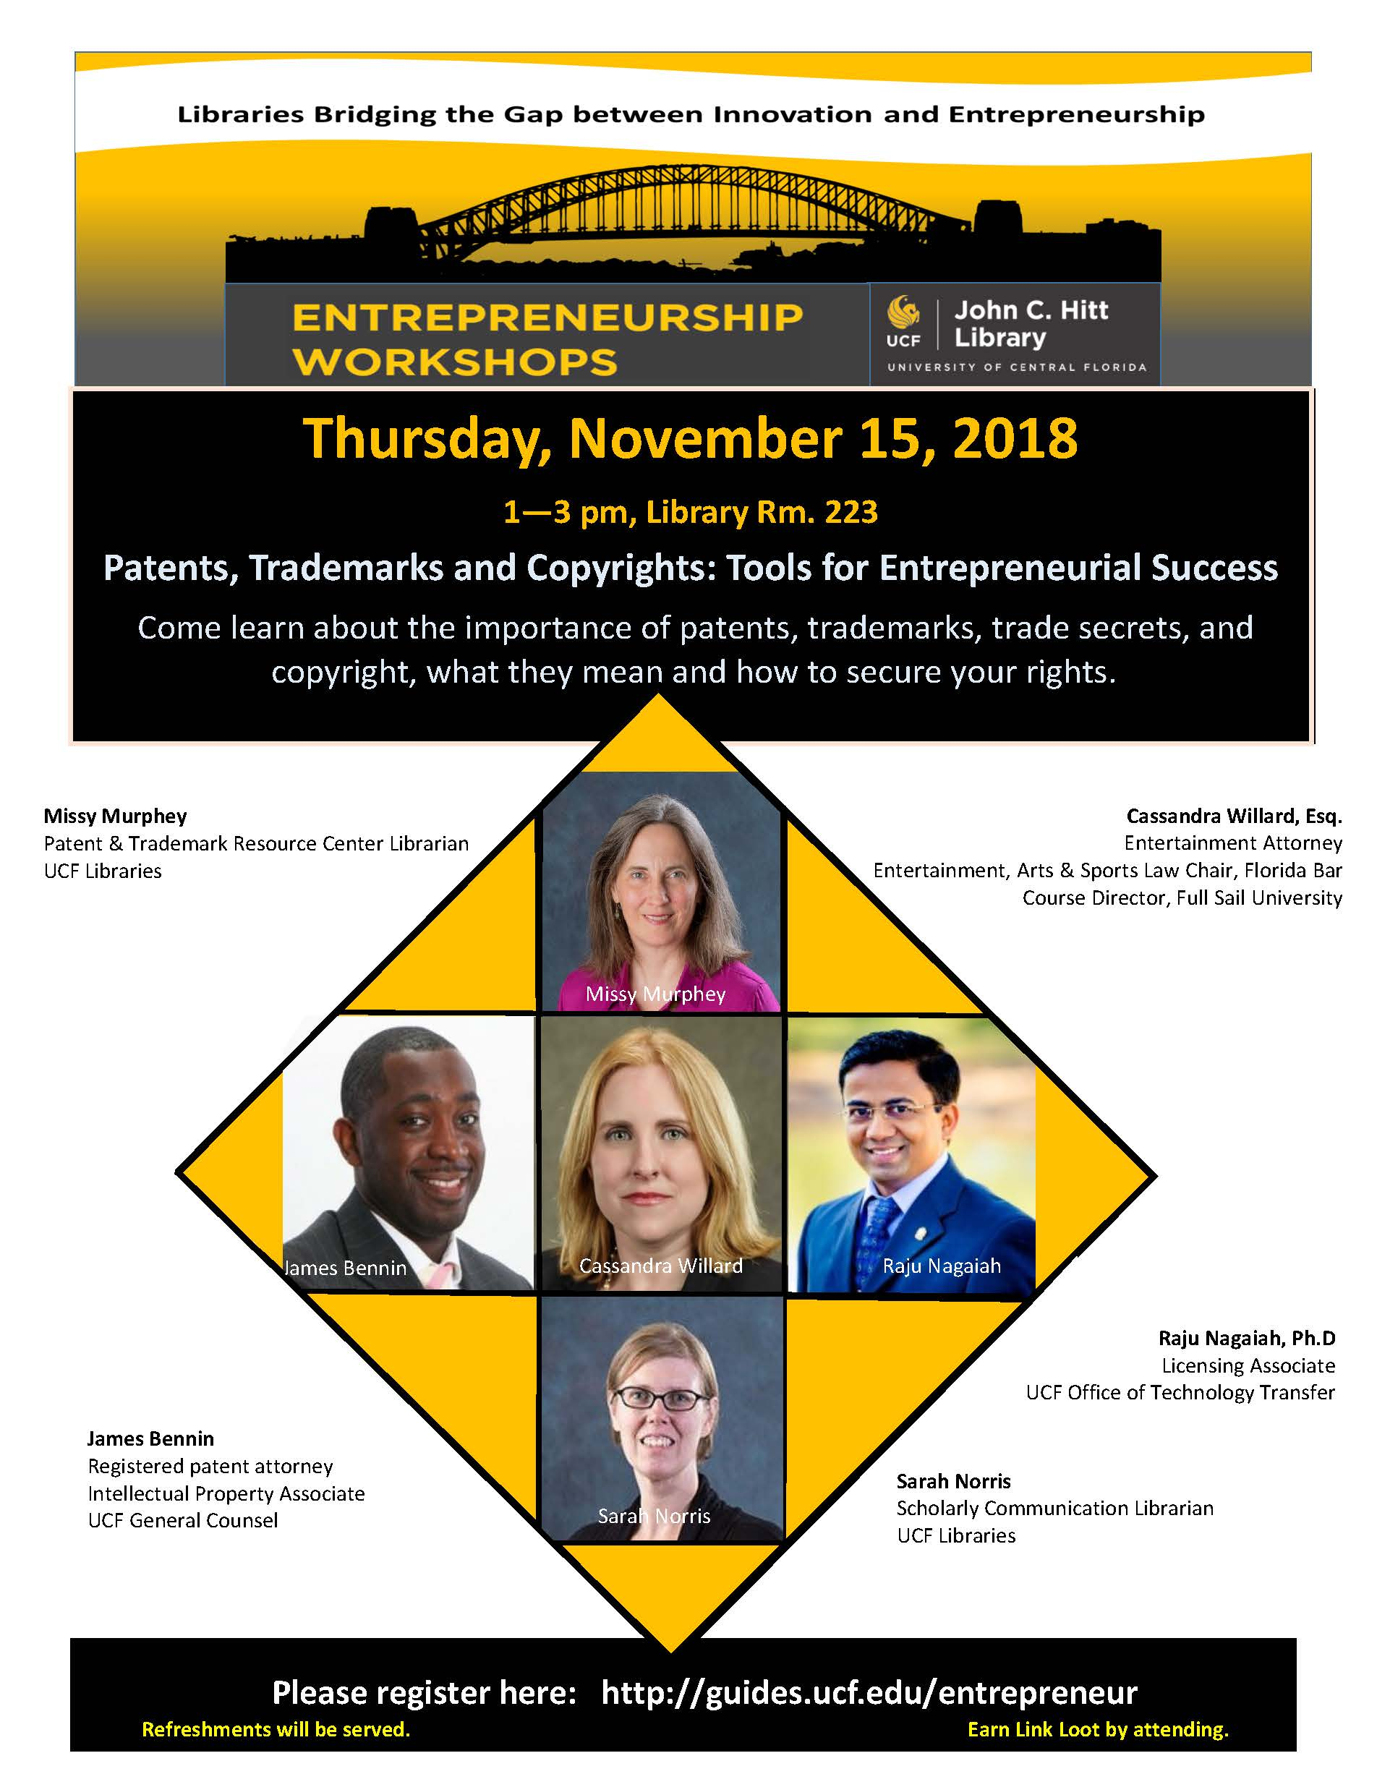
Flyers

Slide 29
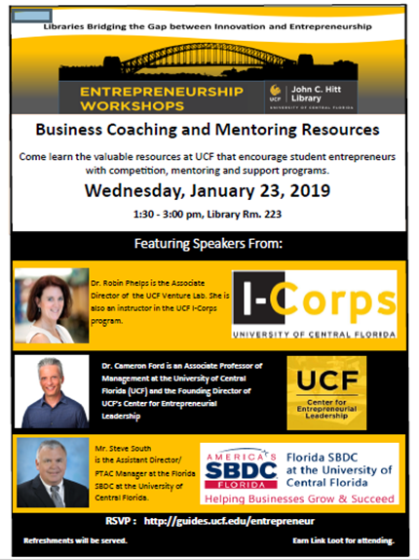
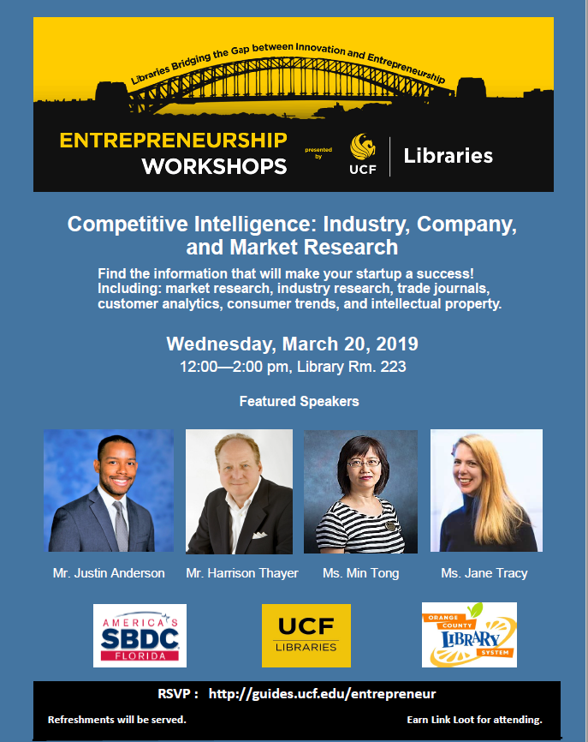
Flyers

Slide 30

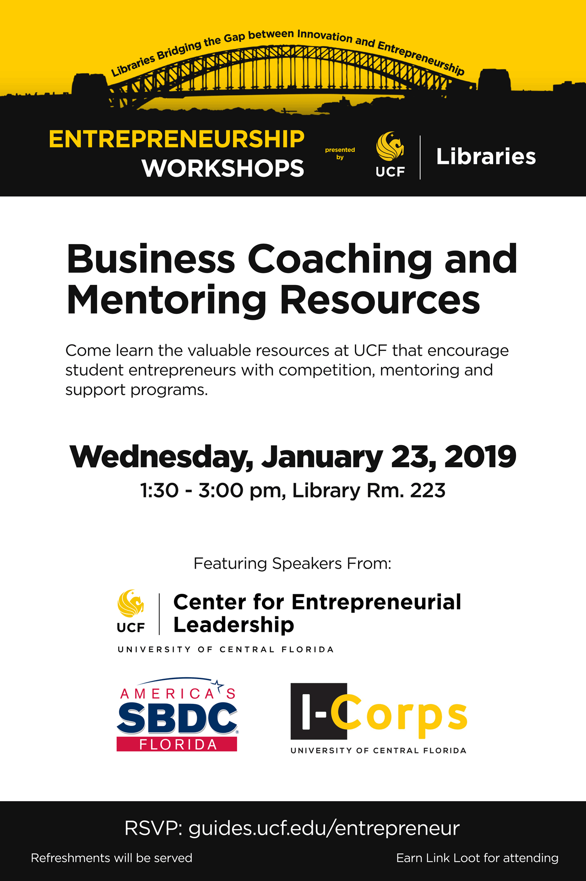
Posters

Slide 31
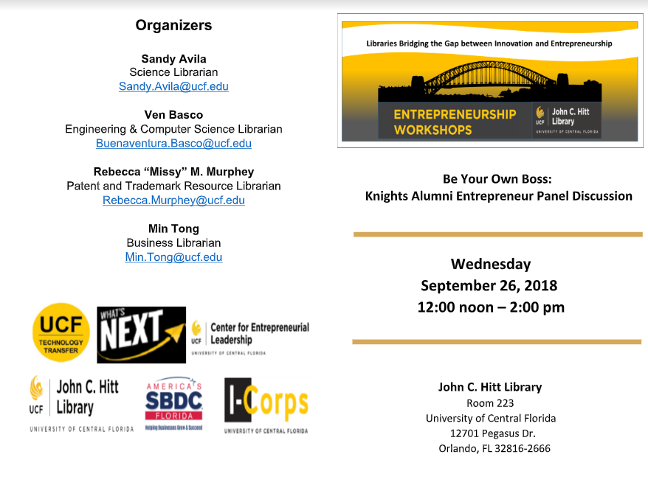
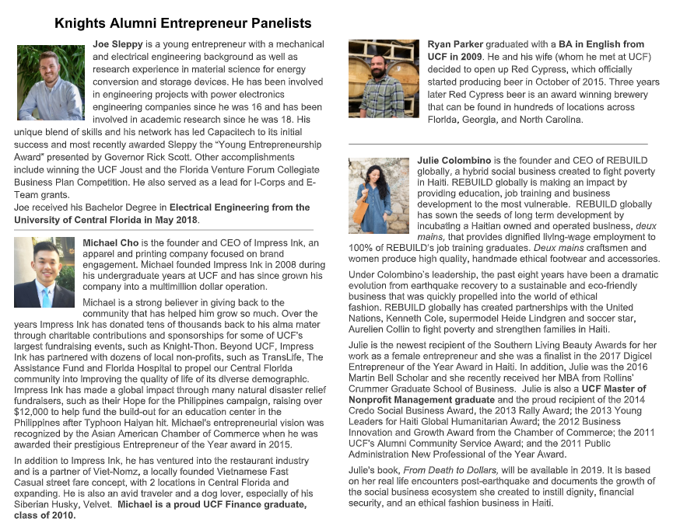
Printed Programs

Slide 32
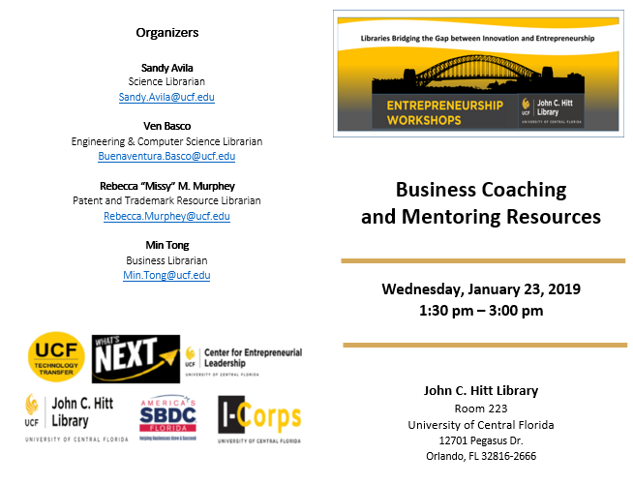
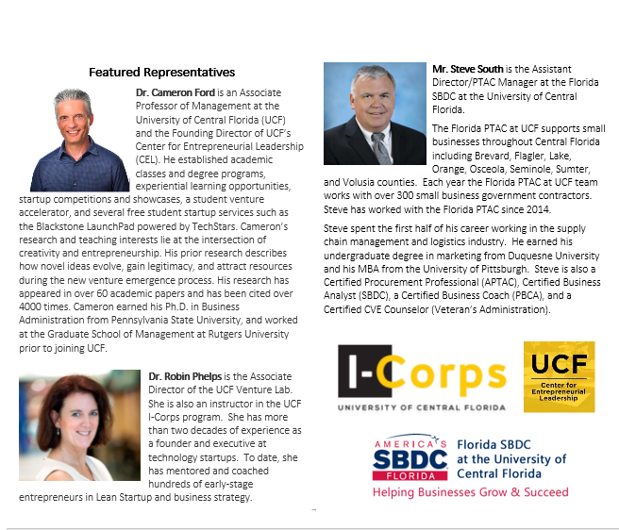
Printed Programs

Slide 33

Using Social Media &
Other Marketing Strategies
Facebook – Library, Student Organizations
Twitter/Blogs
LibGuides
Digital Signage
Bulletin Boards – Campus Buildings (Business, Engineering, etc.)
Emails – Faculty Distribution (by College, Department or Faculty)
Student Tables, Waiting Areas, Reference Desk, Library Instruction Rooms

Slide 34
Attendance Incentives
Link Loot
Prizes at events typically include TVs, Xboxes, movies, video games, digital cameras, theme park tickets, scholarships, etc.
Credit for Gen Ed Business Classes
Refreshments
Subs, cookies, snacks, soda, water.
Business courses requiring extracurricular event attendance

Slide 35
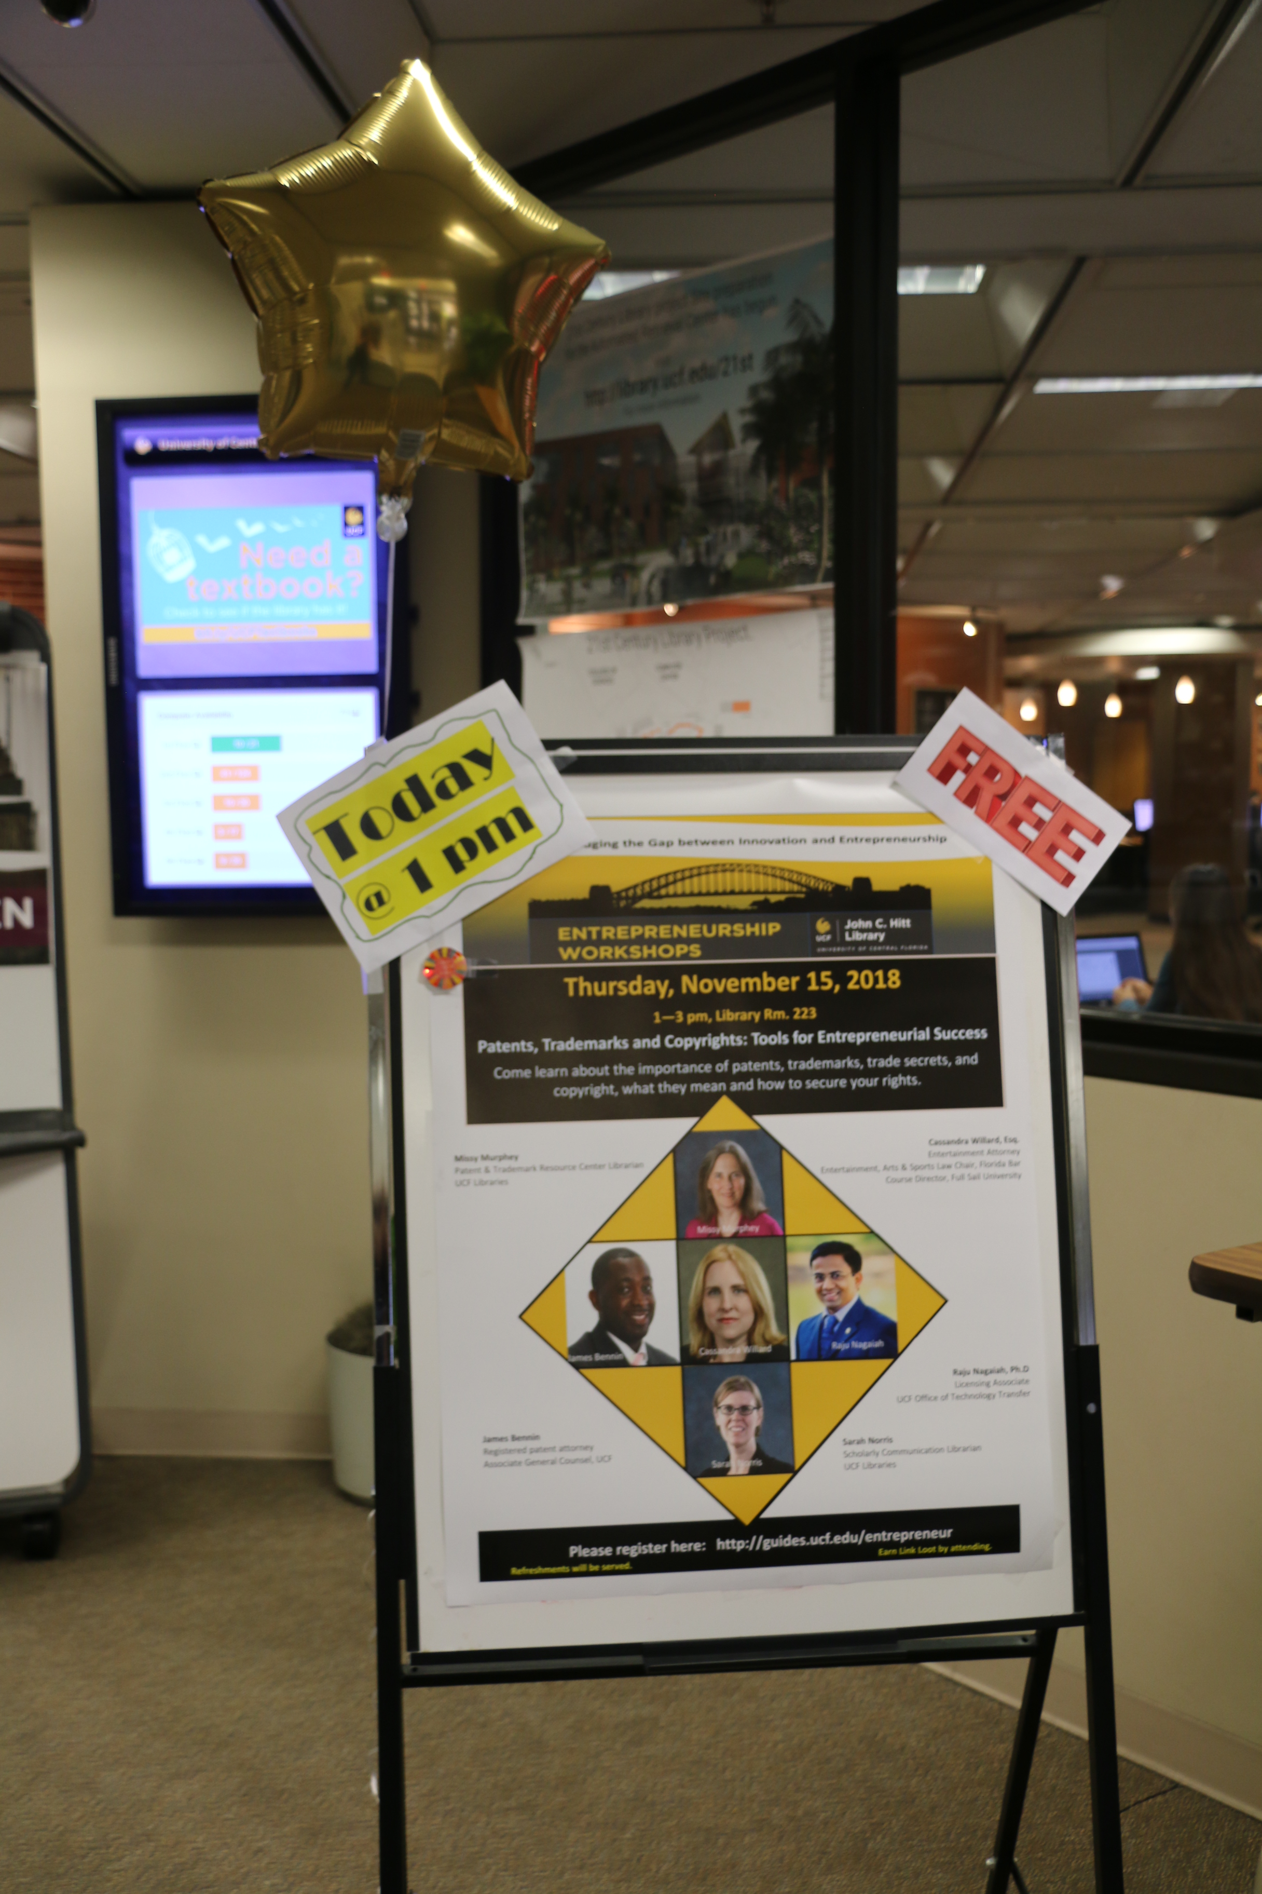
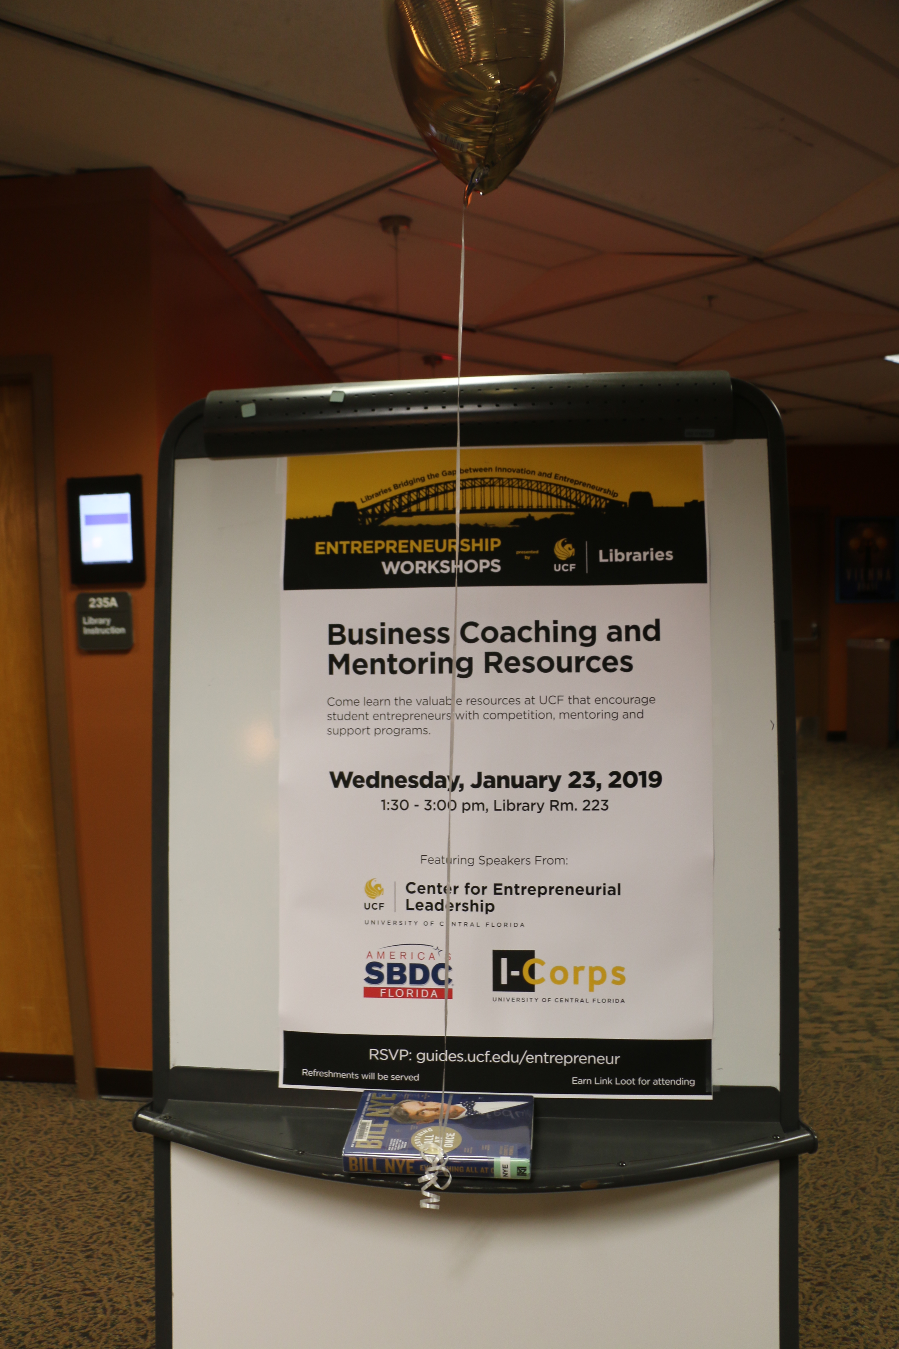
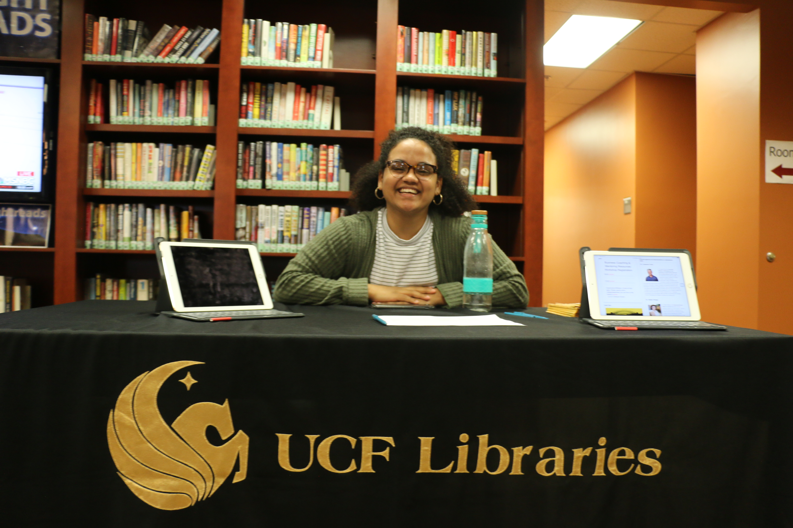
Day of Event – Signs/Sign In Table

Slide 36
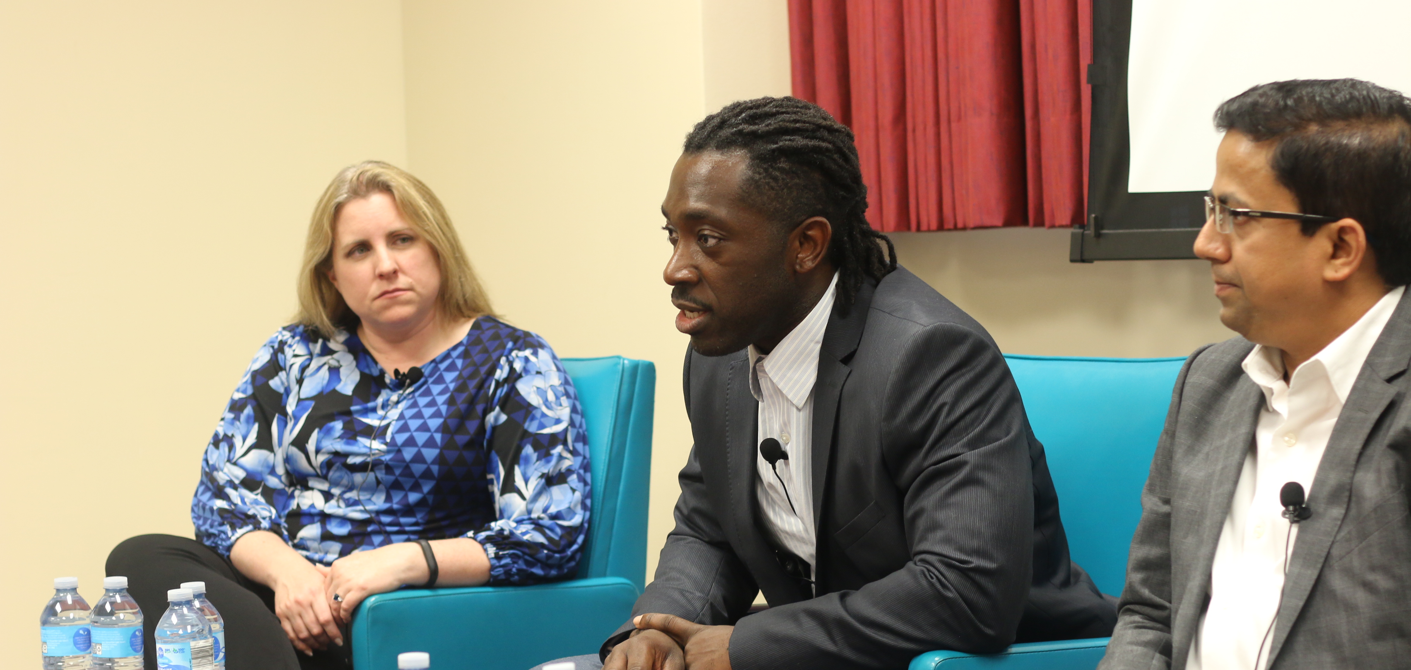
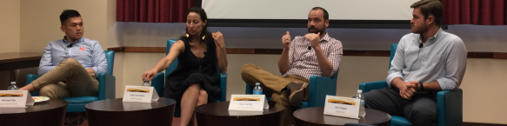
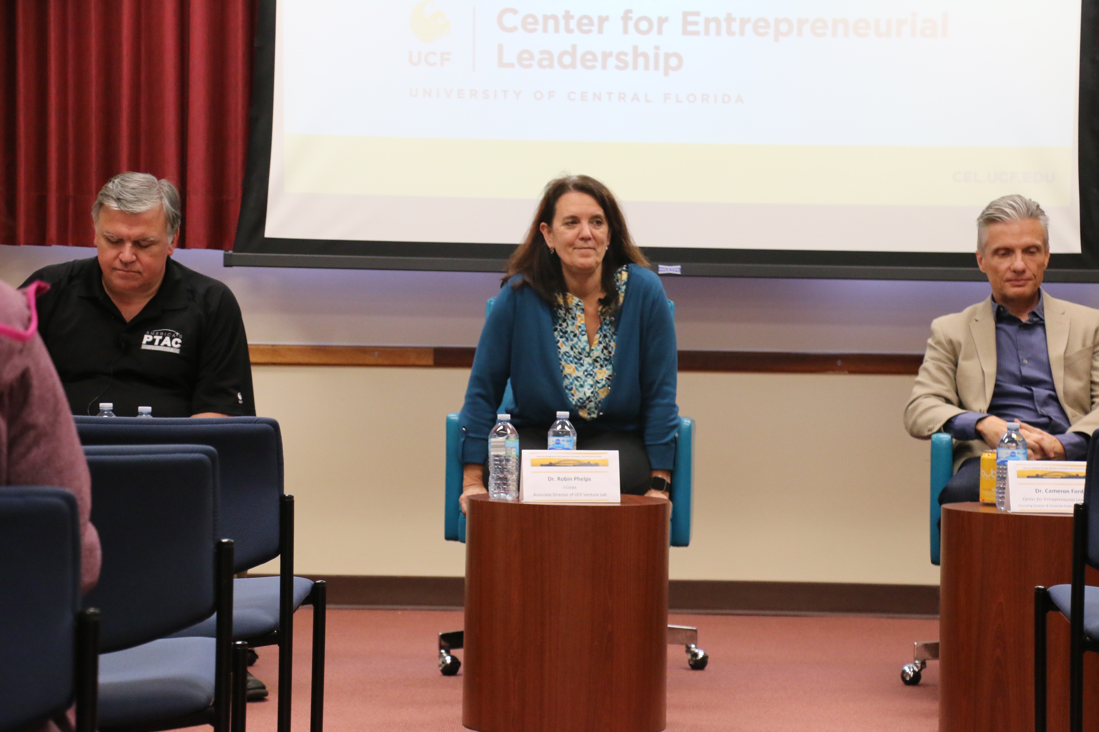
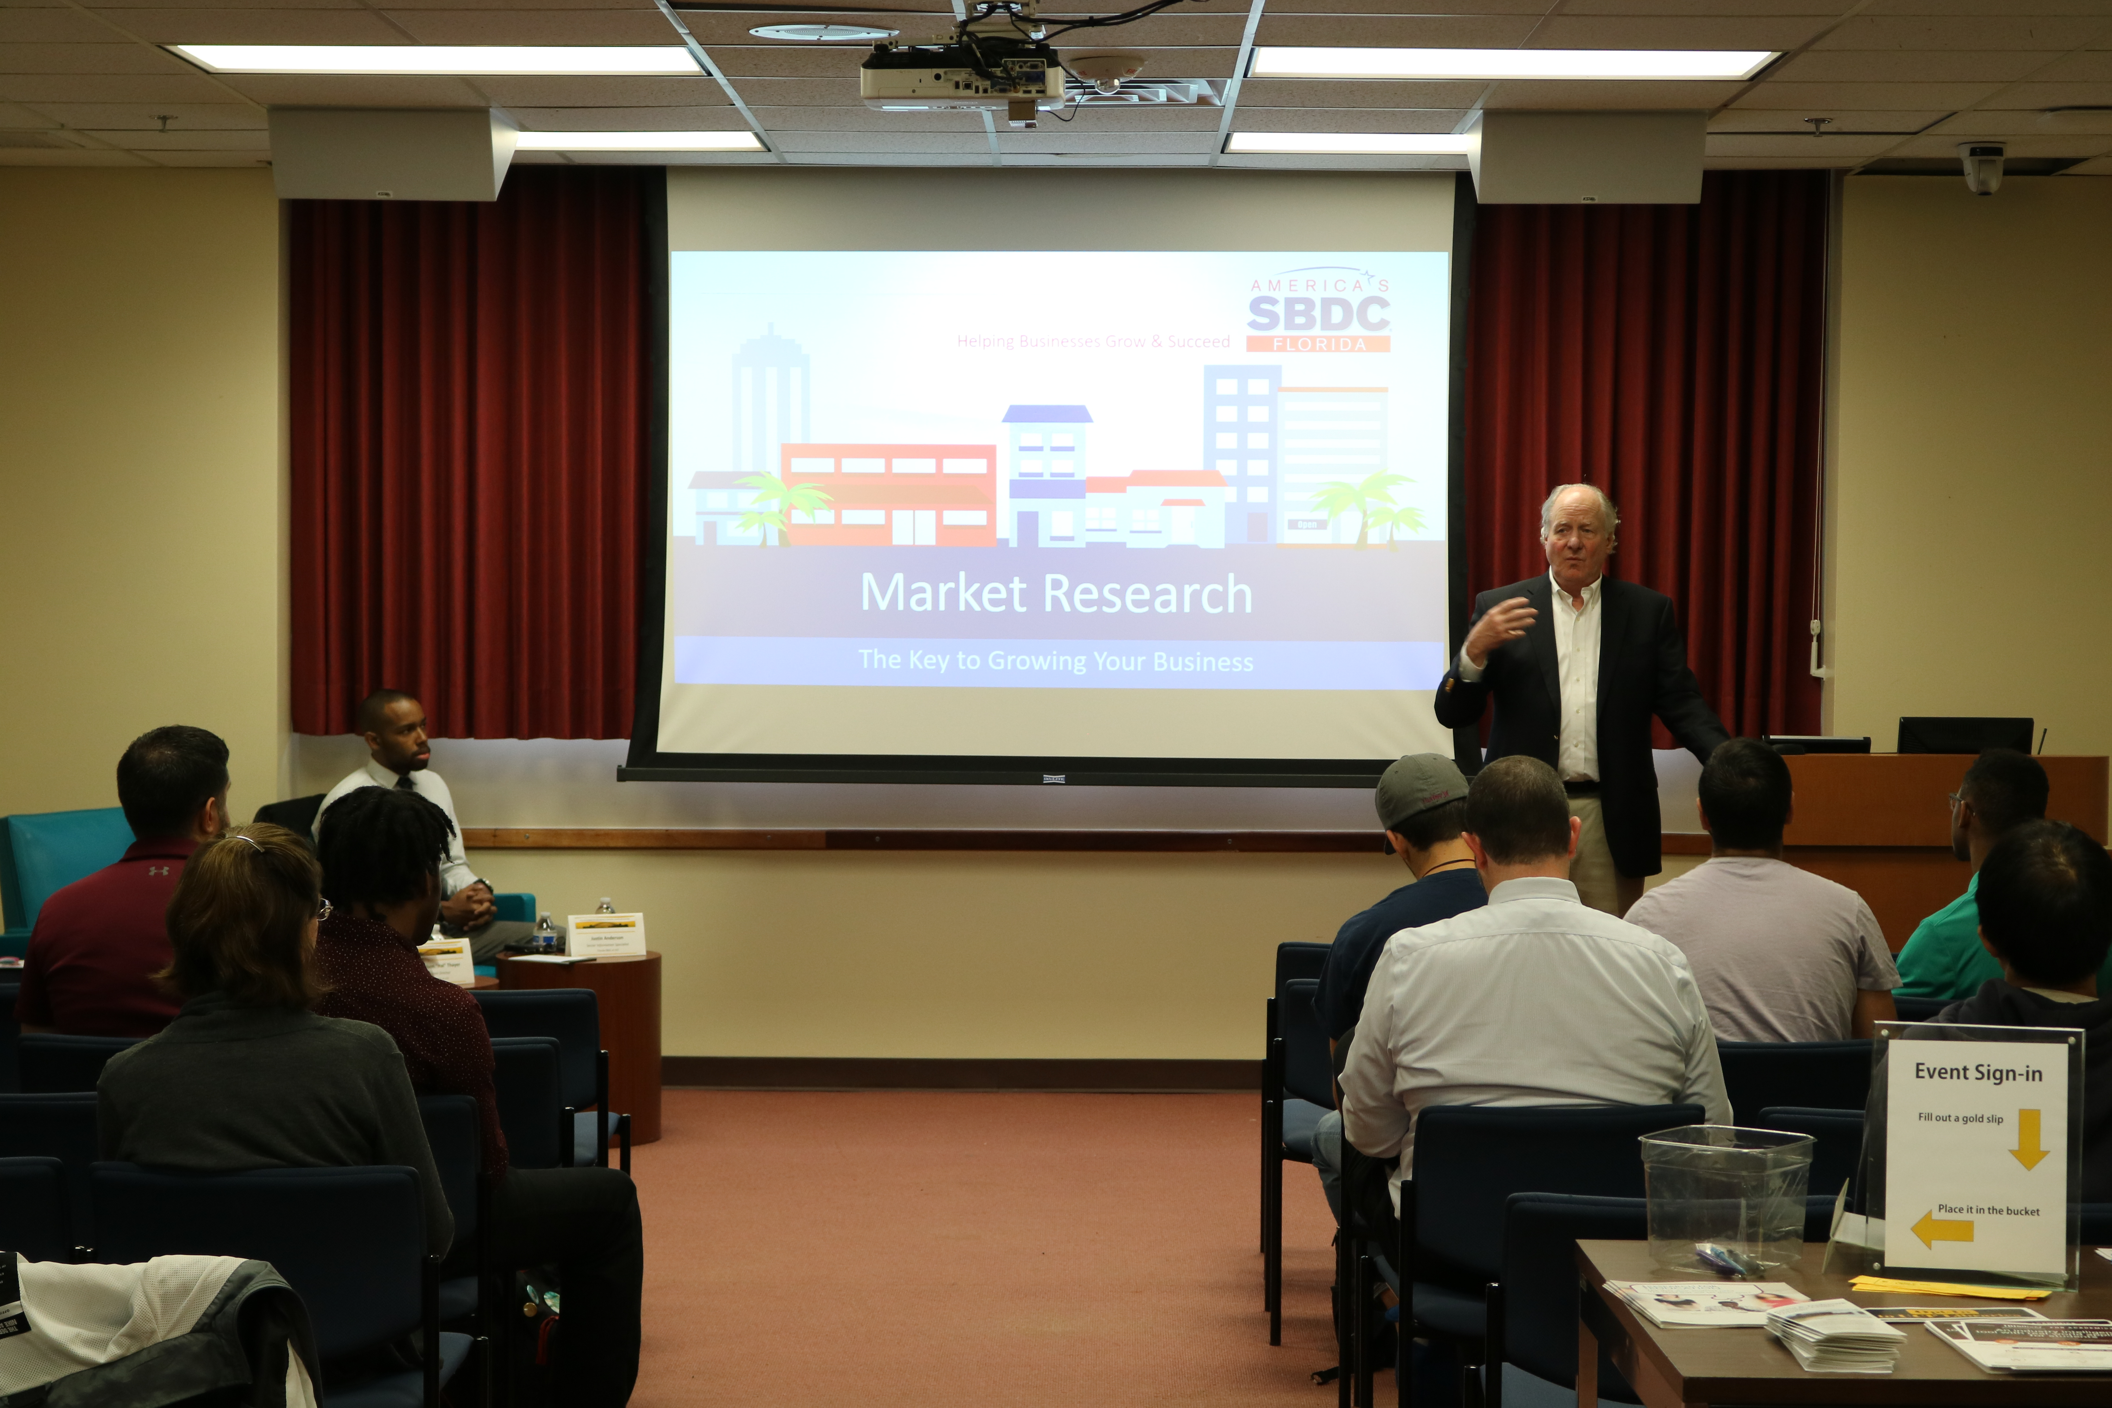
Day of Event - Speakers

Slide 37

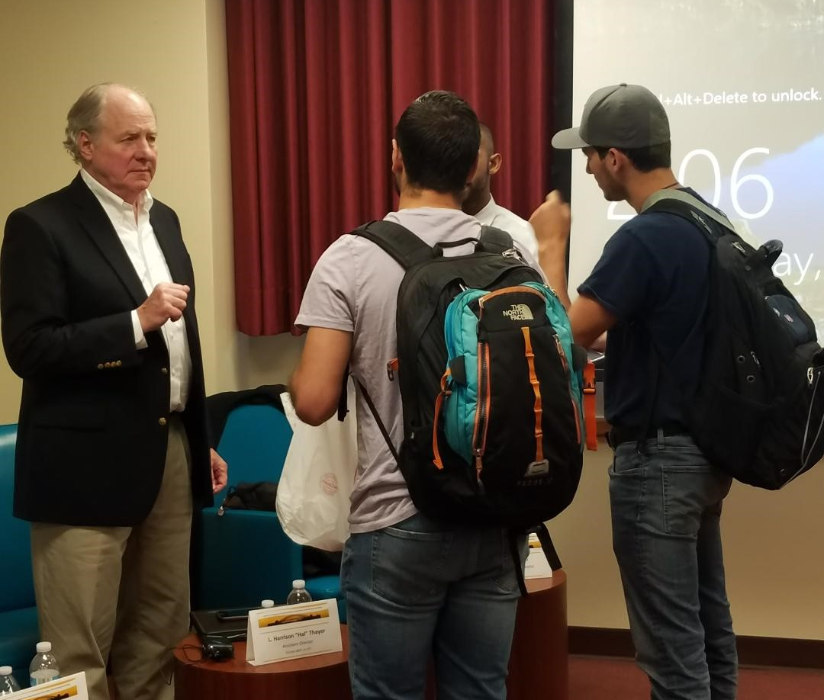
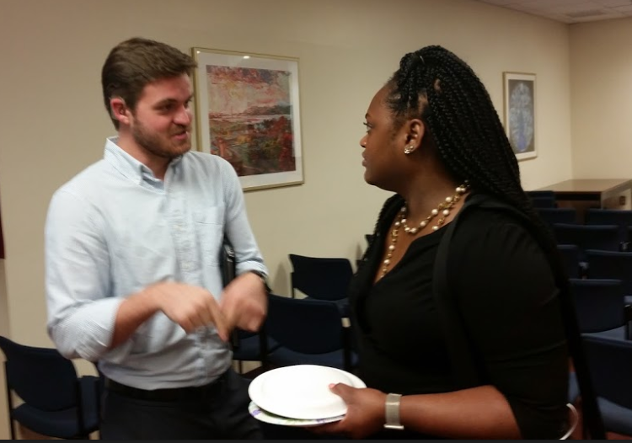
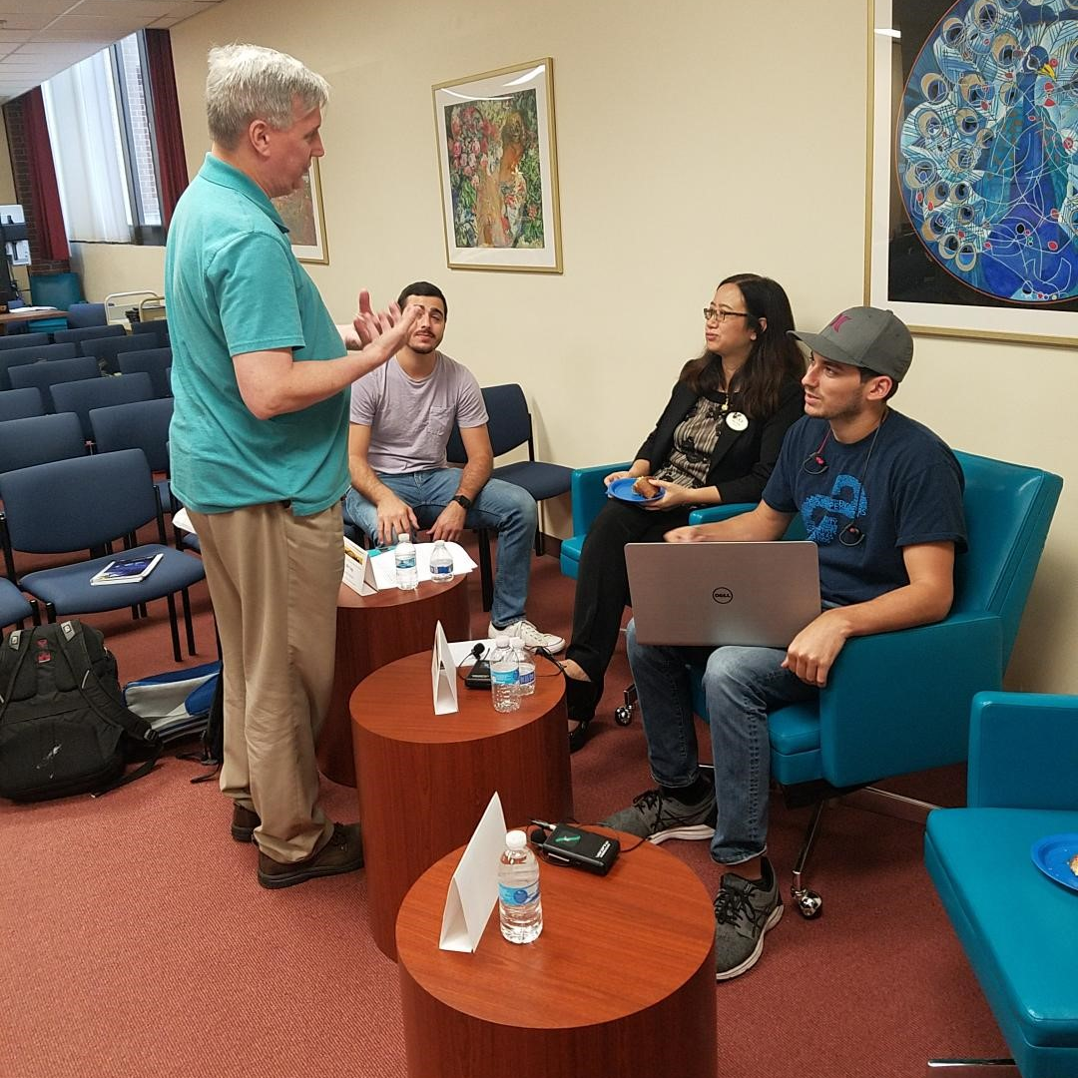
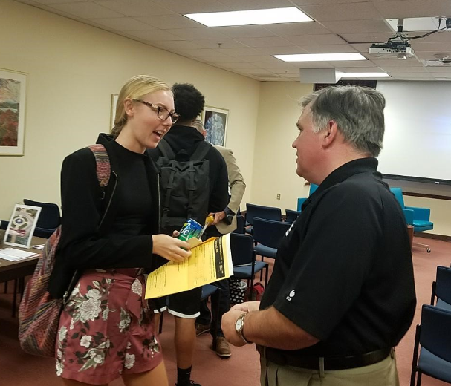
Day of Event - Networking

Slide 38
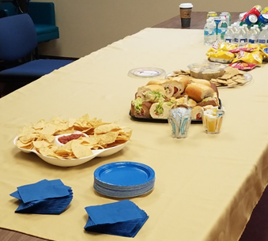
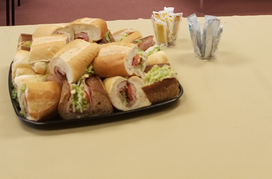
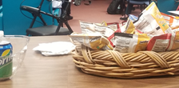
Day of Event - Refreshments

Slide 39
Feedback

Slide 40
Evaluation Comments
“How many resources are available to start ups at UCF.”
“The great amount of information and resources available to students and library card holders.”
“Launchpad connects you with peers and mentors.”
“I learned that knowing my weaknesses are just as important.”
“I didn’t know exactly what I-Corps was about, but now I am excited to apply!”
“Learning that SBDC exists and offers no cost services. I had been focusing on the product and made assumptions without actual market research.”
“Everything that was spoken about I learned. I knew very little.”
“I had no clue what patents were.”
“It was pretty cool and I like that there were snacks, it made it more inviting.”

Slide 41
Impact to our Liaison Areas
Comfort/ease in discussing community entrepreneurial resources
Collaborative opportunities among liaison librarians
Relationship building with entrepreneurial partners & faculty
Opportunities for shared programming outside the library
Utilizing contacts to increase event promotion
Increased utilization of library products & services

Slide 42
What ELSE is Next?
With the UCF Libraries’ previous successes at QEP funding, try for another
Continue annual entrepreneurship to foster connections between library personnel and on-campus/off-campus partners
Collaborate to create new innovative ways to highlight the library’s role in entrepreneurship
More formal presentation and publishing opportunities

Slide 43

Thank you for your attention!
Any questions?
Email us below:
Min Tong: min.tong@ucf.edu
Sandy Avila: savila@ucf.edu
Ven Basco: ven.basco@ucf.edu
Missy Murphey: rebecca.murphey@ucf.edu
Please visit: guides.ucf.edu/entrepreneur

