Slide 1
Copyright for Educators:
Using Copyrighted Content in the Classroom
Sarah A. Norris, Scholarly Communication Librarian
University of Central Florida

Slide 2
If you remember one thing from this presentation...

Slide 3
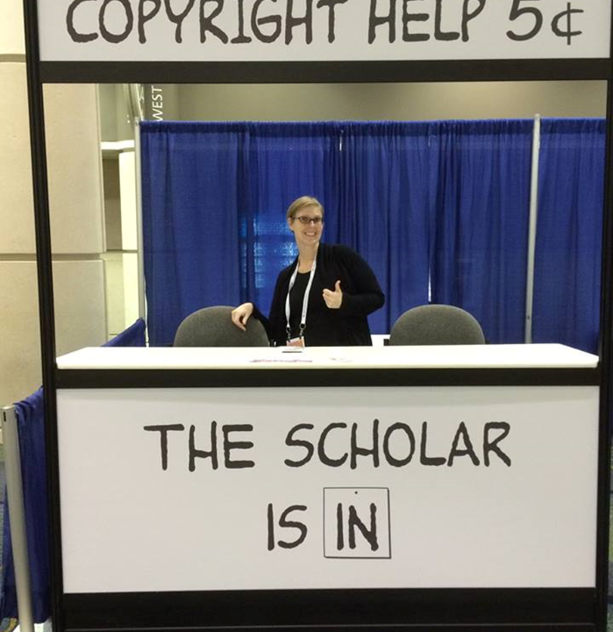
Contact the Library!
We can Help!
Copyright Sarah A. Norris

Slide 4
Session Overview
What is Copyright?
Copyright Basics
Public Domain
Fair Use
Creative Commons Licenses
Classroom Scenarios
Q&A

Slide 5
Question:
How do you feel about copyright?

Slide 6
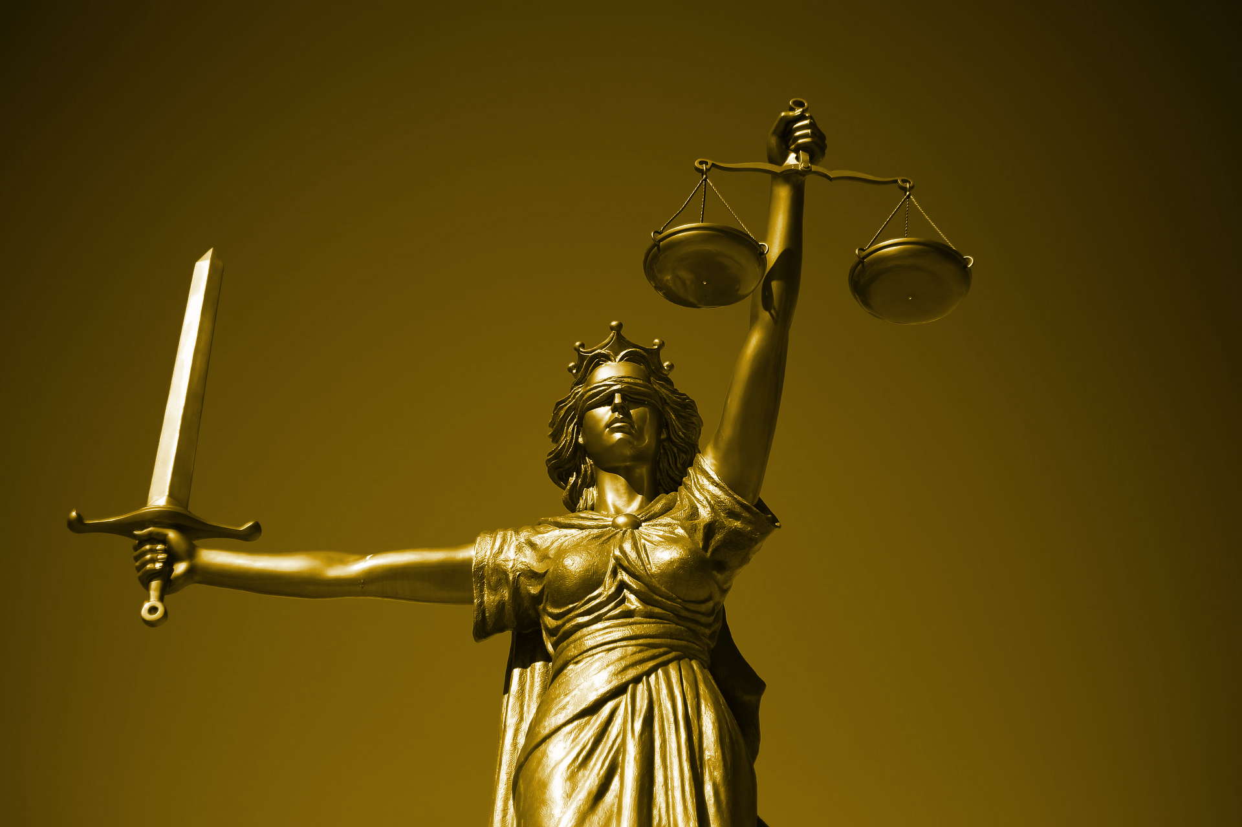
Why is Copyright & Copyright Law so Important?

Slide 7
Why is Copyright Important in the Classroom?

Slide 8
Create New Copyrighted Works
Avoid Infringement
Uphold Academic Integrity
Use Fair Use When Applicable
Ensure
High Quality
Others?

Slide 9
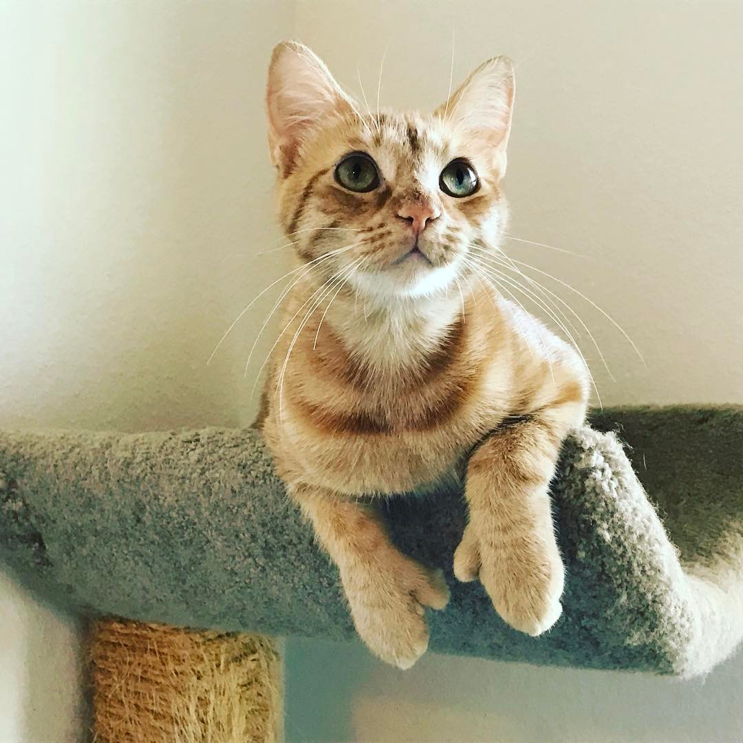
Let’s Talk about Copyright through the Use of a Copyrighted Photograph...
Copyright Sarah A. Norris

Slide 10
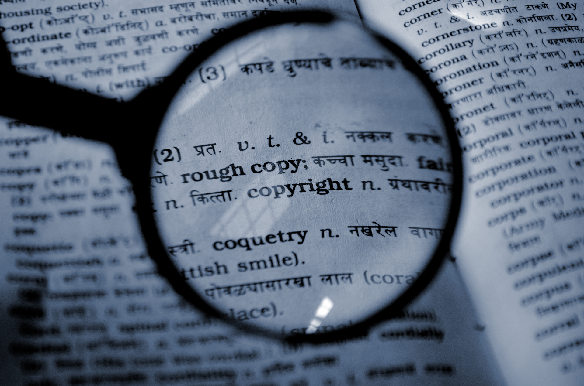
What is Copyright?

Slide 11
“Copyright is a form of protection provided by the laws of the United States (title 17, U.S. Code) to the authors of ‘original works of authorship,’ including literary, dramatic, musical, artistic, and certain other intellectual works. This protection is available to both published and unpublished works.”
http://www.copyright.gov/circs/circ01.pdf

Slide 12
What Rights are Covered by Copyright?
Generally, the following are exclusive rights given to a copyright holder:
reproduce your work
distribute your work
prepare derivative works
publicly display or perform your work
authorize others to do any of the above
*The above does not necessarily apply if the creator/author has given away rights to a publisher and/or other individual or entity

Slide 13
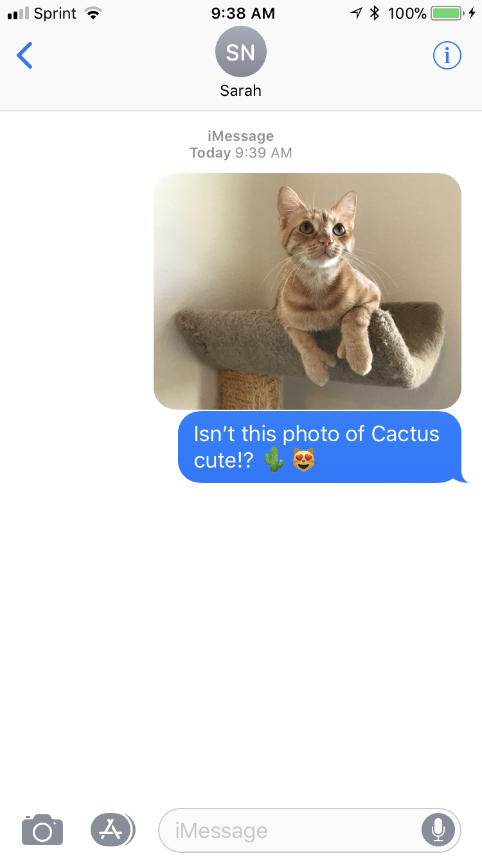
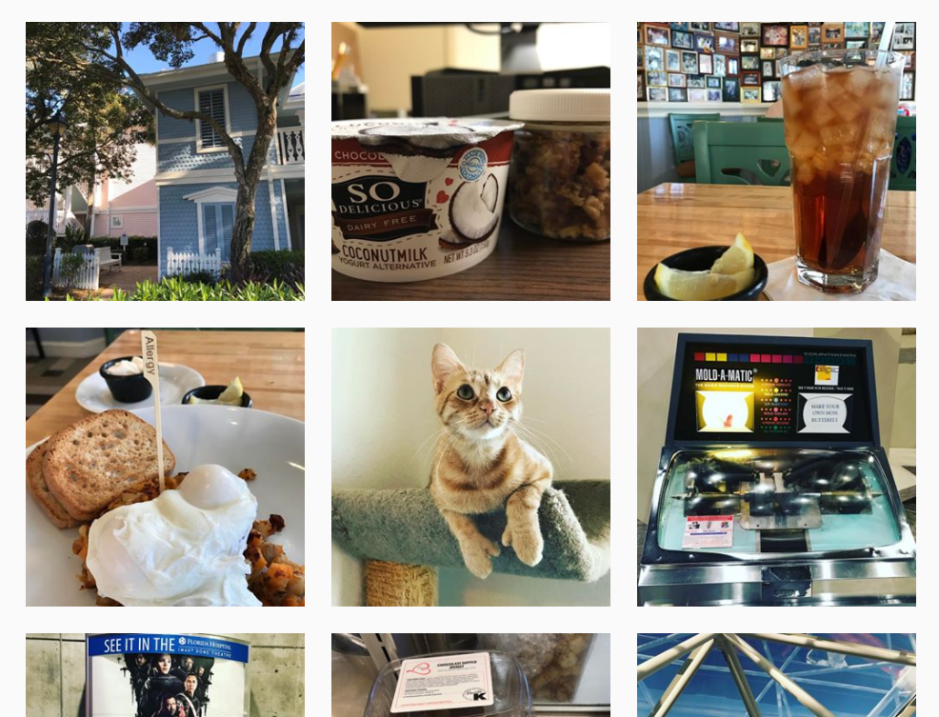
A Copyright Holder Uses Their Work...

Slide 14
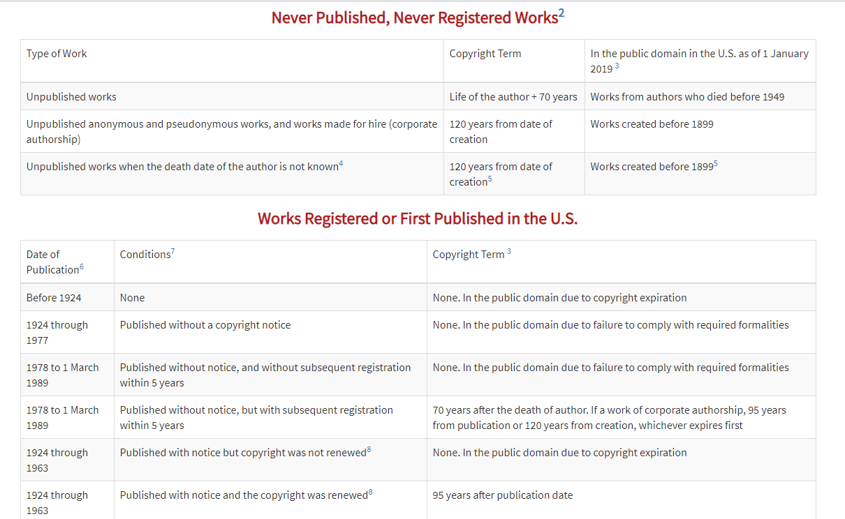
© 2004-2019 Peter B. Hirtle. Last updated 07 February, 2019, Retrieved from: https://copyright.cornell.edu/publicdomain

Slide 15
What is
Public Domain?

Slide 16
Public domain refers to materials “whose exclusive intellectual property rights have expired, have been forfeited, or are inapplicable.”
Items can be used freely
Materials in the public domain include:
Works with expired copyright (generally, this means items published before 1924)
Works that are not copyrightable or protected by copyright
Works produced by the federal government and/or federal government employee as a part of their job
Works donated to the public domain

Slide 17
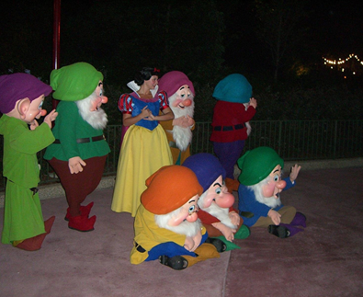
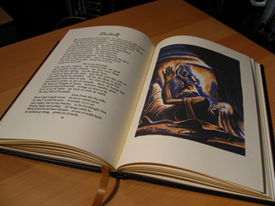
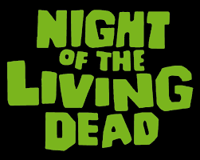
Examples of Public Domain Uses
Beowulf - Translated by William Leonard - Easton Press Edition by Robert is licensed under CC BY 2.0
Snow White and the Seven Dwarfs in the Magic Kingdom by JeffChristiansen is licensed under CC BY-SA 2.0

Slide 18
What About
Fair Use?

Slide 19
“Fair use is a legal doctrine that promotes freedom of expression by permitting the unlicensed use of copyright-protected works in certain circumstances. Section 107 of the Copyright Act provides the statutory framework for determining whether something is a fair use and identifies certain types of uses—such as criticism, comment, news reporting, teaching, scholarship, and research—as examples of activities that may qualify as fair use.”
http://copyright.gov/fair-use/more-info.html

Slide 20
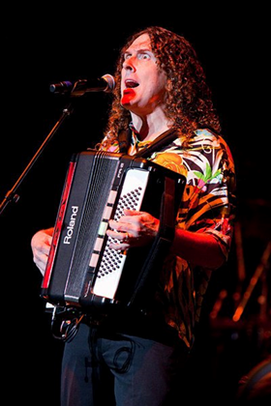
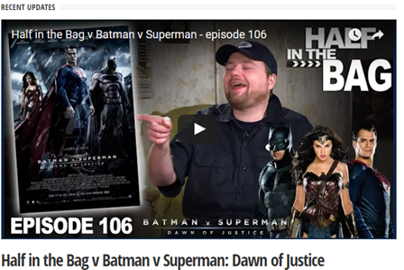
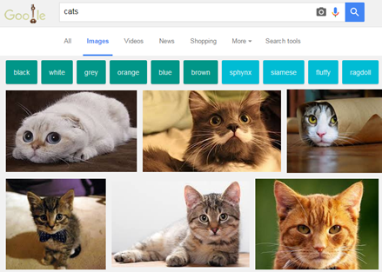
Examples of Fair Use
"Weird Al" Yankovic performing live in concert during his 2010 Tour by Kristinekreations is licensed under CC BY 3.0

Slide 21
Navigating Fair Use...
When considering use of copyrighted work(s), the Four Fair Use Factors are typically used as a benchmark for whether fair use is appropriate or not
The purpose & character of use
The nature of the copyrighted work
The portion used in relation to the copyrighted work as a whole
The effect of the use upon the potential market
Fair use is not applicable in every situation, even if it is for educational purposes
UCF Office of General Counsel Recommends that UCF Faculty adhere to a general 10% rule (i.e. use up to 10% of a copyrighted work)
Students should consult UCF Libraries for assistance
Look for copyrighted materials that have Creative Commons Licenses

Slide 22
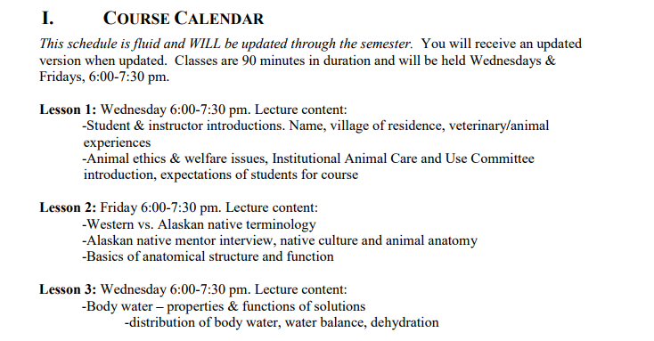
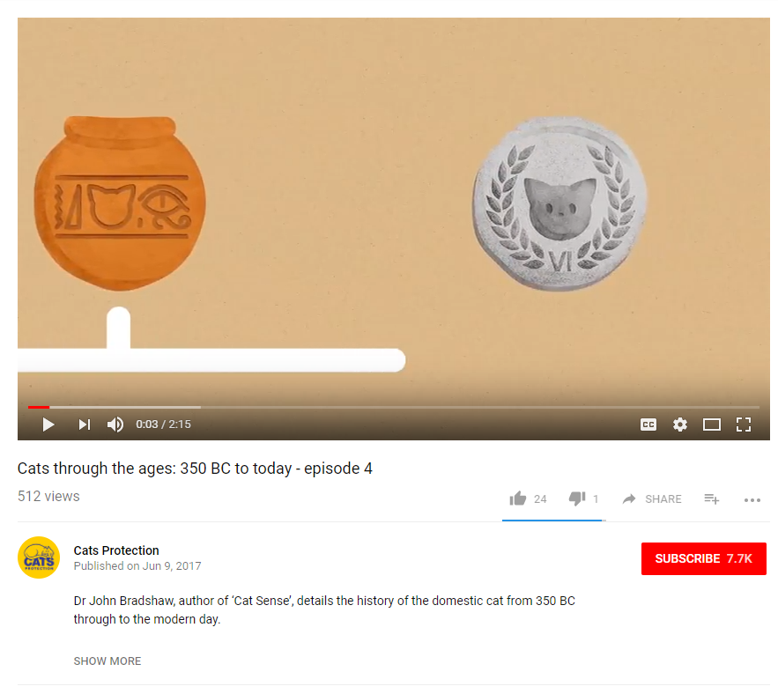
In the Case of Our Copyrighted Image...

Slide 23
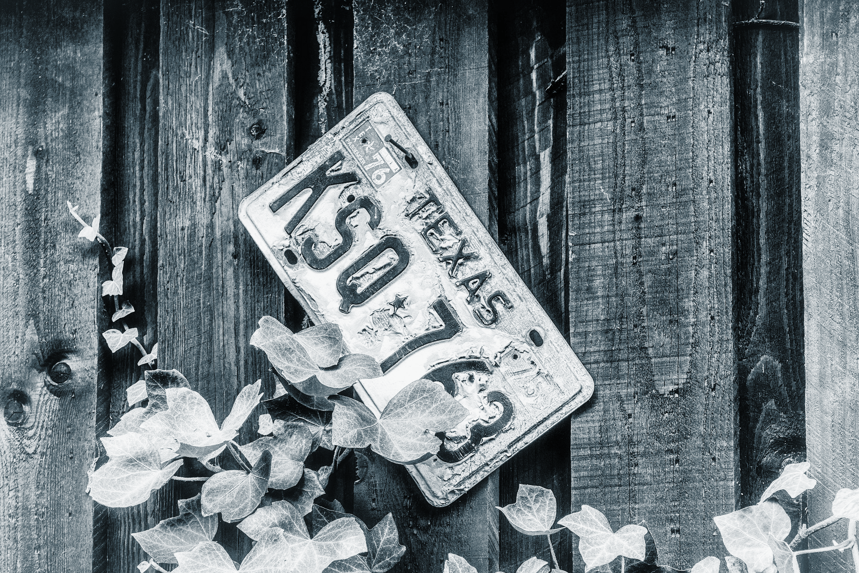
Using Licensed Materials

Slide 24
Generally means “to give permission”
https://en.wikipedia.org/wiki/License
In copyright and intellectual property, this means you are authorizing use of your copyrighted work by others (i.e. publisher, distributor, etc.)
This is often known as “use rights”
They can be exclusive or non-exclusive
Licensing a “use right” doesn’t affect your ownership of the copyright, unless you decide to license the rights away or are employed as a “work for hire”

Slide 25
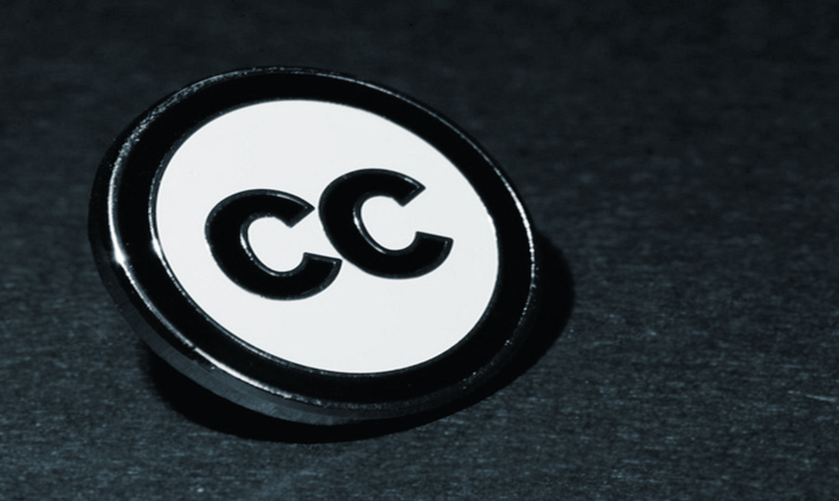
Let’s Explore Creative Commons Licenses...
Image retrieved from: https://flic.kr/p/a8Tsiz © Kristina Alexanderson / CC BY-SA 4.0

Slide 26
“A Creative Commons (CC) license is one of several public copyright licenses that enable the free distribution of an otherwise copyrighted work. A CC license is used when an author wants to give people the right to share, use, and build upon a work that they have created.”
https://creativecommons.org/licenses/

Slide 27
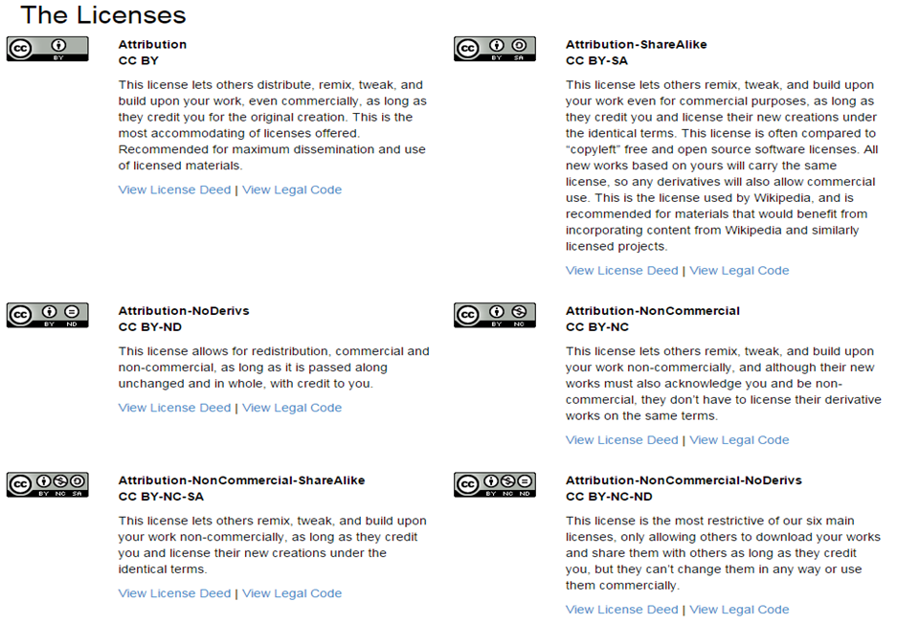
https://creativecommons.org/licenses/

Slide 28
Where Do You See Creative Commons Licenses?

Slide 29
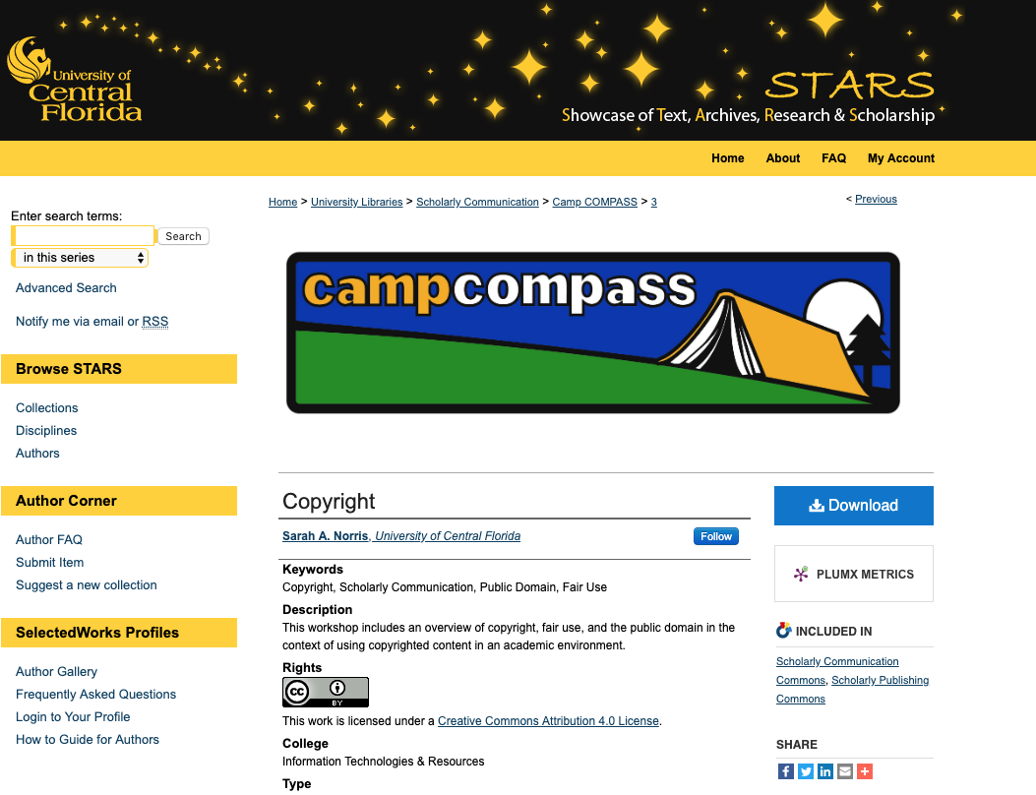

Slide 30
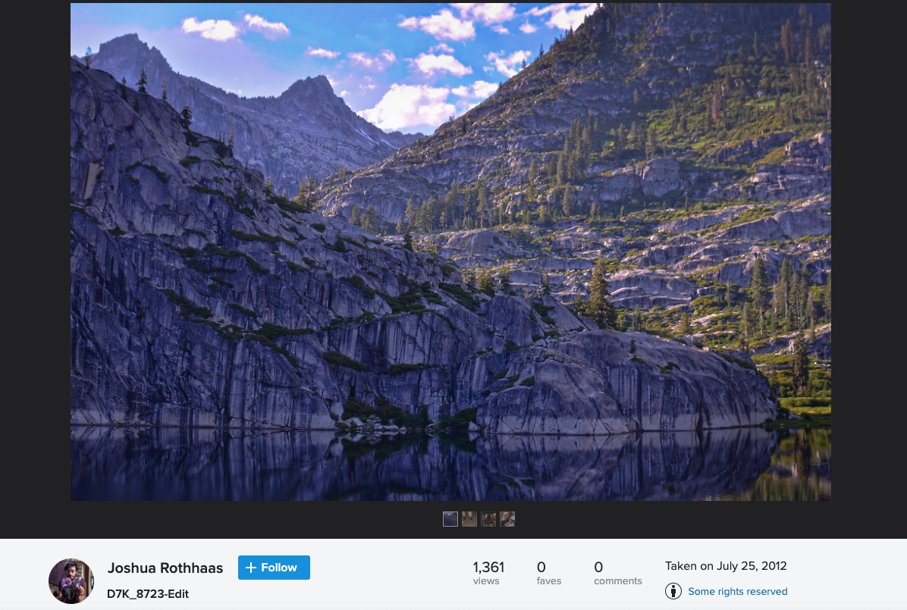
Photo by Joshua Rothhaas is licensed under CC BY 2.0

Slide 31
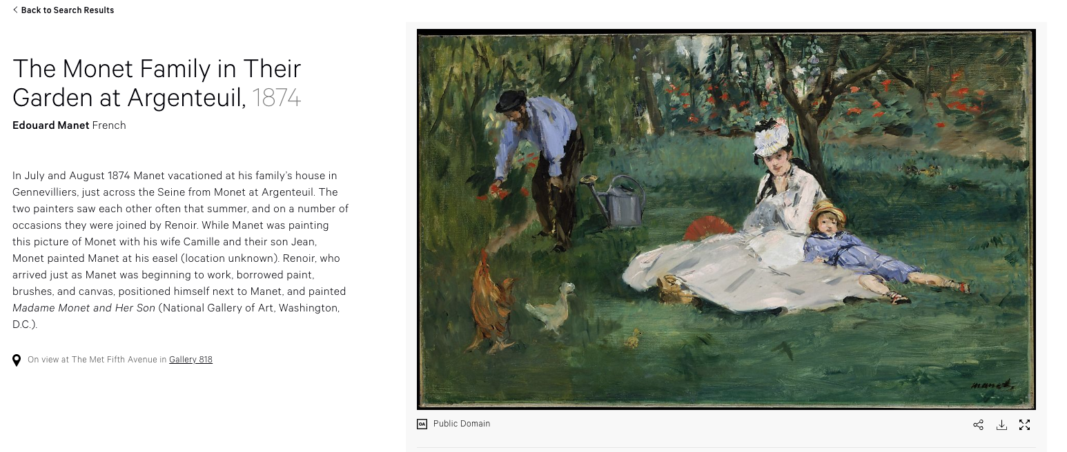
The Monet Family in Their Garden at Argenteuil,1874 by Edouard Manet is licensed under CC0 1.0

Slide 32
Citing Creative Commons Licenses
Always make sure to cite works that are CC licensed
A good rule of them when citing is the acronym TASL
Title
Author
Source
License
Refer to the Creative Commons Wiki for best practices for attribution: https://wiki.creativecommons.org/wiki/Best_practices_for_attribution
Cite according to discipline-specific when appropriate

Slide 33
Let’s Explore Creative Commons Licenses with Our Copyrighted Photo...

Slide 34
Cactus the Cat by Sarah A. Norris is licensed under
CC BY-NC-SA 4.0

Slide 35
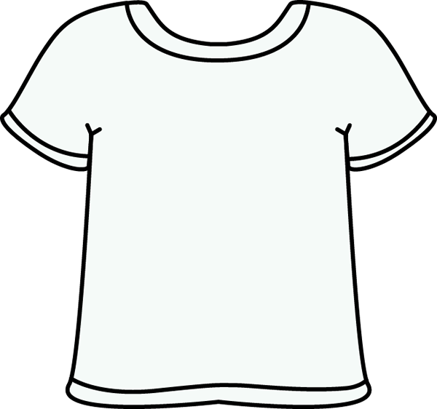
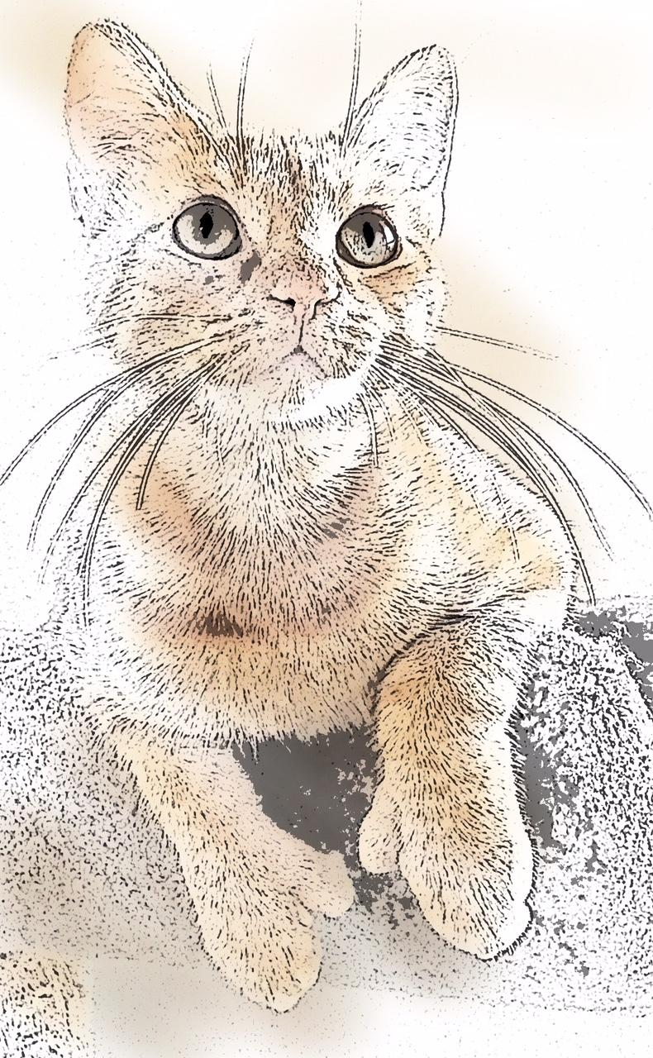
Cactus the Cat by Sarah A. Norris is licensed under
CC BY 4.0

Slide 36
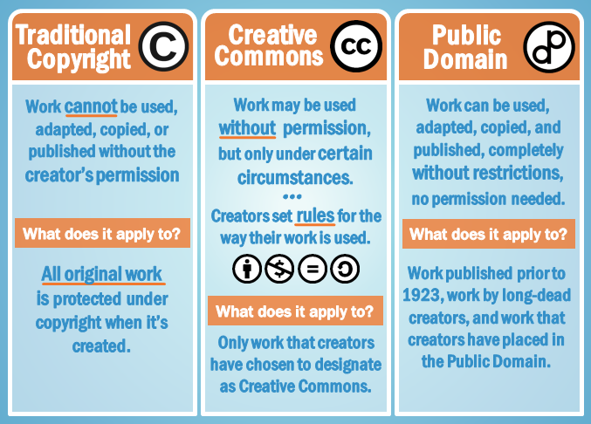
Image Retrieved from: https://www.gcflearnfree.org/blogbasics/copyright-and-fair-use/2 / Copyright GFC Global

Slide 37
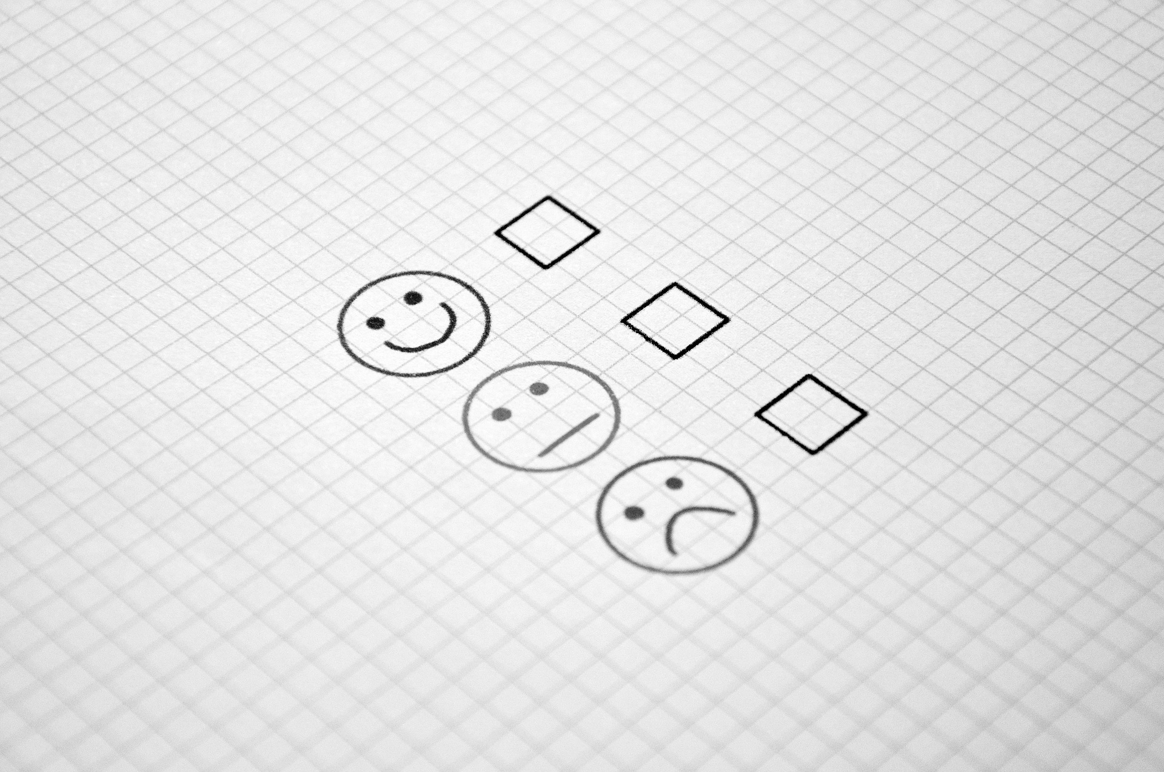
How Do We Make Sure We’re Copyright Compliant in the Classroom?

Slide 38
Ask for Permission
Pay to Use Via Services like the Copyright Clearance Center
Fair Use
Finding Materials That are Public Domain and/or Openly Licensed
Others?

Slide 39
What Would You Do?
Let’s Talk Through Copyright Scenarios...

Slide 40
Scenario #1
“I found these great images on Google for my class. Can I use these in my class or lesson plans as long as I give credit to the source?”

Slide 41
Scenario #1
Consider anything found online under copyright, unless otherwise stated
Determine copyright status (if not clear, assume under copyright)
Ask permission from the copyright holder, if applicable
Use under the guise of Fair Use (using Four Fair Use Factors and/or any other school-specific guidelines)
Consider using public domain and/or Creative Commons licensed images when possible
“Educators and students should exercise caution in using material downloaded from the internet, because there is a mix of works protected by copyright and works in the public domain on the network. Some copyrighted works may have been posted to the internet without authorization of the copyright holder. Anytime an entire work is copied, the fair use defense will be difficult to apply. Crediting the source does not change the fact that this will likely be regarded as copyright infringement. Please keep in mind that crediting the source is appropriate; however, the underlying use needs to be justified first, whether the use relies on the permission of the copyright owner or on fair use. If the underlying use is infringing, crediting the source does not rectify this.”
https://generalcounsel.ucf.edu/files/2015/06/Top-Ten-Copyright-and-Fair-Use-Questions-revised-NNH-clean-4-19-11.docx

Slide 42
Scenario #2
“I want to show a full-length film in my classroom using my Netflix account. Am I allowed to do this?”

Slide 43
Scenario #2
Films/Videos shown should be related to class curriculum (not just filler)
Should be shown in the classroom with the teacher present
Fair use may apply
Teachers should not use their personal accounts for streaming services due to licensing terms
Utilize legitimate copies of a film/video and/or explore options to purchase license to show in the classroom
“Pursuant to United States Code, Title 17, Section 110(1), members of the University of Central Florida community may publicly display and perform the copyrighted works of other people (this includes entire works) during face-to-face teaching activities, provided you are using a legitimate copy of the work, i.e. in this case a legitimate copy of the video (which, in general, does not include one that you have videotaped yourself from a broadcast).
https://generalcounsel.ucf.edu/files/2015/06/Top-Ten-Copyright-and-Fair-Use-Questions-revised-NNH-clean-4-19-11.docx

Slide 44
Scenario #3
“I would like to scan worksheets that came from the class textbook to put them on my website so that parents and students can print them from home in case they have lost their worksheet. I would also like to be able to email these as attachments to parents. Can I do this?”

Slide 45
Scenario #3
While you may be able to reproduce some copyrighted works under the guise of fair use, the Reproduction of Copyrighted Works by Educators and Librarians (U.S. Copyright Office) notes the following:
“There shall be no copying of or from works intended to be “consumable” in the course of study or of teaching. These include workbooks, exercises, standardized tests and test booklets and answer sheets and like consumable material.”
https://www.copyright.gov/circs/circ21.pdf

Slide 46
Final Considerations

Slide 47
When Exploring Using Copyrighted Materials in the Classroom...
Consider the copyright for each work being used
Assume that a work is under copyright until proven otherwise
When in doubt, ask for permission
Explore opportunities to use public domain and/or Creative Commons Licensed Materials
Cite as appropriately for your discipline and/or licensing terms (if applicable)
Follow the Four Fair Use Factors when considering using copyrighted material
Connect with your school and librarians for copyright assistance

Slide 48
Public Domain Image References
rawpixel (Photographer). (2018, February 28). No title [digital image]. Retrieved from https://pixabay.com/photos/art-artist-cafe-calligraphic-3187088/
rawpixel (Photographer). (2017, May 12). No title [digital image]. Retrieved from https://pixabay.com/photos/typewriter-alphabet-vintage-2306479/
WilliamCho (Photographer). (2017, February 13). No Title [digital image]. Retrieved from https://pixabay.com/photos/justice-statue-lady-justice-2060093/
Wokandapix (Photographer). (2017, January 10). No title [digital image]. Retrieved from https://pixabay.com/photos/teach-education-school-class-1968076/
TeroVesalainen (Photographer). (2017, March 7). No title [digital image]. Retrieved from https://pixabay.com/photos/mindmap-brainstorm-idea-innovation-2123973/
PDPics (Photographer). (2014, July 15). No title [digital image]. Retrieved from https://pixabay.com/photos/copyright-magnifier-magnifying-glass-389901/
Free-Photos (Photographer). (2015, April 27). No title [digital image]. Retrieved from https://pixabay.com/photos/bus-train-subway-inside-seats-731317/
rawpixel (Photographer). (2018, February 14). No title [digital image]. Retrieved from https://pixabay.com/photos/old-wood-desktop-vintage-alphabets-3150426/
Tama66 (Photographer). (2016, July 18). No title [digital image]. Retrieved from https://pixabay.com/photos/license-plate-indicator-pkw-texas-1524129/
Free-Photos (Photographer). (2016, July 8). No title [digital image]. Retrieved from https://pixabay.com/photos/binoculars-view-focus-optical-1209892/
Athree23 (Photographer). (2018, September 15). No title [digital image]. Retrieved from https://pixabay.com/photos/feedback-checklist-job-gut-3676922/
RossMannYYC (Photographer). (2017, July 28). No title [digital image]. Retrieved from https://pixabay.com/photos/checklist-chalk-board-list-2549229/
TeroVesalainen (Photographer). (2017, March 7). No title [digital image]. Retrieved from https://pixabay.com/photos/question-mark-why-problem-solution-2123967/
Uki_71 (Photographer). (2016, January 18). No title [digital image]. Retrieved from https://pixabay.com/photos/note-pin-list-stickies-paper-memo-1143037/

Slide 49
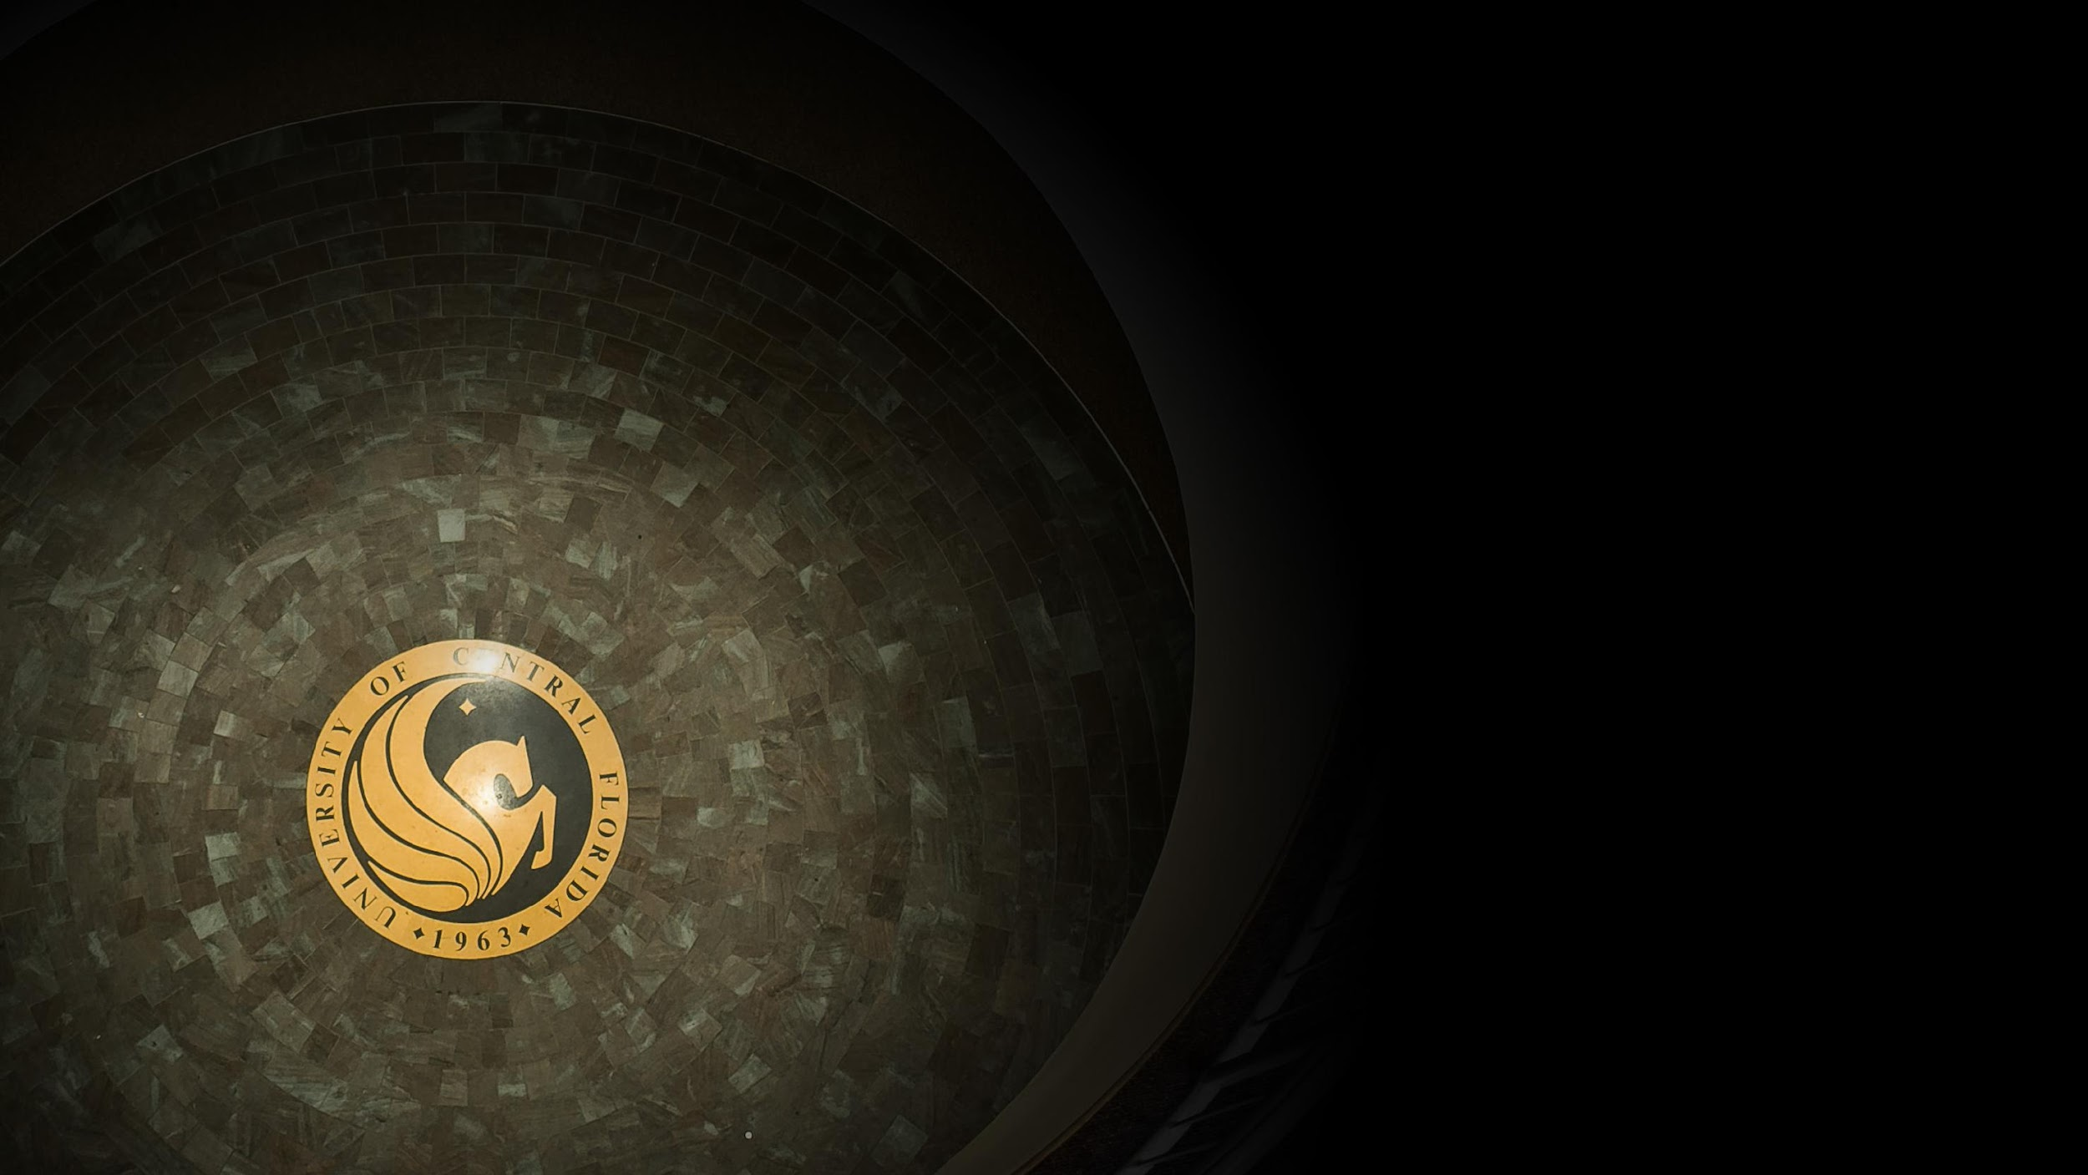
Contact Information
Sarah A. Norris
Scholarly Communication Librarian
UCF Libraries
sarah.norris@ucf.edu
UCF Libraries Office of Scholarly Communication http://library.ucf.edu/about/departments/scholarly-communication/

