Slide 1
Implementing a Proactive Captioning Plan that works!
Kathleen Bastedo
John Raible
University of Central Florida
UDLHE Digicon 2019
Notes:
Kathleen
Proactive Captioning Plan related to Online Course Materials specifically for completely online courses; covered by the Distance Learning Fee
Just ot review:
Accessibility of Online Course Materials and the UDL Connection
Provide multiple means of engagement: When students do not face barriers to accessing materials their engagement increases.
Provide multiple means of representation: Make sure all students can access the materials by offering alternatives to text, audio and visual information.

Slide 2
University of Central Florida
Fall 2010 – enrollment 56,241
24,000 students took at least one web or video–based course
Fall 2019– enrollment 69,037
45,877 students took at least one web or video-based course
Notes:
Kathleen

Slide 3
It takes a village!
Notes:
Kathleen

Slide 4
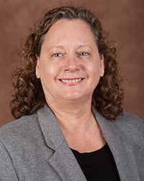
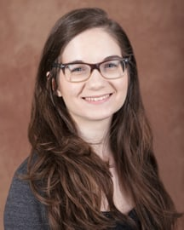
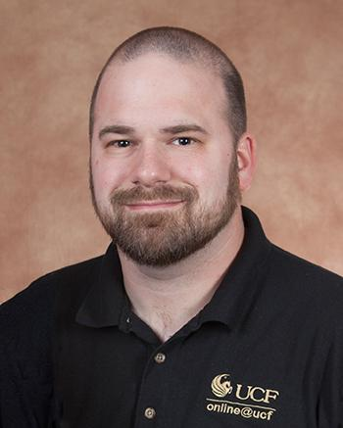
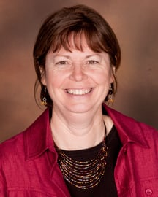
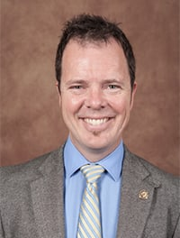
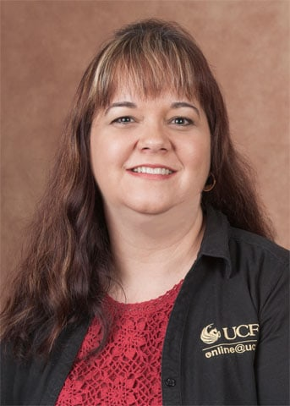
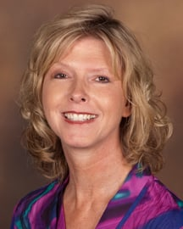
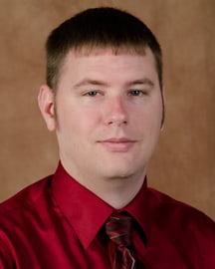
Center for Distributed Learning Staff
Beth Nettles
Jackie Compton
Jacob Bates
Kathleen Bastedo
Kelvin Thompson
Karen Tinsley-Kim
Nancy Swenson
John Raible
Notes:
Kathleen

Slide 5
Immediate Need to Proactive
Well-documented process for requesting closed captioning for immediate need courses
Continued growth in number of DHH students taking online courses and number of online courses overall makes this process increasingly difficult
Continued increase in growth of videos/video links in online courses
Make strategic investment with a shift to proactive
Notes:
Kathleen (UDL and ProActive) – vs. Immediate Need
W
2014-2015: 75 sections
2017-2018: 132 sections
2018-2019: 128 sections
P
2014-2015: 337
2017-2018: 262
P
2014-2015: 368
2017-2018: 278
W
2014-15: 76
17-18: 143

Slide 6
Developing a Plan
How to fund and allocate resources?
What media will be captioned?
How to communicate to faculty?
What level of service should be provided to faculty?
Vendor or in-house?
Notes:
Kathleen
Fall 2019: 1228 W course sections

Slide 7
Research
What other institutions are doing
University of Arizona, George Mason, Kennesaw State, N.C. State, Texas Tech University, University of South Florida/St. Pete
Adapted various components of other programs to fit UCF culture
Notes:
Kathleen
W
2014-2015: 75 sections
2017-2018: 132 sections
P
2014-2015: 337
2017-2018: 262
P
2014-2015: 368
2017-2018: 278
W
2014-15: 76
17-18: 143

Slide 8
The Proposal
A one-time amount of $20,000 from DL fee fund was provided to caption media in fully online courses only for one academic year.
A committee to decide how much content per course will be captioned
Media types: YouTube videos, Vimeo videos, and media hosted in Canvas
Notes:
The committee was abandoned
W
2014-2015: 75 sections
2017-2018: 132 sections
P
2014-2015: 337
2017-2018: 262
P
2014-2015: 368
2017-2018: 278
W
2014-15: 76
17-18: 143

Slide 9
The Proposal (continued)
Communicate to faculty “CDL will allocated XXXX minutes of closed captioning per semester” via website, social media, and direct messaging to faculty
CDL will select media, facilitate captioning, and add to course
Rev was selected as a vendor
Notes:
W
2014-2015: 75 sections
2017-2018: 132 sections
P
2014-2015: 337
2017-2018: 262
P
2014-2015: 368
2017-2018: 278
W
2014-15: 76
17-18: 143

Slide 10
Our Vice Provost said...
Notes:
Thought we would have to do a research report on average number of videos per class, how much it would cost when Our Vice Provost said...
W
2014-2015: 75 sections
2017-2018: 132 sections
P
2014-2015: 337
2017-2018: 262
P
2014-2015: 368
2017-2018: 278
W
2014-15: 76
17-18: 143

Slide 11
Make it so!
Notes:
W
2014-2015: 75 sections
2017-2018: 132 sections
P
2014-2015: 337
2017-2018: 262
P
2014-2015: 368
2017-2018: 278
W
2014-15: 76
17-18: 143

Slide 12
Technology Needed
Collect faculty submissions
Website/Qualtrics
Identify course media
Video Accessibility Scanning Tool (VAST)
Submit media to vendor
Use vendor API to batch upload and retrieve
Customized version of Ableplayer
Display 3rd party YouTube videos in Canvas
Display 3rd party Vimeo videos in Canvas
Notes:
W
2014-2015: 75 sections
2017-2018: 132 sections
P
2014-2015: 337
2017-2018: 262
P
2014-2015: 368
2017-2018: 278
W
2014-15: 76
17-18: 143

Slide 13
Process
Open online application process
Market service to faculty
Review course submissions for eligibility
Review course content
Send videos to Rev
Receive .VTT files from Rev
Upload .VTT to course
Notify faculty upon completion
Notes:
P
2014-2015: 337
2017-2018: 262
P
2014-2015: 368
2017-2018: 278
W
2014-15: 76
17-18: 143

Slide 14
Implementation
Fall 2019 funded courses will be administered the Katie Linder’s student perception of captions survey
Future courses may be funded based on results
Possibility of expanding to other modalities with additional funding sources
Notes:
W
2014-2015: 75 sections
2017-2018: 132 sections
P
2014-2015: 337
2017-2018: 262
P
2014-2015: 368
2017-2018: 278
W
2014-15: 76
17-18: 143

Slide 15
Implementation (continued)
2018-2019: Captioned 1,330 total minutes
8 courses
Fall 2019: Captioned 4,299 minutes so far
16 courses
Notes:
W
2014-2015: 75 sections
2017-2018: 132 sections
P
2014-2015: 337
2017-2018: 262
P
2014-2015: 368
2017-2018: 278
W
2014-15: 76
17-18: 143

Slide 16
Resources
VAST: https://github.com/ucfopen/VAST
Ableplayer: https://github.com/ableplayer
UCF’s proactive website: https://cdl.ucf.edu/proactive
Linder, K. (2016). Student uses and perceptions of closed captions and transcripts: Results from a national study. Corvallis, OR: Oregon State University Ecampus Research Unit.
Notes:
W
2014-2015: 75 sections
2017-2018: 132 sections
P
2014-2015: 337
2017-2018: 262
P
2014-2015: 368
2017-2018: 278
W
2014-15: 76
17-18: 143

Slide 17
Contact Us
Kathleen Bastedo, kathleen.bastedo@ucf.edu
John Raible, john.raible@ucf.edu

