Slide 1
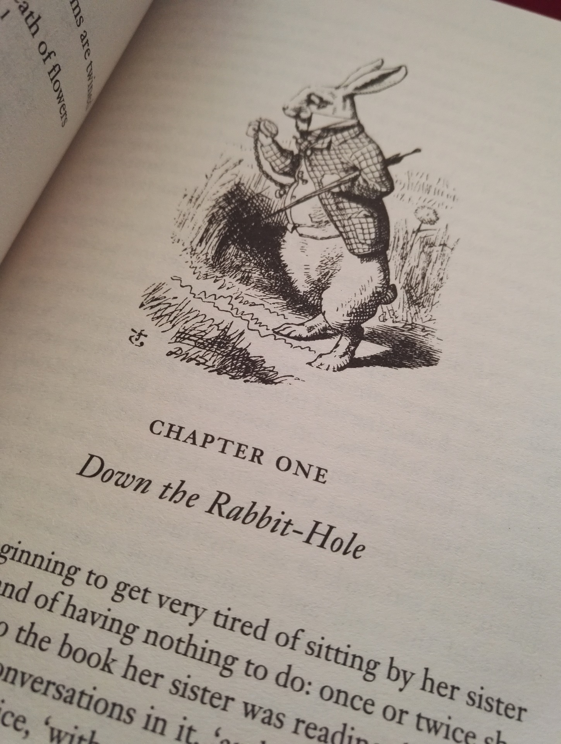
Falling Down the Rabbit Hole:
Exploring the Unique Partnership Between Subject Librarians and Scholarly Communication
Charleston Conference 2019
November 6th, 2019
Ven Basco, Engineering & Computer Science Librarian
Sandy Avila, Science Librarian
Sarah A. Norris, Scholarly Communication Librarian
University of Central Florida

Slide 2
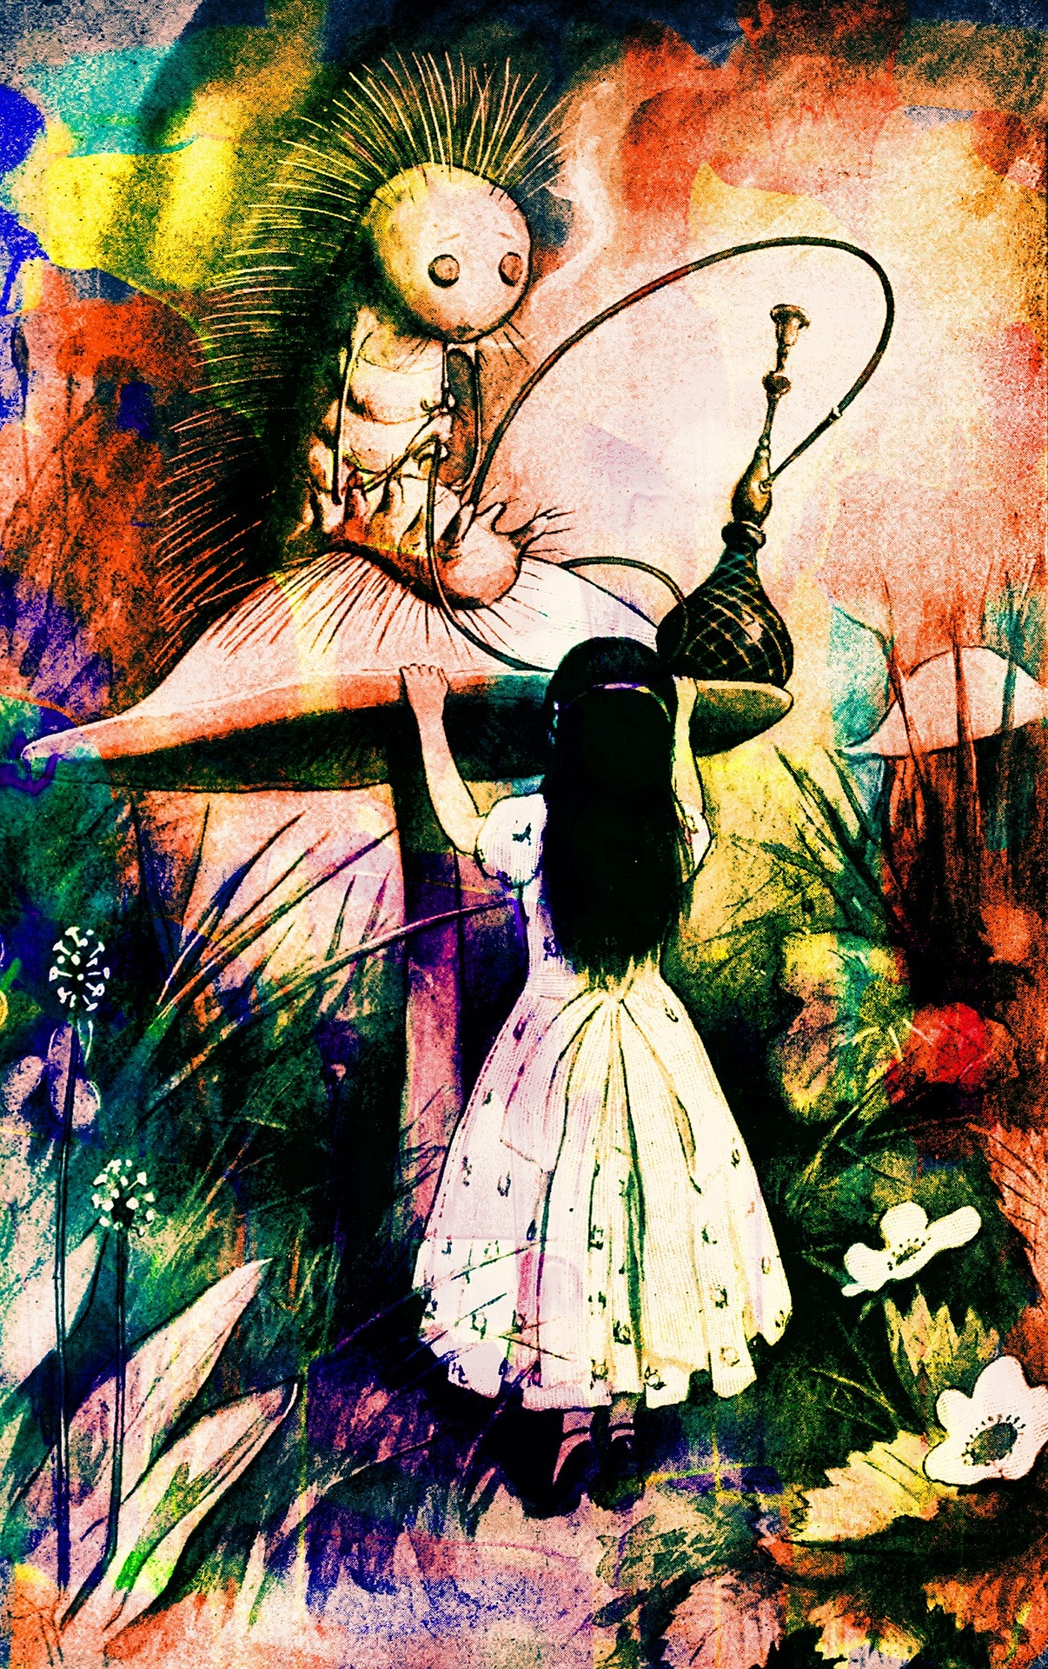
“Who are You?”
-The Caterpillar
Alice’s Adventures in Wonderland by Lewis Carroll
What is Your Role?

Slide 3
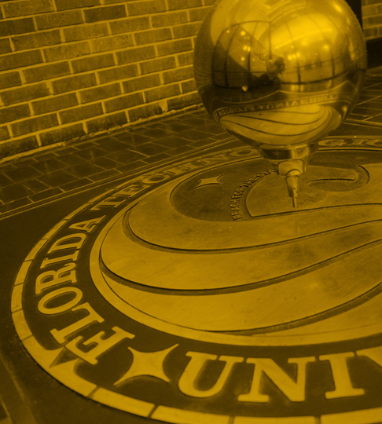
About UCF
One of 12 state public universities in Florida
Located about 10 miles east of downtown Orlando
69,525 students (Fall 2019)

Slide 4
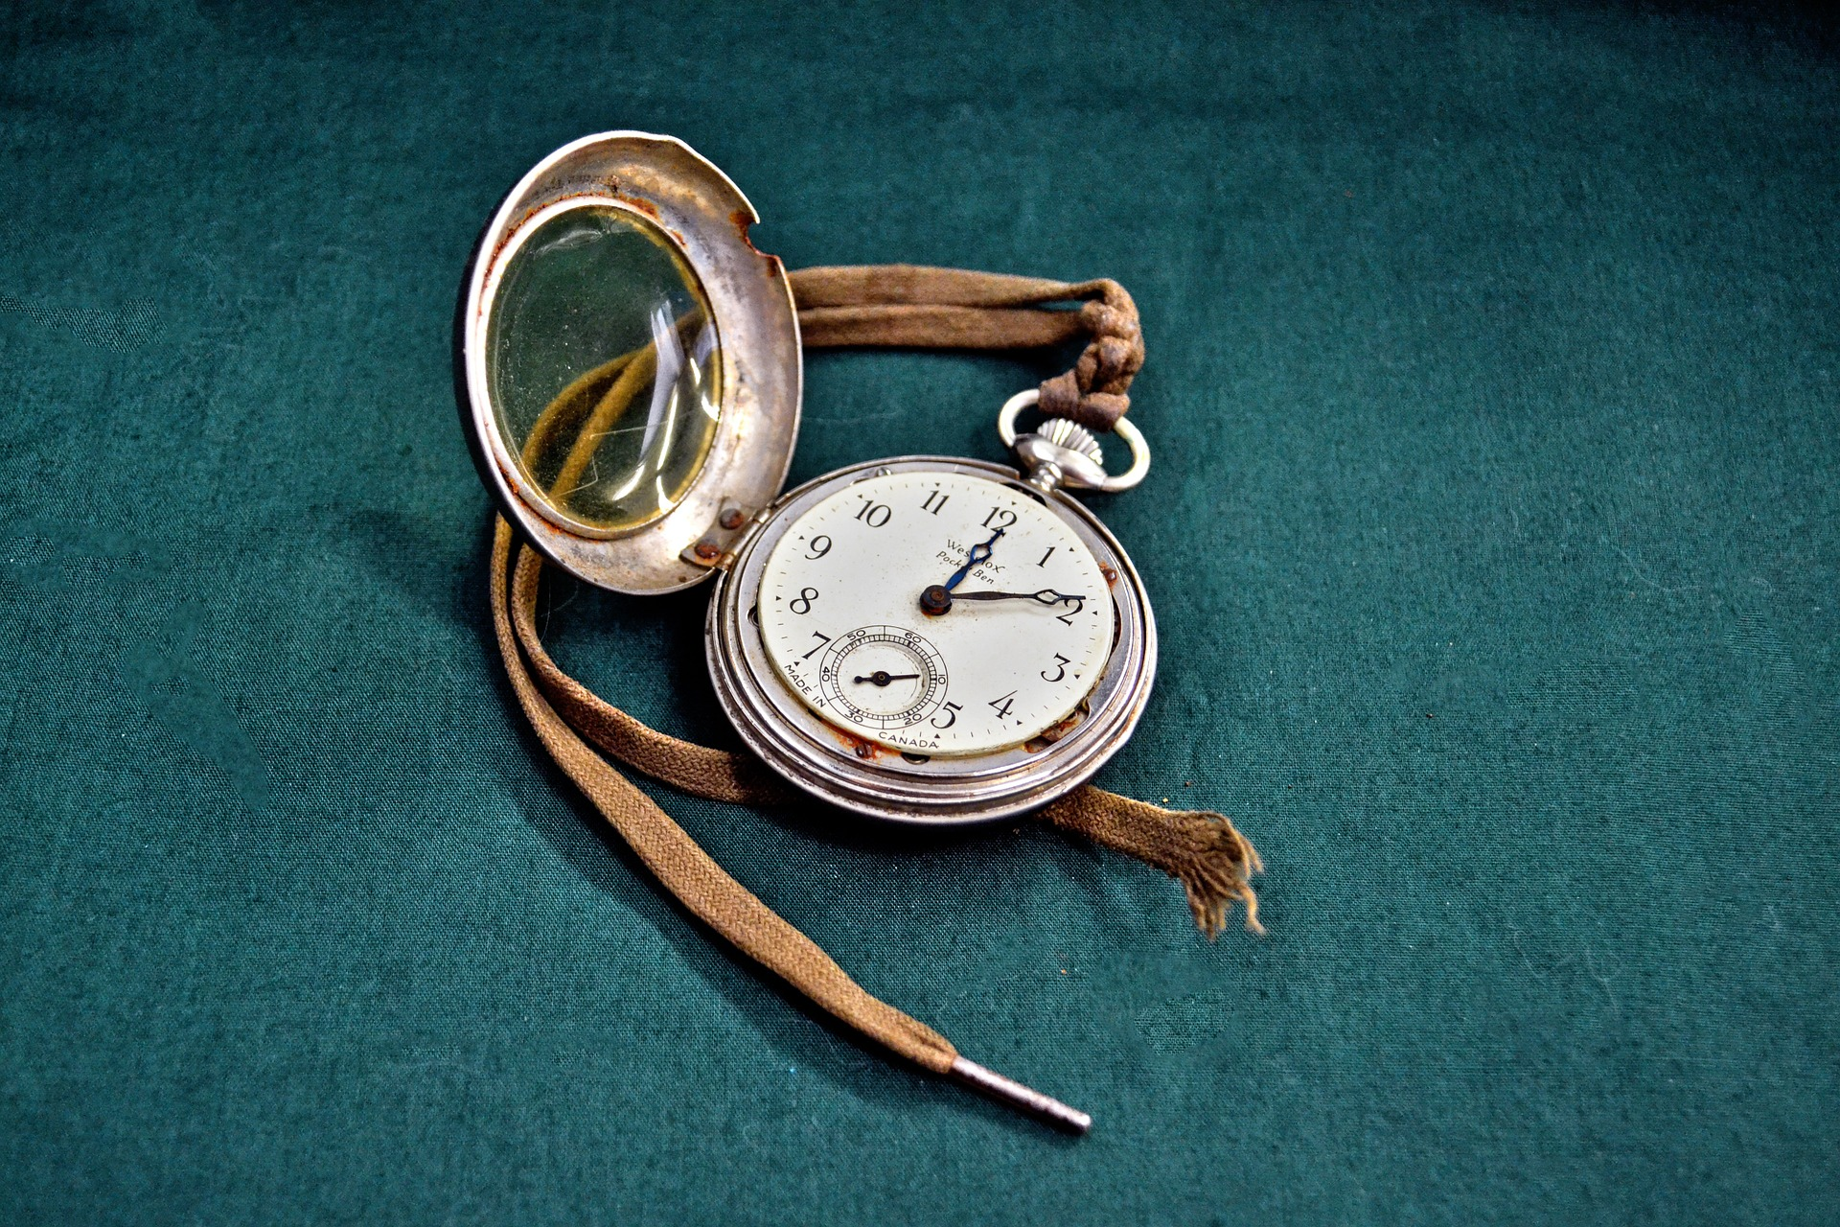
"The Time Has Come...
To Talk of Many Things!"
-The Walrus & The Carpenter
Through the Looking-Glass by Lewis Carroll
UCF Subject Librarians & Scholarly Communication

Slide 5
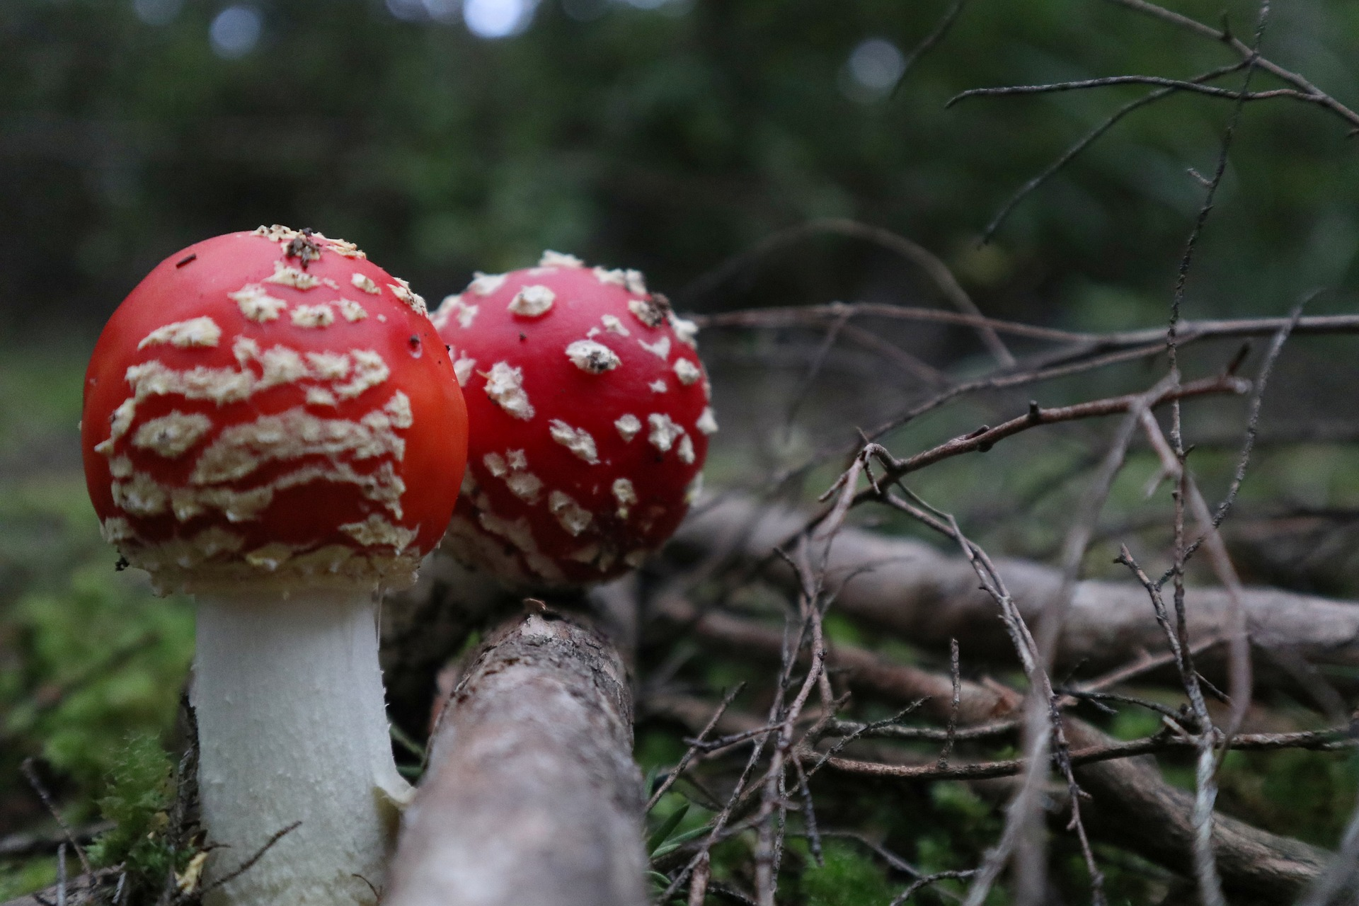
Scholarly Communication at UCF Libraries

Slide 6
History of The Office of Scholarly Communication (OSC)
Scholarly Communication Task Force (2011)
Included members from 6 different library departments
Produced white paper on the state of Scholarly Communication broadly and at UCF
Research Lifecycle (2012)
Mental model that represents components of a 21st century research lifecycle and pulls together into one place campus-wide support and services available to UCF researchers
Blue Button Experts
Scholarly Communication Working Advisory Group
The Office of Scholarly Communication & Scholarly Communication Librarian (2015)

Slide 7
Office of Scholarly Communication (OSC) Goals
Collaborate with other campus units to provide a suite of campus-wide services that supports all aspects of research and scholarly publishing at the University.
Advocate for the infrastructure, staffing, publishing funds and services that further support research and scholarly publishing at the University.
Educate and facilitate discussions about the changing scholarly communication environment, including the move to open access and sustainable publishing and exploring new ways to create, disseminate, evaluate, and preserve research and scholarly outputs at the University.

Slide 8
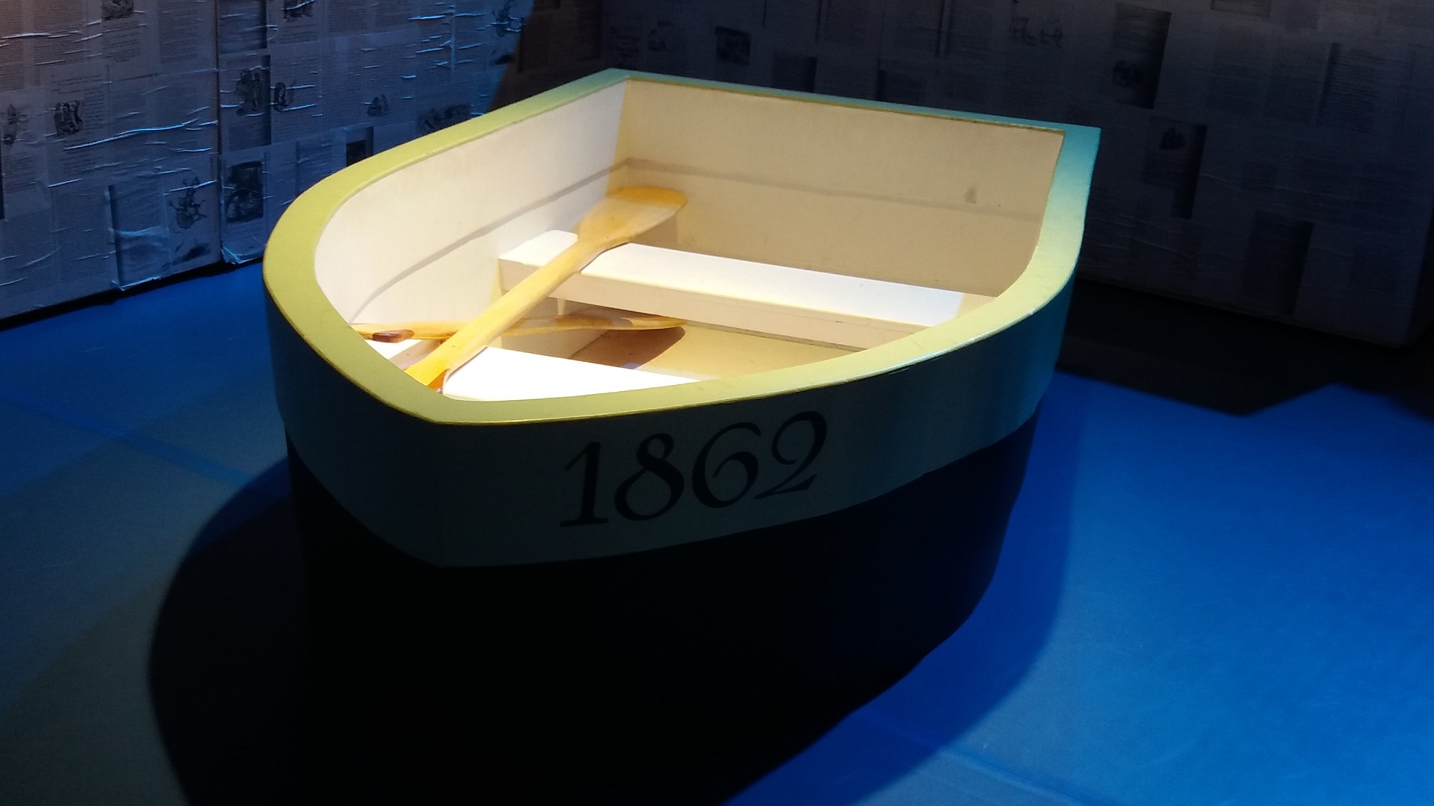
Scholarly Communication Working Advisory Group

Slide 9
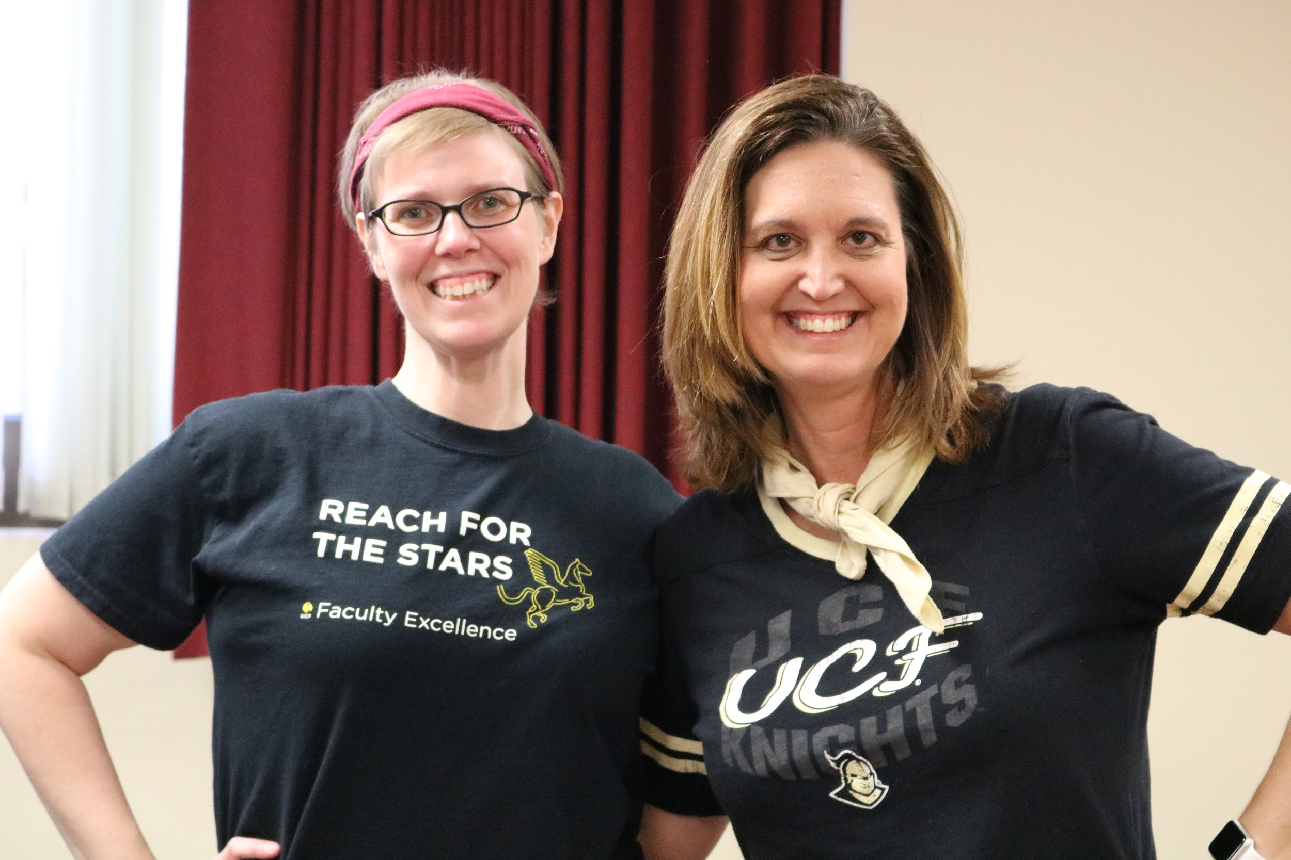
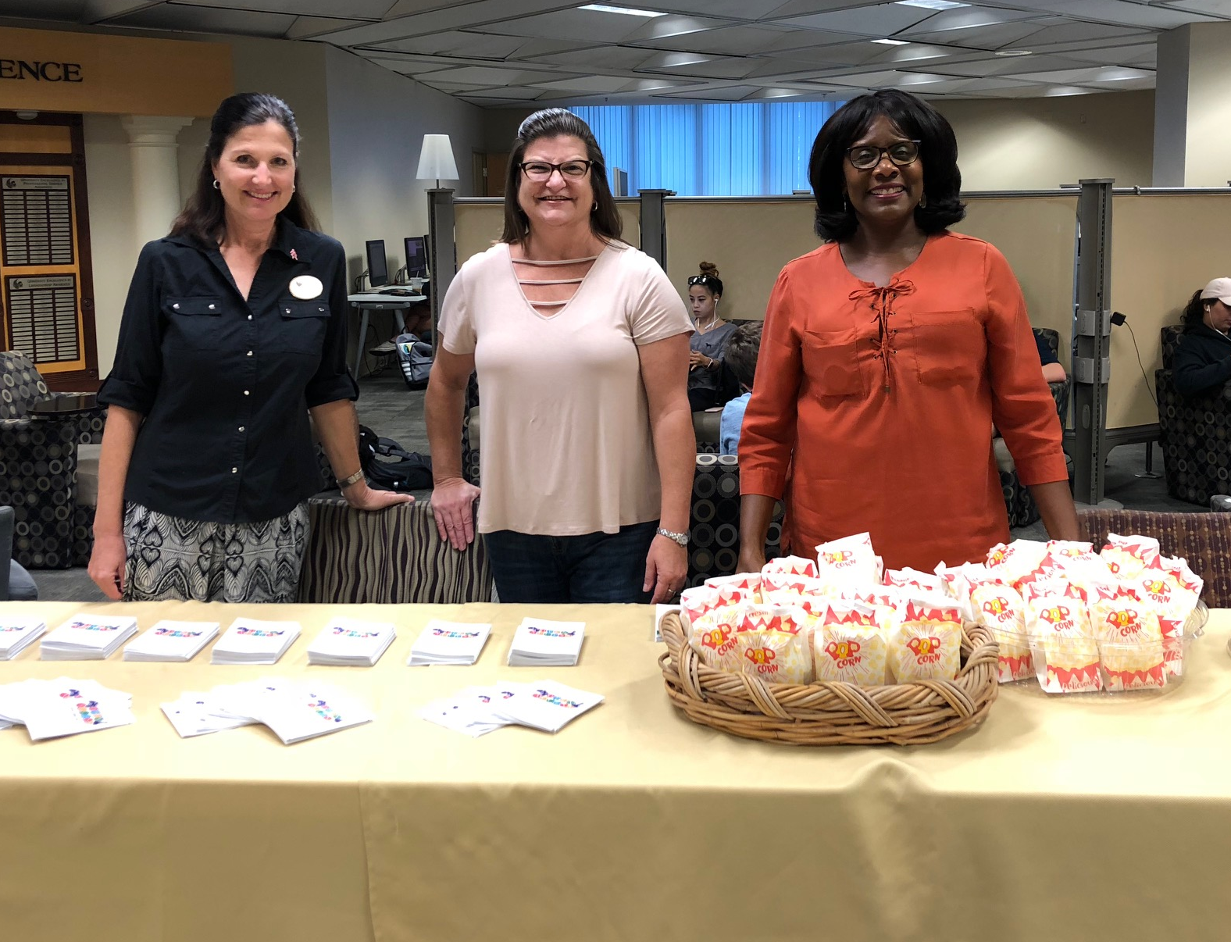
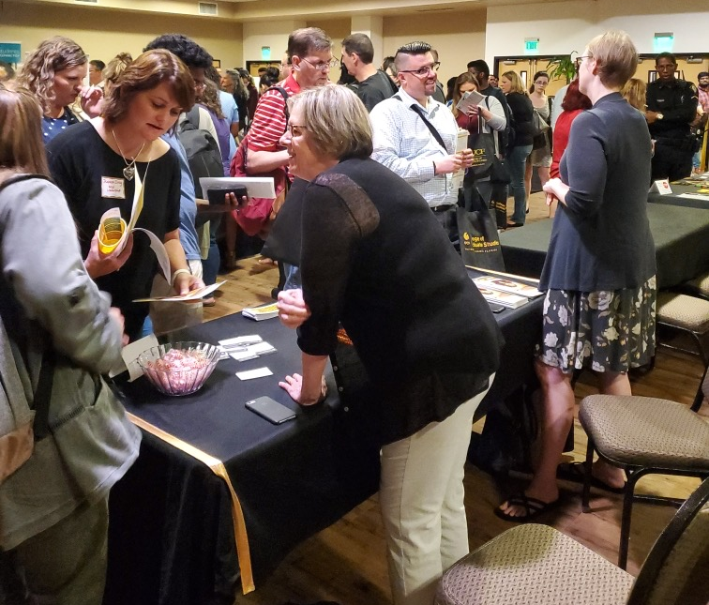
Scholarly Communication Working Advisory Group
Volunteer group of 20+ librarians and library staff from various departments in the library
Participates in scholarly communication outreach, marketing, and educational efforts
Leads projects, such as the Research Lifecycle open text, Open Access Week, etc.

Slide 10
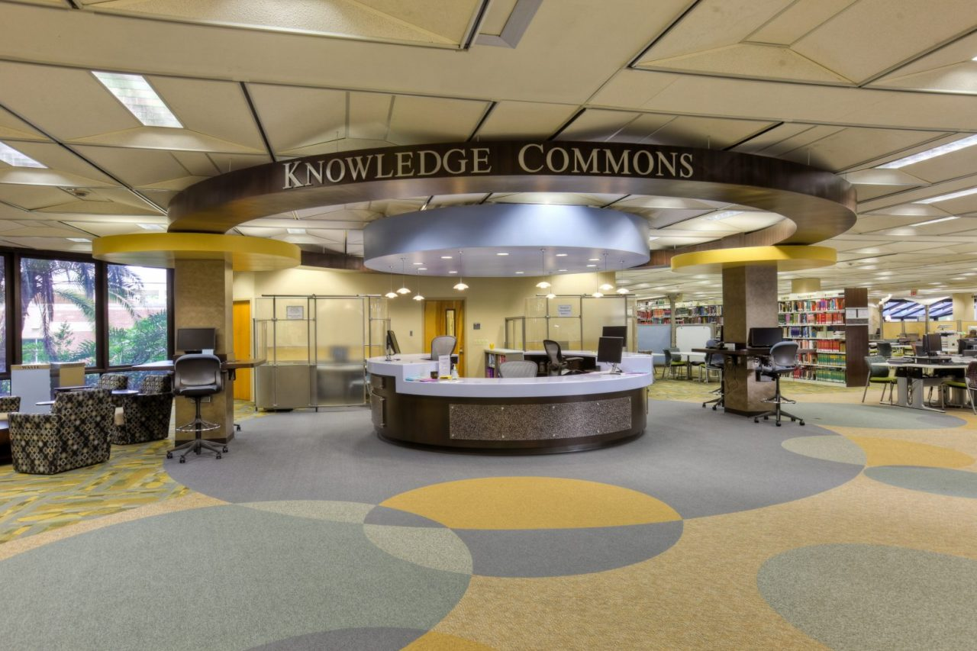
UCF Libraries
Subject Librarian Model
Notes:
Possible photo for student collaborations

Slide 11
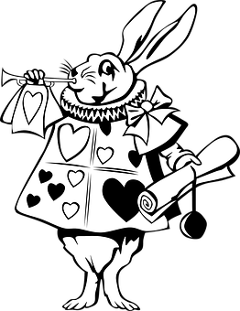
Traditional Model
Before 2012 - Traditional Reference Department
Reference Desk ( up to 16 hours)
Collection Development (with or without expertise)
Library Instruction (English, Speech, Subject Expertise, including other subject areas)
Night and Weekend Hours
Notes:
Possible photo for student collaborations

Slide 12
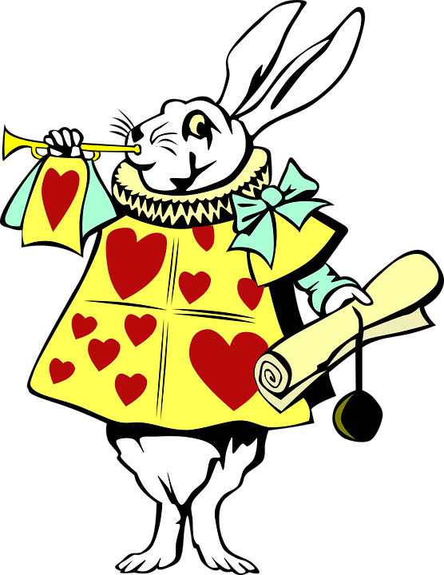
How it all began….
Since 2013 – New Subject Librarian Model
Primary Goal:
Build upon and increase the positive impact already achieved on student learning, faculty teaching and research, and scholarly communication outreach.
Expected Outcome:
Higher visibility and accessibility (on campus and in local, state, regional, national, and international venues)
Notes:
Possible photo for student collaborations

Slide 13
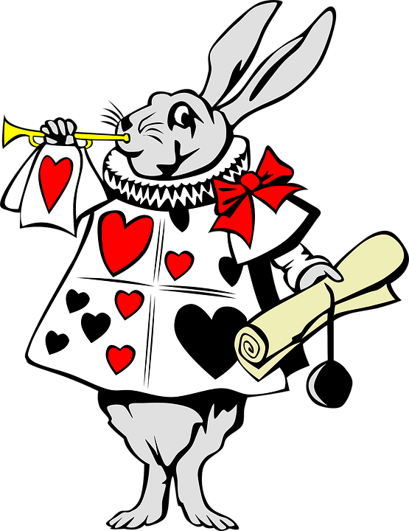
Subject Librarian Model
Product of the Research and Information Services Department, the Acquisitions and Collection Services Department, and the Office of Scholarly Communication
Work collaboratively to realign the librarians’ subject assignments so as to more closely link each librarian with a particular college/department
Maximize positive impacts on collection development; scholarly communication; and faculty/student teaching, learning, and research
Notes:
Possible photo for student collaborations

Slide 14
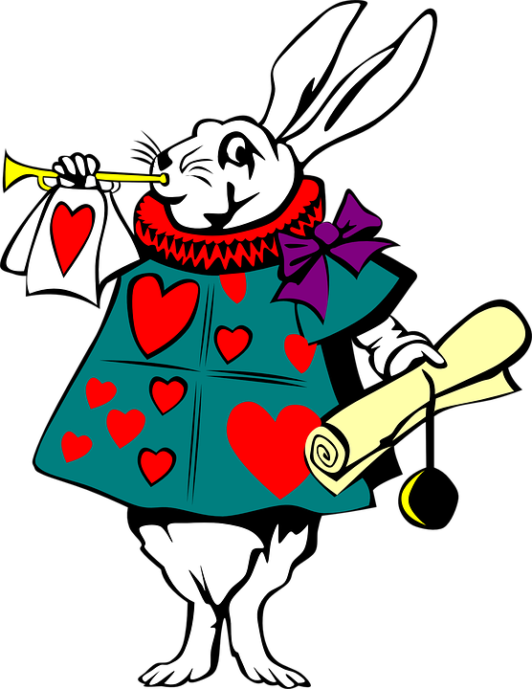
A Subject Librarian Perspective
Librarian’s role – reactive to proactive
Proactive outreach to UCF constituencies in support of Collection Development, Scholarly Communication, Faculty/Student –Teaching, Learning and Research
Notes:
Possible photo for student collaborations

Slide 15
Subject Librarian Model @UCF
Librarians were encouraged to provide practical assistance in helping faculty through the complexities of scholarly communication topics, such as copyright, author rights, open access, and research impact.
Academic department profiling thoroughly understand the mission, goals, activities and new directions of assigned academic departments and programs as well as the department’s criteria for promotion, review, and tenure.
Notes:
Possible photo for student collaborations

Slide 16
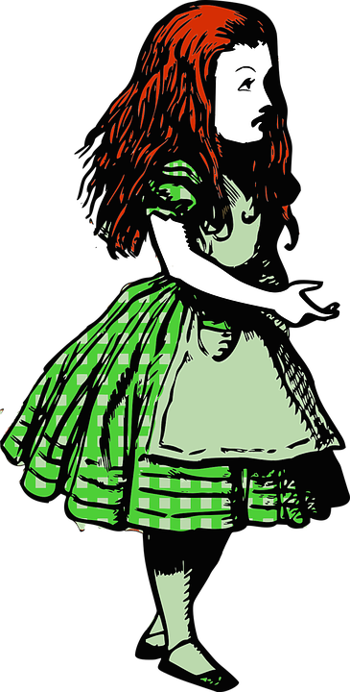
Subject Librarian Activities
Academic faculty profiling so librarians are thoroughly acquainted with their assigned faculty members’ research, grants, publications, and teaching assignments
Do curriculum mapping in order to achieve more refined, on-target curriculum integrated library research instruction, and collection development
Notes:
Possible photo for student collaborations

Slide 17
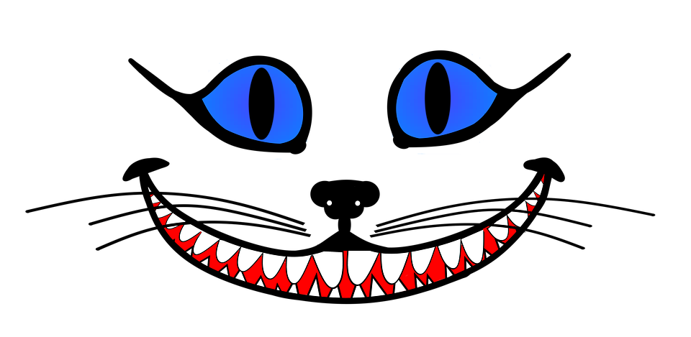
The Expanded Role of Subject Librarians
Becoming mobile –getting out of the library, visit assigned academic departments, participate in department meeting, one-on-one meeting with faculty in their offices
Additional outreach initiatives – create department newsletter, specialized workshops, etc.
Notes:
Possible photo for student collaborations

Slide 18
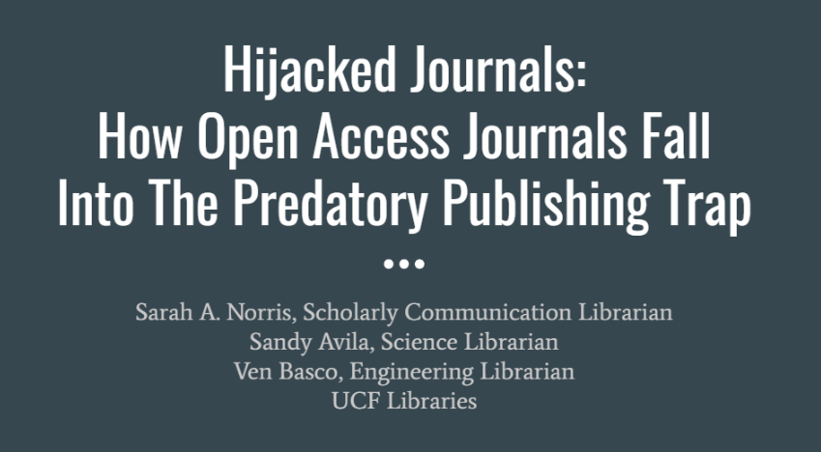
The Impetus of our Collaboration
October 2018

Slide 19
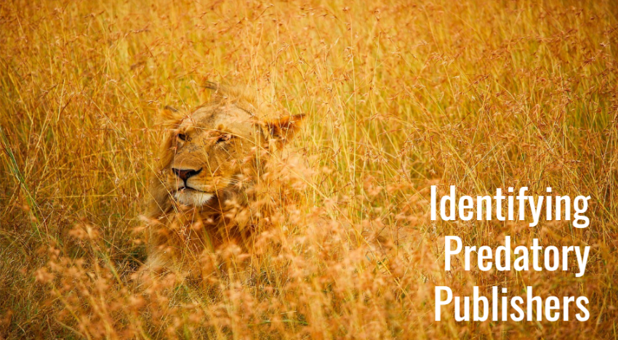
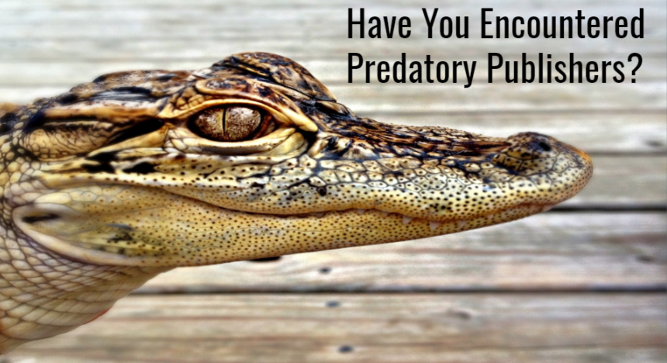
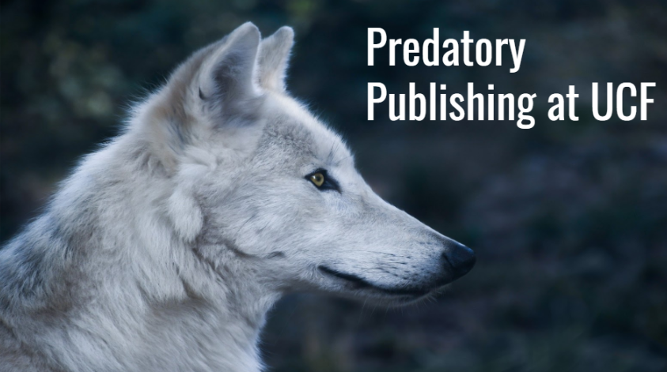

Slide 20
Leading into an ALA Poster Presentation

Slide 21
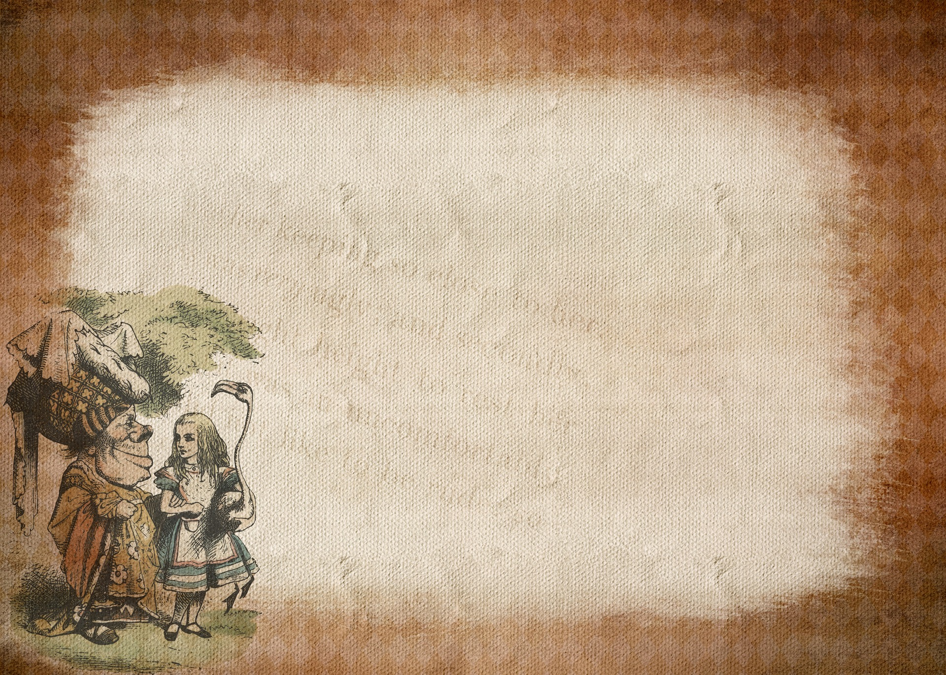
Sandy - Strategies & Best Practices
Strategies for Establishing
Successful Scholarly Communication Collaborations
Connect with discipline-specific focused team to develop topical ideas for workshop/programming
Locate faculty interests and pursue based on questions that arise
Include departments like Acquisitions & Electronic Resources to find out vendor trends
Work with Institutional Repository team to include options for uploading work

Slide 22
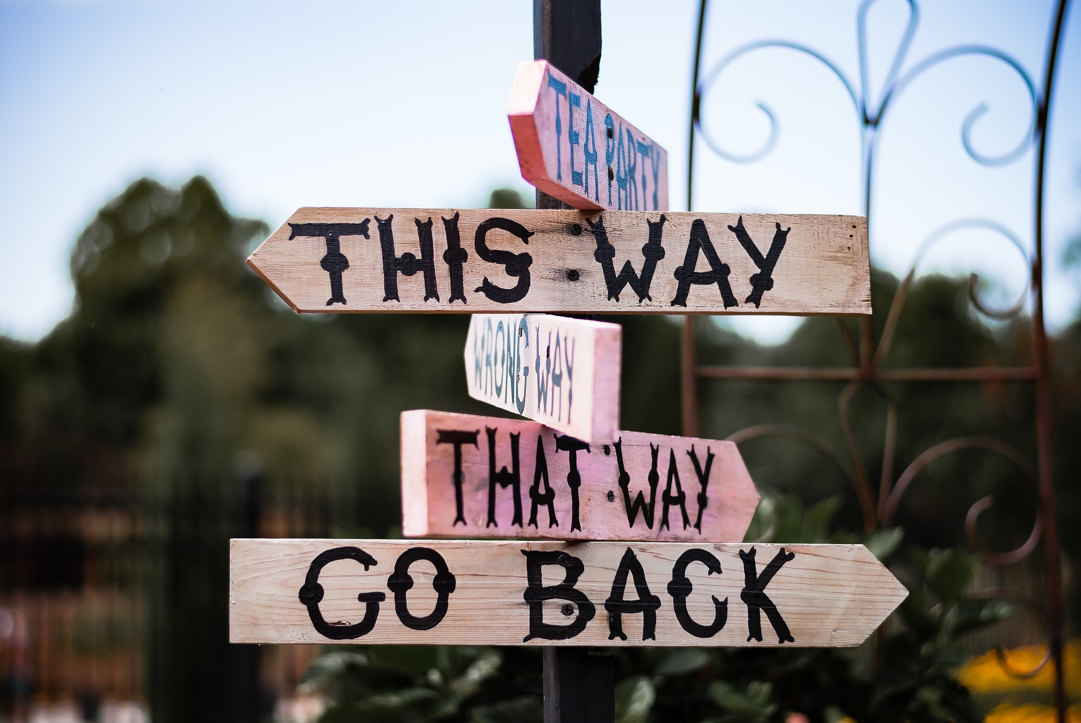
Collaboration Examples

Slide 23
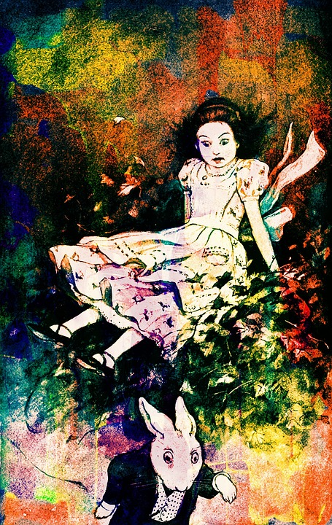
Student-Focused Collaborations

Slide 24
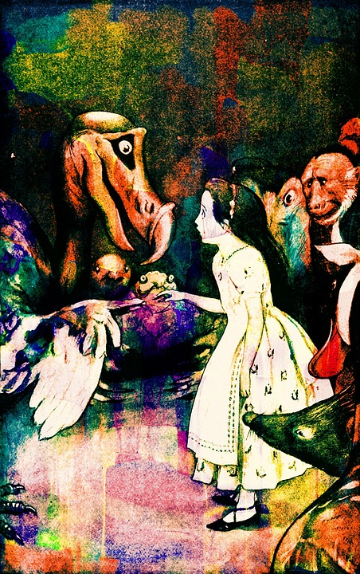
Research Consultation Referrals
Subject librarian meets with student re: research
Further discussion arises and referral to Office of Scholarly Communication is made
Mention of online resources like Research Guides
Takeaways: There is a need for us to work more closely together as a group based on number of referrals
Challenges: It can be difficult to explain there are separate roles for librarians & that students need to visit multiple people
Successes: Knowing we need to work together more has opened up channels of communication and has led to fruitful programming & other networking opps

Slide 25
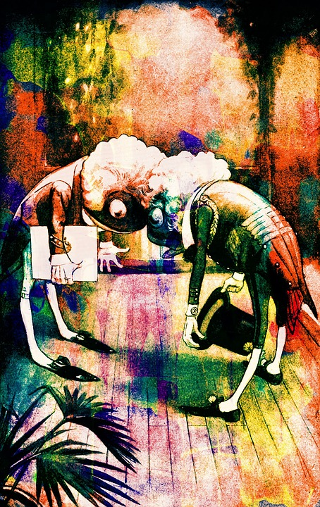
Library Programming & Joint Instruction
Library programming like Welcome Event for International Graduate Students & Graduate Orientation, involves instruction including both Scholarly Communication and Subject Librarian intro
Graduate Workshops: Copyright, Author Rights, Lit Reviews, Citation Metrics, & Apps for Research
Takeaways: Working together is necessary and valuable as well as requested
Challenges: Schedules provide issues- can’t be in two places at one time & not enough hours in a day to do it all!
Successes: Receiving requests for instruction targeted to student organizations and broader STEM related support

Slide 26
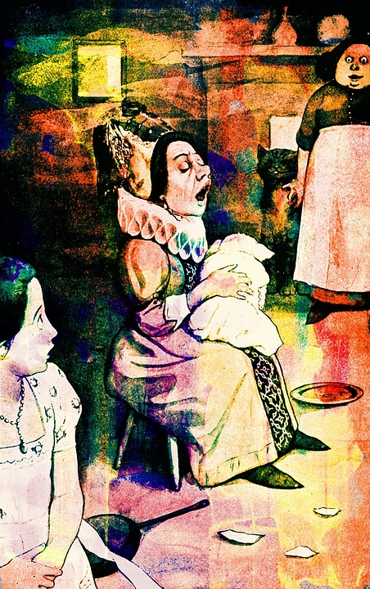
Scholarly Communication/STEM Workshops
STEM Bootcamp: Research, Data, & Tools: a four part workshop series (2 in Fall term, 2 in Spring term) covering Lit Reviews, Data Management, Citation Metrics & Data Visualization
Takeaways: Planning successful events takes time and staying on top of all details is imperative
Challenges: Make sure to remind students they registered to ensure good attendance
Successes: Workshops are being well received and we continue to expand offerings & to develop new ideas

Slide 27
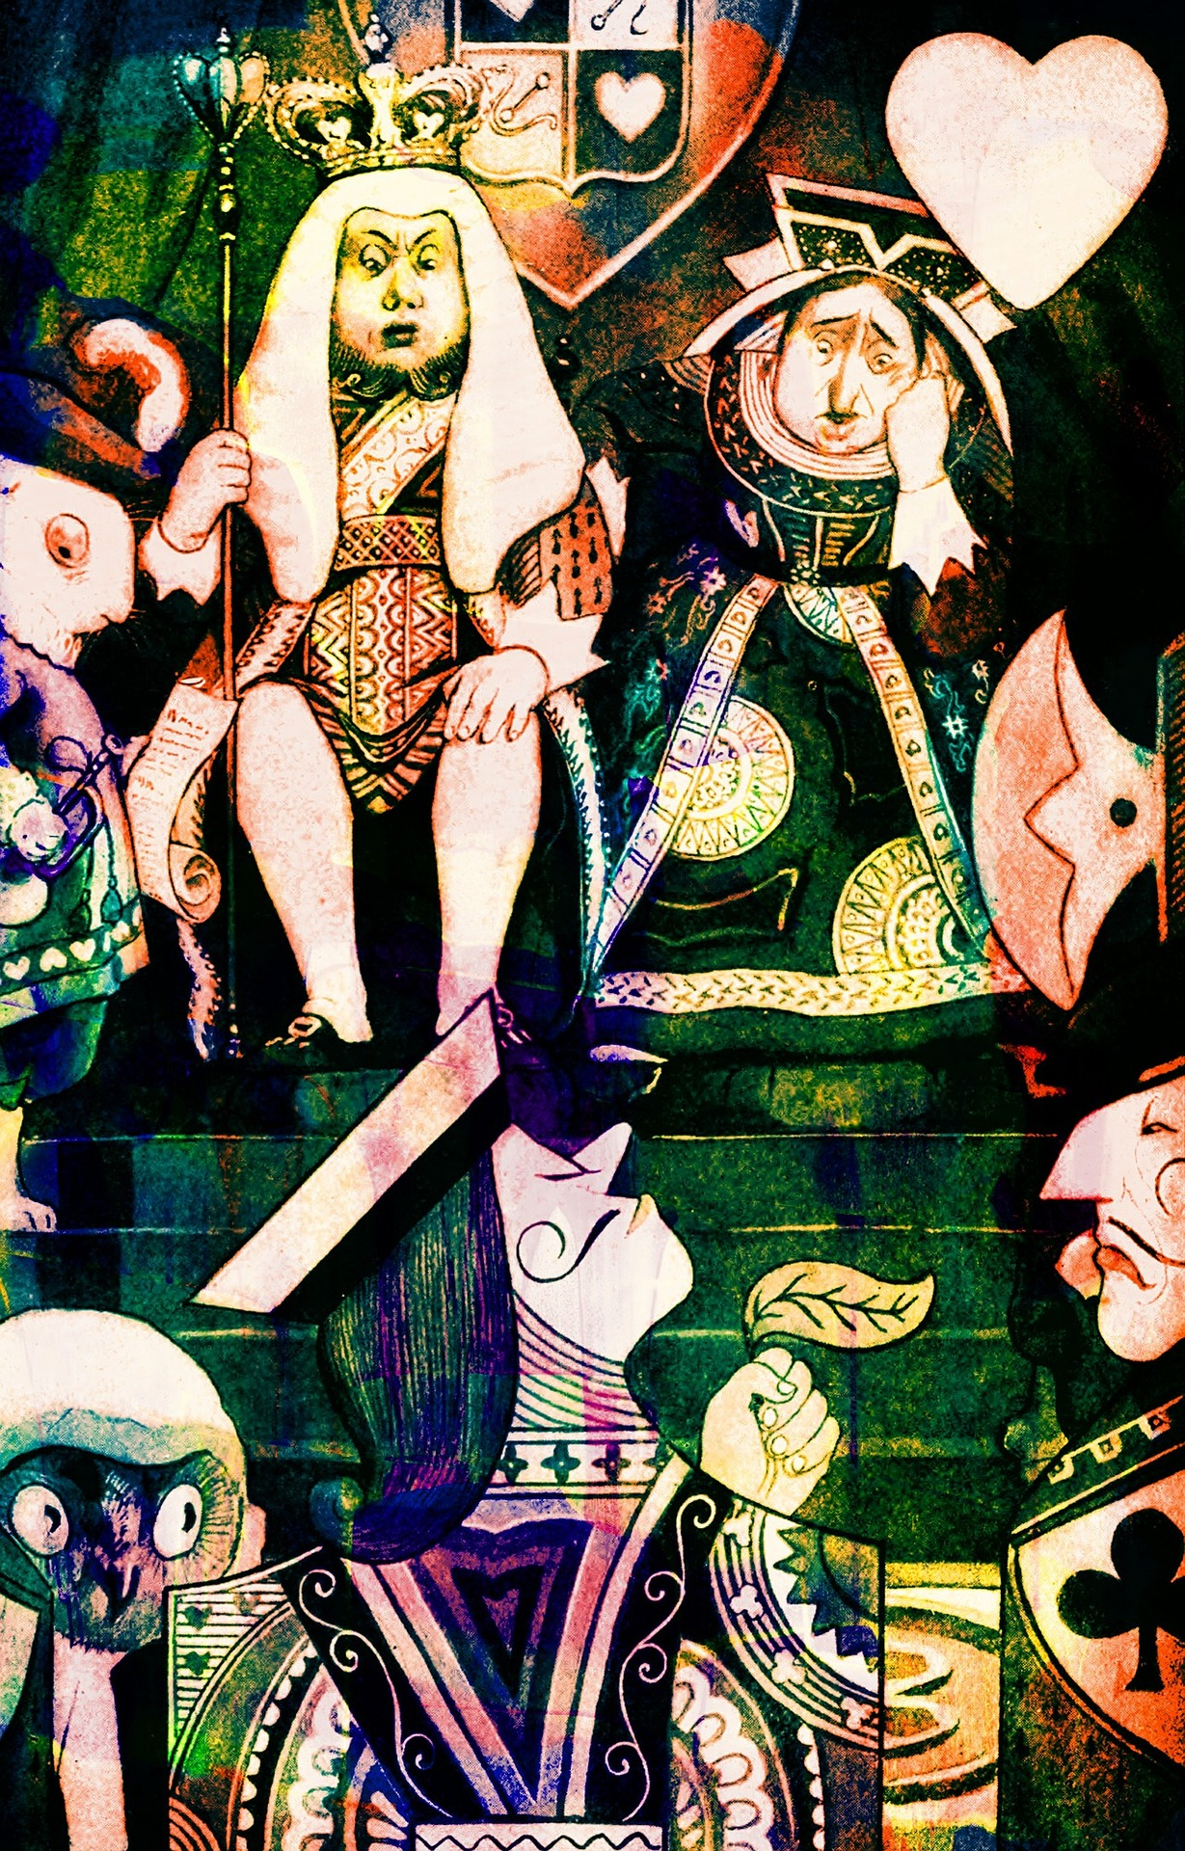
Faculty-Focused Collaborations

Slide 28
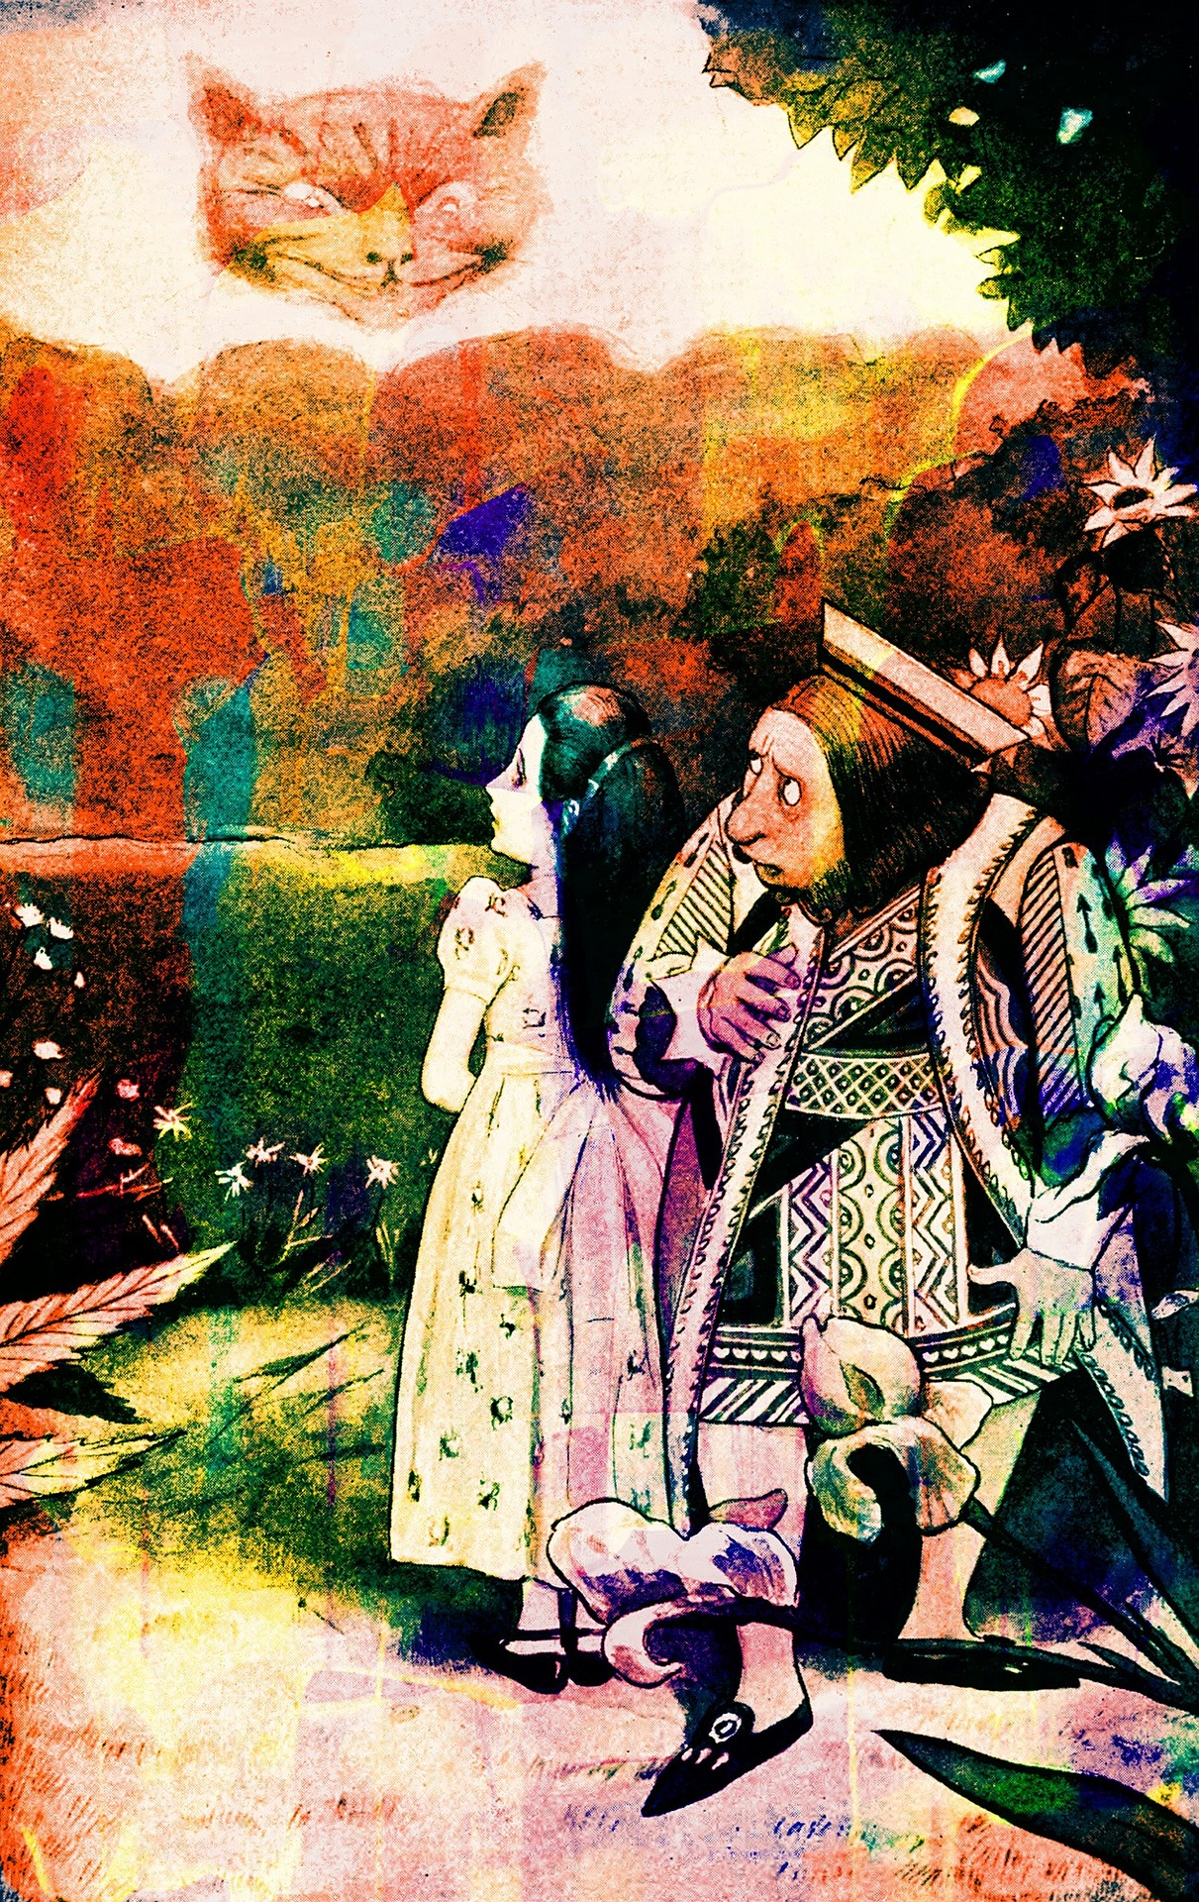
Faculty Questions & One-on-One Appointments
Scholarly Communication Librarian and Subject Librarians work collaboratively to provide research and teaching support for UCF faculty
Queries from faculty may go to Subject Librarians or go directly to the Scholarly Communication Librarian
Methods of support depend based on a variety of factors
One-on-One appointments are facilitated in a variety of ways
Notes:
Open access champions
Schol comm faculty advisory board

Slide 29
Takeaways: Working collaboratively to assist faculty with their teaching & research needs provides stronger, more effective support
Challenges: It can be difficult to explain there are separate roles for librarians & that faculty need to visit multiple people and/or need to meet multiple times for assistance; communication is an important consideration to keep everyone (including librarian colleagues) in the loop
Successes: Working collaboratively has led to increased channels of communication and has led to fruitful programming & other networking opportunities

Slide 30
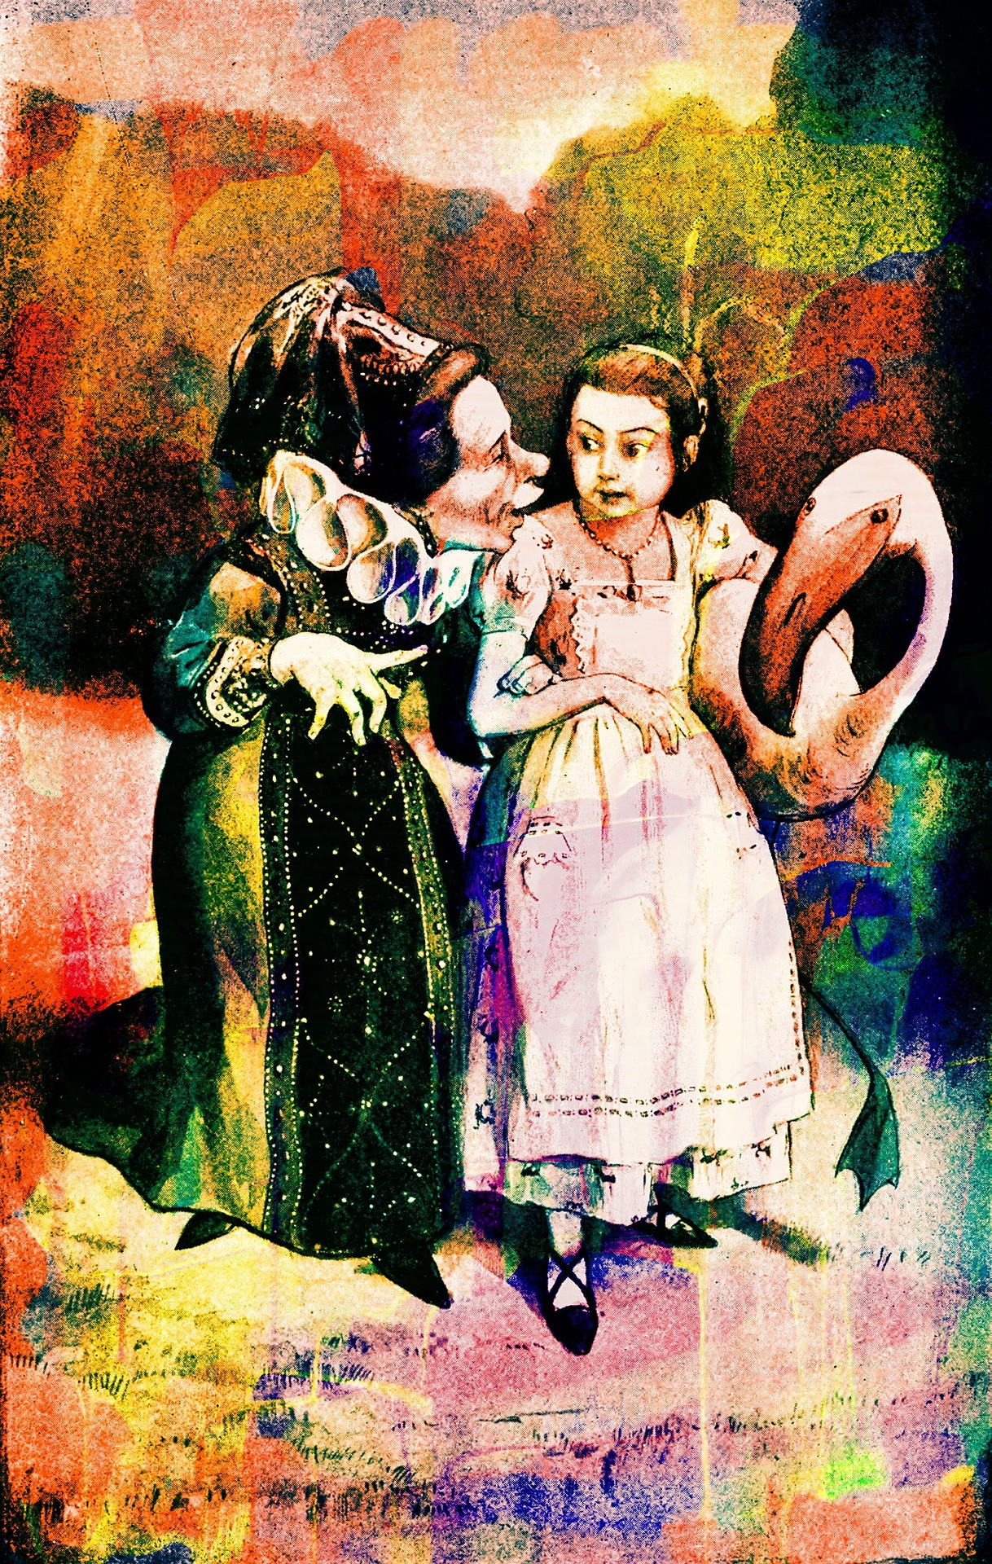
Faculty College & Department Meetings
Invitations to attend and/or present at college & department meetings may go to Subject Librarians or to the Scholarly Communication Librarian
Subject Librarians typically facilitate invitations
Subject Librarians & Scholarly Communication Librarian may attend together (or individually, depending on request)
Subject librarians often present on Scholarly Communication topics with pre-meeting assistance from Scholarly Communication Librarian

Slide 31
Takeaways: Working collaboratively provides stronger, more effective support to colleges & departments; leveraging colleagues with various expertise is beneficial for the college, department, and subject librarian (who is not expected to be an expert in all areas)
Challenges: Invitations to present and/or attend college & department meetings can be a challenge; including multiple librarians in a meeting might not be feasible
Successes: Requests for scholarly communication topics to be discussed at college & department meetings continues to increase, particularly in STEM disciplines

Slide 32
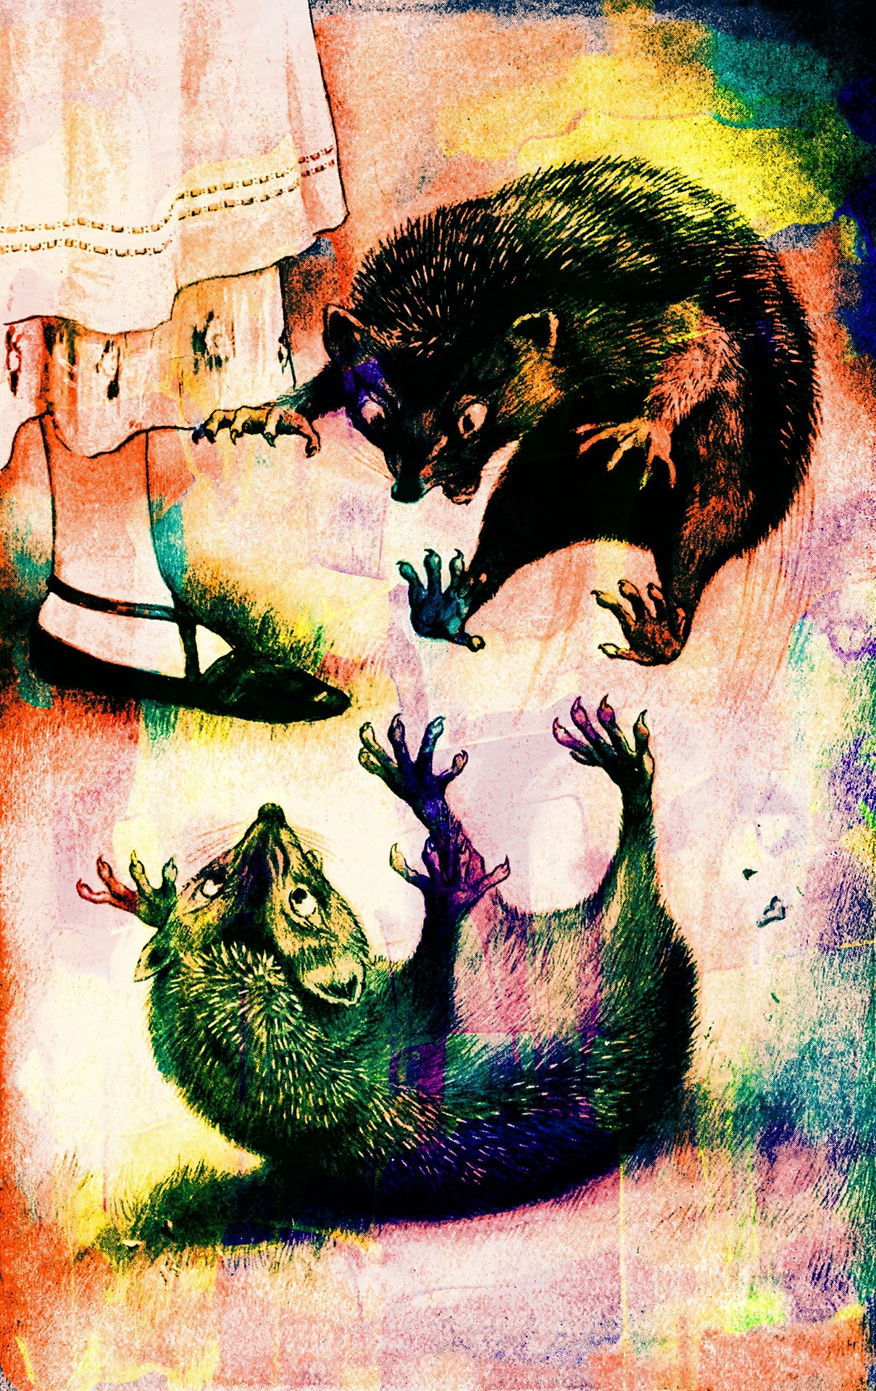
Predatory Publishing Workshops Redux
Offered subject-specific versions of workshop including:
Nursing
Center for Distributed Learning
Invited to speak at several STEM meetings including:
College of Sciences Deans & Chairs Meeting
Statistics Department Meeting
Invited speaker opportunities at national library conference venues on the topic
Continued interest for versions of this workshop to be offered to faculty

Slide 33
Takeaways: Predatory/deceptive publishing and other related OA topics are of particular interest to faculty & faculty-support units on campus
Challenges: Finding the best ways to engage faculty in these types of topics can be difficult (i.e. workshop versus faculty meeting, etc.); topic requires some additional background & info (i.e. intro to OA publishing)
Successes: Interest in this particular topic continues to increase with various requests on campus for related department visits, presentation requests, and more; opportunities for research on this topic and to present more broadly to the library community also continues to increase

Slide 34
American Chemical Society (ACS) on Campus
Web of Science workshop on Publons
Broader discussion of Read & Publish model
Scholarly Communication & Subject Librarian Tag Teaming to hold “On Location” Office Hours

Slide 35
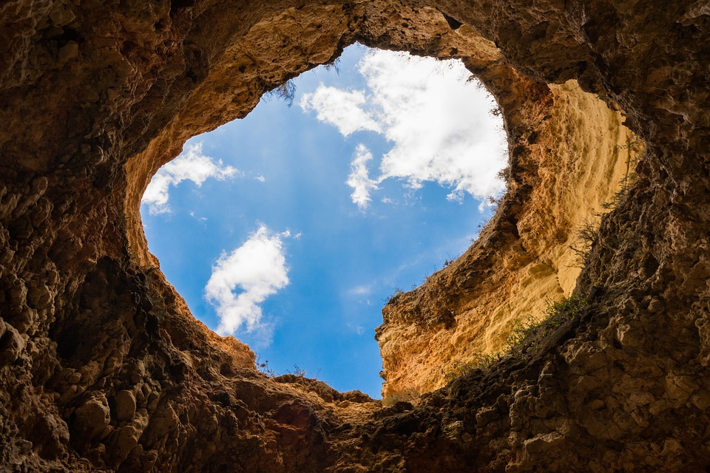
What rabbit hole will you fall into?
Notes:
Possible photo for student collaborations

Slide 36
References
Publications
Arthur, M, Tierney, B.G. (2013). “Subject Librarian Initiative at the University of Central Florida Libraries: Collaboration Amongst Research and Information Services, Acquisitions and Collection Services, and the Office of Scholarly Communication,” Charleston Conference Proceedings: Against the Grain Press, LLC, pp 486-491. https://docs.lib.purdue.edu/charleston/2013/Communication/3/
Norris, S.A., Dotson, L., Tierney, B., Harrison, R. (2017). “The Sky’s the Limit: Scholarly Communication, Digital Initiatives, Institutional Repositories, and Subject Librarians,” Charleston Conference Proceedings: Against the Grain Press, LLC, pp 426-321. https://docs.lib.purdue.edu/charleston/2016/scholcomm/5/

Slide 37
References
Publications
Norris, S.A., Tierney, B., Flick, L. (2019). “Why Every Librarian Should Know About Copyright: Creating Copyright Training Opportunities for Librarians at Your Institution,” In S. Benson (Ed.), Copyright Conversations: Rights Literacy in a Digital World: Association of College & Research Libraries. https://stars.library.ucf.edu/ucfscholar/866/
Forthcoming:
Norris, S.A., Avila, S., Basco, B. “Scholarly Communication: Liaison Librarians Supporting Faculty Research and Scholarly Work,” In C. Crichton and R. Canuel (Ed), Approaches to Liaison Librarianship: Innovations in Organization & Engagement: Association of College & Research Libraries.

Slide 38
References
Presentations
Anderson, R. and Norris, S.A. (2019, January). Predatory Journals: How to Help Faculty and Students Navigate the Good from the Bad. Presented at the American Library Midwinter Conference, Association of College and Research Libraries - Science Technology Section Hot Topics, Seattle, WA. https://acrl.libguides.com/sts2019midwinter/hottopics
Basco, B. , Avila, S. (2018, August). Sound the Alarm: What the Library Community Needs to Know About Predatory Publishing. Presented at the International Federation of Library Associations and Institutions World Library Information Conference-Lightning Round, Kuala Lumpur, Malaysia.
Avila, S., Basco, B. (2018, June). To Catch a Predatory Publisher: A Study of STEM Faculty at the University of Central Florida. Presented at the American Library Association Annual Conference, Association of College and Research Libraries - Science Technology Section Poster Session Breakfast, New Orleans, LA. https://stars.library.ucf.edu/ucfscholar/660/
Dotson, L., Harrison II, R.H., Norris, S.A., Tierney, B. (2016, November). The Sky’s the Limit: Scholarly Communication, Digital Initiatives, Institutional Repositories, and Subject Librarians. Presented at Charleston Conference, Charleston, SC. http://stars.library.ucf.edu/ucfscholar/55/
Tierney, B., Dotson, L., Basco, B., Venecek, J., Norris, S.A. (2016, March). Grow Your Own Academic Library Scholarly Communication Program. Presented at the Florida Library Association Conference, Daytona Beach, FL. http://stars.library.ucf.edu/ucfscholar/35/

Slide 39
Public Domain Image References 1 of 2
Samueles (Photographer). (2017, October 31). No title [digital image]. Retrieved from https://pixabay.com/photos/alice-english-wonderland-rabbit-2902560/
Prawny (Photographer). (2016, November 7). No title [digital image]. Retrieved from https://pixabay.com/illustrations/vintage-book-illustration-1794658/
Wild0ne (Photographer). (2016, March 21). No title [digital image]. Retrieved from https://pixabay.com/photos/watch-time-pocketwatch-white-rabbit-1267417/
ThisIsCool_Productions (Photographer). (2018, April 25). No title [digital image]. Retrieved from https://pixabay.com/photos/nature-mushroom-fungus-outdoors-3349161/
rmsa73 (Photographer). (2017, June 21). No title [digital image]. Retrieved from https://pixabay.com/photos/boat-alice-in-wonderland-exposure-2428091/
Clker_Free_Vector_Images (Photographer). (2012, April 12). No title. [digital image]. Retrieved from https://pixabay.com/vectors/rabbit-alice-in-wonderland-character-30701/
Clker_Free_Vector_Images (Photographer). (2014, August 2). No title. [digital image]. Retrieved from https://pixabay.com/vectors/alice-in-wonderland-white-rabbit-309964/
Clker_Free_Vector_Images (Photographer). (2012, April 12). No title. [digital image]. Retrieved from https://pixabay.com/vectors/rabbit-character-alice-in-wonderland-30751/
Clker_Free_Vector_Images(Photographer). (2014, June 6). No title. [digital image]. Retrieved from https://pixabay.com/vectors/alice-in-wonderland-rabbit-character-304698/
Clker_Free_Vector_Images (Photographer). (2012, April 11). No title. [digital image]. Retrieved from https://pixabay.com/vectors/mad-hatter-alice-in-wonderland-story-28758/
eugeniohansenofs (Photographer). (2019, September 3). No title. [digital image]. Retrieved from https://pixabay.com/vectors/alice-in-wonderland-red-hair-dress-4413732/
Conmongt (Photographer). (2019, March 3). No title. [digital image]. Retrieved from https://pixabay.com/illustrations/cheshire-cat-cat-cat-s-eye-4037421/
DarkWorkX (Photographer). (2018, March 1). No title [digital image]. Retrieved from https://pixabay.com/illustrations/alice-in-wonderland-frame-3191346/

Slide 40
Public Domain Image References 2 of 2
bgphotographyllc (Photographer). (2018, June 18). No title [digital image]. Retrieved from https://pixabay.com/photos/signs-mad-hatter-wonderland-alice-3479398/
Prawny (Photographer). (2016, November 7). No title [digital image]. Retrieved from https://pixabay.com/illustrations/vintage-book-illustration-1793185/
Prawny (Photographer). (2016, November 7). No title [digital image]. Retrieved from https://pixabay.com/illustrations/vintage-book-illustration-1793195/
Prawny (Photographer). (2016, November 7). No title [digital image]. Retrieved from https://pixabay.com/illustrations/vintage-book-illustration-1794687/
Prawny (Photographer). (2016, November 7). No title [digital image]. Retrieved from https://pixabay.com/illustrations/vintage-book-illustration-1794693/
Prawny (Photographer). (2016, November 7). No title [digital image]. Retrieved from https://pixabay.com/illustrations/vintage-book-illustration-1794784/
Prawny (Photographer). (2016, November 7). No title [digital image]. Retrieved from https://pixabay.com/illustrations/vintage-book-illustration-1794741/
Prawny (Photographer). (2016, November 7). No title [digital image]. Retrieved from https://pixabay.com/illustrations/vintage-book-illustration-1794752/
Prawny (Photographer). (2016, November 7). No title [digital image]. Retrieved from https://pixabay.com/illustrations/vintage-book-illustration-1794747/
geralt (Photographer). (2016, March 23). No title [digital image]. Retrieved from https://pixabay.com/photos/directory-signposts-step-next-task-1273088/
Skitterphoto (Photographer). (2014, December 4). No title [digital image]. Retrieved from https://pixabay.com/photos/cave-hole-landscape-blue-sky-sunny-555727/

Slide 41
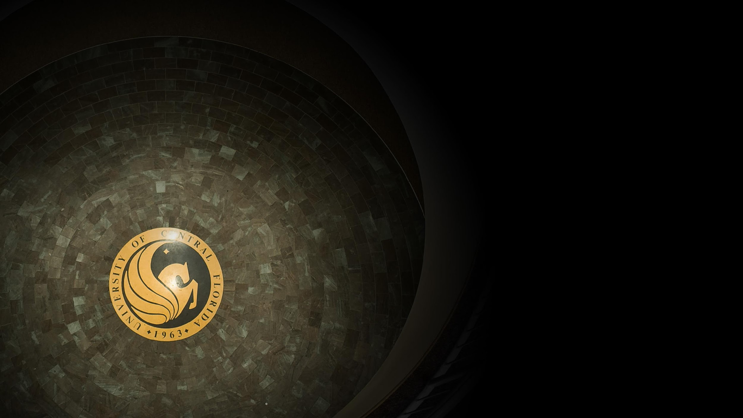
Contact Information
Thank You for Your Attention!
Any Questions…..
Ven Basco
Engineering & Computer Science Librarian
buenaventura.basco@ucf.edu
Sandy Avila
Science Librarian
sandy.avila@ucf.edu
Sarah A. Norris
Scholarly Communication Librarian
sarah.norris@ucf.edu

