Slide 1
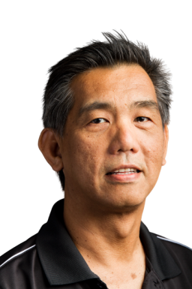
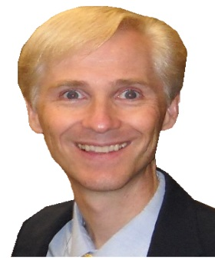
Best Practices:
An Exciting Showcase of
Inclusive, Innovative, & Interconnected
Libraries in Asia and the USA
Buenaventura Basco
MA-LIS, MBA
University of Central Florida
Orlando, Florida, USA
John Hickok
MLIS, MA
California State University
Fullerton, California, USA

Slide 2
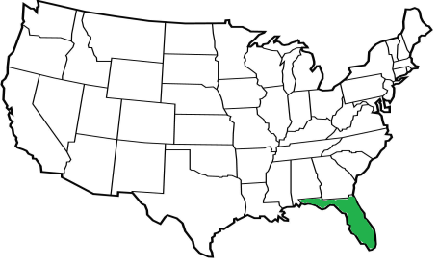
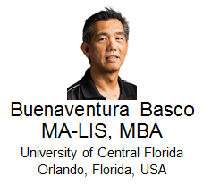
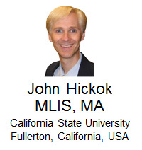
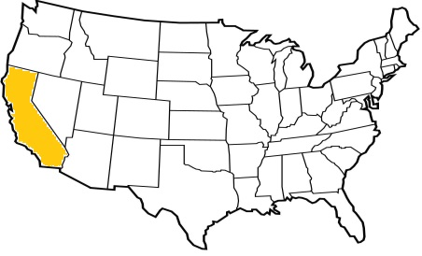
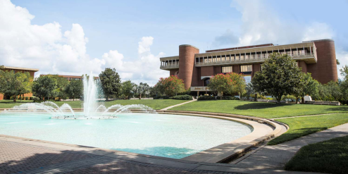
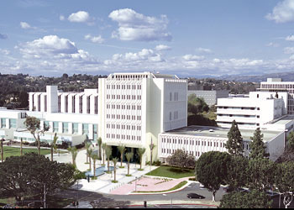
About us:
Orlando, Florida
Fullerton, California

Slide 3
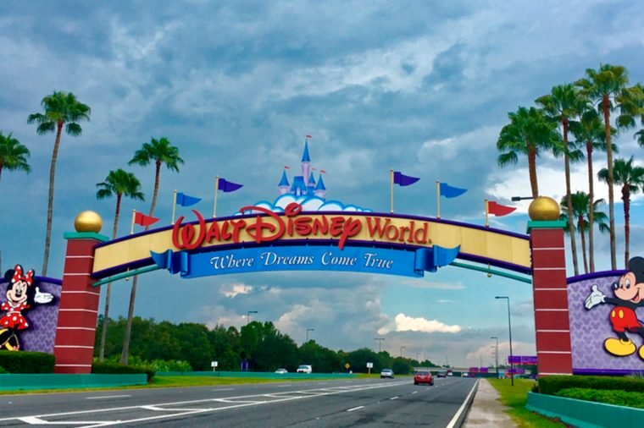
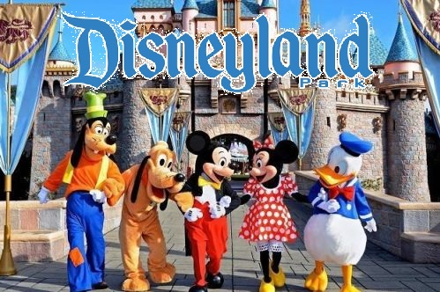
About us:
Orlando, Florida
Fullerton, California

Slide 4

About us:
Orlando, Florida
Fullerton, California

Slide 5
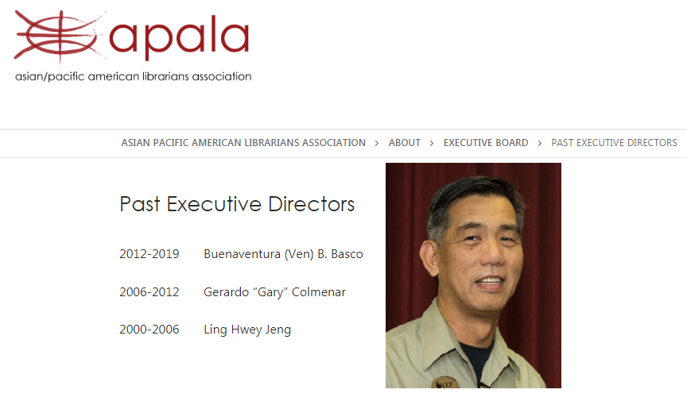
Ven:
Past Exec Director: Asian Pacific American Librarians Association

Slide 6
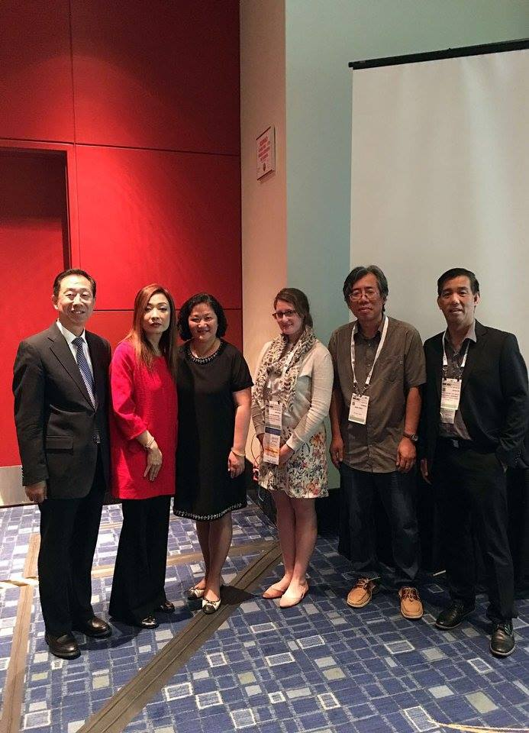
Ven:
ALA International Relations Committee (Asia & Oceania Subcommittee)

Slide 7
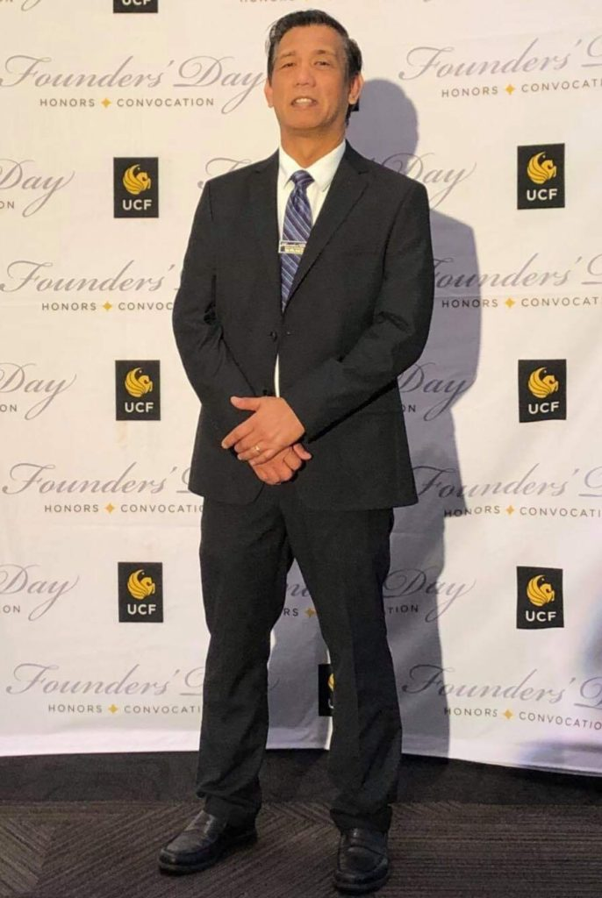
Ven:
Recipient of the 2019 UCF Excellence in Librarianship Award

Slide 8
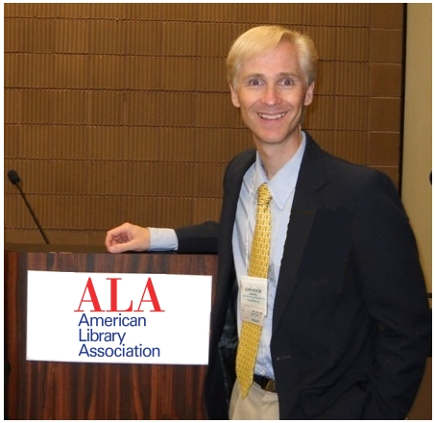
John:
Chair of ALA International Relations Roundtable, 2016

Slide 9
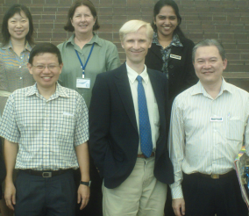
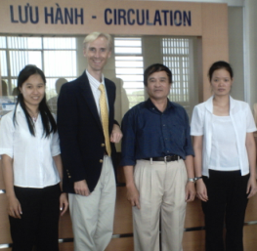

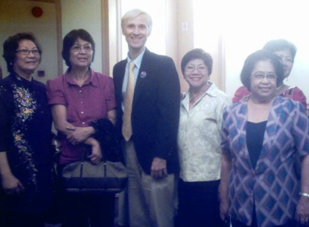
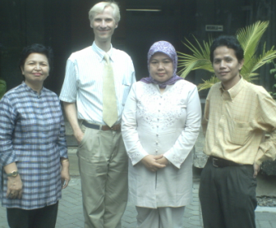
John:
15 years of research on Asia libraries

Slide 10
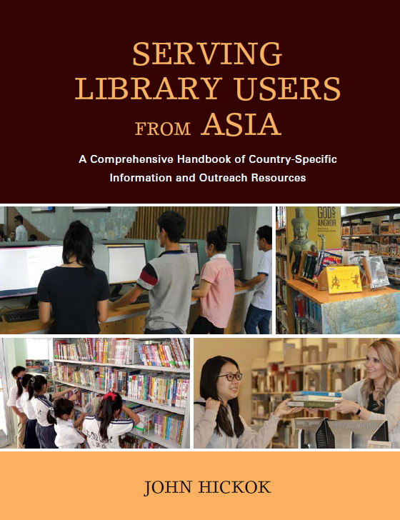
John:
Author of Asia Libraries book this year

Slide 11
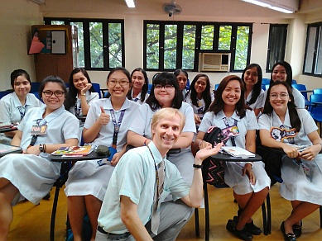
John:
Fulbright LIS Instructor (PNU & UST) Philippines, 2016

Slide 12
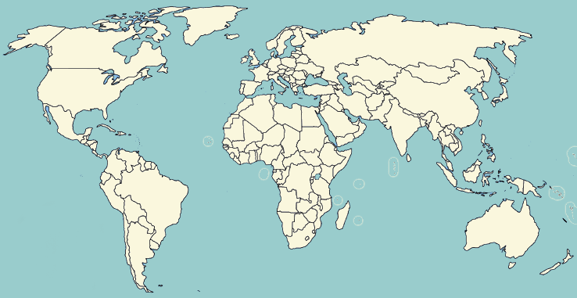
Today’s presentation…
A showcase of Best Practices in US & Asia libraries,
reflecting Inclusion, Innovation, & Interconnectedness

Slide 13
John

Slide 14
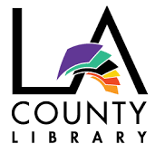

1. Los Angeles California
County & City Public Library

Slide 15
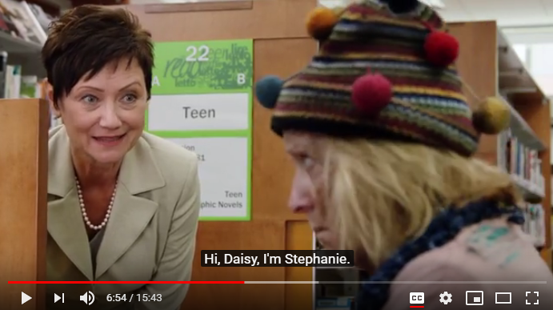
source: https://www.youtube.com/watch?v=P99gdETQ1fU
They created a 2017 video training series for better inclusion of patrons with mental illness

Slide 16
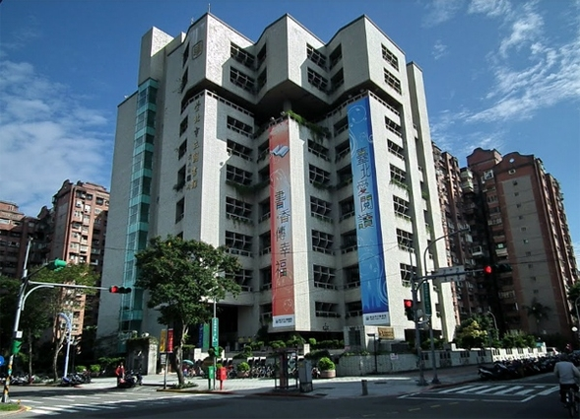
2. Taipei, Taiwan Central Public Library

Slide 17
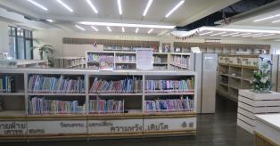
They created an inclusive, multicultural book collection (including Tagalog!)

Slide 18
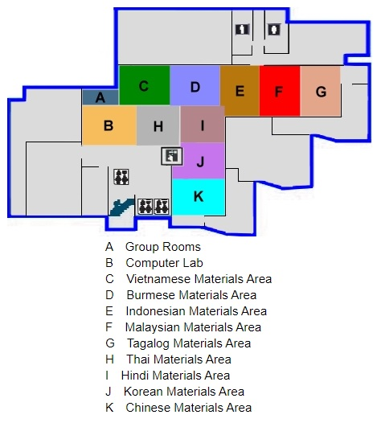
They created an inclusive, multicultural book collection (including Tagalog!)

Slide 19
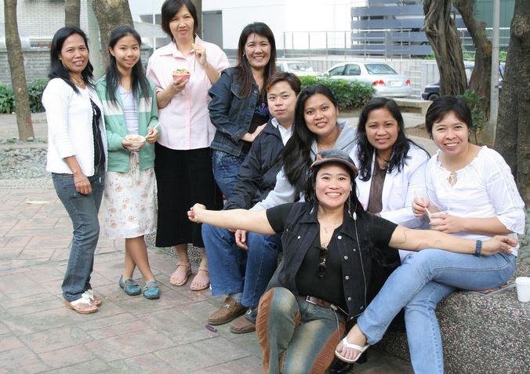
source: https://www.facebook.com/Filipinos-in-Taiwan-144869968860718/
Around 96,000 Filipinos in Taiwan!

Slide 20
Let’s have some fun!
Do you know the word “Library” in other languages??

Slide 21


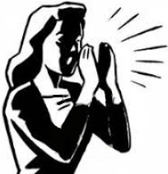
1. I will ask if you know “Library” in a certain language
2. If you know it, raise your hand!
3. My spotters & I will spot the first responder, and ask you to yell out your answer
?

Slide 22
And yes, there are PRIZES!

Slide 23

Are you ready??

Slide 24
How do you say “Library” in…

Slide 25
Chinese?

Slide 26
Tú-shū-guǎn

Slide 27
How do you say “Library” in…

Slide 28
Spanish?

Slide 29
Biblioteca

Slide 30
How do you say “Library” in…

Slide 31
Malaysian/
Indonesian?

Slide 32
Perpustakaan

Slide 33
How do you say “Library” in…

Slide 34
Japanese?

Slide 35
To-shou-kan

Slide 36
How do you say “Library” in…

Slide 37
Vietnamese?

Slide 38
Thư-viện

Slide 39
How do you say “Library” in…

Slide 40
Thai?

Slide 41
H̄̂ong-su-̄mud

Slide 42
How do you say “Library” in…

Slide 43
Arabic?

Slide 44
Maktaba

Slide 45
How do you say “Library” in…

Slide 46
French?

Slide 47
Bibliothèque

Slide 48
How do you say “Library” in…

Slide 49
Korean?

Slide 50
Dose-o-gwan

Slide 51
How do you say “Library” in…

Slide 52
Filipino
Sign Language?

Slide 53
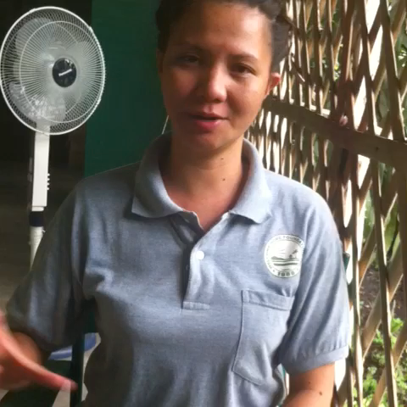
Source: http://whfi.ph/dictionary-beginners-nouns

Slide 54
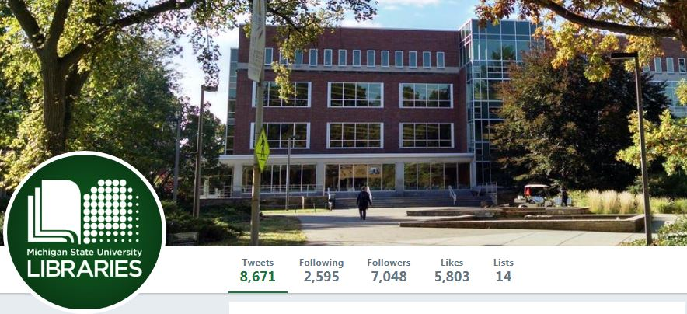
3. Michigan State University

Slide 55
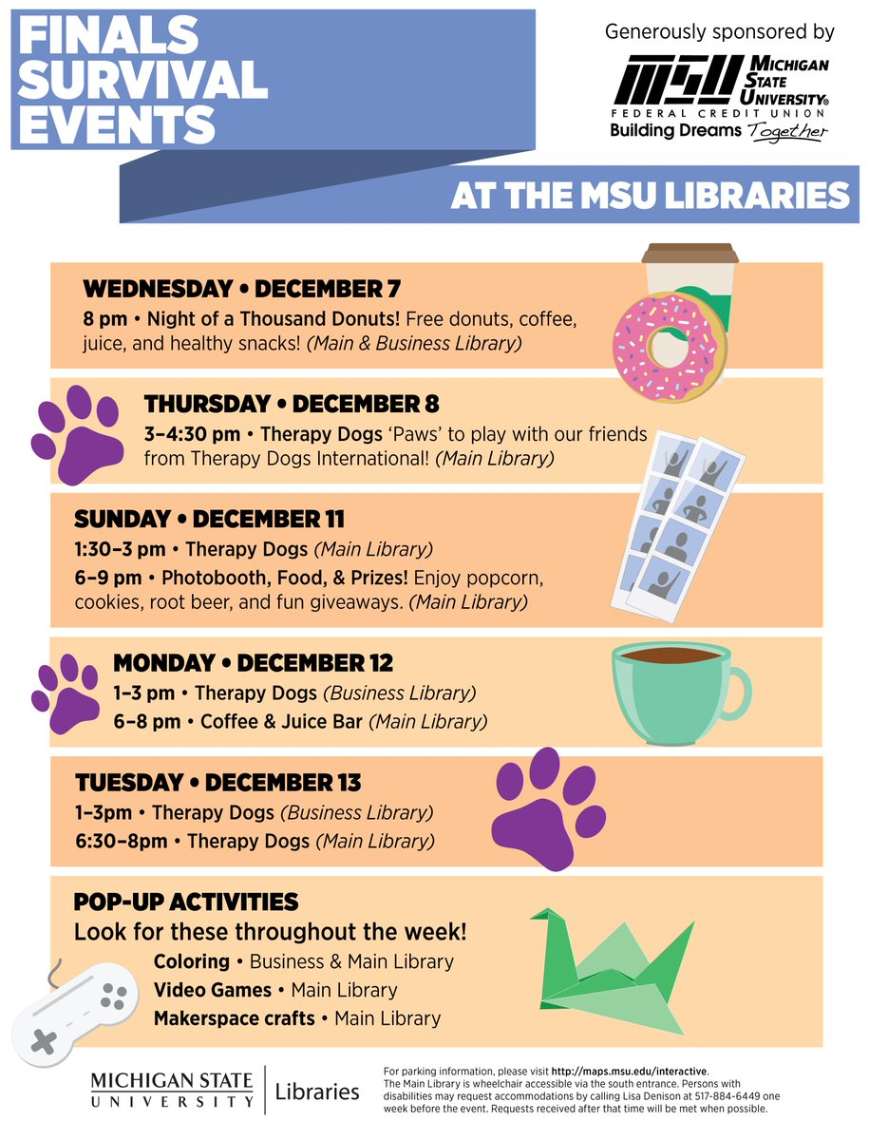
They created an innovative student-stress-relief outreach program for finals week. Including therapy dogs!

Slide 56
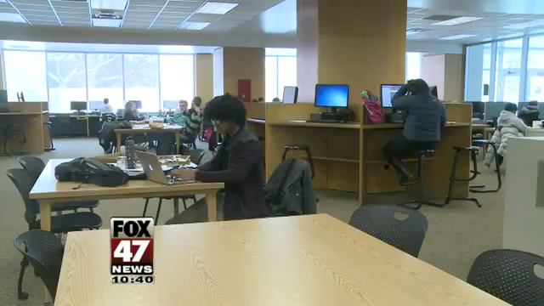
source: https://www.youtube.com/watch?v=Max172DsW1c

Slide 57
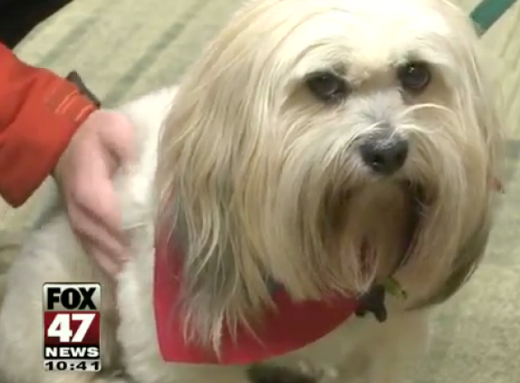
Awww, how can you resist that face?

Slide 58
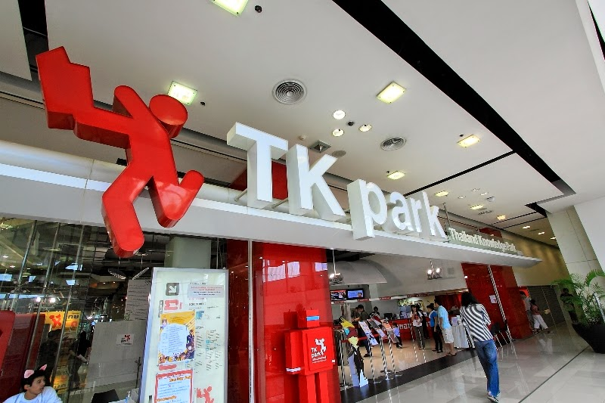
4. Thailand’s “TK Park” libraries

Slide 59
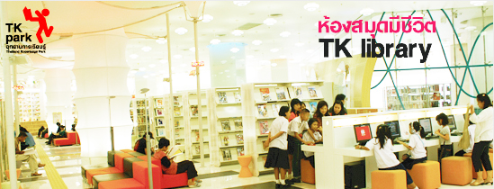
Thailand’s gov’t. innovatively fused libraries and
e-entertainment centers together

Slide 60
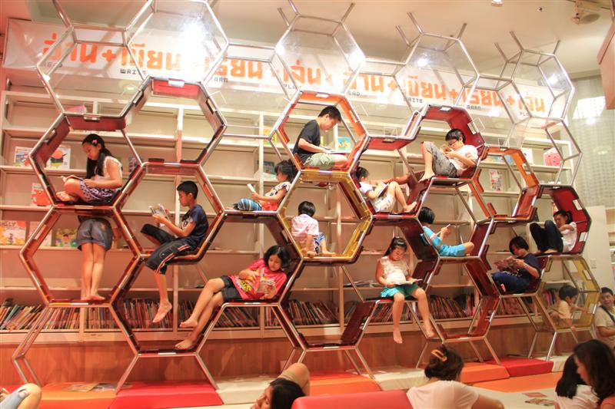
Thailand’s gov’t. innovatively fused libraries and
e-entertainment centers together

Slide 61
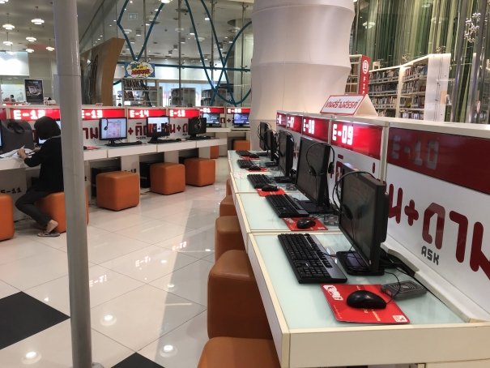
Thailand’s gov’t. innovatively fused libraries and
e-entertainment centers together

Slide 62
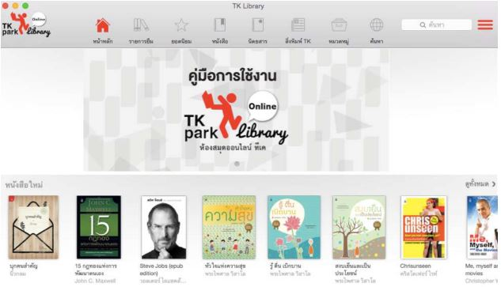
Thailand’s gov’t. innovatively fused libraries and
e-entertainment centers together

Slide 63
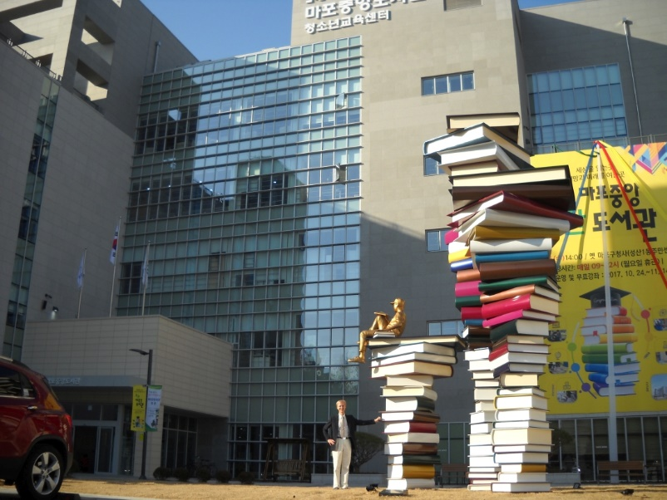
5. Mapo (Seoul) Public Library

Slide 64
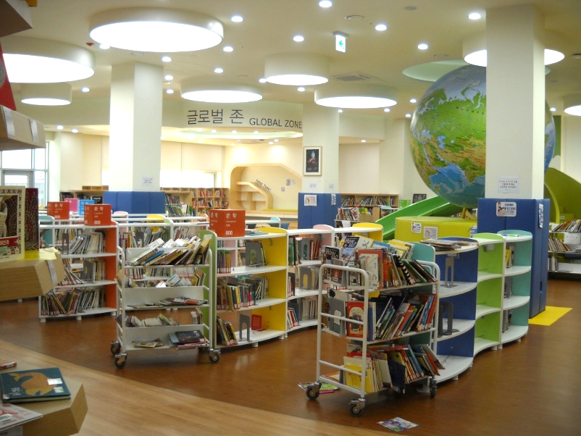
The library is an amazing interconnection of space:
library facilities and community spaces

Slide 65
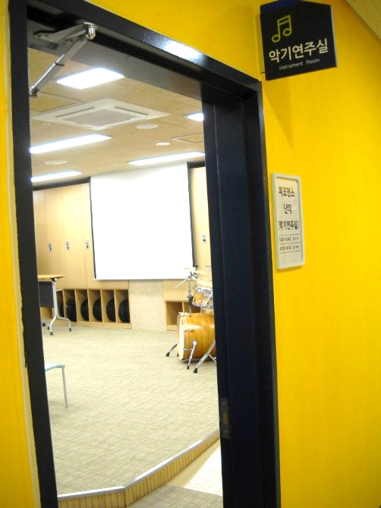
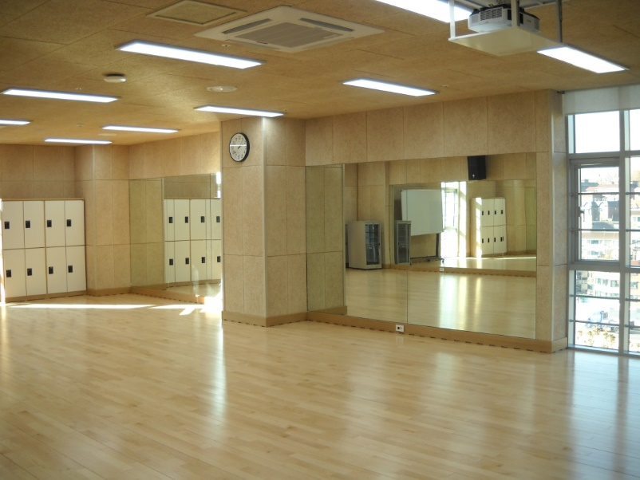
The library is an amazing interconnection of space:
library facilities and community spaces

Slide 66
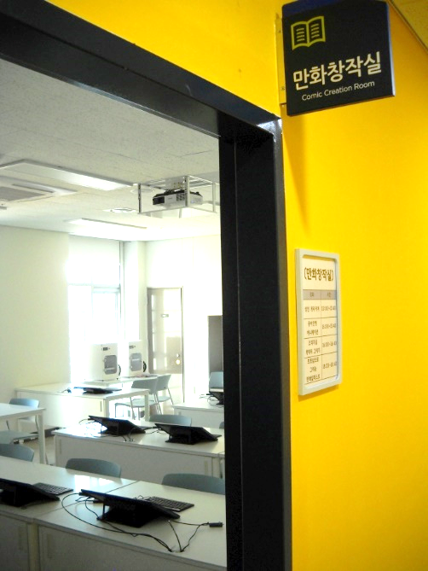
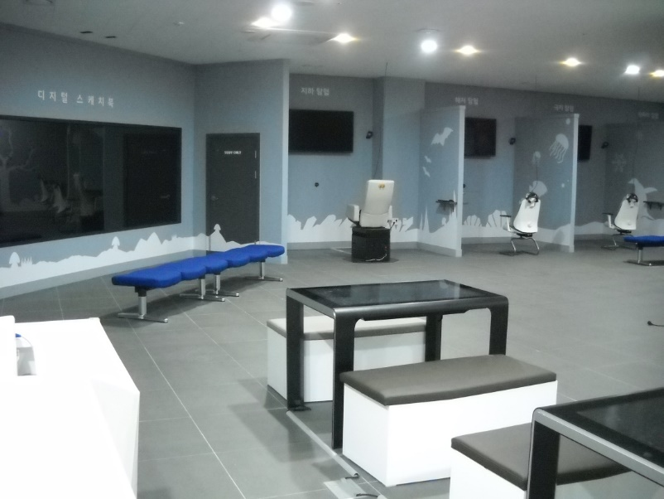
The library is an amazing interconnection of space:
library facilities and community spaces

Slide 67
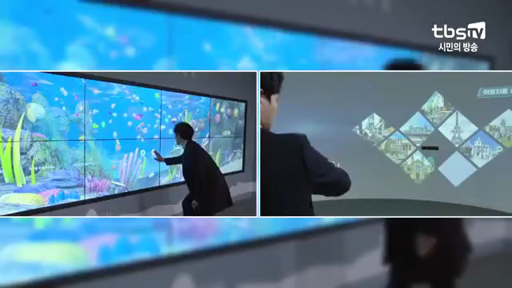
source: https://www.youtube.com/watch?v=hRWD-OPemZs
The library is an amazing interconnection of space:
library facilities and community spaces

Slide 68
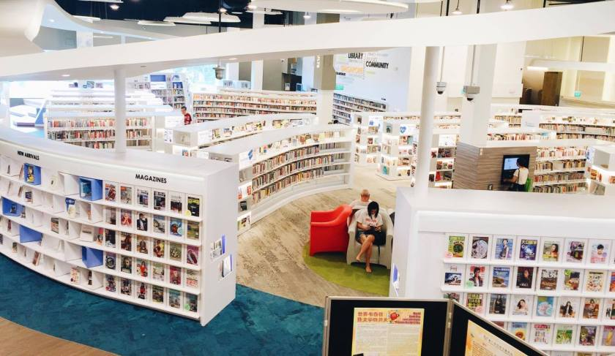
6. Singapore Public Library system

Slide 69
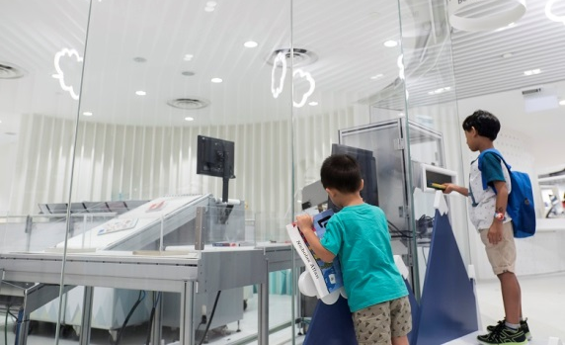
The 26 public libraries are all interconnected by a common catalog, universal return, and high-tech sorting

Slide 70
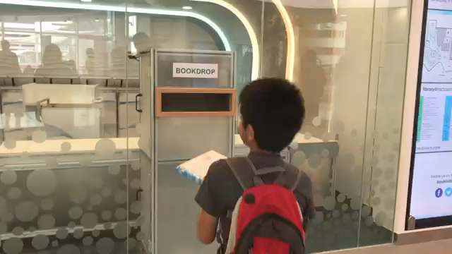
source: https://www.youtube.com/watch?v=T15L8LWZ2-Q
The 26 public libraries are all interconnected by a common catalog, universal return, and high-tech sorting

Slide 71
Amazing examples of inclusion, innovation, & interconnectedness!

Slide 72
Ven

Slide 73
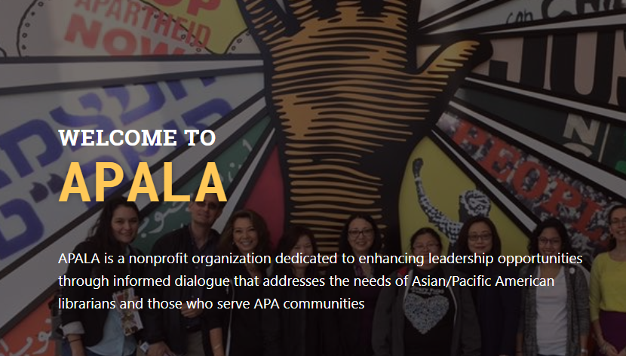

Slide 74

Founded in 1980, incorporated in Illinois in 1981 and formally affiliated with the American Library Association (ALA) in 1982.
Organized and founded by librarians of diverse Asian and Pacific ancestries committed to working together toward a common goal.
Goal - To create an organization that would address the needs of Asian Pacific American librarians and those who serve Asian Pacific American communities.
Founders - Lourdes Collantes, Suzine Har Nicolescu, Sharad Karkhanis, Conchita Pineda, Henry Chang, Betty Tsai, and Tamiye Trejo Meehan (First Generation Americans of Asian descent)

Slide 75

Purpose
To provide a forum for discussing problems of APA librarians.
To provide a forum for the exchange of ideas by APA librarians with other librarians.
To support and encourage library services to APA communities.
To recruit and mentor APA librarians in the library/information science professions.
To seek funding for scholarships in library and information science masters programs for APAs.
To provide a vehicle whereby APA librarians can cooperate with other associations and organizations having similar or allied interests.

Slide 76

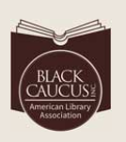



ALA Ethnic Affiliates
AILA – American Indian Library Association.
APALA – Asian/Pacific American Librarians Association.
BCALA – Black Caucus of ALA.
CALA – Chinese American Librarians Association.
REFORMA - The National Association to Promote Library and Information Services to Latinos and the Spanish Speaking.

Slide 77


Slide 78


Developed as part of 2009-2010 American Library Association President Camila Alire’s Family Literacy Focus Initiative.
Initiative to encourage families in ethnically diverse communities to read and learn together.
ALA initially awarded each of the five Ethnic Affiliates $3,000 to develop and implement innovative family literacy models in libraries.
Funded by Toyota Financial Services.

Slide 79
Children Learn Through Stories
Literacy program that reaches out to Asian Pacific American (APA) and American Indian/Alaska Native (AIAN) children and their families.
Celebrates and explores their stories through books, oral traditions, and art to provide an interactive, enriching experience.
Children and their families can connect to rich cultural activities through Talk Story in their homes, libraries, and communities.

Slide 80

Grant Winners
2018
Chinese American Citizen’s Alliance - Washington D.C.
Cranston Public Library - Rhode Island
Newark Free Library - Delaware
South Plainfield Public Library - New Jersey
2017
Cresskill Public Library - New Jersey
Friends of Westminster Library - California
Kodiak Historical Society - Alaska
Stone Soup Fresno - California
2016
California State University Fresno - California
Kenton County Public Library - Kentucky
Long Beach Public Library, North Branch - California
Monroe Township Public Library - New Jersey
Moreno Valley High School - California
Sacramento Public Library, S. Natomas Library - CA
2015
Clarksville-Montgomery County Public Library - TN
Kenton County Public Library - Kentucky
Oceanside Public Library – California
Pacific Islands University – Guam
Palms-Rancho Park Library - California
2014
Asian Pacific American Historical Society - Georgia
Association for the Advancement of Filipino American Arts & Culture (FilAm ARTS) - California
Gwinnett County Public Library - Georgia
Hercules Library – California
Monterey County Free Libraries - California
2013
Council of Asian Pacific Americans - Michigan
Cranston Public Library - Rhode Island
Friends of Asian Library - California
Hercules Library – California
Washington Country Library, Santa Clara Branch - Utah
2012
Baranov Museum - Alaska
Carson Regional Library - California
2011
Gloucester County Library System, Greenwich Branch – N.J.
2010
Pilot Programs
L.A. Public Library System, Carson Regional Library – CA
Marlborough Public Library – Massachusetts
Queens Library - New York

Slide 81

2015 - The Oceanside Public Library (CA) successful program celebrating and sharing Japanese and Okinawan culture. Grant application states - local Japanese parents in Oceanside were looking for a way to connect with each other and to share their culture with their children.
Two story times at the Mission Branch Library, one in May and one in November.
Okinawan dance performance and Okinawan drum workshop for families in July.
Japanese Folk Tales story time with an origami craft component.
Stories and folk songs were purchased for the Library’s collection, such as Japanese Nursery Rhymes: Carp Streamers, Falling Rain and Other Traditional Favorites by Danielle Wright and Japanese Children’s Favorite Stories compiled by Florence Sakude.
Made origami flowers, animals and boats, purchased with special paper using grant funds.
15 new books in Japanese or about Japan as well as 2 children’s DVDs in Japanese were purchased for the Library’s collection
Traditional Japanese snacks, (Pocky, sembei, and little bags of ball cookie) and hot or cold barley tea.

Slide 82



Oceanside Public Library sharing Japanese and Okinawan culture

Slide 83



Drum or Eisa Workshop

Slide 84


Japanese Folk Tales Storytime with an origami craft component

Slide 85

2014 - Association for the Advancement of Filipino American Arts & Culture (FilAm ARTS) - Saysay Stories of Historic Filipinotown
The Saysay Project is a community-sourced documentation project by FilAm ARTS. The aim is to capture the myriad of experiences in the Filipino diaspora through story telling “Saysay”.
To engage the community to tell their stories, and to document and preserve these shared stories for future generations.
To highlight the contributions of Filipinos to U.S. life and culture and to connect these stories of American experience to the stories in the Philippines.
Open to all. Participants include authors, spoken word artists, UCLA Linguistics Professor, State of CA Assembly employee.
Event was videotaped for documentation
Community-sourced oral history project funded in part by The James Irvine Foundation, Cal Humanities, L.A. County Arts Commission and the Asian/Pacific American Librarians Association (APALA)

Slide 86



Slide 87



Slide 88

2018 - South Plainfield Public Library (New Jersey)
Project - Creating a Diwali program that the community could explore the traditions, culture, heritage and music of India.
Purchase new books to the collection. Thirty-six books (8 with included Audio) were purchased from Karadi Tales, a publisher based in India.
Organize a Diwali Celebration -Includes presentation discussing the themes, history and customs of Diwali.
DIY crafts for the children to make such as diyas and rangoli designs.
Diwali brochure was created.
Large banner was printed to draw attention to the new book collection.

Slide 89





Slide 90




Rangoli Designs
Finished Rangoli Designs
Finished Diyas
Making Rangoli

Slide 91

2012 – Kodiak Historical Society (Alaska)
Project - Kodiak Filipino Family Photos: A Community Archive Event
The event addressed this issue by creating an archive of images and fostering positive relationships between the public library, the Baranov Museum, Fil-Am Kodiak, and the community at large.
Filipino Americans have lived on Kodiak for over 100 years, 35% of the Island’s population, yet there is virtually no archival documentation of their stories.
While FilAm cultures and socio-economic contributions compose a vibrant part of the Kodiak community, they are not celebrated nor documented appropriately.
Filipino Fulbright scholar, Joefe Santarita, came to the museum to research the deep connections between Kodiak and the Philippines, the museum was only able to find 3 photographs in their collection of over 30,000 images and a small folder containing almost no information of value.
Hosted by high school students studying the history of Filipinos on Kodiak.
For community members to come in with their family photographs to scan and document their family trees to be stored for public access in the Baranov Museum archives.
Students worked with families in scanning their photographs, filling out a “family tree” form that identifies the people in the photographs, and filling out an “archives deed of gift form

Slide 92

The Talk Story grant funded the purchase of a photo scanner for the Community archives
event, publicity for the event, including the translation of the publicity materials into Tagalog
and books on the Filipino Diaspora in the United States for use during the Community Archives event and the Kodiak Filipino Community Stories film intensive.

Slide 93




Slide 94

2012 – Los Angeles Public Library,
Carlson Regional Library
Project - Enhanced the Filipiniana collection ranging from children’s folktales to adult history book. Workshop with a local artist David Lazaro which discussed and taught the history and art of Baybayin, a Filipino script before Spanish colonization.
Event - Held during the Filipino American Heritage month in October with scavenger hunt, story time and a Baybayin workshop.
The scavenger hunt incorporated the materials purchased with the grant, as well as promoted the Baybayin workshop.
The story time was an opportunity to read and discuss Filipino folktales, and share stories about multiculturalism and diversity.
The final component to the grant was the Baybayin workshop.

Slide 95



Slide 96






Slide 97

Project - Hosted a program entitled “Mooncakes & More Storytime!” in partnership with the Pan Asian Community Services and the Asian/Pacific American Historical Society. The program was billed as an opportunity for families to learn about the Mid-Autumn Festivals held around the world.
Professional storyteller shared traditional folktales from China. Stories representing different facets of Chinese culture along with props and costumes.
Participants made festival related crafts like moon lantern.
Served mooncakes, a traditional festival treat.
The grant was also used to purchase books about mooncakes, the festival and other Asian cultural traditions.
At the end of the event, 75% of the books were immediately checked out.
2014 – Gwinnett County Public Library (Georgia)

Slide 98






Slide 99



2011 -Gloucester County Library System, Greenwich Branch (New Jersey)
Project - Highlighted the Samoan culture through classes on South Pacific Island dance, Samoan tattoo art, and Polynesian musical instruments.

Slide 100





Slide 101





Slide 102

2016 - Long Beach Public Library, North Branch
Project – In partnership with the Pacific Island Ethnic Art Museum held a “Talk Story” program focusing on Polynesian Culture.
Held in conjunction with the relaunch and opening of the new state-of-the-art branch, Michelle Obama Neighborhood Library.
Guests were given a lei that they can exchange for a free shaved ice.
Three one-hour event.
Entertainment provided by a local comedian, actor and ukulelist playing ukulele while a film highlighting the islands of Polynesia was projected on a big screen.
Lei demonstration –materials such as fresh flowers, yarn and ribbons provided by local family.
The library created a “Kieki Room”. Attendees received glitter hibiscus tattoo, took pictures in Tropical Island Sunset photo booth, or color a Disney Moana sheet or a traditional cultural pattern design as the movie Lilo and Stitch are being shown.
The second hour was a cultural presentation about Tonga, Hawaii and Samoa. A mixture of a beautiful display of artifacts, singing and storytelling were shared.
Showcase of live dance performances on a journey of the islands of Hawaii, New Zealand and Tahiti.

Slide 103



Slide 104
References
http://talkstorytogether.org/grants/grant-winners
http://www.apalaweb.org/
http://www.apalaweb.org/wpsandbox/wp-content/uploads/2010/07/apalahistory.pdf

Slide 105
Thank You!
Salamat!

