Slide 1
Know Your Rights:
A Copyright Discussion for Faculty
Sarah A. Norris, Scholarly Communication Librarian
University of Central Florida

Slide 2
If you remember one thing from this presentation...

Slide 3
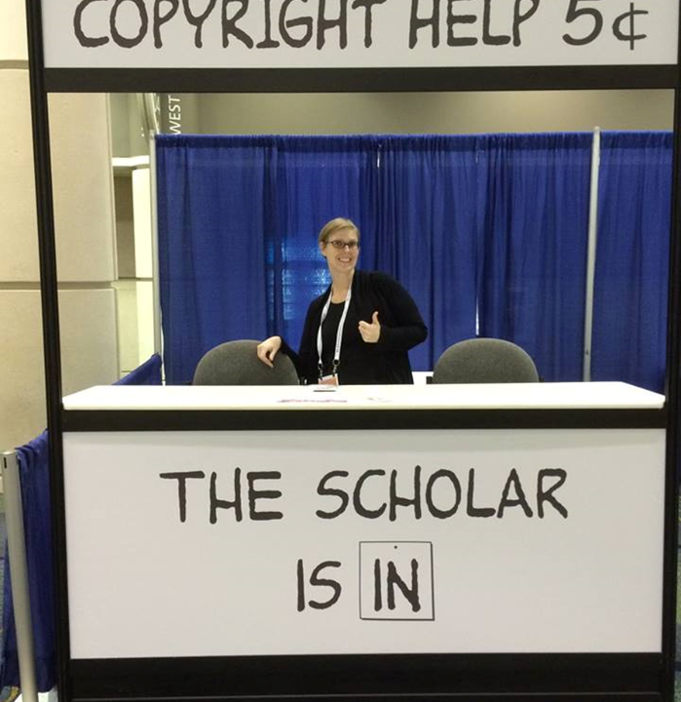
Contact the Library!
We can Help!
Copyright Sarah A. Norris

Slide 4
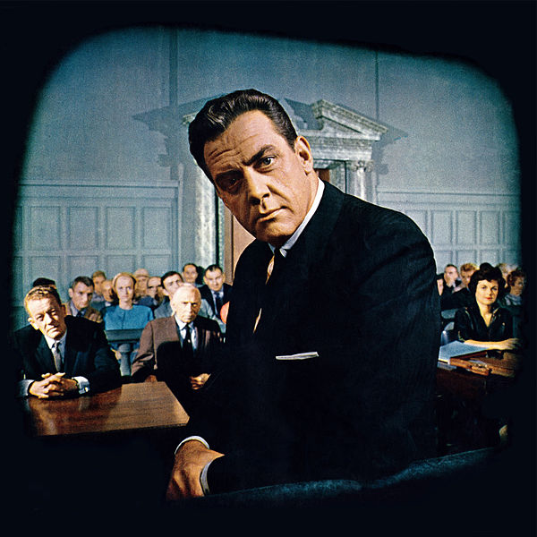
Disclaimer
UCF Libraries does not give legal advice, and any information in this presentation is for informational purposes only.

Slide 5
Session Overview
Hour One:
What is Copyright?
Copyright Basics
Public Domain
Fair Use
Creative Commons Licenses
Classroom Scenarios
Q&A
Notes:
UCF's copyright policrecommends obtaining explicit, written permission to reproduce the following: maps, drawings, tables, figures, photographs, sound files, videos, materials posted on web sites (whether text, graphics, images or video), large excerpts of text and other textual materials (such as survey instruments). UCF's copyright policyLinks to an external site. recommends obtaining explicit, written permission to reproduce the following: maps, drawings, tables, figures, photographs, sound files, videos, materials posted on web sites (whether text, graphics, images or video), large excerpts of text and other textual materials (such as survey instruments). UCF's copyright policyJoin the College of Graduate Studies and UCF Libraries for a faculty discussion about copyright. Learn how to better protect your works as an author, determine copyright status, advise students on copyright issues, and increase the impact of your work by utilizing institutional repositories and/or online faculty profiles.Join the College of Graduate Studies and UCF Libraries for a faculty discussion about copyright. Learn how to better protect your works as an author, determine copyright status, advise students on copyright issues, and increase the impact of your work by utilizing institutional repositories and/or online faculty profi

Slide 6
Session Overview
Hour Two:
Author Rights
Example Author Agreements
Navigating Copyrighted Works Post-Publication
Advising Students on Copyright
Q&A
Notes:
UCF's copyright policrecommends obtaining explicit, written permission to reproduce the following: maps, drawings, tables, figures, photographs, sound files, videos, materials posted on web sites (whether text, graphics, images or video), large excerpts of text and other textual materials (such as survey instruments). UCF's copyright policyLinks to an external site. recommends obtaining explicit, written permission to reproduce the following: maps, drawings, tables, figures, photographs, sound files, videos, materials posted on web sites (whether text, graphics, images or video), large excerpts of text and other textual materials (such as survey instruments). UCF's copyright policyJoin the College of Graduate Studies and UCF Libraries for a faculty discussion about copyright. Learn how to better protect your works as an author, determine copyright status, advise students on copyright issues, and increase the impact of your work by utilizing institutional repositories and/or online faculty profiles.Join the College of Graduate Studies and UCF Libraries for a faculty discussion about copyright. Learn how to better protect your works as an author, determine copyright status, advise students on copyright issues, and increase the impact of your work by utilizing institutional repositories and/or online faculty profil

Slide 7
Question:
How do you feel about copyright?

Slide 8
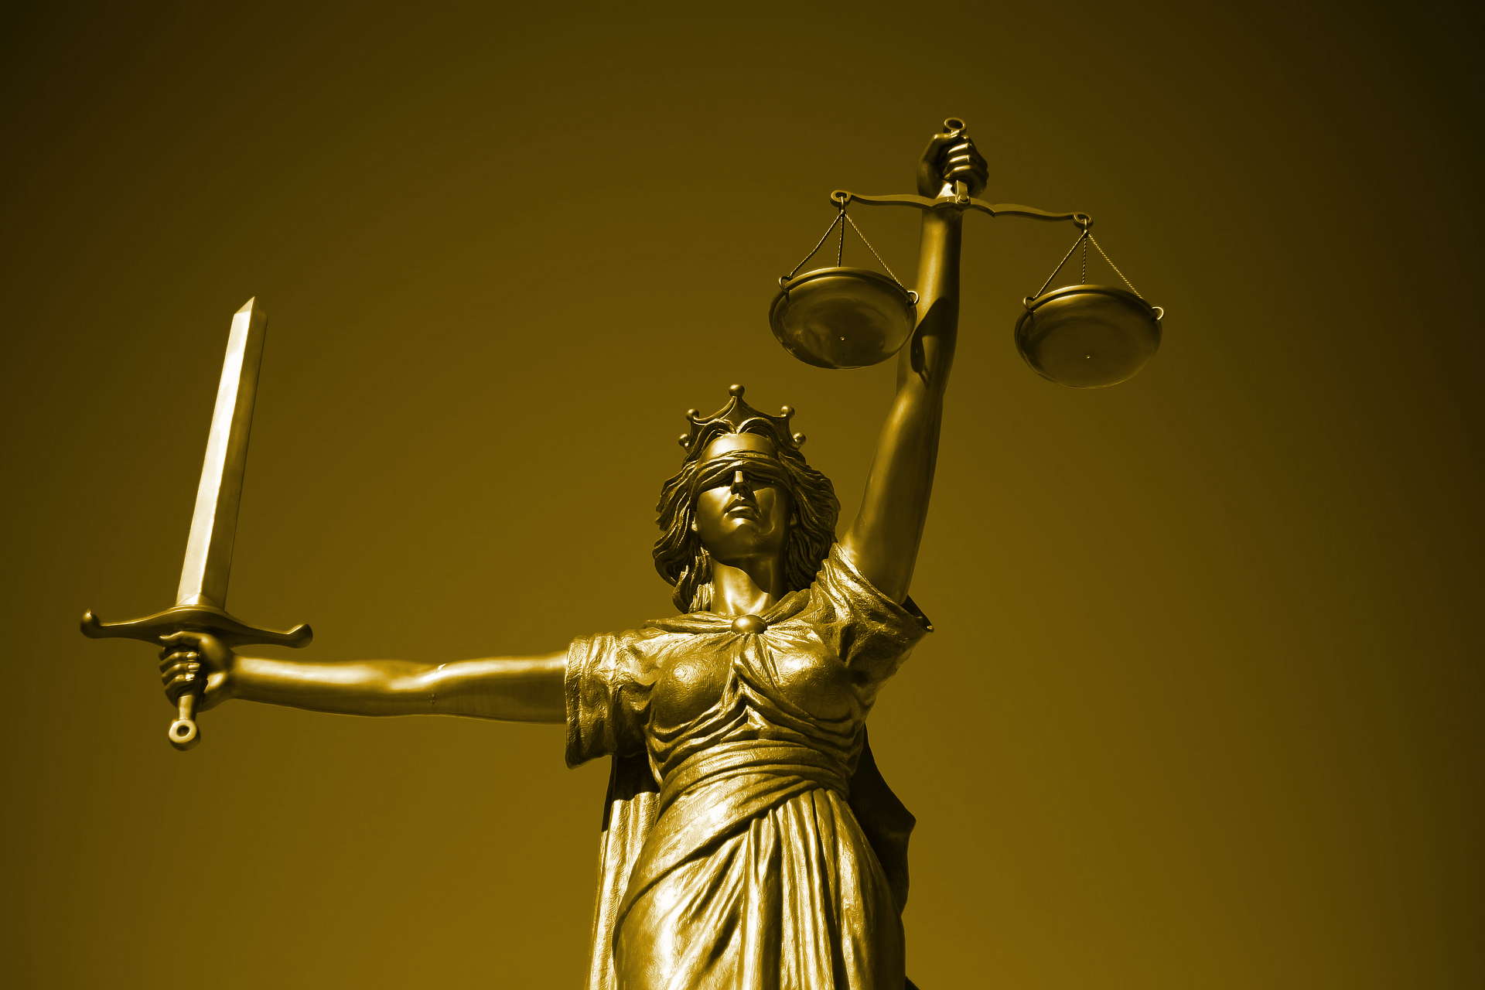
Why is Copyright & Copyright Law so Important?

Slide 9
Create New Copyrighted Works
Avoid Infringement
Uphold Academic Integrity
Use Fair Use When Applicable
Ensure
High Quality
Others?

Slide 10
Why is Copyright Important in the Classroom?

Slide 11
Legal Framework
Copyright Law
Using copyrighted materials for teaching purposes
Creating your own copyrighted materials for teaching purposes
Contract Law
May define copyright ownership in instructional materials
Can affect what materials you may or may not be able to use in a course
UCF Policies and/or Recommendations
Use of Copyrighted Materials Policy
Top 10 Copyright & Fair Use Questions (Office of General Counsel)

Slide 12
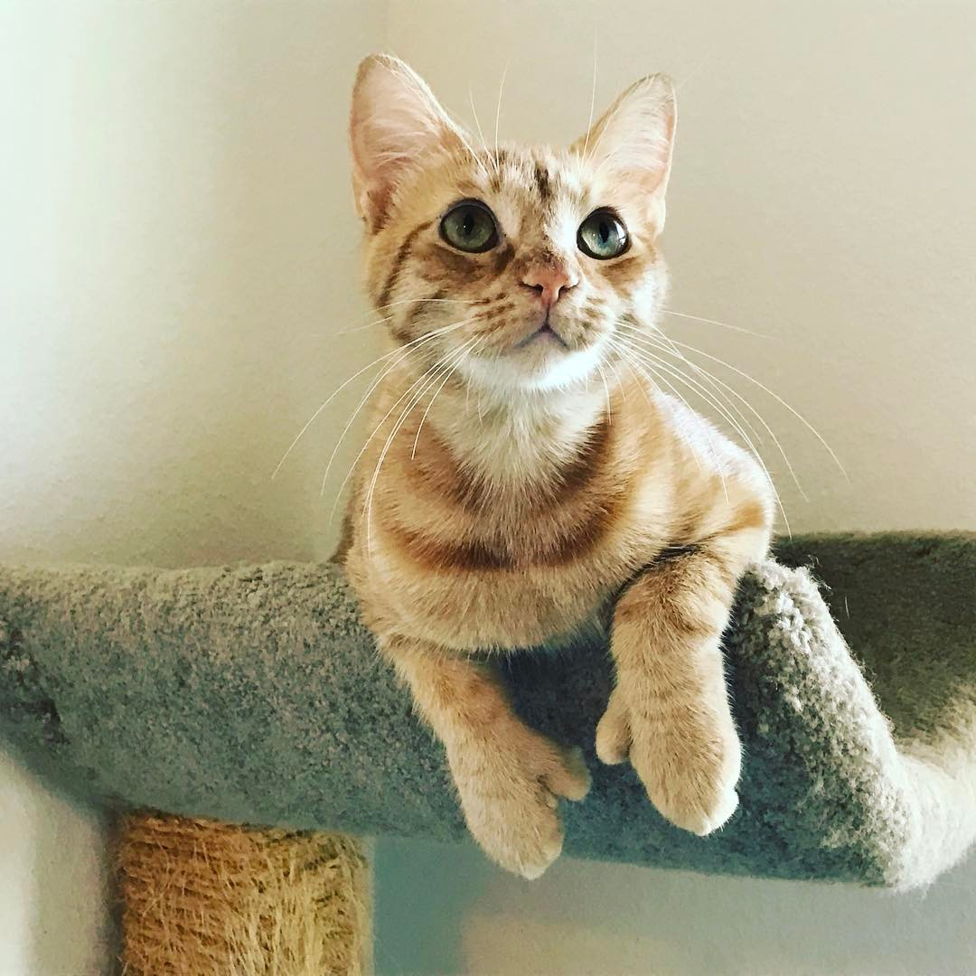
Let’s Talk about Copyright through the Use of a Copyrighted Photograph...
Copyright Sarah A. Norris

Slide 13
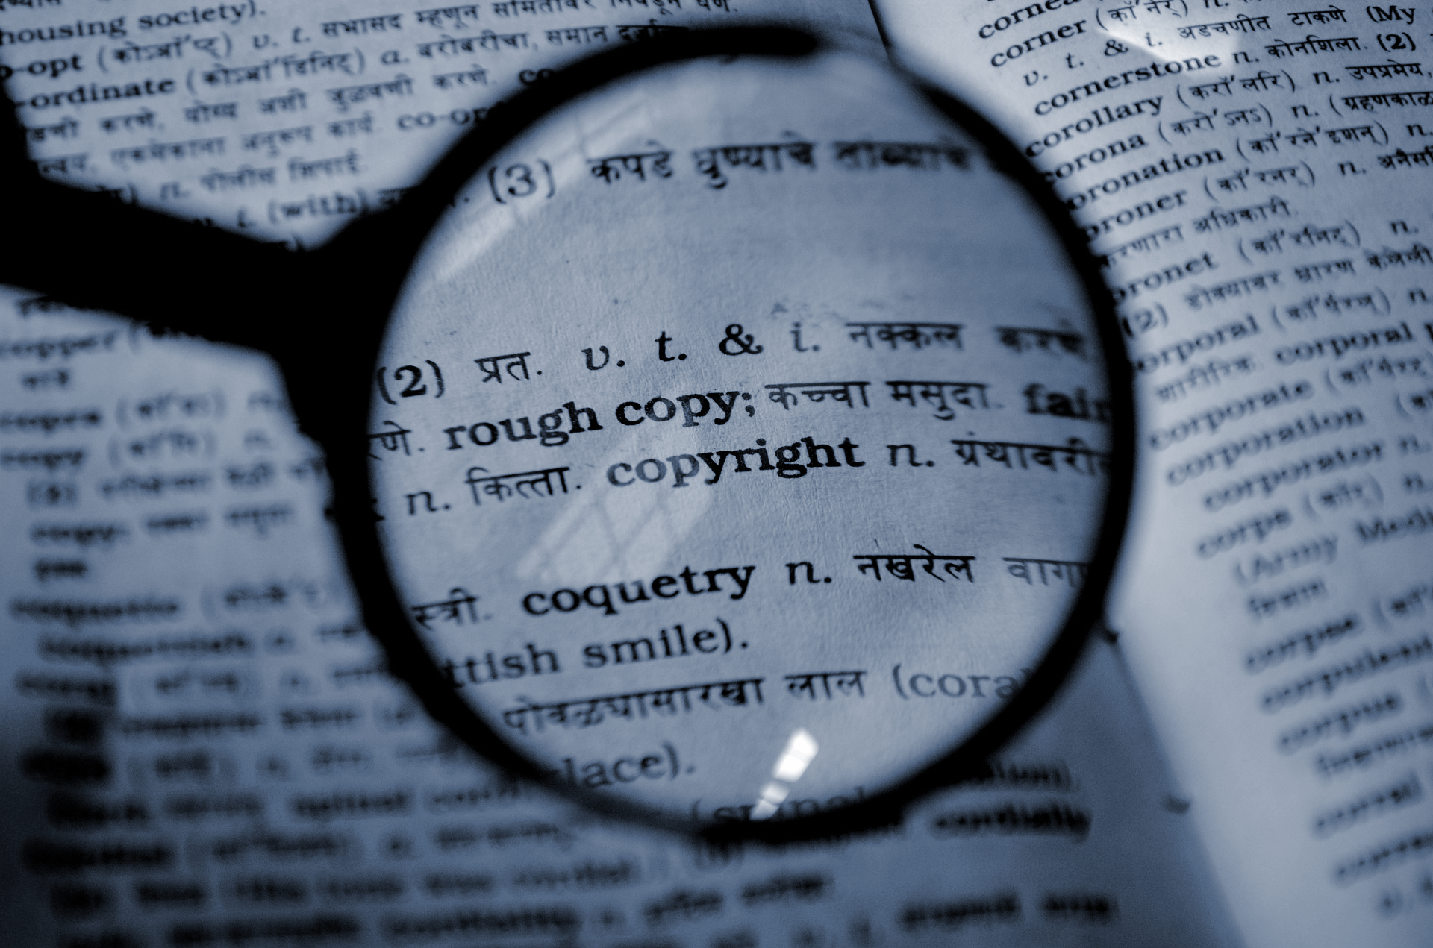
What is Copyright?

Slide 14
“Copyright is a form of protection provided by the laws of the United States (title 17, U.S. Code) to the authors of ‘original works of authorship,’ including literary, dramatic, musical, artistic, and certain other intellectual works. This protection is available to both published and unpublished works.”
http://www.copyright.gov/circs/circ01.pdf

Slide 15
What Rights are Covered by Copyright?
Generally, the following are exclusive rights given to a copyright holder:
reproduce your work
distribute your work
prepare derivative works
publicly display or perform your work
authorize others to do any of the above
*The above does not necessarily apply if the creator/author has given away rights to a publisher and/or other individual or entity

Slide 16
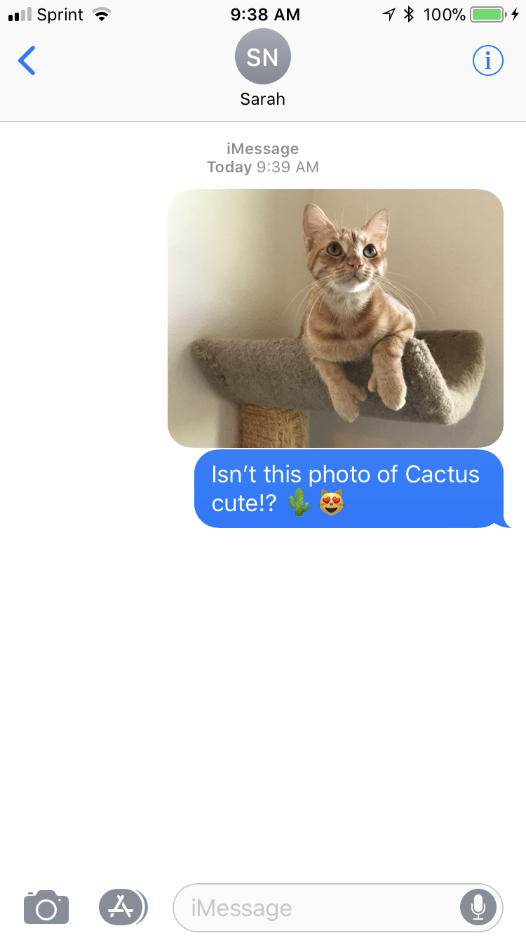
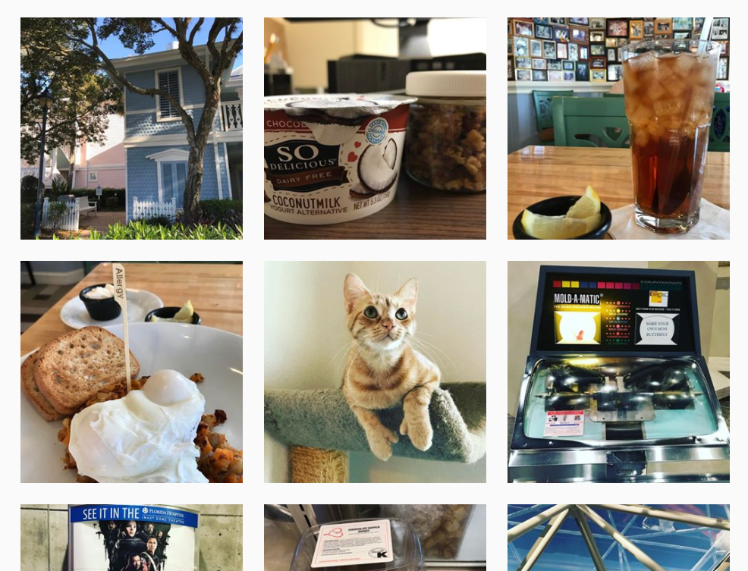
A Copyright Holder Uses Their Work...

Slide 17
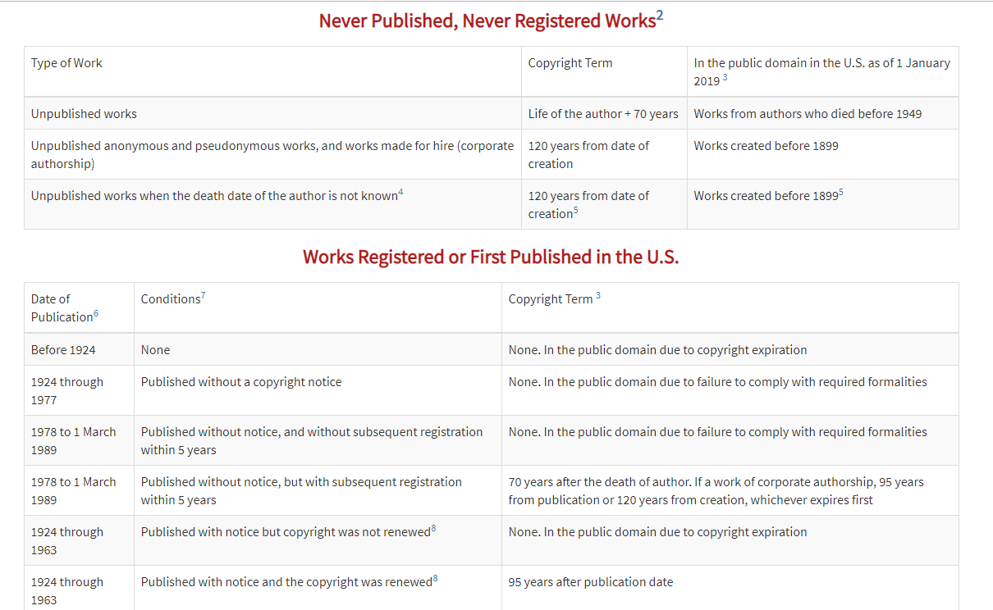
© 2004-2019 Peter B. Hirtle. Last updated 07 February, 2019, Retrieved from: https://copyright.cornell.edu/publicdomain

Slide 18
What is
Public Domain?

Slide 19
Public domain refers to materials “whose exclusive intellectual property rights have expired, have been forfeited, or are inapplicable.”
Items can be used freely
Materials in the public domain include:
Works with expired copyright (generally, this means items published before 1924)
Works that are not copyrightable or protected by copyright
Works produced by the federal government and/or federal government employee as a part of their job
Works donated to the public domain

Slide 20
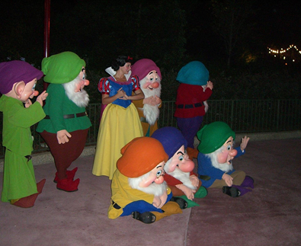
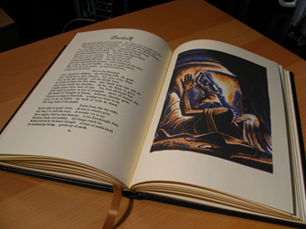
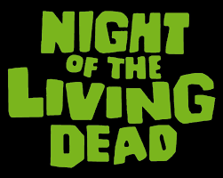
Examples of Public Domain Uses
Beowulf - Translated by William Leonard - Easton Press Edition by Robert is licensed under CC BY 2.0
Snow White and the Seven Dwarfs in the Magic Kingdom by JeffChristiansen is licensed under CC BY-SA 2.0

Slide 21
What About
Fair Use?

Slide 22
“Fair use is a legal doctrine that promotes freedom of expression by permitting the unlicensed use of copyright-protected works in certain circumstances. Section 107 of the Copyright Act provides the statutory framework for determining whether something is a fair use and identifies certain types of uses—such as criticism, comment, news reporting, teaching, scholarship, and research—as examples of activities that may qualify as fair use.”
http://copyright.gov/fair-use/more-info.html

Slide 23
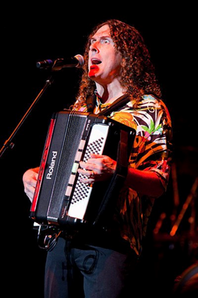
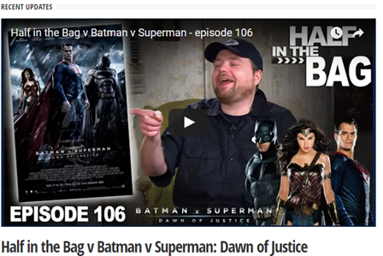
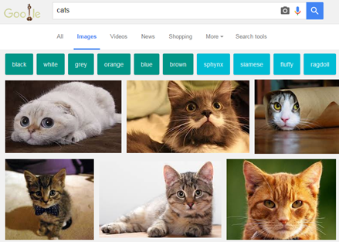
Examples of Fair Use
"Weird Al" Yankovic performing live in concert during his 2010 Tour by Kristinekreations is licensed under CC BY 3.0

Slide 24
Navigating Fair Use...
When considering use of copyrighted work(s), the Four Fair Use Factors are typically used as a benchmark for whether fair use is appropriate or not
The purpose & character of use
The nature of the copyrighted work
The portion used in relation to the copyrighted work as a whole
The effect of the use upon the potential market
Fair use is not applicable in every situation, even if it is for educational purposes
UCF Office of General Counsel Recommends that UCF Faculty adhere to a general 10% rule (i.e. use up to 10% of a copyrighted work)
Students should consult UCF Libraries for assistance
Look for copyrighted materials that have Creative Commons Licenses

Slide 25
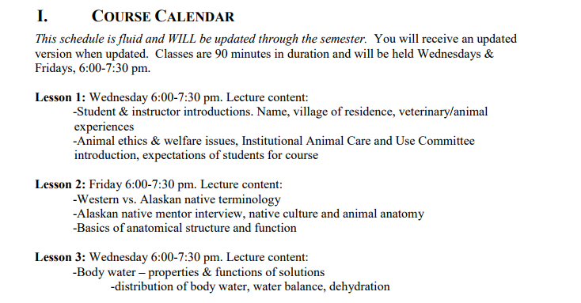
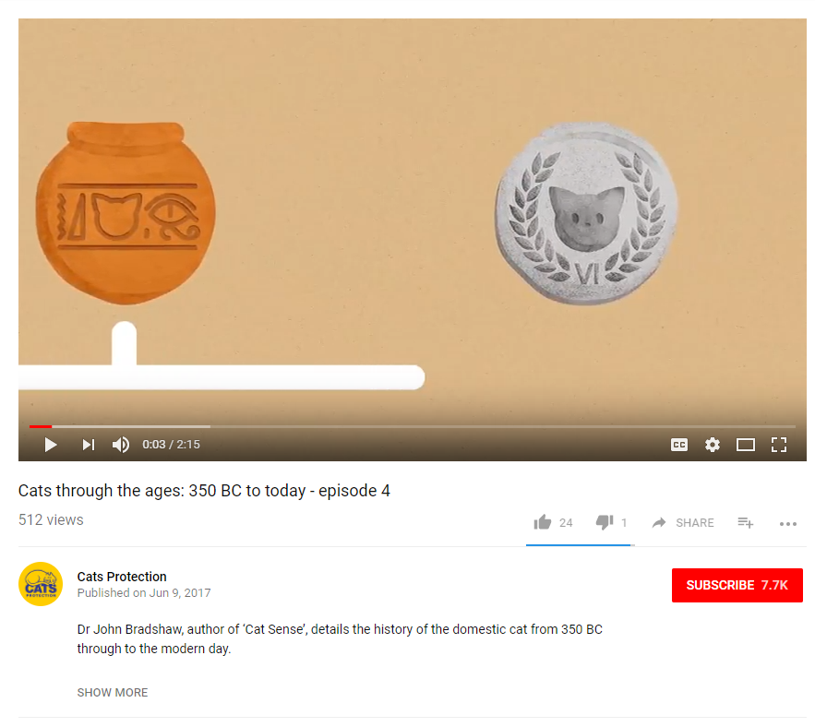
In the Case of Our Copyrighted Image...

Slide 26
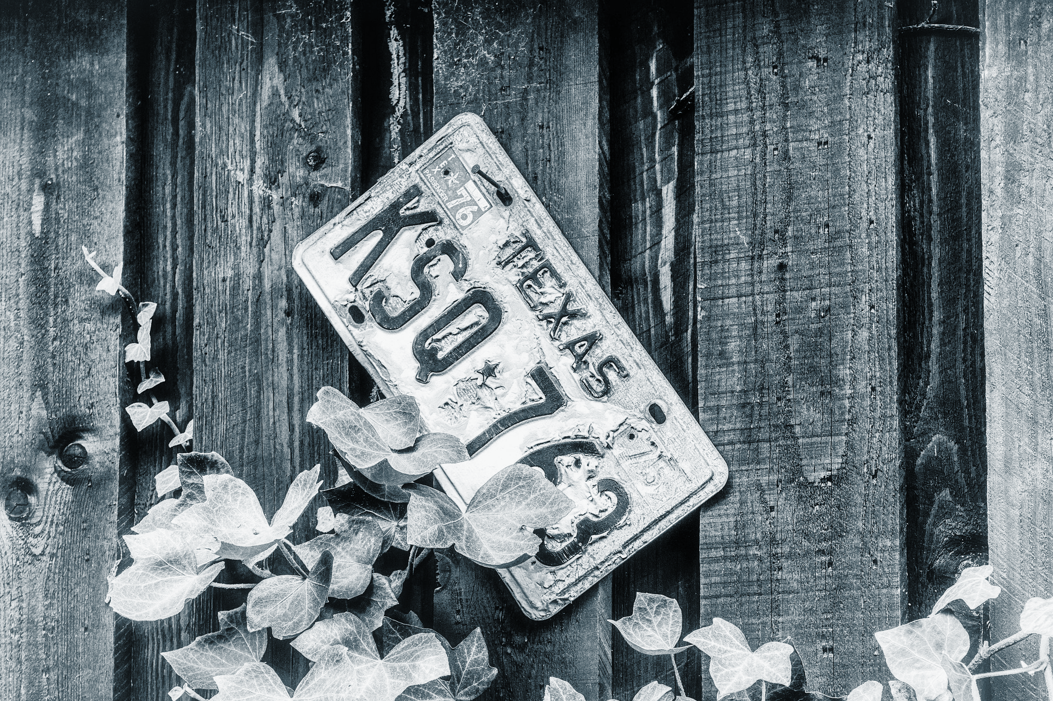
Using Licensed Materials

Slide 27
Generally means “to give permission”
https://en.wikipedia.org/wiki/License
In copyright and intellectual property, this means you are authorizing use of your copyrighted work by others (i.e. publisher, distributor, etc.)
This is often known as “use rights”
They can be exclusive or non-exclusive
Licensing a “use right” doesn’t affect your ownership of the copyright, unless you decide to license the rights away or are employed as a “work for hire”

Slide 28
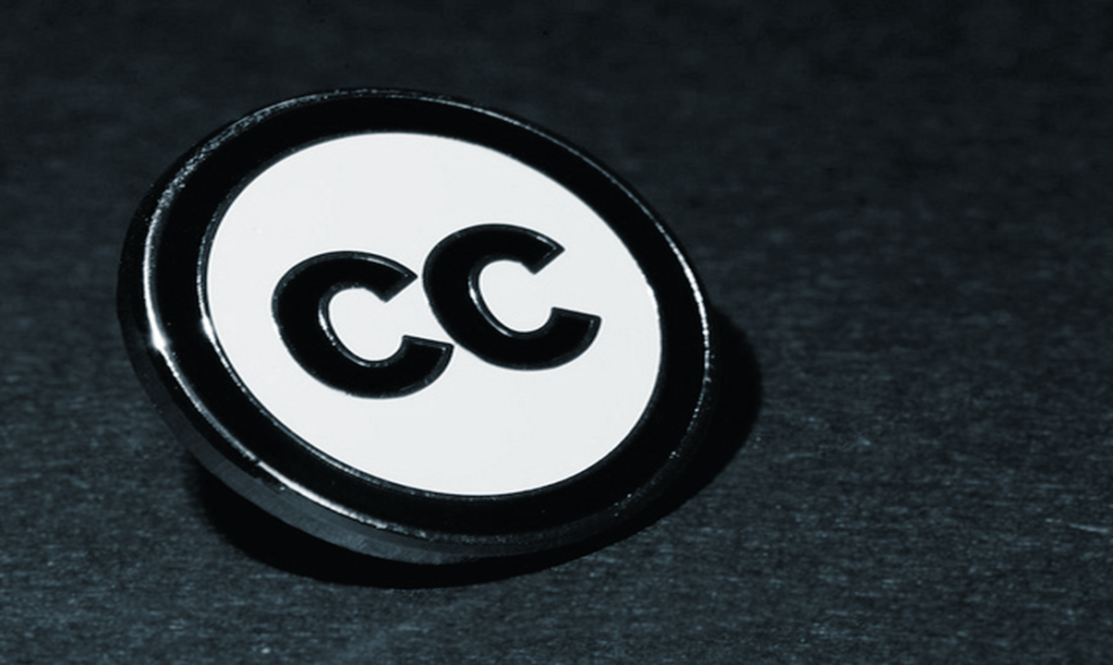
Let’s Explore Creative Commons Licenses...
Image retrieved from: https://flic.kr/p/a8Tsiz © Kristina Alexanderson / CC BY-SA 4.0

Slide 29
“A Creative Commons (CC) license is one of several public copyright licenses that enable the free distribution of an otherwise copyrighted work. A CC license is used when an author wants to give people the right to share, use, and build upon a work that they have created.”
https://creativecommons.org/licenses/

Slide 30
Why Creative Commons Licenses?
Creative Commons “provides a simple, standardized way to give the public permission to share and use your creative work — on conditions of your choice. CC licenses let you easily change your copyright terms from the default of ‘all rights reserved’ to ‘some rights reserved.’ (https://creativecommons.org/about/)
Creative Commons licenses “are not an alternative to copyright. They work alongside copyright and enable you to modify your copyright terms to best suit your needs.” (https://creativecommons.org/about/)
https://creativecommons.org/choose/

Slide 31
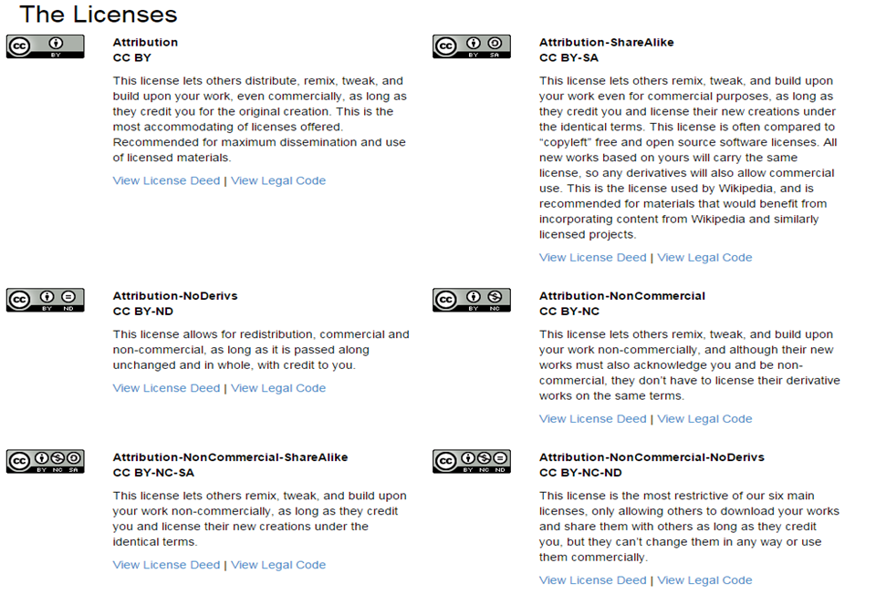
https://creativecommons.org/licenses/

Slide 32
Where Do You See Creative Commons Licenses?

Slide 33
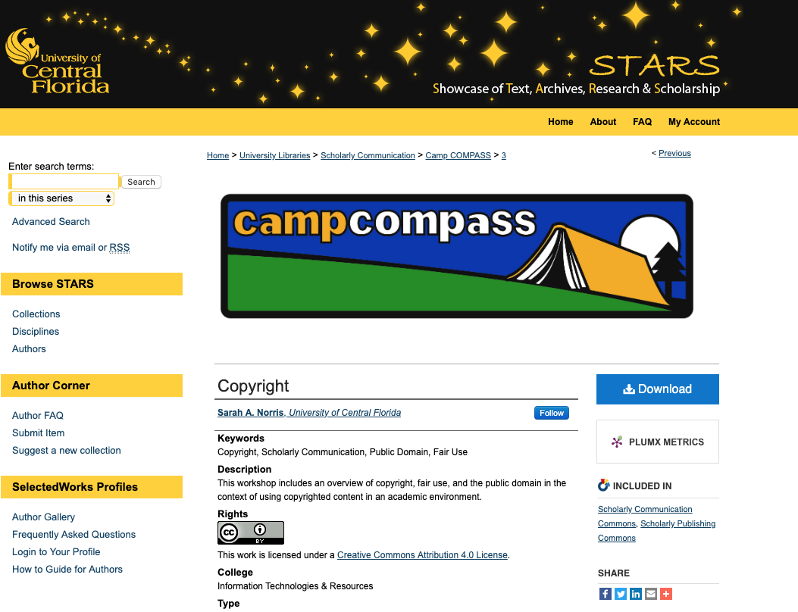

Slide 34
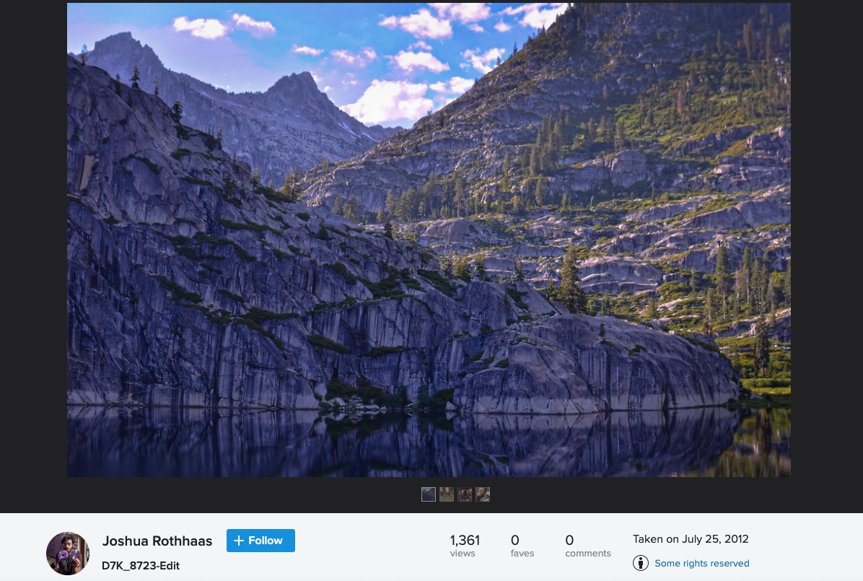
Photo by Joshua Rothhaas is licensed under CC BY 2.0

Slide 35
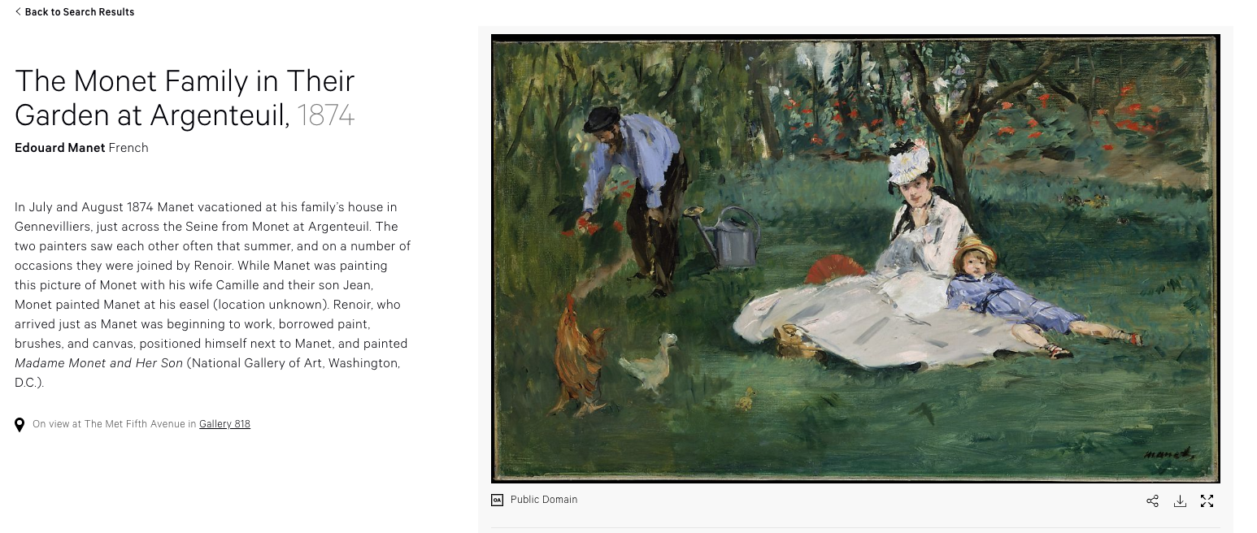
The Monet Family in Their Garden at Argenteuil,1874 by Edouard Manet is licensed under CC0 1.0

Slide 36
Citing Creative Commons Licenses
Always make sure to cite works that are CC licensed
A good rule of them when citing is the acronym TASL
Title
Author
Source
License
Refer to the Creative Commons Wiki for best practices for attribution: https://wiki.creativecommons.org/wiki/Best_practices_for_attribution
Cite according to discipline when appropriate

Slide 37
Let’s Explore Creative Commons Licenses with Our Copyrighted Photo...

Slide 38
Cactus the Cat by Sarah A. Norris is licensed under
CC BY-NC-SA 4.0

Slide 39
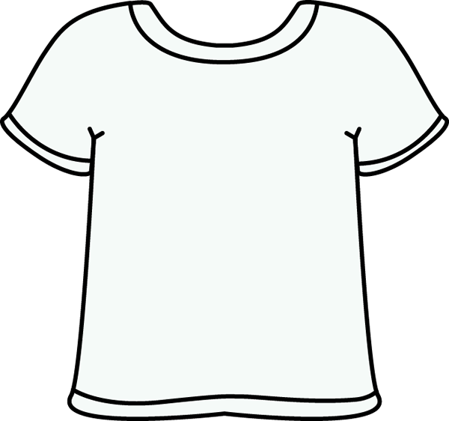
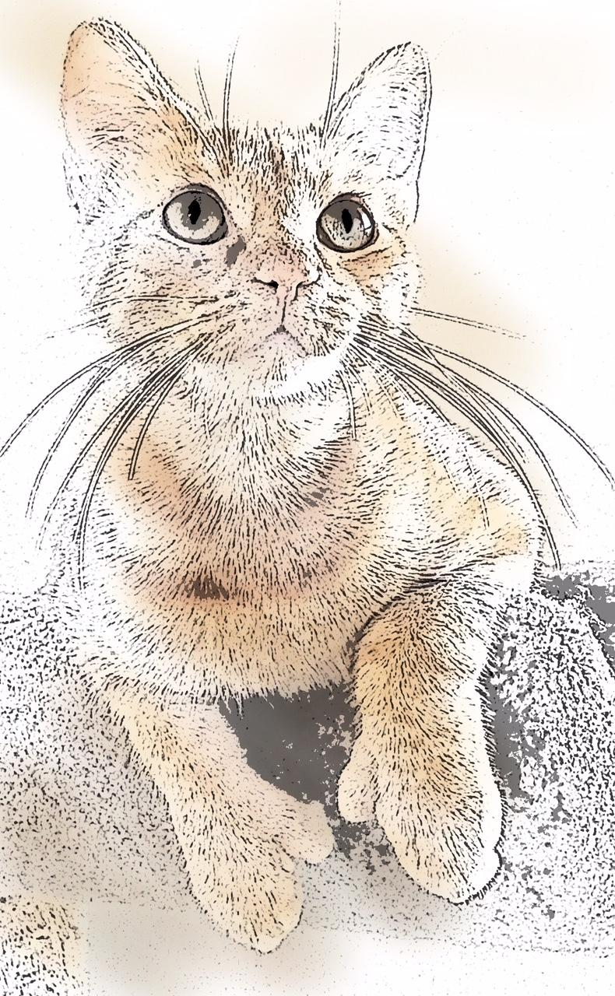
Cactus the Cat by Sarah A. Norris is licensed under
CC BY 4.0

Slide 40
How Do We Make Sure We’re Copyright Compliant in the Classroom?

Slide 41
Copyright in the Classroom
Face to face classroom teaching exception (§110(1))
Online classroom teaching exception - TEACH Act (§110(2) and §112 )
Fair use exception (§107)
Reproduction for blind or other people with disabilities (§121)
First sale doctrine (§109)

Slide 42
Options for Using Copyrighted Materials
If a license applies, it must be complied with
Obtain permission to use copyrighted materials
Pay to use via services like Copyright Clearance Center
Fair Use
TEACH ACT (online teaching)
Linking to Content
Finding materials that are openly licensed
Others?

Slide 43
What Would You Do?
Let’s Talk Through Copyright Scenarios...

Slide 44
Scenario #1
“While browsing the Internet, a particular image caught your eye. In the past, you have copied images, placed them into a PowerPoint presentation, and shown them in your face-to-face courses. However, now that you want to place it into your online course, can you still do so? If the original source is given credit, have you followed copyright protocol? If you believe you should do more, what should you do?”

Slide 45
Scenario #1
Consider anything found online under copyright, unless otherwise stated
Determine copyright status (if not clear, assume under copyright)
Ask permission from the copyright holder, if applicable
Use under the guise of Fair Use (using Four Fair Use Factors and/or any other university-specific guidelines)
Consider using public domain and/or Creative Commons licensed images when possible
“Educators and students should exercise caution in using material downloaded from the internet, because there is a mix of works protected by copyright and works in the public domain on the network. Some copyrighted works may have been posted to the internet without authorization of the copyright holder. Anytime an entire work is copied, the fair use defense will be difficult to apply. Crediting the source does not change the fact that this will likely be regarded as copyright infringement. Please keep in mind that crediting the source is appropriate; however, the underlying use needs to be justified first, whether the use relies on the permission of the copyright owner or on fair use. If the underlying use is infringing, crediting the source does not rectify this.”
https://generalcounsel.ucf.edu/files/2015/06/Top-Ten-Copyright-and-Fair-Use-Questions-revised-NNH-clean-4-19-11.docx

Slide 46
Scenario #2
“In your face-to-face courses, you have always shown Hollywood movie clips to provide scenarios for student learning. Now that you are moving online, can you use still them? If so, how much can you use? And is it possible to reuse them from semester to semester and what copyright information do you need to provide regarding the clips?”

Slide 47
Scenario #2
Films/Videos shown should be related to curriculum (not just filler)
Fair use may apply
Faculty should not use their personal accounts for streaming services due to licensing terms
Utilize legitimate copies of a film/video and/or explore options to purchase license to utilize in courses
Link to Library resources when possible
“Pursuant to United States Code, Title 17, Section 110(1), members of the University of Central Florida community may publicly display and perform the copyrighted works of other people (this includes entire works) during face-to-face teaching activities, provided you are using a legitimate copy of the work, i.e. in this case a legitimate copy of the video (which, in general, does not include one that you have videotaped yourself from a broadcast). Section 110(1) does not authorize the copying of the copyrighted work from the original medium onto another medium though, which would be necessary in utilizing these materials in an online course.”
https://generalcounsel.ucf.edu/files/2015/06/Top-Ten-Copyright-and-Fair-Use-Questions-revised-NNH-clean-4-19-11.docx

Slide 48
Scenario #3
“In your face-to-face course, you have provided handouts on A Different View of Gettysburg: Play, Memory, and Race at the Civil War's Greatest Shrine by James P. Weeks, which can be found in the EBSCOHost database. Now you’re teaching a fully online course. Can you incorporate a scanned copy of this journal article into your online course? If so, what steps should you take? If not, what steps should you take?”

Slide 49
Scenario #3
Link to Library resources when possible
Ask permission from the copyright holder, if applicable
Use under the guise of Fair Use (using Four Fair Use Factors and/or any other university-specific guidelines)
The copying of entire works, such as an entire article, is usually not justifiable as fair use. Per the Fair Use Guidelines for Educational Multimedia, which are incorporated into UCF’s Use of Copyrighted Material Policy, for text material, up to 10% or 1000 words, whichever is less, in the aggregate of a copyrighted work consisting of text material may be reproduced or otherwise incorporated as part of a multimedia project. However, if the article is available through the university’s library holdings online, it would be permissible to provide the students with an online bibliography with links to these resources, making sure that on your course site you clearly indicate that the student is being taken to another site that is not part of your actual online course.
https://generalcounsel.ucf.edu/files/2015/06/Top-Ten-Copyright-and-Fair-Use-Questions-revised-NNH-clean-4-19-11.docx

Slide 50
When Exploring Using Copyrighted Materials in the Classroom...
Consider the copyright for each work being used
Assume that a work is under copyright until proven otherwise
When in doubt, ask for permission
Follow UCF Office of General Counsel recommendations when employing fair use in both face-to-face & online courses
Explore opportunities to use public domain and/or Creative Commons Licensed Materials
Cite as appropriately for your discipline and/or licensing terms (if applicable)
Connect with the Office of General Counsel and librarians for copyright assistance

Slide 51
Author Rights
vs
Copyright...
Author Rights = Rights of the creator of a work
Can be both economic & moral
Copyright = Rights that protect a specific work

Slide 52
What Author Rights are Covered by Copyright?
Generally, the following are exclusive rights given to a copyright holder:
reproduce your work
distribute your work
prepare derivative works
publicly display or perform your work
authorize others to do any of the above
*The above does not necessarily apply if the creator/author has given away rights to a publisher and/or other individual or entity

Slide 53
Putting Copyright & Author Rights Together...

Slide 54
Author/Publication Agreements

Slide 55
What Are Author/Publication Agreements?
Legally binding agreement between an author of a work (e.g. journal article, book chapter) and a publisher.
Dictates the rights the author has upon publication
Terms vary depending on publisher
Important point to remember: Most standard author agreements with publishers include the transfer of intellectual property ownership of a work to the publisher (i.e. the author is no longer the copyright holder)
There are exceptions to this, depending on the publisher

Slide 56
Publication Agreement Examples

Slide 57
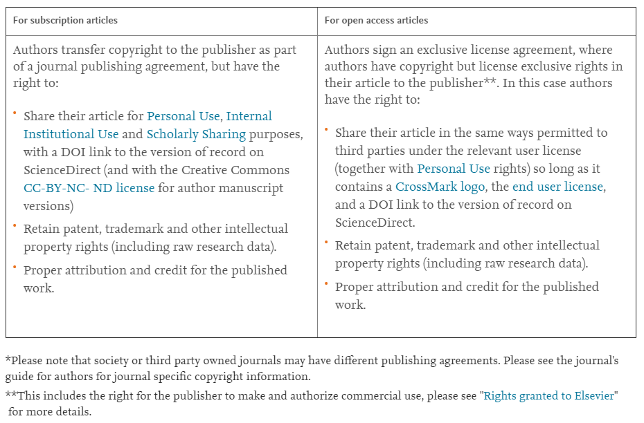
https://www.elsevier.com/about/policies/copyright

Slide 58
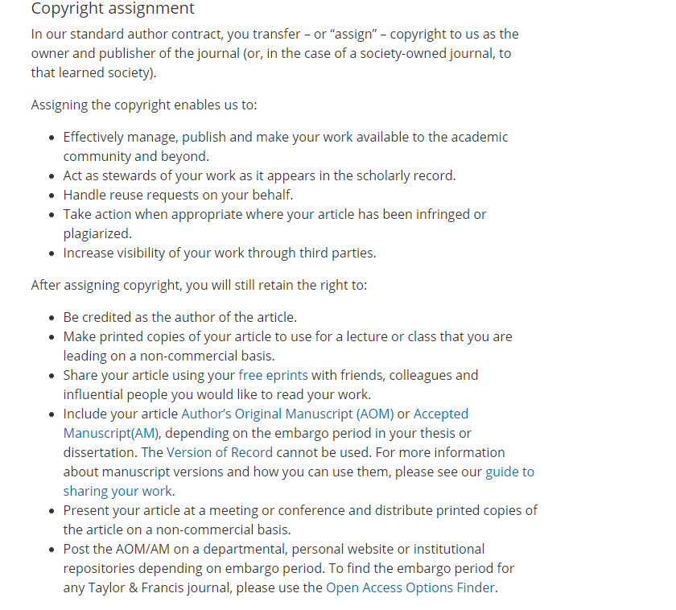
https://authorservices.taylorandfrancis.com/copyright-and-you/

Slide 59
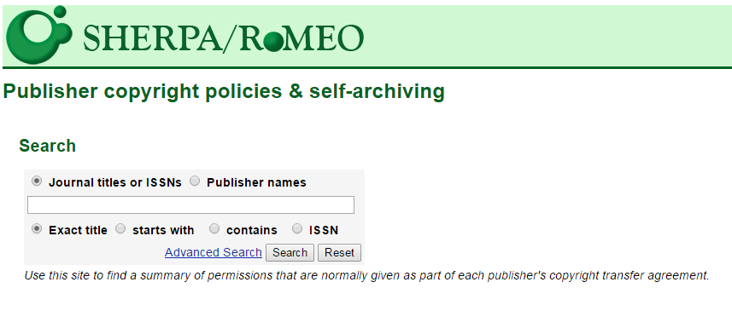
http://sherpa.ac.uk/romeo/index.php

Slide 60
Remember! Your Work Belongs to You…until you give it away.
As soon as your work is in a tangible form (a Word document, a website, a recording), the copyright is yours. You own the right to:
reproduce your work
distribute your work
prepare derivative works
publicly display or perform your work
authorize others to do any of the above
You can give away or sell any or all of your rights. Giving up your rights may limit access to and impact of your work.

Slide 61
When Considering Author/Publication Agreements...
Publication agreements are a bundle of rights
Read your agreement
Know that you can try to negotiate to retain some rights
Reuse charts and graphs or reproduce the work
Give copies to your colleagues or students
Post on a website (Academia.edu or ResearchGate) or repository
SPARC Author Addendum https://sparcopen.org/our-work/author-rights/#addendum
Check SHERPA/RoMEO for publisher copyright policies http://sherpa.ac.uk/romeo/index.php

Slide 62
Copyright Considerations for
Theses & Dissertations

Slide 63
Students retain the copyright of their thesis and/or dissertation
Theses & dissertations are distributed via STARS, UCF’s Institutional Repository, through a non-exclusive license
https://stars.library.ucf.edu/thesesdissertations/
Important Copyright Matters to Remember!

Slide 64
When Advising Students...
Discuss intellectual property ownership with students (and any other IP related issues, like patents, trademarks, etc.)
Discuss copyright and using copyrighted materials in their thesis
UCF’s Use of Copyrighted Materials Policy generally recommends obtaining explicit, written permission to reproduce the following: maps, drawings, tables, figures, photographs, sound files, videos, materials posted on web sites (whether text, graphics, images or video), large excerpts of text and other textual materials (such as survey instruments).
Encourage students to address and reconcile copyright concerns earlier in the process to avoid last minute challenges

Slide 65
Final Considerations

Slide 66
Best Practices for Navigating Copyright...
When in doubt, ask for permissions
Keep records of all permissions obtained (e.g. attach as an appendix to thesis or dissertation)
Utilize fair use, when appropriate
Recognize that fair use may not apply to all situations
Always cite works cited as a matter of ethical practice
Model good behavior as a faculty member
Understand university policies regarding copyright
When questions arise, contact UCF Libraries for assistance

Slide 67
Public Domain Image References
Robert Vose / Cowles Communications, Inc. (Photographer). Photograph of Raymond Burr and other cast members on the set of the CBS-TV series Perry Mason, from the front cover of Look magazine [digital image]. Retrieved from https://commons.wikimedia.org/wiki/File:Perry-Mason-Look-1961.jpg
193584 (Photographer). (2014, March 22). No title [digital image]. Retrieved from https://pixabay.com/photos/law-books-library-rows-of-books-291676/
rawpixel (Photographer). (2018, February 28). No title [digital image]. Retrieved from https://pixabay.com/photos/art-artist-cafe-calligraphic-3187088/
rawpixel (Photographer). (2017, May 12). No title [digital image]. Retrieved from https://pixabay.com/photos/typewriter-alphabet-vintage-2306479/
WilliamCho (Photographer). (2017, February 13). No Title [digital image]. Retrieved from https://pixabay.com/photos/justice-statue-lady-justice-2060093/
Wokandapix (Photographer). (2017, January 10). No title [digital image]. Retrieved from https://pixabay.com/photos/teach-education-school-class-1968076/
TeroVesalainen (Photographer). (2017, March 7). No title [digital image]. Retrieved from https://pixabay.com/photos/mindmap-brainstorm-idea-innovation-2123973/
PDPics (Photographer). (2014, July 15). No title [digital image]. Retrieved from https://pixabay.com/photos/copyright-magnifier-magnifying-glass-389901/
Free-Photos (Photographer). (2015, April 27). No title [digital image]. Retrieved from https://pixabay.com/photos/bus-train-subway-inside-seats-731317/
rawpixel (Photographer). (2018, February 14). No title [digital image]. Retrieved from https://pixabay.com/photos/old-wood-desktop-vintage-alphabets-3150426/
Tama66 (Photographer). (2016, July 18). No title [digital image]. Retrieved from https://pixabay.com/photos/license-plate-indicator-pkw-texas-1524129/
Free-Photos (Photographer). (2016, July 8). No title [digital image]. Retrieved from https://pixabay.com/photos/binoculars-view-focus-optical-1209892/
Athree23 (Photographer). (2018, September 15). No title [digital image]. Retrieved from https://pixabay.com/photos/feedback-checklist-job-gut-3676922/
RossMannYYC (Photographer). (2017, July 28). No title [digital image]. Retrieved from https://pixabay.com/photos/checklist-chalk-board-list-2549229/
TeroVesalainen (Photographer). (2017, March 7). No title [digital image]. Retrieved from https://pixabay.com/photos/question-mark-why-problem-solution-2123967/
Uki_71 (Photographer). (2016, January 18). No title [digital image]. Retrieved from https://pixabay.com/photos/note-pin-list-stickies-paper-memo-1143037/

Slide 68
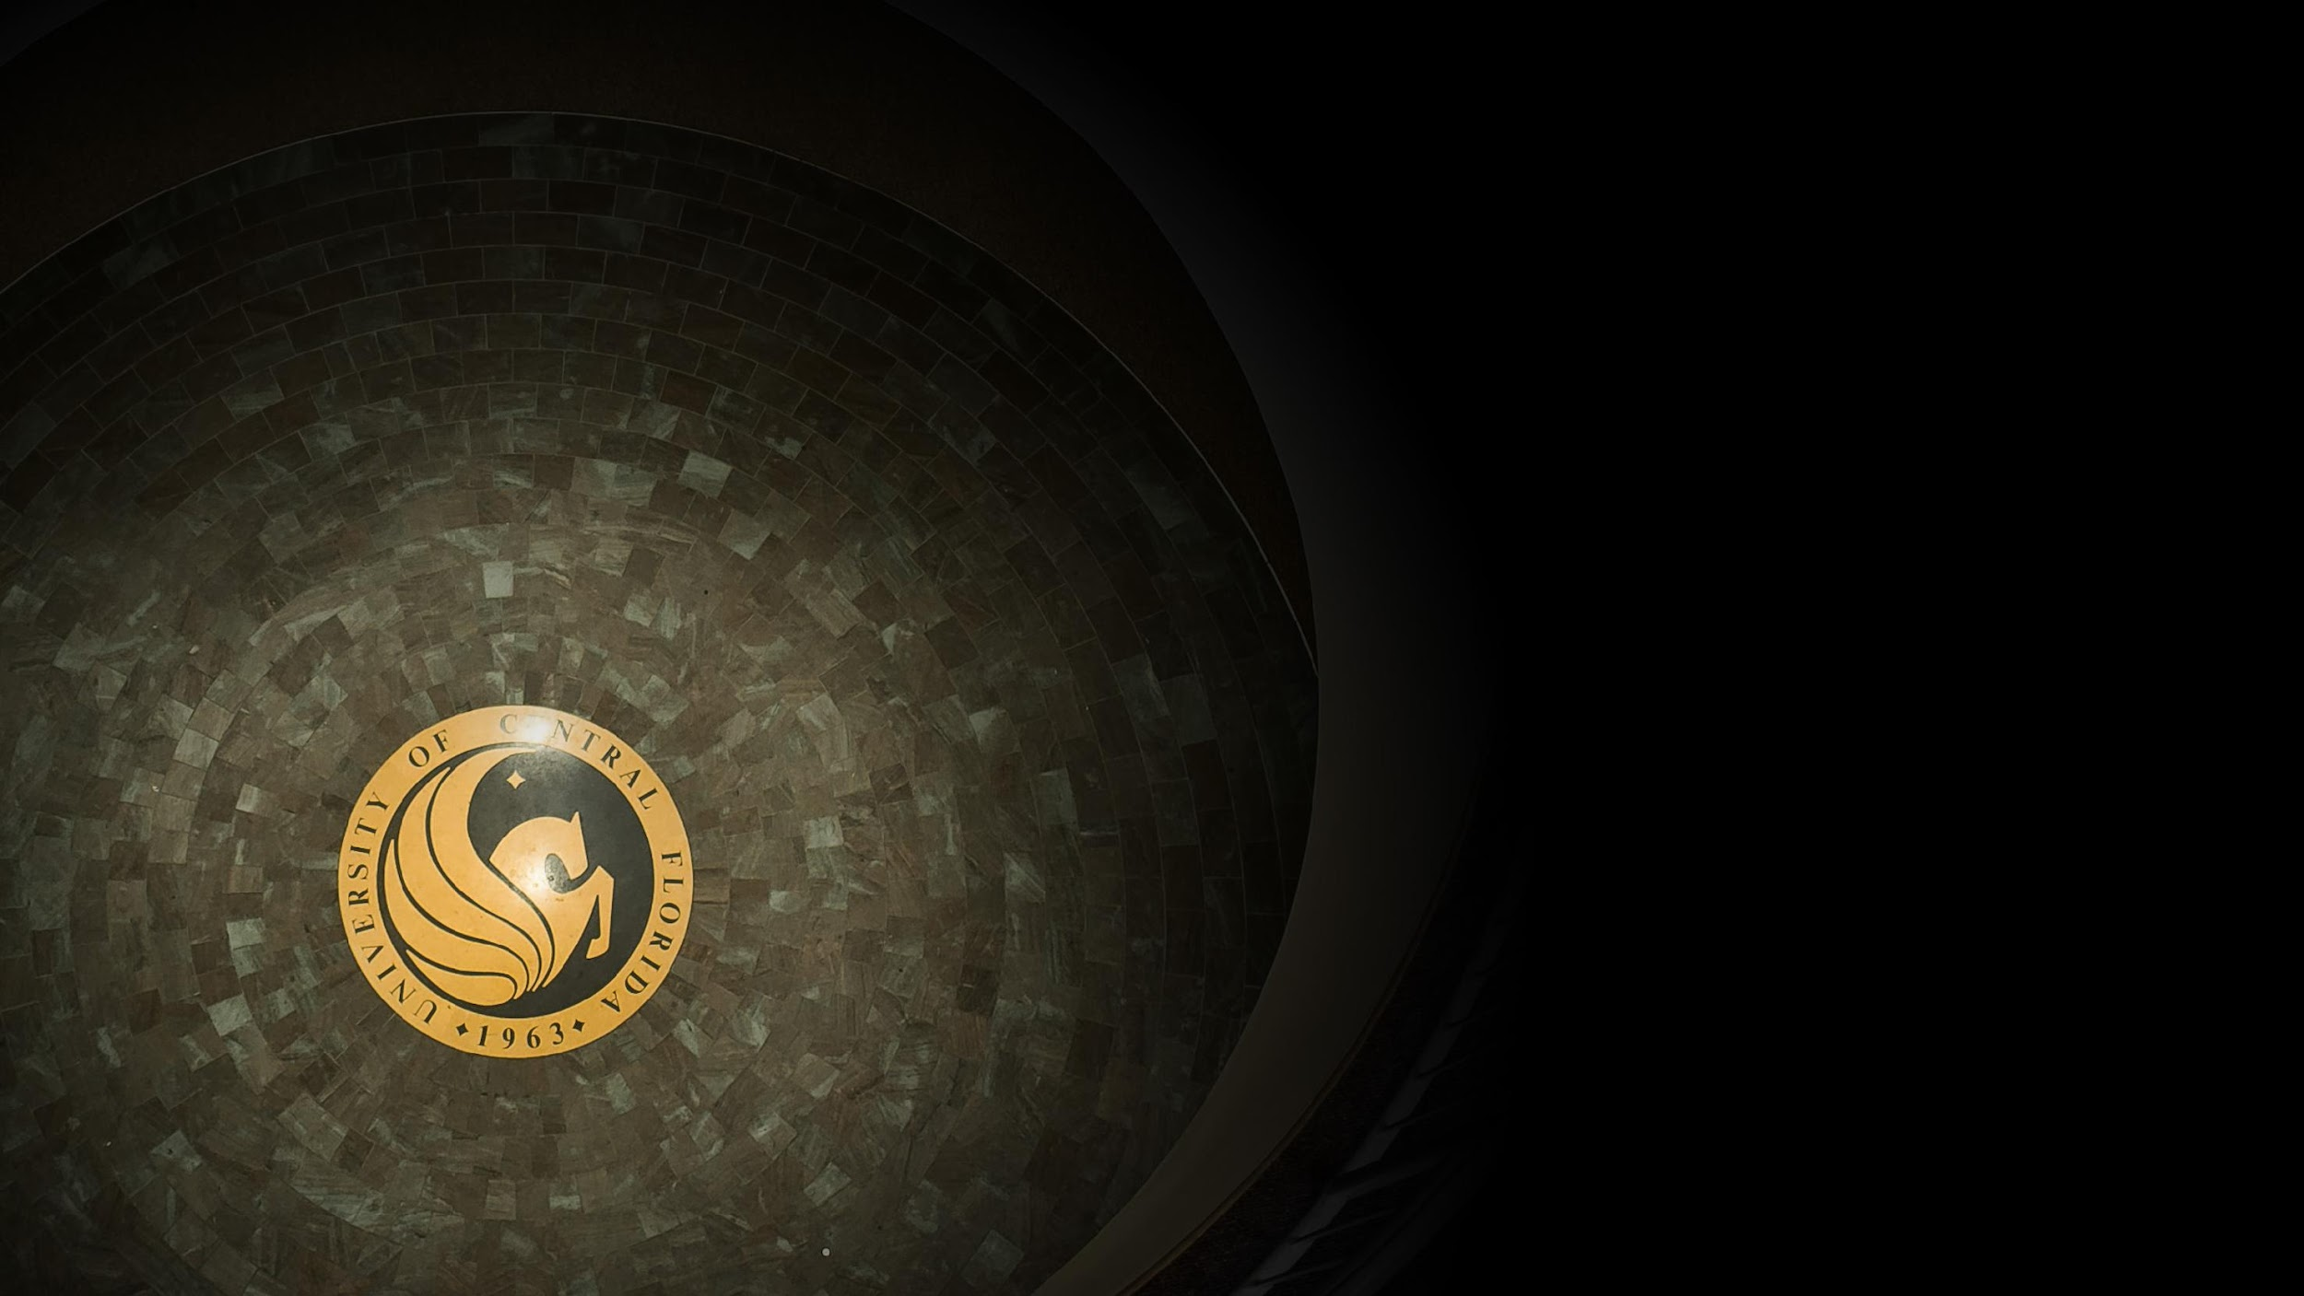
Contact Information
Sarah A. Norris
Scholarly Communication Librarian
UCF Libraries
sarah.norris@ucf.edu
UCF Libraries Office of Scholarly Communication http://library.ucf.edu/about/departments/scholarly-communication/

