Slide 1
Seek and Find:
Tips on Exploring STEM Journal Evaluation & Metrics
Sandy Avila, Science Librarian
Sarah A. Norris, Scholarly Communication Librarian
University of Central Florida

Slide 2
If You Remember One Thing from Today’s Discussion…
Contact the Library.
We can help.

Slide 3
Discussion

Slide 4
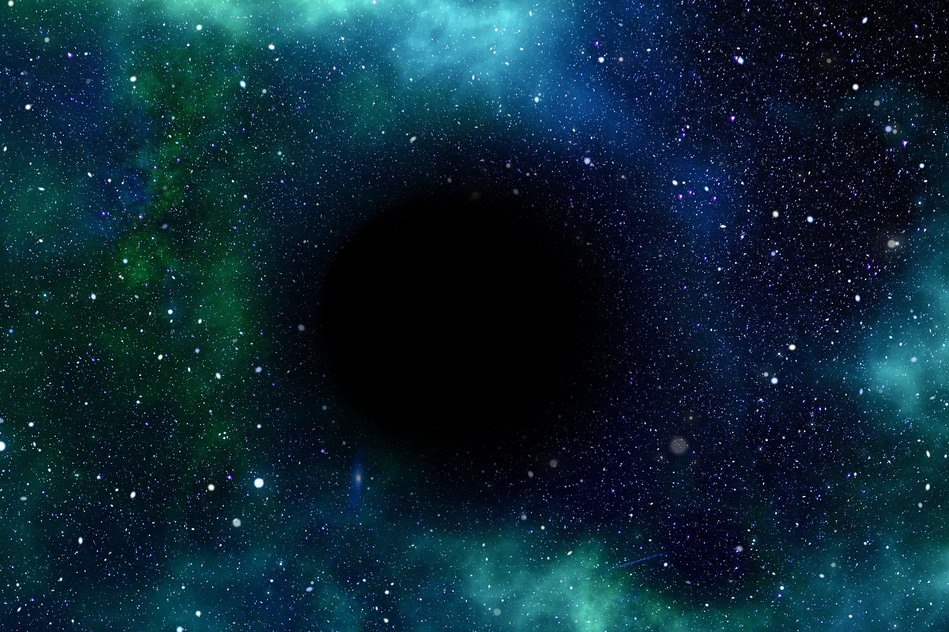
"Science is a cooperative enterprise, spanning the generations. It's the passing of a torch from teacher, to student, to teacher. A community of minds reaching back to antiquity and forward to the stars."
-Neil DeGrasse Tyson
What Are Your Publication Goals?

Slide 5
What Kinds of Publications Are You Interested In?
“To get to know, to discover, to publish -- this is the destiny of a scientist.”
-Francois Arago

Slide 6
“Open-access (OA) literature is digital, online, free of charge, and free of most copyright and licensing restrictions.”
© 2004-2015 Peter Suber. Last updated 5 December, 2015,
Retrieved from: http://bit.ly/oa-overview

Slide 7
Ways to Publish Open Access
Publish in a fully open access journal (Gold Open Access)
e.g. PLOS One
2. Publish in a traditional journal that includes an open access option (Hybrid Open Access)
e.g. Reference Librarian (Taylor & Francis)
3. Publish in a traditional journal & later archive your work in an open access repository, online faculty profile, or personal website (Green Open Access)
STARS
ResearchGate
Academia.edu

Slide 8
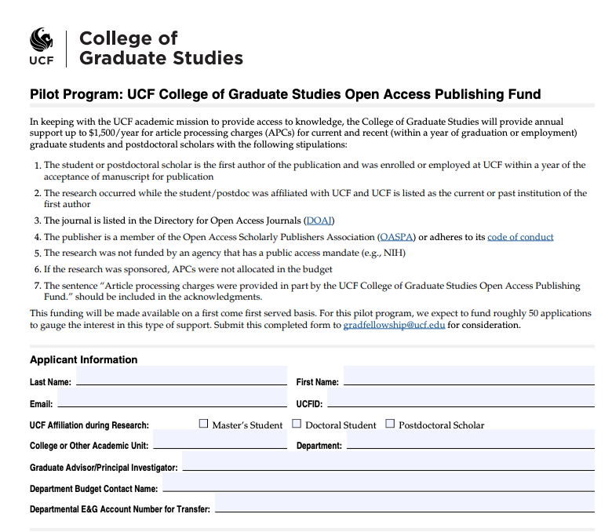
NEW! UCF Article Processing Charge Fund
https://graduate.ucf.edu/other-funding-resources/

Slide 9
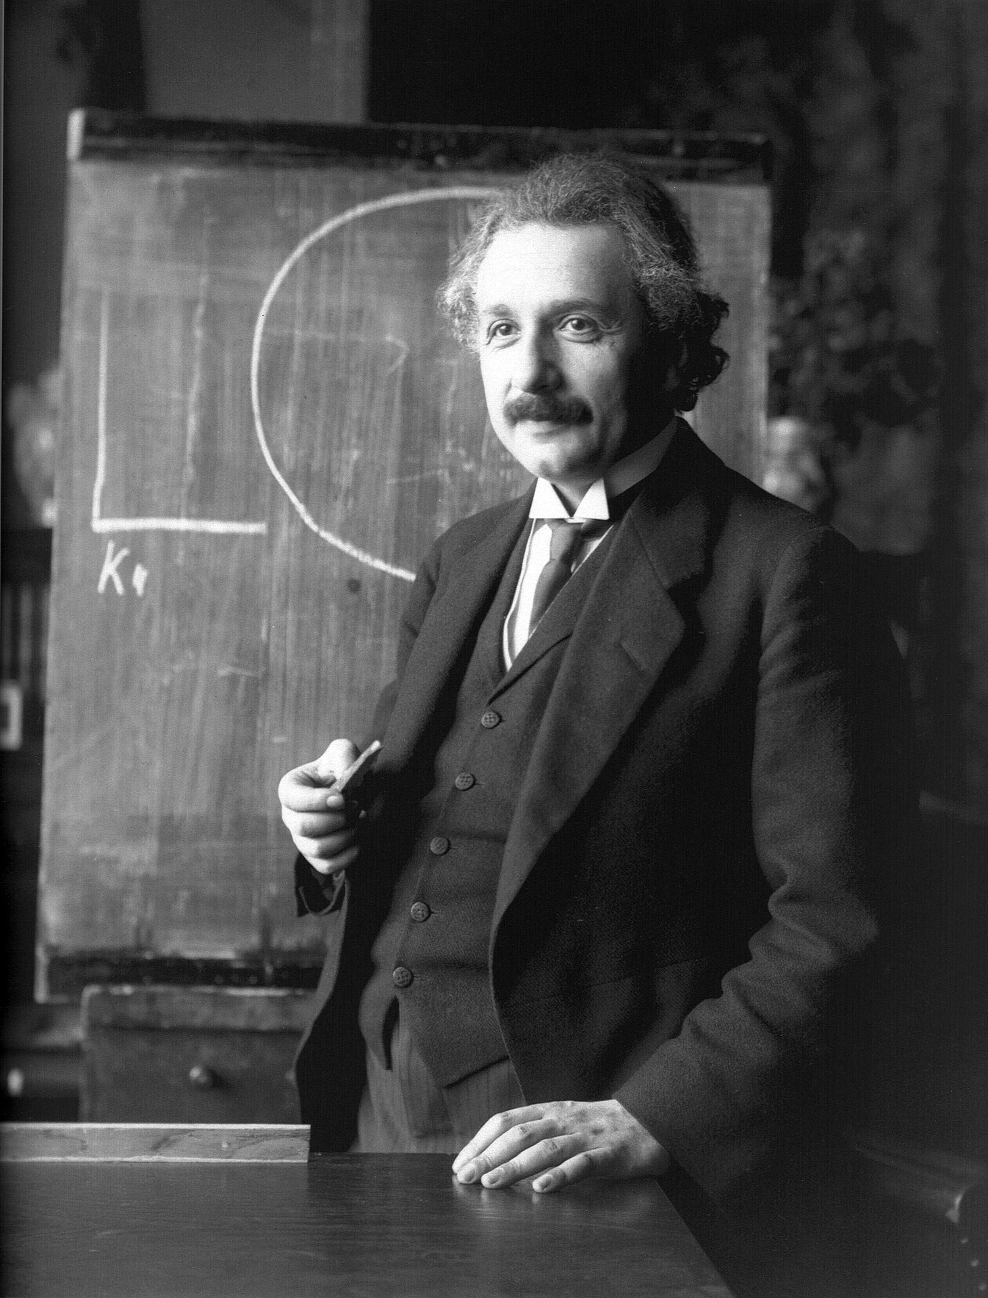
How Much Do Academic Expectations Play a Role in Your Publication Decisions?
Promotion & Tenure
Research Goals
Professional Goals (e.g. reputation in discipline, continuing employment & research opportunities)
College/Departmental Expectations
“Valuable achievement can sprout from human society only when it is sufficiently loosened to make possible the free development of an individual's abilities.”
-Albert Einstein

Slide 10
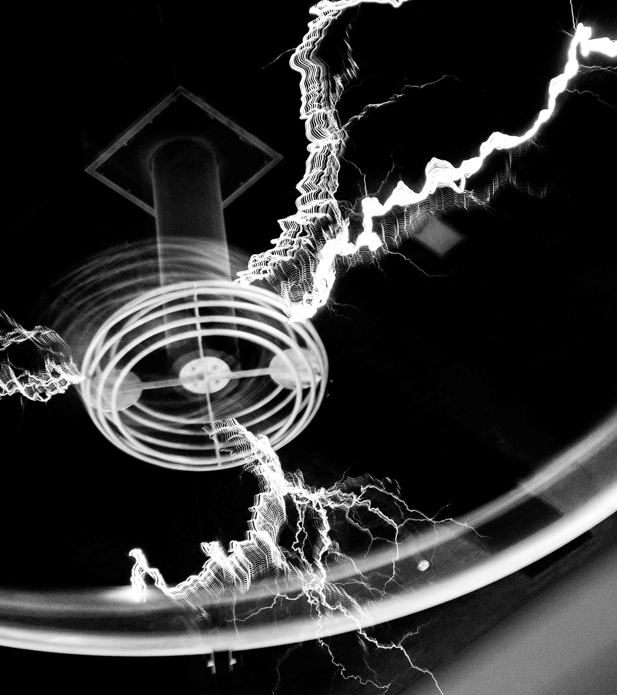
What is Your Personal Criteria for Determining Where to Publish?
“Have no fear of perfection; you’ll never reach it.”
-Marie Curie

Slide 11
What is the journal’s prestige and reputation?

Slide 12
Factors that Impact Prestige & Reputation...
Who’s on the editorial board
Is it indexed anywhere? (i.e. can you find it in library databases?)
Is it peer reviewed?
What is it impact factor?
Is it well-known in your discipline or area of work?
What are the acceptance rates? (i.e. is it really hard to get accepted or too easy?)
How widely is it circulated (print, online, open access or subscription-based)?
Has it been around for a long time?
Does it have UCF affiliation?
Is it open access (is there an APC involved in publication)?

Slide 13
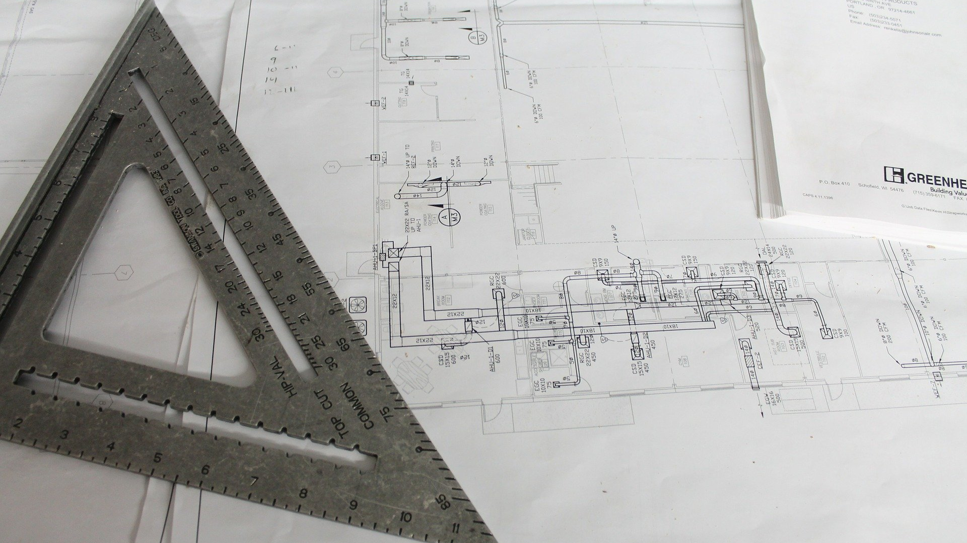
Putting It All Together...
Tools You Can Use

Slide 14
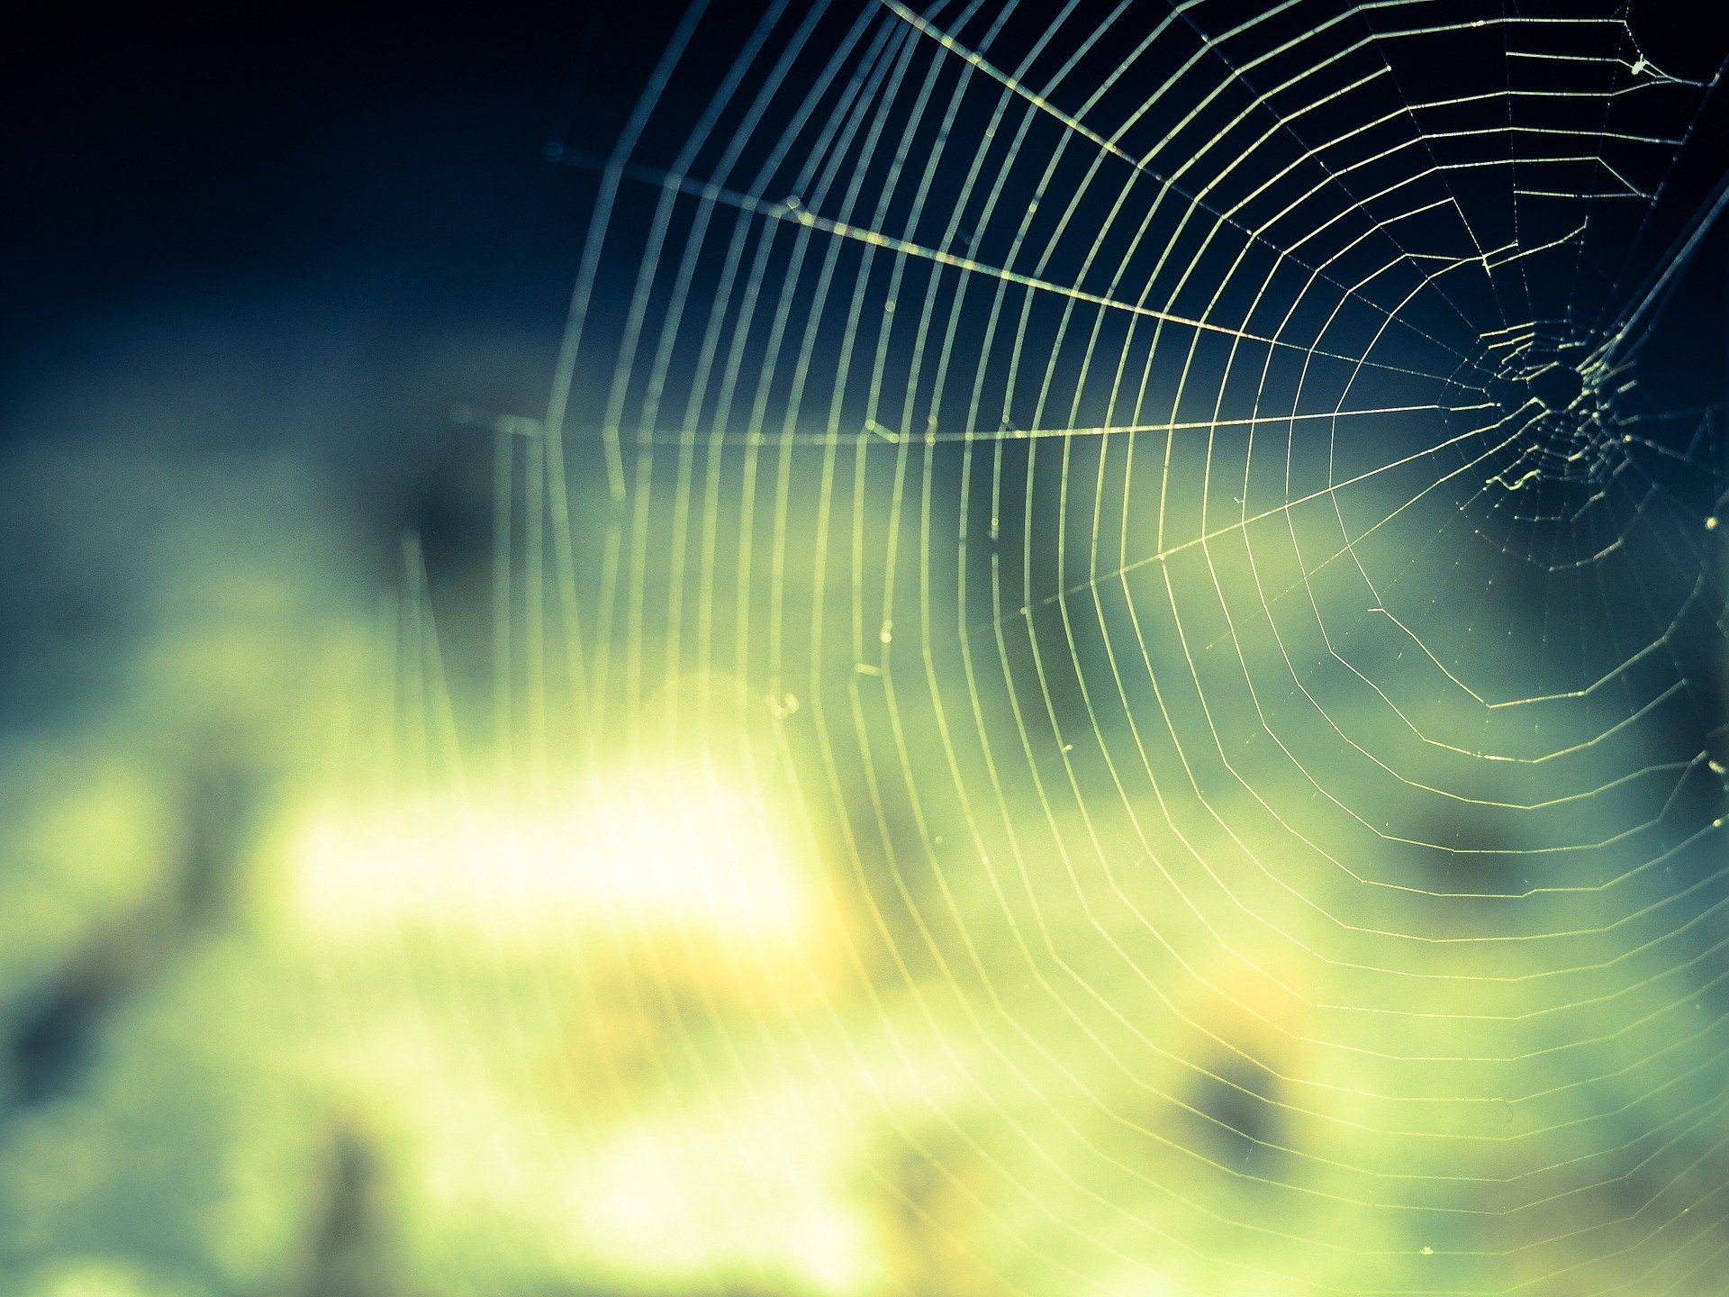
Browse journal rankings by journal title, category, or make a custom report
Access the database through the UCF Library website
Web of Science’s
Journal Citation Reports-
(Journal Impact Factor- JIF)

Slide 15
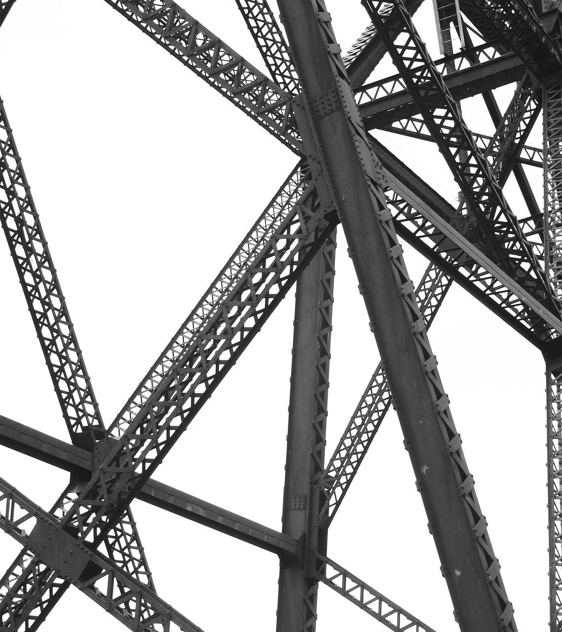
Scopus Preview’s Journal CiteScore
View your personal h-index or use as a way to check journal rankings
https://www.scopus.com/home.uri

Slide 16
Scimago
Journal & Country Ranking
Review Journal Rankings by subject area, subject category, region/country, publication type, and by year
https://www.scimagojr.com/

Slide 17
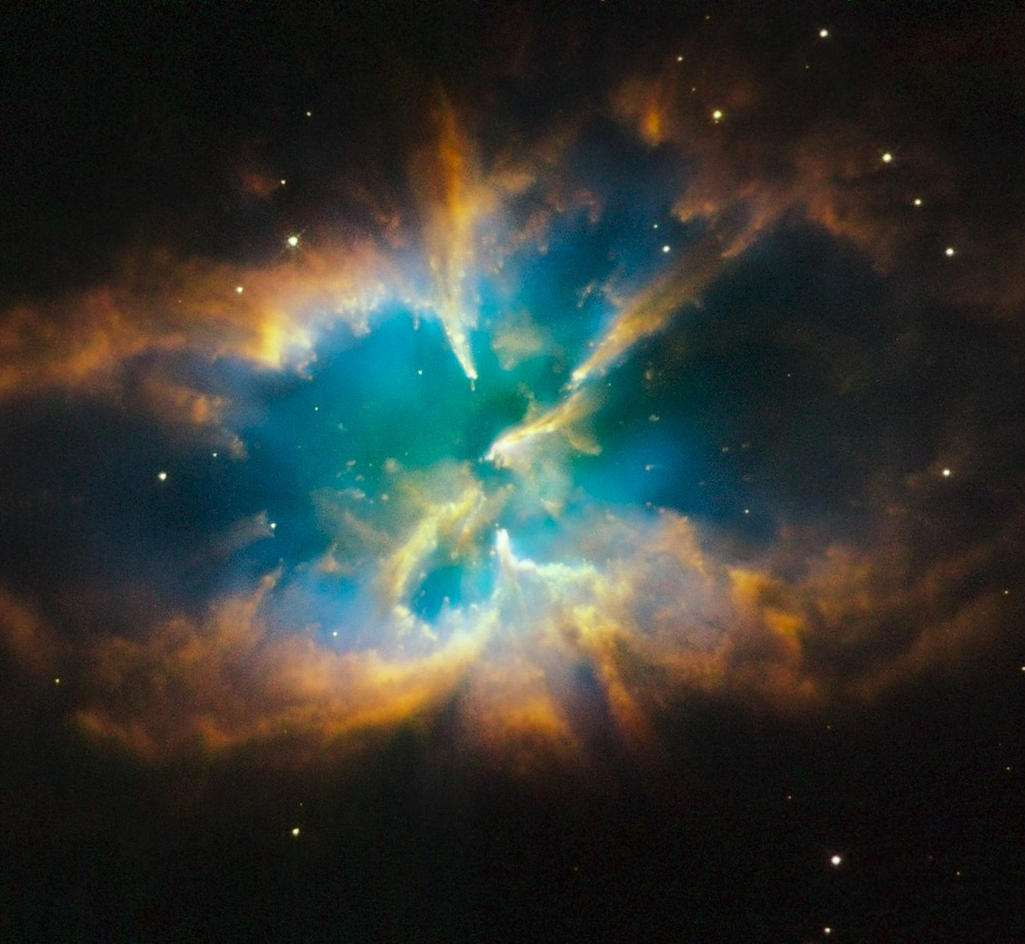
Google Scholar’s
Metrics
Google Scholar’s Metrics uses an h5-index which is the h-index for articles published in the last 5 complete years.
https://scholar.google.com/citations?view_op=top_venues&hl=en

Slide 18
SHERPA/RoMEO
Copyright, Self-Archiving Rules, and Author Guides
http://sherpa.ac.uk/romeo/index.php

Slide 19
When Assessing Open Access Journals...
Directory of Open Access Journals
https://doaj.org/

Slide 20
When Evaluating Journals...
Think.Check.Submit.
https://thinkchecksubmit.org/

Slide 21
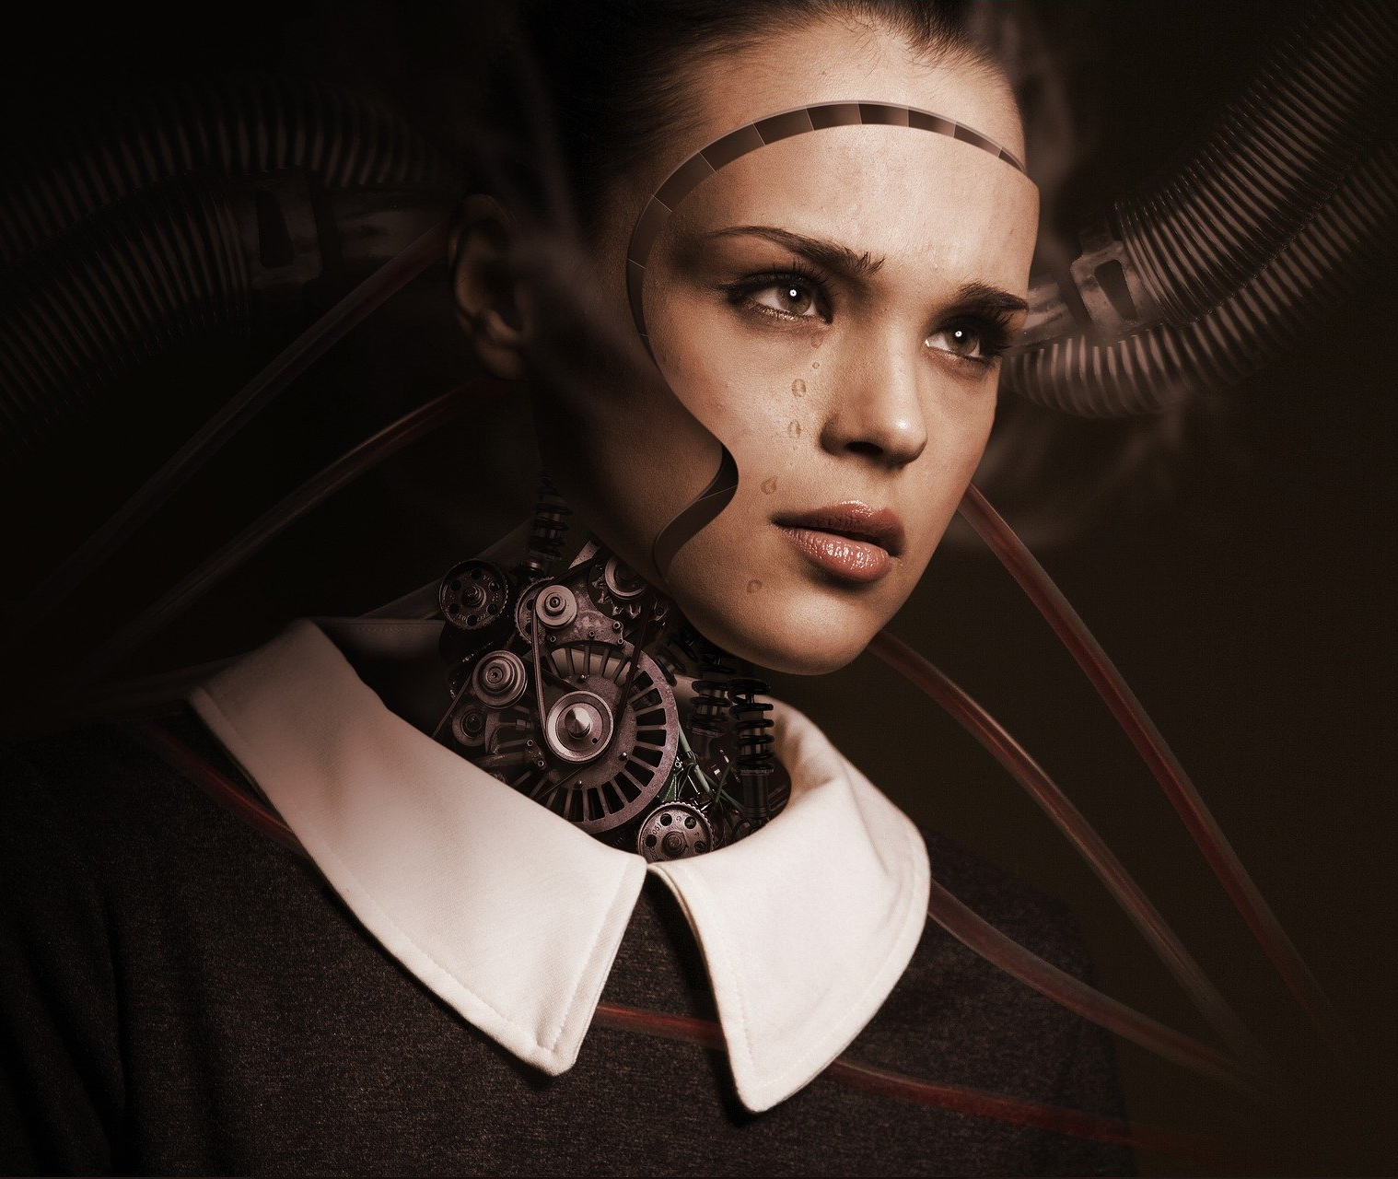
A Last Minute Reminder….
When in need, reach out to your trusted librarian!
“By far, the greatest danger of Artificial Intelligence is that people conclude too early that they understand it.”
-Eliezer Yudkowsky

Slide 22
Public Domain Image References
6689062 (Photographer). (2017, October 14). No title [digital image]. Retrieved from https://pixabay.com/photos/background-blank-book-bindings-2850204/
Axonite (Photographer). (2017, June 24). No title [digital image]. Retrieved from https://pixabay.com/photos/board-computer-circuit-background-2437882/
Geralt (Photographer). (2019, March 1). No title [digital image]. Retrieved from https://pixabay.com/illustrations/universe-hole-space-fog-galaxy-4027609/
Qimono (Photographer). (2016, December 2). No title [digital image]. Retrieved from https://pixabay.com/illustrations/lightbulb-bulb-light-idea-energy-1875247/
Pattern Pictures (Photographer). (2016, January 8). No title [digital image]. Retrieved from https://pixabay.com/photos/stars-rating-travel-four-hotel-1128772/
Skeeze (Photographer). (2015, February 23). No title [digital image]. Retrieved from https://pixabay.com/photos/einstein-albert-classroom-645461/
Schoemannb (Photographer). (2017, February 13). No title [digital image]. Retrieved from https://pixabay.com/photos/electricity-shock-tesla-coil-2057082/
BrooklynJohn (Photographer). (2014, June 17). No title [digital image]. Retrieved from https://pixabay.com/photos/construction-plans-square-plan-370588/
TBIT (Photographer). (2015, September 28). No title [digital image]. Retrieved from https://pixabay.com/photos/cobweb-networking-nature-close-up-959578/
Foundry (Photographer). (2014, July 1). No title [digital image]. Retrieved from https://pixabay.com/photos/structure-beams-engineering-839656/
Pexels (Photographer). (2016, April 25). No title [digital image]. Retrieved from https://pixabay.com/photos/code-code-editor-coding-computer-1839406/
WikiImages (Photographer). (2011, December 15). No title [digital image]. Retrieved from
https://pixabay.com/photos/ngc-2818-planetary-fog-11126/
Qimono (Photographer). (2016, November 14). No title [digital image]. Retrieved from https://pixabay.com/illustrations/virus-microscope-infection-illness-1812092/
Jklugiewicz (Photographer). (2016, November 22). No title [digital image]. Retrieved from https://pixabay.com/photos/keys-key-lock-security-home-1837155/
Manuchi (Photographer). (2017, July 1). No title [digital image]. Retrieved from https://pixabay.com/illustrations/background-abstract-line-2462436/
024-657-834 (Photographer). (2017, December 13). No title [digital image]. Retrieved from https://pixabay.com/photos/robot-woman-face-cry-sad-3010309/

Slide 23
Contact Information
Thank You!
Sandy Avila
Science Librarian
John C. Hitt Library
sandy.avila@ucf.edu
Sarah A. Norris
Scholarly Communication Librarian
John C. Hitt Library
sarah.norris@ucf.edu

