Slide 1
Copyright & Fair Use...
in the Time of COVID-19
Sarah A. Norris, Scholarly Communication Librarian
Rich Gause, Government Information Librarian
University of Central Florida

Slide 2
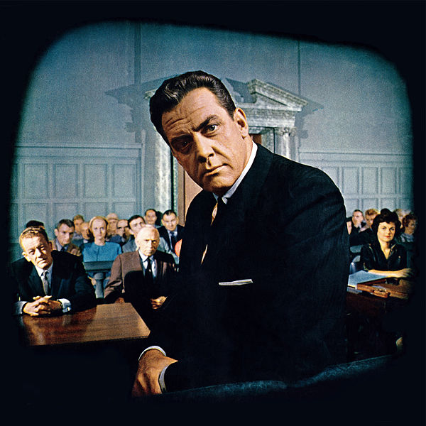
Disclaimer
UCF Libraries does not give legal advice, and any information in this presentation is for informational purposes only.

Slide 3
Session Agenda
Copyright & Fair Use in Brief
Copyright & Fair Use Online vs Face-to-Face
Fair Use Online During Exigent Circumstances
Resources to Help Navigate Copyrighted Content
Copyright & Fair Use Considerations for Future Semesters
Q&A

Slide 4
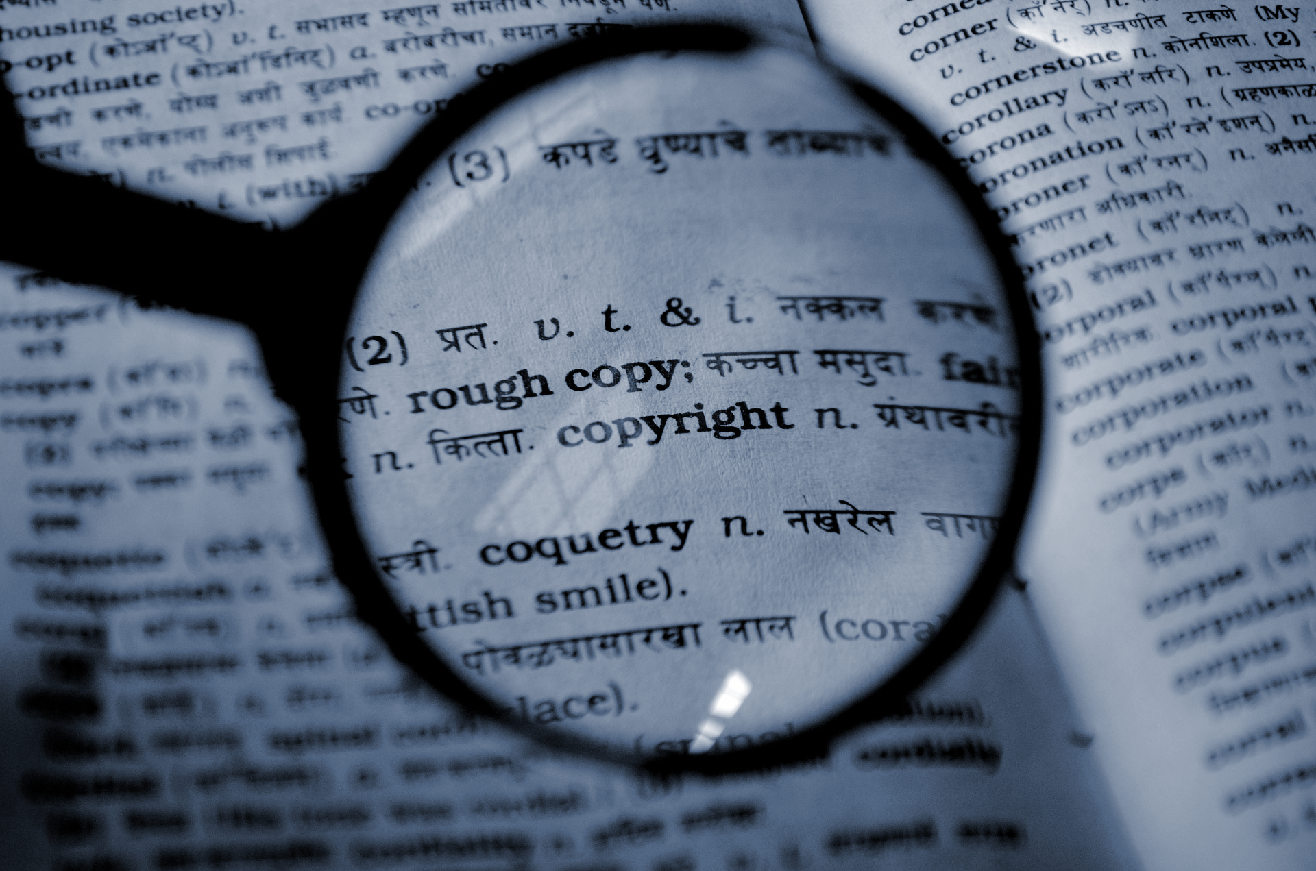
Copyright &
Fair Use In Brief

Slide 5
“Copyright is a form of protection provided by the laws of the United States (title 17, U.S. Code) to the authors of ‘original works of authorship,’ including literary, dramatic, musical, artistic, and certain other intellectual works. This protection is available to both published and unpublished works.”
http://www.copyright.gov/circs/circ01.pdf

Slide 6
“Fair use is a legal doctrine that promotes freedom of expression by permitting the unlicensed use of copyright-protected works in certain circumstances. Section 107 of the Copyright Act provides the statutory framework for determining whether something is a fair use and identifies certain types of uses—such as criticism, comment, news reporting, teaching, scholarship, and research—as examples of activities that may qualify as fair use.”
http://copyright.gov/fair-use/more-info.html

Slide 7
Navigating Fair Use...
When considering use of copyrighted work(s), the Four Fair Use Factors are typically used as a benchmark for whether fair use is appropriate or not
The purpose & character of use
The nature of the copyrighted work
The portion used in relation to the copyrighted work as a whole
The effect of the use upon the potential market
Fair use is not applicable in every situation, even if it is for educational purposes
UCF Office of General Counsel Recommends that UCF Faculty adhere to a general 10% rule (i.e. use up to 10% of a copyrighted work)
Top 10 Copyright & Fair Use Questions

Slide 8
Copyright in the Classroom: Face-to-Face versus Online

Slide 9
Legal Framework
Copyright Law
Using copyrighted materials for teaching purposes
Creating your own copyrighted materials for teaching purposes
Contract Law
May define copyright ownership in instructional materials
Can affect what materials you may or may not be able to use in a course
UCF Policies and/or Recommendations
Use of Copyrighted Materials Policy
Top 10 Copyright & Fair Use Questions (Office of General Counsel)

Slide 10
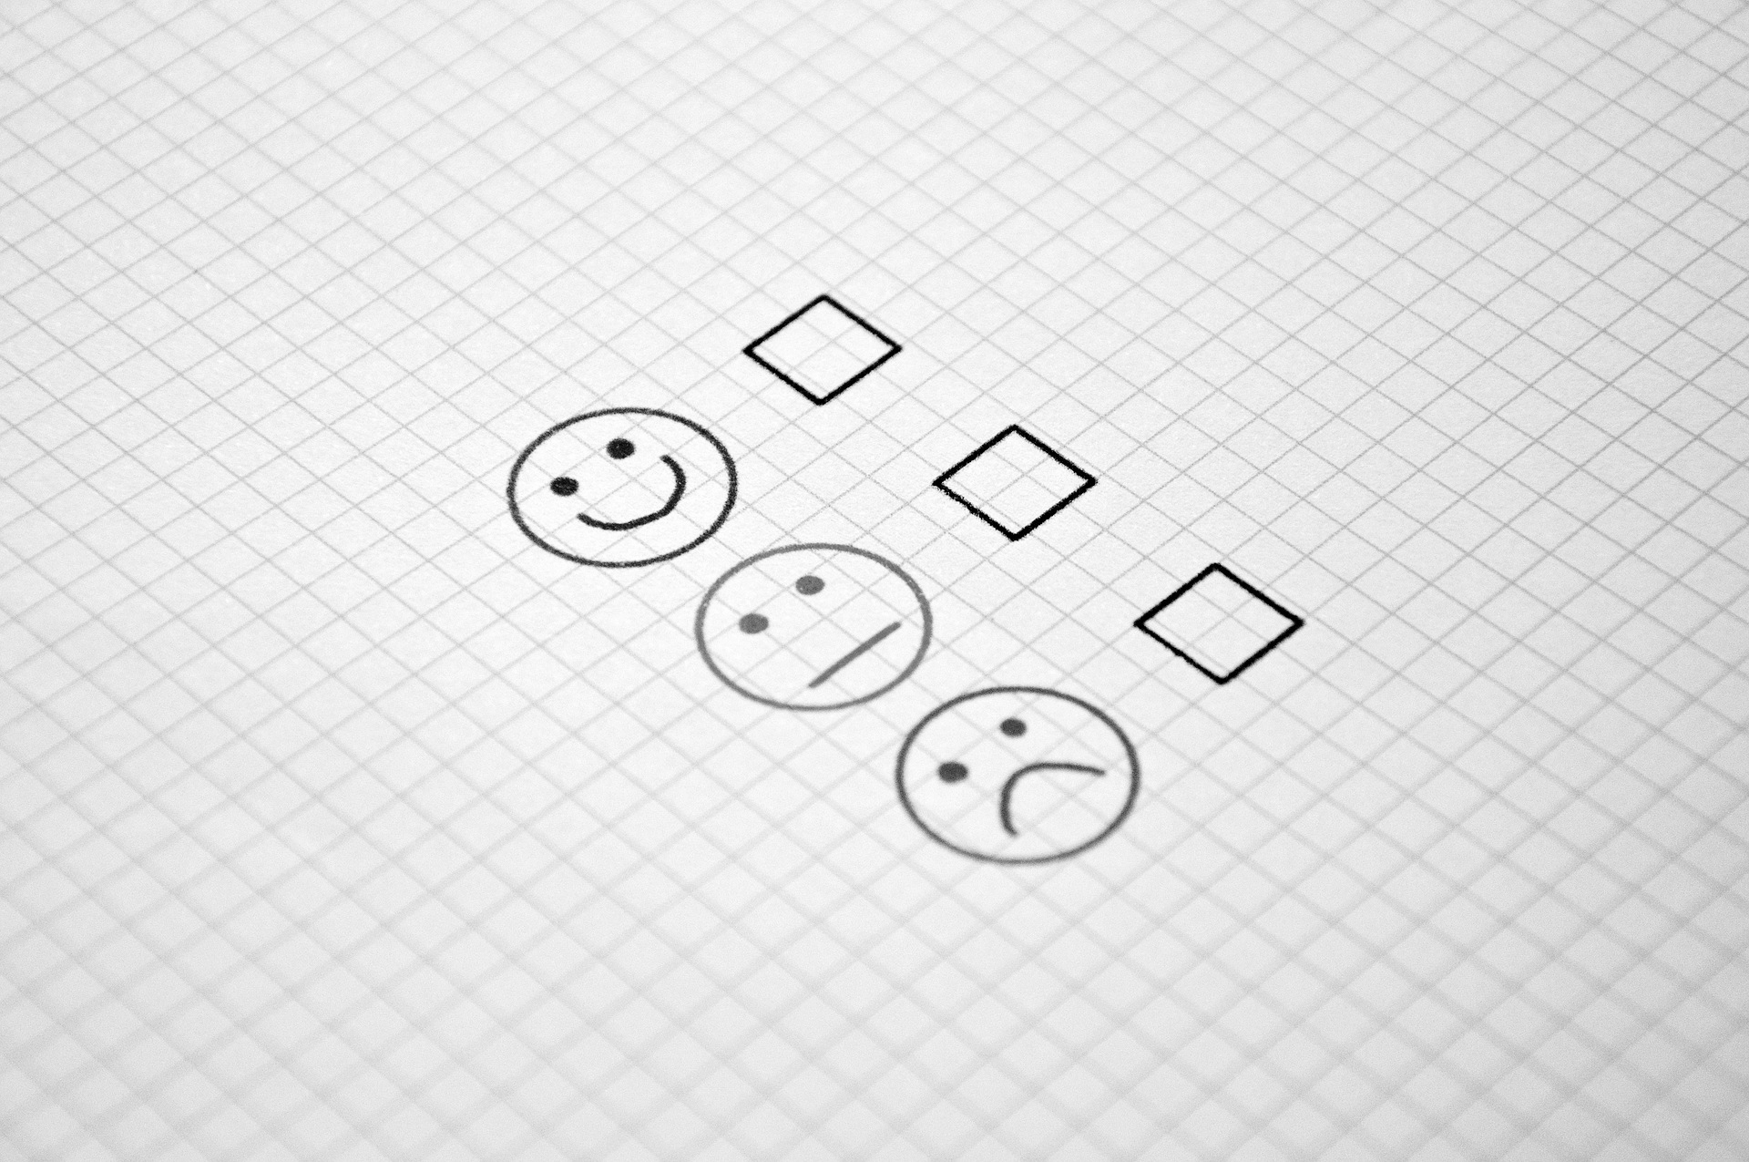
How Do We Make Sure We’re Copyright Compliant in the Classroom?

Slide 11
Copyright in the Face-to-Face Classroom
Face to face classroom teaching exception (§110(1))
Publicly display & perform
Doesn’t apply online
Fair use exception (§107)
Reproduction for blind or other people with disabilities (§121)
Special HathiTrust access via Missy Murphey
First sale doctrine (§109)
Does not apply if end-user license agreements are in place

Slide 12
Copyright in the Online Classroom
Online classroom teaching exception - TEACH Act (§110(2) and §112 )
Provides some guidance, but is more technical and restrictive
“Due to the extremely restrictive nature of the TEACH Act, the UCF General Counsel’s Office prefers to rely on the traditional fair use principles instead.”
Fair use exception (§107)
Reproduction for blind or other people with disabilities (§121)
Special HathiTrust access via Missy Murphey
First sale doctrine (§109)

Slide 13
General Recommendations for both Face-to-Face & Online
If a license applies, it must be complied with
Obtain permission to use copyrighted materials
Pay to use via services like Copyright Clearance Center
Fair Use
Linking to Content
Finding materials that are in the public domain and/or are openly licensed

Slide 14
Copyright, Fair Use &
Emergency Circumstances

Slide 15
Important Points to Consider
Copyright and Fair Use still apply
However... fair use, in particular, offers flexibility during emergency situations (Four Fair Use Factors)
“making materials available and accessible to students in this time of crisis will almost always be a fair use.”
Faculty should consider copyright & fair use but not agonize to the point of not being able to use resources
These emergency circumstances are not necessarily applicable to those who were already teaching online

Slide 16
Public Statement of Library Copyright Specialists: Fair Use & Emergency Remote Teaching & Research
Can be found at: https://tinyurl.com/tvnty3a
UCF Office of General Counsel recommends following this document as a guideline when navigating fair use during these circumstances
Key points:
Consider multiple approaches to mitigate risk
Restrict access to materials only to students, instructors, or TAs in the course
Only provide content for the period of time needed & that are pedagogically appropriate
Look for longer-term solutions to needs presented during this public health crisis

Slide 17
Other Resources to Help Navigate Copyrighted Content
Library-Licensed Materials
Temporary access materials
UCF Libraries LibGuide https://guides.ucf.edu/covid
Vendor Love in the Time of COVID-19 https://tinyurl.com/vendorsupportedaccess
Copyright Clearance Center License
Public domain (e.g. Internet Archive, HathiTrust, Project Gutenberg, etc.)
Open Educational Resources

Slide 18
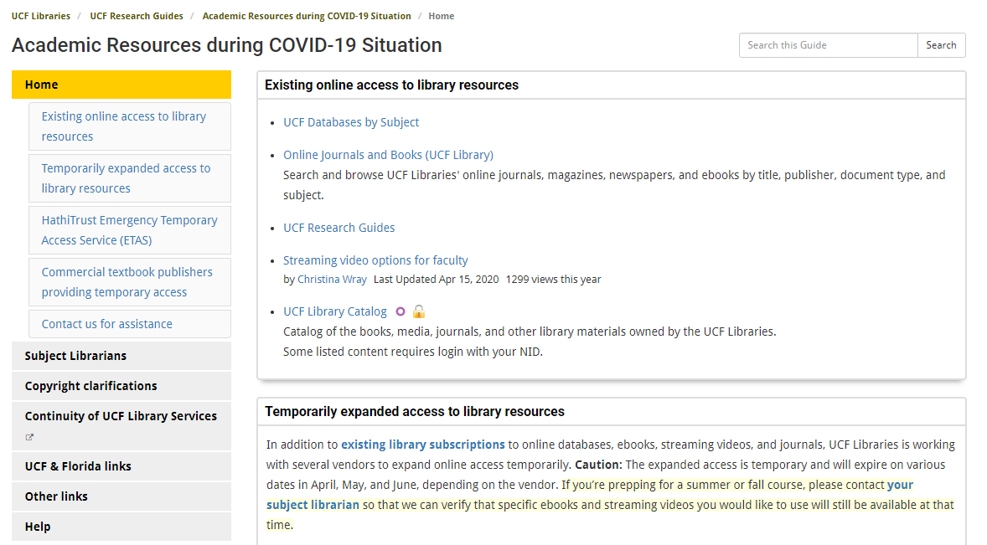
https://guides.ucf.edu/covid

Slide 19
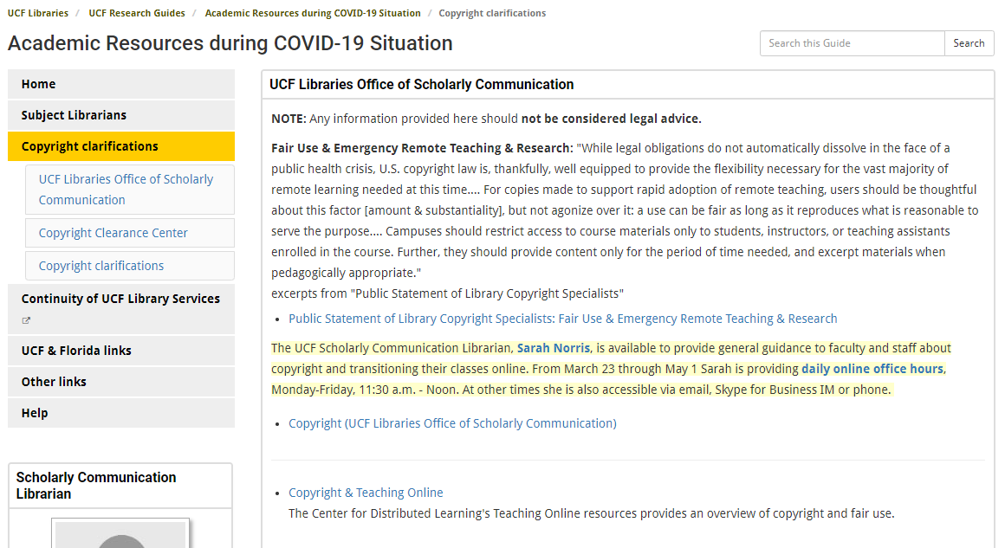
https://guides.ucf.edu/covid/copyright

Slide 20
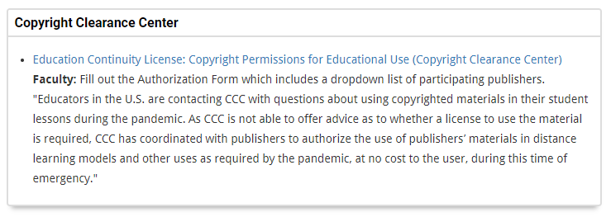
https://guides.ucf.edu/covid/copyright

Slide 21
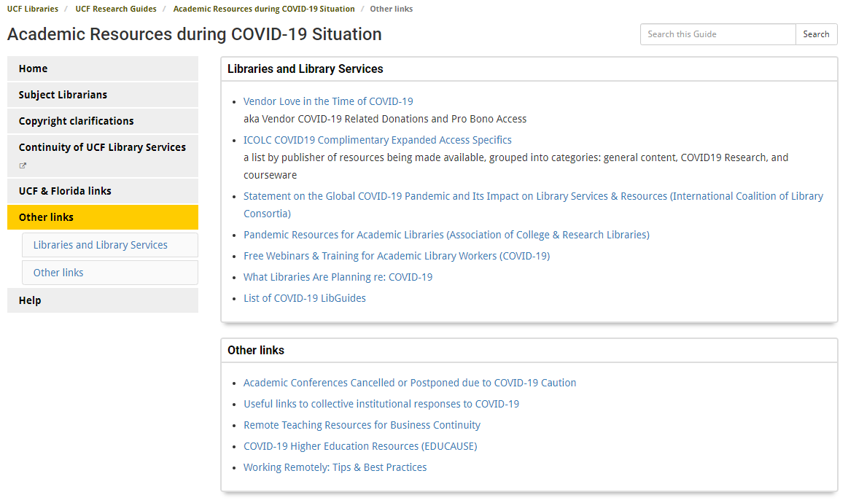
https://guides.ucf.edu/covid/other

Slide 22
Copyright & Fair Use Considerations for Future Semesters
For Summer semesters, fair use for emergency circumstances should still be applicable
This is particularly applicable for faculty who were scheduled to teach face-to-face only courses but now must teach online
Encourage faculty to start thinking about fall courses and online alternatives
This time frame is no longer an emergency situation, as faculty have time to plan for the fall

Slide 23
Final Considerations

Slide 24
General Recommendations for Emergency Situations
Assess copyright & fair use on a case-by-case basis
When possible, look for alternative versions of materials (e.g. ebooks, online journal articles, streaming video)
If UCF has purchased and/or licensed materials, it is always preferable to link to them vs uploading to Canvas
Consider freely available and/or openly licensed materials
Approach from a pedagogical perspective

Slide 25
What Would You Do?
Let’s Talk Through Scenarios...

Slide 26
Scenarios
Scanning an entire textbook
Uploading PDFs of articles, book chapters, etc.
Uploading/Using Multimedia (videos, etc.)

Slide 27
Resources
UCF Office of General Counsel: Top 10 Copyright & Fair Use Questions
https://generalcounsel.ucf.edu/files/2015/06/Top-Ten-Copyright-and-Fair-Use-Questions-revised-NNH-clean-4-19-11.docx
Public Statement of Library Copyright Specialists: Fair Use & Emergency Remote Teaching & Research
https://tinyurl.com/tvnty3a
UCF Libraries LibGuide
https://guides.ucf.edu/covid
Vendor Love in the Time of COVID-19
https://tinyurl.com/vendorsupportedaccess

Slide 28
Public Domain Image References
Robert Vose / Cowles Communications, Inc. (Photographer). Photograph of Raymond Burr and other cast members on the set of the CBS-TV series Perry Mason, from the front cover of Look magazine [digital image]. Retrieved from https://commons.wikimedia.org/wiki/File:Perry-Mason-Look-1961.jpg
PDPics (Photographer). (2014, July 15). No title [digital image]. Retrieved from https://pixabay.com/photos/copyright-magnifier-magnifying-glass-389901/
Wokandapix (Photographer). (2017, January 10). No title [digital image]. Retrieved from https://pixabay.com/photos/teach-education-school-class-1968076/
Athree23 (Photographer). (2018, September 15). No title [digital image]. Retrieved from https://pixabay.com/photos/feedback-checklist-job-gut-3676922/
SCY (Photographer). (2015, June 24). No title [digital image]. Retrieved from https://pixabay.com/photos/laptop-book-information-online-819285/
Uki_71 (Photographer). (2016, January 18). No title [digital image]. Retrieved from https://pixabay.com/photos/note-pin-list-stickies-paper-memo-1143037/
TeroVesalainen (Photographer). (2017, March 7). No title [digital image]. Retrieved from https://pixabay.com/photos/question-mark-why-problem-solution-2123967/

Slide 29
Contact Information
Sarah A. Norris
Scholarly Communication Librarian
sarah.norris@ucf.edu
Rich Gause
Government Information Librarian
richg@ucf.edu
UCF Libraries Office of Scholarly Communication http://library.ucf.edu/about/departments/scholarly-communication/

