Slide 1
Copyright, Fair Use & Online Teaching
During Emergency Circumstances
Sarah A. Norris, Scholarly Communication Librarian
Rich Gause, Government Information Librarian
University of Central Florida

Slide 2
If you remember one thing from this presentation...

Slide 3
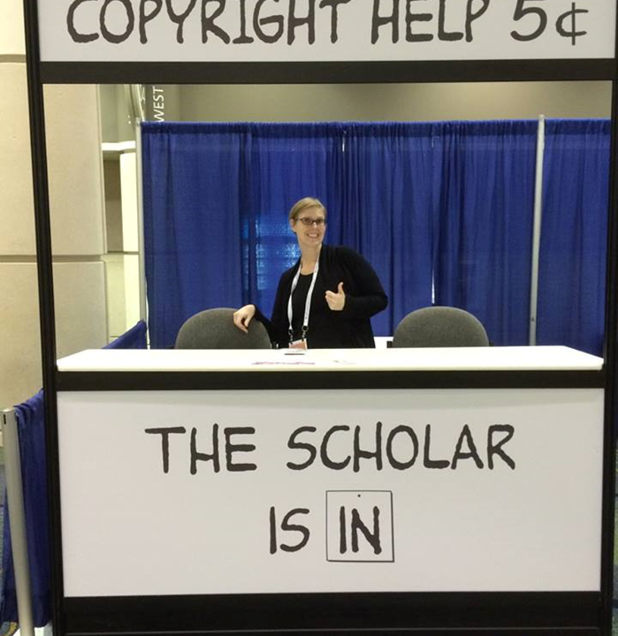
Contact the Library!
We can Help!
Copyright Sarah A. Norris

Slide 4
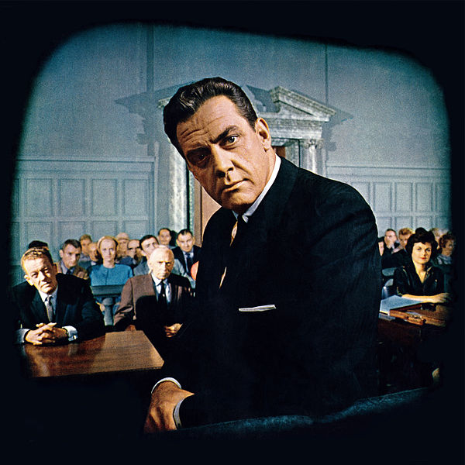
Disclaimer
UCF Libraries does not give legal advice, and any information in this presentation is for informational purposes only.

Slide 5
Session Agenda
Copyright in Brief
Fair Use Fundamentals
Copyright & Fair Use Online vs Face-to-Face
Fair Use Online During Exigent Circumstances
Resources to Help Navigate Copyrighted Content
Copyright & Fair Use Considerations for Future Semesters
Best Practices, Licensing & Mitigating Risk
Q&A

Slide 6
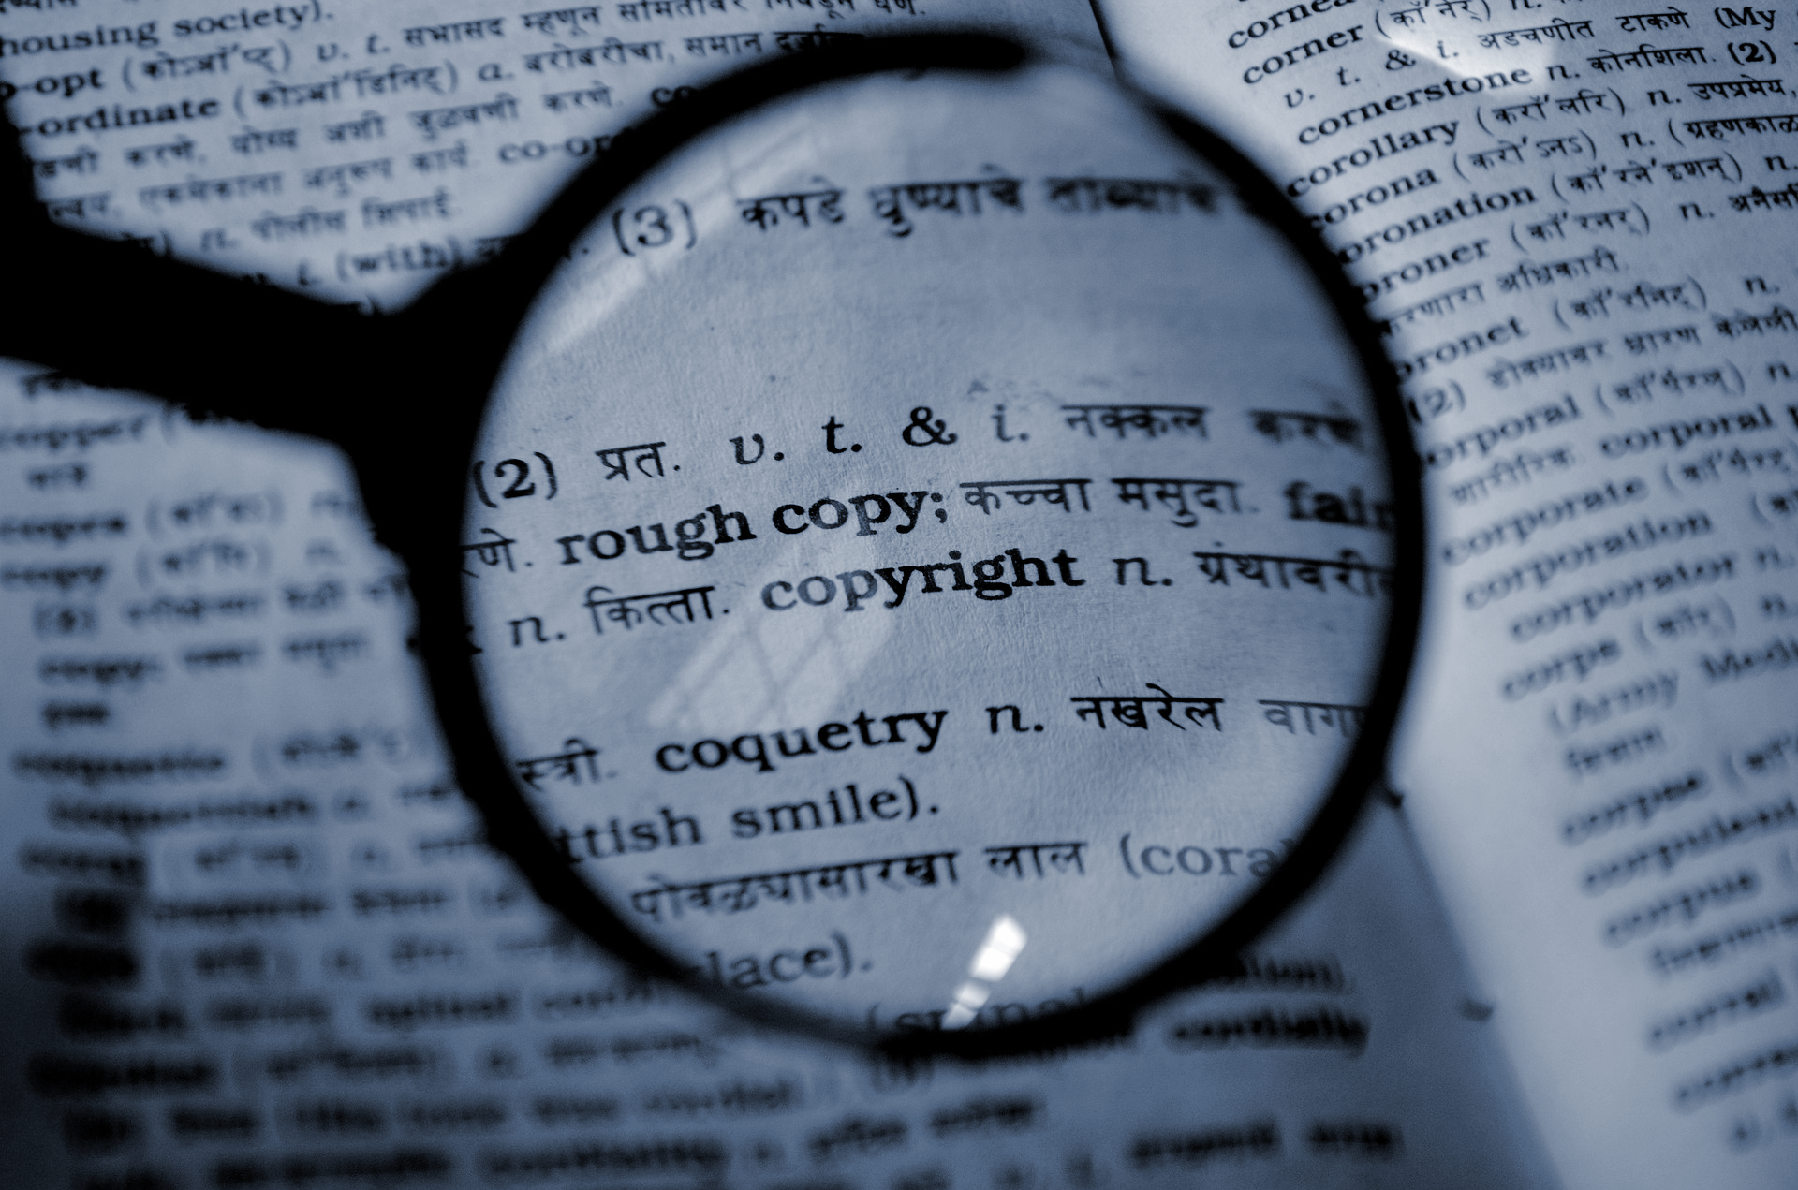
Copyright In Brief

Slide 7
“Copyright is a form of protection provided by the laws of the United States (title 17, U.S. Code) to the authors of ‘original works of authorship,’ including literary, dramatic, musical, artistic, and certain other intellectual works. This protection is available to both published and unpublished works.”
http://www.copyright.gov/circs/circ01.pdf

Slide 8
Fair Use Fundamentals

Slide 9
“Fair use is a legal doctrine that promotes freedom of expression by permitting the unlicensed use of copyright-protected works in certain circumstances. Section 107 of the Copyright Act provides the statutory framework for determining whether something is a fair use and identifies certain types of uses—such as criticism, comment, news reporting, teaching, scholarship, and research—as examples of activities that may qualify as fair use.”
http://copyright.gov/fair-use/more-info.html

Slide 10
Why Fair Use?
Copyright broadly is meant “to promote the progress of science”
Fair Use is a mechanism that can aid this
Ideal for educational purposes
Favors the public interest
Courts favor fair use
Fair Use is flexible and responsive
Based on context
Decided by Four Fair Use Factors
“Fair use is made for just these kinds of circumstances” https://tinyurl.com/tvnty3a

Slide 11
Navigating Fair Use...
When considering use of copyrighted work(s), the Four Fair Use Factors are typically used as a benchmark for whether fair use is appropriate or not
The purpose & character of use
The nature of the copyrighted work
The portion used in relation to the copyrighted work as a whole
The effect of the use upon the potential market
Fair use is not applicable in every situation, even if it is for educational purposes
UCF Office of General Counsel Recommends that UCF Faculty adhere to a general 10% rule (i.e. use up to 10% of a copyrighted work)
Top 10 Copyright & Fair Use Questions

Slide 12
The Four Fair Use Factors
Factor 1: The purpose & character of use
Why do you want to use the work?
What is the nature of using the work?
General support for education
Access as a public good
However…
Has the original work been transformed by adding new expression or meaning?
Was value added to the original by creating new information, new aesthetics, new insights, and understandings?

Slide 13
The Four Fair Use Factors
Factor 2: The nature of the copyrighted work
Is the work fact-specific?
Is the work creative in nature?
Is the work published or unpublished?
This particular factor isn’t as highly weighted
However…
You still want to consider this as you navigate the other factors

Slide 14
The Four Fair Use Factors
Factor 3: The portion used in relation to the copyrighted work as a whole
How much of the work do you want to use?
Is the amount used considered the “heart of the work?”
There is no exact amount or limit to how much you can/can’t use
Fair use provides flexibility
UCF Office of General Counsel recommendations
How much do you need for pedagogical purposes?
Keep it reasonable and don’t agonize

Slide 15
The Four Fair Use Factors
Factor 4: The effect of the use upon the potential market
Will the use cause market harm?
Spontaneity & exigent circumstances
Limiting use to only students, faculty, RAs/TAs in the course
Use limited amounts whenever possible & pedagogically relevant
Explore the use of licenses whenever possible and available
*This factor is often the factor that triggers legal action

Slide 16
Copyright in the Classroom: Face-to-Face versus Online

Slide 17
Legal Framework
Copyright Law
Using copyrighted materials for teaching purposes
Creating your own copyrighted materials for teaching purposes
Contract Law
May define copyright ownership in instructional materials
Can affect what materials you may or may not be able to use in a course
UCF Policies and/or Recommendations
Use of Copyrighted Materials Policy
Top 10 Copyright & Fair Use Questions (Office of General Counsel)

Slide 18
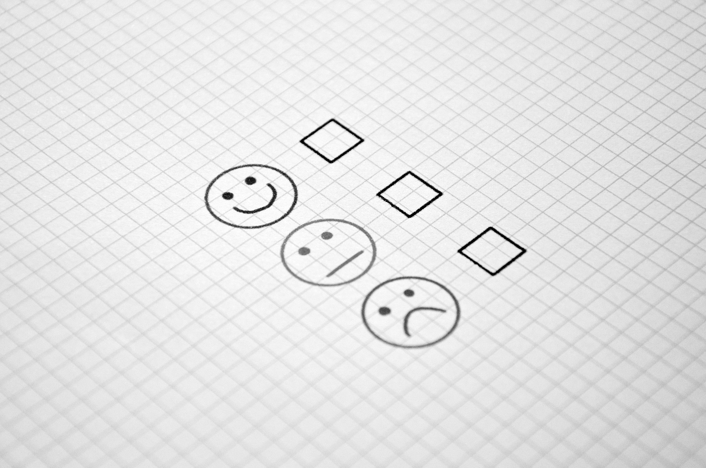
How Do We Make Sure We’re Copyright Compliant in the Classroom?

Slide 19
Copyright in the Face-to-Face Classroom
Face to face classroom teaching exception (§110(1))
Publicly display & perform
Doesn’t apply online
Fair use exception (§107)
Reproduction for blind or other people with disabilities (§121)
Special HathiTrust access via Missy Murphey
First sale doctrine (§109)
Does not apply if end-user license agreements are in place

Slide 20
Copyright in the Online Classroom
Online classroom teaching exception - TEACH Act (§110(2) and §112 )
Provides some guidance, but is more technical and restrictive
“Due to the extremely restrictive nature of the TEACH Act, the UCF General Counsel’s Office prefers to rely on the traditional fair use principles instead.”
Fair use exception (§107)
Reproduction for blind or other people with disabilities (§121)
Special HathiTrust access via Missy Murphey
First sale doctrine (§109)

Slide 21
General Recommendations for both Face-to-Face & Online
If a license applies, it must be complied with
Obtain permission to use copyrighted materials
Pay to use via services like Copyright Clearance Center
Fair Use
Linking to Content
Finding materials that are in the public domain and/or are openly licensed

Slide 22
Copyright, Fair Use &
Emergency Circumstances

Slide 23
Important Points to Consider
Copyright and Fair Use still apply
However... fair use, in particular, offers flexibility during emergency situations (Four Fair Use Factors)
“making materials available and accessible to students in this time of crisis will almost always be a fair use.”
Faculty should consider copyright & fair use but not agonize to the point of not being able to use resources
These emergency circumstances are not necessarily applicable to those who were already teaching online

Slide 24
Public Statement of Library Copyright Specialists: Fair Use & Emergency Remote Teaching & Research
Can be found at: https://tinyurl.com/tvnty3a
UCF Office of General Counsel recommends following this document as a guideline when navigating fair use during these circumstances
Key points:
Consider multiple approaches to mitigate risk
Restrict access to materials only to students, instructors, or TAs in the course
Only provide content for the period of time needed & that are pedagogically appropriate
Look for longer-term solutions to needs presented during this public health crisis

Slide 25
Other Resources to Help Navigate Copyrighted Content
Library-Licensed Materials
Temporary access materials
UCF Libraries LibGuide https://guides.ucf.edu/covid
Vendor Love in the Time of COVID-19 https://tinyurl.com/vendorsupportedaccess
Copyright Clearance Center License
Public domain (e.g. Internet Archive, HathiTrust, Project Gutenberg, etc.)
Open Educational Resources

Slide 26
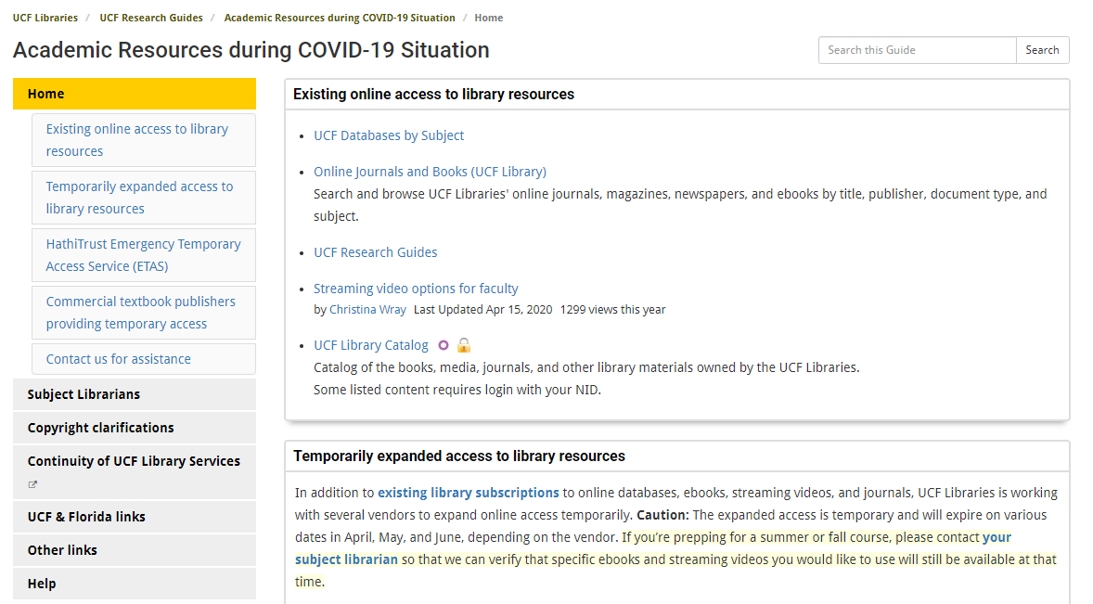
https://guides.ucf.edu/covid

Slide 27
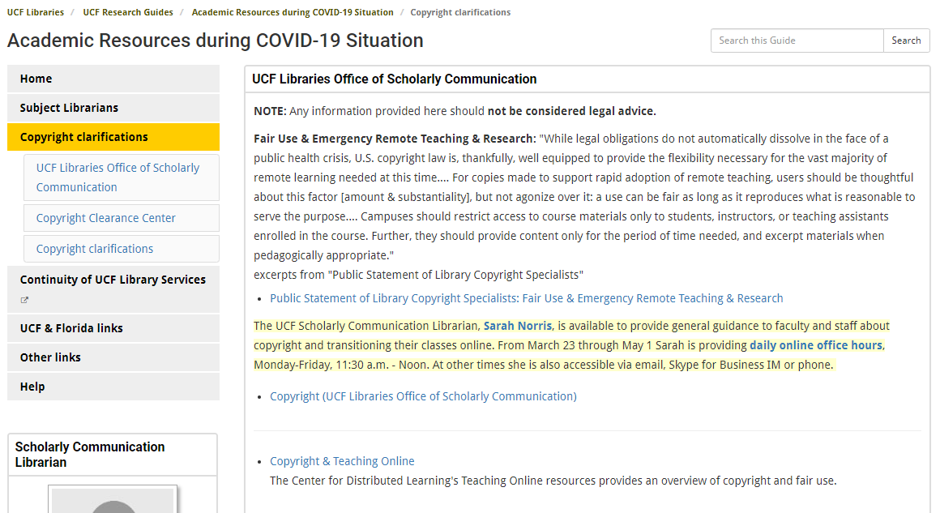
https://guides.ucf.edu/covid/copyright

Slide 28
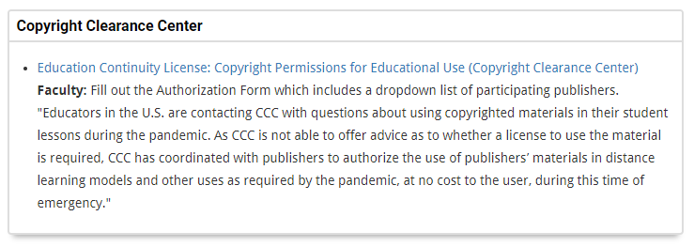
https://guides.ucf.edu/covid/copyright

Slide 29
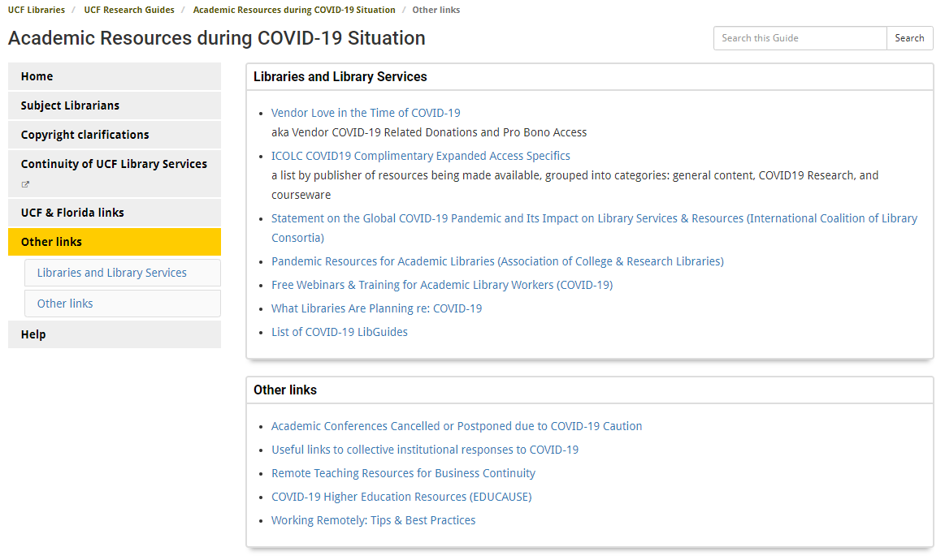
https://guides.ucf.edu/covid/other

Slide 30
Copyright & Fair Use Considerations for Future Semesters
For Summer semesters, fair use for emergency circumstances should still be applicable
This is particularly applicable for faculty who were scheduled to teach face-to-face only courses but now must teach online
Encourage faculty to start thinking about fall courses and online alternatives
This time frame is no longer an emergency situation, as faculty have time to plan for the fall

Slide 31
Final Considerations

Slide 32
General Recommendations for Emergency Situations
Assess copyright & fair use on a case-by-case basis
When possible, look for alternative versions of materials (e.g. ebooks, online journal articles, streaming video)
If UCF has purchased and/or licensed materials, it is always preferable to link to them vs uploading to Canvas
Consider freely available and/or openly licensed materials
Approach from a pedagogical perspective

Slide 33
What Would You Do?
Let’s Talk Through Scenarios...

Slide 34
Scenarios
Scanning an entire textbook
Uploading/Using Multimedia (videos, etc.)
Uploading PDFs of articles, book chapters, etc.

Slide 35
Scenario #1
“I’m using a textbook for my summer course, and several of my students have mentioned that they can’t buy the book. Can I scan the textbook for them?”

Slide 36
Scenario #1
Contact your subject librarian for assistance
Determine if textbook is available in electronic formats (Library databases, HathiTrust, etc.)
Explore options from publishers (VitalSource Helps, Cengage Unlimited, etc.)
https://cdl.ucf.edu/support/webcourses/etextbooks/
Explore Education Continuity License through Copyright Clearance Center
https://www.copyright.com/pardot-landing-page/education-continuity-license/
Ask permission from the copyright holder, if applicable
Use under the guise of Fair Use (using Four Fair Use Factors and/or any other university-specific guidelines) with guidance from the Public Statement of Library Copyright Specialists: Fair Use & Emergency Remote Teaching & Research
https://tinyurl.com/tvnty3a

Slide 37
Scenario #2
“In my face-to-face courses, I have always shown Hollywood movie clips to provide scenarios for student learning. Now that I am moving my courses online, can I still use them? If so, how much can I use?”

Slide 38
Scenario #2
Films/Videos shown should be pedagogically appropriate
Fair use may apply
Faculty should not use their personal accounts for streaming services due to licensing terms
However, students can use streaming services that they subscribe to to view videos
Utilize legitimate copies of a film/video and/or explore options to purchase license to utilize in courses
Link to Library resources when possible
“Pursuant to United States Code, Title 17, Section 110(1), members of the University of Central Florida community may publicly display and perform the copyrighted works of other people (this includes entire works) during face-to-face teaching activities, provided you are using a legitimate copy of the work, i.e. in this case a legitimate copy of the video (which, in general, does not include one that you have videotaped yourself from a broadcast). Section 110(1) does not authorize the copying of the copyrighted work from the original medium onto another medium though, which would be necessary in utilizing these materials in an online course.”
https://generalcounsel.ucf.edu/files/2015/06/Top-Ten-Copyright-and-Fair-Use-Questions-revised-NNH-clean-4-19-11.docx

Slide 39
Scenario #3
“In my face-to-face course, I have provided handouts to a journal article, which can be found in the EBSCOHost database. Now I’m teaching a fully online course. Can I incorporate a scanned copy of this journal article into the course?”

Slide 40
Scenario #3
Link to Library resources when possible
Ask permission from the copyright holder, if applicable
Use under the guise of Fair Use (using Four Fair Use Factors and/or any other university-specific guidelines) with guidance from the Public Statement of Library Copyright Specialists: Fair Use & Emergency Remote Teaching & Research, as applicable
https://tinyurl.com/tvnty3a
The copying of entire works, such as an entire article, is usually not justifiable as fair use. Per the Fair Use Guidelines for Educational Multimedia, which are incorporated into UCF’s Use of Copyrighted Material Policy, for text material, up to 10% or 1000 words, whichever is less, in the aggregate of a copyrighted work consisting of text material may be reproduced or otherwise incorporated as part of a multimedia project. However, if the article is available through the university’s library holdings online, it would be permissible to provide the students with an online bibliography with links to these resources, making sure that on your course site you clearly indicate that the student is being taken to another site that is not part of your actual online course.
https://generalcounsel.ucf.edu/files/2015/06/Top-Ten-Copyright-and-Fair-Use-Questions-revised-NNH-clean-4-19-11.docx

Slide 41
Resources
UCF Office of General Counsel: Top 10 Copyright & Fair Use Questions
https://generalcounsel.ucf.edu/files/2015/06/Top-Ten-Copyright-and-Fair-Use-Questions-revised-NNH-clean-4-19-11.docx
Public Statement of Library Copyright Specialists: Fair Use & Emergency Remote Teaching & Research
https://tinyurl.com/tvnty3a
UCF Libraries LibGuide
https://guides.ucf.edu/covid
Vendor Love in the Time of COVID-19
https://tinyurl.com/vendorsupportedaccess

Slide 42
Public Domain Image References
6689062 (Photographer). (2017, October 14). No title [digital image]. Retrieved from https://pixabay.com/photos/journal-write-blank-pages-notes-2850091/
Robert Vose / Cowles Communications, Inc. (Photographer). Photograph of Raymond Burr and other cast members on the set of the CBS-TV series Perry Mason, from the front cover of Look magazine [digital image]. Retrieved from https://commons.wikimedia.org/wiki/File:Perry-Mason-Look-1961.jpg
PDPics (Photographer). (2014, July 15). No title [digital image]. Retrieved from https://pixabay.com/photos/copyright-magnifier-magnifying-glass-389901/
rawpixel (Photographer). (2017, May 12). No title [digital image]. Retrieved from https://pixabay.com/photos/typewriter-alphabet-vintage-2306479/
Wokandapix (Photographer). (2017, January 10). No title [digital image]. Retrieved from https://pixabay.com/photos/teach-education-school-class-1968076/
Athree23 (Photographer). (2018, September 15). No title [digital image]. Retrieved from https://pixabay.com/photos/feedback-checklist-job-gut-3676922/
SCY (Photographer). (2015, June 24). No title [digital image]. Retrieved from https://pixabay.com/photos/laptop-book-information-online-819285/
Uki_71 (Photographer). (2016, January 18). No title [digital image]. Retrieved from https://pixabay.com/photos/note-pin-list-stickies-paper-memo-1143037/
TeroVesalainen (Photographer). (2017, March 7). No title [digital image]. Retrieved from https://pixabay.com/photos/question-mark-why-problem-solution-2123967/

Slide 43
Contact Information
Sarah A. Norris
Scholarly Communication Librarian
sarah.norris@ucf.edu
Rich Gause
Government Information Librarian
richg@ucf.edu
UCF Libraries Office of Scholarly Communication http://library.ucf.edu/about/departments/scholarly-communication/

