Slide 1
Library Support
for Course Materials
Sara Duff, Acquisitions Librarian
Rich Gause, Government Information Librarian
Sarah A. Norris, Scholarly Communication Librarian
University of Central Florida

Slide 2
Using eBooks and Streaming Video

Slide 3
eBooks: FAQ
Why can’t you buy this as an eBook? Amazon has it for $15
How do I know if my book is only temporarily accessible?
It says “Unlimited” but my students can only check it out for 21 days. What happens then?
Can I assign this for required reading?

Slide 4
User Models & DRM
DRM (digital rights management) is the limitations that publishers or vendors put on materials to restrict how we can access and use the materials. Publishers have very different DRM for libraries versus consumers.
The library prefers to purchase eBooks as DRM-free or DRM-friendly as possible, to provide as much access as possible.

Slide 5
User Models & DRM
1 User/3 User (or any other number): these restrict the number of simultaneous users. While in use, no one else will be able to access the text of the eBook.
Nonlinear/Concurrent: a set number of uses per year (usually 325). These uses can be simultaneous, but once all uses are spent, the book will not be fully accessible until they refresh.
Unlimited Users: there is no limit to the number of simultaneous users.

Slide 6
User Models & DRM
All of these user models may still have DRM attached. This may effect:
How many pages can be downloaded as a PDF at once
What can be copied & pasted
How much a student can print
Whether or not the entire book can be checked out & downloaded

Slide 7
User Models & DRM
DRM-free or DRM-friendly eBooks allow:
Download of entire eBook as a PDF
May have to download chapters individually, but no limit on number of pages or sections
Unlimited number of simultaneous users

Slide 8
COVID-19 Temporary eBook Access
Trial access to large eBook collections from EBSCO and ProQuest https://guides.ucf.edu/covid
Some 1 User/3 User/Nonlinear titles have been temporarily upgraded to Unlimited
Both temporary modes are due to expire in late June. But things are constantly changing! We are asking them to extend the trials.

Slide 9
Other Temporary eBook Access
Not all eBooks in the catalog are things the library owns perpetually.
Methods of eBook acquisitions:
Firm order by title
Package order
Evidence-based selections
Demand-driven acquisitions
Consortial purchases & subscriptions

Slide 10
Other Temporary eBook Access
These all involve non-perpetual access:
Evidence-based selections (EBS)
Demand-driven acquisitions (DDA)
Consortial purchases & subscriptions

Slide 11
Other Temporary eBook Access
The only way to know for sure is to check acquisitions resources (like GOBI), or ask.
But there are some tricks:
https://ucf.catalog.fcla.edu/permalink.jsp?29CF036584153
https://ucf.catalog.fcla.edu/permalink.jsp?29CFPDA007371416

Slide 12
Other Temporary eBook Access
https://ucf.catalog.fcla.edu/permalink.jsp?29CF033210599
|y UCF: Click here for ONLINE ACCESS |u https://site.ebrary.com/lib/univcentralfl/Doc?id=10250323 |z ebrary |x ucf main library ebrary FL Virtual Campus |5 FOFT

Slide 13
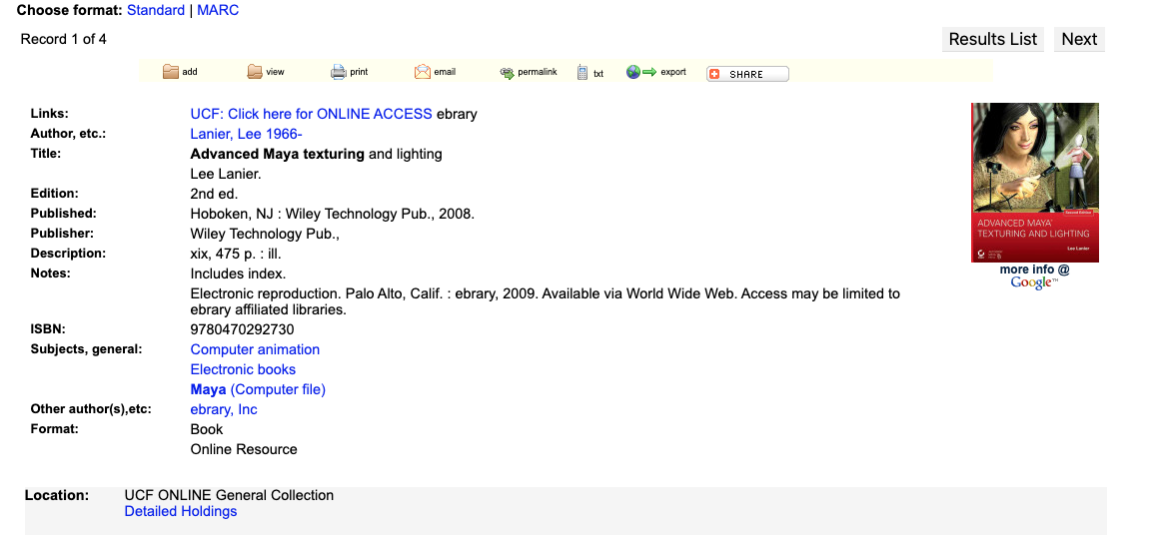

Slide 14
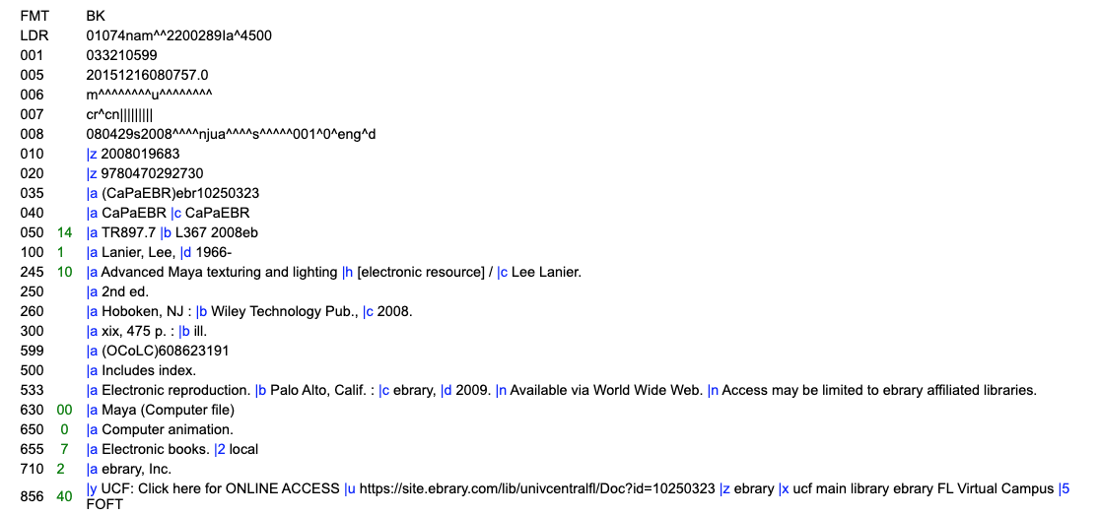

Slide 15
eBook Platforms
Which eBook platforms do you prefer? Why?
EBSCOhost
ProQuest Ebook Central
Taylor & Francis
Other

Slide 16
eBooks: FAQ
Why can’t you buy this as an eBook? Amazon has it for $15
How do I know if my book is only temporarily accessible?
It says “Unlimited” but my students can only check it out for 21 days. What happens then?
Can I assign this for required reading?

Slide 17
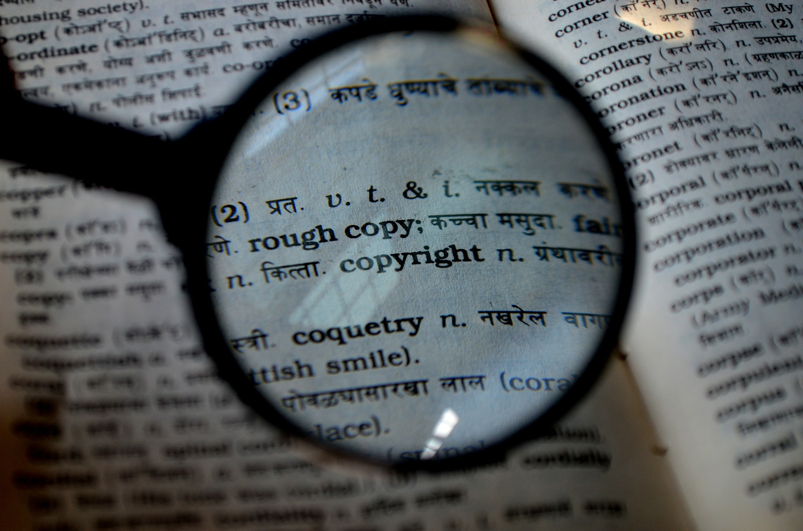
Copyright Considerations for Ebooks

Slide 18
Copyright Considerations for Ebooks
If a license applies, it must be complied with
Most licensing indicates that use is for personal, individual use only for non-commercial, educational, scholarly or research purposes
Not all licenses are the same (ask UCF Libraries for assistance)
Violating licensing may result in loss of access to materials for entire UCF community
Licensing may supercede copyright law
Link to content
Ask for permission from copyright holder
Fair use may or may not apply*

Slide 19
Streaming Video: FAQ
We own the DVD, can I just screen it over Zoom?
Can I upload a video file to Canvas?
I heard about a great new film, can the library buy a streaming copy?
Can I link to YouTube, Vimeo, and Tubi?

Slide 20
Streaming Video Licensing
Alexander Street
Many packages were perpetual purchases
AVON is a subscription that functions like an EBS
Films on Demand
DDA model, option to purchase some perpetually when dropped
Kanopy
DDA too expensive, now license individually
Most licenses are 1-year, but a very few are longer
Kanopy no longer offers nearly-perpetual licenses. Options now are 1 and 3 year.

Slide 21
Streaming Video Licensing
Perpetual streaming video can quite complicated. Even when we purchased perpetual access via a package, if a company loses rights, it can sometimes be applied retroactively.
PBS is particularly notorious. This Spring, Alexander Street pulled PBS videos from our American History in Video Package. They gave us the option of replacing them with other films.
But there are also risks for non-perpetual licenses. Once a license expires, there is no guarantee it will be available to re-license.

Slide 22
Streaming Video Licensing
Each platform has different access models, and Alexander Street has different models for our different packages.
Alexander Street:
AVON works like Netflix. We have no control over what’s in it, and they swap content out.
Our other packages in Alexander Street are perpetual purchases.

Slide 23
Streaming Video Licensing
Films on Demand:
This works like a hybrid of Netflix and digital rentals. We are given broad access to their packages. When films are viewed a certain number of times, they automatically trigger a one-year license.
Kanopy:
Straight digital rental. When a film is requested, we license that film.

Slide 24
Streaming Video Licensing
Purchasing Direct From Producers
Not all films are available on these 3 platforms. When a faculty member requests a film unavailable from our preferred providers, we investigate who might have rights.
On rare occasions, the producers who own the rights have offered to sell us a perpetual digital file.
We would then be responsible for hosting that digital file.

Slide 25
Streaming Video Licensing
Purchasing Direct From Producers - Downsides:
This is often prohibitively expensive. Our typical limit for films (including DVDs) is normally $350. Oftentimes producers sell the digital file for over $500.
The library does not have a server that can host these films. We are limited in how many we can host on 3rd-party platforms.
Because we are hosting these on 3rd-party platforms, it is a time-intensive process from purchase to access.

Slide 26
Streaming Video Licensing
We subscribe to the main library streaming video platforms, but there are others out there. It can be difficult to add additional platforms:
All new platforms need to go through UCF’s licensing process, which can be extremely time-consuming
The market is volatile, and smaller platforms are going bankrupt or being bought-out continuously

Slide 27
Streaming Video Licensing
The library aims to include PPR (public performance rights) for streaming video purchases, but they are not always included.
PPR is needed for screenings outside of a curriculum. They are NOT needed for:
Showings of films in face-to-face class, regardless of format
Films you assigned your students to watch outside of class
PPR is needed for:
Screening a film for people (even UCF students) as a special event outside of class, like a seminar at the library or special event

Slide 28
Streaming Video Licensing
Public Performance Rights (PPR) for platforms:
Alexander Street: All films include PPR
Films on Demand: All films include PPR
Kanopy: case by case basis

Slide 29
Copyright Considerations for Streaming Video

Slide 30
Copyright Considerations for Streaming Video
UCF Streaming Video:
If a license applies, it must be complied with
Most licensing indicates that use is for personal, individual use only for non-commercial, educational, scholarly or research purposes
Not all licenses are the same (ask UCF Libraries for assistance)
Violating licensing may result in loss of access to materials for entire UCF community
Personal Subscriptions to Streaming Video:
If a license applies, it must be complied with
Most licensing indicates that use is for personal, individual use only
Violating licensing may result in loss of access and legal action
Licensing may supercede copyright law

Slide 31
Copyright Considerations for Streaming Video
Streaming video licenses often change/renegotiated/lost which impacts access
Link to content
Library-licensed video
Video online (be cautious of copyright & other IP concerns)
Ask for permission from copyright holder
Fair use may or may not apply*
If streaming video is no longer available or accessible, check with the library for other options

Slide 32
Streaming Video: FAQ
We own the DVD, can I just screen it over Zoom?
Can I upload a video file to Canvas?
I heard about a great new film, can the library buy a streaming copy?
Can I link to YouTube, Vimeo, and Tubi?

Slide 33
Best Practices for E-Resources
If a license applies, it must be complied with
Obtain permission to use copyrighted materials
Pay to use via services like Copyright Clearance Center
Fair Use may apply*
Linking to content is always preferable
Consider freely available and/or openly licensed materials
For video, consider subscriptions for streaming services as a course requirement for the semester
Approach from a pedagogical perspective
Contact UCF Libraries for assistance

Slide 34
Save the Date!
Upcoming Sessions
Library Support for Course Materials (Teaching Faculty Session)
May 28 - 1 p.m. / https://ucf.zoom.us/j/96316588748
Copyright & Student Works (open to all)
June 16 - 1 p.m. / https://ucf.zoom.us/j/98182827712

Slide 35
Public Domain Image References
inproperstyle (Photographer). (2016, April 1). No title [digital image]. Retrieved from https://pixabay.com/photos/ipad-apple-tablet-computer-mobile-1291524/
loufe (Photographer). (2016, October 21). No title [digital image]. Retrieved from https://pixabay.com/photos/search-help-faq-magnifying-glass-1756278/
PDPics (Photographer). (2014, July 15). No title [digital image]. Retrieved from https://pixabay.com/photos/copyright-magnifier-magnifying-glass-389901/
Catkin (Photographer). (2017, February 15). No title [digital image]. Retrieved from https://pixabay.com/photos/calendar-entry-ring-binder-write-2052492/

Slide 36
Contact Information
Sara Duff
Acquisitions Librarian
sara.duff@ucf.edu
Rich Gause
Government Information Librarian
richg@ucf.edu
Sarah A. Norris
Scholarly Communication Librarian
sarah.norris@ucf.edu

