Slide 1
Data Documentation, Analysis & Statistical Software
UCF Graduate Workshop
Sai Deng, Metadata Librarian,
University of Central Florida Libraries
Xiang Zhu, Statistician,
College of Medicine, University of Central Florida

Slide 2
What will be covered?
Part I: The Data Basics
Why data documentation
Understanding Data, Research Data and Datasets
Data documentation & Metadata
Part II: Data Documentation
Practices & Recommendations
Data Documentation: Study-level, Data-level (w/Examples)
Data Curation Primers (NVivo, SPSS)
Part III: Dataset Metadata
Part IV: Data Analysis
Biostatistician Services
Data Analysis
Part V: Statistical Software
R/Stata/SAS/SPSS
Introductions & Examples
Discussion
Part VI: Related Resources and Services

Slide 3
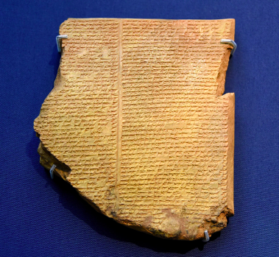
Part I: The Data Basics
When Things are Incomprehensible
Clay tablet
Prehistorical document?
History? Stories?
Knowledge?
What is it trying to say?

Slide 4
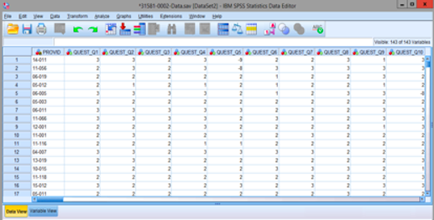
When Things are Incomprehensible
A spreadsheet;
A SPSS file;
What is it about?

Slide 5
What might help with decoding data?
“Data documentation explains how data were created or digitised, what data mean, what their content and structure are, and any manipulations that may have taken place.”
- UK Data Archive
The term 'documentation' encompasses all the information necessary to interpret, understand and use a given dataset or set of documents. - Cambridge University Library
“…a minimum requirement for closing the gap between the data producer and the secondary analyst is a high standard of data documentation.” (note: the secondary analyst refers to the data user)
Nielsen, Per: How to teach data producers "the noble art" of data documentation. http://nbn-resolving.de/urn:nbn:de:0168-ssoar-326298
Contextual/historical information?
A dictionary (e.g.,
Sumerian Cuneiform)?
Project information?
Codebook/ data dictionary?
Perhaps some kind of Documentation

Slide 6
Data, Research Data, Dataset
Data are numerical quantities or other factual attributes derived from observation, experiment or calculation.
– National Research Council, 1992a. "Setting priorities for space research: Opportunities and imperatives."
…“research data” are defined as factual records (numerical scores, textual records, images and sounds) used as primary sources for scientific research, and that are commonly accepted in the scientific community as necessary to validate research findings.
– Organisation for Economic Co-operation and Development (OECD, 2007). OECD Principles and Guidelines for Access to Research Data from Public Funding. P.13. http://www.oecd.org/science/sci-tech/38500813.pdf
Dataset: A logically meaningful collection or grouping of similar or related data, usually assembled as a matter of record or for research, for example, the American FactFinder Data Sets provided online by the U.S. Census Bureau, National Elevation Dataset available from the U.S. Geological Survey.
- Online dictionary for library and information science (ODLIS). http://www.abc-clio.com/ODLIS/odlis_A.aspx

Slide 7
Data Documentation & Metadata
Metadata can be taken as a type of data documentation.
Metadata is data associated with an object, a document, or a dataset for purposes of description, administration, technical functionality and preservation.
Metadata can be embedded in the data files/documents themselves.
Metadata can be produced, recorded, and reused in the research lifecycle.
Documentation is meant to be read by humans; some metadata is designed more for machine processing.
Data documentation facilitates data sharing, reuse and long-term preservation.

Slide 8
Part II: Data Documentation Practices & Recommendations
The UCF Research Data Management Survey (Nov. 2013) (https://stars.library.ucf.edu/lib-docs/144/)
Some results:
Response rate: 18.2%
Types of data - most generated: numerical data, medical data, tabular data, text
Formats - most popular: spreadsheet, text, statistical analysis software related
Data annotation: 77% manually label or annotate their data; 44% uses data collection tool; 26% uses codebook
Lab data recording: in paper (59%), Excel or other files (98%), Electronic Lab Notebook (6%)
Document metadata: No (66%), Yes (34%)
Standards/guidelines: No (71%), Yes (24%), Not sure (5%)
More popular tools: SAS, MatLab, SPSS, R, Nvivo, SigmaPlot

Slide 9
Data Documentation: Recommendations
Ensure that all data collected and generated through your research lifecycle is documented.
At the beginning of your research, it is recommended to check what kind of documentation is available or necessary for your data, and identify needed documentations which will enable data preservation and reuse in the future.
The various kinds of documentation may include:
Embedded documentation (included within the data, e.g.,variables)
Supporting documentation (in separate files, e.g., readme, project information, questionnaires or interview guides, reports & publications)
Catalog Metadata (for data archiving, identification and locating)

Slide 10
Data Documentation: Recommendations
It is recommended to keep the wide variety of materials that are generated or collected in your research, e.g.,
Documents (text, Word), spreadsheets
Laboratory notebooks, field notebooks, diaries
Questionnaires, transcripts, codebooks
Audiotapes, videotapes
Photographs, films
Test responses
Slides, artifacts, specimens, samples
Collection of digital objects acquired and generated during the process of research
Data files
Database contents (video, audio, text, images)
Models, algorithms, scripts
Contents of an application (input, output, log files for analysis software, simulation software, schemas)
Methodologies and workflows
Standard operating procedures and protocols
Other: Correspondence, Project files, Grant applications, Ethics applications, Technical reports, Research reports, Master lists, Signed consent forms
Types of Documentations:
Lab notebooks
Questionnaires, code books
Information about equipment settings
Software syntax & output files
Database schema
Methodology reports
Assumptions made during analysis
Provenance info about sources of derived data, data versions
Source: How to manage research data, Research Support Services, University of Edinburgh Information Services

Slide 11
Data Documentation: Recommendations
It is recommended to document all research data formats utilized by your project during your research, for example (by broad categories):
Text - flat text files, Word, PDF, RTF, XML.
Numerical - Statistical Package for the Social Sciences (SPSS), Stata, Excel.
Multimedia - jpeg, tiff, dicom, mpeg, quicktime.
Models - 3D, statistical.
Software - Java, C programs.
Discipline specific - Flexible Image Transport System (FITS) in astronomy, Crystallographic Information File (CIF) in chemistry.
Instrument specific - Olympus Confocal Microscope Data Format, Carl Zeiss Digital Microscopic Image Format (ZVI).
It is considered good practice to keep formats fit for data sharing, reuse and long-term preservation.

Slide 12
Research Data Types and Formats for Preservation
Type of data | Recommended file formats for sharing, reuse and preservation | Other acceptable formats for data preservation
Quantitative tabular data with extensive metadata a dataset with variable labels, code labels, and defined missing values, in addition to the matrix of data | SPSS portable format (.por) delimited text and command ('setup') file (SPSS, Stata, SAS, etc.) containing metadata information some structured text or mark-up file containing metadata information, e.g. DDI XML file | proprietary formats of statistical packages e.g. SPSS (.sav), Stata (.dta) MS Access (.mdb/.accdb)
Quantitative tabular data with minimal metadata a matrix of data with or without column headings or variable names, but no other metadata or labelling | comma-separated values (CSV) file (.csv) tab-delimited file (.tab) including delimited text of given character set with SQL data definition statements where appropriate | delimited text of given character set - only characters not present in the data should be used as delimiters (.txt) widely-used formats, e.g. MS Excel (.xls/.xlsx), MS Access (.mdb/.accdb), dBase (.dbf) and OpenDocument Spreadsheet (.ods)
Geospatial data vector and raster data | ESRI Shapefile (essential - .shp, .shx, .dbf, optional - .prj, .sbx, .sbn) geo-referenced TIFF (.tif, .tfw) CAD data (.dwg) tabular GIS attribute data | ESRI Geodatabase format (.mdb) MapInfo Interchange Format (.mif) for vector data Keyhole Mark-up Language (KML) (.kml) Adobe Illustrator (.ai), CAD data (.dxf or .svg) binary formats of GIS and CAD packages
Qualitative data textual | eXtensible Mark-up Language (XML) text according to an appropriate Document Type Definition (DTD) or schema (.xml) Rich Text Format (.rtf) plain text data, ASCII (.txt) | Hypertext Mark-up Language (HTML) (.html) widely-used proprietary formats, e.g. MS Word (.doc/.docx) some proprietary/software-specific formats, e.g. NUD*IST, NVivo and ATLAS.ti

Slide 13
Research Data Types and Formats for Preservation
Type of data | Recommended file formats for sharing, reuse and preservation | Other acceptable formats for data preservation
Digital image data | TIFF version 6 uncompressed (.tif) | JPEG (.jpeg, .jpg) but only if created in this format TIFF (other versions) (.tif, .tiff) Adobe Portable Document Format (PDF/A, PDF) (.pdf) standard applicable RAW image format (.raw) Photoshop files (.psd)
Digital audio data | Free Lossless Audio Codec (FLAC) (.flac) | MPEG-1 Audio Layer 3 (.mp3) but only if created in this format Audio Interchange File Format (AIFF) (.aif) Waveform Audio Format (WAV) (.wav)
Digital video data | MPEG-4 (.mp4) motion JPEG 2000 (.mj2)
Documentation | Rich Text Format (.rtf) PDF/A or PDF (.pdf) HTML (.htm) OpenDocument Text (.odt) | plain text (.txt) some widely-used proprietary formats, e.g. MS Word (.doc/.docx) or MS Excel (.xls/.xlsx) XML marked-up text (.xml) according to an appropriate DTD or schema, e.g. XHMTL 1.0
Source: https://ukdataservice.ac.uk/media/622417/managingsharing.pdf

Slide 14
Data Documentation: Recommendations
Document research data at different levels:
Study-level: Study/project information
Data-level: Qualitative data, Quantitative data
Utilize software to create embedded documentation for the data (if applicable), and make separate supporting documentation (e.g. readme text files) to describe the list of files and documentations in a folder;
Provide unique identifier for the dataset (e.g. doi, purl, handle…);
Make sure that your data meets citation requirement (if applicable), and discuss with relevant personnel on how data can be archived and shared in a data center, or a library digital repository for others to search, locate and reuse.
Recommendations on standards, tools will be covered in “Dataset Metadata” and “Statistical Software” section.

Slide 15
Data Documentation: Study-level
Study-level information:
Research context and design
data collection methods
structure of data files
secondary data sources used and provenance
data validation, modifications made
data confidentiality, access & use
publications and other research output
More information: https://www.ukdataservice.ac.uk/manage-data/document/study-level.aspx
Can be presented as “Readme” or “User Guide.” Project reports, lab books, questionnaires or interview guides, as well as publications can serve as sources for this information. In other words, these files can be described in “Readme.”
See a list of recommended elements (for “Readme” as well as the repository record): Appendix 2: Project/ Study Level Metadata

Slide 16
Data Documentation: Study-level
Qualitative Data
Being a Doctor: a Sociological Analysis, 2005-2006
UKDA study number:6124
Principal Investigator, Sponsor, Distributed by information
Bibliographic Citation, Acknowledgement, Disclaimer
6124. Being a Doctor: a Sociological Analysis, 2005-2006
Depositor: Nettleton, S. , University of York. Department of Sociology
Principal Investigator: Nettleton, S. , University of York. Department of Sociology
Sponsor: Economic and Social Research Council
Grant Number: RES-000-22-1158
Abstract:...
Main Topics: education and career, current work...
Coverage: ...
Universe Sampled: ...
Methodology:
Time Dimensions: Cross-sectional (one-time) study
Sampling Procedures: Purposive selection/case studies
Number of Units: 50 interviews
Method of Data Collection: Face-to-face interview
Weighting: Not applicable
Language(s) of Written Materials: ...
Access: ...
Date of First Release: 17 March 2009
Copyright: S. Nettleton
Study Information & Citation
Example
Source: How to manage research data, Research Support Services, University of Edinburgh Information Services

Slide 17
Data Documentation: Study-level
Qualitative Data
Being a Doctor: a Sociological Analysis, 2005-2006
UKDA study number:6124
Background
Theoretical Context
Research Design
Dissemination
Reference
RESEARCH PARTICIPANT INFORMATION SHEET
DOCTORS CONSENT FORM TO BE INTERVIEWED
Semi structured, qualitative Interview Schedule
ACTIVITIES AND ACHIEVEMENTS QUESTIONNAIRE
ESRC End of Award Report
User Guide
Example

Slide 18
Data Documentation: Data Level
For qualitative textual data,
Interview context, participant details, observations can be embedded as a header or summary page in data files.
Data lists accompanying the interview or image collection.
For quantitative data,
Variable name, variable label, variable type, value label, missing value, measure etc.;
Can be embedded in data files, e.g., in an SPSS file.
Source: UK Data Archive (https://www.ukdataservice.ac.uk/manage-data/document/data-level.aspx)

Slide 19
Data Documentation: Data Level - Qualitative Data
Recording data
Anonymization of textual data
replacing real names of people, organizations and locations with pseudonyms, e.g., I (Interviewer), R1 (Respondent 1), R2 (Respondent 2)
File naming
Meaningful, short names;
identify file types, e.g.
Interviews: 1890int020 (for transcript), 1890int020a (for interview audio 1)
focus groups: 1890fg001 (for transcript)
field notes: 1890notes001
audio recordings: 1890aud001… (for audio of general nature)
avoid space, special characters;
avoid long names
XML mark-up of data, for example,
Text Encoding Initiative (TEI) to mark up interview transcript
Qualitative Data Exchange Format (QuDEx) for researcher annotations and data linking

Slide 20
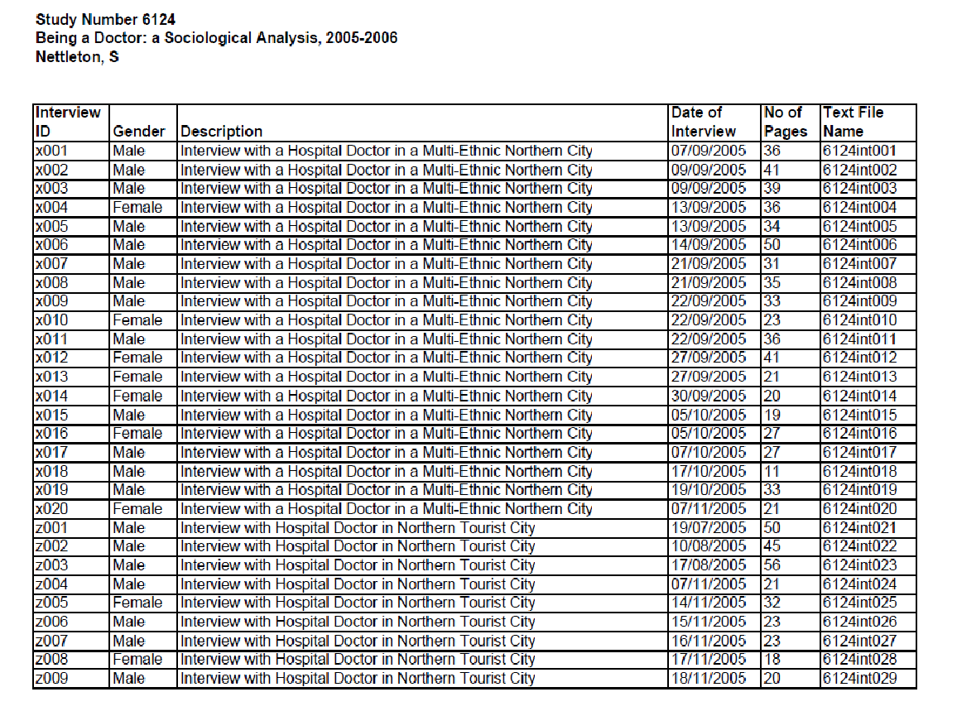
Data Documentation: Data Level
Qualitative Data
Example: Data List
Text File Name:
6124int001
6124int002
…
Interview ID:
x001
x002
…

Slide 21
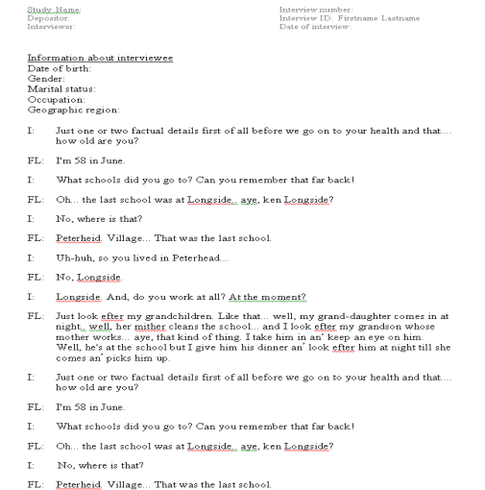
Data Documentation: Data Level
Qualitative Data
Example:
Transcript
Study Name
Depositor
Interviewer
Interview number
Interviewer ID
Date of interview
Information about interviewee
Date of birth
Gender
Marital status
Occupation
Geographic region
Interviewer/
Respondent tags
Interviewer:
FL: Text
I: Text
FL: Text
I: Text
R: Text
I: Text
R1: Text
R2: Text

Slide 22
Data Documentation: Qualitative Data (w/NVivo 12)
Data Preparation before importing into NVivo
Digitization, audio/video transcription (can be done in NVivo w/ a fee)
Anonymization of names, locations etc.
File naming: use standardized names for each group of files (numerical-based, e.g., Int001; name-based, e.g., Int_Marc)
Importing and Organizing data in NVivo
Organizing files in folders
Create uniform and structured folder names based on cases, studies, locations, data types etc.;
Internal folders for interviews, focus groups, field notes, audio recordings…
Consider different folders for: original, anonymized, coded or annotated versions of data
Data import: textual data (.docx, .pdf, .txt), tabular data (.xls, .xlsx)

Slide 23
Data Documentation: Qualitative Data (w/NVivo 12)
Editing data after import
Anonymization and editing
Version control: edit mode
Documentation
Methodology description, Project plan, Interview guidelines, Consent form templates: can be imported as Notes--memos, or, linked externally
Data analysis and manipulation: can be created as memos, annotations
Classifications, logs and other project information can be exported
Exporting data & Documentation
Keep the proprietary format; export components (files, memos)
Nodes can be exported as codebook (.docx or .xslx)
Readme (explain project info, components, access etc.)

Slide 24
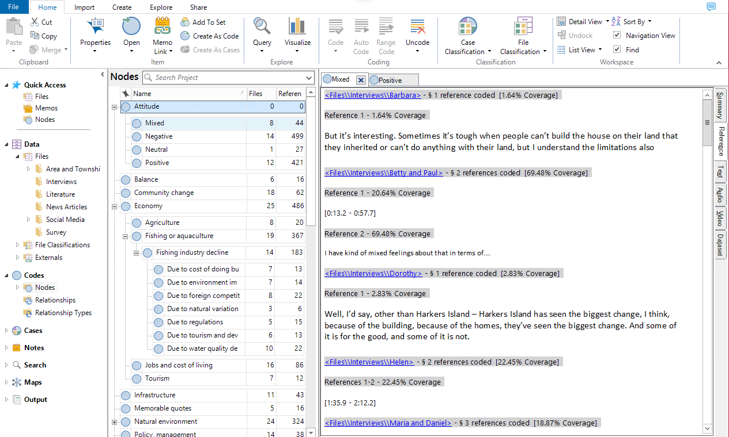
Data Documentation: Qualitative Data (w/ NVivo)
Organizing files in folders
NVivo 12 Sample Project
Creating nodes for themes/topics

Slide 25
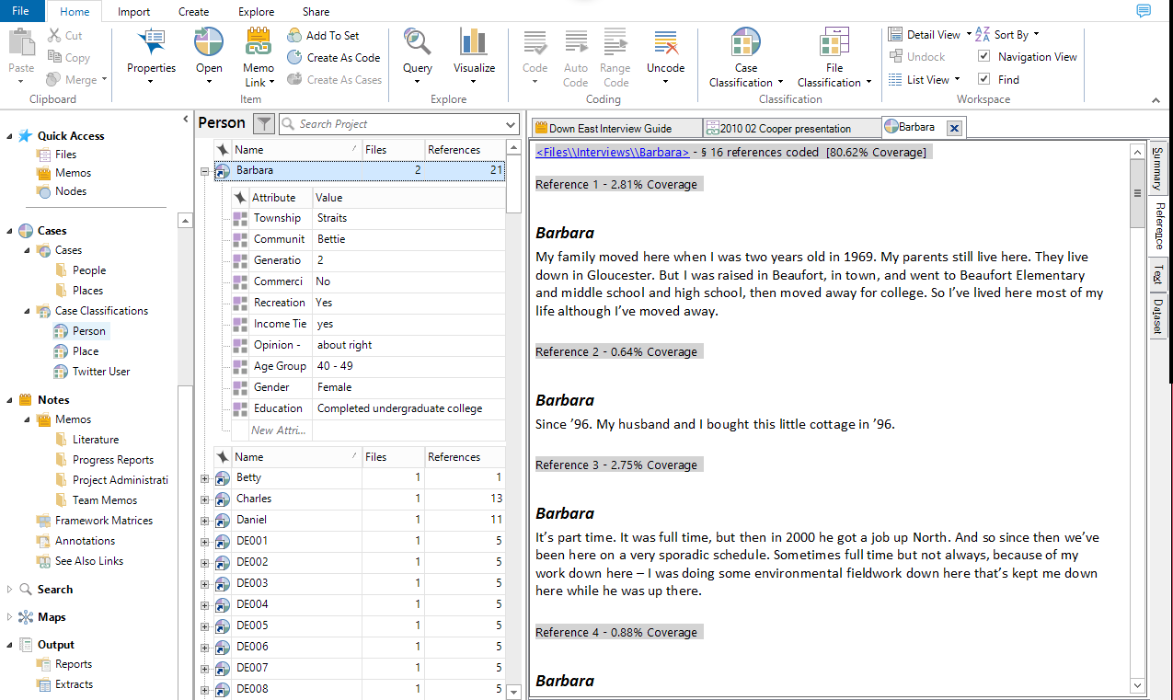
Data Documentation: Qualitative Data (w/ NVivo)
Creating Cases and Assigning Attributes
Creating cases (case nodes) for people, places, organizations…

Slide 26
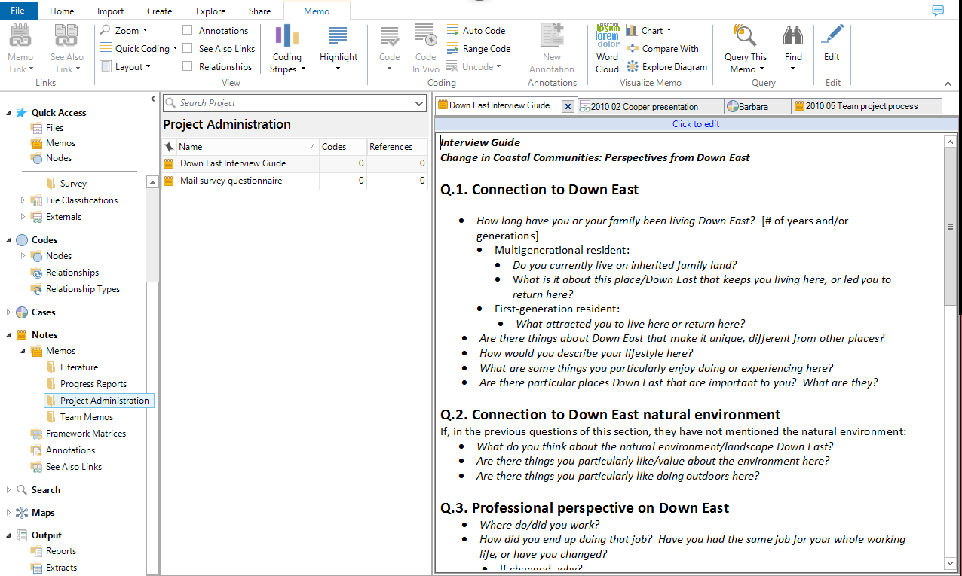
Data Documentation: Qualitative Data (w/ NVivo)
Documentation: Notes-Memos & Annotations
Creating memos for sources, nodes, or project information

Slide 27
Data Curation Network
Data Curation Network (DCN) (https://datacurationnetwork.org/)
Collaborative model for curating research data across academic and general data repositories.
CURATE Model (https://datacurationnetwork.org/home/resources/)
The DCN has developed a CURATE model, including a series of steps to curate research data: Check, Understand, Request, Augment, Transform and Evaluate.
Data curation primers are interactive, living documents that detail a specific subject, disciplinary area or curation task and that can be used as a reference to curate research data.
Acrobat PDF Primer
ATLAS.ti Primer
Confocal Microscopy Image Primer
Geodatabase Primer
GeoJSON Primer
Jupyter Notebooks Primer
Matlab Primer
Microsoft Access Primer
Microsoft Excel Primer
netCDF Primer and Tutorial using an NCAR dataset
NVivo Primer
SPSS Primer
STL Primer
R Primer
Tableau Primer
WordPress.com Primer...

Slide 28
NVivo Data Curation Primer
Description of the format (components, examples)
Key Questions to ask of the data
Which format of NVivo 12 (for Mac, PC Pro, PC Plus)
Problems opening the file (version)
Content issues (data loss, sensitive data)
Key Clarifications to ask the researcher
To enclave or not to enclave (where to put the data)
File format preferences for reuse
Keeping the proprietary format
Exporting components (files, memos)
Data content necessary for reuse
Codebook (can be exported from nodes; make sure nodes are complete, named, consistent, w/ description)
Keeping the project contextual (sets/linkages/memos)
Description
Metadata (DDI, QuDEx)
ReadMe (Cornell guide to writing a README)
Preservation actions
Further considerations
Reuse across QDAS software
Workflow based on the Data Curation Network CURATED steps
URL: https://github.com/DataCurationNetwork/data-primers/blob/master/NVivo%20Data%20Curation%20Primer/NVivo-data-curation-primer.md

Slide 29
SPSS Data Curation Primer
Format Overview: for Social sciences, psychology, education, health sciences, and survey data...
Description of Format: .sav: Proprietary binary format;
.por: Portable file format...
Example Data: from ICPSR
Start the Conversation, Broad Questions and Clarifications on Research Data
Key Questions: file format, version, naming, variable, codebook, Readme, data, additional documentation (survey, interview etc.), essential files, potential re-users
Key Clarifications:
data analysis and curation (date, missing data, tools used for manipulation);
sensitive data (human subjects protocol, anonymization)
Applicable Metadata Standards, Recommended Elements and Readme:
Project-Level or Study-Level Metadata (Readme, record, what to collect, refer to standards such as DC, DDI);
Data Level Metadata (variable name, label, type; value label, missing value…);
Codebook can be created from SPSS data file

Slide 30
SPSS Data Curation Primer
Tutorials
Software
Preservation Actions:
Recommendations from CESSDA, LC, ICPSR, Dataverse);
Reading & converting options (R, SAS import etc.);
Data archive preferred file formats (ICPSR, UK Data Archive, GESIS, DANS, CESSDA, Dataverse)
FAIR Principles & SPSS: Findable, Accessible, Interoperable, Reusable
Format Use
Documentation of Curation Process
Appendixes:
Other SPSS File Formats;
Project Level or Study Level Metadata;
DDI Metadata;
Dictionary Schema
Bibliography
Deng, Sai; Dull, Joshua; Finn, Jeanine; Khair, Shahira. (2019). SPSS Data Curation Primer. Data Curation Network. Retrieved from the University of Minnesota Digital Conservancy, http://hdl.handle.net/11299/202812.
Also in Github: https://github.com/DataCurationNetwork/data-primers/blob/master/SPSS%20Data%20Curation%20Primer/SPSS-data-curation-primer.md

Slide 31
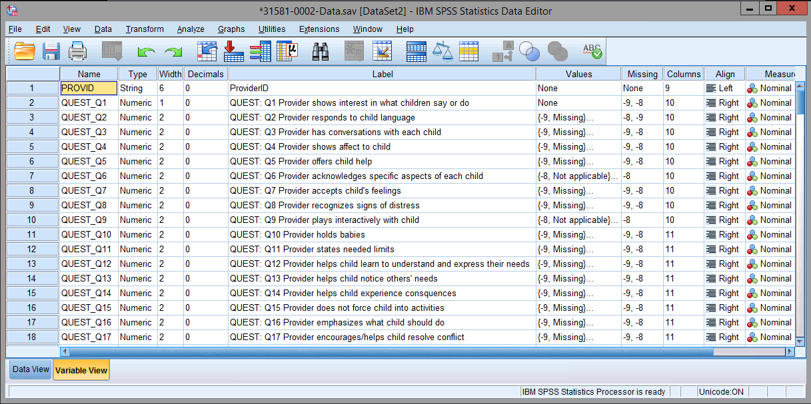
Data Documentation: Example
Variable view (Data downloaded from: https://www.icpsr.umich.edu/icpsrweb/ICPSR/studies/31581/)

Slide 32
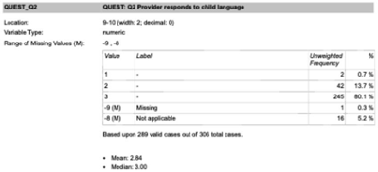
Data Documentation: Example
Codebook
Variable names
Labels
Column location
Width
Type
Frequency
Summary statistics
Can be exported from SPSS
Evaluation of Child Care Subsidy Strategies.
DS2 2005 Baseline Observation Data [codebook].
https://www.icpsr.umich.edu/icpsrweb/ICPSR/studies/31581/datadocumentation

Slide 33
Part III: Dataset Metadata Dataset Metadata ABC
Create and generate metadata for your research data and datasets in your research lifecycle to preserve the data in the long run.
Consider what information is needed for the data to be read and interpreted in the future.
Understand your funder requirements for data documentation and metadata (https://dmptool.org/public_templates).
Consult available metadata standards in your field. You may refer to General Metadata Standards and Domain Specific Metadata Standards for details.
Describe data and datasets created in your research lifecycle, and use software programs and tools to assist in data documentation; generate a data dictionary or a code book for your dataset

Slide 34
Dataset Metadata ABC
Working with your curator or librarian, assign or capture administrative, descriptive, technical, structural and preservation metadata for data deposited in a data catalog or repository. For details on the different types of metadata, check out: http://guides.ucf.edu/metadata/datasetmetadata_checklist
Adopt a thesauri in your field, if applicable.
Obtain persistent identifiers (e.g. doi, purl) for datasets if possible to ensure data can be found in the future.
For your full data management plan, visit UCF Libraries Data Management Guide.

Slide 35
Metadata Standards and Datasets
Common Metadata Standards (http://guides.ucf.edu/metadata/genMetaStandards)
e.g., DC, EAD, GILS, CDWA, See Appendix 3 for details
Disciplinary Metadata Standards (http://guides.ucf.edu/metadata/domMetaStandards)
Social Sciences & Humanities: DDI, TEI
Biological Sciences: ABCD, Darwin Core, EML
Health Sciences: NIH CDEs, ClinicalTrials.gov Protocol Data Element
Earth Science: AgMES, DIF, FGDC/CSDGM
Physical Science: CIF
See appendix 4 for disciplinary metadata standards and data repositories
Questions on metadata standards:
Are you aware of any data or metadata standards in your field? Are they adequate? Can data be well documented in your opinion?
Have you used any standard, or, will you consider it in your future study and research?

Slide 36
Controlled Vocabulary and Datasets
Controlled vocabulary is a standardized set of terms used to organize knowledge for subsequent retrieval. It can facilitate search and browsing. It can be universally agreed on or locally created.
What to consider in applying or designing a thesauri for your project: scope, project needs, funder requirement, institutional expectation, types of vocabularies (names, subject, genre, format etc.), literary/user/organizational warrant
(Gazan, CONTROLLED VOCABULARY & THESAURUS DESIGN, http://www.loc.gov/catworkshop/courses/thesaurus/pdf/cont-vocab-thes-trnee-manual.pdf)
See Appendix 5 for a list of vocabularies and thesauri.

Slide 37
Disciplinary Metadata and Data Repositories
OpenDOAR: An authoritative worldwide directory of academic open access repositories. http://v2.sherpa.ac.uk/opendoar/
It offers detailed information on more than 2,000 research data repositories http://www.re3data.org/.
Open Access Directory: Data Repositories A list of repositories and databases for open data. It is part of the Open Access Directory maintained by Simmons College.
http://oad.simmons.edu/oadwiki/Data_repositories
For information on data repositories and digital repositories, refer to re3data, OpenDOAR and OAD.
For Dataset Examples in Data Repositories, see Appendix 6 for: Social Science Dataset, Humanities dataset, Biological Science Dataset, Geospatial Dataset & Earth Science Dataset

Slide 38
Part IV: Data Analysis
Biostatistician Services
Statistical Guidance
Provide professional advice as to what methods, software, and presentation may be most effective or appropriate for the projects and collaborators needs.
Study Design
Provide assistance with the statistical design of research projects in the following ways:
Power Analysis and sample size estimation
Determining appropriate and best statistical methodologies to be used
Randomization Lists
Assistance with wording for grant proposals as it relates to the statistical plan
Data formatting suggestions for easy analysis

Slide 39
Biostatistician Services
Data Analysis
Offer a wide range of data analysis measures, methods, and techniques.
P-values
Confidence Intervals
Comparison of Means
Paired T-test
Independent two-sample t-test
ANOVA
Regression (line fitting)*
Simple regression
Multiple Regression
Logistic Regression
Non-parametric Tests
Wilcoxon Rank Sum Test
Wilcoxon Sign Rank Test

Slide 40
Biostatistician Services
Data Analysis
Offer a wide range of data analysis measures, methods, and techniques.
Association Tests
Correlation Tests
Chi-Square Test
Contingency Table
Odds Ratio
Accuracy, Specificity, and Sensitivity
Experimental Design
Response Surface Designs
Balanced Incomplete Block Designs
Latin Squares
Fractional Factorial

Slide 41
Biostatistician Services
Data Analysis
Offer a wide range of data analysis measures, methods, and techniques.
Data Analysis Methods (complex)*
Variable Selection/ Model Selection (ex. LASSO)
Specialty Regressions (ex. Poisson)
Cluster Randomized Analysis
Group-Sequential
Microarray Data
Survival Analysis
Directional and Angular Data
American Statistical Association Recommended Practices
ASA Statement on the Use of P-Values

Slide 42
Part V: Statistical Software
R
Stata
SAS
SPSS

Slide 43
Introduction to R
Can be downloaded and installed for free of charge: https://www.r-project.org/
R and RStudio (https://rstudio.com/products/rstudio/download/)
Why R? R is a language of data science
Free open source
Vector/matrix operation
Great community
>9000 packages

Slide 44
Introduction to R
R applications are organized in packages. Packages are bundles of code that add new functions to R.
Two types of packages: base and contributed.
Contributed packages are documented in and can be downloaded from:
CRAN: https://cran.r-project.org/web/packages/
Crantastic: crantastic.org
Github: https://github.com/trending/r

Slide 45
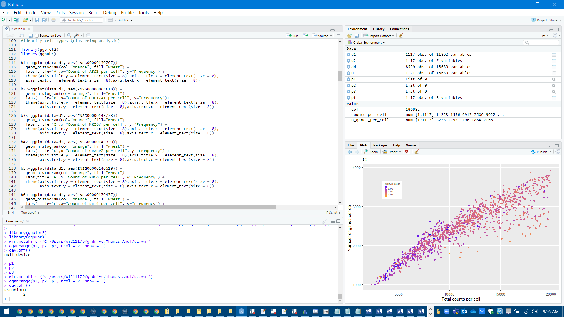
R (Demo)

Slide 46
Introduction to Stata
Stata is a full-featured commercial statistical programming language like SAS, SPSS….
Stata is available in several versions: Stata/IC (the standard version), Stata/SE (an extended version) and Stata/MP (for multiprocessing). The major difference between the versions is the number of variables allowed in memory.
Two types of working modes: Interactive mode (through graphical user interface) and programming mode.
Open source and customer developed applications.
3 major strengths: data manipulation, statistics and graphics

Slide 47
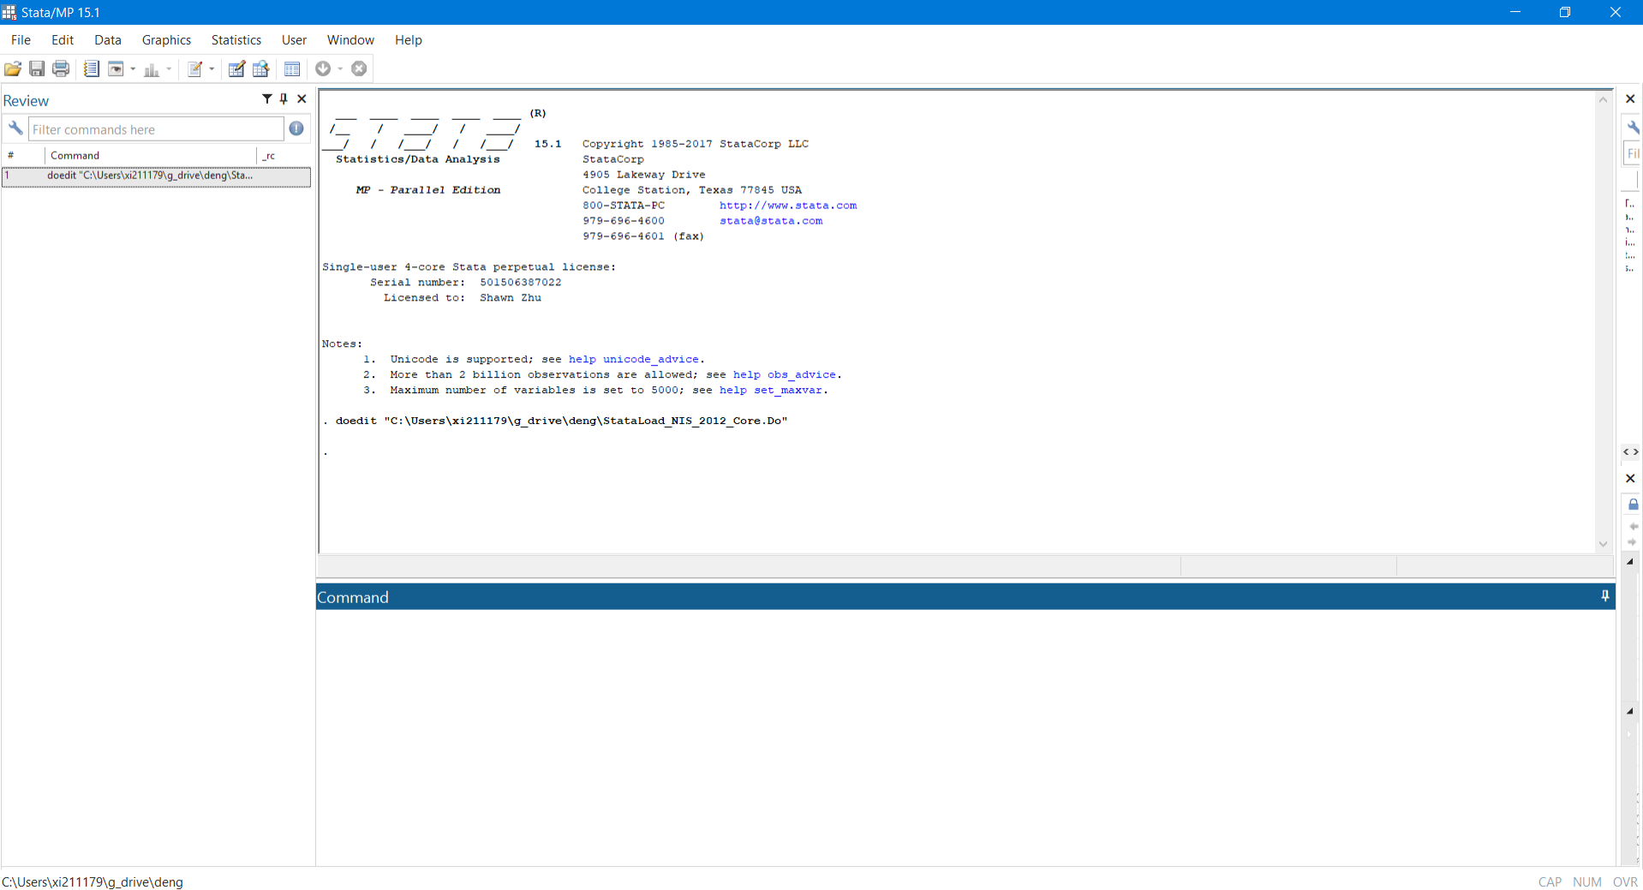
Stata (Demo)

Slide 48
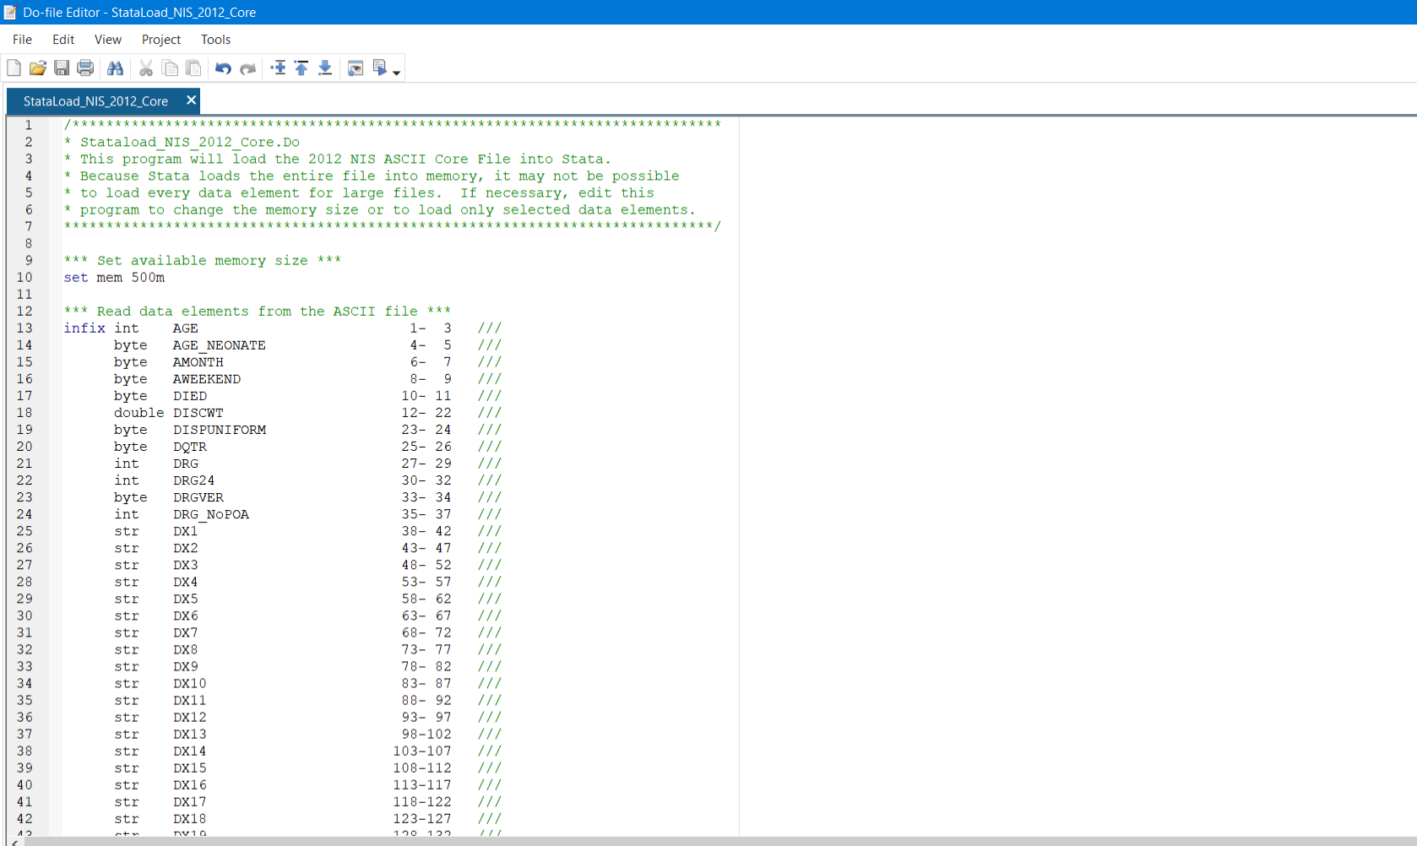
Stata (Demo)

Slide 49
Introduction to SAS
What is SAS?
Stands for “Statistical Analysis System”
Widely used commercial statistical software
SAS Products
Base SAS - data management and basic procedures
SAS/STAT - statistical analysis
SAS/GRAPH - presentation quality graphics
SAS/OR - Operations research
SAS/ETS - Econometrics and Time Series Analysis
SAS/IML - interactive matrix language
SAS/AF - applications facility (menus and interfaces)
SAS/QC - quality control

Slide 50
Introduction to SAS
Basic Structure
Data step
Procedure step
The data step reads data from external sources, manipulates and combines it with other data set and prints reports. The data step is used to prepare your data for use by one of the procedures.
The procedure steps perform analysis on the data and produce (often huge amounts of) output.

Slide 51
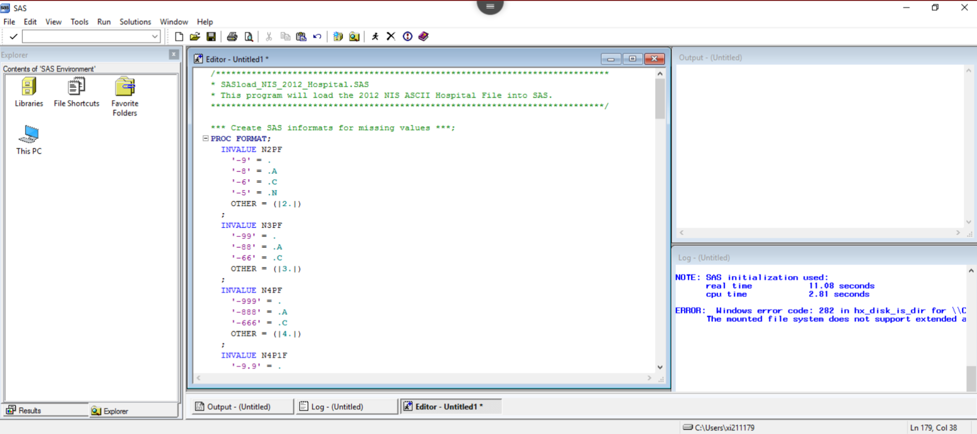
SAS (Demo)

Slide 52
Introduction to SPSS
SPSS means “Statistical Package for the Social Sciences” and was first launched in 1968. Since SPSS was acquired by IBM in 2009, it's officially known as IBM SPSS Statistics but most users still just refer to it as “SPSS”.
SPSS is software for editing and analyzing all sorts of data. These data may come from basically any source: scientific research, a customer database, Google Analytics or even the server log files of a website. SPSS can open all file formats that are commonly used for structured data such as
spreadsheets from MS Excel or OpenOffice;
plain text files (.txt or .csv);
relational (SQL) databases;
Stata and SAS.
Both interactive (GUI) and programming modes.

Slide 53
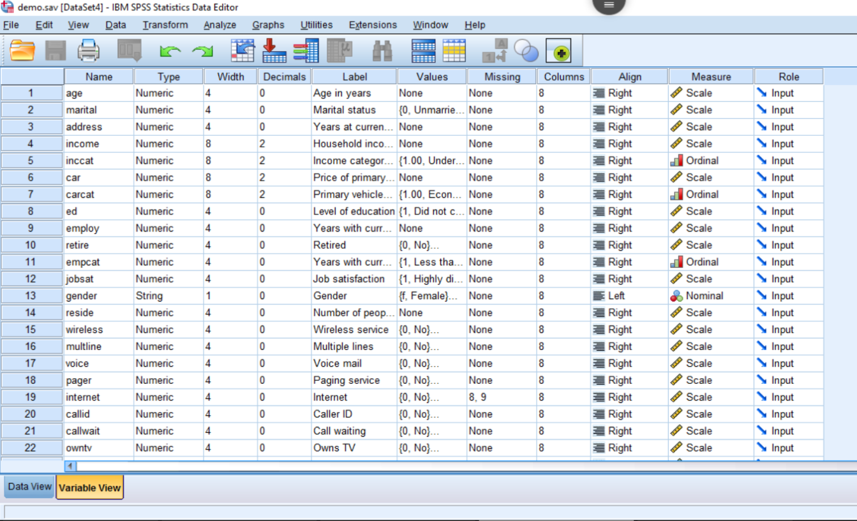
SPSS (Demo)

Slide 54
Data Documentation: Quantitative Data
Structured, tabular data should have as documentation:
Variable names, labels and descriptions
maximum of 80 characters
units of measurement for variables
reference the question number of a survey or questionnaire
Variable naming
Full variable name
Meaningful abbreviations
e.g. oz%=percentage ozone; moocc=mother occupation
Question number system, e.g., Q1a, Q1b, Q2, Q3a...
Numerical order system, e.g., V1, V2, V3...
Questions:
How to name the variable and label to document the survey result for “Q11: hours spent taking physical exercise in a typical week”?
e.g., label: Q11: hours spent taking physical exercise in a typical week
variable: q11hexw

Slide 55
Data Documentation: Quantitative Data
Code labels
How to name the variable for female respondents?
For example: p1sex (with codes '1=female ', '2=male', '-8=don't know', '-9=not answered‘)
Coding or classification schemes used, ideally with a bibliographic reference
Where to find a list of codes to classify respondents' jobs?
Reference: Standard Occupational Classification 2000
Where to get the country codes?
Reference: ISO 3166 alpha-2 country codes
Codes of, and reasons for, missing data
How to document missing data?
For example: '99=not recorded', '98=not provided (no answer)', '97=not applicable', '96=not known', '95=error'
Source: https://www.ukdataservice.ac.uk/manage-data/document/data-level/tabular.aspx

Slide 56
Data Documentation: Quantitative Data (w/ SPSS)
IBM SPSS Statistics: metadata embedded in data files; can be exported and saved as data dictionary or code book
Metadata for the SPSS data:
Variable name: the name assigned to the variable that acts as an identifier. Required.
Variable label: descriptive information of the meaning of the variable.
Variable type: information on how the value is stored internally (numeric, string). Required.
Value label: descriptive information on how the variable is coded (e.g., 0 for male, 1 for female).
Missing value: information on values to be ignored in calculations.

Slide 57
Data Documentation: Quantitative Data (w/ SPSS)
Other metadata information:
Width: the maximum number of characters that a value can have. Required.
Decimals: information on how to display numeric values. Required.
Columns: Column width for a variable. Required.
Align: Alignment of data values. Required.
Measure: how the variable is measured (nominal/categorical, ordinal, scale).
Role: the variable’s supposed relation to other variables.

Slide 58
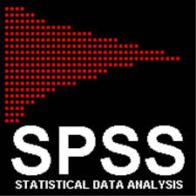
Tools for Data Analysis and Visualization

Slide 59
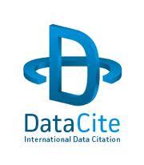
Tools for Files & Notes Sharing, Lab Management, Data Management Plan…

Slide 60
Part VI: Related Resources and Services
Library & Campus Resources
UCF Libraries Scholarly Communication (http://library.ucf.edu/ScholarlyCommunication/)
Open Access Hosting, Digital Collection Hosting, Author Rights...
Dataset Metadata Services
UCF Library Research Guides (http://guides.ucf.edu)
Metadata Guide (http://guides.ucf.edu/metadata)
Data Management Guide (http://guides.ucf.edu/data)
STARS: Showcase of Text, Archives, Research & Scholarship (http://stars.library.ucf.edu)
UCF Libraries Research and Information Services (https://library.ucf.edu/about/departments/reference/)
Biostatistician Services (https://med.ucf.edu/research/research-resources/biostatistician-services/)
High Performance Computing (https://arcc.ist.ucf.edu)

Slide 61
Appendixes: Appendix 1: How to Set Up Your PC as a Server for a Database Appendix 2: Project/Study Level Metadata Appendix 3: Common Metadata Standards Appendix 4: Disciplinary Metadata Standards & Data Repositories Appendix 5: Controlled Vocabularies and Thesauri Appendix 6: Dataset Examples

Slide 62
Appendix 1: How to Set Up Your PC as a Server for a Database

Slide 63
What is Database

Slide 65
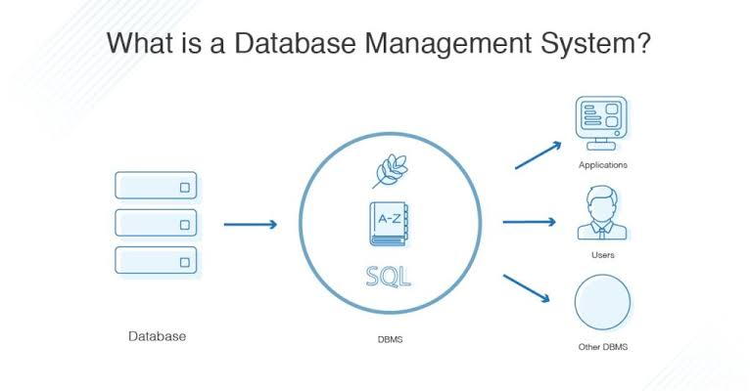
Database Management System (DMS)

Slide 66
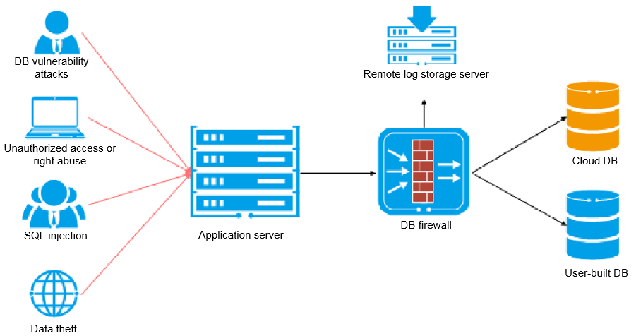
Database Management System (DMS)

Slide 67
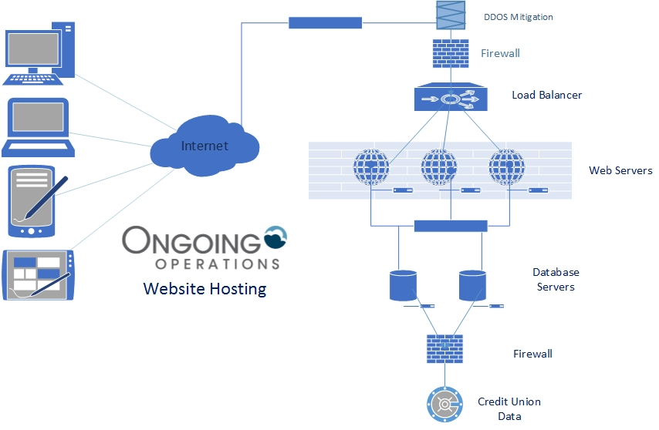
Web Based Database Structure and Security

Slide 68
How to setup your PC as a server for a database
https://www.instructables.com/id/Make-Your-Computer-Into-A-Server-in-10-Minutes-fr/

Slide 69
The Software you need to install (all free)
APACHE
MySQL
PHP
ASP/Java
Javascript/HTML for web page development

Slide 70
Some examples of web based databases
https://redcap.med.ucf.edu/RedCap/
https://idp-prod.cc.ucf.edu/idp/profile/SAML2/Redirect/SSO?execution=e1s1
https://ucf.qualtrics.com
https://www.hcup-us.ahrq.gov/

Slide 71
Appendix 2: Project/ Study Level Metadata
A list of elements is recommended to document project level or study level metadata in the README file and/or the metadata record in the digital repository (if available and needed). This list is compiled based on research data characteristics and several metadata standards including DC and DDI.
Title: Title of the data collection. Mapped to dc:title.
Principal Investigator(s): The person, corporate body, or agency responsible for the work's intellectual content. Mapped to dc:creator.
Publisher: The person or organization responsible for the physical processes of the document. Mapped to dc:publisher.
Funding Agency: The source(s) of funds for production of the work. Mapped to dc:description or dc:description.sponsorship (if available).
Grant Number: The grant or contract number of the project. Mapped to dc:description or dc:description.sponsorship (if available).
Identifier: Unique string or number (producer's or archive's number), such as doi, handle number. Mapped to dc:identifier.
Rights: Copyright statement for the data collection. Mapped to dc:rights.
Citation: The citation information for the dataset. Mapped to dc.identifier.citation.
Subjects: The topic or broad category classification of the dataset. Mapped to dc:subject.
Description: Summary describing the purpose, nature, and scope of the data collection, special characteristics of its contents including major variables, subject areas covered, and what questions the PIs attempted to answer when they conducted the study. Mapped to dc:description or dc:description.abstract.
Geographic Coverage: Geographic coverage of the dataset including the geographic scope of the data, and geographic coding provided in the variables. Mapped to dc:coverage.
Time Period: The time period covered by the dataset. Mapped to dc:coverage.

Slide 72
Appendix 2: Project/ Study Level Metadata
Date of Collection: Date when the data were collected. Mapped to dc.date.created.
Data Collection Notes: Methodology used in data collection. Mapped to dc:description.
Data Type(s): Types of data such as survey data, experimental data, psychological test, textual data, coded textual etc. Mapped to dc:type.
Methodology: Study purpose, study design, sample, time method, universe, unit(s) of observation, data source, data type(s), mode of data collection, description of variables, response rates, presence of common scales. Mapped to dc.description.
Data Source: The source of the data collection. Mapped to dc:source.
Other Study Description Materials: Other materials that are related to the study description, including appendices, sampling information, weighting details, methodological and technical details, publications based upon the study content, related studies or collections of studies. Mapped to dc:relation.
Language: Language of the study as well as the dataset. Mapped to dc:language.
Format: Type of data file (e.g., .sav, .sps., .spv, .por, .txt, .pdf, .doc, .xls, .xml, .jpg). Mapped to dc:format.
Original Release Date: The original release date of the dataset. Mapped to dc:date or dc:date.issued.
Data Update Information: Information on data updates, transformation, versioning, summarization, descriptions of migration and replication, and information about other events that have affected the files. Some of these administrative metadata are generated by the system. Can also include a description field for this information.
Data Preservation Information: More information on properties of data, the technical environment and fixity information. Can also include a description field for this information.
Data Files Description: Other technical information such as compression or encoding algorithms, encryption and decryption keys, software, hardware on which the data were, operating systems, application software, as well as file relationships. Can also include a description field for this information.
(SPSS Data Curation Primer, Sai Deng, Joshua Dull, Jeanine Finn & Shahira Khair.)

Slide 73
Appendix 3: Common Metadata Standards
Dublin Core (DC)
A general metadata standard for describing a wide range of digital resources.
DCMI Metadata Terms (https://www.dublincore.org/specifications/dublin-core/dcmi-terms/).
Encoded Archival Description (EAD)
A standard for encoding archival finding aids with XML.
Government Information Locator Service (GILS)
The Global Information Locator Service defines a core element set for government information so that it can be more searchable and discoverable by the general public.
ONIX for Books (ONline Information eXchange)
An international standard for representing and communicating book industry product information in XML format.

Slide 74
Common Metadata Standards: Image and Multimedia Metadata Standards
Visual Resources Association Core Categories (VRA Core)
A data standard for the description of works of visual culture as well as the images that document them.
Categories for the Description of Works of Art (CDWA)
A conceptual framework and guidelines for the description of art objects and images.
PBCore
The metadata standard for audiovisual media developed by the public broadcasting community.
NISO Metadata for
Digital Images
This technical metadata standard defines a set of metadata elements for raster digital images to enable users to develop, exchange, and interpret digital image files. The dictionary has been designed to facilitate interoperability between systems, services, and software as well as to support the long-term management of and continuing access to digital image collections.
Technical Metadata for Multimedia: MPEG-7
The Multimedia Content Description Interface MPEG-7 is an ISO/IEC standard and specifies a set of descriptors to describe various types of multimedia information and is developed by the Moving Picture Experts Group.

Slide 75
Metadata Structure Standards for Linked Data
Resource Description Framework (RDF)
RDF is a standard model for data interchange on the Web. RDF extends the linking structure of the Web to use URIs to name the relationship between things as well as the two ends of the link (this is usually referred to as a “triple”). Using this simple model, it allows structured and semi-structured data to be mixed, exposed, and shared across different applications.
SKOS: Simple Knowledge Organization for the Web
SKOS is a W3C recommendation designed for representation of thesauri, classification schemes, taxonomies, subject-heading systems, or any other type of structured controlled vocabulary.
Linked data examples:
FAST: Faceted Application of Subject Terminology;
Dewey Decimal Classification;
Open Metadata Registry (RDA vocabularies)
Library of Congress Linked Data Service
…
Web Ontology Language
(OWL)
The OWL 2 Web Ontology Language, is an ontology language for the Semantic Web with formally defined meaning. OWL 2 ontologies provide classes, properties, individuals, and data values and are stored as Semantic Web documents. OWL 2 ontologies can be used along with information written in RDF, and OWL 2 ontologies themselves are primarily exchanged as RDF documents.
MADS/RDF
The Metadata Authority Description Schema (MADS) is an XML schema for an element set that may be used to provide metadata about authorized forms of agents (people, organizations), events, and terms (topics, geographics, genres, etc.). MADS/RDF
builds on MADS/XML as a knowledge organization system.

Slide 76
Appendix 4: Disciplinary Metadata Standards & Data Repositories: Social Sciences & Humanities
Data Documentation Initiative (DDI)
A metadata specification for the social and behavioral sciences. Expressed in XML, the DDI metadata specification supports the entire research data life cycle.
Text Encoding Initiative (TEI)
A standard for the representation of texts in digital form, chiefly in the humanities, social sciences and linguistics.
ICPSR
Inter-university Consortium for Political and Social Research. It maintains a data archive of more than 250,000 files of research in the social and behavioral sciences.
LAUDATIO-Repository
An open access research data repository for historical linguistic data.

Slide 77
Disciplinary Metadata Standards:
Biological Sciences
0
ABCD - Access to Biological Collection Data
A standard for the access to and exchange of data about specimens and observations (a.k.a. primary biodiversity data).
Darwin Core
A metadata specification for information about the geographic occurrence of species and the existence of specimens in collections.
Ecological Metadata Language (EML)
A metadata specification developed by the ecology discipline and for the ecology discipline. EML is implemented as a series of XML document types that can be used in a modular and extensible manner to document ecological data.

Slide 78
Disciplinary Metadata Standards:
Health Sciences
0
Health Level 7 Standards
HL7 and its members provide a framework (and related standards) for the exchange, integration, sharing, and retrieval of electronic health information. HL7 standards support clinical practice and the management, delivery, and evaluation of health services.
The Cross-Enterprise Document Sharing (XDS) Metadata
The Healthcare Enterprise (IHE) XDS profile is a protocol for sharing clinical documents in health information exchanges. IHE IT Infrastructure Technical Framework volumes can be accessed at: http://ihe.net/Resources/Technical_Frameworks/
National Institute of Health (NIH) Common Data Elements (CDEs)
CDE is a data element that is common to multiple data sets across different studies. NIH encourages the use of CDEs in clinical research, patient registries, and other human subject research in order to improve data quality and opportunities for comparison and combination of data from multiple studies and with electronic health records.
0
ClinicalTrials.gov Protocol Data Element Definitions
It describes the registration data items (required and optional) that are entered via the Protocol Registration and Results System (PRS).

Slide 79
Disciplinary Metadata:
Biological Sciences and Health Sciences - Repositories
NIH Data Sharing Repositories page lists NIH-supported data repositories that make data accessible for reuse. Most accept submissions of appropriate data from NIH-funded investigators (and others).
Dryad (https://datadryad.org/)
A digital repository for data underlying the international scientific publications, with an initial focus on evolutionary biology and related fields.
GenBank is the NIH genetic sequence database, an annotated collection of all publicly available DNA sequences.
GBIF - Global Biodiversity Information Facility
GBIF is a free and open access global web portal promoting and facilitating the mobilization, access, discovery and use of biodiversity data.
clinicaltrials.gov is a registry and results database of publicly and privately supported clinical studies of human participants conducted around the world.

Slide 80
Disciplinary Metadata Standards:
Earth Science
DIF
AgMES
Agricultural Metadata Element Set
AgMES is designed to include agriculture specific extensions for terms and refinements from established metadata standard such as Dublin Core and AGLS to facilitate resource discovery, interoperability and data exchange in the agriculture domain.
Directory Interchange Format
An early metadata initiative from the Earth sciences community, intended for the description of scientific data sets. It includes elements focusing on instruments that capture data, temporal and spatial characteristics of the data, and projects with which the dataset is associated.
ISO 19115:2014
An internationally-adopted schema for describing geographic information and services. It provides information about the identification, the extent, the quality, the spatial and temporal aspects, spatial reference, and the portrayal, distribution of digital geographic data and services.
FGDC/CSDGM
Federal Geographic Data Committee Content Standard for Digital Geospatial Metadata
Content standard for digital geospatial metadata maintained by the Federal Geographic Data Committee (FGDC). Often referred to as the “FGDC Metadata Standard.”
(Climate and Forecast) Metadata Conventions
A standard for climate and forecast “use metadata” that aims both to distinguish quantities (such as physical description, units, or prior processing) and to locate the data in space–time.

Slide 81
Disciplinary Metadata:
Earth Science - Repositories and Data Centers
CEOS International Directory Network
An international effort to assist users in locating Earth science data sets, data services, and visualizations using DIF metadata. It provides free, online access to metadata on scientific data in the Earth sciences: geoscience, hydrospheric, biospheric, satellite remote sensing, and atmospheric sciences.
AGRIS - International System for Agricultural Science and Technology
A global public domain database using the AgMES standard to describe structured bibliographical records on agricultural science and technology.
NCDC - National Climatic Data Center
The world's largest climate data archive, providing climatological services and data worldwide. It currently promotes the FGDC/CSDGM metadata standard for its datasets.

Slide 82
Disciplinary Metadata Standards & Data Repositories: Physical Science
CIF - Crystallographic Information Framework
An extensible standard file format and set of protocols for the exchange of crystallographic and related structured data.
American Mineralogist Crystal Structure Database
A CIF crystal structure database that includes every structure published in the American Mineralogist, The Canadian Mineralogist, European Journal of Mineralogy and Physics and Chemistry of Minerals, as well as selected datasets from other journals.
Crystallography Open Database
An open-access collection of crystal structures of organic, inorganic, metal-organic compounds and minerals, many of which are in CIF form.

Slide 83
Appendix 5: Controlled Vocabularies and Thesauri
For digital and online resources:
Internet Media Types www.iana.org/assignments/media-types/index.html
MODS Note Types http://www.loc.gov/standards/mods/mods-notes.html
DCMI Type Vocabulary http://dublincore.org/documents/dcmi-terms/index.shtml#H7
For traditional library catalog:
MARC Code List for Countries http://www.loc.gov/marc/countries/
MARC Code List for Languages http://www.loc.gov/marc/languages/
MARC Source Codes for Vocabularies, Rules, and Schemes http://www.loc.gov/marc/sourcecode/form/formsource.html

Slide 84
Controlled Vocabularies: Subject Thesauri
Subject Thesauri and Ontologies
AGROVOC (Agricultural Organization of the United Nations Vocabulary)
Astronomy Thesaurus
CAB Thesaurus (for life sciences, technology and social sciences)
CIF dictionaries (for Physics)
Eurovoc (European Union Thesaurus)
AFS Ethnographic Thesaurus
Gene Ontology
GeoNames
Getty Institute Art and Architecture Thesaurus Online
Getty Institute Thesaurus of Geographic Names
ICD (International Classification of Diseases)
Library of Congress Authorities for subject headings
Library of Congress Thesaurus for Graphic Materials
Logical Observation Identifiers Names, and Codes (LOINC)
MESH (Medical Subject Headings)
Public Health Language
Rare Books and Manuscripts Section (RBMS) Controlled Vocabularies
RxNorm (for drugs)
SNOMED CT (Systematized Nomenclature of Medicine - Clinical Terms)
STW Thesaurus for Economics
UNBIS Thesaurus
UNESCO Thesaurus
USDA National Agricultural Library Agriculture Thesaurus

Slide 85
Controlled Vocabularies: Name Authorities and Registries
Library of Congress Name Authority File (LC/NAF)
The LC/NAF provides authoritative data for names of persons, organizations, events, places, and titles.
Virtual International Authority File (VIAF)
The VIAF™ (Virtual International Authority File) combines multiple name authority files into a single OCLC-hosted name authority service. The goal of the service is to lower the cost and increase the utility of library authority files by matching and linking widely-used authority files and making that information available on the Web.
Getty Union List of Artist Names (ULAN)
The ULAN includes proper names and associated information about artists. Artists may be either individuals (persons) or groups of individuals working together (corporate bodies). Artists in the ULAN generally represent creators involved in the conception or production of visual arts and architecture.
ORCID
ORCID provides a persistent digital identifier that distinguishes a researcher from every other researcher and, through integration in key research workflows such as manuscript and grant submission, supports automated linkages between the researcher and his/her professional activities ensuring that his/her work is recognized.

Slide 86
Appendix 6: Dataset Examples
Social Science Dataset
Example: Experience of Violence in the Lives of Homeless Persons: The Florida Four City Study, 2003-2004 (ICPSR 20363) http://www.icpsr.umich.edu/icpsrweb/NACJD/studies/20363?archive=NACJD&q=%22university+of+central+florida%22&permit%5B0%5D=AVAILABLE&x=-999&y=-84
Data Documentation Initiative (DDI) http://www.ddialliance.org/
DDI-compliant data repository:
ICPSR (Inter-university Consortium for Political and Social Research)
UKDA (UK Data Archive)

Slide 87
Humanities Data
TEI by Example: https://teibyexample.org/
Examples for 8 Modules:
TEI Header Examples: https://teibyexample.org/examples/TBED02v00.htm
Prose Examples: https://teibyexample.org/examples/TBED03v00.htm
Primary sources
https://teibyexample.org/examples/TBED06v00.htm
Tools:
TEI validation service: https://teibyexample.org/xquery/TBEvalidator.xq
TEI Tools (wiki): https://wiki.tei-c.org/index.php/Category:Tools
The official TEI P5 guideline is at:
https://tei-c.org/guidelines/P5/

Slide 88
Biological Science Dataset
Example: Data from: More than 1000 ultraconserved elements provide evidence that turtles are the sister group of archosaurs
https://datadryad.org/stash/dataset/doi:10.5061/dryad.75nv22qj
In Dryad (https://datadryad.org/): built upon the open-source DSpace repository software; It utilizes a combination of Dublin Core (DC) and Darwin Core (DwC) metadata standards; Digital Object Identifiers (DOIs)
BirdLife Australia, Birdata
https://www.gbif.org/dataset/4bf1cca8-832c-4891-9e17-7e7a65b7cc81
In: Global Biodiversity Information Facility (GBIF)

Slide 89
Geospatial Dataset
Examples:
National Register of Historic Places
https://irma.nps.gov/DataStore/Reference/Profile/2210280
Coastal Storm Modeling System (CoSMoS)
https://www.sciencebase.gov/catalog/item/5633fea2e4b048076347f1cf
ISO19115:2003 Metadata Standard/North American Profile
FGDC-CSDGM Metadata:
https://www.usgs.gov/products/data-and-tools/data-management/metadata

Slide 90
Earth Science Dataset
Example: Measurement of Air Pollution from Satellites (MAPS) Space Radar Laboratory - 2 (SRL2) Carbon Monoxide Second by Second data
https://cmr.earthdata.nasa.gov/search/concepts/C1536049393-LARC_ASDC.html
NASA Atmospheric Science Data Center (ASDC)
Directory Interchange Format (DIF):
A descriptive and standardized format for exchanging information about scientific data sets.
The DIF Writer’s Guide: http://gcmd.gsfc.nasa.gov/User/difguide/difman.html

Slide 91
Thank you!
Contact:
Sai Deng, Metadata Librarian and Associate Librarian
sai.deng@ucf.edu
407-823-4312 (Office)
Xiang Zhu, Statistician,
College of Medicine
Xiang.Zhu@ucf.edu
407-266-7160 (Office)

