Slide 1
Measuring Research Impact: Citation Analysis Tools
Stay Savvy with Scholarly Communication summer professional development sessions.
July 27, 2020
1:00 – 2:00 pm
Ven Basco

Slide 2
Learn about citation analysis tools that can make it easy to showcase your work or your faculty.
The three best known citation analysis databases are Web of Science (WoS), Scopus and Google Scholar (GS).
Other tools that provide citation count.

Slide 3
What is citation analysis?
Citation analysis is a way of measuring the relative importance or impact of an author, an article or a publication by counting the number of times that author, article, or publication has been cited by other works.

Slide 4
Sources for Citation Analysis.
Several tools available for citation analysis, some are subscription-based, and others are free.
The citation data will relate only to articles indexed within the database.
Each tool has its strengths and weaknesses and none of them covers the entire universe of scholarly publications.

Slide 5
Sources for Citation Analysis.
Using citation information from multiple databases and comparing the results can offer a better perspective of impact within a field. (Fuller picture of the scholarly impact of an author or journal.)

Slide 6
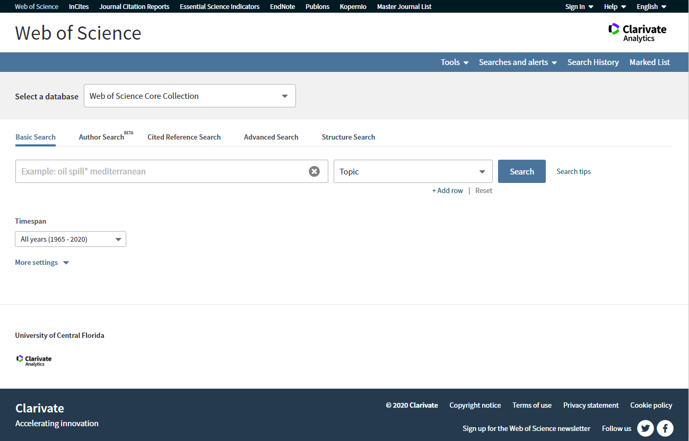
Sources for Citation Analysis – Web of Science

Slide 7
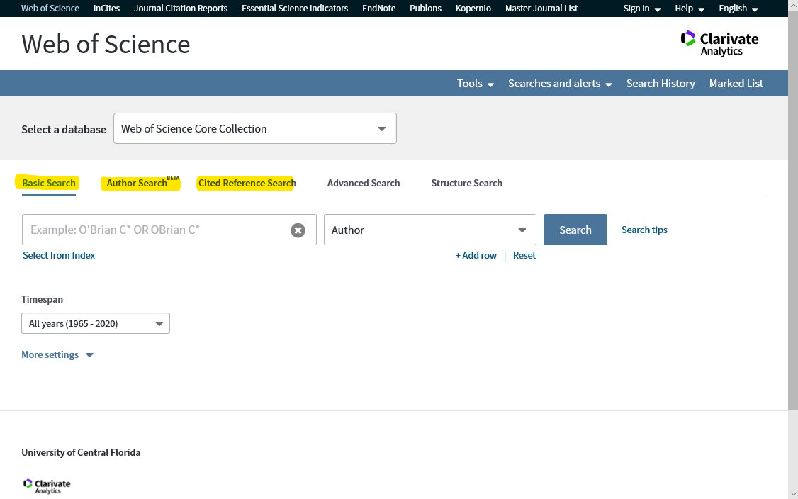

Slide 8
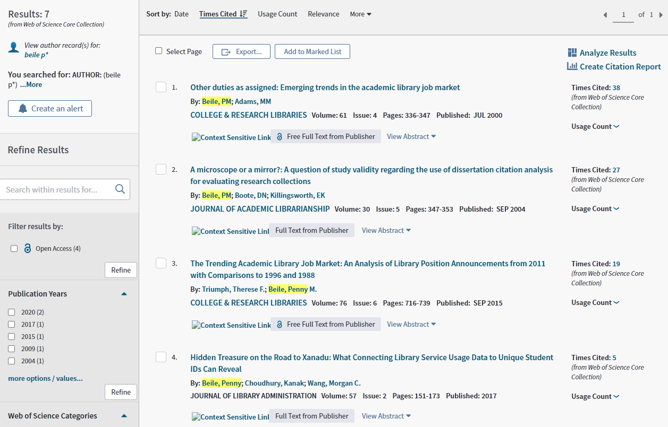

Slide 9
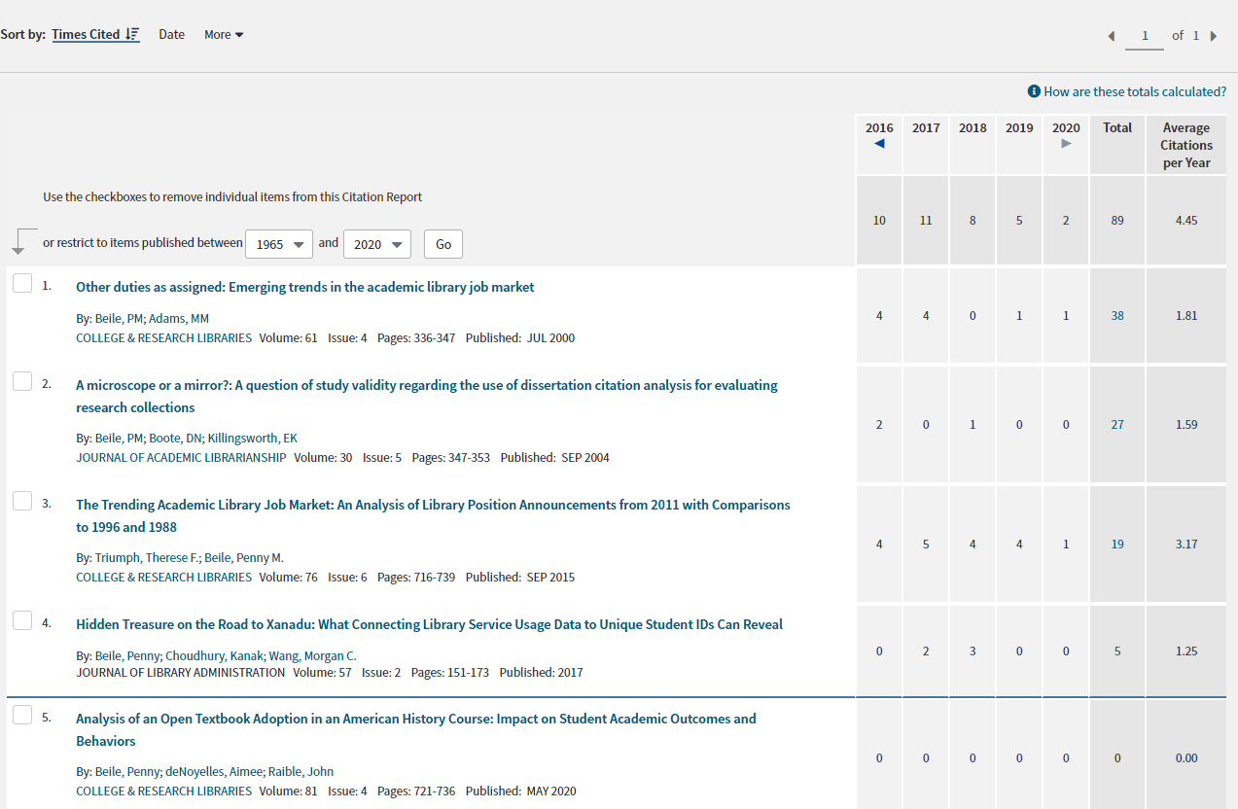

Slide 10
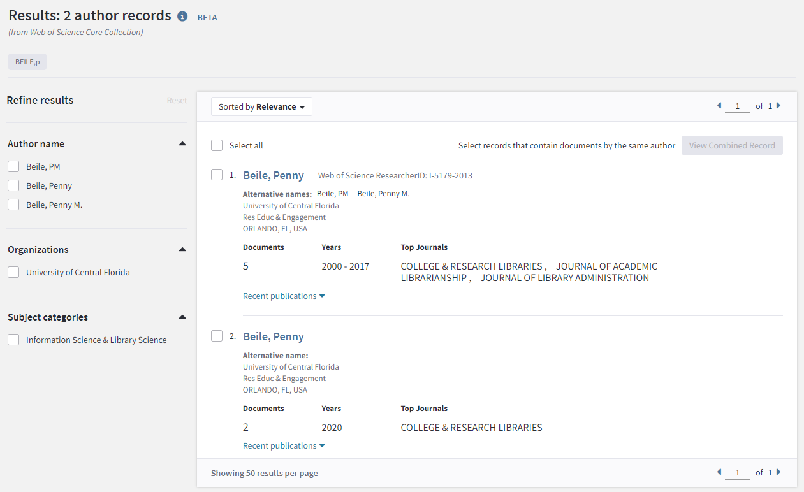

Slide 11
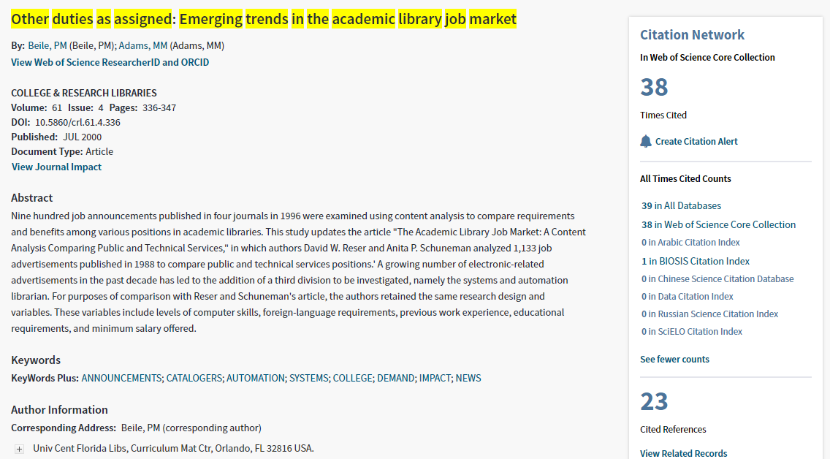

Slide 12
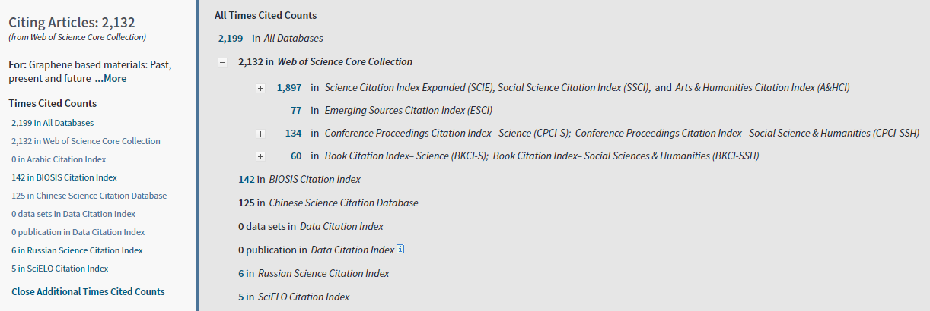
Duplicate records across all product databases are only counted once. However, a record of an item can appear in multiple product databases.

Slide 13
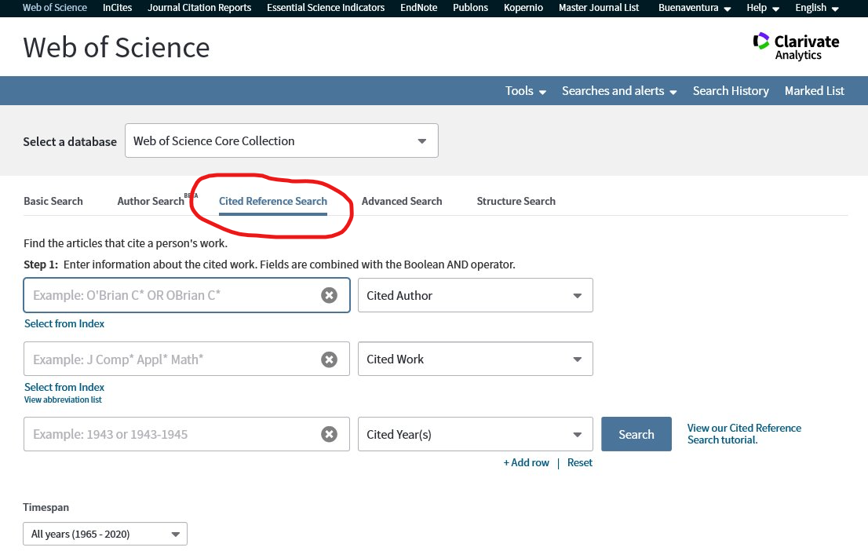

Slide 14
Duplicate records across all product databases are only counted once. However, a record of an item can appear in multiple product databases.

Slide 15
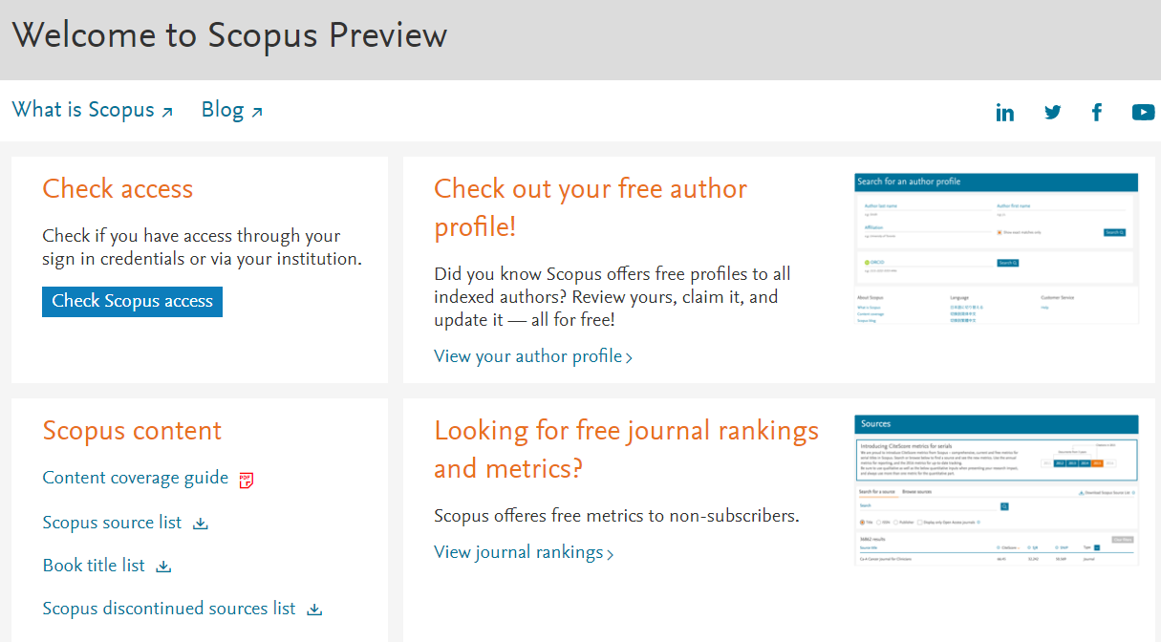
Sources for Citation Analysis - Scopus
Scopus is the largest abstract and citation database of peer-reviewed literature: scientific journals, books and conference proceedings.

Slide 16
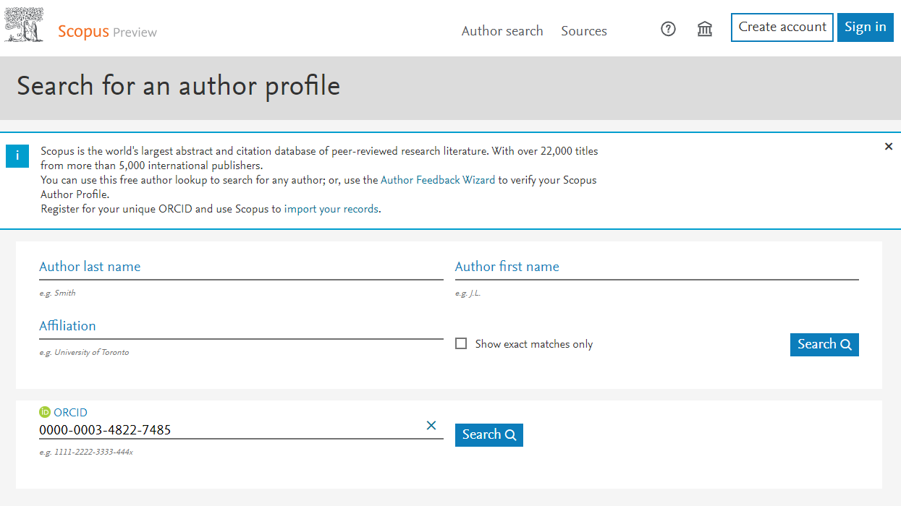
https://www.scopus.com/freelookup/form/author.uri

Slide 17
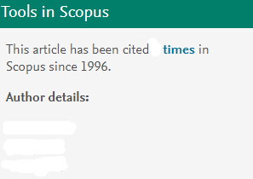
Sources for Citation Analysis - Scopus
Doe, John
x
Doe, John
Search by article to get to the author link

Slide 18
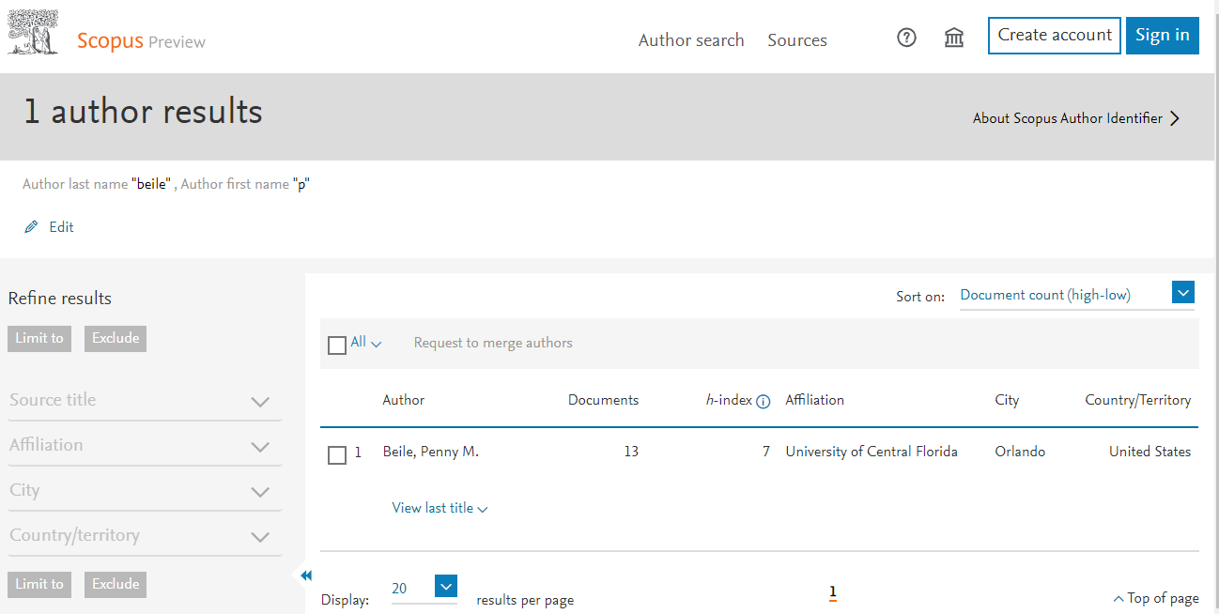

Slide 19
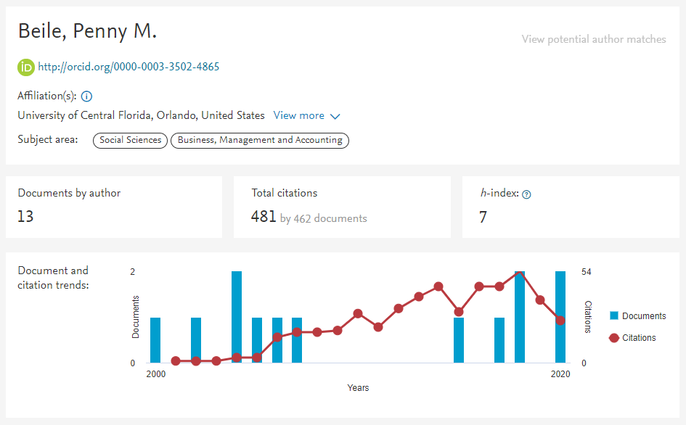

Slide 20
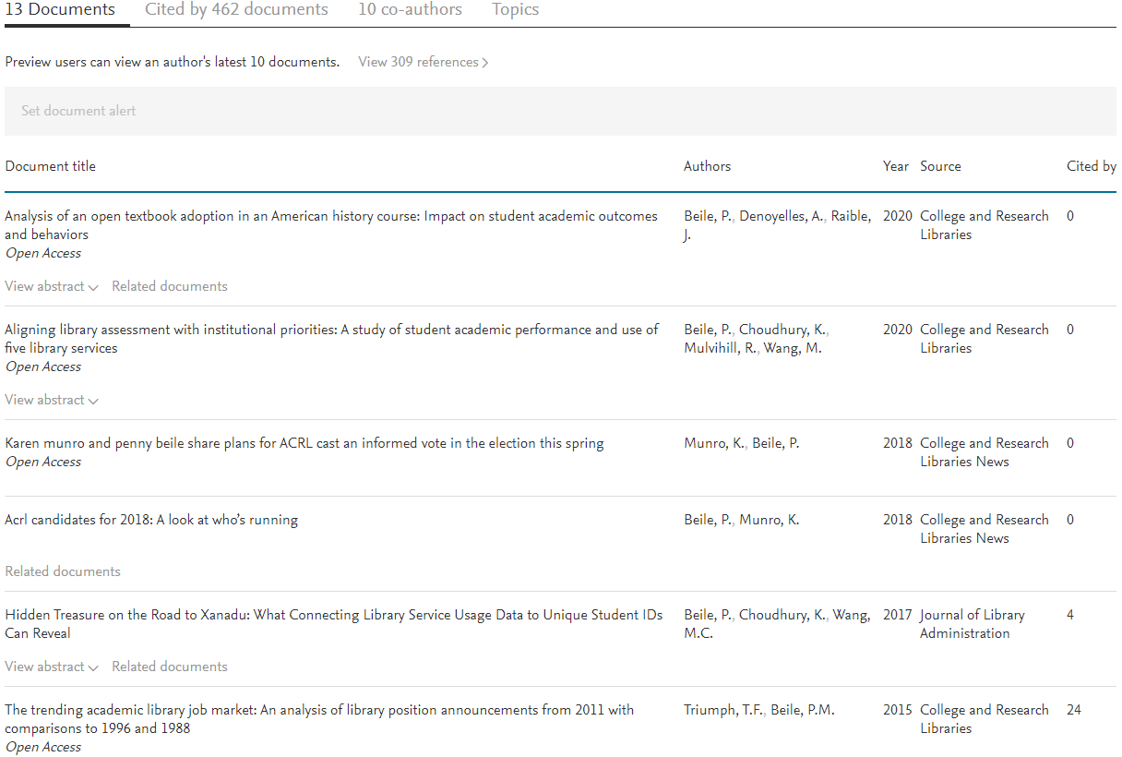

Slide 21
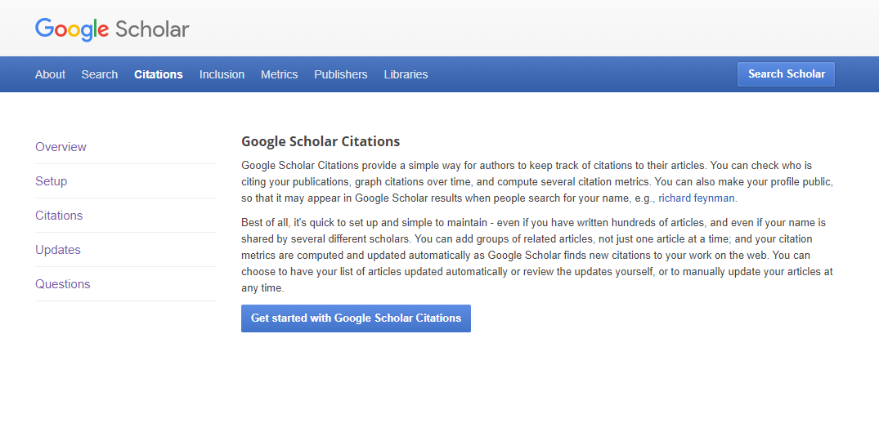
Sources for Citation Analysis – Google Scholar

Slide 22
Consists of scholarly articles including journal papers, conference papers, technical reports, theses, pre-prints, post-prints and other publications on the Web
Indexed by Google from individual author’s personal website, university repositories, journal publishers
Author profile – not automatically created, but author could create

Slide 23
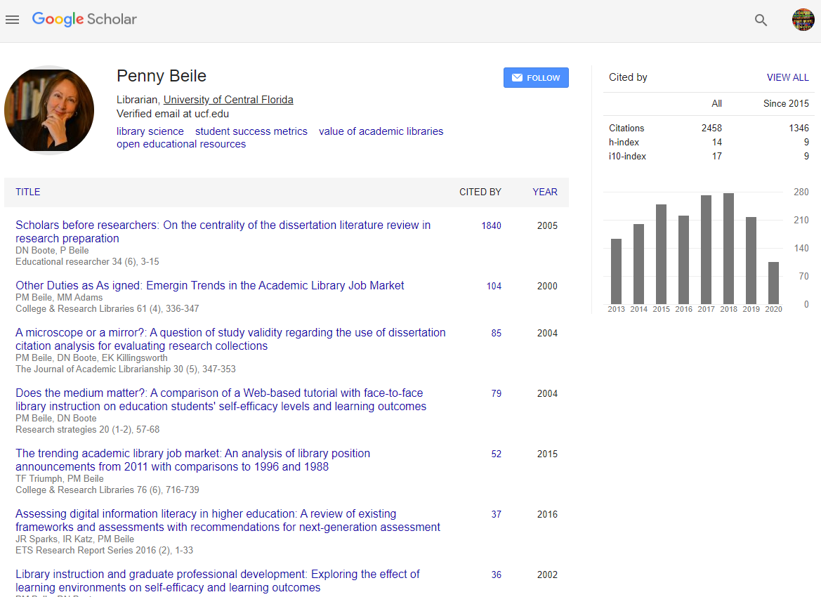

Slide 25
Part of the portfolio from Digital Science, also owns Figshare, Altmetric, Overleaf, other software products
Dimensions Plus - Enhanced version of Dimensions, offers more than the free version. Includes publications, awarded grants, clinical trials, policy documents.
Dimension - Free version available to the public. Publication and datasets only. No filter.

Slide 26
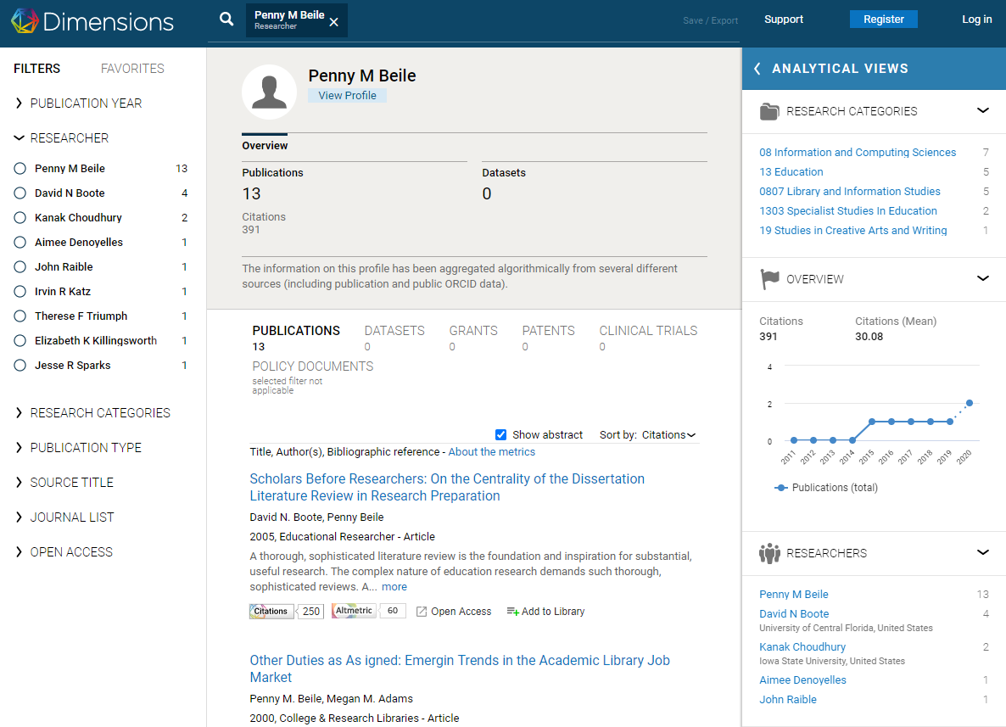

Slide 27
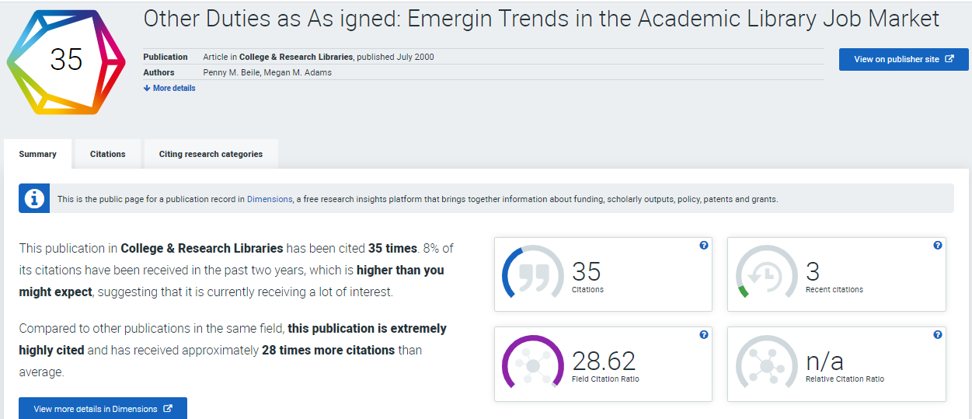

Slide 28
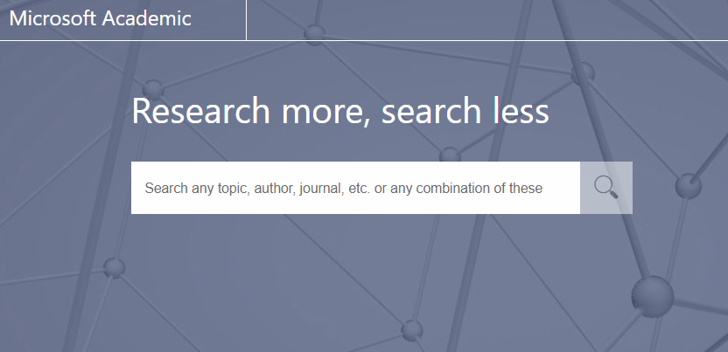
Sources for Citation Analysis – Microsoft Academic
Microsoft Academic (MA) employs advances in machine learning, semantic inference and knowledge discovery to help you explore scholarly information in more powerful ways than ever before.
https://academic.microsoft.com/

Slide 29
Data source – indexed by Bing. From author’s personal homepage, university repositories, publisher’s website.
Documents – journal/conference papers, book chapters, patents.
Citation count – uses a statistical model to estimate a more accurate citation count.
Emphasizes quality than quantity
Author profile – automatically created, and author could claim
Name disambiguation – using CV and user homepages to make sure less error.

Slide 30
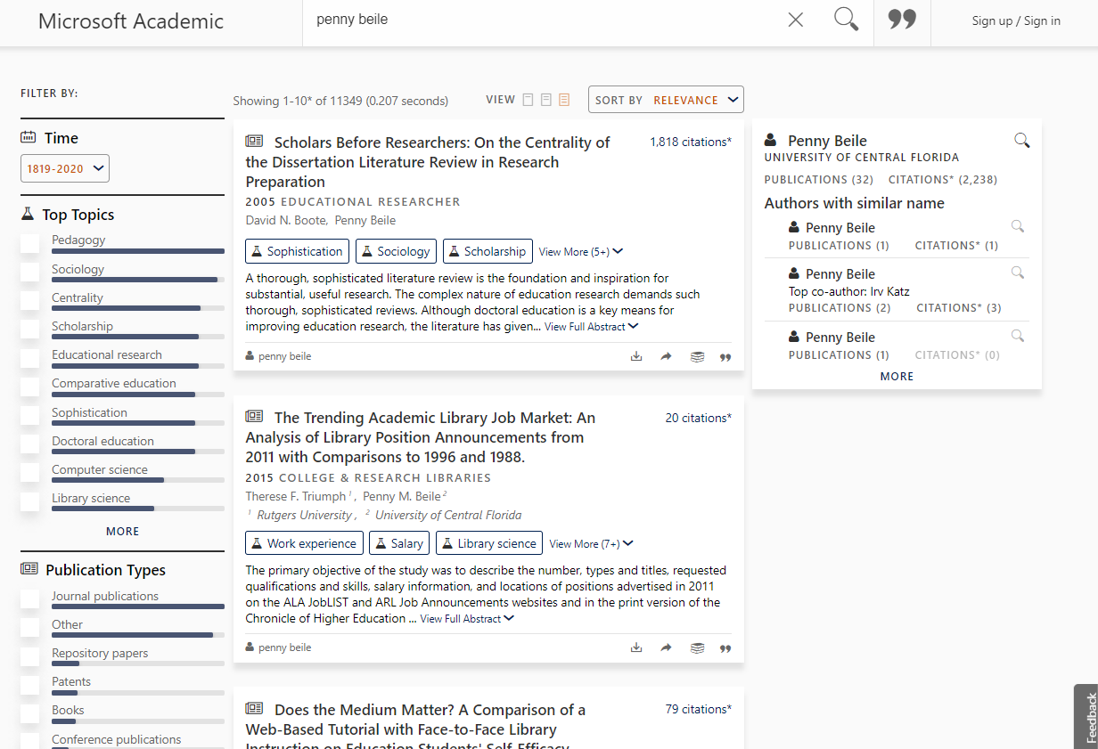

Slide 31
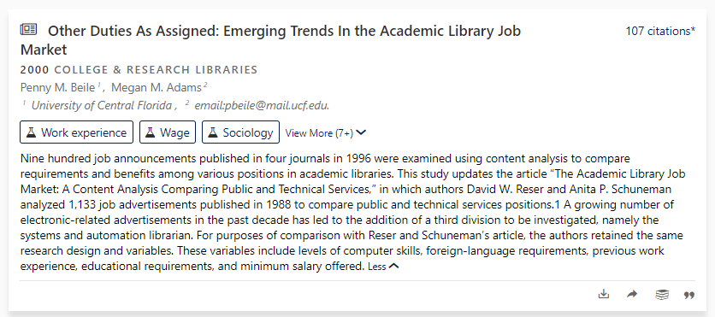

Slide 32
Other Tools:
Databases Containing Limited Citation Counts

Slide 33
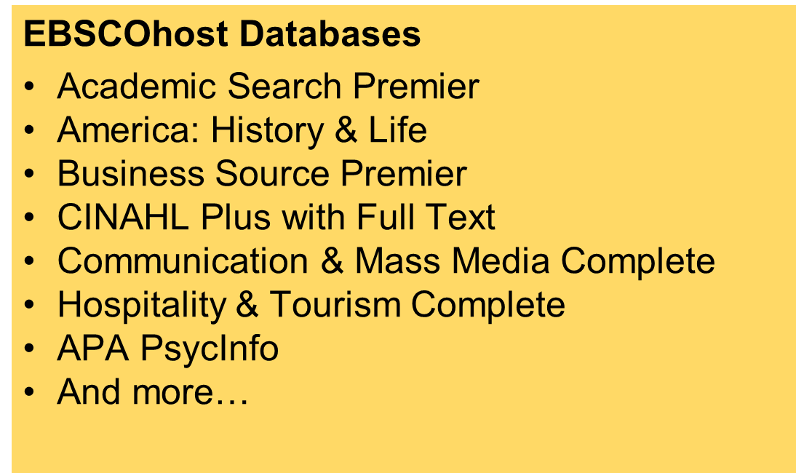

Slide 34
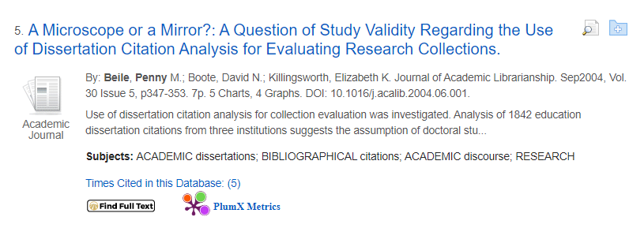

Slide 35
ProQuest Databases
ABI/INFORM Collection
Sociological Abstracts
SciTech Premium Collection
Worldwide Political Science Abstracts
And more.

Slide 37
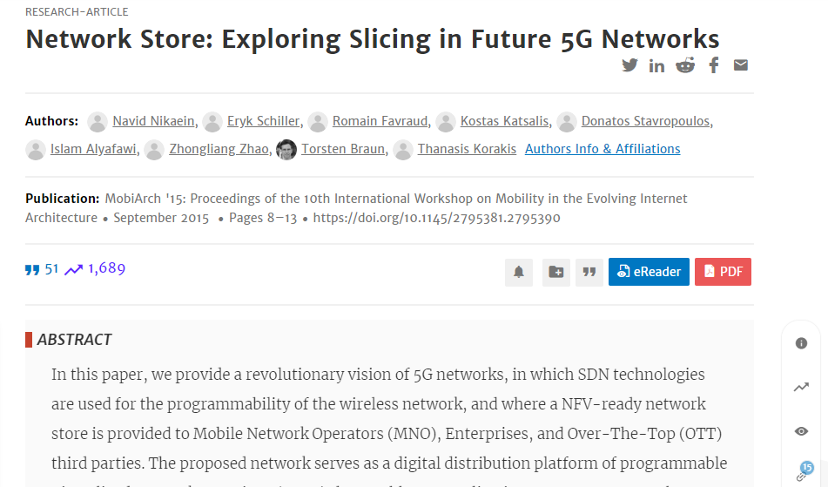
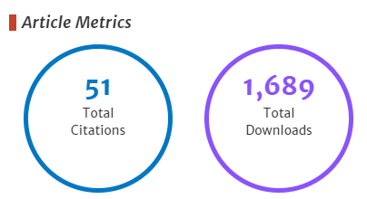

Slide 38
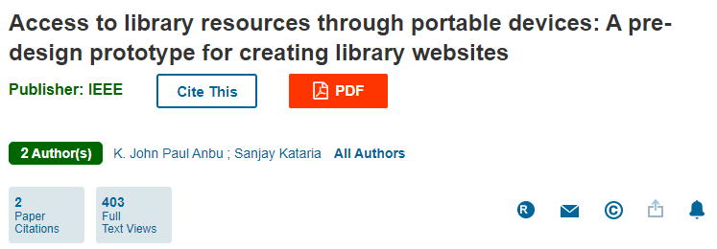
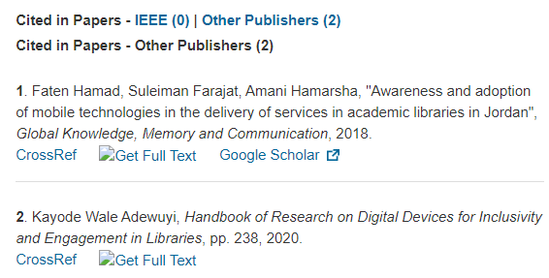

Slide 40
Thank You!
https://pixabay.com/users/jeff-cr%c3%a9ation-15919403/

