Slide 1
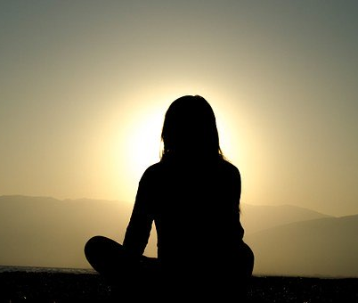
Mindfulness Meditation: Benefits to Meditation & Basic Practice techniques
https://pixabay.com/photos/sunset-dusk-silhouette-shadow-girl-691848/
Ucf LIBRARIES’ Wellness Wednesdays
July 22, 2020
Sandy Avila
https://pixabay.com/photos/beauty-flower-lotus-meditation-1845520/

Slide 2
A quick reminder about mindfulness... Mindfulness [i]s “paying attention in a particular way: on purpose, in the present moment, and non-judgmentally” (Dr. Kobat-Zinn) ...to one’s experience that is deliberate, sustained and nonjudgmental

Slide 3
Types of Meditation
Focused-attention meditation: Concentrates attention on a single object, thought, sound or visualization. It emphasizes ridding your mind of attention and distraction. Meditation may focus on breathing, a mantra or a calming sound.
Open-monitoring meditation: Encourages broadened awareness of all aspects of your environment, train of thought and sense of self. It may include becoming aware of thoughts, feelings or impulses that you might normally try to suppress.

Slide 4
Leading into the Benefits of Meditation
Researchers at the University of Waterloo in Canada found that meditating for just 10 minutes a day was enough to see significant results. If done consistently, sitting still and breathing deeply for just 10 minutes can help you concentrate better throughout the day.
Science Daily News from May 1, 2017
https://www.sciencedaily.com/releases/2017/05/170501094325.htm

Slide 5
Benefits to Meditation
We can look at this from multiple perspectives.....
Mental health
Physical health
Emotional/Spiritual health

Slide 6
Mental Health
Reduce stress by helping to gain a new perspective on situations
Help to build skills to manage stress
Improve sleep
Lengthen/strengthen attention span
Help control anxiety
Increase self-awareness/focus on the present moment
Increase imagination and creativity

Slide 7
Physical Health
Calms your Nervous System by deeply calming & relaxing alpha-wave
states in the brain
Focuses Your Energy
Optimizes your Circulatory System
Boosts your Immune System
Decreases blood pressure
Reduces age related memory loss

Slide 8
Emotional/Spiritual Health
Help fight addictions
Generate kindness
Control pain
Can help with healing
Reduce negative emotions
Increase patience and tolerance

Slide 9
Some Resources to Check Out
https://www.headspace.com/meditation/benefits
The Many Benefits of Meditation
https://www.healthline.com/nutrition/12-benefits-of-meditation#section13
12 Science Based Benefits to Meditation
https://news.harvard.edu/gazette/story/2018/04/harvard-researchers-study-how-mindfulness-may-change-the-brain-in-depressed-patients/
When Science Meets Mindfulness

Slide 20
Reflection time....
If you attended last week, what things were different today during this meditation session? Was it easier, harder, why?
Did you find having slides to focus on as a visual helpful or more distracting?
What other questions do you have about meditation so we can follow up on for our last session?
From the following, which would you prefer to cover during our last session:
sound meditation
walking meditation
chakra/energy center meditation
meta (compassion/loving kindness meditation)

