Slide 1
Introduction to Mindfulness Mediation
UCF Libraries’
Wellness Wednesdays
July 8, 2020
Sandy Avila

Slide 2
The practice of mindfulness, which cultivates a present moment connection to the unfolding of our lives..... (Walsh & Shapiro 2006).
https://www.google.com/url?sa=i&url=https%3A%2F%2Fwww.youtube.com%2Fwatch%3Fv%3DT_hnxLCXsAs&psig=AOvVaw3QmUZKnmSiL5zVSEP3KHO4&ust=1594305851449000&source=images&cd=vfe&ved=0CAIQjRxqFwoTCKD3yaXyveoCFQAAAAAdAAAAABAI
What does mindfulness really mean?

Slide 3
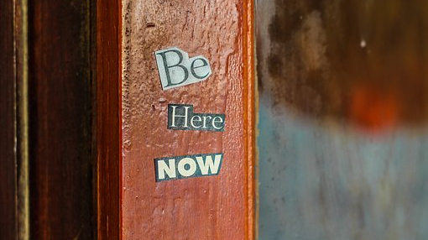
Mindfulness is.........
A way of paying
attention
https://pixabay.com/photos/wood-old-door-motivational-quotes-3345661/

Slide 4
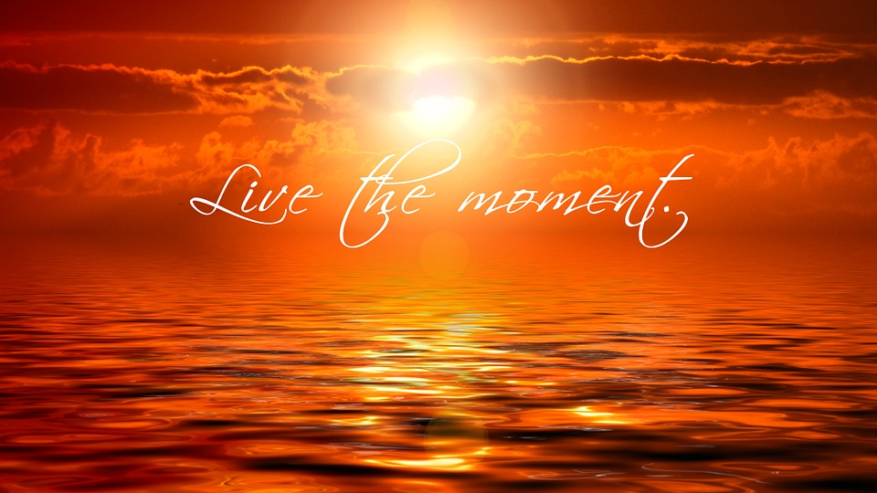
Mindfulness is a form of “awareness”
https://pixabay.com/illustrations/sunset-cloud-meditation-buddhism-473603/

Slide 5
Mindfulness [i]s “paying attention in a particular way: on purpose, in the present moment, and non-judgmentally” (Dr. Kobat-Zinn) ...to one’s experience that is deliberate, sustained and nonjudgmental

Slide 6
https://pixabay.com/illustrations/woman-burnout-multitasking-face-1733891/

Slide 7
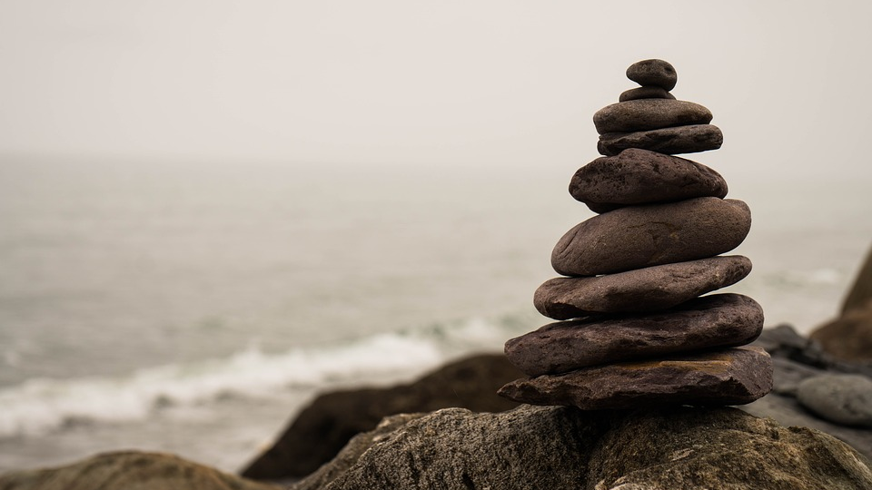
Balance
https://pixabay.com/photos/balance-stone-nature-meditation-2686214/

Slide 8
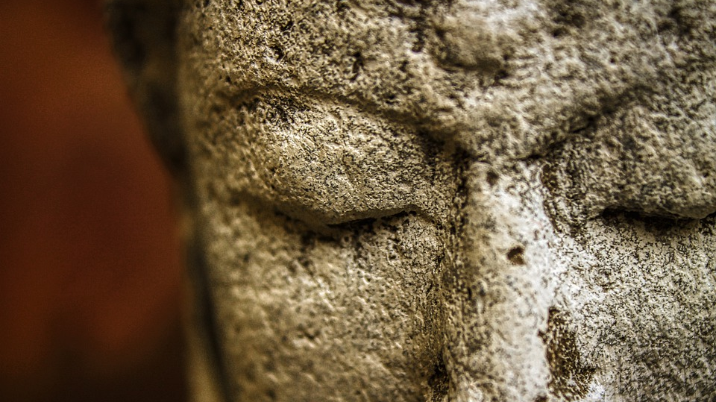
P
E o M
A f I
C N
E D
https://pixabay.com/photos/statue-buddha-sculpture-art-4882778/

Slide 9
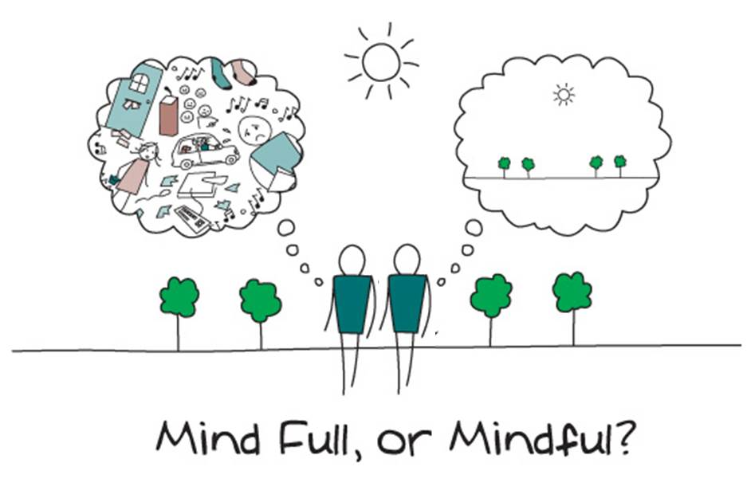
Let’s try an exercise in mindfulness meditation
https://sites.uci.edu/mindfulhs/what-is-mindfulness/

Slide 10
