Slide 1
Staying Calm & Carrying On: How the UCF Libraries’ STEM Librarians Extended their Reach Through Remote Access
Sandy Avila
Ven Basco
University of Central Florida Libraries
Science Librarianship in the Time of COVID-19 Virtual Conference
August 5, 2020

Slide 2
Does COVID-19 make you feel like you are under water? Well, you aren’t alone....

Slide 3
Agenda
Our Changing Landscape Due to COVID-19
Library Partnership Strategies- Internal/External Collaborations
Extension of Liaison Librarian Service
Use of Technology to Improve Remote Work Conditions

Slide 4
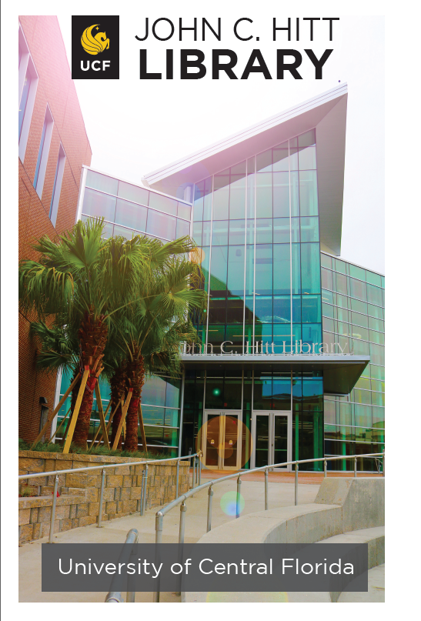
Our Changing Landscape
Quick facts about the John C. Hitt Library
Main campus library at UCF
Collection holdings of 1.8 million print vol.
Subscribe to 50,600 serials, including 49,000 electronic full-text journals
Deliver documents to UCF students all over the country and as far away as Germany
21st Century Library Project
Construction of an Automated Retrieval Center
that connects to the existing library
New primary entrance, includes increased seating
Reading Room, Digital Commons, Exhibits area Planned opening is this Fall 2020

Slide 5
Initial COVID-19 Response
UCF suspended all campus events starting Saturday, March 14, 2020
All library locations remained open virtually
All Faculty and Staff worked remotely
And Now…
July 28, 2020 NY Times article reported that more than 6,600 cases of Coronavirus cases have been linked to US Colleges- https://www.nytimes.com/interactive/2020/07/28/us/covid-19-colleges-universities.html?action=click&module=Top%20Stories&pgtype=Homepage
438 cases per 100,000 residents reported in the county where UCF is located- 2nd in the country!
Return to campus plan for Fall 2020, encourages all staff to work remotely
Library is opening – some in person service

Slide 6
We made it above water. So then what?
We went inward....

Slide 7
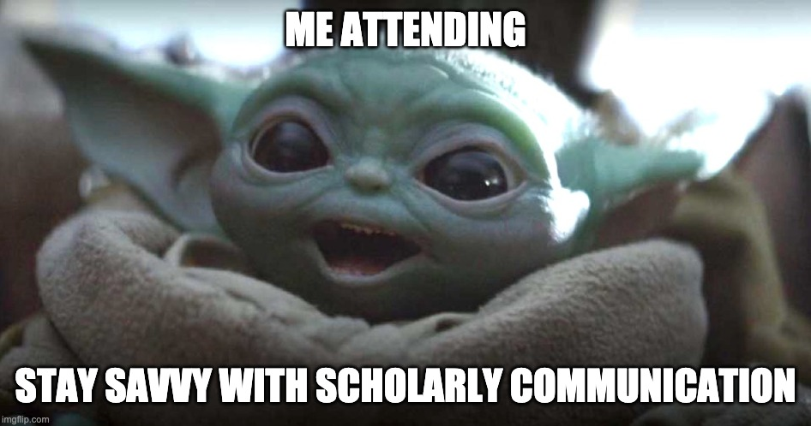
Partnership Strategies: Internal Collaborations
Faculty Support Blog Series partnership with UCF Libraries’ Student, Learning & Engagement Department
https://library.ucf.edu/news/
Stay Savvy- Brown Bag Series in partnership with UCF Libraries’ Scholarly Communication Dept.
https://stars.library.ucf.edu/scholcom-brownbag/

Slide 8
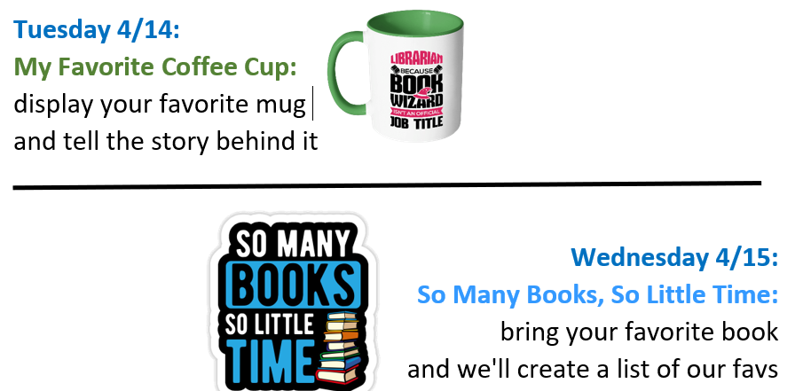
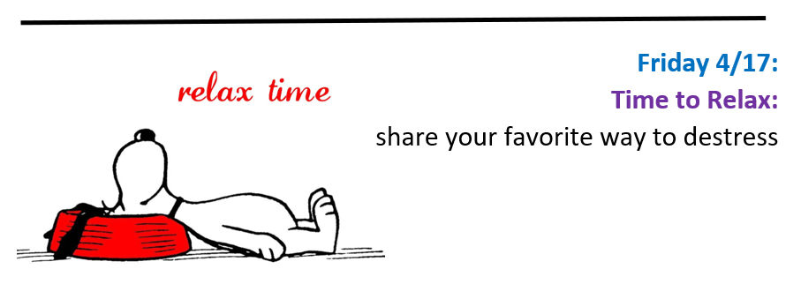
UCF Libraries’ Zoom Lounge Daily Virtual Chats

Slide 9
Things are moving along, and we are having some success....
We now turn our attention externally.

Slide 10
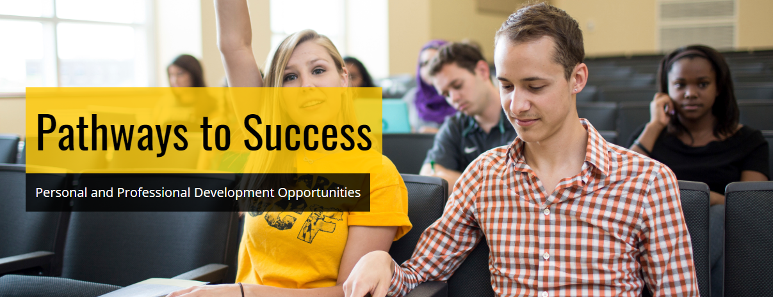
Partnership Strategies- External Collaborations
Coordinated by the College of Graduate Studies, the Pathways to Success program offers free development opportunities for graduate students and postdoctoral scholars.
https://guides.ucf.edu/graduateworkshops

Slide 11
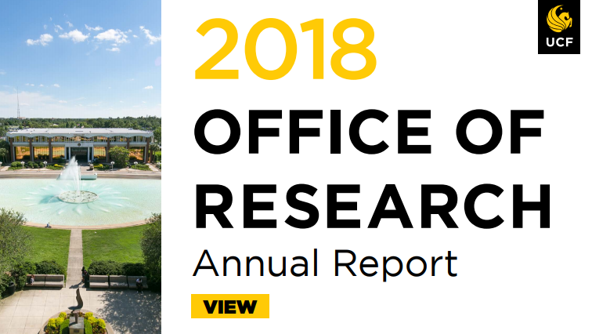

Slide 12
And now the STEM Librarians
begin to go deeper....
extending our reach!

Slide 13
Extension of STEM Liaison Librarian Service
A patents video collaboration with our Patent & Trademark Resource Center Librarian
Research guide for Diversity in STEM & future project in General Chemistry courses
Introduction of STEAM Bootcamp: Research, Data, & Tools workshops
Additional Faculty blog posts- IGI Global, Web of Science
Acquiring of JoVE on limited basis and sharing information w/faculty
Textbook Affordability push across departments- Student Government Association $

Slide 14
Getting Creative
Development of UCF Libraries’ Professional Development programs
Meet Up Mondays- scale down of Zoom lounge daily virtual chats
Tech Tuesdays- new technology topic each week led by UCF IT staff
Wellness Wednesdays- meditation, library step challenge, fiber arts, & cooking
UCF Libraries’ Support Videos & other fun stuff on social media
https://www.facebook.com/ucflibrary/
https://www.instagram.com/ucflibrary/
https://twitter.com/UCFLibrary
https://ucflibrary.tumblr.com/

Slide 15
We are getting the hang of things and learning even more new skills
...with technology tools!

Slide 16
Using Technology to Improve Remote Work Conditions
All physical phones removed & Skype for Business deployed in 2017 but will soon be retired July 31, 2021, and after that date the service will no longer be accessible.
Campus-wide license purchased in 2020 for Zoom, a video conferencing platform for online classes, meetings, conferences, remote office hours, webinars, and lectures.

Slide 17
Accepting Internal Technology Platform Changes
The Microsoft product will soon replace Skype for Business and will be the home for all shared drives within the library
A series of Channels has been developed which contains chat records, shared files, a place post announcements
All internal library-wide virtual meetings to be conducted via Teams

Slide 18
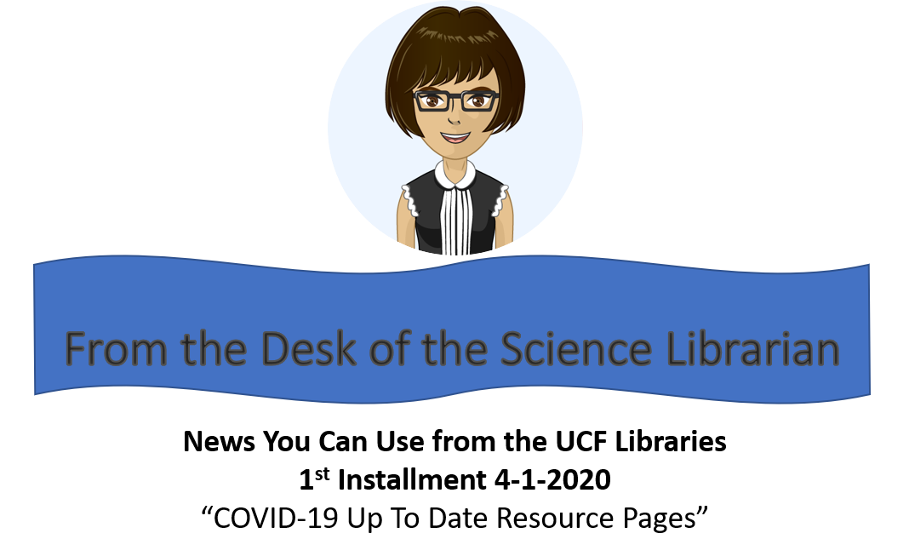
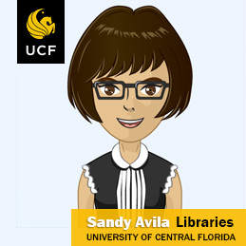
Unique Subject Librarian Marketing Using Avatars
Created using online tool Avatar Maker https://avatarmaker.com/

Slide 19
We are in Zen land now and have risen to the occasion
We hope to meet you all here!

Slide 20
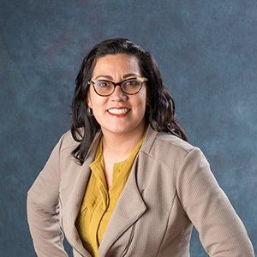
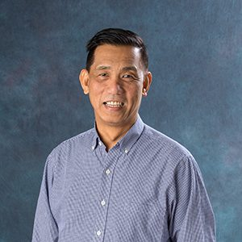
Always remember...
Sandy Avila
Science Librarian
Sandy.Avila@ucf.edu
Ven Basco
Engineering &
Computer Science Librarian Buenaventura.Basco@ucf.edu
Thank you!!!!

