Slide 1
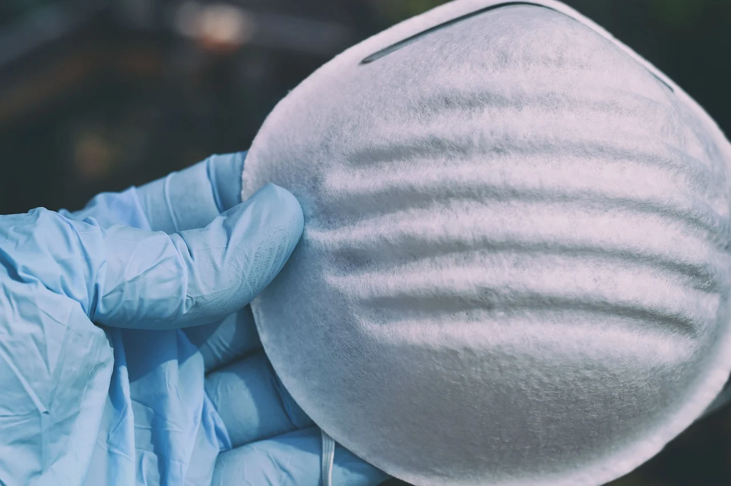


Top Apps to Explore During COVID-19 Quarantine
Sandy Avila
Science Librarian
Research & Information Services Remote Department Meeting
UCF Libraries
April 17, 2020

Slide 2


Slide 3


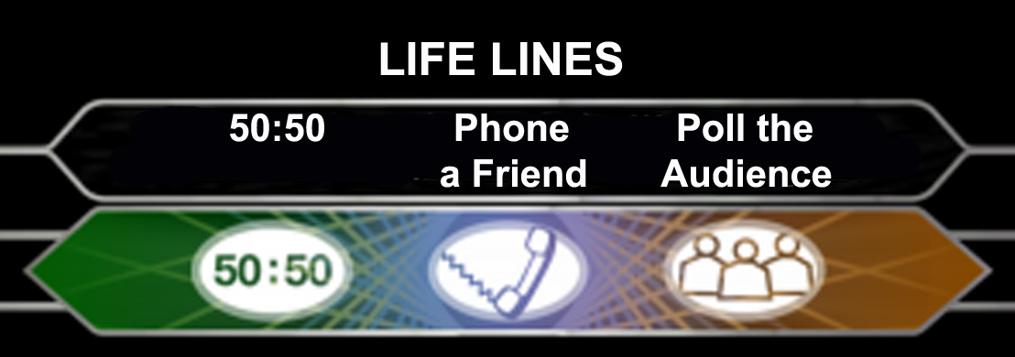
So why not use your mobile technology to stay connected with life as you once knew it….
https://polysyllabicprofundities.files.wordpress.com/2013/09/reach-out.jpg
https://sunningdaledentalblog.files.wordpress.com/2013/03/question_graphic_5.jpg

Slide 4

Pew Research Center study from 2019 shows that :
-96% of Americans own a cell phone.
-81% of Americans own a smartphone which is up from 77% in 2016 and from 35% in 2011.
This is across gender, race, age, education and income lines
More of us are “connected on the go” than ever before!
Reference: https://www.pewresearch.org/internet/fact-sheet/mobile/

Slide 5

But don’t despair, mobile apps CAN help….

Slide 6

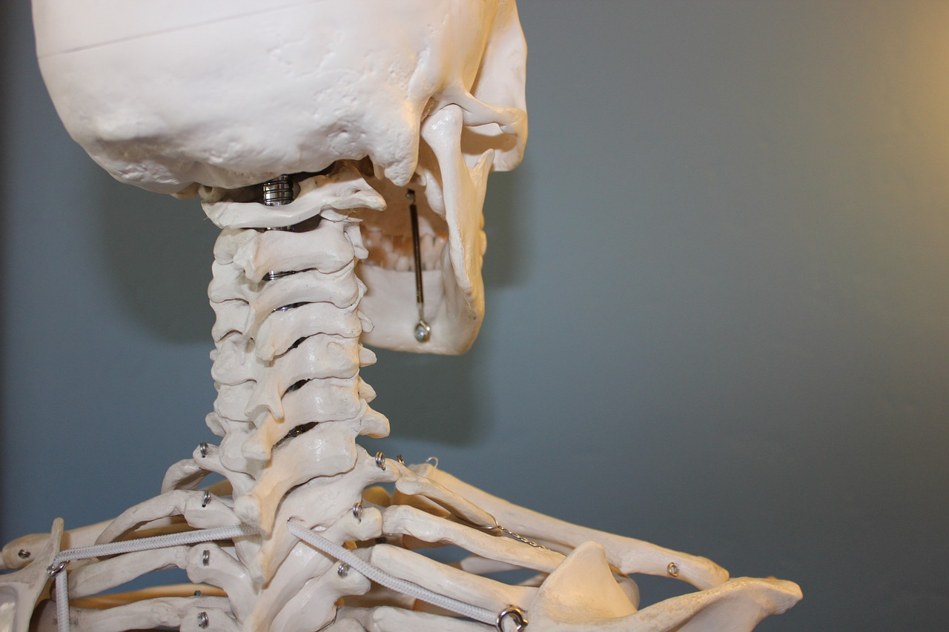

We will explore three themes
Escape your Mind
Center your Body
Tickle your Spirit

Slide 7
But before we begin, keep the following in mind:
The following apps are all FREE to start- premium versions come with a fee
Every app listed is available via the iTunes Store & on the Google Play Store
All apps shown have a corresponding desktop website besides one
And most apps can “sync” across devices via your user account credentials
Lastly, make sure you are downloading the correct app and not a spin off

Slide 8

Escape your Mind
Need to stay on task, keep organized, or stick to a plan of action?
Looking for a new way to connect with others?
Or want to store information for later use/reading, when you have more time?

Slide 9

Create to-do lists, tasks, &
reminders with Todoist
https://youtu.be/8ZKq0r-g87M
Free up your mental space
“Regain clarity and calmness by getting all those tasks out of your head and onto your to-do list (no matter where you are or what device you use).”
Create tasks, projects, set priority levels, and due dates and even share them with others. Great visualizations to track your productivity.

Slide 10



Dialup
https://dialup.com/
https://quarantinechat.com/
Reviving the magic of talking on the phone.
Dialup is a voice-chat app that connects you serendipitously to the people you want to stay in touch with. Try their

Slide 11

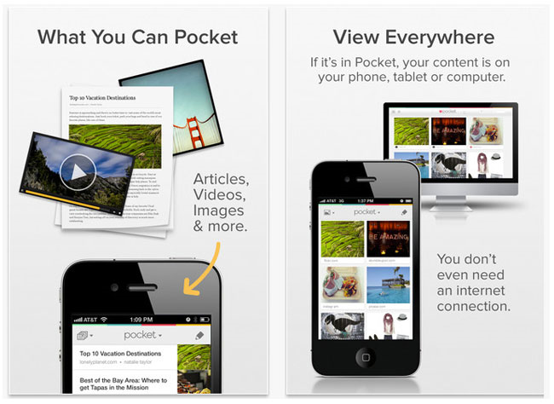
Organize your Information with Pocket
https://www.youtube.com/watch?v=MoJHYNKmS2U
When you find something you want to view later, put it in Pocket.
SAVE FOR LATER
Put articles, videos or pretty much anything into Pocket.
Save directly from your browser or from apps.
VIEW WHEN READY
If it's in Pocket, it's on your phone, tablet or computer. You don't even need an Internet connection.
Notes:
A great place to find things online while searching to read offline for later. Yes I said to read offline. I usually log into Google and go through this demonstration live. Most students find this is a new app they didn’t know about before.

Slide 12
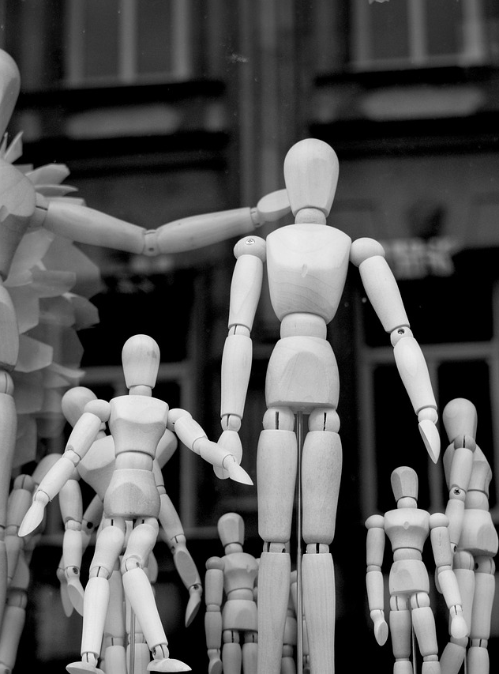
Center your Body
Looking to keep yourself healthy by watching what you eat?
How about tracking your sleep patterns or need help getting to sleep?
Are you ready to challenge yourself to stay active and fit?

Slide 13

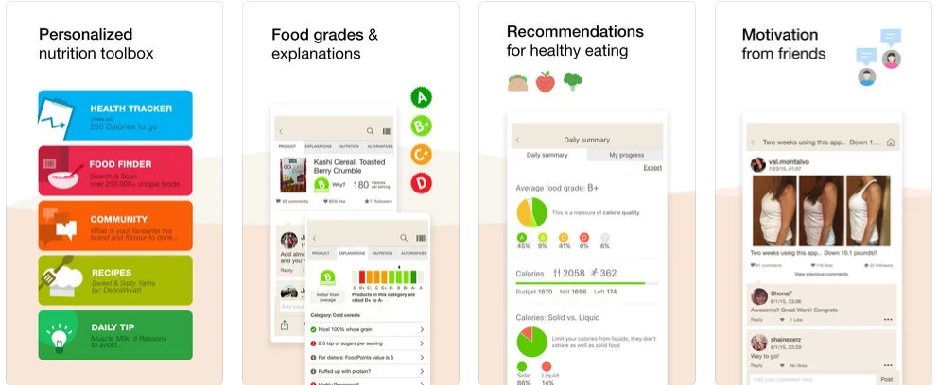
Fooducate https://www.fooducate.com/
Eat better. Lose weight. Get healthy.
Includes health tracker, diet tips, & trending recipes.

Slide 14

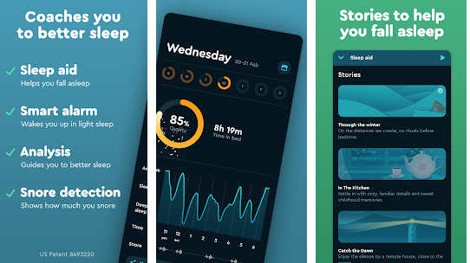
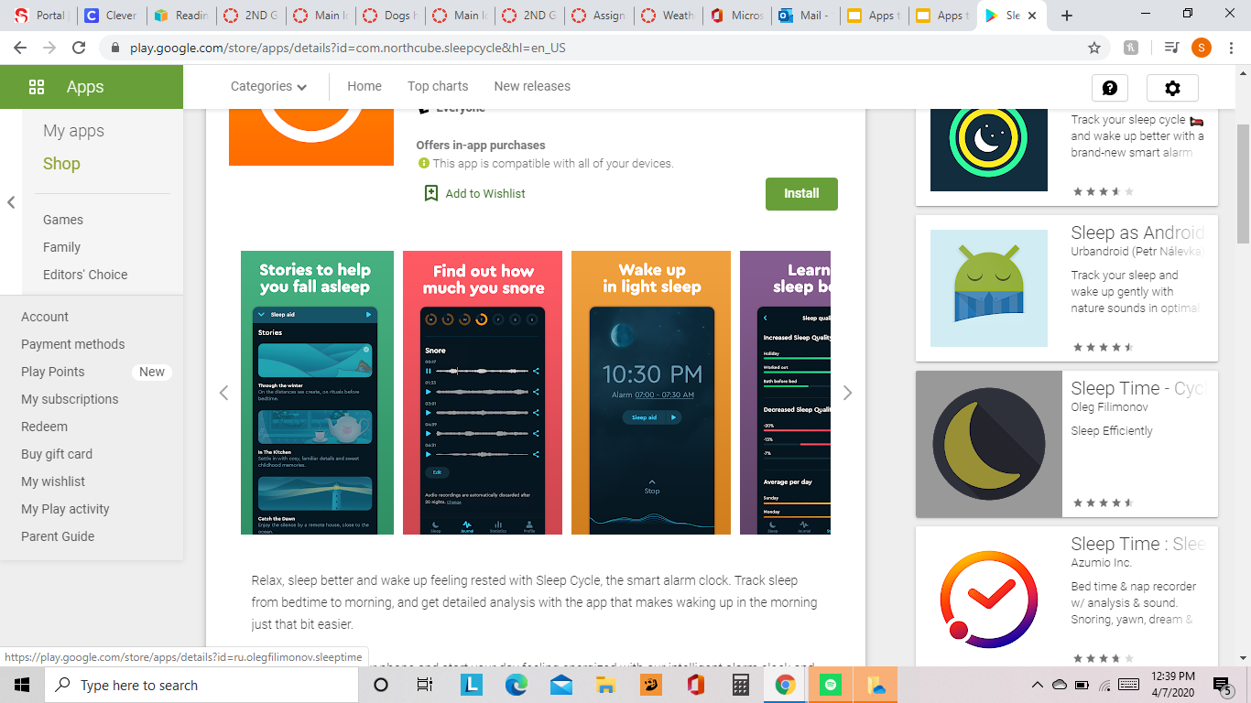
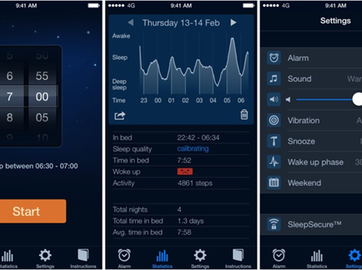
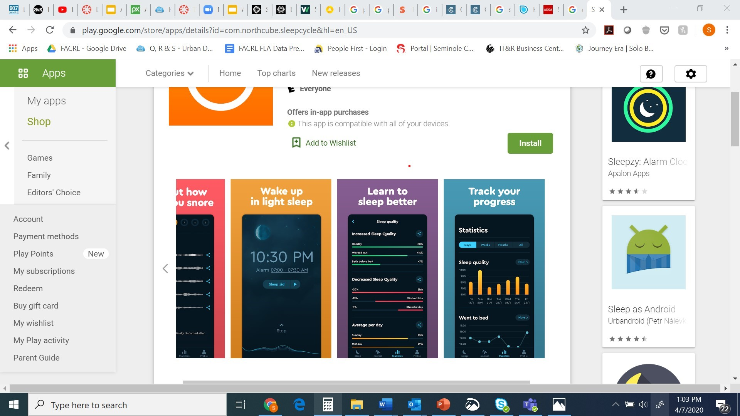
Let Sleep Cycle coach you to better sleep https://www.sleepcycle.com/
Notes:
The only app in the presentation that costs anything. Provides students with an alarm to help them maximize their potential for burning the midnight oil. I usually go into a story about knowing how many hours are needed for you to sleep- including getting up with a newborn infant.

Slide 15

Nike Training Club
https://www.nike.com/ntc-app?cp=34674701600_search_&gclid=CLfp3_yJ8OgCFVV6gQodUjgO_A&gclsrc=ds
Come Train With Us
The Nike Training Club app helps you reach your fitness goals with expertly designed workouts from our world-class Nike Master Trainers. NTC provides free workouts for everything from bodyweight-only sessions, invigorating yoga classes, targeted training programs, and full-equipment home workouts for all fitness levels.

Slide 16

Tickle your Spirit
Ready to learn a new skill with your free time?
Would you like to get lost in a famous museum?
Need some digital self-help that goes the extra mile?

Slide 17

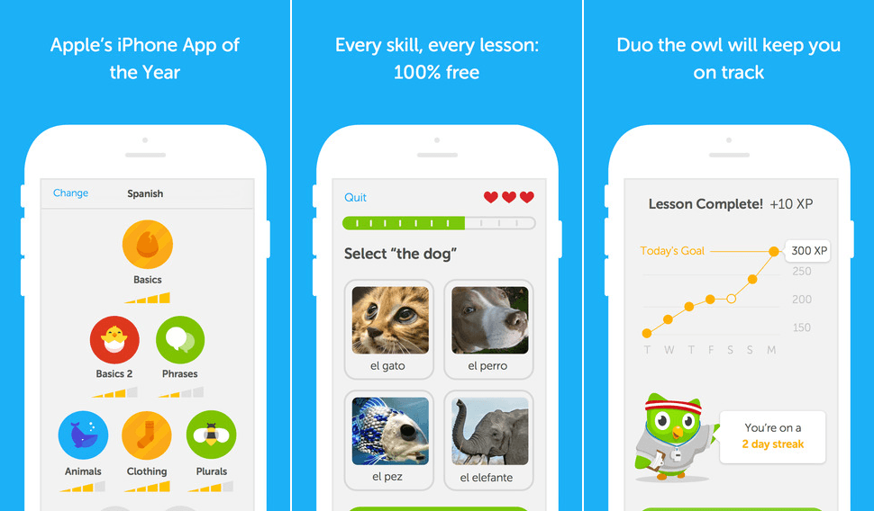
Learn a new language with Duolingo
https://www.duolingo.com/

Slide 18
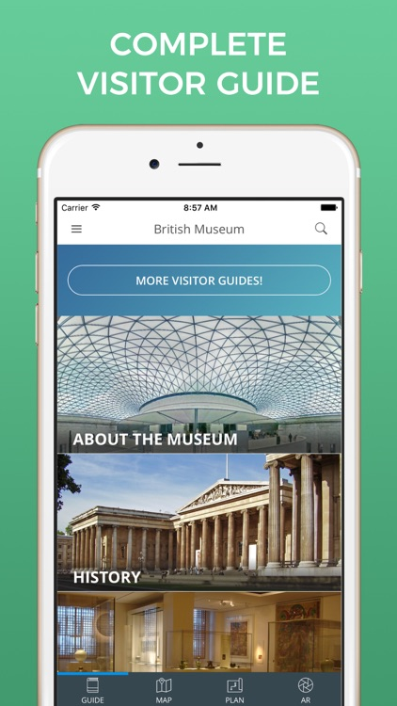
Musée du Louvre Official App https://www.louvre.fr/en/mediaapps/musee-du-louvre-official-app
If you’re craving culture in a time where travel is essentially prohibited, you can access beautiful artworks via your smartphone.
Explore hundreds of artworks and learn about their history as a way to enrich your self-isolation and inspire future travels.

Slide 19
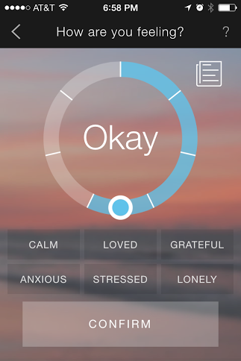

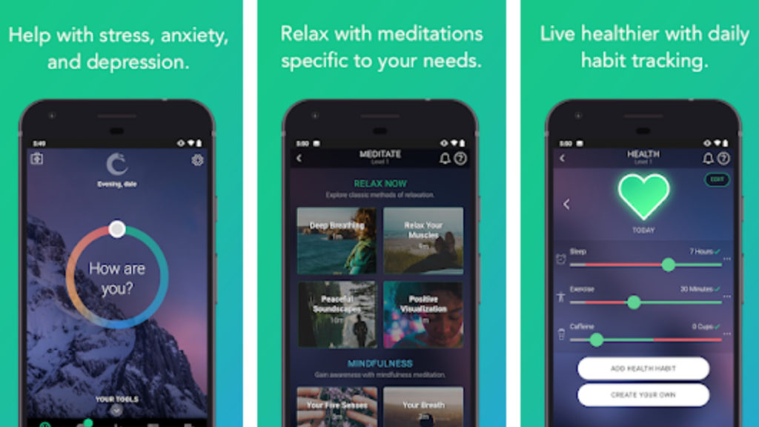
Pacifica
Self Help at its Best: Pacifica
https://www.youtube.com/watch?v=HljBbEN8rV0

Slide 20
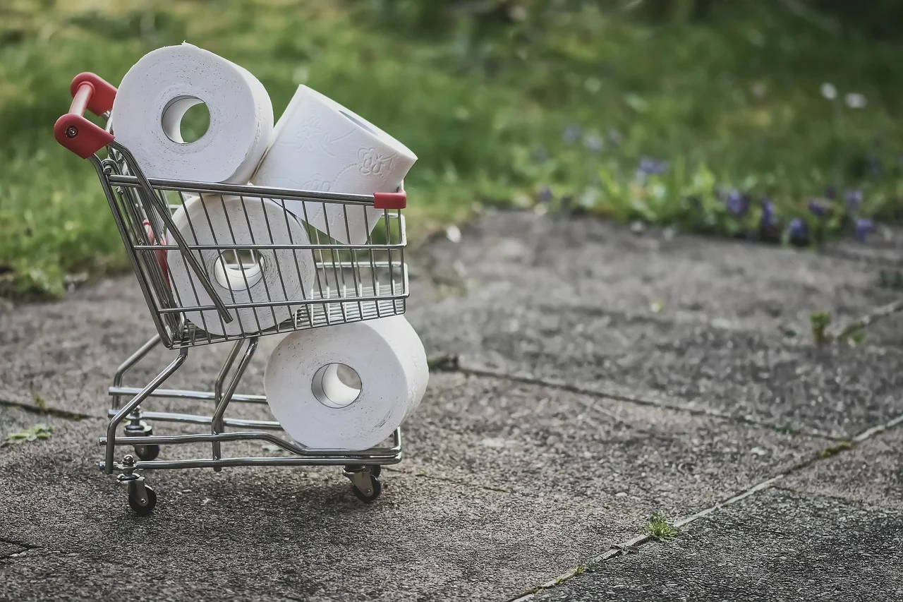
Thank you for your attention. Stay well, safe, & keep your sanity!!!
Go use an
app...
Now let’s hear about your favorite apps!
Notes:
I close with this….I hope you have enough toilet paper AND thank you for your attention! I enjoyed hearing about the mobile apps that you have been using to keep yourself afloat during this time. Be safe, stay healthy, and keep your sanity! Remember, you aren’t alone, use your mobile technology to “phone a friend” or to “reach out and touch someone.”

Slide 21
Slide References:
Slide 1: https://pixabay.com/photos/protective-mask-protection-duty-5021416/
Slide 2: https://pixabay.com/illustrations/quarantine-virus-coronavirus-4925797/
Slide 4: https://pixabay.com/photos/change-board-door-new-beginning-4056014/
Slide 5: https://pixabay.com/vectors/mask-virus-coronavirus-disease-4964590/
Slide 6: https://pixabay.com/photos/head-man-person-people-face-2379686/
Slide 6: https://pixabay.com/photos/skull-vertebrae-anatomy-bone-body-778073/
Slide 6: https://pixabay.com/photos/dream-catcher-dreamcatcher-feather-4065288/
Slide 7: https://pixabay.com/illustrations/face-soul-head-smoke-light-sad-622904/
Slide 11: https://pixabay.com/photos/family-artist-s-mannequin-figure-2755604/
Slide 15: https://pixabay.com/photos/feather-ease-airy-plumage-1598302/
Slide 19: https://pixabay.com/photos/shopping-toilet-paper-covid-19-4974738/

Slide 22

Contact Information
Please reach out to me with any questions or
to share a special app that is helping you get through quarantine.
Sandy Avila
Science Librarian
John C. Hitt Library
UCF Libraries
savila@ucf.edu

