Slide 1
Data Visualization: The What, Why, & How
Sandy Avila
Stay Savvy with Scholarly Communication
August 6th, 2020

Slide 2
Today’s Agenda
What is data visualization?
Why do we visualize data?
How do we visualize data?

Slide 3
What is data visualization?
Some standard definitions:
“ data visualization is anything that converts data sources into a visual representation.”
“...the graphic representation of data.”
Data Visualization is an umbrella term for the following:
Information visualization
Scientific visualization
Infographics
But not to be confused with Visual Analytics

Slide 4
Information visualization
“is the process of representing data in a visual and meaningful way so that a user can better understand it” & “it plays an important role in making data digestible and turning raw information into actionable insights”
Scientific visualization
“is the practice of producing graphical representations of scientific phenomena as a means of gaining understanding and insight into the data”
Infographics
“graphic visual representations of information, data, or knowledge intended to present information quickly and clearly”
The
Umbrella Terms

Slide 5
Why do we visualize data?
Visuals commit to long term memory easier than text
Visuals can tell stories
Visuals reveal patterns, trends, changes, and correlations
Visuals can simplify complex information....by processing information faster by the brain
“to convert slow reasoning tasks into fast perception tasks”
“to perceive relative difference....with pre-attentive processing”

Slide 6
Can you quickly tell me what the largest value on this screen is?
https://www.esri.com/videos/watch?videoid=1k7sryECatk&title=data-visualization-for-spatial-analysis

Slide 7
In looking at this same information, using length as the visual marker....the largest value is immediately evident.
https://www.esri.com/videos/watch?videoid=1k7sryECatk&title=data-visualization-for-spatial-analysis

Slide 8
So how long have we really been doing this?
Few, S. (2009). Now you see it: simple visualization techniques for quantitative analysis. Pg. 14

Slide 9
The End Goal for Why we Visualize Data
Few, S. (2009). Now you see it: simple visualization techniques for quantitative analysis. Pg. 12

Slide 10
How do we visualize data?

Slide 11
Ways we Symbolize Data- A Graphic Representation
https://www.esri.com/videos/watch?videoid=1k7sryECatk&title=data-visualization-for-spatial-analysis

Slide 12
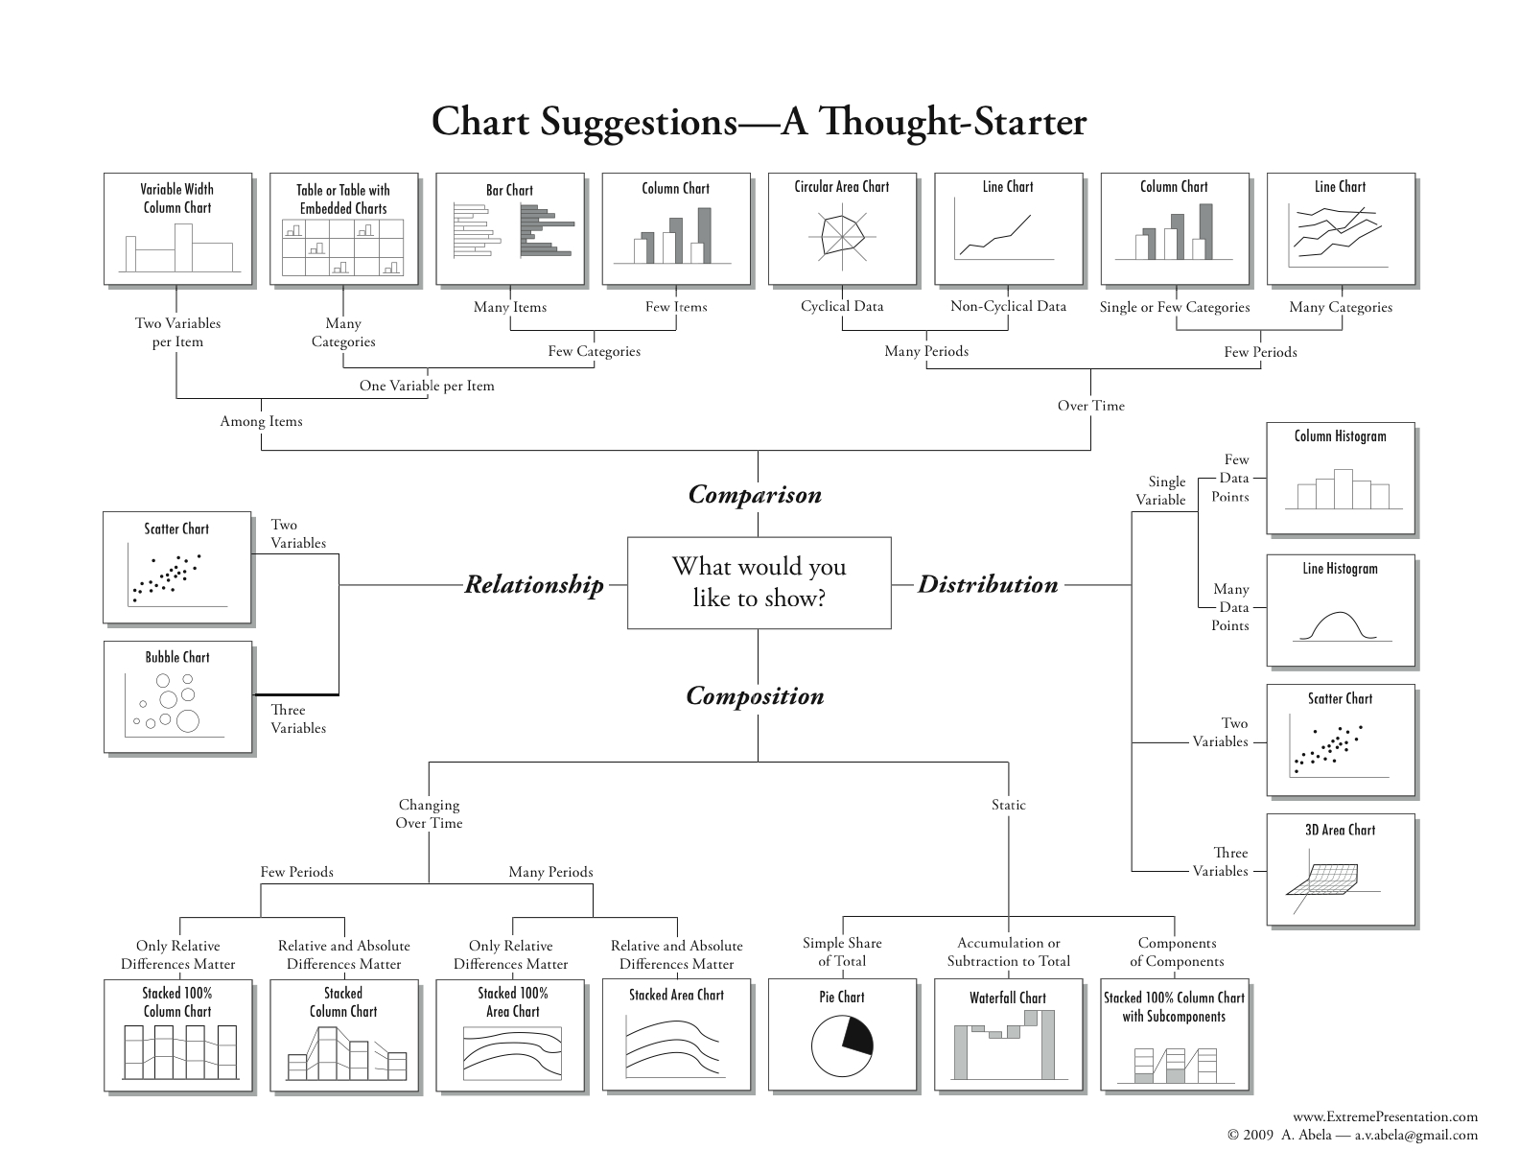
https://extremepresentation.typepad.com/.a/6a00d8341bfd2e53ef01b7c736487a970b-pi

Slide 13
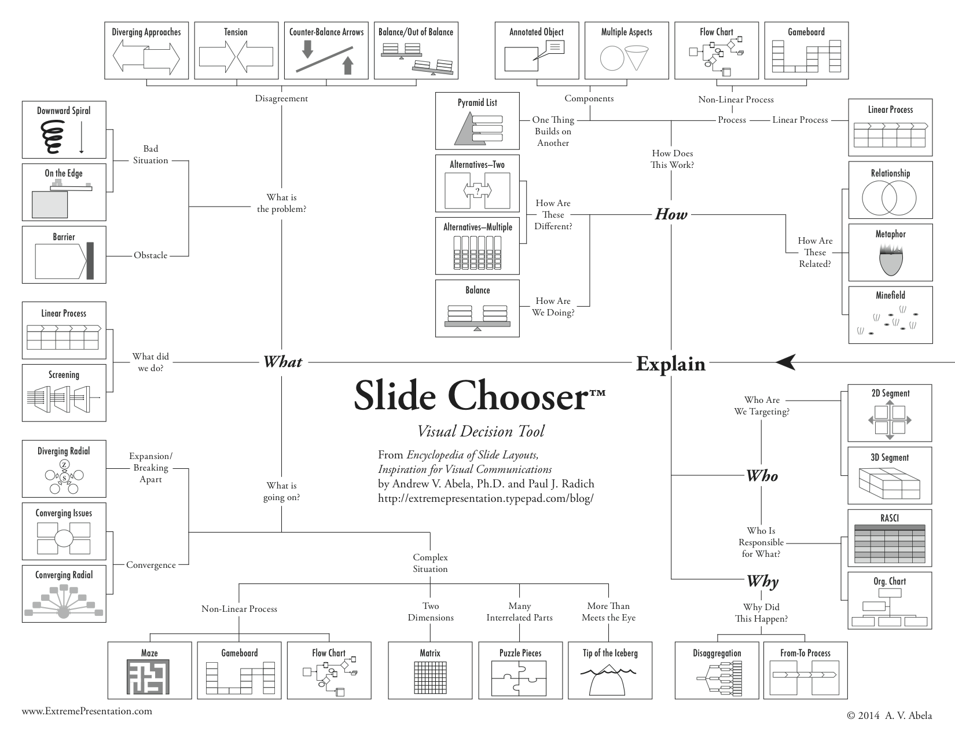
https://extremepresentation.typepad.com/.a/6a00d8341bfd2e53ef01b8d0bfb4ec970c-pi

Slide 14
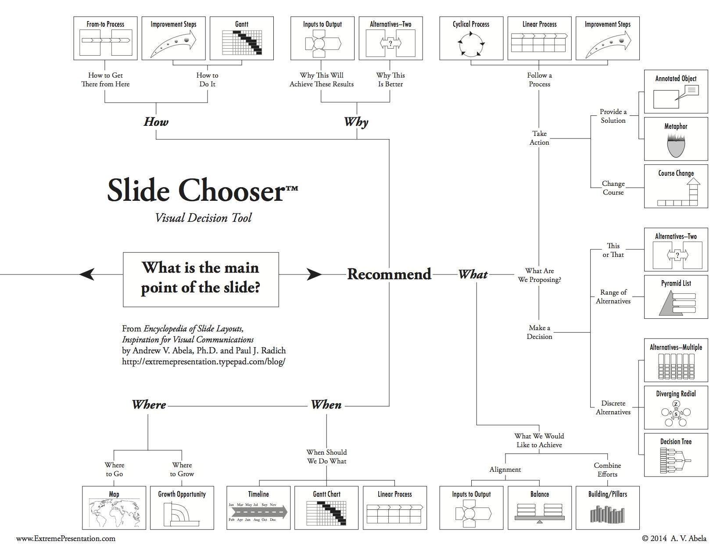
https://extremepresentation.typepad.com/.a/6a00d8341bfd2e53ef01b7c7364507970b-pi

Slide 15
Infographic Tools To Consider
Canva
https://www.canva.com/
Piktochart
https://piktochart.com/
Animaker
https://www.animaker.com/

Slide 16
https://www.youtube.com/watch?time_continue=13&v=RB2bjq-Wc4Y&feature=emb_title

Slide 17
https://www.youtube.com/watch?v=Eq-85gzw3GI

Slide 18
https://www.youtube.com/watch?v=ugw8vL3b7H8

Slide 19
R and R Studio
https://www.r-project.org/
https://rstudio.com/products/rstudio/download/
Tableau Public
https://public.tableau.com/en-us/s/
ArgGIS StoryMaps
https://storymaps.arcgis.com/
Data Visualization Tools To Consider

Slide 20
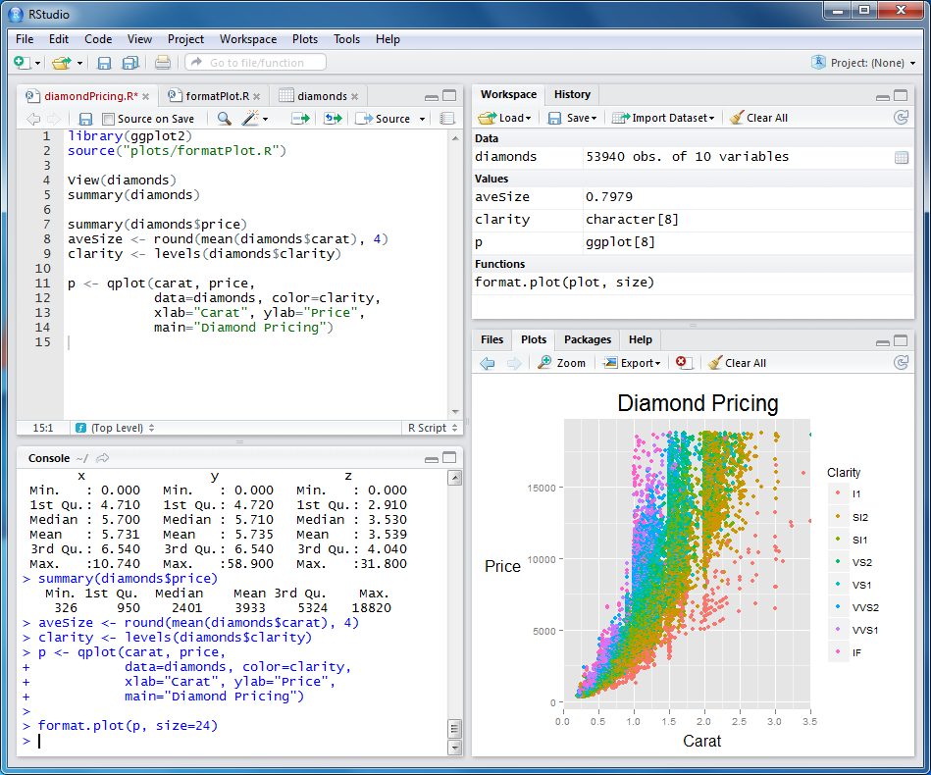
https://www.youtube.com/watch?v=kQYbt_4jCQQ

Slide 21
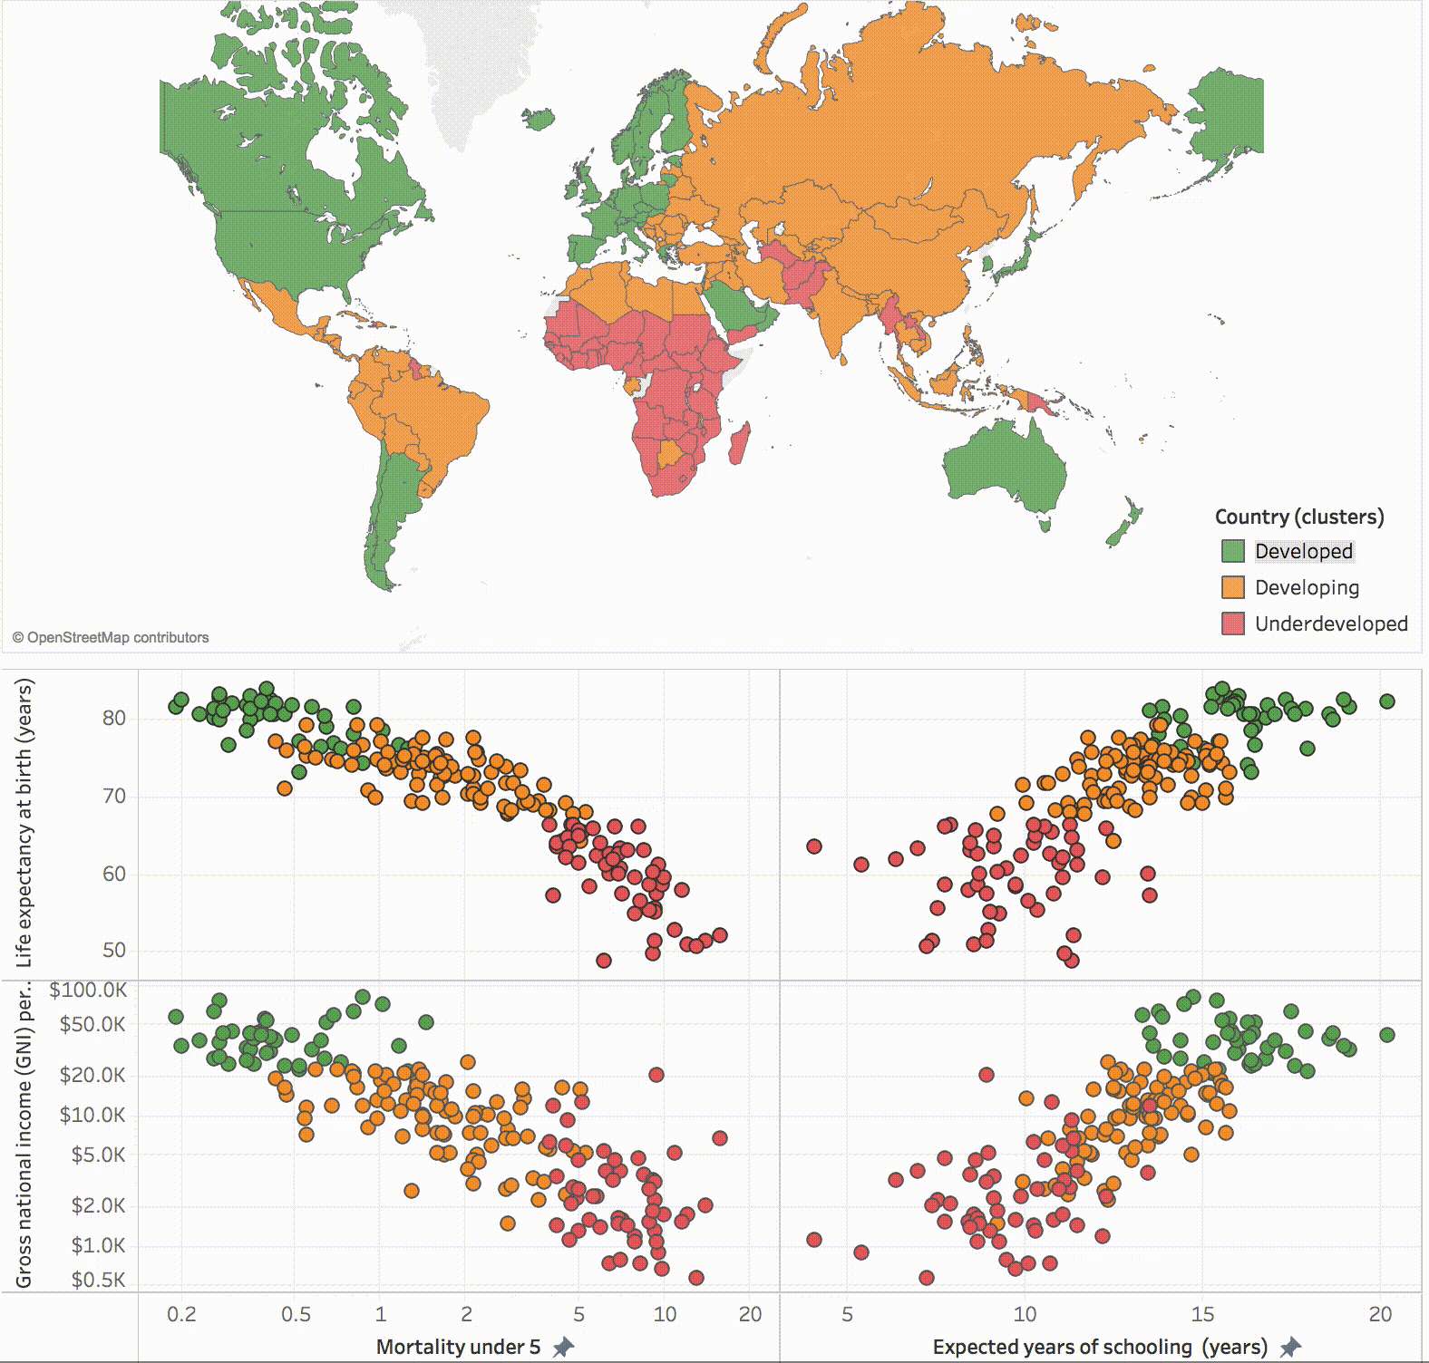
https://www.youtube.com/watch?v=QZBvkLHZwZE

Slide 22
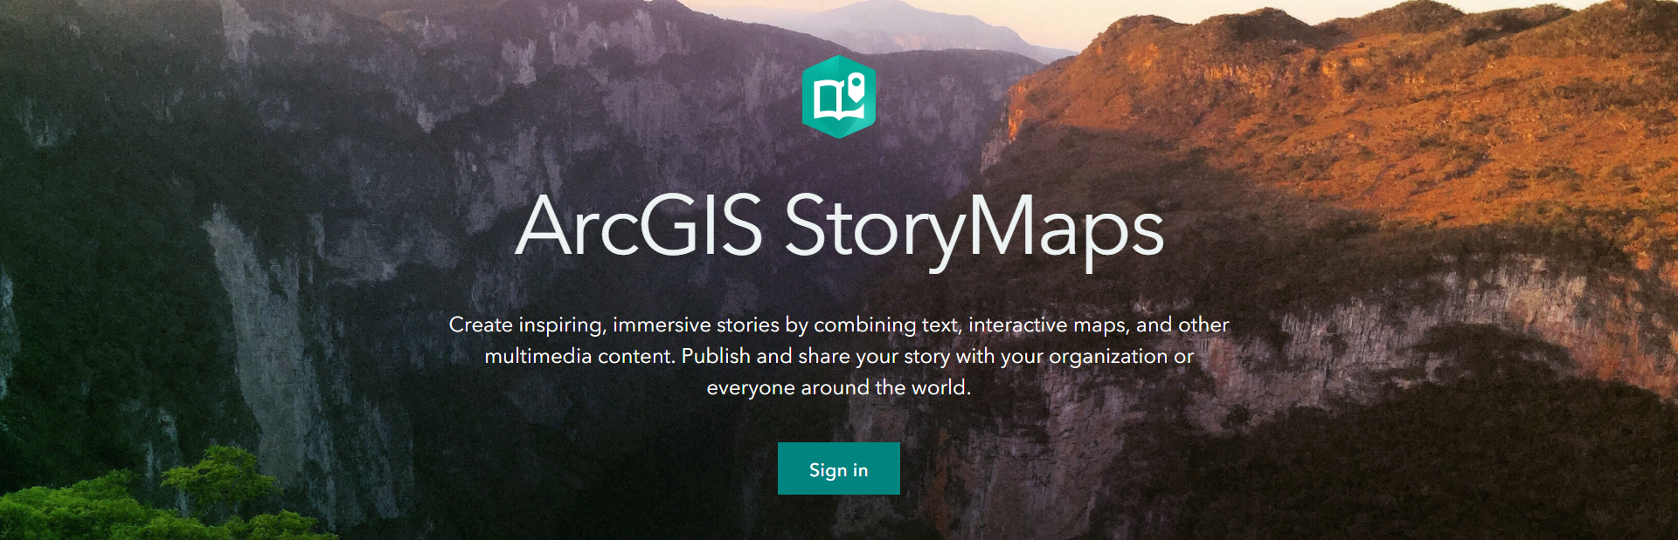
ArcGIS Story Maps
https://www.youtube.com/watch?v=Kl-J9GjieYM

Slide 23
Sources for the Best Data Visualization Reads Out There
The Top 18 Data Visualization Books That Should Be On Your Bookshelf
https://www.datapine.com/blog/best-data-visualization-books/
DataViz Books Everyone Should Read
https://informationisbeautiful.net/visualizations/dataviz-books/

Slide 24
References
University of Arkansas’ Introduction to Data Visualization Research Guide
https://uark.libguides.com/dataviz
ESRI Video: ESRI 360-Data Visualization for Spatial Analysis
https://www.esri.com/videos/watch?videoid=1k7sryECatk&title=data-visualization-for-spatial-analysis
Few, S. (2009). Now you see it: simple visualization techniques for quantitative analysis. Analytics Press.
Chart Suggestions- A Thought Starter
https://extremepresentation.typepad.com/.a/6a00d8341bfd2e53ef01b7c736487a970b-pi
Slide Chooser- A Visual Decision Tool
https://extremepresentation.typepad.com/.a/6a00d8341bfd2e53ef01b8d0bfb4ec970c-pi
The Top 18 Data Visualization Books That Should Be On Your Bookshelf
https://www.datapine.com/blog/best-data-visualization-books/
DataViz Books Everyone Should Read
https://informationisbeautiful.net/visualizations/dataviz-books/

Slide 25
Thanks for your attention!
Sandy Avila
Science Librarian
Sandy.Avila@ucf.edu
Feel free to reach out to me if you have any questions!

