Slide 1
Adapting to Faculty & Student Needs for Data and Support
for Social Justice and Other Projects
Sarah A. Norris, Scholarly Communication Librarian - Presenter
Contributors:
Corinne Bishop, Social Sciences Librarian
Sandy Avila, Science Librarian
Ven Basco, Engineering Librarian
Lee Dotson, Digital Initiatives Librarian
University of Central Florida Libraries
RDAP Summit 2021 - March 11, 2021

Slide 2
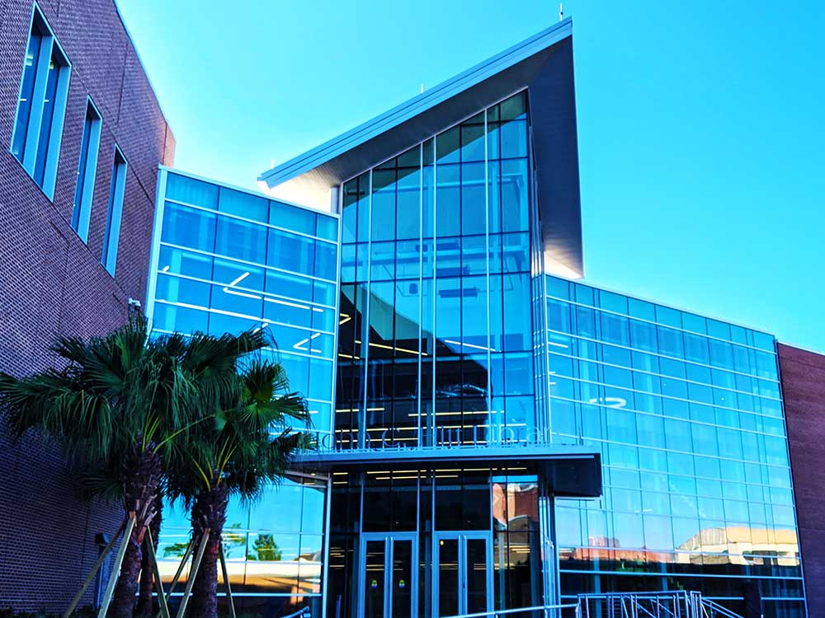
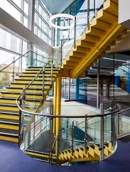
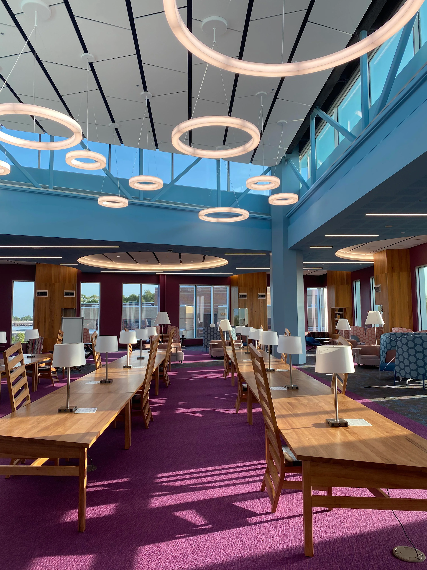
About the University of Central Florida
One of 12 public universities in the state
Located about 10 miles east of downtown Orlando
69,525 students¹
UCF was ranked top 20 most innovative universities in the US and placed top 50 in best undergraduate teaching and undergraduate research by U.S. News & World Reports in Sept. 2020²
1. Fall 2019 https://www.ucf.edu/about-ucf/facts/
2. https://www.ucf.edu/news/ucf-ranks-among-nations-top-20-most-innovative-universities/

Slide 3
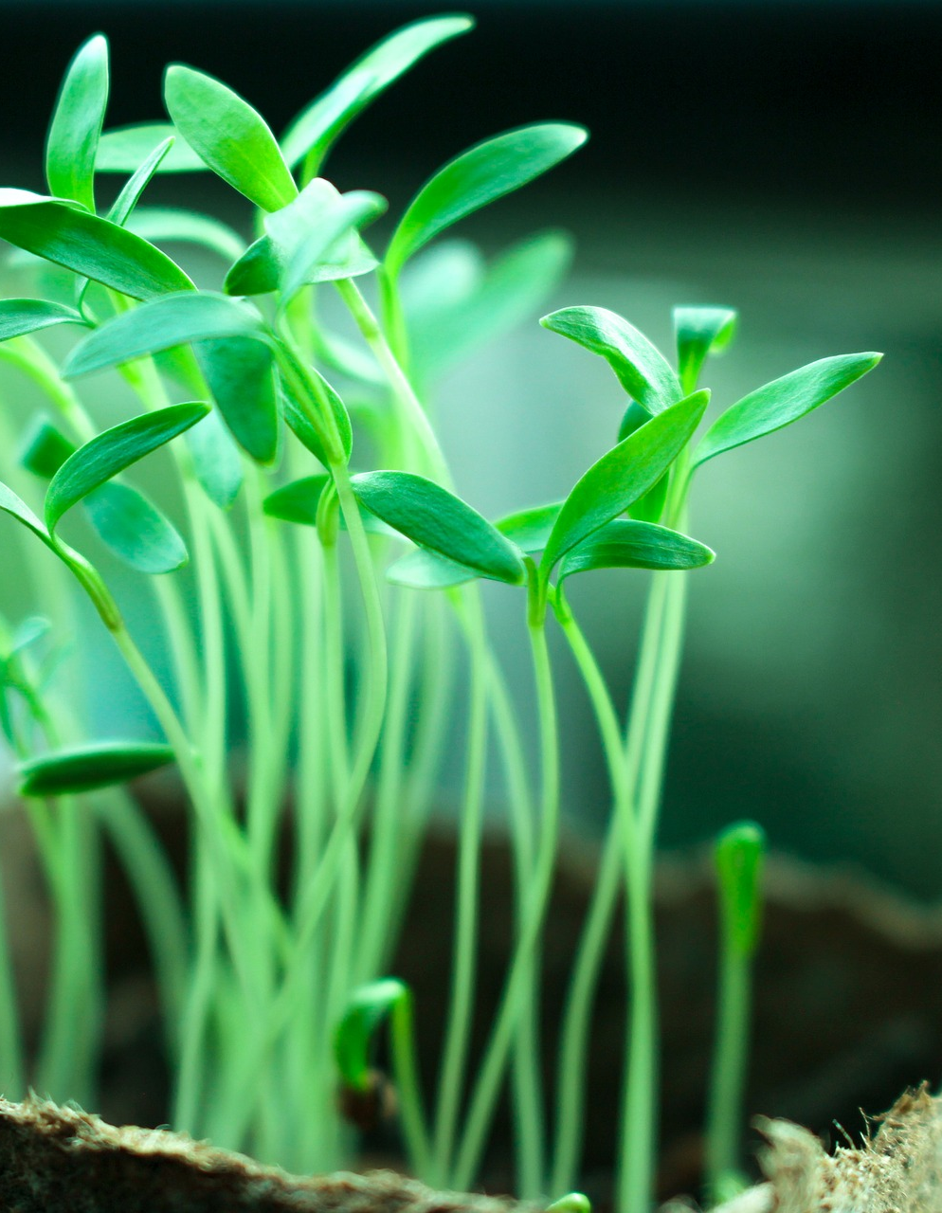
Data Support through UCF Libraries
Grassroots efforts
No formal data librarians or roles within the library
Some librarians have data-related areas that aligned with their roles but are not dedicated positions
Group of librarians that work together to support researchers in data-related needs

Slide 4
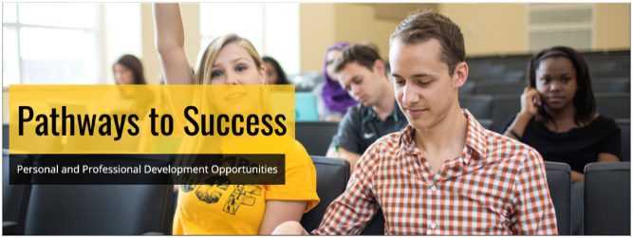
Working Group & Campus Partners for Data Support
UCF Libraries (STEAM) Working Group:​
Subject Liaisons​
Scholarly Communication Librarian​
Digital Initiatives Librarian​
Key Campus Partners:
College of Graduate Studies
College of Sciences
Graduate Research & Information Technology (GRIT)

Slide 5
How Working Group Developed
Various activities happening concurrently over the years…
Subject specific support
Professional Development
Workshops
Examples of activities include:
Digital Initiatives & Engineering Librarians offering NSF workshops on DMP Tool through the Office of Research for over 10 years
Graduate Workshops through the College of Graduate Studies
Office of Scholarly Communication professional development series, “Stay Savvy with Scholarly Communication” includes data topics (since 2015)
Science & Engineering Librarians interest & engagement with Data Services through conference participation led to the formation of the broader working group

Slide 6
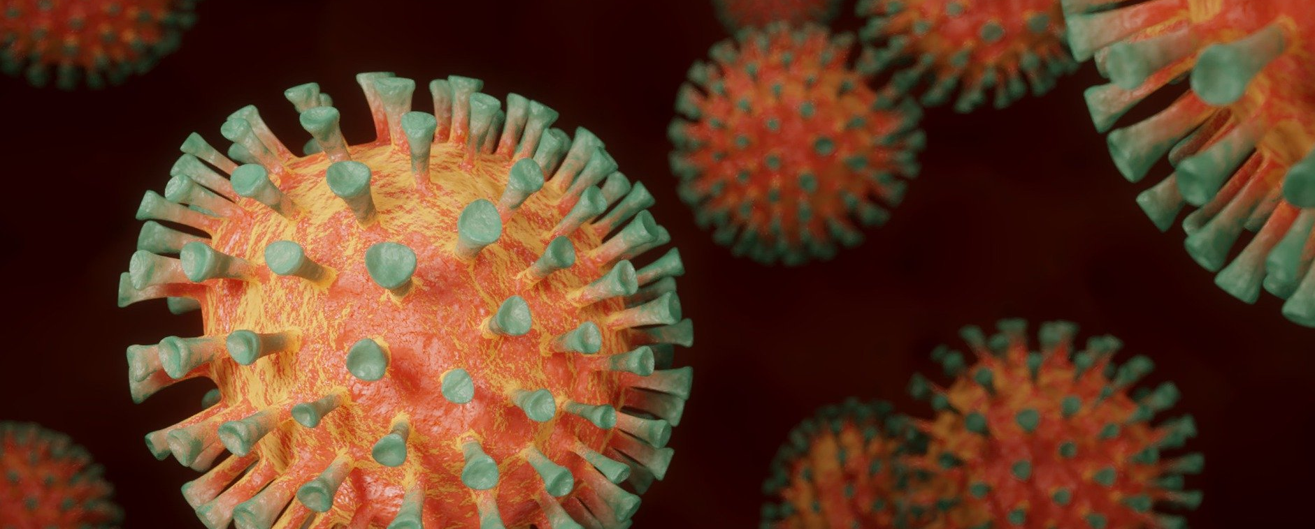
COVID-19 & Public Health Data

Slide 7
UCF COVID-19 Data & Statistics

Slide 8
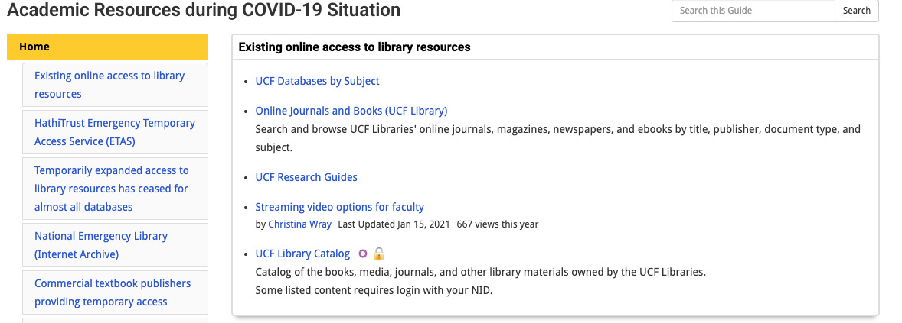
UCF Libraries COVID-19 Resources

Slide 9
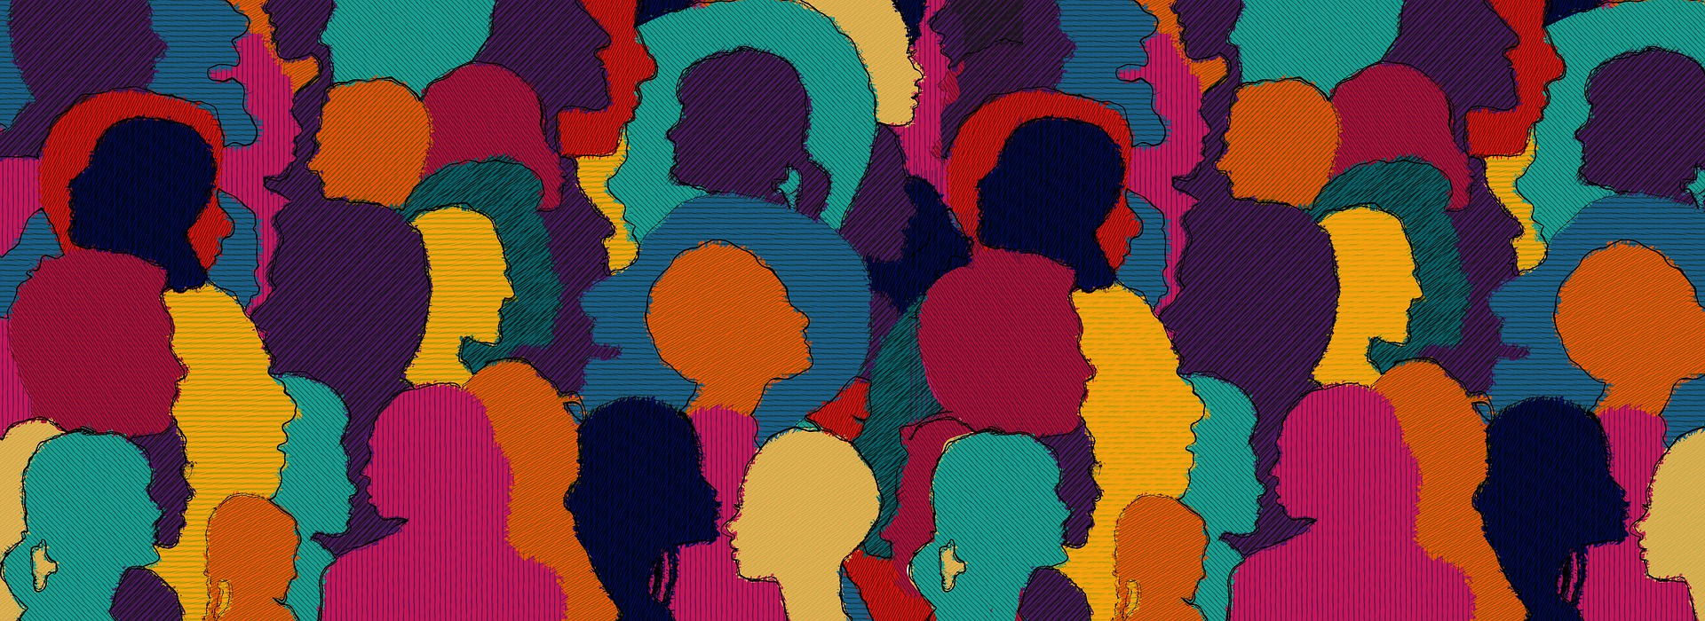
Data & Support Needs for Social Justice

Slide 10
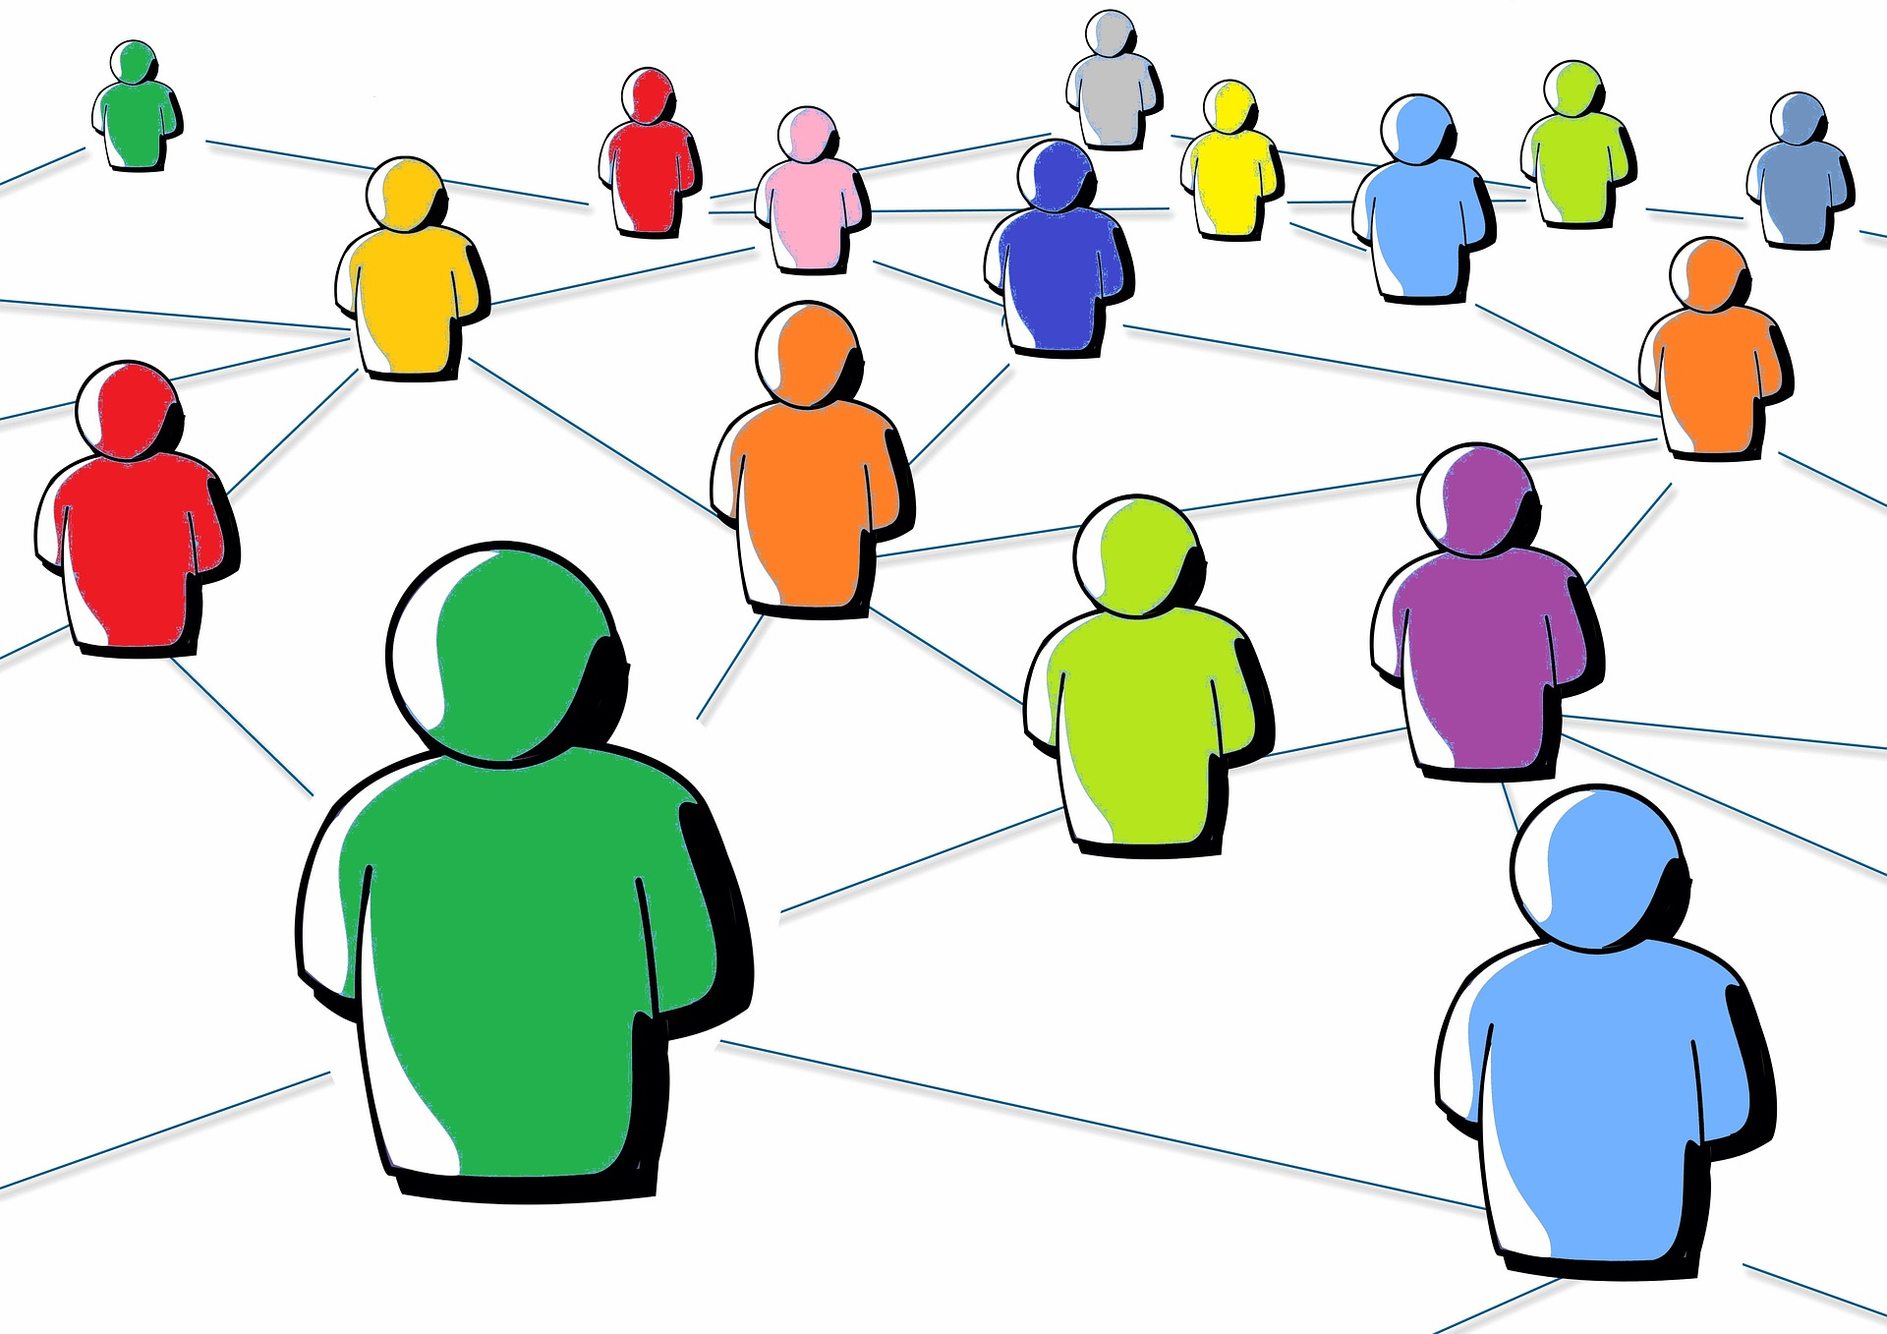
Faculty Collaboration

Slide 11
School of Public Administration (SPA) Social Justice Research Guide
*Key aim of Public Administration is preparing students to manage and design government and nonprofit services that support the aims of social justice and awareness of the issues surrounding access and equity within the professions.
Created in Spring 2021 by Corinne Bishop, subject librarian
Requested by SPA faculty committee (committee also provides input on guide)
Goal was to help identify resources related to social justice at the University of Central Florida Libraries
Tool to support resource discovery for faculty & students across programs
Brings together resources from Libraries’ collections and data resources associated with issues of diversity and inclusion, environmental justice, gender and racial disparities, and the intersection of these topics with policy and society
https://guides.ucf.edu/spasocialjustice

Slide 12
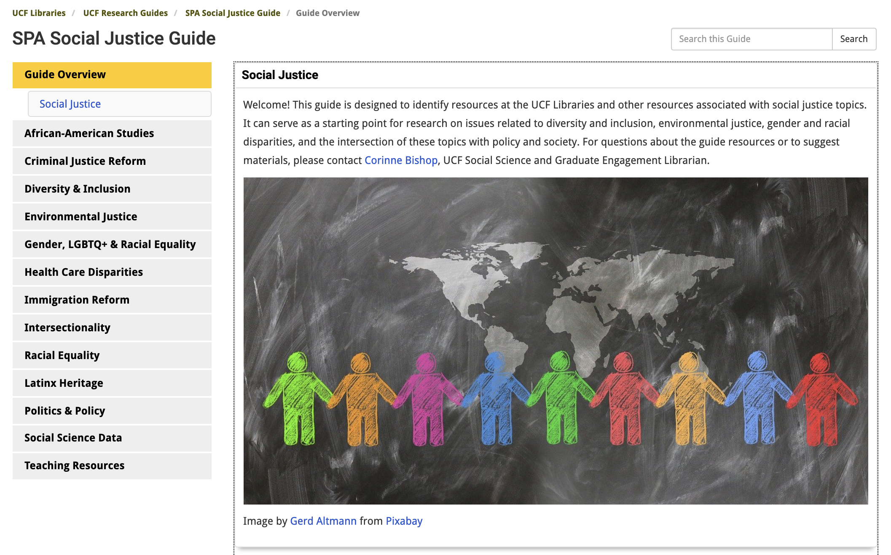

Slide 13
Library Projects

Slide 14
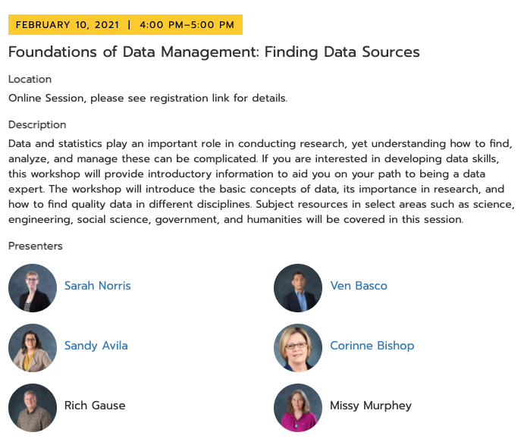

Slide 15
Open Access Resources for Activism & Social Justice - Research Guide
Open Access Research Guide redesign - summer / early fall 2020
Launched during OA Week 2020
Opportunity to examine the existing information & incorporate new topics
Humanities librarian developed OA resources for activism & social justice in the guide
Incorporated aspects of data & open data

Slide 16
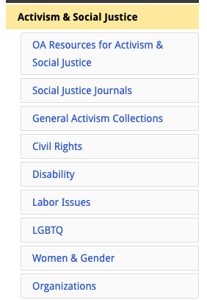
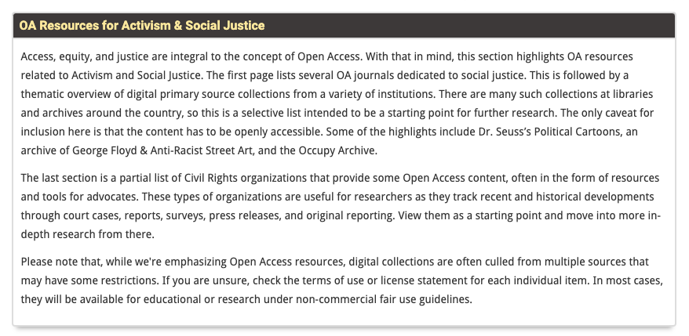
https://guides.ucf.edu/oa

Slide 17
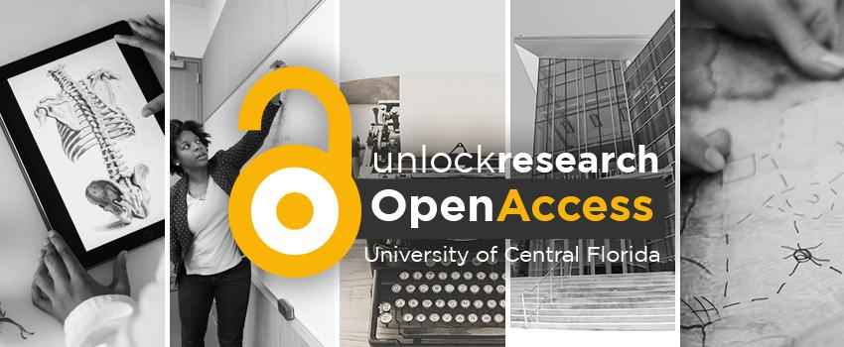
Open Access Week

Slide 18
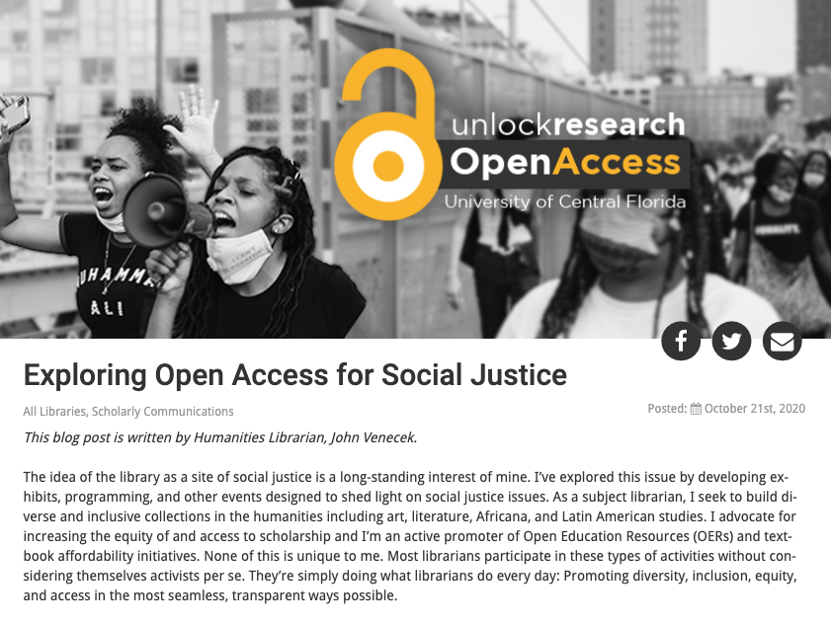

Slide 19
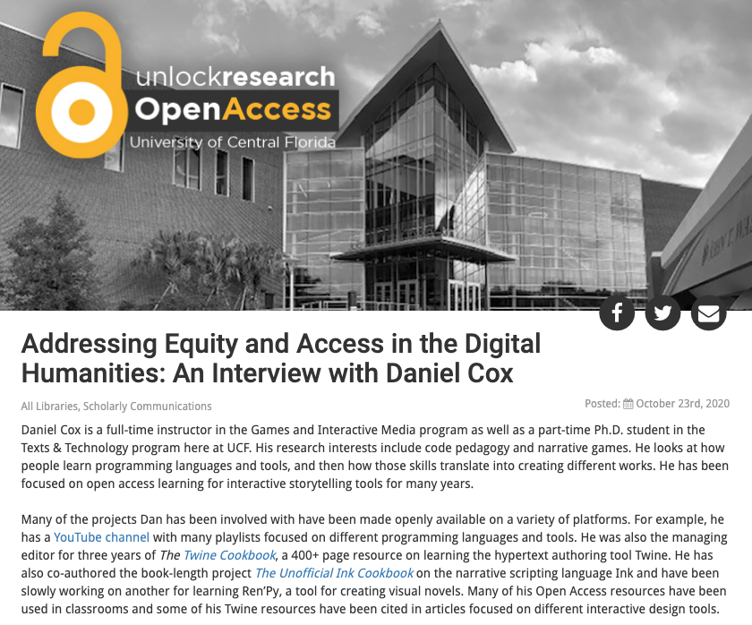

Slide 20
Final Thoughts

Slide 21
Public Domain Image References
shimulnath (Photographer). (2017, June 17). No title [digital image]. Retrieved from https://pixabay.com/photos/plants-tree-green-tree-planting-2411458/
BlenderTimer (Photographer). (2020, March 27). No title [digital image]. Retrieved from https://pixabay.com/photos/coronavirus-corona-virus-pandemic-4972480/
geralt (Photographer). (2017, September 19). No title [digital image]. Retrieved from https://pixabay.com/illustrations/diversity-people-heads-humans-5582454/
civilservicelocal (Photographer). (2017, May 15). No title [digital image]. Retrieved from https://pixabay.com/illustrations/social-media-social-networks-2314696/
geralt (Photographer). (2020, May 3). No title [digital image]. Retrieved from https://pixabay.com/illustrations/network-web-digital-5113947/
Open access logo [digital image]. Retrieved from https://commons.wikimedia.org/wiki/File:Open_Access_logo_PLoS_white.svg
geralt (Photographer). (2017, September 3). No title [digital image]. Retrieved from https://pixabay.com/photos/question-question-mark-board-school-2709670/
Manuchi (Photographer). (2017, July 1). No title [digital image]. Retrieved from https://pixabay.com/illustrations/background-abstract-line-2462431/

Slide 22
Thank you! Any questions?
Feel free to contact our team
Sandy Avila
Science Librarian
savila@ucf.edu
Ven Basco
Engineering & Computer Science Librarian
buenaventura.basco@ucf.edu
Corinne Bishop
Social Sciences & Graduate Engagement Librarian
corinne.bishop@ucf.edu
Lee Dotson
Interim Department Head / Technology Solutions & Digital Initiatives
lee.dotson@ucf.edu
Sarah A. Norris
Scholarly Communication Librarian
sarah.norris@ucf.edu

