Slide 1
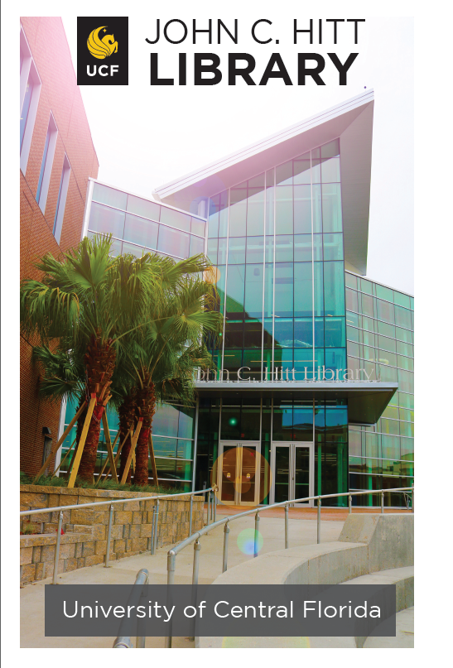
Improvisation in Improbable Times: Pivoting to a Tele-Reference Service Model
University of Central Florida Libraries
Sandy Avila
Richard Harrison
Sarah Norris
Min Tong

Slide 2
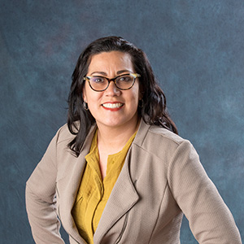
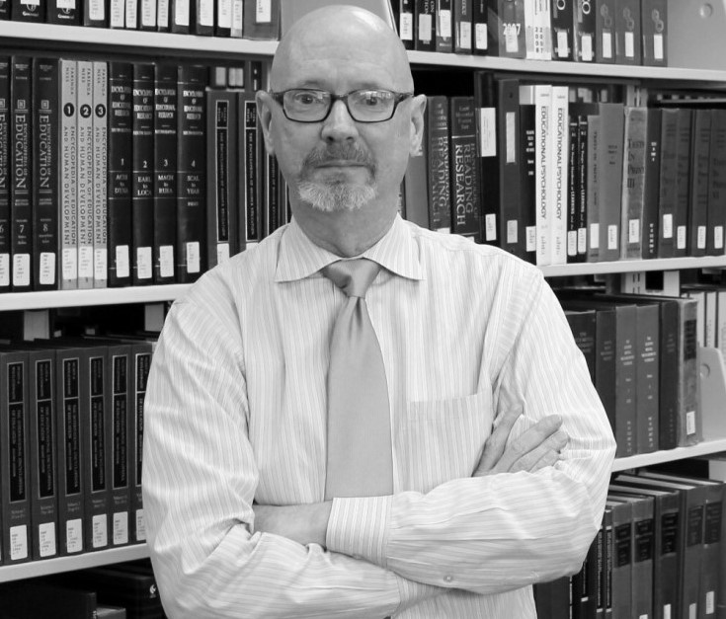
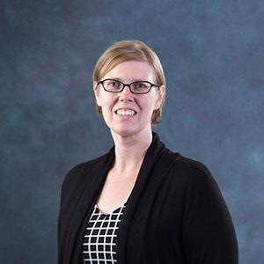
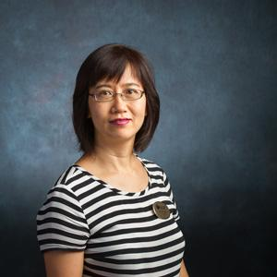
About the Presenters
Sandy Avila
Science Librarian
Richard Harrison
Humanities Librarian
Sarah Norris
Scholarly Communication Librarian
Min Tong
Business Librarian

Slide 3
Outline
About UCF
Background of the Tele-Reference Model
How a Tele-Reference Model works
Challenges & Opportunities
Q&A

Slide 4
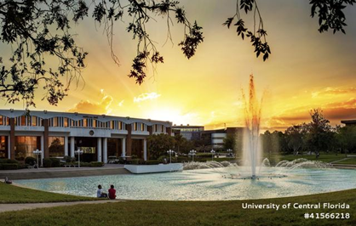
About UCF
One of 12 state public universities in FL
Located about 13 miles east of downtown Orlando
71,948 students (2nd largest university in enrollment)⭑
13 colleges and more than 230 degree programs
* Fall 2020 Enrollment

Slide 5
About UCF Libraries’ Staff & Campuses
64 full time library staff
37 full time non-tenure faculty librarians
4 library administrators also holding faculty librarian status
Serving across 8 campus libraries around Central Florida
Main Campus- John C. Hitt Library (main library)
Main Campus- Curriculum Materials Center
Downtown Campus- Downtown Campus Library
Rosen School of Hospitality Management- Rosen Library
UCF Connect Campuses- Daytona State College, Cocoa, Valencia College & Seminole State College

Slide 6
Research & Information Services Reopening Task Force
Internal Task Force Created in June of 2020 for
Reopening RIS’ Research & Information Desk (RAID)
(Department Head, 3 Coordinators)
*UCF Libraries was closed to the public between March 2020 until August 2020
Task: Make recommendations regarding RAID – hours of service, staffing protocols, safety measures, etc.
Considerations:
RIS staff must be able to participate fully in AAPD (job description) assignments
Age or health profiles of RIS staff that prevent them from working onsite or have small children enrolled in home-based online education
RIS staff concerns about “physical distancing” behind RAID
RIS staff concern with “mask fatigue” for staff members at RAID
Physical presence at the RAID service point- 1 of 3 in the library on 2nd floor

Slide 7
Before Implementation of Tele-Reference
In July 2020, an onsite demo was established for internal testing
Official name “Tele-Reference” was proposed and adopted
Beta testing was scheduled for all RIS Librarians to staff the virtual desk (July 27 – August 14, 12 noon – 3 pm)
Encouraged managers and staff from Government Docs, Circulation, LibTech, Interlibrary Loan, and Special Collections, to stop by RAID during the beta-testing to provide real-world scenarios and questions to test system out
Feedback requested from everyone in the library

Slide 8
Additional Considerations Ahead of Implementation
Survey of the other 10 State University Libraries in Florida yielded that NO library in the state was providing this type of service and ALL were providing Ask a Librarian service only via chat, phone, or text as their reference desks were closed to patrons
Email from UCF Associate Vice President and Chief HR Office in August of 2020:
“We must be prepared to handle requests made in person, as well as requests that may require staff to work onsite to fulfill them. To provide these services, all UCF offices need to begin providing an appropriate physical presence during regular business hours.”

Slide 9
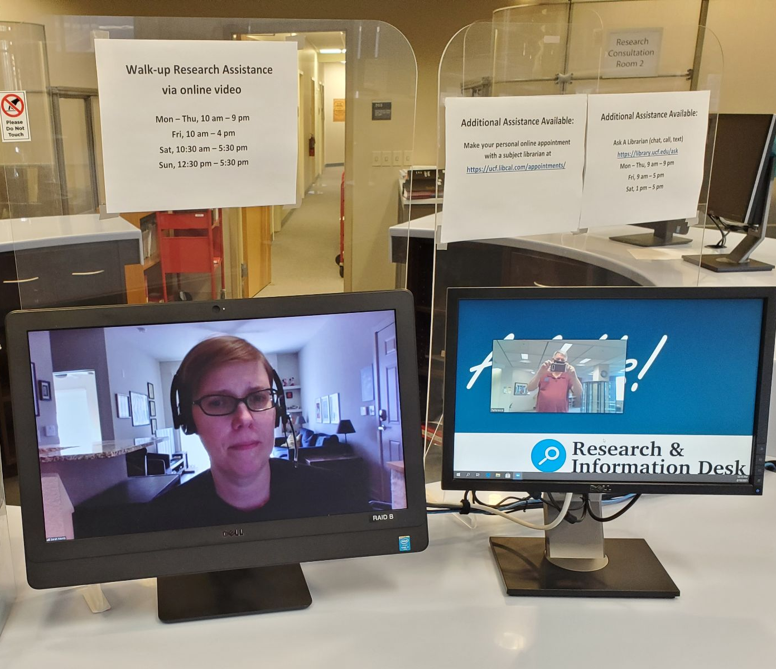
How Tele-Reference Works
Staffing:
Remote librarian or adjunct librarian
On-call / in-person librarians (2 daily)
1 hr shifts (with some 2-3 hour shifts)
NEW Position! In-person Reference Ambassador
Helps direct assistance at desk
Can answer basic directional, informational questions
Physically distanced to help ensure safety (also other measures like plexiglass)
Notes:
Add in shifts (1-2 hours)

Slide 10
How Tele-Reference Works
Technology:
Zoom*
Runs continuously on-site during reference hours
Remote access requires login
Both on-site and off-site technology setups needed
Stable Internet connection
Computer monitors (dual use monitors on-site and recommended for off-site)
Audio (mic) and video capabilities
*Current university license for Zoom is through end of 2021.

Slide 11
How Tele-Reference Works
Training & Resources:
Basic training on how to use Zoom
Emphasis on logging in and out to help make shift transitions easy and seamless
Also covered:
Turning audio and web cameras on and off
Optimal settings for audio/video
Mute and unmuting
Using virtual backgrounds
Screensharing considerations (i.e. sharing entire desktop versus a specific browser or application)
LibGuide (Password protected)
Includes Zoom login information
Ready Reference information
On-Call contact information
Quick Instructions (1-page PDF with basic info, link to LibGuide, etc.)

Slide 12
How Tele-Reference Works

Slide 13
Benefits & Opportunities
Continued reference support throughout the COVID-19 pandemic
Allows users to receive assistance at the moment of need
Tele-Reference allows librarians to work in a safe and socially distanced environment
Change in the mode of reference service well received based on LibInsights data

Slide 14
Challenges
Staff skepticism/reluctance to adopt Zoom for reference assistance
Patron accessibility
Technology issues
Software
Hardware
Library laptop availability

Slide 15
Thank you! Any questions?
Feel free to contact our team
Sandy Avila
Science Librarian
savila@ucf.edu
Richard Harrison
Humanities Librarian
richard.harrison@ucf.edu
Sarah A. Norris
Scholarly Communication Librarian
sarah.norris@ucf.edu
Min Tong
Business Librarian
min.tong@ucf.edu

