Slide 1
Copyright in a Post-COVID World:
How Remote Teaching Has Informed Copyright and Licensing Support
Sarah A. Norris, Scholarly Communication Librarian
University of Central Florida Libraries
Kraemer Copyright Conference 2021 - June 8, 2021
Notes:
The COVID-19 pandemic rapidly changed the teaching environment and has provided both challenges and opportunities for copyright and licensing support. This lightning talk will reflect on the public health crisis’ impact on online teaching, explore copyright and licensing challenges faced by educators, share examples from the University of Central Florida, and provide best practices and tips for outreach and support for those who facilitate copyright information at their institution. It will also reflect on how the pandemic has provided increased interest in open access materials, including openly licensed works and open educational resources, and it will also highlight solutions, such as Controlled Digital Lending, that support online teaching in new and innovative ways.

Slide 2
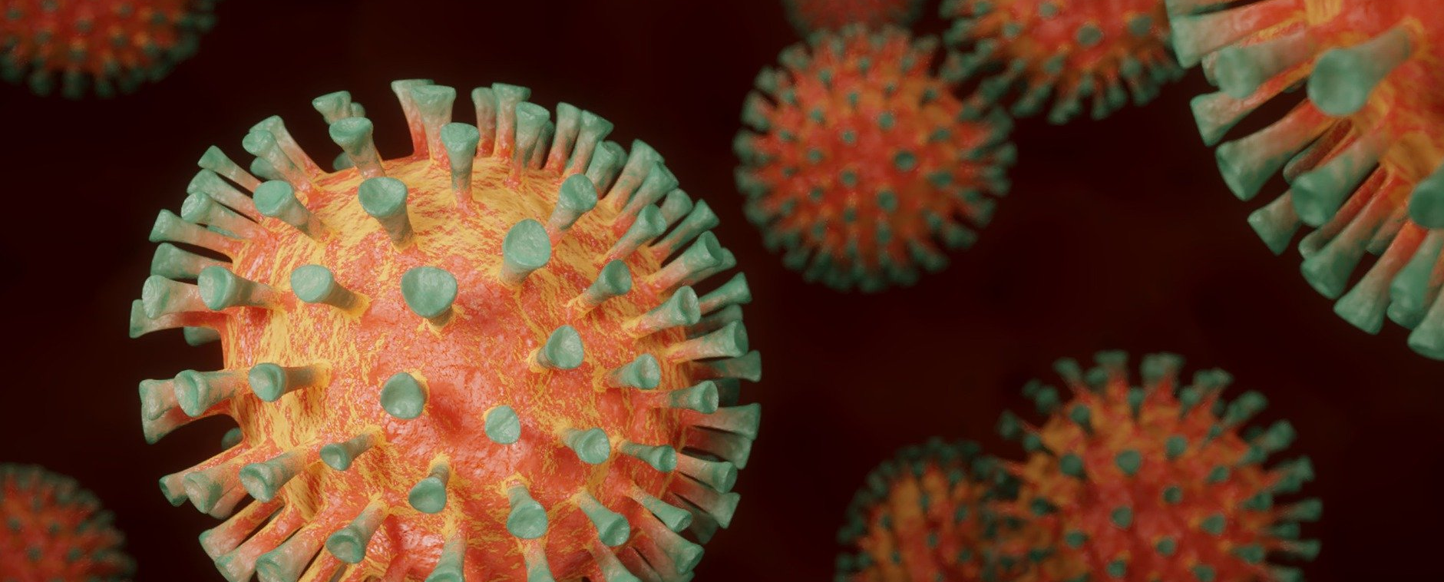
COVID-19, Remote Access & Work & Copyright

Slide 3
COVID-19 Impacts on Remote Teaching & Learning
Faculty new to online teaching
Lack of training and/or experience in online teaching
Lack of understanding of copyright law and/or nuances for online teaching versus face-to-face
Courses not optimized for online teaching
Adapting swiftly to meet the needs of an online course (with or without assistance from an institution)
Lack of access to print materials
Common question: Can I scan and upload an article, book chapter, textbook to my online course for my students?
Challenges with e-resources
eBooks & streaming video licenses
Information & resource overload
What can or can’t you upload or link to in your online course?
Stressors of the global pandemic

Slide 4
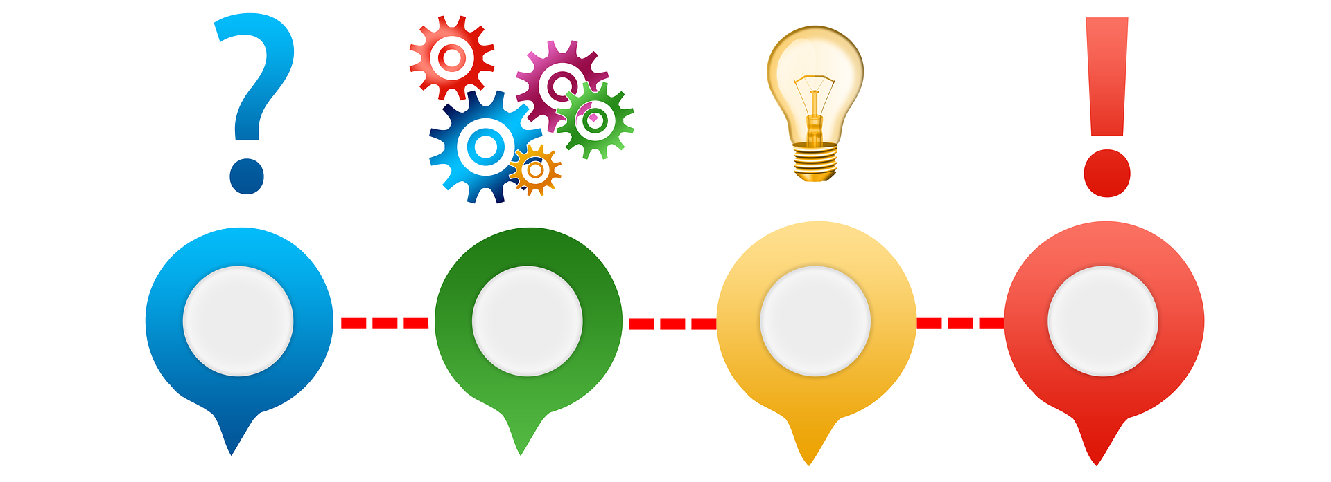
Copyright Rapid Response
Local copyright triage
Listserv discussion on copyright & emergency circumstances
Copyright professionals coming together
Resources on Copyright & Emergency Remote Teaching & Research https://tinyurl.com/v6dvmcb
Public Statement of Library Copyright Specialists: Fair Use & Emergency Remote Teaching & Research: https://tinyurl.com/tvnty3a
Rapidly Shifting Your Course from In-person to Online: https://www.lib.umn.edu/copyright/rapidly-shifting-a-course-online

Slide 5
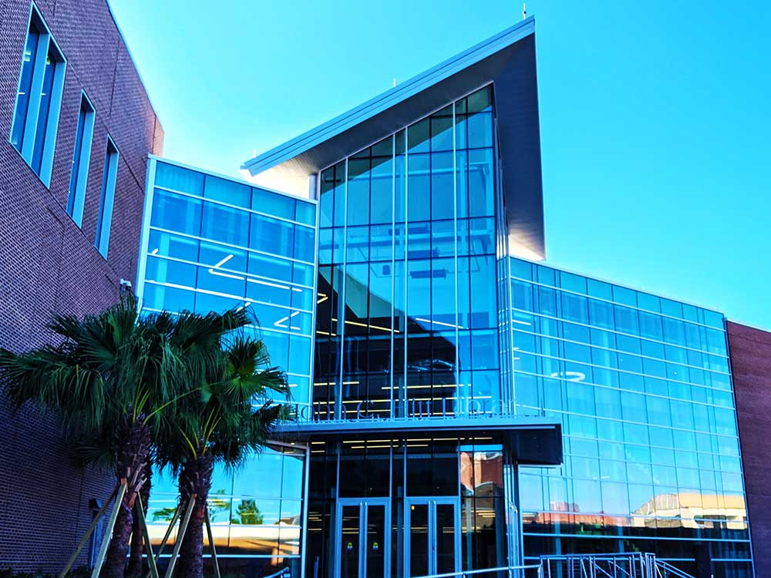
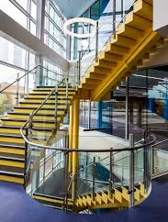
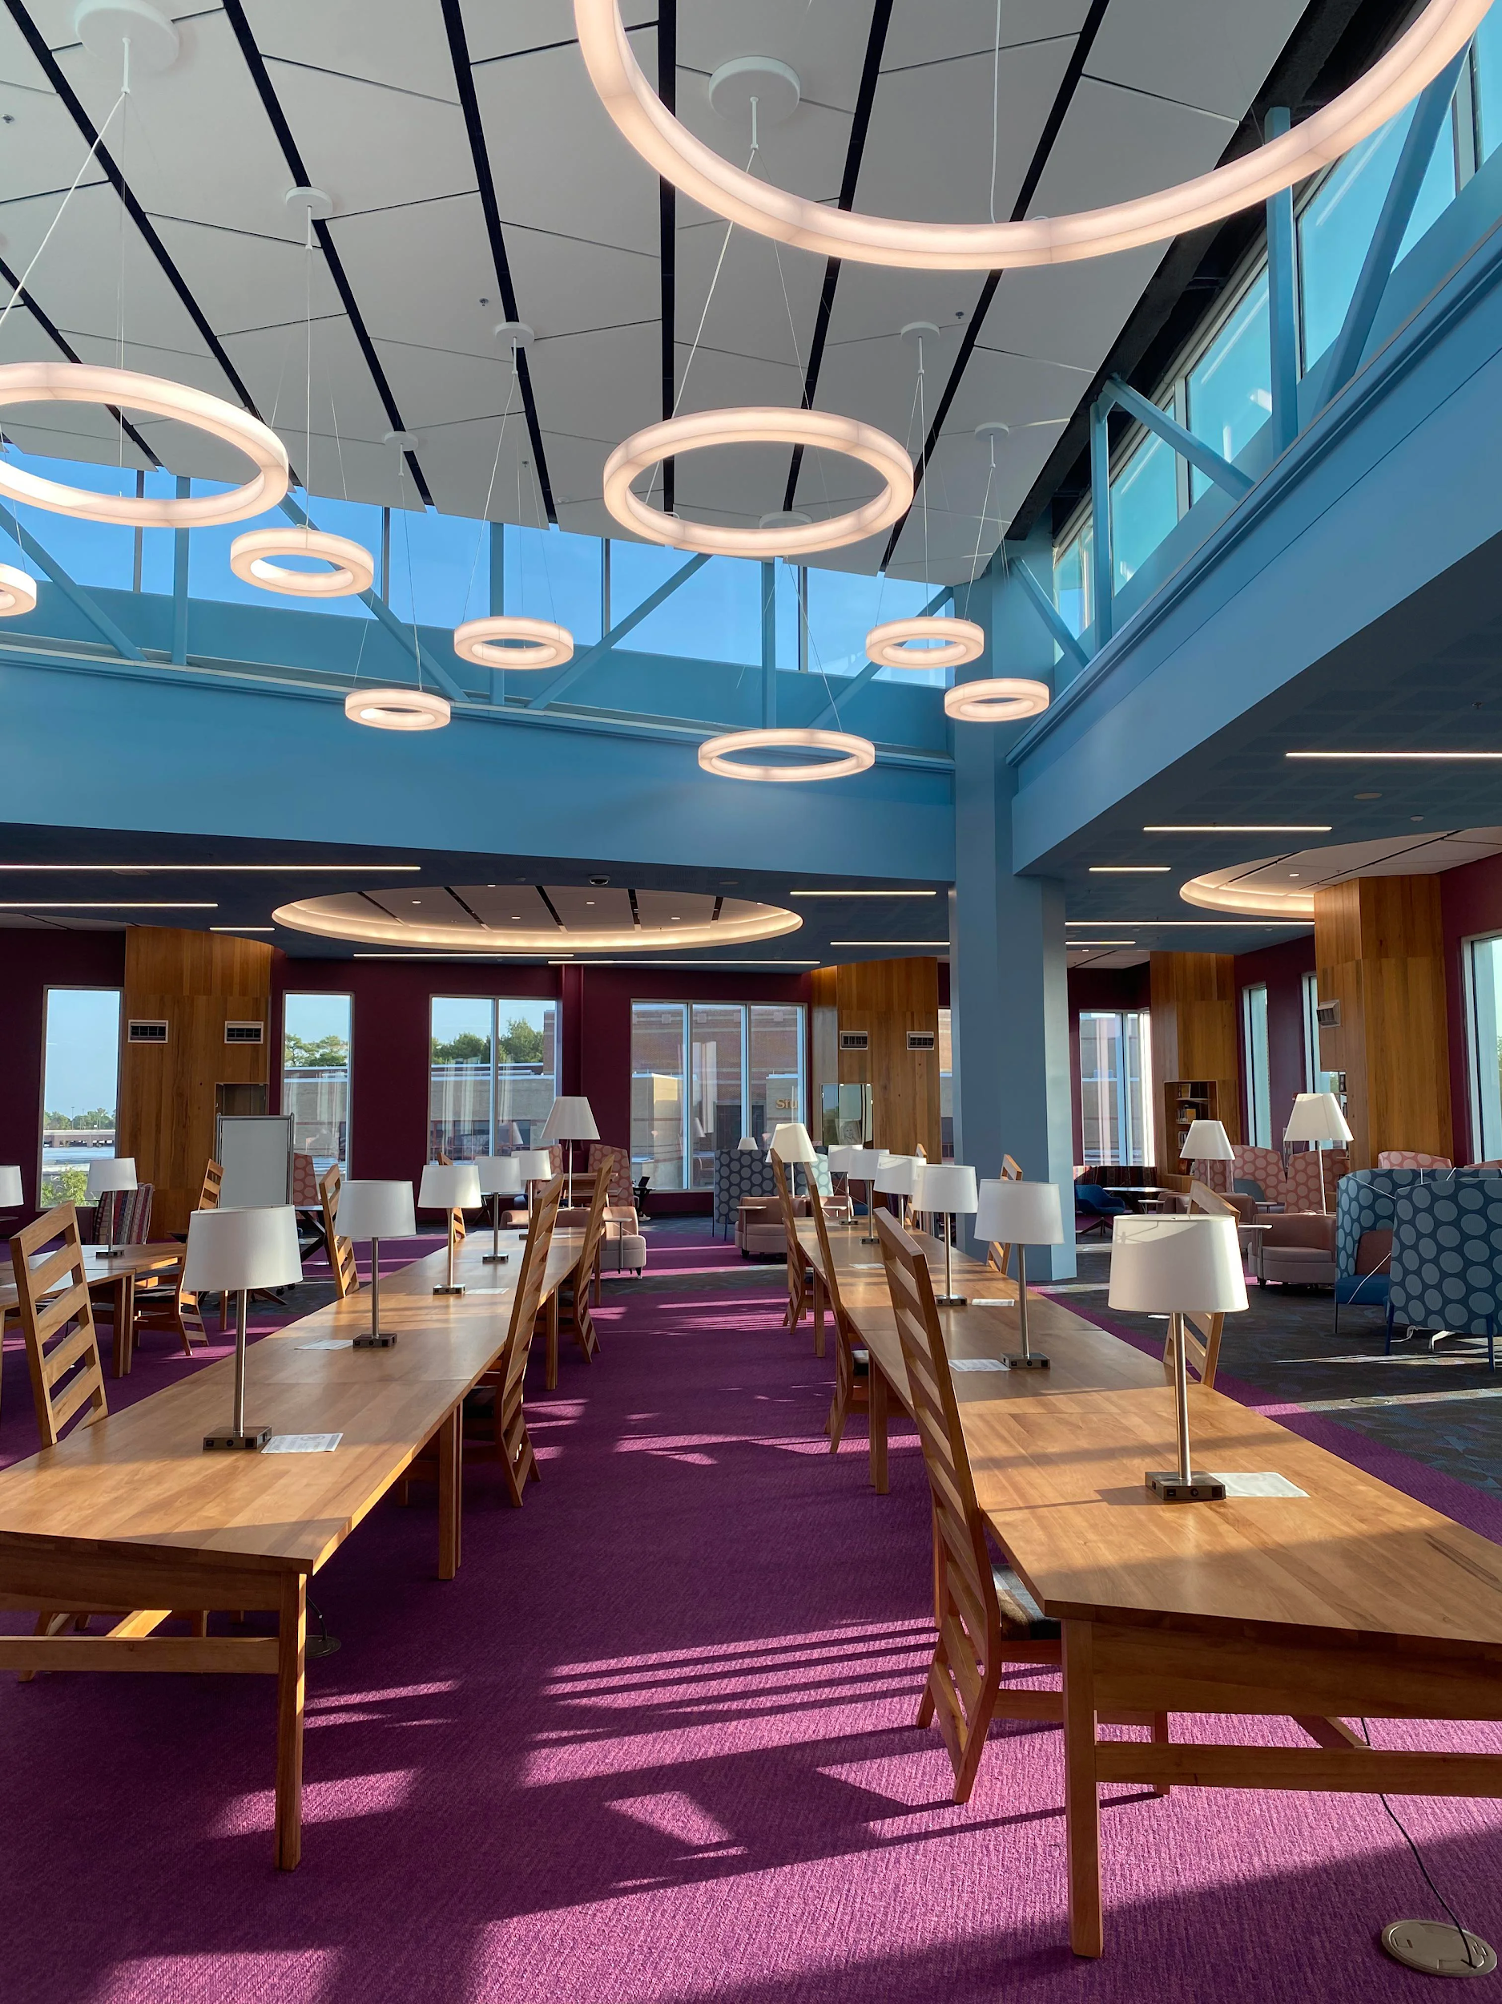
About the University of Central Florida
One of 12 public universities in the state
Located about 10 miles east of downtown Orlando
69,525 students¹
UCF was ranked top 20 most innovative universities in the US and placed top 50 in best undergraduate teaching and undergraduate research by U.S. News & World Reports in Sept. 2020²
1. Fall 2019 https://www.ucf.edu/about-ucf/facts/
2. https://www.ucf.edu/news/ucf-ranks-among-nations-top-20-most-innovative-universities/

Slide 6
UCF Libraries Copyright Support
Provides general information on copyright for teaching, research & scholarship
Queries, consultations, workshops, etc.
Reviews licensing for e-resources, journal packages, databases, etc.
Works with the Office of General Counsel:
Licensing review & approval
Faculty queries within the course of their employment
Librarians involved in copyright & licensing:
Scholarly Communication Librarian
Discovery Services Librarian
Government Information Librarian
Head of Interlibrary Loan
And others...

Slide 7
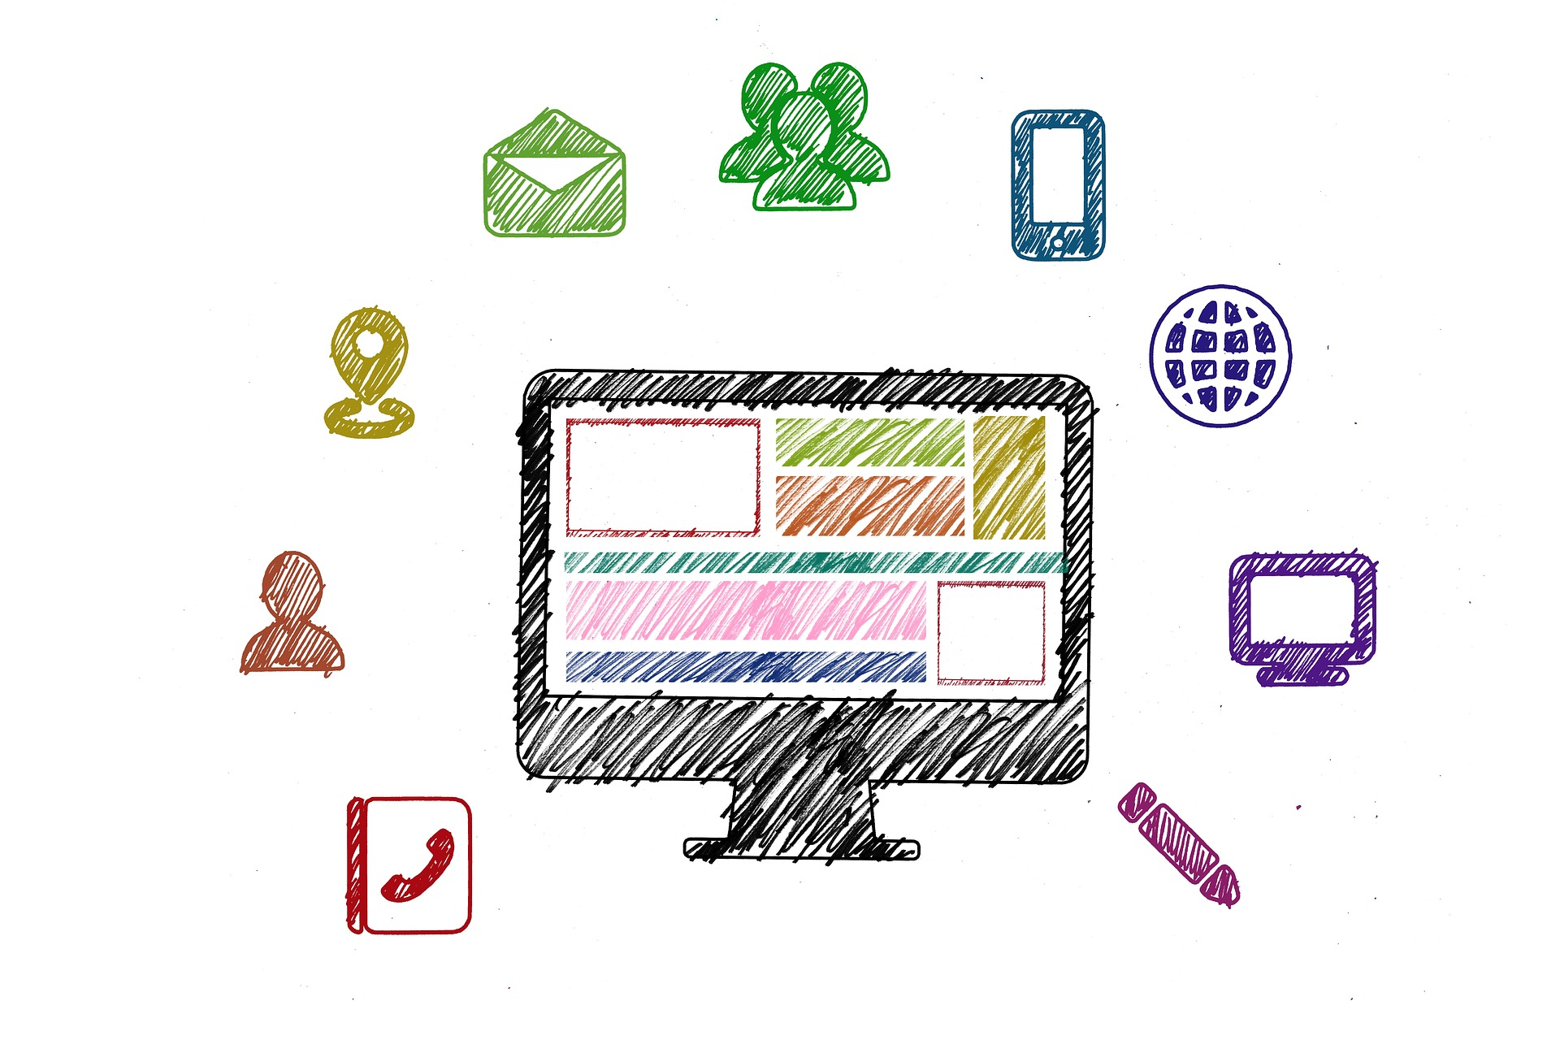
Copyright Support During COVID-19
Initial Response:
Triaged critical copyright questions for teaching (first month)
Discussed with Office of General Counsel copyright & fair use support for rapid transition to online teaching
Provided general information and resources about copyright for remote teaching and access
Academic Resources during COVID-19 Situation LibGuide
Sample verbiage for subject librarians to send to their faculty
Instituted virtual office hours via Zoom
(April 2020 - May 2021)

Slide 8
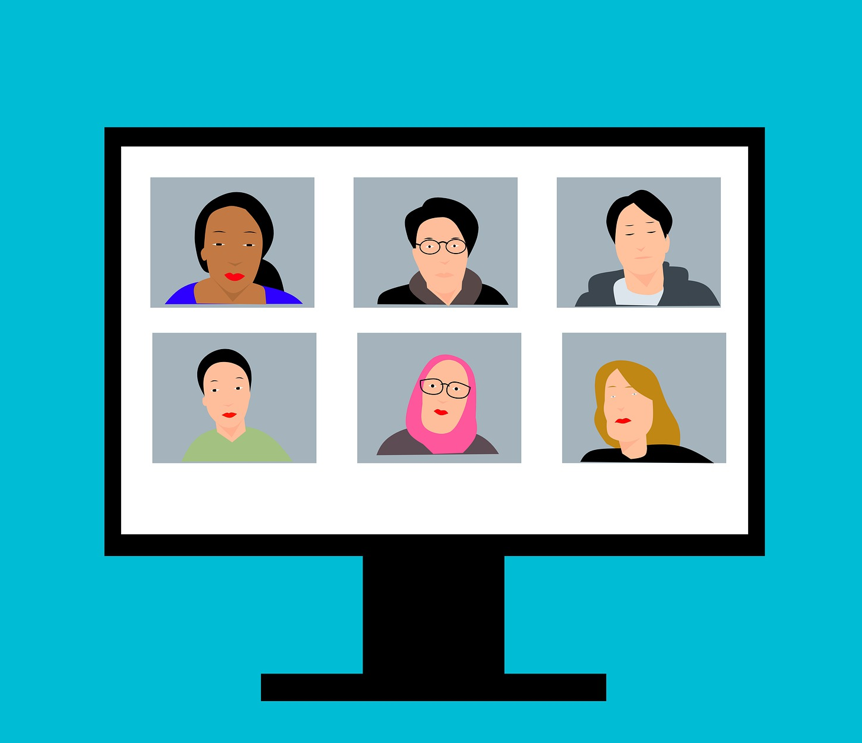
Copyright Support During COVID-19
Summer 2020:
3-part workshop series via Zoom on copyright & library licensed content
Copyright, Fair Use & Online Teaching
Library Support for Course Materials
Copyright & Student Works
Course Reserves Scanning Working Group
Representatives from Circulation, ILL, Government Information, Scholarly Communication, and branch libraries
Discussed both general scanning requests and explored Controlled Digital Lending

Slide 9
Copyright Support During COVID-19
Fall 2020 and Beyond:
Re-offered 3-part workshop series but updated student-centric session
Partnered with College of Graduate Studies to offer Copyright Basics workshop open to graduate students, post-docs, and faculty
Developed copyright & images workshop for the College of Graduate Studies for the Academic Integrity workshop series

Slide 10
Copyright Support
...in a Post-Pandemic World

Slide 11
Copyright Issues & Trends That Have Emerged (Or Been Highlighted)
Increased blended & extended remote course offerings
Highlighted the differences for copyright law as it pertains to face-to-face versus online teaching
Exacerbated inequitable aspects of education
Textbook affordability
Access to technology & Infrastructure (Internet)
Highlighted the importance and role of OER, public domain, and openly licensed content
Illustrated the need for accessible materials physically and digitally
Highlighted emerging methods, such as Controlled Digital Lending, as potential avenues for increasing access

Slide 12
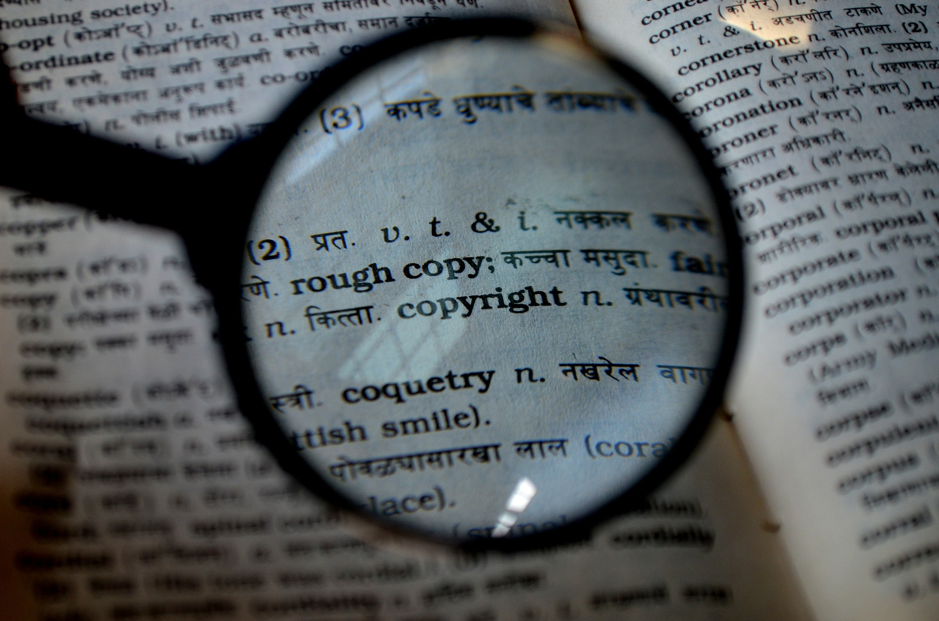
Copyright Support at UCF Post-Pandemic
Workshops
Faculty and student workshop offerings
Virtual options using Zoom
LibGuide Updates & Development
Copyright & IP LibGuides
Streaming Video FAQ LibGuide
Controlled Digital Lending
Statewide representation on committees to discuss Controlled Digital Lending
Updated Institutional Resources
e.g. Top 10 Copyright & Fair Use Questions

Slide 13
https://controlleddigitallending.org/
Controlled Digital Lending by Libraries by David R. Hansen & Kyle K. Courtney is licensed under CC BY 4.0

Slide 14
Best Practices & Tips for Outreach & Support
Assess needs at your institution
Are there emerging trends or common questions being asked?
What infrastructure do you have to support copyright outreach & support?
Do you have campus partners who can help facilitate?
Leverage virtual opportunities to engage your users
Look for opportunities to engage faculty on copyright & licensing in dynamic & interesting ways
Capitalize on interest in open access materials, including openly licensed works & OERs
Keep in touch with copyright colleagues & conversation

Slide 15
Public Domain Image References
BlenderTimer (Photographer). (2020, March 27). No title [digital image]. Retrieved from https://pixabay.com/photos/coronavirus-corona-virus-pandemic-4972480/
geralt (Photographer). (2018, April 9). No title [digital image]. Retrieved from https://pixabay.com/illustrations/problem-solution-help-support-3303396/
geralt (Photographer). (2017, September 25). No title [digital image]. Retrieved from https://pixabay.com/illustrations/social-media-digitization-digital-2786261/
mohamed_hassan (Photographer). (2020, June 18). No title [digital image]. Retrieved from https://pixabay.com/illustrations/webinar-conferencing-video-call-5310229/
geralt (Photographer). (2017, September 25). No title [digital image]. Retrieved from https://pixabay.com/illustrations/social-media-digitization-digital-2786261/
geralt (Photographer). (2020, April 3). No title [digital image]. Retrieved from https://pixabay.com/illustrations/corona-virus-covid-19-search-bar-4999179/
PDPics (Photographer). (2014, July 15). No title [digital image]. Retrieved from https://pixabay.com/photos/copyright-magnifier-magnifying-glass-389901/

Slide 16
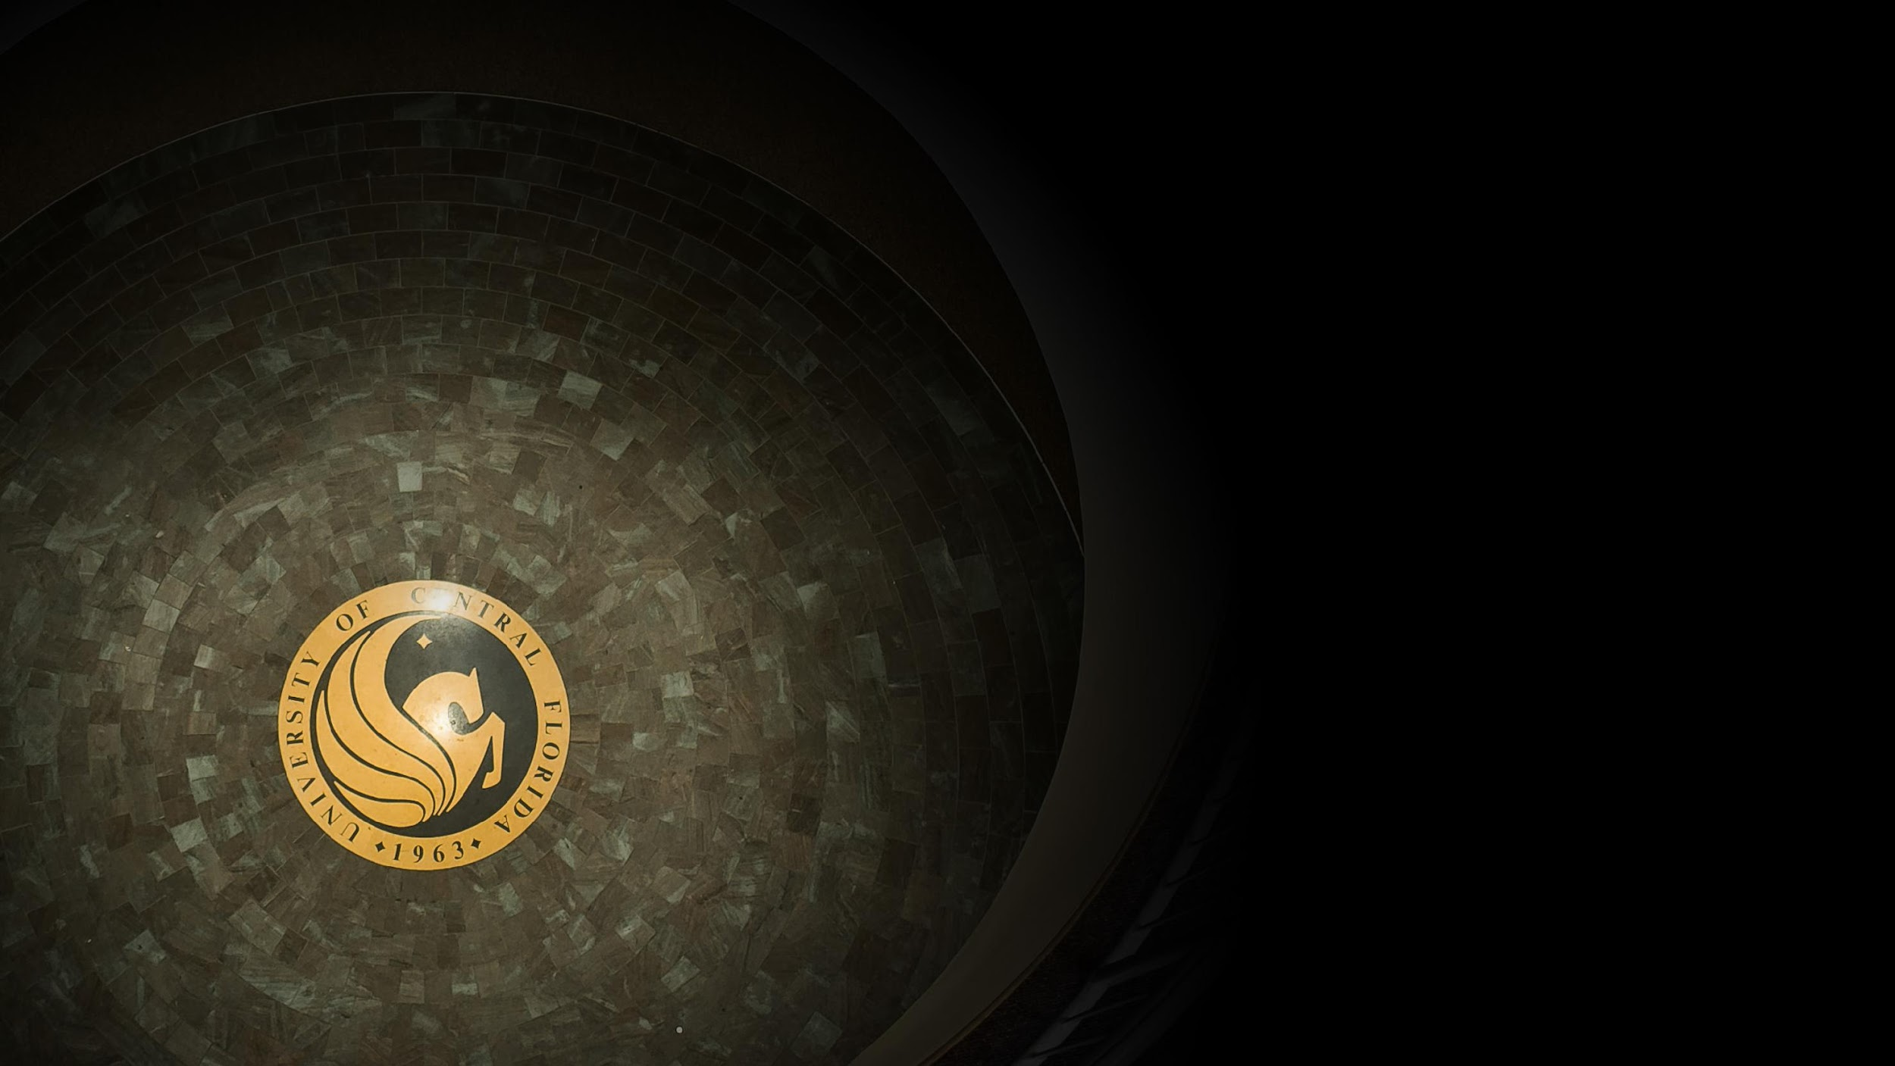
Thank you! Any questions?
Sarah A. Norris
Scholarly Communication Librarian
sarah.norris@ucf.edu
https://library.ucf.edu/about/departments/scholarly-communication/

